Slide 1
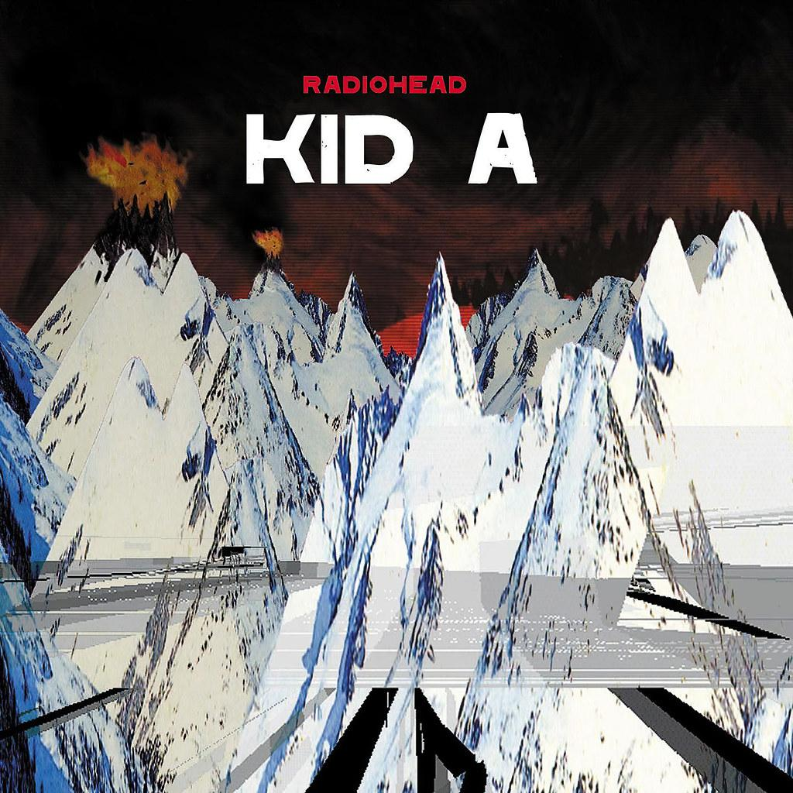
RadioHead
By Loz

Slide 2

How they were formed/How many members were they
The Radiohead members met while attending Abington School, an independent school for boys in Abingdon Oxford
There are 5 members
The names are Thom Yorke, Jonny Greenwood, Colin Greenwood, Ed O’Brien and Philip Selway

Slide 3

What Kind of Band Were They and What Did They Do?
Radiohead is an English rock band in Abington, Oxfordshire in 1985 experimenting with Alternative music.
In the early 21st century they made some majestic music and amazing combinations and new different sounds.
They made angst saturated and postmodern era music.

Slide 4

Where are Radiohead today?
According to the metalinjection.net Radiohead hasn’t released an album since 2016.
They have played a show in 2018 but that is it
Vocalist Thom Yorke and guitarist Jonny Greenwood have gone on to form The Smile and have already released their debut album A Light For Attracting Attention this year.

Slide 5

What is Radiohead’s Most Popular Song /Album?
The Greatest Albums made by Radiohead's Ok Computer
The Bends is Almost up there
The most popular songs are Paranoid Android, Karma Police, No Surprises and Knives Out

Slide 6

Sources
https://en.wikipedia.org/wiki/Radiohead_discography#:~:text=Kid%20A%20followed%20in%20October,on%20the%20US%20Billboard%20200.
metalinjection.net
https://en.wikipedia.org/wiki/Radiohead
https://www.youtube.com/watch?v=YTH8cxXBGBo&ab_channel=Radiohead-Topic

