Slide 1
Productive U
Sinziana Giju

Slide 2
SCOP: cresterea productivitatii studentilor prin intermediul unei serii de resurse
Limbaje de programare folosite
HTML | CSS | JavaScript
Elemente cheie
Pop-up box, formular de contact, header fixat
butoane pentru social media

Slide 3
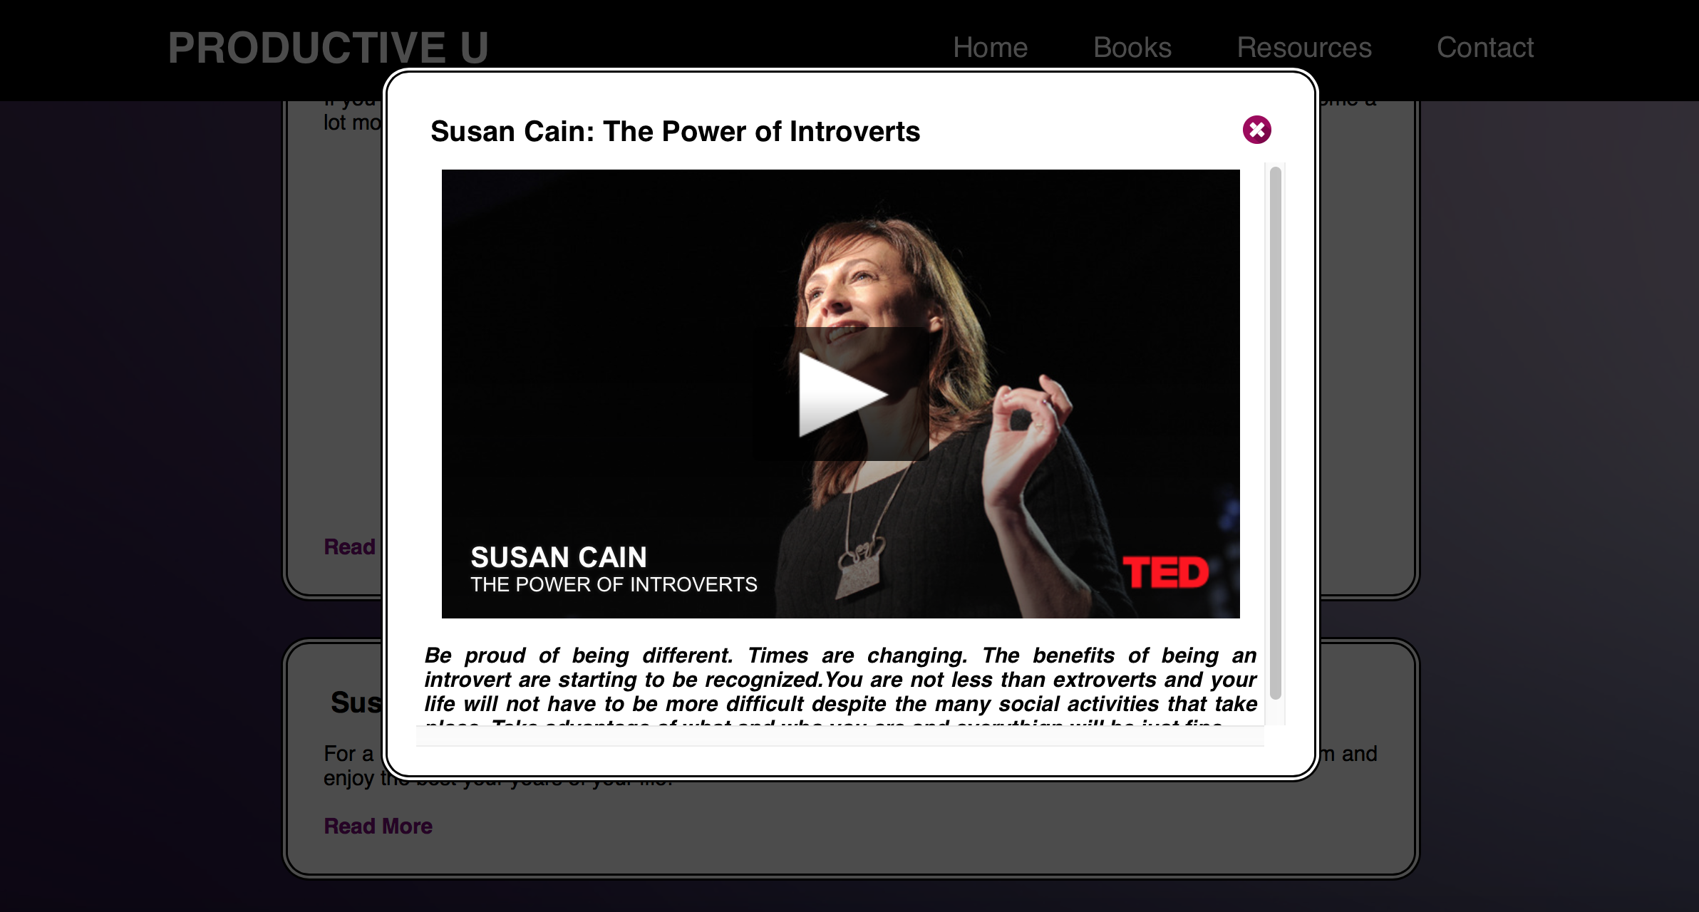
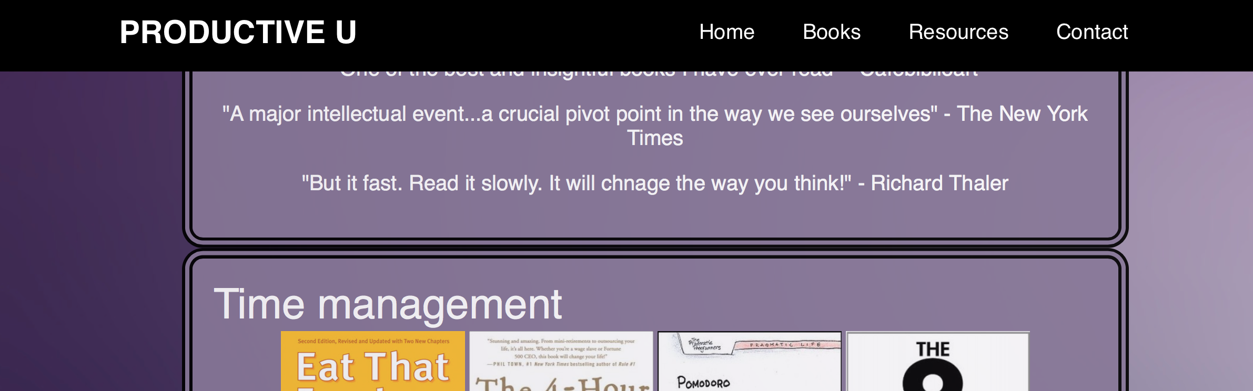
Elemente cheie - exemple
Pop up box
Header fixat

Slide 4
Harta site
Home
Let’s get started
Books
Resources
Contact
5 pagini: 4 principale, 1 anexa

Slide 5
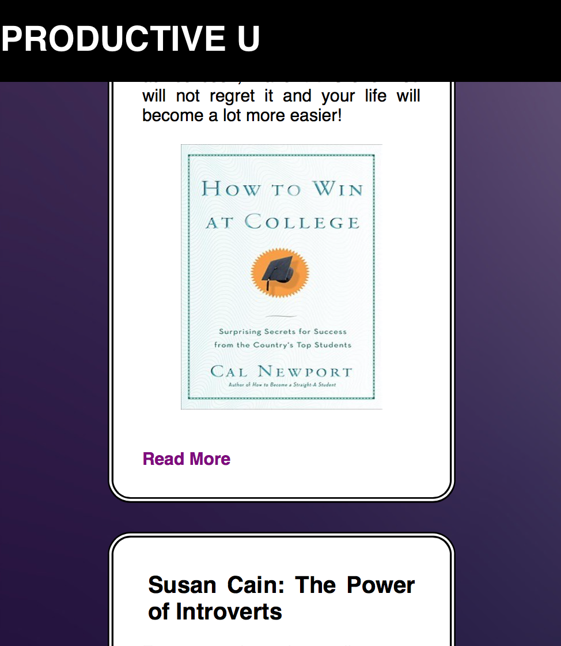
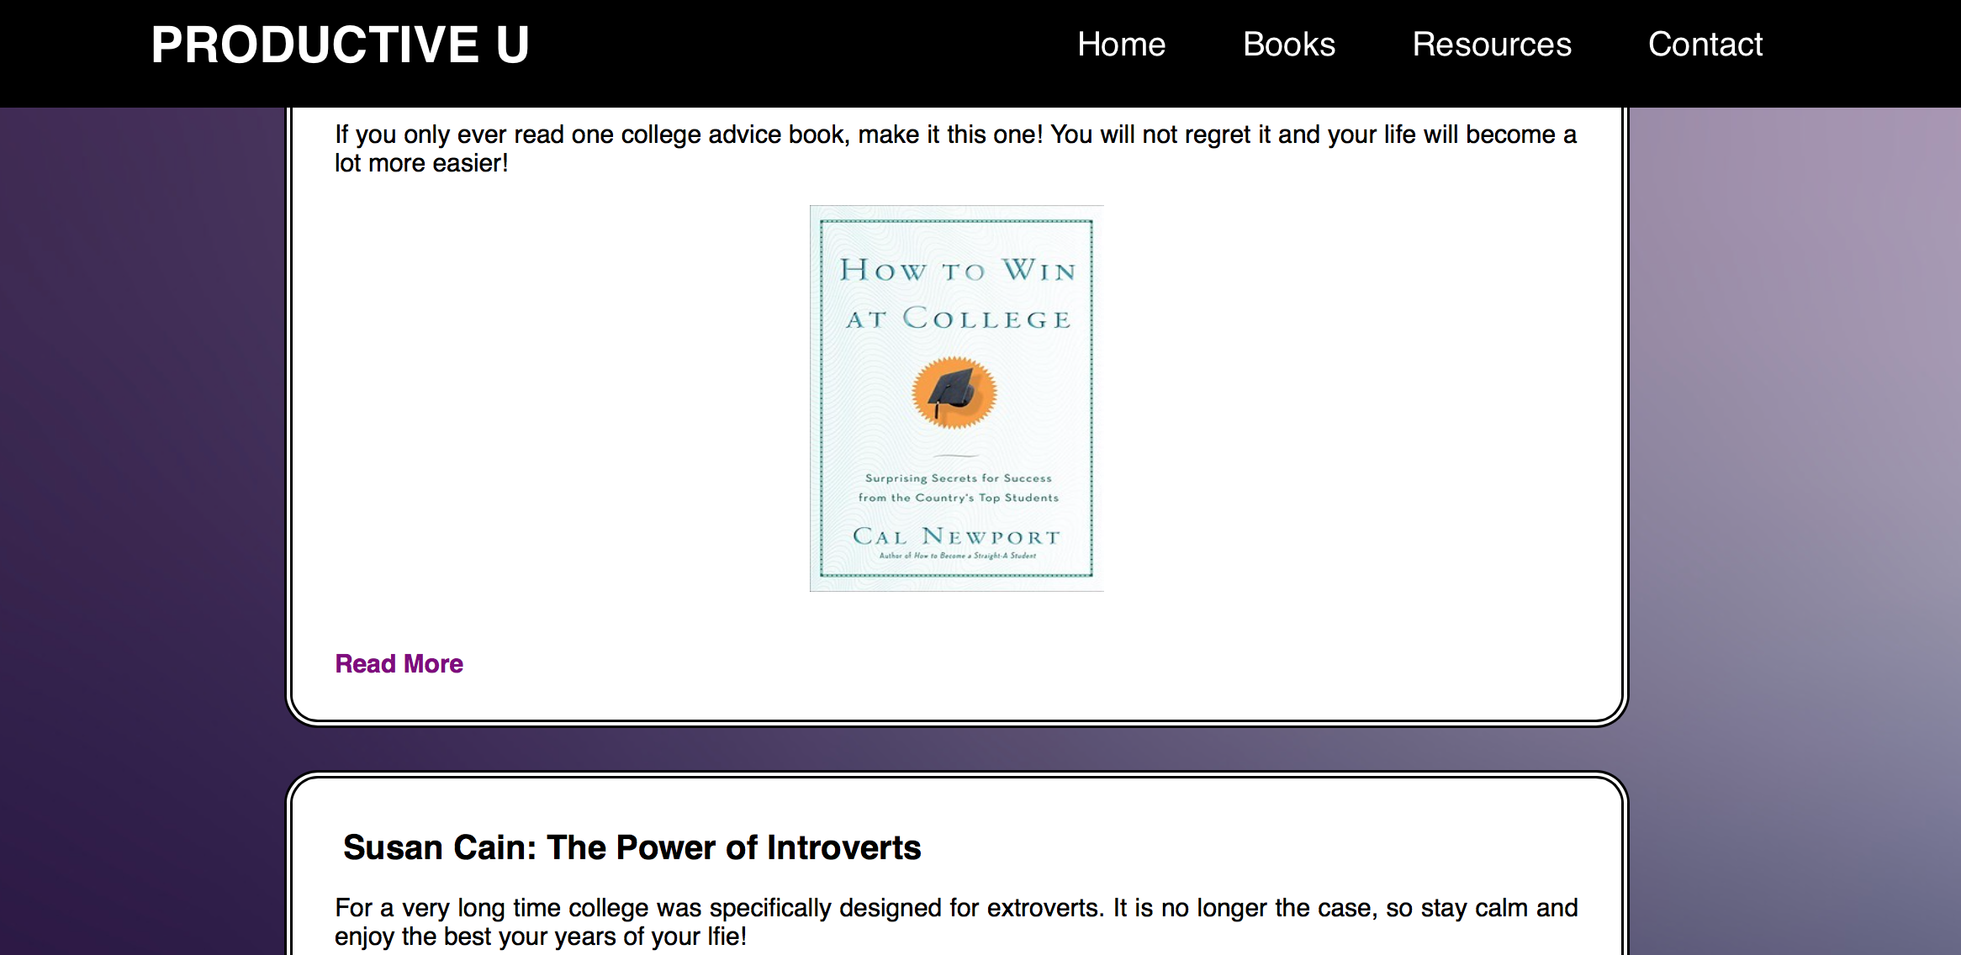
Concluzii
Design simplu, elegant
Interfata prietenoasa
Usor modificabil

Slide 6
Intrebari?
Multumesc pentru atentie!

Slide 7
Bibliografie
A complete guide to flex box. 2015. CSS Tricks. Disponibil Online [https://css-tricks.com/snippets/css/a-guide-to-flexbox/] [Accesat : August 10 2015]
Intro to HTML and CSS.2015. Udacity. Disponibil online [https://www.udacity.com/course/intro-to-html-and-css--ud304] [Accesat: Mai 15 2015]
JavaScript Basics.2015. Udacity. Dispoanibil online [https://www.udacity.com/course/javascript-basics--ud804] [Accesat: August 12 2015]

