Slide 1


Slide 2
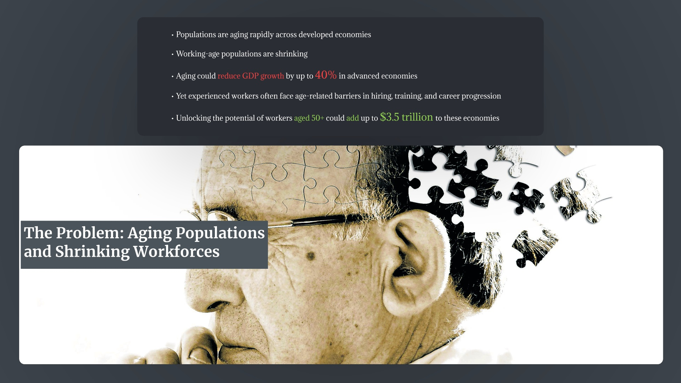

Slide 3
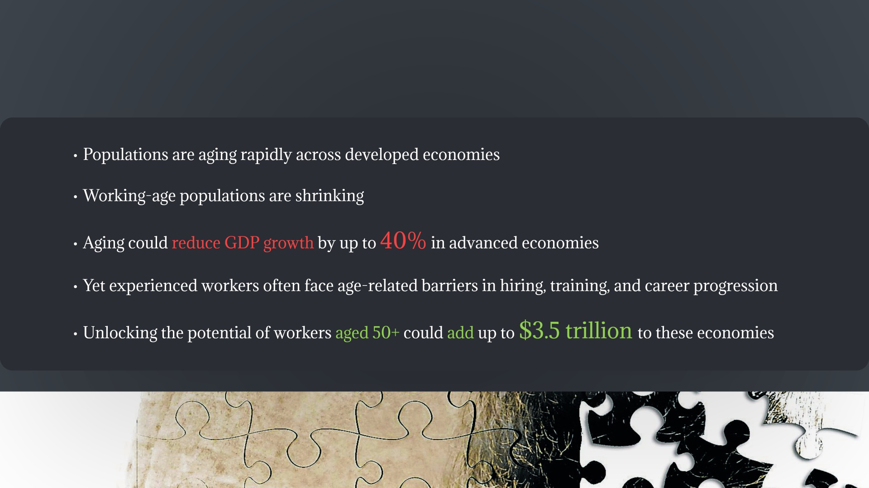

Slide 4


Slide 5


Slide 6

Notes:
To guide the analysis behind this business idea, we tested two hypotheses.
First, that countries with aging populations can maintain economic productivity if older adults remain active in the workforce.
Second, that countries investing more in human capital tend to have higher labor force participation among older adults.
In other words, aging itself is not necessarily the problem — the real question is whether economies invest enough in skills and participation.

Slide 7

Notes:
To test these hypotheses, we combined three datasets from the World Bank.
The World Development Indicators dataset provided demographic and economic data.
The Human Capital Index dataset measures how well countries develop and maintain the productivity of their workforce.
And finally, labor force participation Indicator allowed us to analyze how adults remain engaged in the workforce.
We cleaned and merged these datasets to compare demographic structure, the investment on human development, and the actual workforce participation across countries.

Slide 8

Notes:
There are a few important limitations to our analysis.
The Human Capital Index is not updated every year — the latest comprehensive data only goes up to 2020.
So because we combined several datasets, we had to limit our analysis to the overlapping years of 2010 and 2018.
That said, it is important to note that demographic changes happen gradually, so an 8-year window may not capture the full long-term effects of aging. BUT it still provides a meaningful snapshot for comparing how different countries are responding to demographic change.

Slide 9

Notes:
Our analysis revealed three main insights into how aging populations are managed across various countries. First, aging is accelerating rapidly — for example Japan’s elderly population increased by about five percentage points in less than a decade.
Second, aging does NOT necessarily reduce productivity — Japan still sustains one of the largest economies despite having over 28% of its population over 65.
And third, countries with stronger human capital investment tend to maintain stronger workforce participation.

Slide 10

Notes:
Our analysis revealed three main insights into how aging populations are managed across various countries. First, aging is accelerating rapidly — for example Japan’s elderly population increased by about five percentage points in less than a decade.
Second, aging does NOT necessarily reduce productivity — Japan still sustains one of the largest economies despite having over 28% of its population over 65.
And third, countries with stronger human capital investment tend to maintain stronger workforce participation.

Slide 11
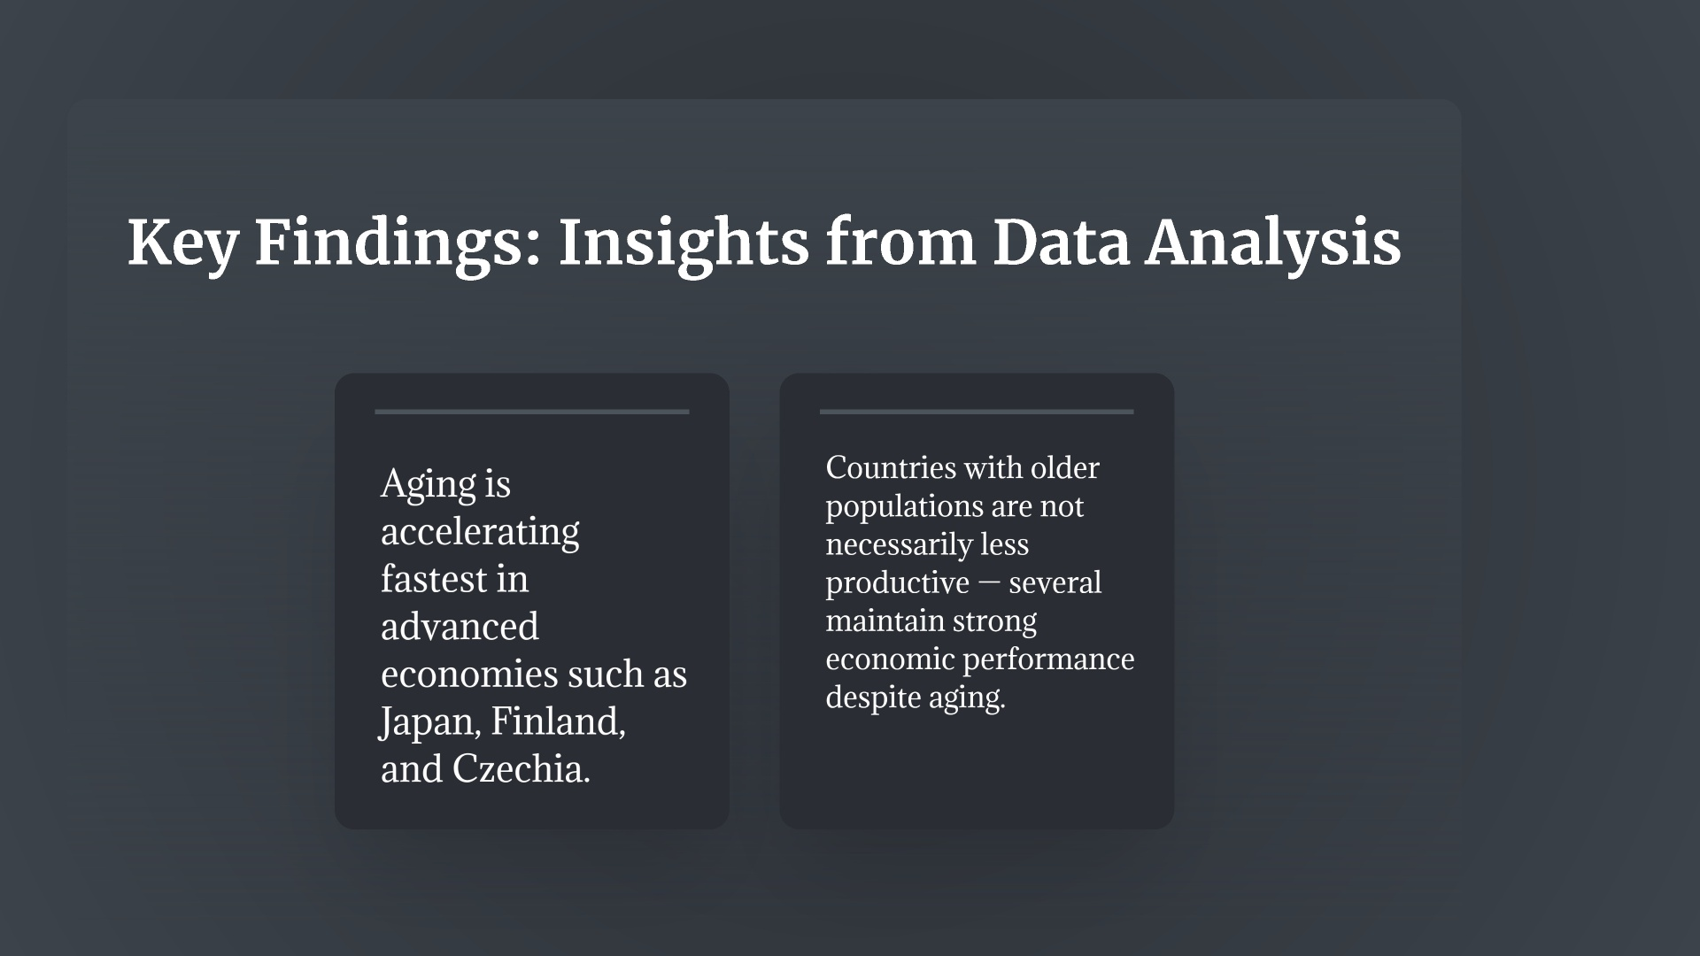
Notes:
Our analysis revealed three main insights into how aging populations are managed across various countries. First, aging is accelerating rapidly — for example Japan’s elderly population increased by about five percentage points in less than a decade.
Second, aging does NOT necessarily reduce productivity — Japan still sustains one of the largest economies despite having over 28% of its population over 65.
And third, countries with stronger human capital investment tend to maintain stronger workforce participation.

Slide 12
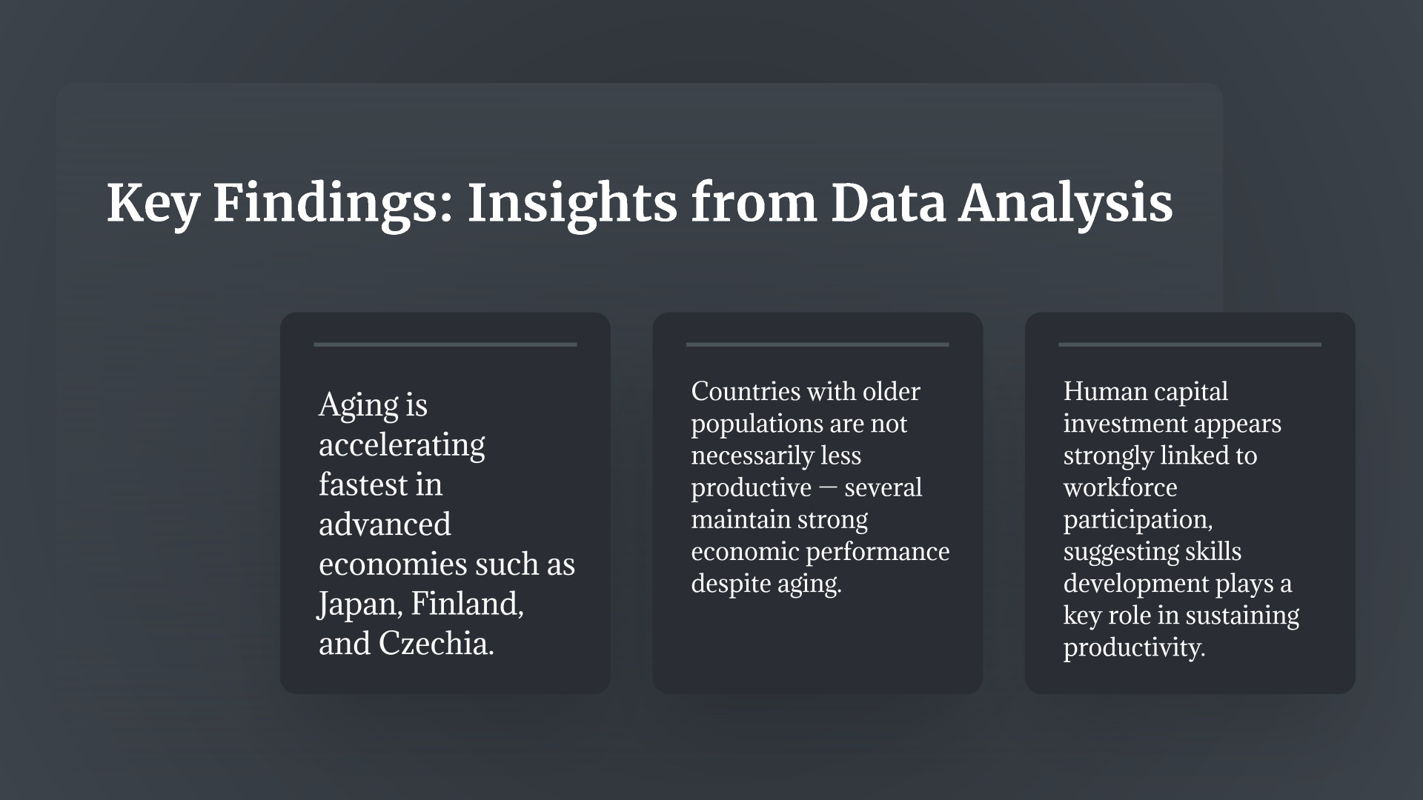
Notes:
Our analysis revealed three main insights into how aging populations are managed across various countries. First, aging is accelerating rapidly — for example Japan’s elderly population increased by about five percentage points in less than a decade.
Second, aging does NOT necessarily reduce productivity — Japan still sustains one of the largest economies despite having over 28% of its population over 65.
And third, countries with stronger human capital investment tend to maintain stronger workforce participation.

Slide 13
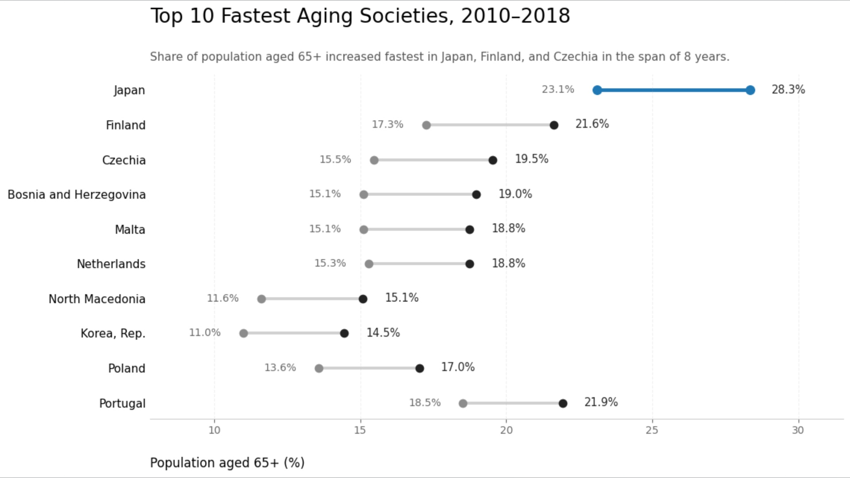
Notes:
This chart shows the ten countries where the share of people aged 65 and over increased the fastest between 2010 and 2018.
Japan shows the most dramatic increase, rising from about 23% to over 28% of the population in just eight years.
Several European countries — including Finland, Czechia, and Portugal — also show rapid aging.
The key takeaway is that aging is not limited to one region. It is a broad structural shift affecting many developed economies.
This reinforces the importance of policies and organizational strategies that keep older workers engaged in the labor market.

Slide 14
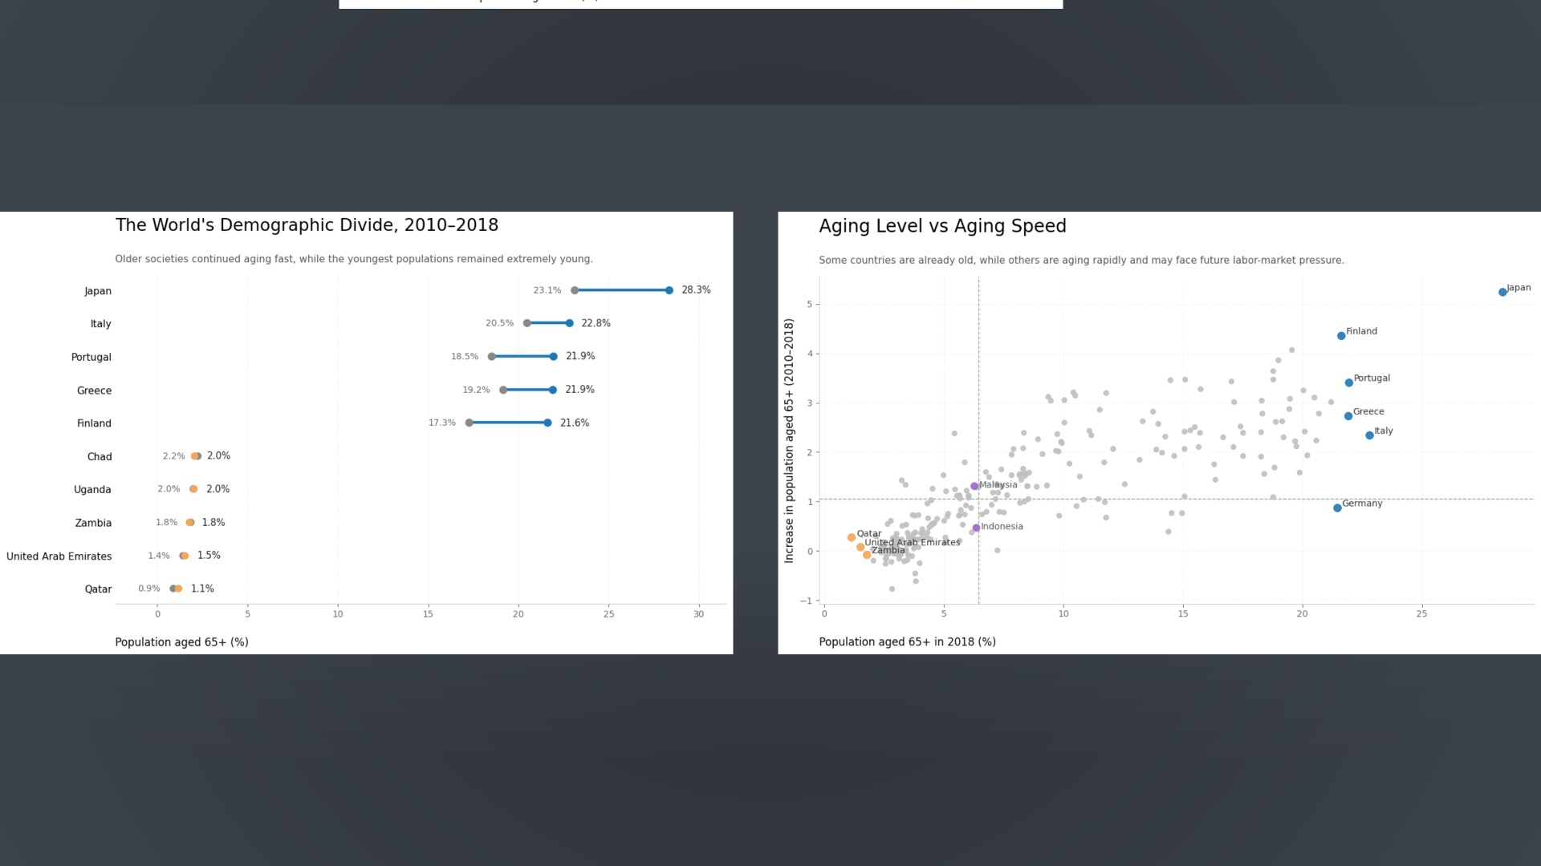
Notes:
These two charts show different ways of looking at the same story.
On the left, we see a clear demographic divide: countries like Japan, Italy, and Portugal have very high shares of people over 65, while countries like Uganda and Zambia remain very young.
On the right, we compare how old a country already is with how quickly it is aging in a more visual way that also allows you to gage where the rest of the world is in this progression, and how uneven it actually is.
However, there is an important caveat that will be more clear in the next graph: a young population alone is not enough to produce economic growth.
Without investment in education, skills, and institutions, a large youth population can also lead to unemployment and political instability.
Just as an example: from external research, we found that in many regions like Sub-Saharan Africa and the Middle East, youth unemployment can reach around 25%, and millions of young people enter the labor market each year without enough jobs being created.

Slide 15
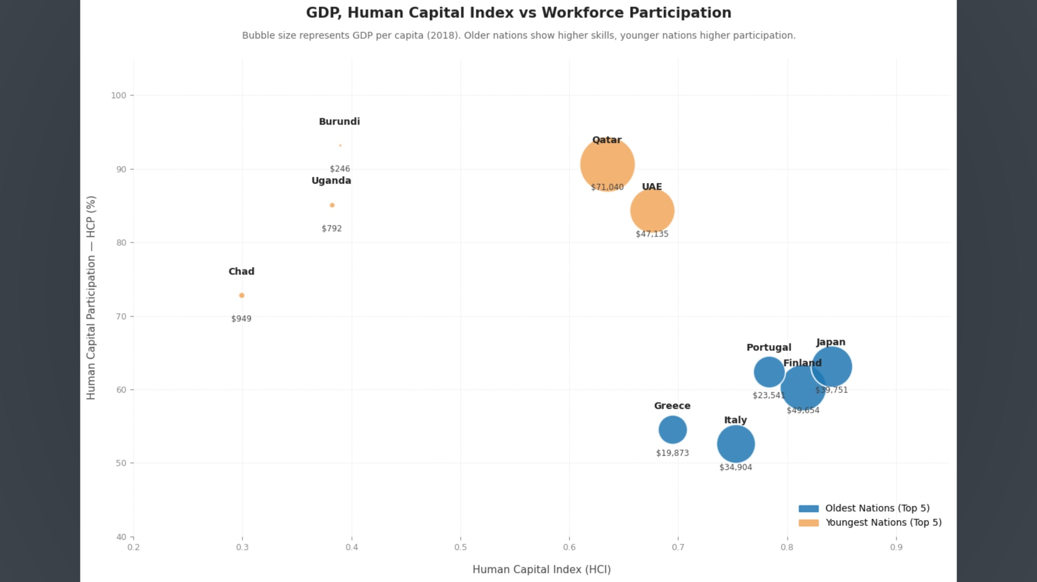
Notes:
This final chart compares human capital investment with workforce participation.
Each bubble represents a country, and the size reflects GDP per capita.
We observe that countries with stronger human capital scores tend to maintain relatively strong labor participation even with older populations.
For example, Japan and Finland remain economically productive despite aging demographics.
This supports our second hypothesis: investing in human capital helps economies sustain workforce participation and productivity.

Slide 16
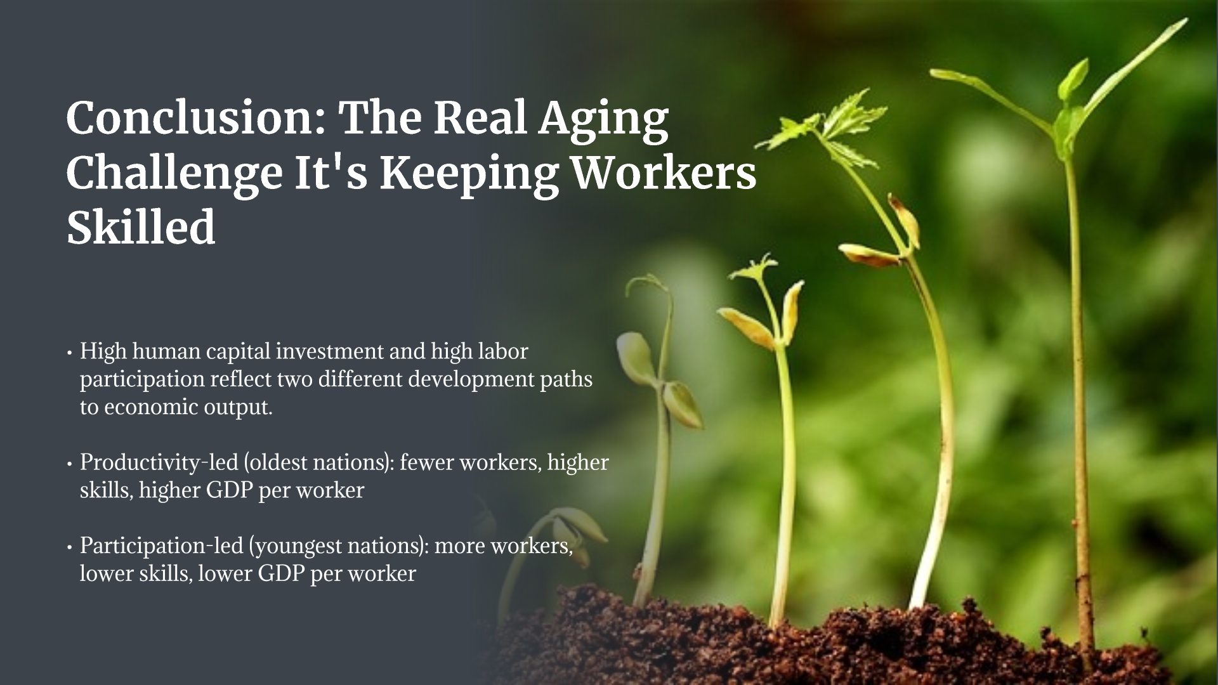

Slide 17
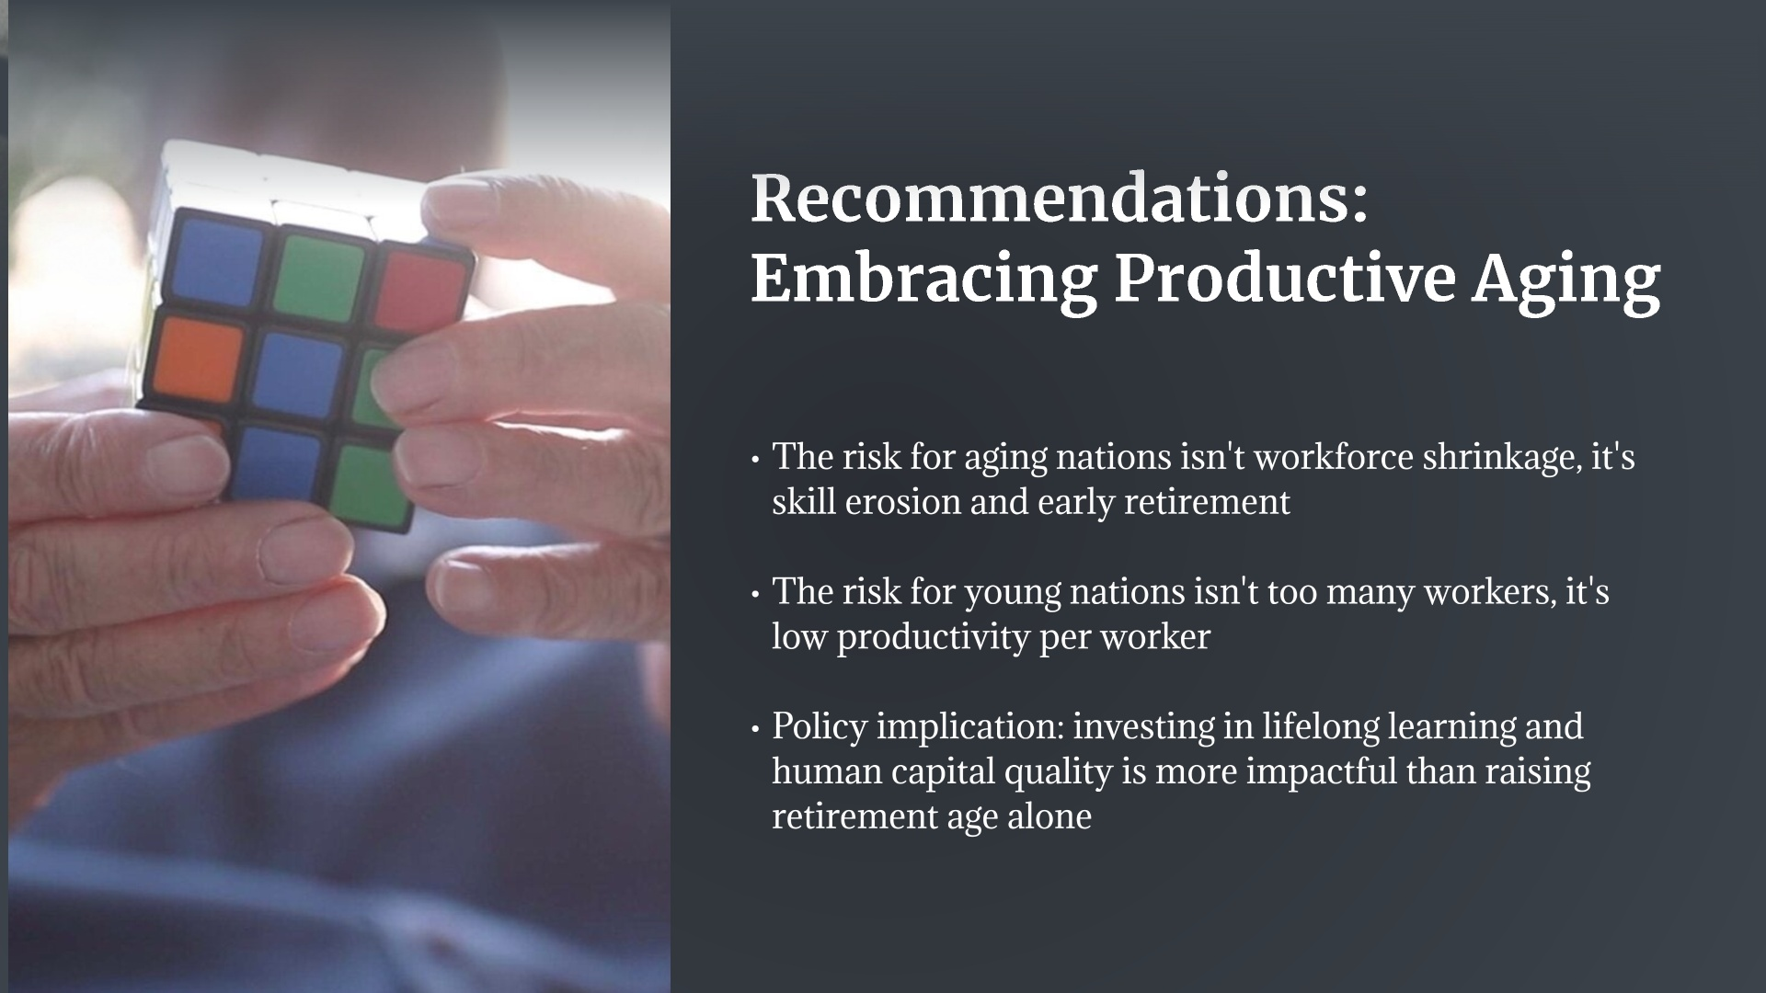

Slide 18
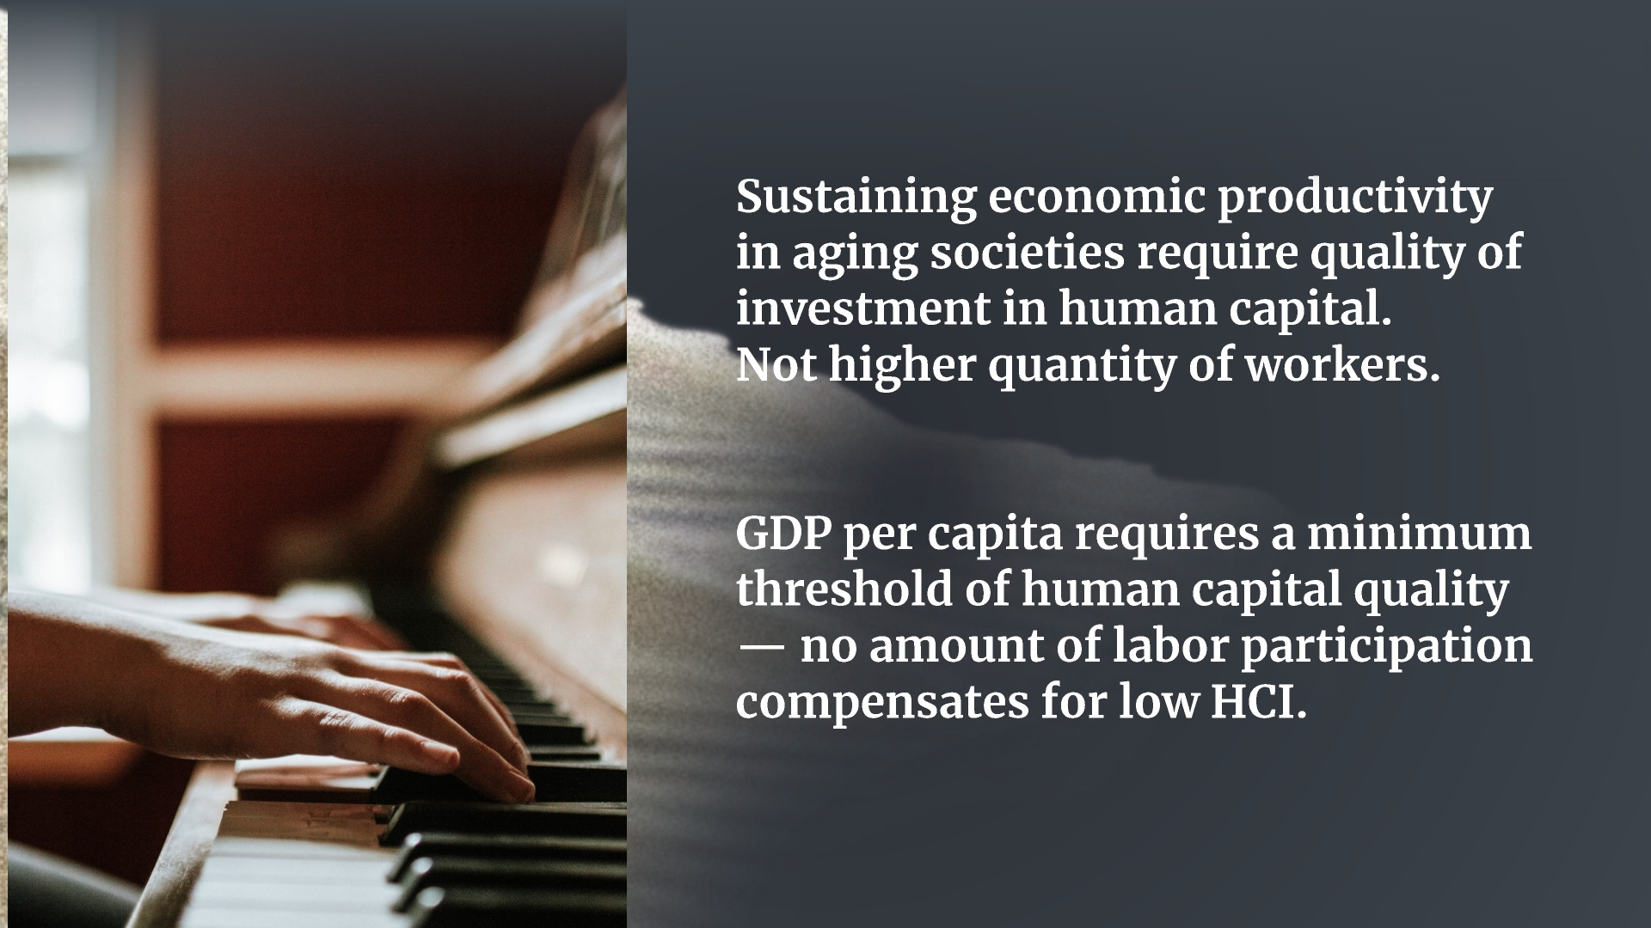

Slide 19


Slide 20



