Slide 1

[Data_Yedis]

Slide 2
Business case
Startup.
We offer different services, including data collection and data analytics services.
Our main customers are researchers, master students and PhD students.

Slide 3
Project overview
Description: We received a customer order to collect information about innovation in the world.
Objective: Deliver a clean and robust dataset that includes innovation variables (like R&D and Patents) and other economic variables.

Slide 4
Innovation variables
Research and experimental development (R&D) is an important component of a country’s national innovation system (NIS), and R&D statistics are among the most widely-used indicators to monitor the NIS.
The Frascati Manual (OECD, 2002) outlines the methodology to measure R&D. The well-established practices provided in the manual have been applied for over 50 years.
R&D is located within the innovation systems approach and is recognised as one of the many activities that contribute to innovation.
R&D is important in and of itself, and for its role in the process of technology absorption and adaptation. This indirect contribution of R&D to the economy is difficult to measure and often under-appreciated.

Slide 5
The main UIS regions
The UIS (United Nations Educational, Scientific and Cultural Organization Institute for Statistics) divides the world into several regions for statistical purposes. The main UIS regions are:
Africa
Arab States
Asia and the Pacific
Europe and North America
Latin America and the Caribbean
These regions are used to categorize data related to education, science, and culture across different countries. Each region may have sub-regions to provide more specific data analysis.

Slide 6
R&D Dataset
Science, Technology and Innovation:
Research and experimental development expenditure as a proportion of Gross Domestic Product (GDP) -> R&D intensity.
GDP is the standard measure of the value added created through the production of goods and services in a country during certain period.
Researchers (in full-time equivalent) per million inhabitants.
The most commonly-used indicators to monitor resources devoted to R&D worldwide are gross domestic expenditure on R&D (GERD) expressed in purchasing power parity (PPP$) and R&D intensity (percentage of gross domestic product (GDP) devoted to R&D activities).
Researchers are professionals engaged in the conception or creation of new knowledge. They conduct research and improve or develop concepts, theories, models, techniques instrumentation, software or operational methods, in the
framework of R&D projects (Frascati Manual, 2015).

Slide 7
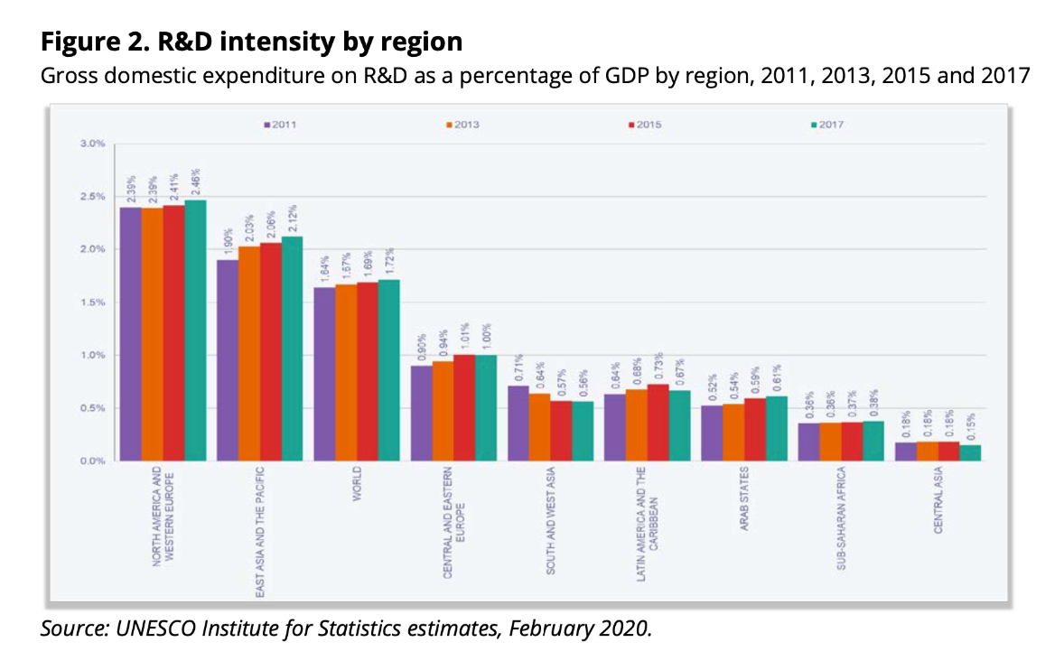
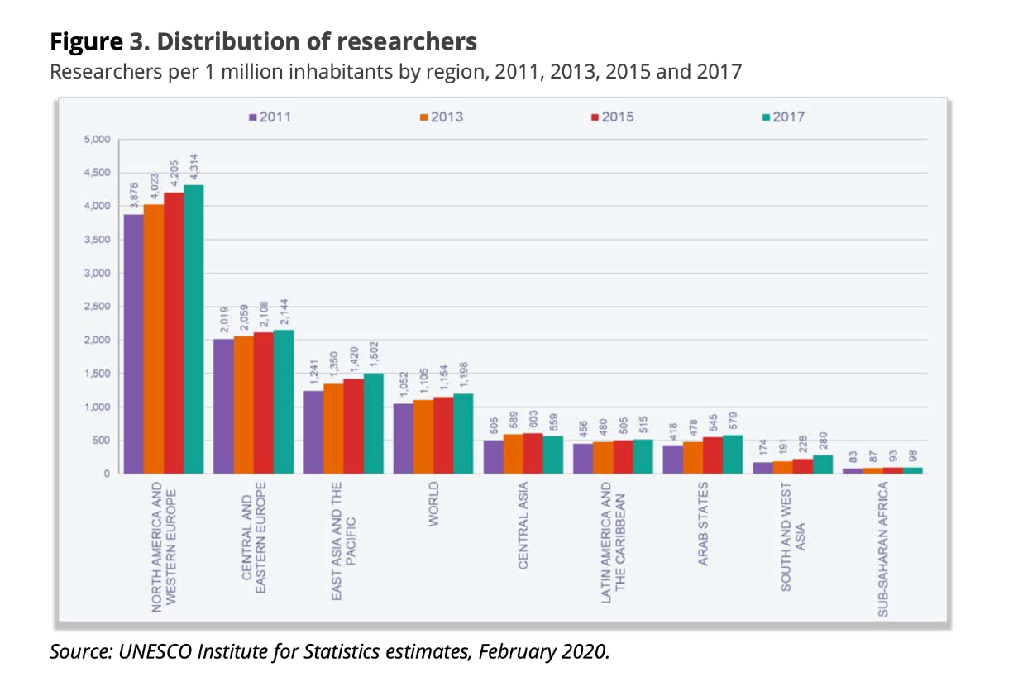
R&D dataset
North America and Western Europe
East Asia and The Pacific

Slide 8
Patents dataset

Slide 9
Gdp dataset

Slide 10
roles
Project manager
Developers
Lorena
Bru, Clara, Camil and Vasco

Slide 11
Deliverables
Dataset
Github repository (Data, Notebooks, Notes, Slides, etc)
Presentation (slides)

Slide 12
timeline
Team
Monday 04/11
Tuesday 05/11
Wednesday 06/11
Thursday 07/11
Task
IPS
DOL
LOR
IPS
DOL
LOR
IPS
DOL
LOR
IPS
DOL
Getggggggg
Data cleaning and merge all the datasets
Analyse again the definitive dataset
Prepare the final presentation
Camil
Clean the series column and get familiar with the HDI dataset
Bru and Clara
Clean the Area and Country column
Vasco
Delete the footnotes and source columns and get familiar with the Education, Patents and Unemployment datasets
Lorena
Get descriptive file and make slides
LOREM

Slide 13
resources
UN Data repository (maintained by the United Nations) https://data.un.org/
United Nations Educational, Scientific and Cultural Organization (UNESCO)
https://uis.unesco.org/en/topic/research-and-development
The UNESCO Institute for Statistics (UIS) statistics database.
https://data.uis.unesco.org/

Slide 14
assumptions
There are no differences in price levels among countries (R&D intensity)
Headcounts (HC) were used for countries where FTE figures were not available (Researchers)

Slide 15

THANK YOU= gracias + merci + obrigado

