Slide 1


SPOTIFY STREAMING METRICS
TRACK RECORD
AWARDS
Spotify
OFFICIAL DATA PARTNER
Celebrating the winners across global reach, track virality, album achievements, and genre leadership on the Spotify streaming platform.
Data Analytics Team: Marta Atencia ◦ Juan Contreras ◦ Francisco Reis
01 / 13

Slide 2


Strictly Confidential & Proprietary
This document contains sensitive internal Spotify metrics and awards shortlists.
For designated Track Record Awards committee members only.
External distribution or copying is strictly prohibited.
Track Record Awards
02 / 13

Slide 3
Awards
2025
Track Record Awards
03 / 13

Slide 4
AWARD CATEGORY 01
Most Followed Artist
Artist with the highest number of followers in 2025
#1 WINNER
Taylor Swift
#2 FINALIST
#3 FINALIST
#4 FINALIST
#5 FINALIST
145,542,136 Followers
Ed Sheeran
The Weeknd
Ariana Grande
Drake
122,802,777 Followers
112,995,439 Followers
107,401,919 Followers
103,067,383 Followers
Unrivaled global followers leader in 2025.
Track Record Awards
04 / 13

Slide 5
AWARD CATEGORY 02
Track of the Year
Most popular track of 2025
#1 WINNER
"Golden"
POPULARITY SCORE: 99
HUNTR/X
#2 FINALIST
"Opalite"
POPULARITY SCORE: 97
Taylor Swift
#3 FINALIST
"Man I Need"
POPULARITY SCORE: 95
Olivia Dean
Track Record Awards
05 / 13

Slide 6
AWARD CATEGORY 03
Album of the Year
Most popular album of 2025
#1 WINNER
“KPop Demon Hunters (OST)”
POPULARITY SCORE: 94
HUNTR/X / Saja Boys
#2 FINALIST
“The Life of a Showgirl”
POPULARITY SCORE: 93
Taylor Swift
#3 FINALIST
DON’T TAP THE GLASS
POPULARITY SCORE: 90
Tyler, The Creator
Track Record Awards
06 / 13

Slide 7
AWARD CATEGORY 04
Genre Excellence
Most popular artist in 2025 - by genre
// WINNER POP
// WINNER ELECTRONIC MUSIC
// WINNER R&B
HUNTR/X
Disco Lines
DJ Japa NK
SCORE: 92
SCORE: 92
SCORE: 85
HONORABLE MENTIONS
HONORABLE MENTIONS
HONORABLE MENTIONS
BLACKPINK, KATSEYE
Fuerza Regida, David Guetta
Chris Brown, Chris Grey
// WINNER HIP-HOP
// WINNER ROCK
// WINNER COUNTRY
Bad Bunny
Tame Impala
Taylor Swift
SCORE: 90
SCORE: 80
SCORE: 93
HONORABLE MENTIONS
HONORABLE MENTIONS
HONORABLE MENTIONS
Drake, Playboi Carti
Mariah Scientist, Royel Otis
Luke Combs, Megan Moroney
Track Record Awards
07 / 13

Slide 8
10th Anniversary
Awards
Track Record Awards
08 / 13

Slide 9

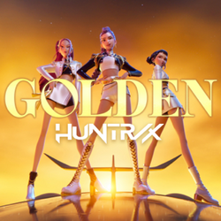




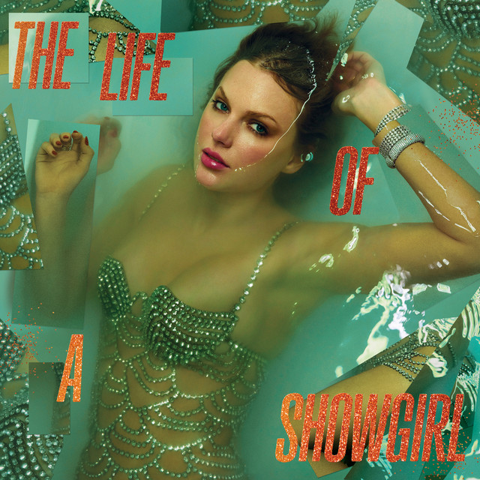
AWARD CATEGORY 01
All-time Genre Excellence
// WINNER POP
// WINNER ROCK
// WINNER EM
HUNTR/X
Ravyn Lenae
Disco Lines
Golden
Love Me Not
No Broke Boys
// WINNER HIPHOP
// WINNER R&B
// WINNER COUNTRY
Bad Bunny
DJ Napa NK
Taylor Swift
DtMF
Posso Até Não Te Dar Flores
Opalite
Track Record Awards
09 / 13

Slide 10
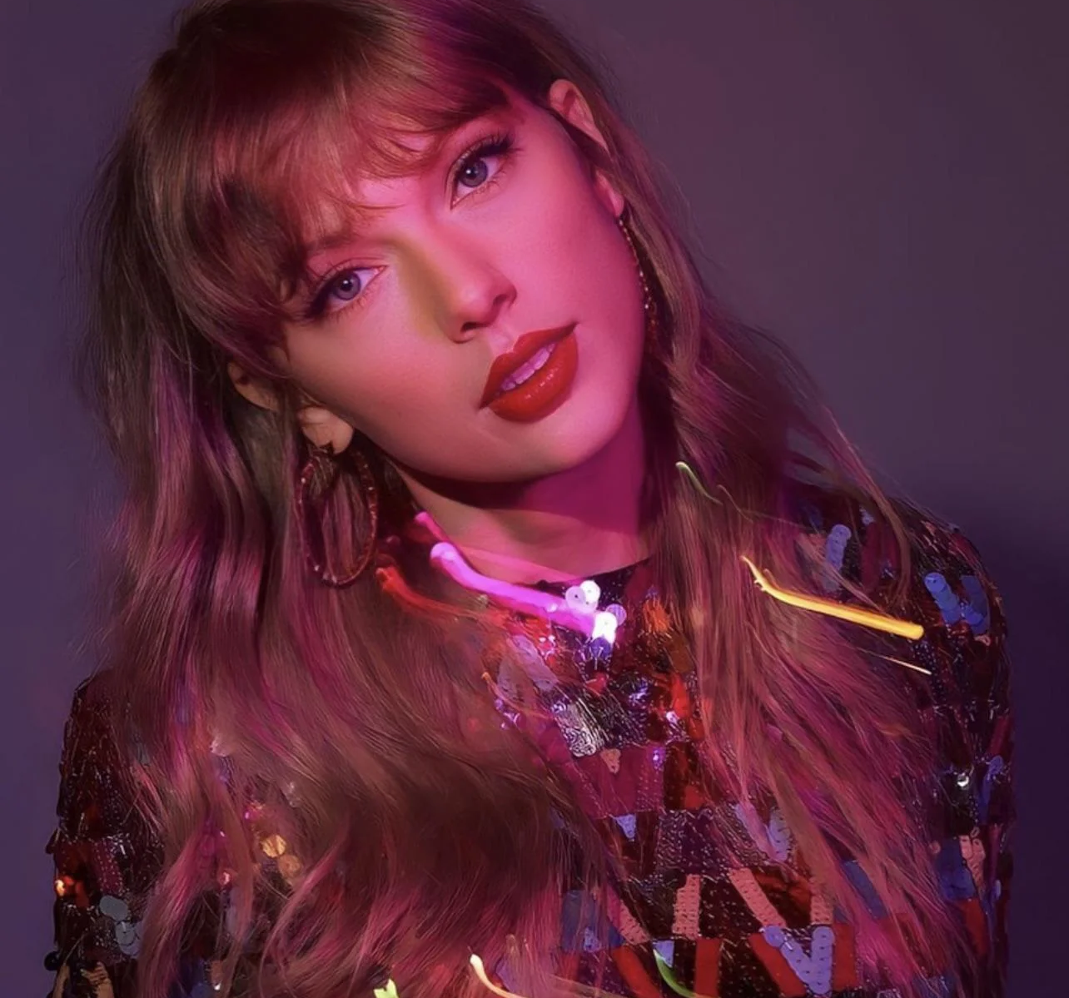
AWARD CATEGORY 02
All-time Favorite Track
WINNER
Taylor Swift
The Fate of Ophelia
The Life of a Showgirl
TRACK FAVORITE SCORE
TOTAL FOLLOWERS
99/100
145,542,136
Track Record Awards
10 / 13

Slide 11

AWARD CATEGORY 03
All-time Favorite Artist
WINNER
Billie Eilish
FAVORITE SCORE
TOTAL FOLLOWERS
75/100
118,797,451
Track Record Awards
11 / 13

Slide 12
METHODOLOGY & GOVERNANCE
Data Challenges & Recommendations
DATA CHALLENGES ENCOUNTERED
BUSINESS RECOMMENDATIONS
METRIC GAP
REFINE CRITERIA
Missing Granular Listener Data
Incorporate Deep Streaming Metrics
Dataset lacks monthly listeners, streaming minutes and general granularity for accurate story telling. Limiting separation between reach, engagement, and sustained interest.
Integrate unique listeners for Artist of the Year and long-term retention trends for Anniversary awards to validate true reach.
OUTLIER BIAS
GOVERNANCE
Single-Hit Skew on Overall Popularity
Transparent Scoring
Track popularity makes up 80% of All-Time scores. A single viral hit can artificially inflate an artist’s catalog rating.
Agree on and publish exact scoring weights and measuring rules publicly.
Track Record Awards
12 / 13

Slide 13
Thank you
Track Record Awards
13 / 13

