Slide 1
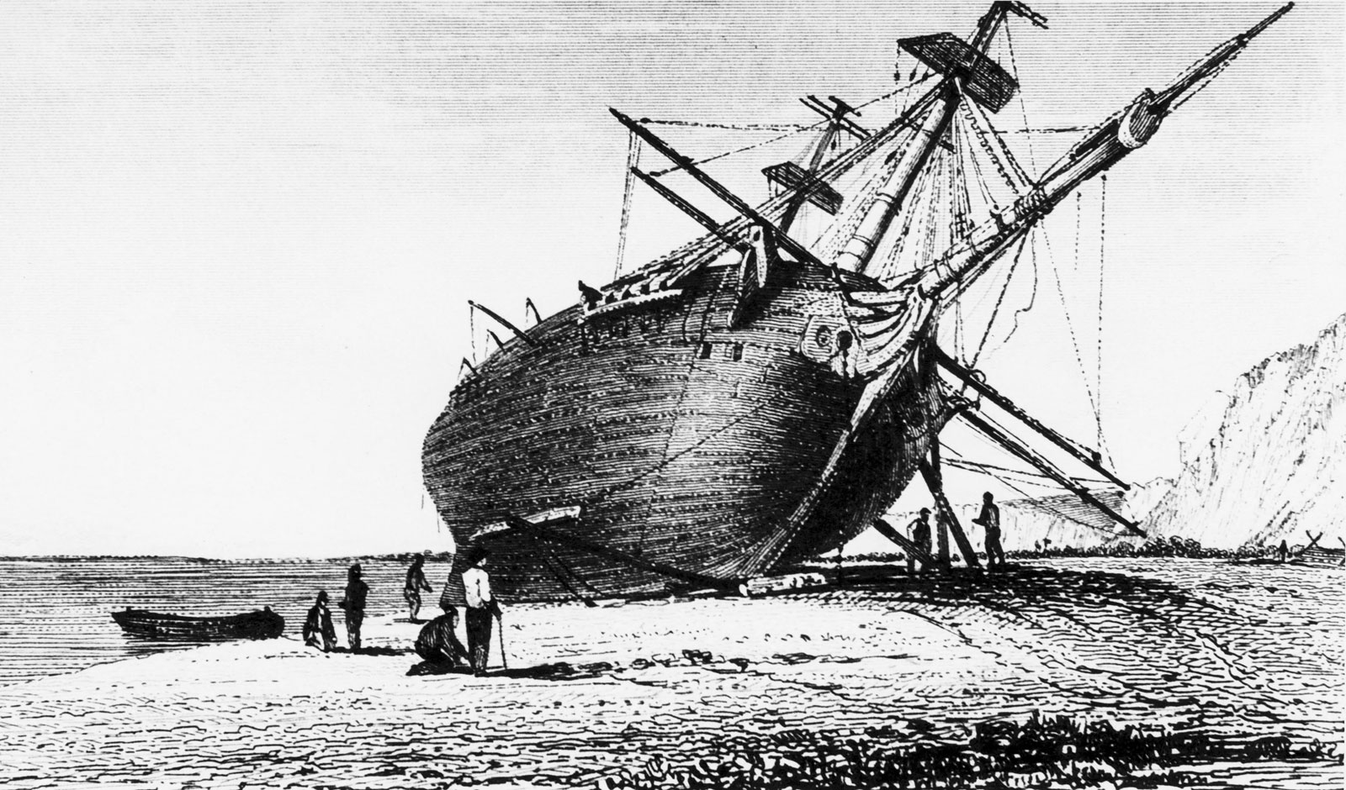


| 1
Python Tools for Oceanography (day 2)
Isabelle Giddy University of Cape Town | University of Gothenburg |
SOCCO, CSIR
isgiddy@gmail.com
@isgiddy
Content adapted somewhat from
that of J.M. Lilly and R. Abernathy
Nasa Earth Observatory
https://www.britannica.com/biography/Charles-Darwin/The-Beagle-voyage

Slide 2
| 2
Outline
16 August - Introduction, motivation, workflow/ using the terminal and git
23 August – Python fundamentals
30 August – Numpy + Functions
6 September – Matplotlib
13 September - Pandas/ working with tabular data/ low level statistics
20 September – Xarray for multidimensional data
27 September - Making maps/ cartopy
4 October – Summary / maybe brief intro to interactive plotting

Slide 3
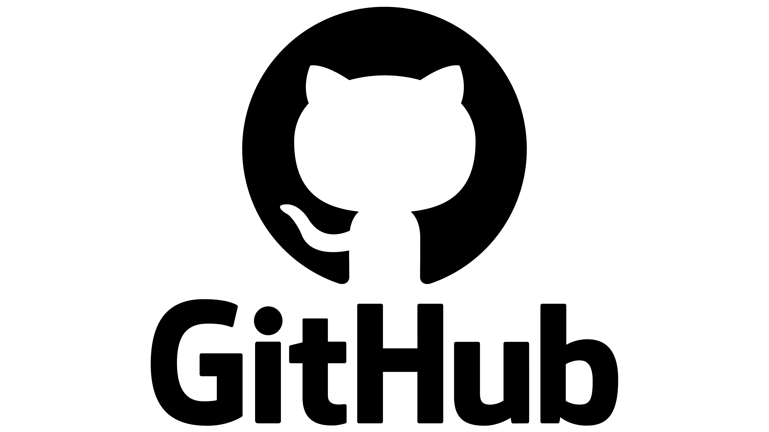
| 3
Outline
23 August – Python fundamentals
Review Git and github
- Questions and troubleshooting
Python fundamentals

Slide 4

| 3
Git and github
I have made the intro-to-git much more explicit, hopefully everyone can follow. We can work through common and specific issues today
Fundamentally, git is a version control tool, github is a provider (also others eg bitbucket)
We are only just dipping into the basic functionalities. git is designed like a tree, with branches. We will mostly use the main branch. Other branches are usually used when collaborating or working on larger projects. We won’t touch on this in the course. But just so you know.

Slide 5
| 4
Python fundamentals
Python is object orientated. It thinks a little like us. We see tables, chairs, computers and do things with them. Similarly, python functions are grouped as objects. (other languages may use features/ networks).

