Slide 1
Sentiment Analysis: MarketWatch.Com News of Fortune 500 Companies
Web Scraping Project
by Igor Gitlevich

Slide 2
Motivation
Can Sentiment Analysis of Market News provide insights into price movement of Fortune 500 companies stocks?

Slide 3
Data Sources
Data.World Fortune500 dataset containing NYSE Ticker and Sector information
MarketWatch.Com over 10,000 latest news summaries (Scrapy)
Yahoo Finance daily stock prices quotes

Slide 4


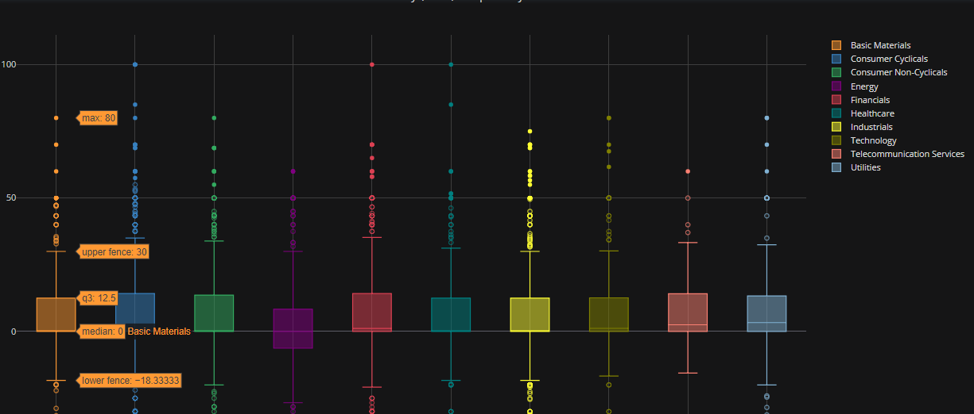

Data Flow
Fortune500 CSV:
[Ticker, Sector]
www.marketwatch.com/investing/stock/<Ticker>
[Date, Ticker, Sector, Average Polarity]
Analysis with PyPlot
[Date, Ticker, Close Price, Volume, PriceChange, VolumeChange]

Slide 5
PyPlot Dashboard
https://plot.ly/dashboard/isgitlevich:4

Slide 6
Conclusions
Analysis of Polarity of the data related to the daily stock prices movement seems to be informative
Volume changes are evident to be related to the polarity of the news feed
Further statistical analysis can be performed to show quantitative evidence of significance

Slide 7
QUESTIONS
?

Slide 8
THANK YOU!

