Slide 1
INTRODUCTION TO EPIGENOME-WIDE ASSOCIATION STUDIES (EWAS)
3. EPIGENOME-WIDE ASSOCIATION STUDIES (EWAS)
(THEORY)

Slide 2
EPIGENOME-WIDE ASSOCIATION STUDY (EWAS)
Workflow
Scientific question
Study population
Biological sample
DNA methylation data acquisition
Quality control of DNA methylation data
Epigenome-wide association study (EWAS)
Meta-EWAS or replication / validation
Biological interpretation

Slide 3

EPIGENOME-WIDE ASSOCIATION STUDY (EWAS)
Workflow
Scientific question
Study population
Biological sample
DNA methylation data acquisition
Quality control of DNA methylation data
Epigenome-wide association study (EWAS)
Meta-EWAS or replication / validation
Biological interpretation

Slide 4
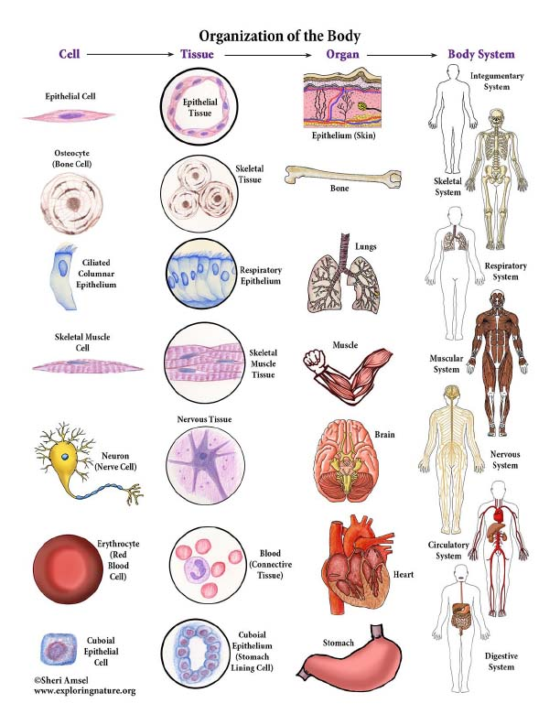
3. BIOLOGICAL SAMPLE
Target tissue vs accesible tissue
Accessible tissues: blood, placenta, ….
Proxy?

Slide 5
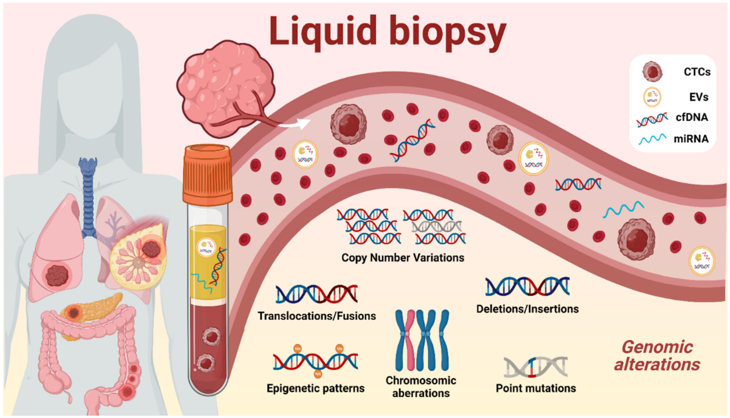
3. BIOLOGICAL SAMPLE
Target tissue vs accesible tissue
Accessible tissues: blood, placenta, ….
Proxy?

Slide 6
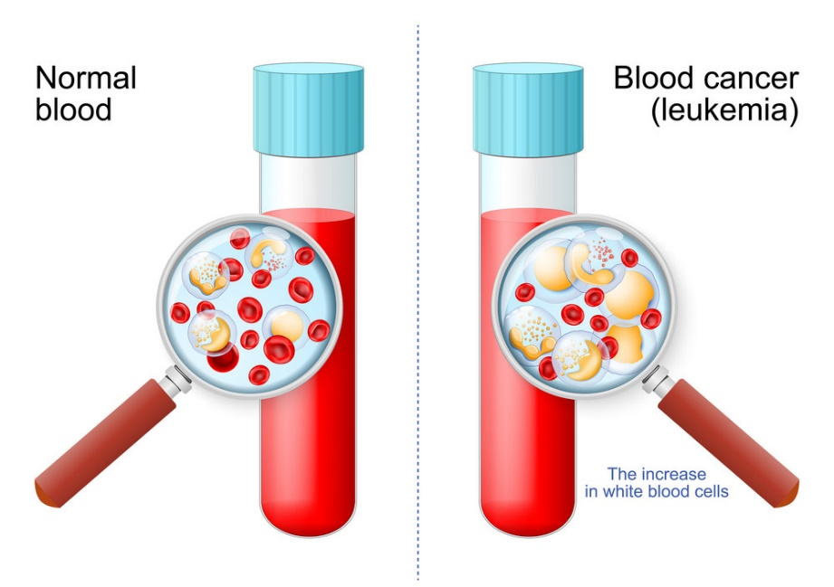
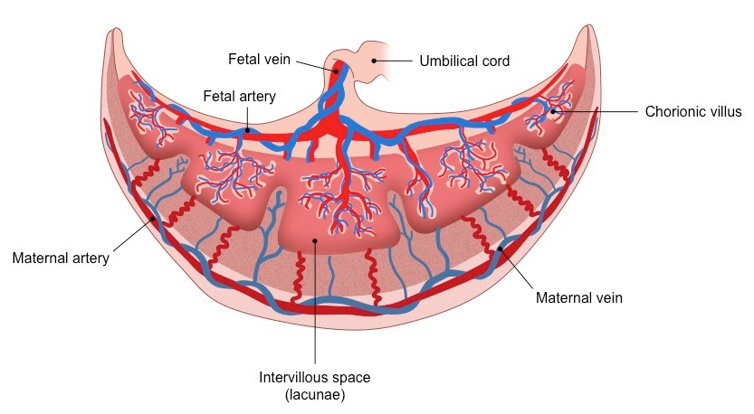
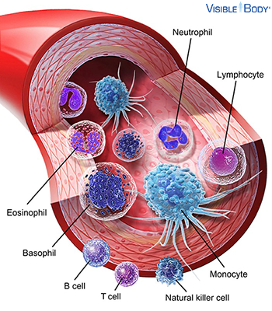
3. BIOLOGICAL SAMPLE
Tissue cellular composition
Heterogeneity:
Different composition across individuals
Different place of biopsy (solid tissues)

Slide 7
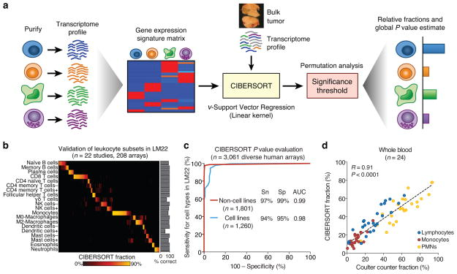
3. BIOLOGICAL SAMPLE
Cell mixture deconvolution
Cell sorting and single cell/nuclei analysis
Cell mixture deconvolution (statistical approach)
4. Bulk target tissue
Reference panel
Methylation
profile
Methylation
profile
Bulk tissue
Bulk tissue
2. Signature selection algorithm
pickCompProbes (in minfi)
Identifying Optimal Libraries (IDOL)
3. Deconvolution algorithm
Quadratic programming-constrained projection (QP-CP) (Houseman in minfi)
Support vector machine (SVM) (Newman in CIBERSORT)
Robust partial correlation (RPM) – (Teschendorff in EpiDISH)
adapted from Newman 2015

Slide 8
3. BIOLOGICAL SAMPLE
Reference panels for cell deconvolution
FlowSorted.Blood.EPIC R package (but also adapted to 450K)
6 cells blood cells adults (TCD4, TCD8, Bcells, Mono, NK, Neu)
FlowSorted.BloodExtended.EPIC R package (but also adapted to 450K)
12 cells blood cells adults (Neu, Eos, Bas, Mono, Bnv, Bmem, CD4nv, CD4mem,
Treg, CD8nv, CD8mem, and NK)
FlowSorted.CordBloodCombined.450k R package
7 cells cord blood cells (TCD4, TCD8, Bcells, Mono, NK, Neu, nRBC)
planet R package
7 cells placenta cells (Trophoblasts, Synsitiotrophoblasts, Hofbauer,
Stromal, Endothelial, nRBC)

Slide 9
3. BIOLOGICAL SAMPLE
Yesterday, already estimated with meffil R package
Reference panels for cell deconvolution
FlowSorted.Blood.EPIC R package (but also adapted to 450K)
6 cells blood cells adults (TCD4, TCD8, Bcells, Mono, NK, Neu)
FlowSorted.BloodExtended.EPIC R package (but also adapted to 450K)
12 cells blood cells adults (Neu, Eos, Bas, Mono, Bnv, Bmem, CD4nv, CD4mem,
Treg, CD8nv, CD8mem, and NK)
FlowSorted.CordBloodCombined.450k R package
7 cells cord blood cells (TCD4, TCD8, Bcells, Mono, NK, Neu, nRBC)
planet R package
7 cells placenta cells (Trophoblasts, Synsitiotrophoblasts, Hofbauer,
Stromal, Endothelial, nRBC)

Slide 10
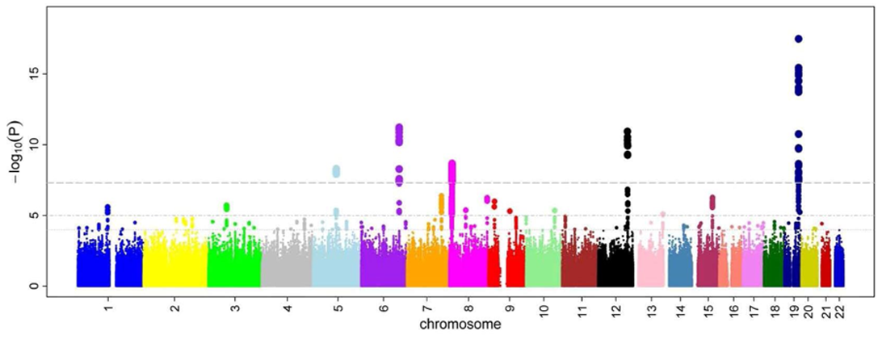
EPIGENOME-WIDE ASSOCIATION STUDY (EWAS)
Workflow
Scientific question
Study population
Biological sample
DNA methylation data acquisition
Quality control of DNA methylation data
Epigenome-wide association study (EWAS)
Meta-EWAS or replication / validation
Biological interpretation

Slide 11
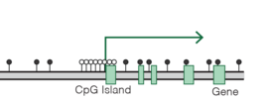
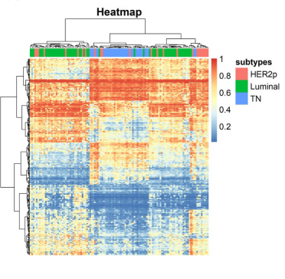
6. EWAS
Types of DNA methylation analyses
By position: differently methylated position (DMP)
By region: differently methylated region (DMR)
All methylation dataset: cluster analysis, heatmap…

Slide 12
6. EWAS
Types of DNA methylation analyses
By position: differently methylated position (DMP)
By region: differently methylated region (DMR)
All methylation dataset: cluster analysis, heatmap…

Slide 13
6. EWAS
Statistical test
Methylation as outcome (better to model):
Linear or robust linear regression models (one per each CpG)
Effect size:
change in methyl (from 0 to 1) by trait category (smoker/non-smoker)
change in methyl (from 0 to 1) by trait unit (unit of cotinine)
Methylation as predictor:
Linear or logistic regression models (one per each CpG)
Effect size:
Cont: change in units of disease trait (kg) by methyl unit (from 0 to 1)
Cat: change in disease odds by methyl unit (from 0 to 1)
Tool: meffil R package (linear or robust regression)
Methyl CpG1 (cont) = trait + cov
Methyl CpG2 (cont) = trait + cov
…
Trait (cont or cat) = methyl CpG1 + cov
Trait (cont or cat) = methyl CpG2 + cov
…

Slide 14
6. EWAS
Differently from GWAS, EWAS can be confounded by several variables and can suffer from reverse causation.
Confounding
A measured or unmeasured third variable that influences both the supposed cause and the supposed effect.
How to select confounders:
A priori knowledge from literature
Directed Acyclic Graph (DAG) (https://www.dagitty.net/)
Cell types
Surrogate variables
Exposure
(vitD)
Outcome
(obesity)
Exposure
(vitD)
Outcome
(obesity)
Causal
Exposure
(vitD)
Outcome
(obesity)
Reverse
causation
Immune
Exposure
(vitD)
Outcome
(obesity)
Mediation
Exercise
Exposure
(vitD)
Outcome
(obesity)
Confounding

Slide 15
6. EWAS
Surrogate variables (SVs) in EWAS
Surrogate variables are covariates constructed directly from high-dimensional data (ex. DNA methylation) that can be used in subsequent analyses to adjust for unknown, unmodeled, or latent sources of noise.
Biological variables: sex, cell type proportions, ancestry, etc…
Technical variables: slide, plate, etc...
sva R package

Slide 16
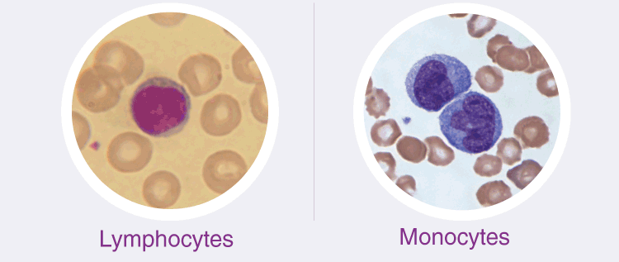
6. EWAS
Cell type proportion in EWAS: confounding and mediation
Causation
(mediation by cell%)
Causation
(cell% final outcome)
Confounding
Exposure
Methyl
Exposure
Methyl
Disease
Methyl
Example:
Smoking -> Inflamation -> Diff cell%
Diff cell% -> Diff methyl
Example:
Smoking -> Diff methyl -> Diff cell%
Diff cell% -> Inflamation
Example:
Inflamation -> Diff cell% -> Allergy
Diff cell% -> Diff methyl
Methyl = Exp + Cov
Methyl = Exp + Cov
Methyl = Exp + Cov + Cells

Slide 17
6. EWAS
Cell type proportion in EWAS: interaction or cell type specific effects
Example: smoking affects DNA methylation in CpG1, only in monocytes
Tools:
EpiDISH (CellDMC)
RaMWAS
Non-smokers
Smokers
Unmethyl
Unmethyl
Unmethyl
Methyl
Methyl = Trait * Cell type% + Cov
You et al. Nat Comm 2020

Slide 18
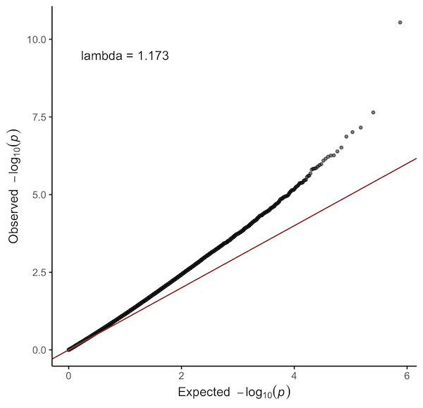
6. EWAS
Multiple-testing correction
Methods
Bonferroni (p-value 0.05 / N CpGs)
False Discovery Rate (FDR)
QQ plots and lambda inflation factor
Ratio of the median of the empirically observed
distribution of the test statistic to the expected median
In general close to 1
If lower: xxxxxxxxxxx
If higher:
true biological signals
technical bias

Slide 19
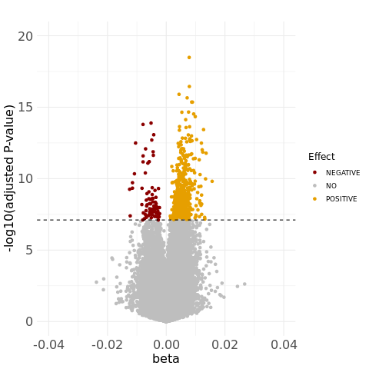
6. EWAS
Visualitzation of genome-wide results
Volcano plot
Manhattan plot

Slide 20
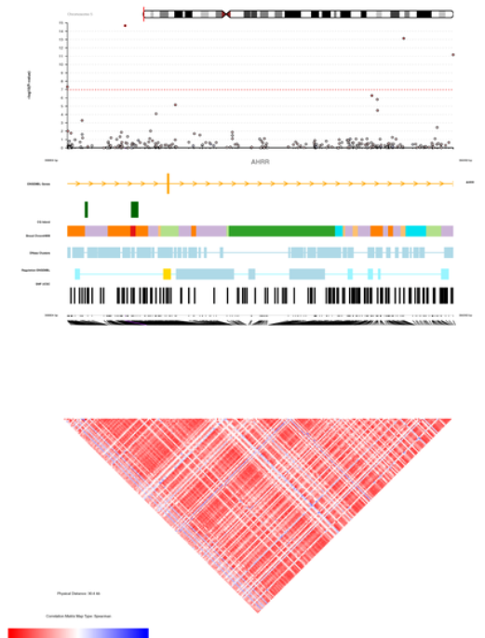
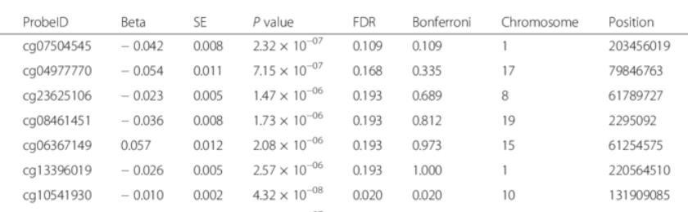
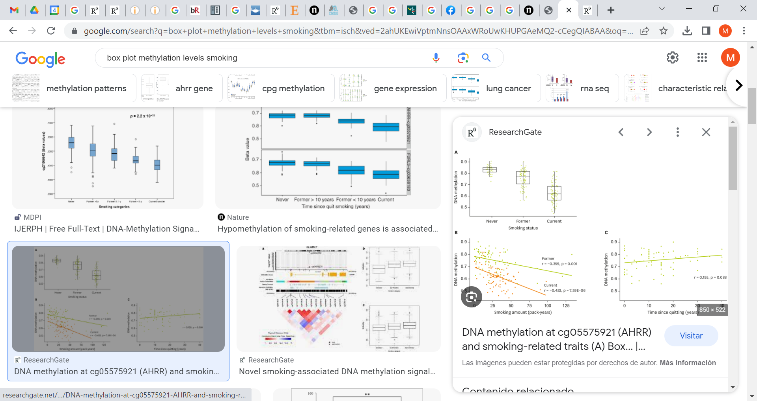
6. EWAS
Visualitzation of locus specific results
Comet plot
Table of results (CpG vs locus)
Box plot
Scatter plot

Slide 21
INTRODUCTION TO EPIGENOME-WIDE ASSOCIATION STUDIES (EWAS)
3. EPIGENOME-WIDE ASSOCIATION STUDIES (EWAS)
(PRACTICAL SESSION)

Slide 22
EWAS OF CURRENT AND FORMER SMOKING
Data: Cohort 1 (N = xxx)
Array: 450K
Tissue: blood
Ancestry: White European
Sex: males and females
Smoking: never, former, current
Age: yes
Array batch: yes
Cells: yes
Input: ExpressionSet with matrix of beta values + covariates dataframe (exposure, covariates, cells)
Output (for current and former): results dataframes (not adj, adj, adj and sva) + report (descriptive, QQ plot and lambda, Manhattan plot)
Tool: meffil R package
Questions:
Which is the lambda of the unadjusted EWAS of current smoking? How does it change in adding covariates and surrogate variables?
How many CpGs are associated with current smoking (after False Discovery Rate – FDR - correction)?
How many of the FDR CpGs show higher methylation and how many lower methylation?
xxxxxxxxxxxxxx

