Slide 1
INTRODUCTION TO EPIGENOME-WIDE ASSOCIATION STUDIES (EWAS)
4. META-ANALYSIS OF EPIGENOME-WIDE ASSOCAITION STUDIES (EWAS)
(THEORY)

Slide 2
EPIGENOME-WIDE ASSOCIATION STUDY (EWAS)
Workflow
Scientific question
Study population
Biological sample
DNA methylation data acquisition
Quality control of DNA methylation data
Epigenome-wide association study (EWAS)
Meta-EWAS or replication / validation
Biological interpretation

Slide 3
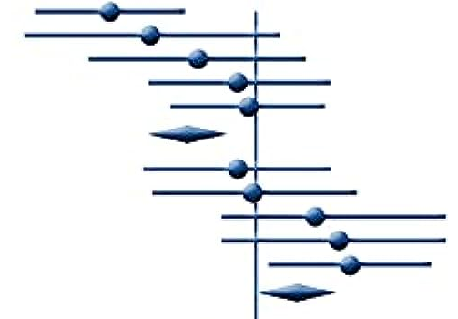
EPIGENOME-WIDE ASSOCIATION STUDY (EWAS)
Workflow
Scientific question
Study population
Biological sample
DNA methylation data acquisition
Quality control of DNA methylation data
Epigenome-wide association study (EWAS)
Meta-EWAS or replication / validation
Biological interpretation

Slide 4
7. META-EWAS
Robustness of results
Statistical power (methyl=smoking):
Sample size
Percentage of exposed
Effect size on DNA methylation
Type I error (and multiple-testing)
Statistical power calculator:
pwrEWAS for case/control studies (https://github.com/stefangraw/pwrEWAS)
Solutions:
Validation with another method in same samples
Replication in an independent sample
Increase statistical power -> increase sample size -> combine data from different studies

Slide 5
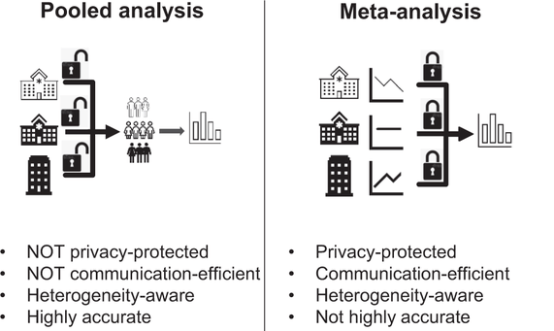
7. META-EWAS
Statistical synthesis of information from multiple independent studies
Luo et al Nat Comm 2022

Slide 6

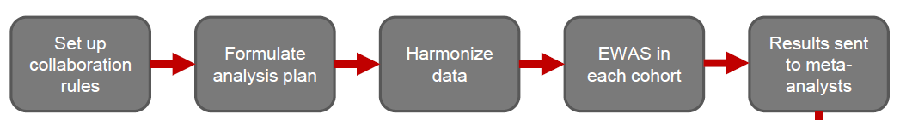
7. META-EWAS
Steps
Sources
1.1. Individual-level data
Directly from other studies
-> Pregnancy and Childhood Epigenetics Consortium – PACE
https://www.niehs.nih.gov/research/atniehs/labs/epi/pi/genetics/pace/index.cfm
Online repositories of individual level data

Slide 7
7. META-EWAS
Steps
Sources
1.1. Individual-level data
Directly from other studies
-> Pregnancy and Childhood Epigenetics Consortium – PACE
https://www.niehs.nih.gov/research/atniehs/labs/epi/pi/genetics/pace/index.cfm
Online repositories of individual level data
1.2. Summarized results -> check units and covariates!!!
Online repositories of summary statistics
Papers

Slide 8
7. META-EWAS
Steps
Sources
1.1. Individual-level data
Directly from other studies
-> Pregnancy and Childhood Epigenetics Consortium – PACE
https://www.niehs.nih.gov/research/atniehs/labs/epi/pi/genetics/pace/index.cfm
Online repositories of individual level data
1.2. Summarized results
Online repositories of summary statistics
Papers
2. Transfer summarized results (CpG, effect, SE, pvalue)
3. Quality control of the results of each study
4. Meta-analysis

Slide 9
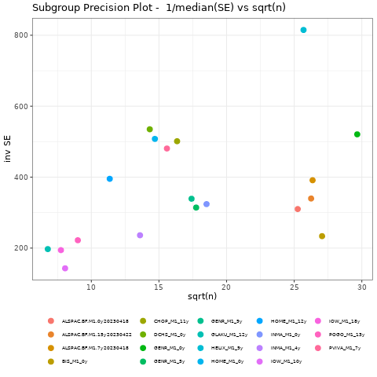
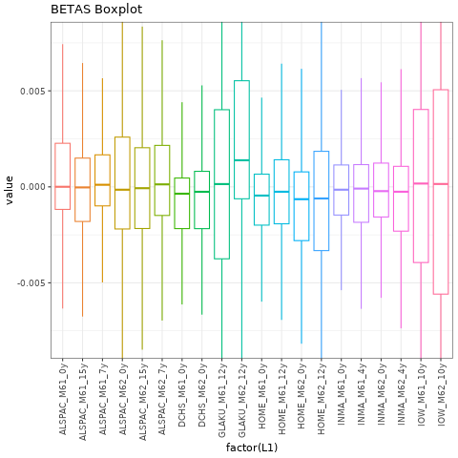
7. META-EWAS
Quality control of results of each study
QQ plot and lambda inflation factor
Check consistency of results (effects, SE, p-values)
Check filtering of CpGs
Precision-plot

Slide 10
7. META-EWAS
Statistical tests
Meta-analysis of p-values
Inverse-variance weighted meta-analysis (IVW)
More precise studies (usually larger ones) will have more weight in the meta-analysis
Types:
Fixed effect IVW MA: assumes one true effect size share by all studies (diff. are sampling error)
Random effect IVW MA: allows true effect sizes to vary from study to study (heterogeneity)
–> less power
Estimates of heterogeneity: I², p-value het
Low-moderate (I²<50)
Moderate-high (I²>50)
Tools
GWAMA (fixed and random-effects, https://genomics.ut.ee/en/tools)
METAL (fixed-effects IVW, https://genome.sph.umich.edu/wiki/METAL_Documentation)
metafor R package
Rice, Higgins & Lumley, 2018

Slide 11
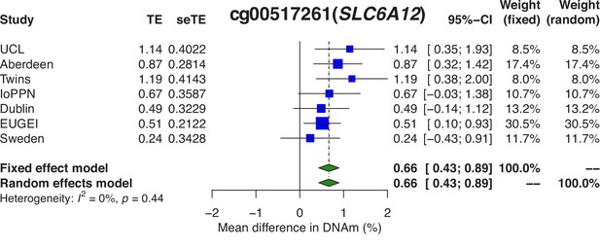
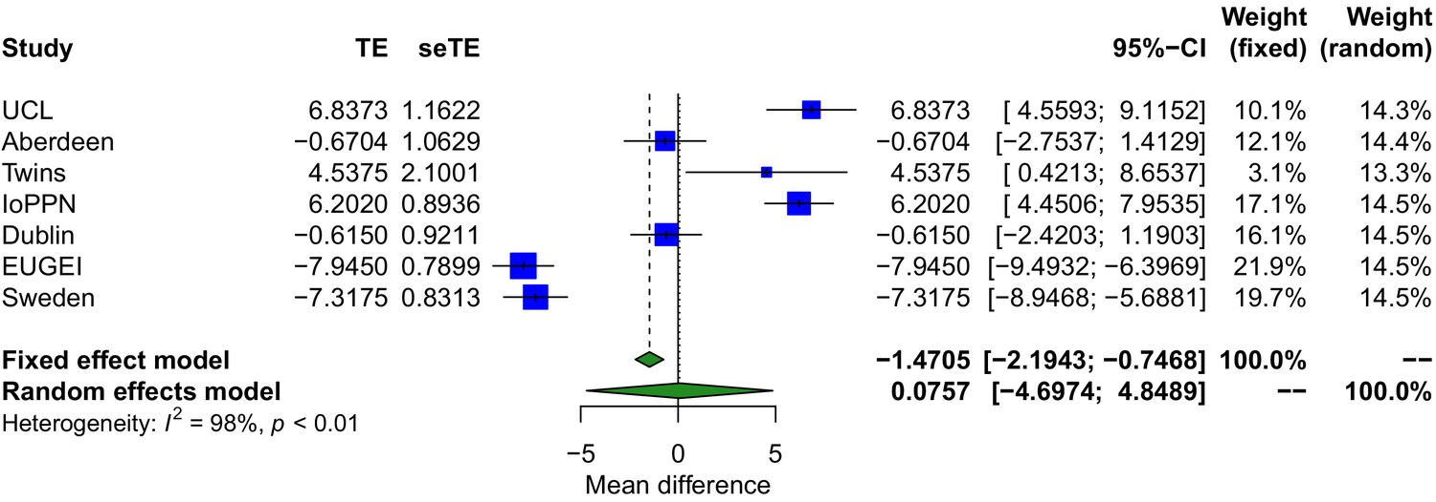
7. META-EWAS
Visualization of results
Table with results
Manhattan plot
Volcano plot
Scatter plots
Comet plot
Forest plot
Leave-one-out MA plot
Forest plots
CpG 1
CpG 2

Slide 12
INTRODUCTION TO EPIGENOME-WIDE ASSOCIATION STUDIES (EWAS)
4. META-ANALYSIS OF EPIGENOME-WIDE ASSOCAITION STUDIES (EWAS)
(PRACTICAL SESSION)

Slide 13
META-EWAS OF CURRENT AND FORMER SMOKING
Data: Cohort 1 (N = xxx), Cohort 2 (N=xx), Cohort 3 (N=xxx)
Array: 450K
Tissue: blood
Ancestry: White European
Sex: males and females
Smoking: never, former, current
Age: yes
Array batch: yes
Cells: yes
Input (for each cohort and current and former smoking): results dataframe (adj and sva)
Output (for current and former / each cohort): QC boxplot, QC precision plot, meta-results dataframe, lambda, QQ plot, forestplot
Tool: metafor R package
Questions:
What does the precision plot show?
How many FDR CpGs are associated with current smoking? and how many with former smoking?
Which is the CpG with the lowest p-value for current smoking? Does it show increased or decreased methylation? Does it show heterogeneity across studies? Is the effect size of this CpG similar between current and never smokers and between former and never smokers?

