Slide 1
Introduction to Backend Development
FSD

Slide 2
We are going to move from our Campus Pulse app to a new app
GearVault - Equipment Rental and Asset Management
Develop a full stack platform that rents specialized equipment to customers
The company manages equipment available, customer reservations, checkouts, returns, maintenance, and rental history
This applications functionality will depend heavily on backend processing, database relationships, and business rules

Slide 3
Core features
  Equipment catalog with categories, condition, and availability.
  Customer registration and login.
  Equipment reservations and checkouts.
  Returns, late fees, and rental history.
  Maintenance requests and equipment status.
  Administrative dashboard and reporting.
The interesting part is that you must enforce business rules on the server.
For example, an item cannot be rented to two customers for overlapping periods, and equipment undergoing maintenance cannot be checked out.
Helps you understand why backend programming is more than simply storing information.

Slide 4
Technology stack
Frontend
  React + Vite (understand this part)
Backend
  Node.js + Express (routes, middleware, services)
Database
  MongoDB + Mongoose (persistent data and schemas)
Authentication
  Sessions + password hashing (secure user access)
Development
  VSCode + GitHub (source control and collaboration)
Deployment
  Docker + Compose (containerized apps)

Slide 5
There are other frameworks and it’s good to learn TypeScript too
But it would take a rework of the frontend learning
For this course, we should focus on understanding the separation of frontend, backend and database responsibilities
We may introduce some different frameworks at the end - for your own research

Slide 6
From this point forward - we are going to chat but it’s going to take you into areas where you will need to perform your own research to learn deeper
This lecture - Introduction to Backend Development
  How servers work
  Node.js runtime
  HTTP request and response cycle
  Create an Express server
  Routes
  Request parameters
  JSON responses
  Build our first GearVault API - using in-memory array at first

Slide 7
Next:
REST APIs and CRUD Ops
Database Integration
Full-Stack Integration
Authentication and Authorization
Professional Backend Architecture
Deployment and Integration

Slide 8
So, our approach will be:
Detailed lectures, concepts, living code
Some guided exercises (as in the past)
Individual and team development and demos of code and processes
You need to document your API designs, create test cases, and explain your coding

Slide 9
Try to work through individual / team labs as we move forward
Individual labs may focus more on smaller backend systems that reinforce concepts
Teams - continue to develop GearVault or maybe you stick with your team theme - depending on that demo.

Slide 10
By the end of this semester, you should be able to:
Explain how React applications communicate with backend servers through HTTP.
Design and implement RESTful APIs using Node.js and Express.
Store and retrieve application data using MongoDB.
Integrate React frontend components with backend services.
Implement authentication, authorization, validation, and error handling.
Organize, test, and deploy a full-stack application using Docker.

Slide 11
Let’s begin!
Understanding the Backend
Architecture, HTTP, Node.js, and the request/response cycle
What is backend development?
You have spent several weeks building React applications.
These applications run in the browser and manage data using JavaScript state.

Slide 12
Consider a GearVault equipment object:
const equipment = {
id: 101,
name: "Canon EOS R50",
category: "Camera",
condition: "Excellent",
available: true
};
React can display this object, update it, filter it, and remove it from an array.
But several questions remain:
What happens when the browser refreshes?
How can two users access the same equipment inventory?
How do we prevent two customers from reserving the same equipment?
Where should sensitive business rules execute?
How can the application retain information after the server restarts?
These problems introduce the need for backend services and persistent storage.

Slide 13
But several questions remain:
  What happens when the browser refreshes?
  How can two users access the same equipment inventory?
  How do we prevent two customers from reserving the same equipment?
  Where should sensitive business rules execute?
  How can the application retain information after the server restarts?
  These problems introduce the need for backend services and persistent storage.

Slide 14
Client/server architecture
React Frontend
Displays equipment and captures user actions
HTTP / JSON
Express Backend
Receives requests and processes business rules
Database operations MongoDB
Stores equipment, customers, and rentals

Slide 15

Frontend | Backend
Displays equipment cards | Provides equipment data
Handles form inputs | Validates submitted information
Shows availability | Enforces reservation rules
Displays errors | Returns meaningful HTTP errors
Manages interface state | Manages shared application data
The responsibilities of each layer:

Slide 16
If a customer changes available: false to available: true using browser developer tools, should the server accept the change?
No. The server must independently verify whether the equipment is available.

Slide 17
HTTP fundamentals
The anatomy of a request:
GET /api/equipment HTTP/1.1
Host: localhost:3001
Accept: application/json
The response:
HTTP/1.1 200 OK
Content-Type: application/json
[
{
"id": 101,
"name": "Canon EOS R50",
"available": true
}
]

Slide 18
You should understand the most important HTTP methods and status codes.
Method | Purpose | Example
GET | Retrieve data | Get all equipment
POST | Create data | Add new equipment
PUT | Replace a resource | Replace equipment details
PATCH | Partially update | Change equipment condition
DELETE | Remove a resource | Delete equipment
Status | Meaning
200 | Successful request
201 | Resource created
400 | Invalid request
401 | Authentication required
403 | Access denied
404 | Resource not found
409 | Conflict with current state
500 | Server error

Slide 19
Introduction to Node.js
Node.js allows JavaScript to execute outside the browser.
Note:
Browser JavaScript, which can interact with the DOM.
Node.js, which can access server resources and handle network requests.
Express, which simplifies building HTTP applications on Node.js.

Slide 20
Let’s look at a node program:
const equipment = [
{ id: 1, name: "Camera", available: true },
{ id: 2, name: "Projector", available: false },
{ id: 3, name: "Microphone", available: true }
];
console.log("GearVault Inventory");
const available = equipment.filter(item => item.available);
console.log("Available equipment:", available.length);
available.forEach(item => {
console.log(`${item.id}: ${item.name}`);
});

Slide 21
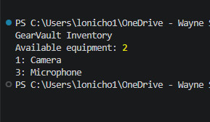
We would execute it with:
node hello.js

Slide 22
Let’s build a backend express server
Grab the GearVaultStarter.zip - from Canvas
This includes:
Reusable components and props
useState, useEffect, and useMemo
Equipment CRUD operations
Controlled forms and validation
Search, filtering, and conditional rendering
Immutable state updates
JSON data and browser localStorage
Responsive dashboard styling

Slide 23
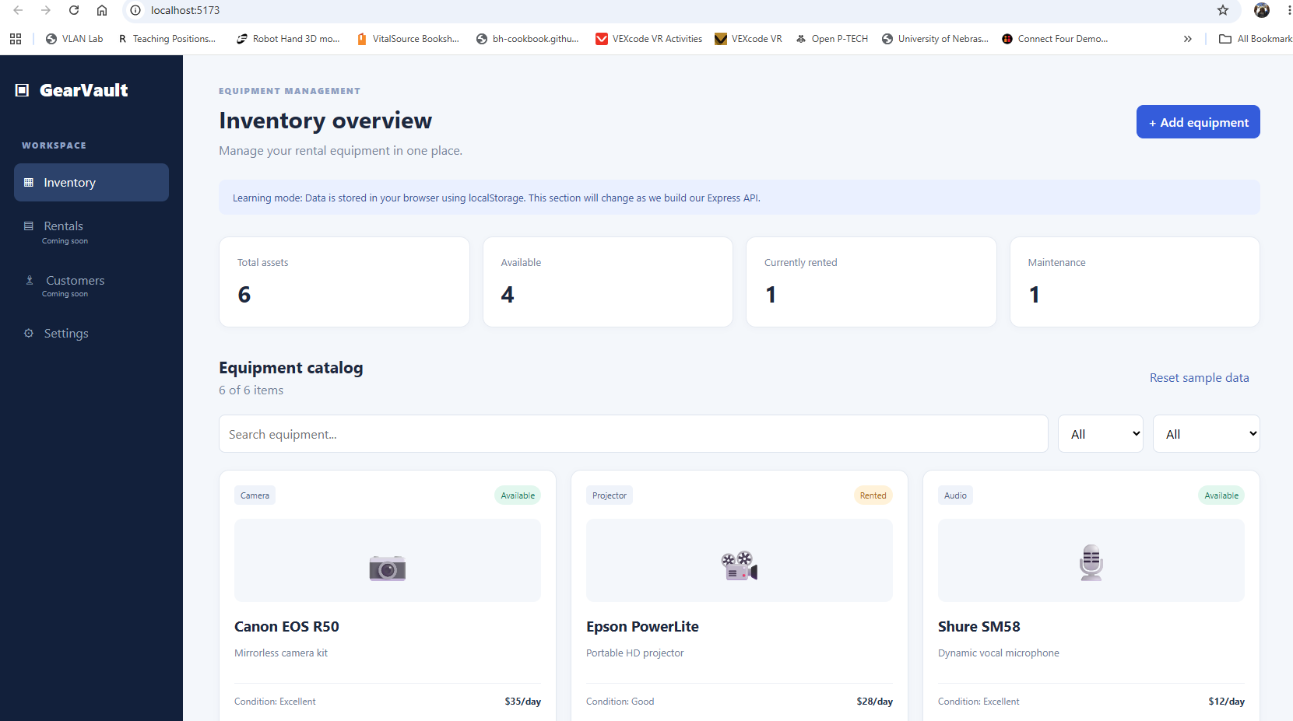
Unzip in your FSDProject folder
cd to that folder in the terminal
run:
npm install
npm run dev
Should see --->

Slide 24
Backend starting point
The server directory includes the Express configuration, sample equipment data, and an initial working server.
You will add the GET and POST routes during class rather than receiving all the backend solutions in advance.

Slide 25
Let me explain the code to this point ……
Now - split the terminal so you have two different terminals
Terminal 1 - in the project directory
npm install (unless you’ve done that the first time)
npm run dev
Terminal 2 - should be in project directory - now:
cd server
npm install
npm run dev
Notice ports

Slide 26
In server directory - let’s examine the code
First - package.json:
{
"name": "gearvault-api",
"private": true,
"type": "module",
"scripts": {
"start": "node server.js",
"dev": "node --watch server.js"
},
"dependencies": {
"express": "^5.1.0"
}
}

Slide 27
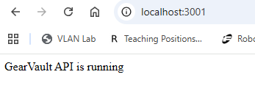
Now server.js
import express from 'express';
const app = express();
const PORT = 3001;
app.use(express.json());
app.get('/', (req, res) => {
res.send('GearVault API is running');
});
app.listen(PORT, () => console.log(`API: http://localhost:${PORT}`));
Browser - localhost:3001 →

Slide 28
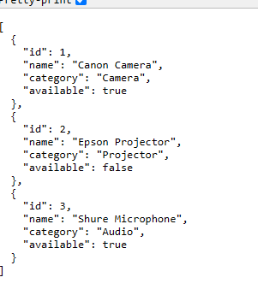
Create the first equipment endpoint
Extend server.js with an in-memory inventory:
const equipment = [
{ id: 1, name: "Canon Camera", category: "Camera", available: true },
{ id: 2, name: "Epson Projector", category: "Projector", available: false },
{ id: 3, name: "Shure Microphone", category: "Audio", available: true }
];
app.get("/api/equipment", (req, res) => {
res.json(equipment);
});
Place this route before app.listen().
Test:
http://localhost:3001/api/equipment

Slide 29
Then add a parameterized route:
app.get("/api/equipment/:id", (req, res) => {
const id = Number(req.params.id);
const item = equipment.find(item => item.id === id);
if (!item) {
return res.status(404).json({
error: "Equipment not found"
});
}
res.json(item);
});
req.params.id is a string and numeric conversion is necessary.

Slide 30
Now test with:
http://localhost:3001/api/equipment/1
http://localhost:3001/api/equipment/2
http://localhost:3001/api/equipment/6

Slide 31
Now we might write code for:
GET /api/equipment/available
Returns only equipment whose available property is true
An equipment summary
GET /api/summary
Returns an object containing the total equipment count, available count, and unavailable count

Slide 32
What about finding equipment
Use the existing parameterized route to return one equipment object by ID, or a 404 response if it does not exist.
Important:
register the /api/equipment/available route before /api/equipment/:id so Express does not interpret "available" as an ID.

Slide 33
Code:
Available Equipment
app.get("/api/equipment/available", (req, res) => {
const availableEquipment = equipment.filter(
item => item.available === true
);
res.json(availableEquipment);
});

Slide 34
How it works
app.get() creates an HTTP GET endpoint.
equipment.filter() examines every object in the array.
item.available === true selects only available equipment.
res.json() returns the filtered array as JSON.
Test in your browser:
http://localhost:3001/api/equipment/available

Slide 35
Output
[
{
"id": 1,
"name": "Canon Camera",
"category": "Camera",
"available": true
},
{
"id": 3,
"name": "Shure Microphone",
"category": "Audio",
"available": true
}
]

Slide 36
Equipment Summary
Objective: Create an API endpoint that summarizes the inventory.
Endpoint: GET /api/summary
app.get("/api/summary", (req, res) => {
const total = equipment.length;
const available = equipment.filter(
item => item.available === true
).length;
const unavailable = total - available;
res.json({
totalEquipment: total,
availableEquipment: available,
unavailableEquipment: unavailable
});
});

Slide 37
How it works
equipment.length counts every equipment item.
filter() selects available items.
.length counts the filtered results.
Subtraction determines how many items are unavailable.
res.json() returns a summary object.
Test:
http://localhost:3001/api/summary

Slide 38
Output
{
"totalEquipment": 3,
"availableEquipment": 2,
"unavailableEquipment": 1
}

Slide 39
Find Equipment by ID
Objective: Return a specific equipment item using a route parameter.
Endpoint: GET /api/equipment/:id
app.get("/api/equipment/:id", (req, res) => {
const equipmentId = Number(req.params.id);
const item = equipment.find(
item => item.id === equipmentId
);
if (!item) {
return res.status(404).json({
error: "Equipment not found"
});
}
res.json(item);
});

Slide 40
How it works
req.params.id retrieves the ID from the URL.
Number() converts the string into a number.
find() searches the array for a matching ID.
If no match exists, Express returns HTTP 404.
Otherwise, the matching equipment object is returned.
Test 1 — Existing equipment:
http://localhost:3001/api/equipment/2

Slide 41
{
"id": 2,
"name": "Epson Projector",
"category": "Projector",
"available": false
}

Slide 42
Equipment not found:
http://localhost:3001/api/equipment/99
{
"error": "Equipment not found"
}
The second request should return HTTP status 404, not 200.

