Slide 1
REST APIs and CRUD Ops
FSD

Slide 2
Next - Adding to GearVault moving towards a full stack equipment management system
Open up your GearVault react starter - should include all the API route parameters added last lecture.
Now let’s move from a frontend / backend into a full stack system
We will first learn how to design and test REST APIs
There are a couple of common choices for API development
Thunder Client or Postman

Slide 3
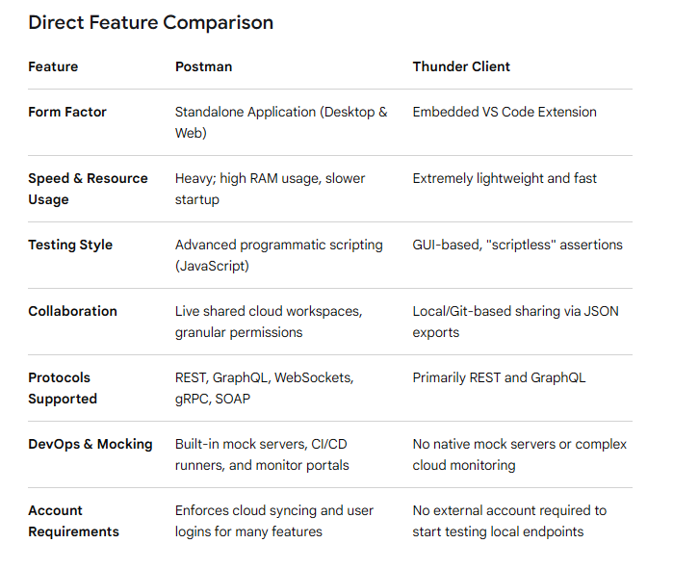

Slide 4
Why choose Thunder Client:
Zero content-switching
Git friendly integration
No cloud bloat

Slide 5
Why choose postman
Large team coordination
Complex testing logic
Beyond REST - need to test WebSockets or integrate with microservices
Good resource:
https://www.geeksforgeeks.org/node-js/postman-vs-thunder-client-api-testing-tools/

Slide 6
Should be able to:
Explain REST principles and identify resources, endpoints, HTTP methods, request bodies, and status codes.
Use Thunder Client or Postman to test and debug API requests.
Implement CREATE, READ, UPDATE, and DELETE operations in Express.
Validate incoming data and return appropriate HTTP responses.
Explain CORS and configure an Express API for a separate React frontend.
Use fetch(), async/await, and useEffect() to communicate with an API.
Build a React equipment manager that performs CRUD operations through Express rather than modifying only local data.

Slide 7
Series of lectures:
This one - REST API Design, Thunder Client, POST and validation
Next - PUT DELETE, API testing, CORS
Then - React fetch(), async / await, useEffect, frontend integration

Slide 8
REST API Development and Testing
REST fundamentals, API testing tools, POST requests
What is a REST API
Remember last lecture our Week 1 of Backend concepts
Created a server that could return equipment info
The server returned an array of equipment objects
Need more functionality - rental business must:
  Add equipment
  Update condition information
  Remove discontinued items
  Retrieve inventory records

Slide 9
REST API design becomes important
REST (Representational State Transfer) is an architectural style for designing networked applications.
RESTful APIs expose resources through URLs and use standard HTTP methods to operate on those resources.
A resource is something the application manages.
For GearVault, possible resources include:
  Equipment
  Customers
  Reservations
  Rentals
  Maintenance records
Each resource can be represented using JSON.

Slide 10
Understanding resources and endpoints
Consider the equipment resource.
/api/equipment
This represents the equipment collection.
/api/equipment/3
This represents one equipment item with ID 3.

Slide 11

HTTP method | Endpoint | Purpose
GET | /api/equipment | Retrieve all equipment
GET | /api/equipment/3 | Retrieve equipment ID 3
POST | /api/equipment | Create equipment
PUT | /api/equipment/3 | Replace equipment ID 3
PATCH | /api/equipment/3 | Update selected fields
DELETE | /api/equipment/3 | Delete equipment ID 3
The URL identifies the resource. The HTTP method describes the requested operation.
These endpoints use nouns, not verbs.

Slide 12
Instead of:
  /api/getEquipment
  /api/createEquipment
  /api/deleteEquipment
We use:
  GET /api/equipment
  POST /api/equipment
  DELETE /api/equipment/3
This creates a consistent API that is easier to understand and maintain.

Slide 13
REST principles
Client/server separation: The React application handles the interface, while Express handles backend requests.
Stateless requests: Each request contains the information the server needs to process it. Statelessness does not mean the server cannot store equipment or customer data.
Resources: Equipment, customers, and reservations have identifiable URLs.
Standard HTTP methods: GET, POST, PUT, PATCH, and DELETE communicate the requested action.
Representations: JSON is the format GearVault uses to exchange data.
Status codes: Responses indicate success, failure, or other outcomes.

Slide 14
Code | Name | GearVault example
200 | OK | Equipment retrieved
201 | Created | Equipment added
204 | No Content | Equipment deleted
400 | Bad Request | Missing equipment name
401 | Unauthorized | Login required
403 | Forbidden | User lacks permission
404 | Not Found | Equipment ID does not exist
409 | Conflict | Duplicate equipment name
500 | Internal Server Error | Unexpected server failure
HTTP status codes
The response status communicates the result independently of the JSON body.
Frontend applications can use this status to decide how to handle the request.

Slide 15
Before connecting React to Express, you should know how to test the backend independently
A browser address bar is useful for GET requests, but it is not a complete API development environment.
We are going to use Thunder Client for these first exercises

Slide 16

Installing Thunder Client
  Open VS Code.
  Select Extensions.
  Search for Thunder Client.
  Install the extension.
  Open Thunder Client from its sidebar icon.
  Select New Request.
Thunder Client official documentation is here:
https://www.thunderclient.com/
You need to create a free account

Slide 17
Anatomy of an API request
An API request generally contains:
POST http://localhost:3001/api/equipment
Headers
Content-Type: application/json
Body (JSON)
{
"name": "Sony Camera",
"category": "Camera",
"condition": "Excellent"
}
201 Created
Response from the serve

Slide 18
URL: Identifies the resource being accessed.
Method: Specifies the operation.
Headers: Provide metadata about the request.
Body: Contains data being submitted.
Response: Contains the server's status and any returned data.

Slide 19
Let’s test GearVault
Make sure you are logged into Thunder client with your free account
Start your express server - in split terminal
cd server
npm run dev
In Thunder Client - create these requests:
Retrieve all equipment
GET http://localhost:3001/api/equipment
Retrieve one item
GET http://localhost:3001/api/equipment/1
Retrieve an invalid ID
GET http://localhost:3001/api/equipment/999

Slide 20
Should all work with 200 and final one with 404.
Take a look at the status code, response body, and response headers for each request.

Slide 21
Creating resources with POST
Why GET is not enough
GET retrieves information. It should not create or modify equipment.
To create a new resource, the client sends a POST request with a JSON body.
Example:
POST /api/equipment
Content-Type: application/json
{
"name": "DJI Drone",
"category": "Drone",
"condition": "Excellent"
}
The server validates the request, creates an equipment record, and returns the result.

Slide 22
Understanding express.json()
In server.js, already have:
app.use(express.json());
This middleware parses incoming JSON request bodies and makes the resulting data available through:
req.body
For example:
const { name, category, condition } = req.body;
This is object destructuring, a JavaScript concept you have already encountered.

Slide 23
Implement the POST endpoint
Add the following route after app.use(express.json())
and before app.listen().
Grab - postendpoint1.txt Canvas - copy to server.js
Let’s use our data file now in /data
Add:
import {equipment} from './data/equipment.js’;
And remove:
/*
const equipment = [
{ id: 1, name: "Canon Camera", category: "Camera", available: true },
{ id: 2, name: "Epson Projector", category: "Projector", available: false },
{ id: 3, name: "Shure Microphone", category: "Audio", available: true },
];
*/

Slide 24
Explain code - first post code:
Step 1 — Extract data
const { name, category, condition } = req.body;
The server retrieves information from the JSON request.
Step 2 — Validate
if (!name.trim()) {
// Reject invalid input
}
The server should not assume that every request contains valid information.
The complete route also checks the data type before calling .trim().
Step 3 — Generate an ID
Math.max(...equipment.map(item => item.id)) + 1
This identifies the largest current ID and generates the next one.
It is suitable for our temporary in-memory demonstration, not for a production database with concurrent users.

Slide 25
Step 4 — Create an object
const newEquipment = {
id: newId,
name: name.trim(),
category: category.trim(),
condition: condition?.trim() || "Good",
available: true
};
The shortened expression above assumes condition is a string or is omitted
The full endpoint handles invalid types safely.

Slide 26
Step 5 — Store and respond
equipment.push(newEquipment);
res.status(201).json(newEquipment);
The server adds the object to the array and returns the newly created equipment.
This information is stored only in server memory.
Restarting Express restores the original sample data.
MongoDB will solve this in the future

Slide 27
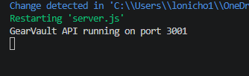
Let’s test this process
In Thunder client - we will submit this information:
{
"name": "GoPro Hero",
"category": "Camera",
"condition": "Excellent"
}
Make sure server is running

Slide 28

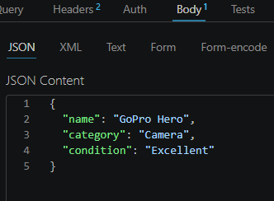
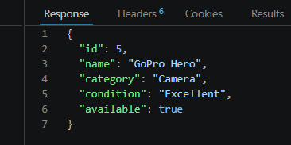
In the Thunder Client
Click send ---------------------------------→

Slide 29
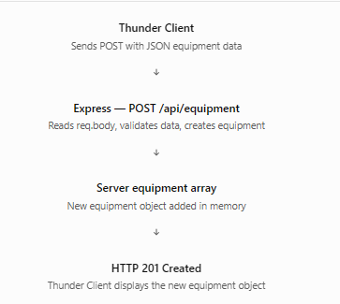

Slide 30
Verify the equipment was actually added
Creating equipment is only half the exercise.
You should confirm the new item exists.
In Thunder Client, create another request or reuse the current one.
Change the HTTP method to GET.
Use the same URL:
GET http://localhost:3001/api/equipment
Select Send.
You should now see the original equipment plus the newly created GoPro Hero.

Slide 31
Notice that the original sample objects do not necessarily contain the condition field.
We will eventually standardize the equipment model.

