Slide 1
Database Integration
FSD

Slide 2
In-class Exercise
Back-End Dev
Database Integration
Persistent Inventory System
Final - A working Express REST API backed by MongoDB, with persistent equipment and customer data

Slide 3
Overview
You have already developed the GearVault React application and started building an Express backend.
You have worked with fetch(), JSON, GET and POST requests, CORS, and Thunder Client.
Currently, your backend stores equipment in a JavaScript array.
That works for demonstrating REST APIs, but introduces a major problem:
  What happens when the Express server restarts?
  Any equipment added to the in-memory array disappears.
Now - we will replace that temporary storage with a real database.

Slide 4
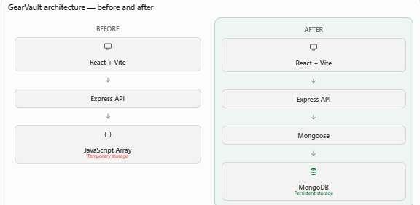

Slide 5
Objectives
  Explain the differences between relational and document-oriented databases.
  Identify MongoDB databases, collections, documents, and _id values.
  Design a Mongoose schema with appropriate data types and validation.
  Connect an Express application to a MongoDB database.
  Build asynchronous CRUD operations using Mongoose.
  Demonstrate persistence by restarting the Express server and retrieving previously stored records.

Slide 6
Introduction to Document Databases
The problem with our current GearVault implementation
Data stored in data/equipment.js
If we:
  Start Express.
  Send GET /api/equipment in Thunder Client.
  Send POST /api/equipment to add a microphone.
  Send another GET and verify the microphone appears.
  Stop the server with Ctrl+C.
  Restart Express.
  Send GET again.
  No dynamic storage

Slide 7
The JavaScript array was modified in the running process, but the original source file was not rewritten.
Restarting Express creates a new array from the original data.
Three storage approaches:
A database also supports queries, indexes, validation, and controlled concurrent access.
Storage method | Survives restart? | Appropriate use
JavaScript array | No, unless separately saved | Learning, temporary data
JSON file | Yes, when explicitly written | Small local projects
Database | Yes, when writes succeed | Multi-user, persistent applications

Slide 8
Relational versus document databases
You may already know relational databases such as MySQL or MariaDB. (Intro to DB and Adv DB courses)
Equipment record might appear in two different systems.
Relational representation
CREATE TABLE equipment (
id INT PRIMARY KEY AUTO_INCREMENT,
name VARCHAR(100) NOT NULL,
category VARCHAR(50),
available BOOLEAN
);

Slide 9
Each piece of equipment becomes a row.
id | name | category | available
1 | Canon EOS R50 | Camera | 1
2 | Epson PowerLite | Projector | 0

Slide 10
MongoDB representation
MongoDB stores BSON documents, a binary representation that supports JSON-like objects and additional data types.
{
"_id": "example-generated-id",
"name": "Canon EOS R50",
"category": "Camera",
"available": true,
"specifications": {
"resolution": "24 MP",
"lens": "RF-S 18-45mm"
},
"tags": ["photography", "portable"]
}
The nested specifications object and tags array illustrate why document databases are convenient for data that naturally forms an object.

Slide 11
Terminology comparison
MongoDB is flexible about document structure, but flexibility does not mean we should ignore schema design.
Relational database | MongoDB
Database | Database
Table | Collection
Row | Document
Column | Field
Primary key | _id
SQL query | MongoDB query
Table schema | Optional database-level validator or application-level schema

Slide 12
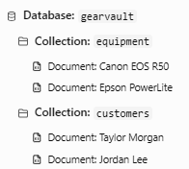
MongoDB structure
Explain the hierarchy:

Slide 13
Three important ideas:
1. Every document has an _id. MongoDB automatically generates an ObjectId if one is not supplied.
2. Documents in a collection do not have to contain identical fields. However, our application will enforce consistent structure through Mongoose.
3. MongoDB supports queries. We can find equipment by category, availability, name, or other fields without loading every record into JavaScript.

Slide 14
Take a look at this document:
{
"_id": "507f1f77bcf86cd799439011",
"name": "Sony FX30",
"category": "Camera",
"available": true,
"dailyRate": 45,
"tags": ["video", "4k"]
}
Identify the collection, fields, likely data types, unique identifier, and which fields might be optional.
Now - How could we find all cameras with a daily rental rate below $50?

Slide 15
The query in JavaScript:
db.equipment.find({
category: "Camera",
dailyRate: { $lt: 50 }
});
$lt - less than. This is MongoDB shell syntax, not code to place directly inside Express.

Slide 16
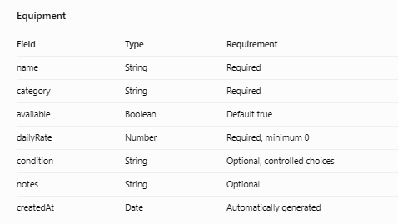
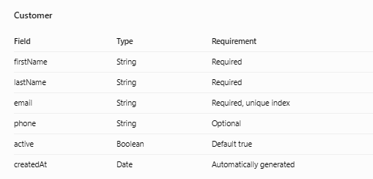
Let’s modify GearVault
We will create two collections:

Slide 17
It’s very important to design data before writing backend routes.
A poorly designed model can create problems later when we add rentals, returns, reservations, and customer history
So, before coding and before we start - think about a collection called rentals
Identify:
  What information should a rental contain?
  How would a rental refer to a customer?
  How would a rental refer to equipment?
  Should a rental store the full customer object or just the customer's ID?
  What happens when equipment is returned?

Slide 18
An initial design might be:
{
"customerId": "customer-object-id",
"equipmentId": "equipment-object-id",
"rentalDate": "2026-11-06",
"dueDate": "2026-11-10",
"returned": false
}
IDs are conceptual placeholders. In a real Mongoose rental model, they could be declared as Schema.Types.ObjectID references.

Slide 19
Let’s connect Express to MongoDB with Mongoose
We will connect the existing Express server to a MongoDB database and create two models -- Equipment and Customers
The Express app should start only after it has successfully connected to MongoDB

Slide 20
Understanding the technology stack
Three technologies involved.
Mongoose is an Object Data Modeling (ODM) library.
It provides a convenient way to work with MongoDB using JavaScript objects.
Technology | Responsibility
MongoDB | Stores documents permanently
Mongoose | Defines models, validates data, and performs database operations
Express | Receives HTTP requests and sends responses

Slide 21
For example, rather than manually managing database commands, we can write:
const cameras = await Equipment.find({
category: "Camera"
});
This asks MongoDB for matching documents and returns the results through Mongoose.

Slide 22
What does await do?
Database operations take time.
They may involve a network connection, disk access, and server processing.
An asynchronous function can wait for a database operation to complete without blocking Node.js from processing other work.
const equipment = await Equipment.find();
Note - recognize that await must be used inside an asynchronous function or in a supported top-level module context.

Slide 23
Prepare the development environment
Step 1 — Install MongoDB
We will use MongoDB Community Server running locally with MongoDB Compass for inspecting documents.
You will need:
Node.js and npm (check)
VS Code (check)
MongoDB Community Server (need)
MongoDB Compass (need)
Thunder Client (check)
Your existing GearVault Express project (check) (from Friday’s lecture)

Slide 24
First go to:
https://www.mongodb.com/try/download/community
Scroll to Community Server
Select Package
Windows x64 – Download
Run installer
Select Complete
Select – Install MongoDB as a Service – Run service as Network Service user
Keep default settings
Install MongoDB Compass – if installer offers it (its automatically installed)

Slide 25
Reboot will be required so save all your stuff first
Once rebooted check to see if MongoDB is running
On Windows:
Press Win + R.
Enter services.msc.
Locate MongoDB Server
Verify its status is Running.
If stopped, right-click and select Start.

Slide 26
MongoDB runs on mongodb://127.0.0.1:27017
That's localhost port 27017
Now open MongoDB Compass – that was just installed.
Click Start
Select New Connection

Slide 27
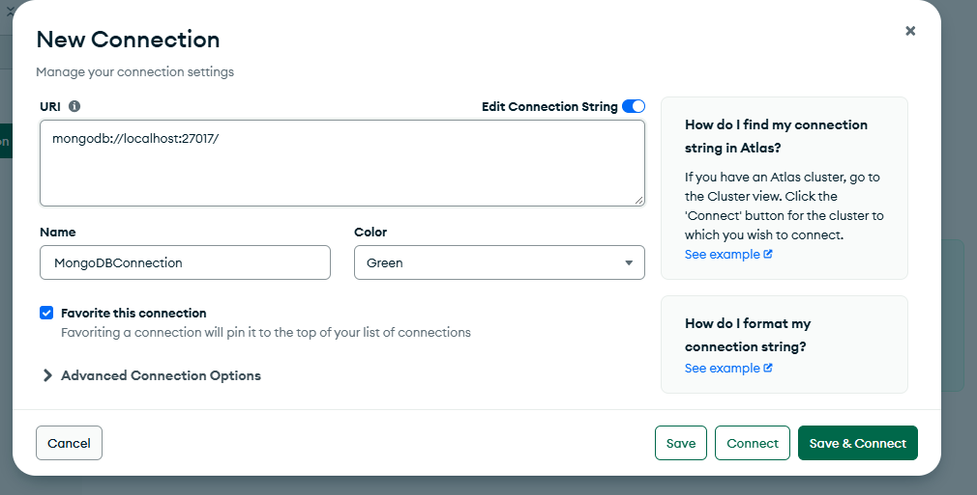

Slide 28
Click Save and Connect
If successful, Compass displays the databases available on the server.
Initially, students may see only system databases such as admin, config, and local.
That is normal. GearVault's database will be created when we first save data.
At this point – take a screen shot of the MongoDB Compass page showing you have a connected server – submit that to this assignment.
Part 2 – Next!

