Slide 1

AssetIQ Smart Asset Manager (LEMP Stack Project)
Name : Ishita Ghosh
College : Zeal College of Engineering and Research

Slide 2
Agenda
Problem Statement
Solution Overview
Tech Stack (LEMP Architecture)
Key Features
Conclusion & Future Scope

Slide 3

Problem Statement
Most people track expenses but not their total wealth
No single platform to manage assets and liabilities together
Difficult to calculate net worth manually
Lack of financial awareness and insights
Existing tools are either complex or incomplete

Slide 4
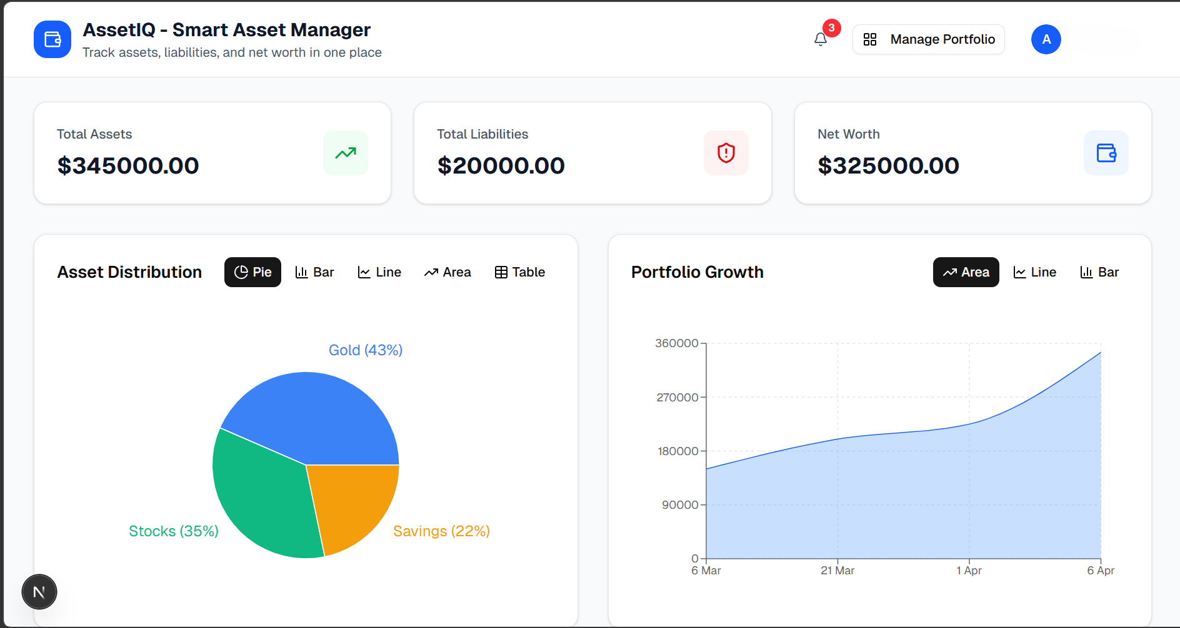
Key Features :
Developed a Smart Asset Manager web application.
Allows users to track assets and liabilities in one place.
Automatically calculates net worth.
Provides smart financial insights.
Secure login ensures user-specific data

Slide 5

Tech Stack (LEMP Architecture)
L – Linux: Deployment environment
E – Nginx: Web server for handling requests
M – MongoDB Atlas : Database for storing user data
P – PHP: Backend API for business logic
Frontend:
Styling :
Next.js (React)
Tailwind CSS

Slide 6
User Flow
The overall flow is user interacts with frontend, which communicates with PHP APIs, and data is stored in MongoDB.
P1
User
P2
Frontend
P3
PHP API
P4
MongoDB Atlas (Cloud)
6

Slide 7
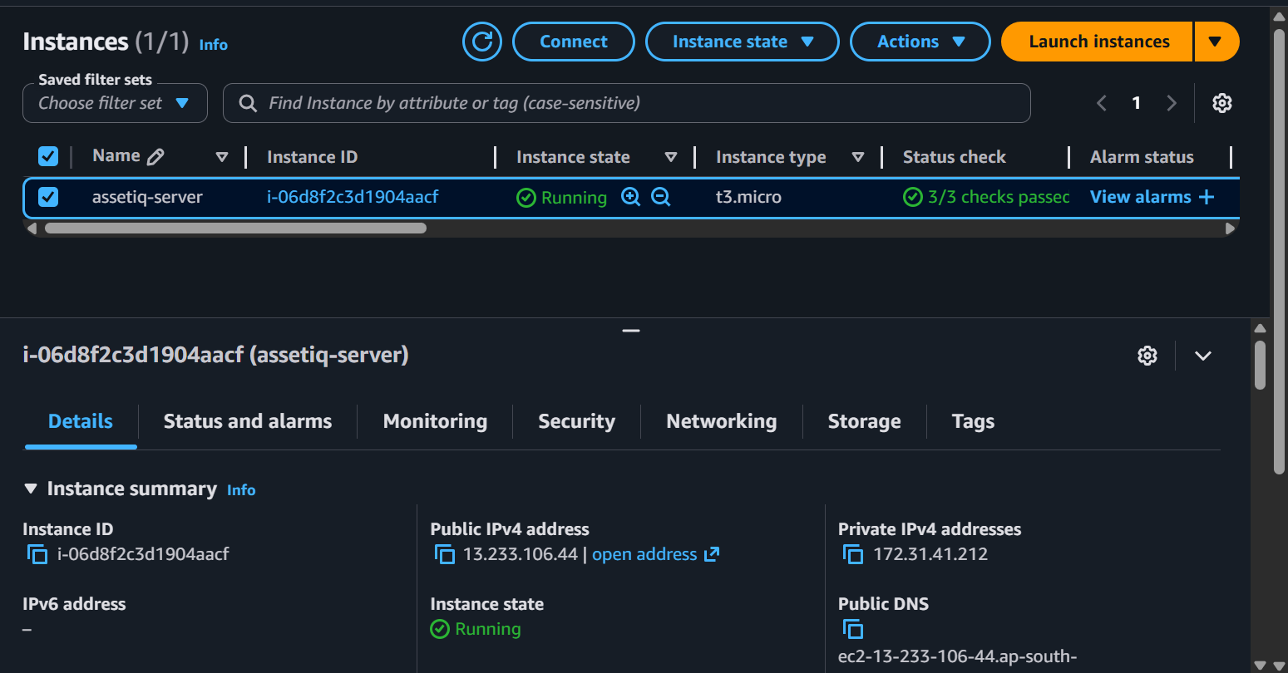
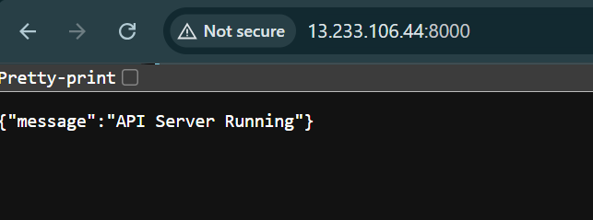
PHP Backend Live on EC2 {"message":"API Server Running"} Means: ✅ Backend LIVE on EC2 ✅ API reachable from internet ✅ MongoDB connected

Slide 8

Future Scope
• AI-based financial recommendations
• Mobile application development
• Bank API integration for real-time data
• Advanced analytics and prediction
• Budget planning and expense tracking
8

Slide 9
Conclusion
In conclusion, AssetIQ is a smart asset management system that helps users track their assets and liabilities efficiently. It provides net worth calculation and useful insights, improving financial awareness. The system is simple, secure, and user-friendly.

Slide 10
Thank you
Thanks for being patient !

