Slide 2
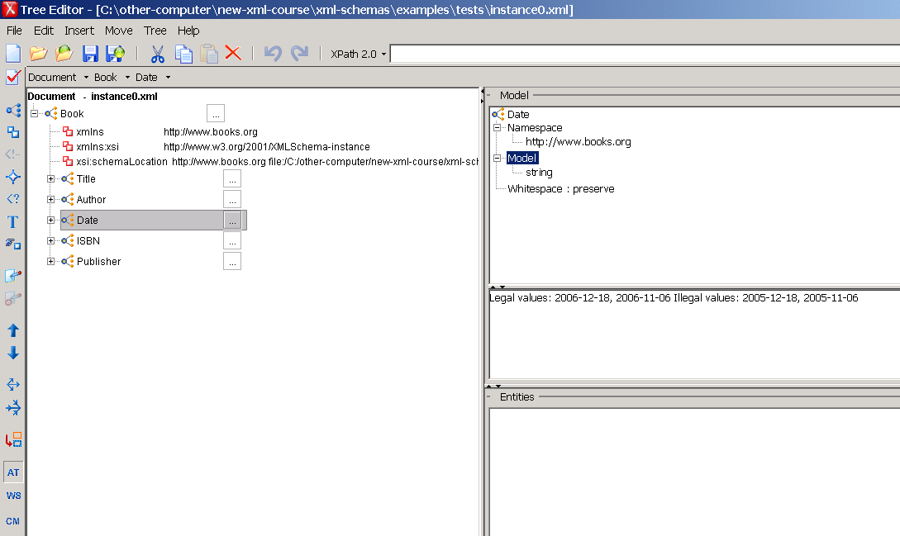
I preprocess the
schema, insert an
annotation for every
element/attribute,
showing the legal and
illegal values.

Slide 3
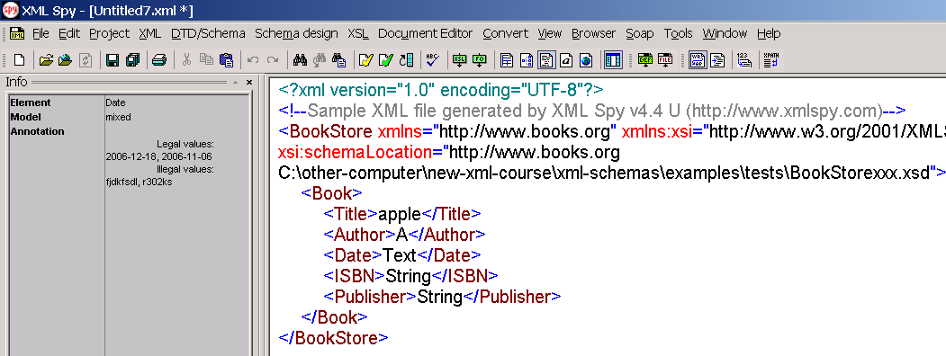

Slide 4
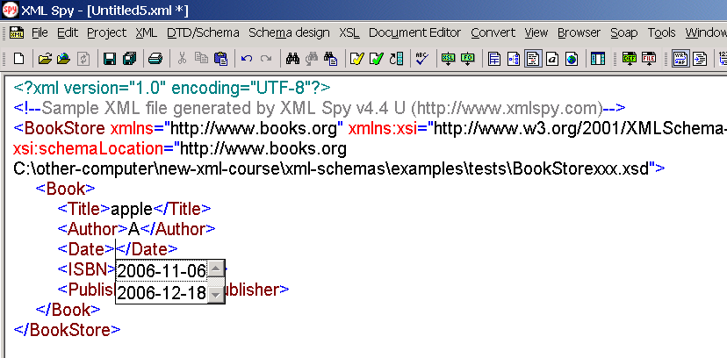

Slide 5
