Slide 1
Metadata Enrichment of Structured OSDU records
Names : Ishanika Radder & Ishan Tandon
Mentors: Denzil & Saood
Notes:
Vector db ka compute check kraa

Slide 2
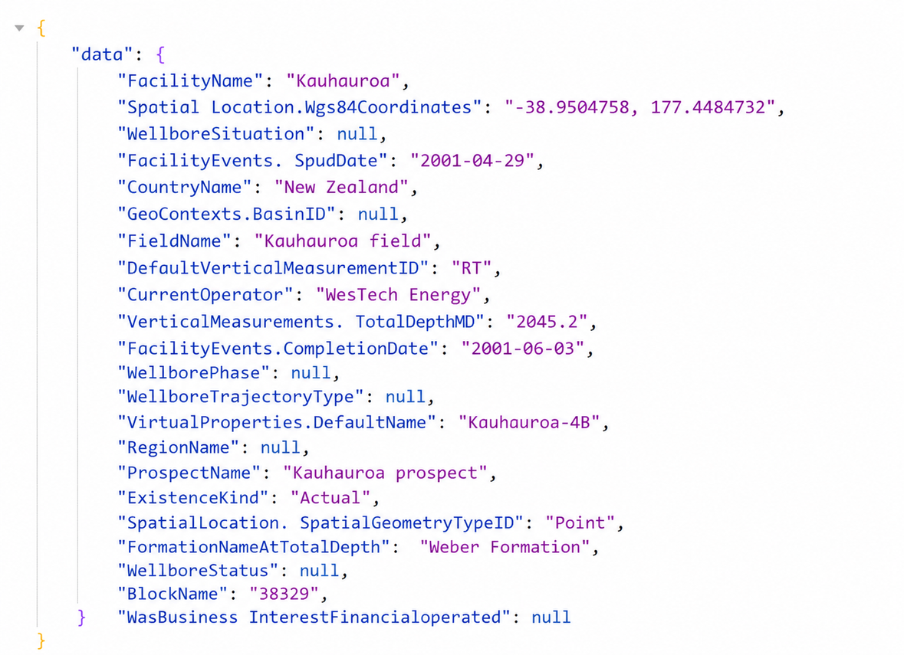
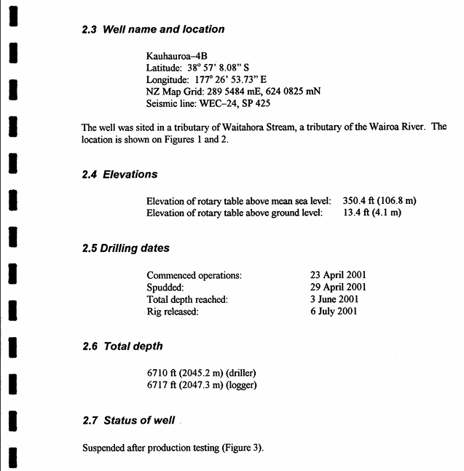


Problem
Statement
Unstructured record:
Well completion report PR2610
Structured OSDU record:
PR2610 (Wellbore schema)
Some of the structured OSDU data we have is null or unverified.
PROBLEM SOLUTION DEMO RESULTS ARCHITECTURE PARTS VALUE TIMELINE FUTURE SCOPE
1
Notes:
OSDU data is been enriched

Slide 3
Approaches & Roadblocks
1. Keyword / text search
  Match words in the PDF.
  Reports use different terms than OSDU (completion = 'rig released' = 'End of drilling').
  No understanding of meaning → misses answers, returns noise.
The obvious approaches don't work at scale
2 · Feed the whole PDF to an LLM
  ~400K tokens per report.
  Blows the context window and costs a fortune per document.
  Millions of docs → not affordable, not reliable.
3 · Retrieval-Augmented Generation
  Don't read the whole book — jump to the right paragraphs first.
  Send only those few passages to the LLM.
  Cheap, fast, scalable, and traceable.
PROBLEM SOLUTION DEMO RESULTS ARCHITECTURE PARTS VALUE TIMELINE FUTURE SCOPE
2

Slide 4
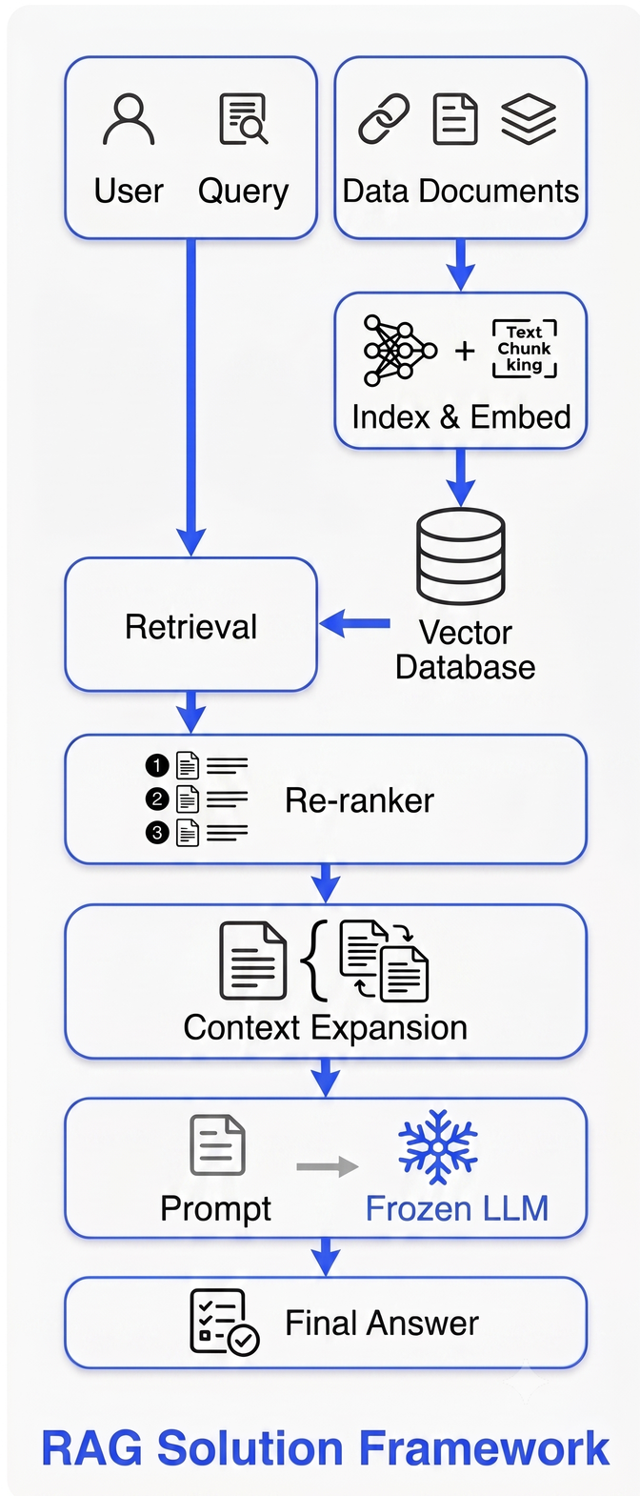
Break report into smaller passages and store as meaningful vectors (embeddings)
For each question, fetch the handful of passages most likely to hold the answer.
A second, sharper model re-orders those passages by true relevance.
The LLM answers using only that small, focused context — with page citations.
Solution:
RAG Approach
Instead of re-reading a 300-page book to answer one question, you flip to the two paragraphs that matter, then read carefully.
PROBLEM SOLUTION DEMO RESULTS ARCHITECTURE PARTS VALUE TIMELINE FUTURE SCOPE
3

Slide 5
Business Value
Enrichment
Populate missing OSDU attributes into populated, usable metadata.
How does this solution add to SLB?
Validation
Flags values in OSDU that disagree with the source report.
Verifiable
Every answer carries a page citation + a confidence score.
• Search
becomes much easier
• Speed
hours of review in seconds
• Compliance
auditable, cited answers
• Reuse
one engine for any attribute
Cost effective
Cents per document instead of dollars.
Human-in-the-loop
Reviewers approve or correct low confidence answers.
PROBLEM SOLUTION DEMO RESULTS ARCHITECTURE PARTS VALUE TIMELINE FUTURE SCOPE
4
Notes:
Now the point comes how our approach is adding value to the buissness
The project will enrich i.e. populate the missing values of OSDU attributes and also validate the data of the structured documents.
This will have major impact to any downstream processes which will be using this data.
lets say a chatbot was built and it was asked the well name and well name field is empty in structured data, how will the chatbot will be able to return the answer.
Even these answers can be verified as there is page citation with every answer.
Our method is cost effective , costs only few cents for populating a document.
Even the human in the loop is involved for the low confidence answers which our model returns, i.e. these answers can be verified by humans as well.

Slide 6
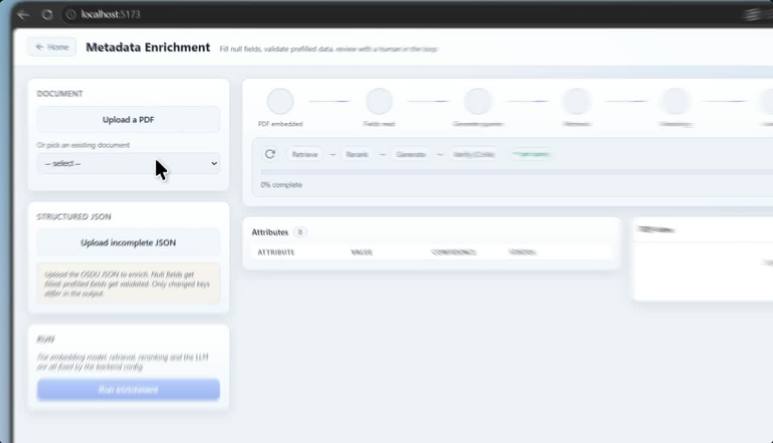

Slide 7
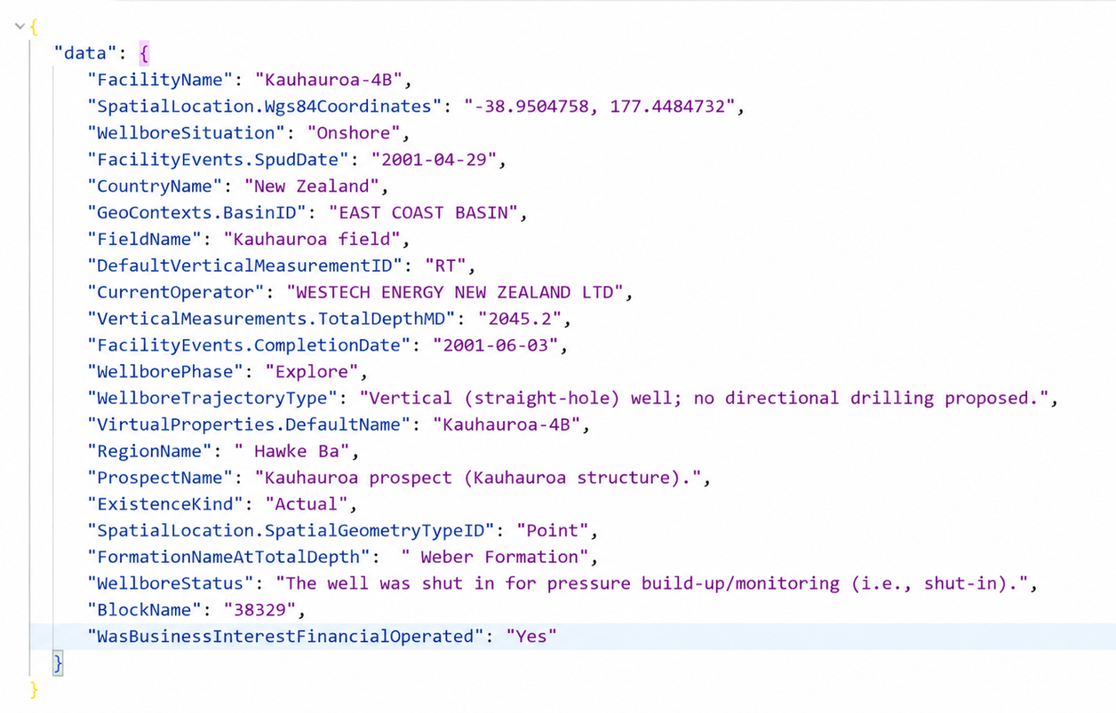
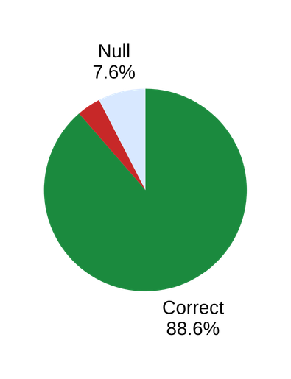
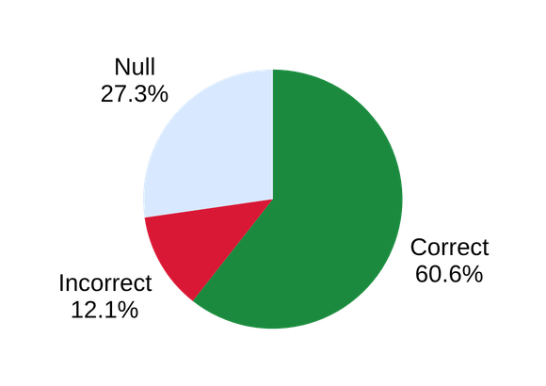
Before
After
Results
How we improved our result.We didn't just match the data — we improved it
~39.4% defective
~11.4% defective
structured OSDU record
RAG enriched record
PROBLEM SOLUTION DEMO RESULTS ARCHITECTURE PARTS VALUE TIMELINE FUTURE SCOPE
5

Slide 8

Architecture
End-to-end pipeline
INGESTION (build once per document)
PDF report
Well completion report
›
Parsing
Chandra VLM → hierarchical structure
›
Chunk
Section + hierarchy-aware
›
Embbedings
ChromaDB + rich metadata
›
Store
ChromaDB + rich metadata
INFERENCE (per query)
Generate queries
OSDU attribute → smart question
›
Retrieve
Hybrid dense + keyword
›
Re-rank
Cross-encoder
›
Answer
LLM + page citations
›
Verify (CoVe)
Confidence + suggestion
Every component is swappable from one config file — embedding model, vector DB, re-ranker, LLM, context strategy.
PROBLEM SOLUTION DEMO RESULTS ARCHITECTURE PARTS VALUE TIMELINE FUTURE SCOPE
6

Slide 9
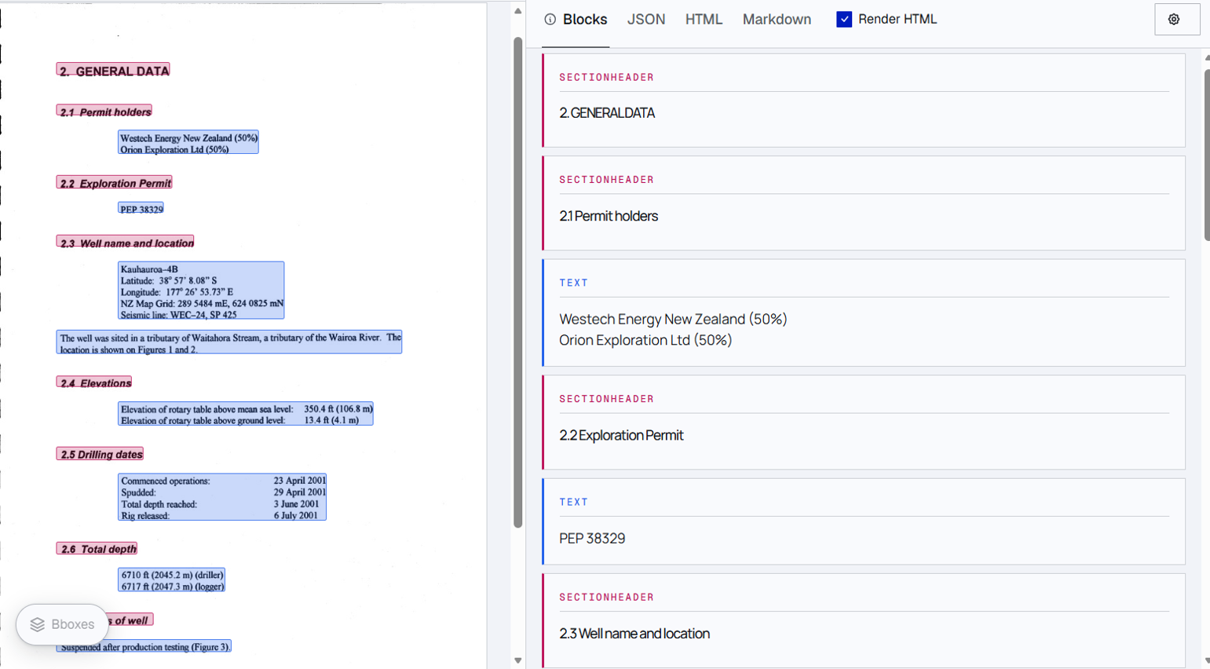
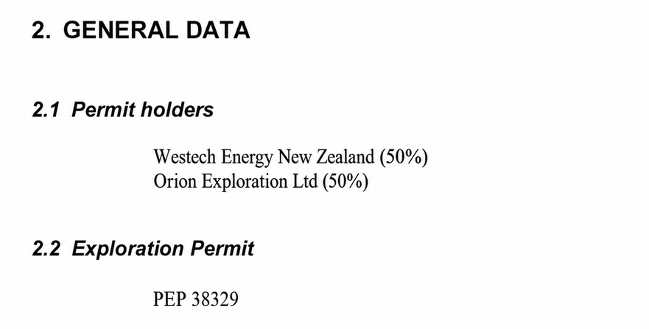
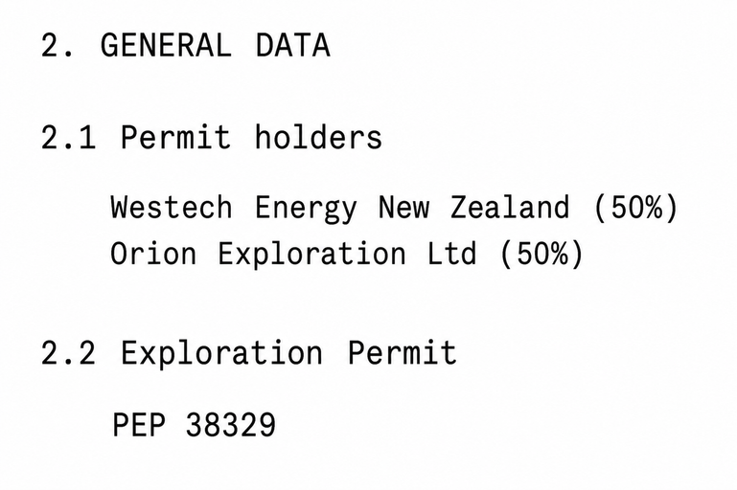
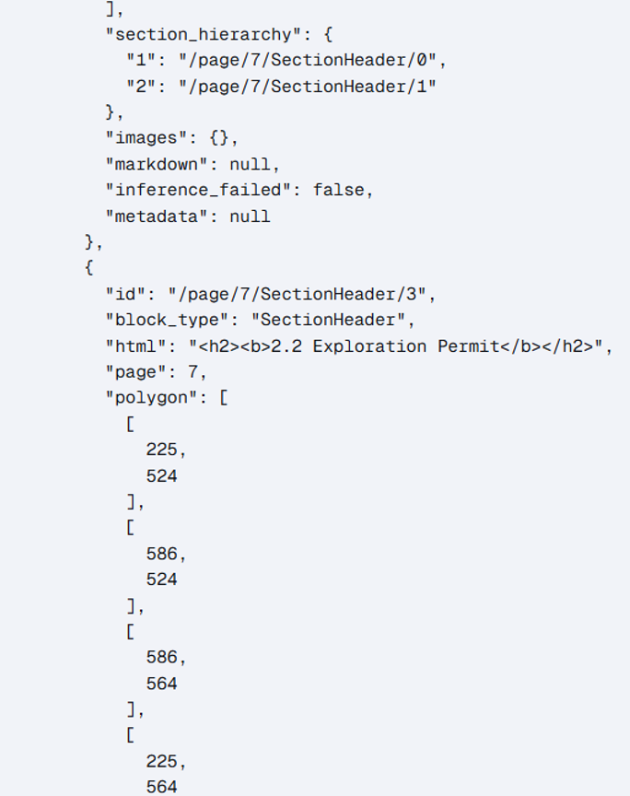
Document Parsing
How to parse text and information from digitized and non-digitized pdfs.
Excerpt from a pdf
Excerpt from a pdf
Chandra output
Model: Chandra VLM extract feature
Naive OCR output
Output as json
representation
PROBLEM SOLUTION DEMO RESULTS ARCHITECTURE PARTS VALUE TIMELINE FUTURE SCOPE
14

Slide 10
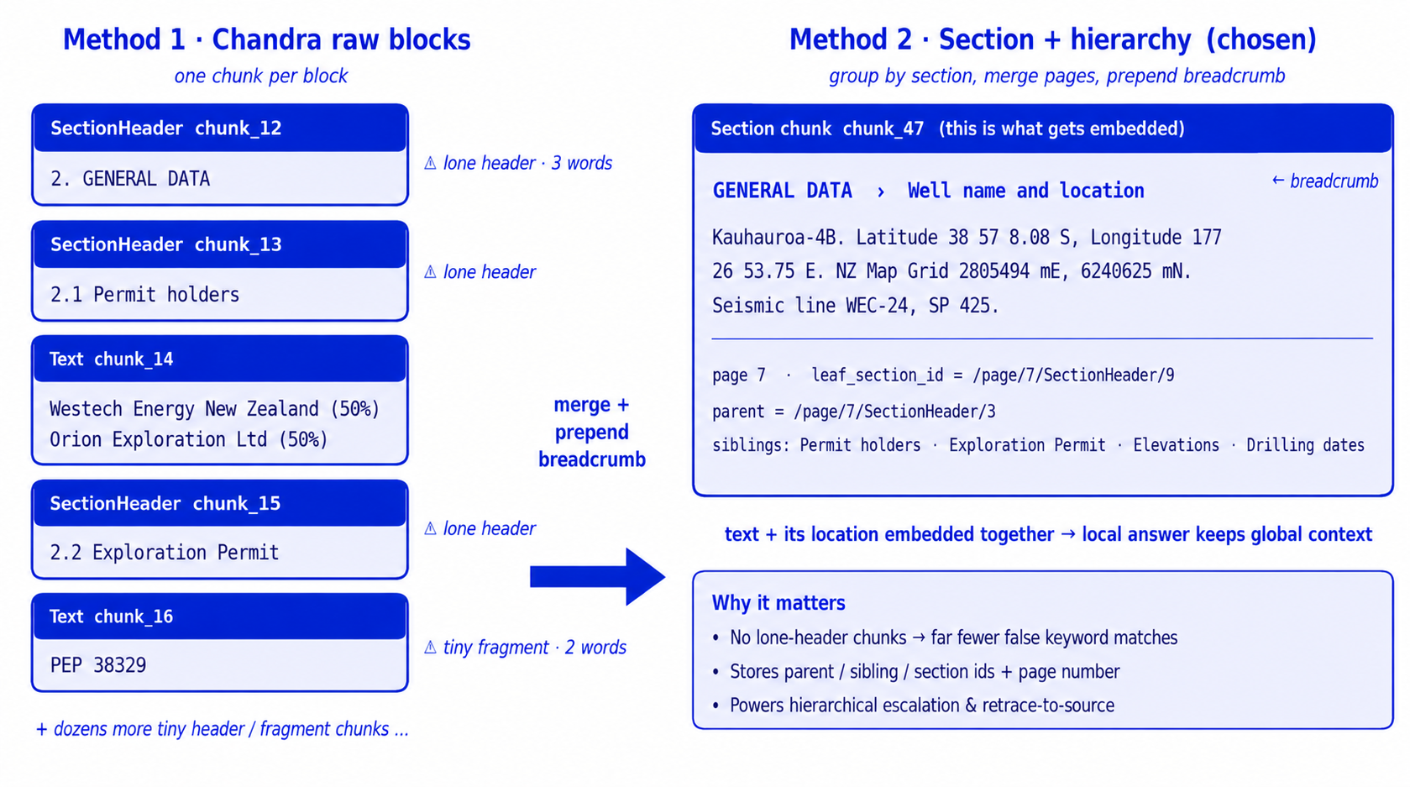
Chunking
How we cut the full document into smaller passages or blocks
Using: Section path+ hierarchy chunking strategy
PROBLEM SOLUTION DEMO RESULTS ARCHITECTURE PARTS VALUE TIMELINE FUTURE SCOPE
8
14
Notes:
this were the initially test done, at that time we were not ready with the full stack, so we had rough idea of 55% accuraccy that times, but it jumped to 85%.
we didnt have goldenset that time, we saw improvemnt so we didnt go back that time , so we dont have result
and also dont mention about other method of chunking it will create confusion.

Slide 11
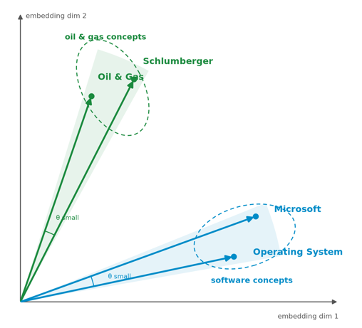
Embeddings
Model | Type | Final Accuracy | Cost per 1000 pages
OpenAI 3-small-1024 | API (licensed) | 88.6% | ~$0.011
OpenAI 3-large-3072 | API (licensed) | 85.6% | ~$0.071
Jina v3 | Self-hosted (L4 GPU) | 85.6% | ~$0.025
Ablations run across different embedding models
  OpenAI models retrieve best
  Jina v3: 570M-param, 8K context, multilingual.
Self-hosted = no per-token cost,infra-cost =$0.67/hr
  Governance flag: Jina v3 is CC-BY-NC-4.0 → non-commercial.
PROBLEM SOLUTION DEMO RESULTS ARCHITECTURE PARTS VALUE TIMELINE FUTURE SCOPE
9
14
Notes:
increment in cost doesnt satidy the increment in accuracy
since the 132 queries onlyy
and there may be noisee consideration as this is for one run only
show the cost per page rather than doc
and also include hit 10
EMBedding are representation of words in vector space , so that we may capture the semantic meaning of the words for example as we can see in htis diagram the schlumberger and oil and gas are marked near , meanwhile the microsoft and OS is marked near.
For generating these type of embeddings there are many models , for eg : open ai small,large and JINA .
So to find the best embedding model we ran experiments, in which all the three models got compartively similar accuracy , our dataset is also of 132 queries onlyy.
since we get almost similar accuracy , the cost factor came into play , open-ai small provide same accuracy , than openai large model, meanwhile while researching on jina we came across that jina is a good find in the research but it is more useful when the context matter more .I.e in our case the answer can directly be factual , which we can get from the paragraphs directly. It doesnt need need the context of other pages or paragraphs . And JINA uses late chunking approach to capture this context effectively. Hence JINA may be more effective in a chatbot type of thing rather than our project.

Slide 12
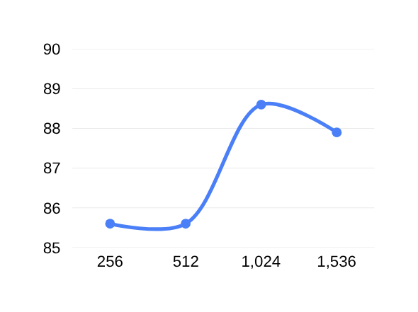
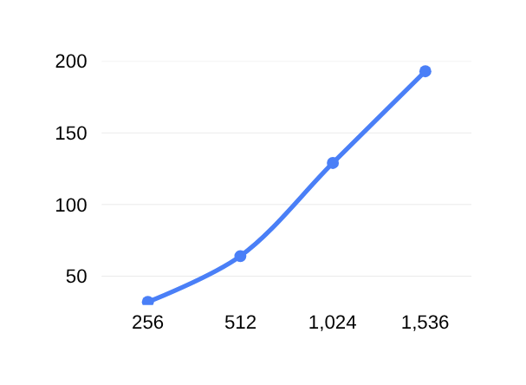
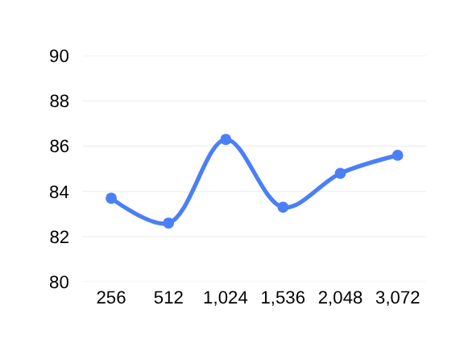
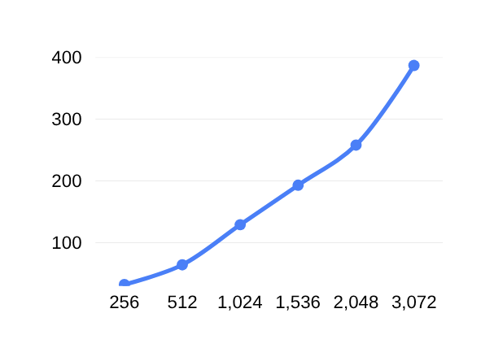
Text-embedding-3-small
Embeddings
Memory (33k embeddings)
final accuracy
Matryoshka Study
Text-embedding-3-large
Memory (33k embeddings)
final accuracy
Using: Open AI small (1024)
  Performance best at 1024 dimension size across both open AI large and small
PROBLEM SOLUTION DEMO RESULTS ARCHITECTURE PARTS VALUE TIMELINE FUTURE SCOPE
10
Notes:
if we are portying small accuracy variation , we may see the highest accuracy is in some in middlle

Slide 13
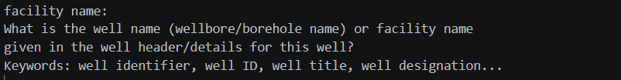
Automated
Query Generation
Type 1: Direct Question
Type 2: Domain-explained
Turning an attribute name from OSDU into a natural language question.
Type 3: Query + keywords
Ablations run across different levels of query enrichment
  A generator reads the OSDU attribute and writes a domain-aware retrieval query for all attributes
  We enrich so that retrieval finds the answer even when the report never uses the OSDU attribute name.
Using: Query +keywords
PROBLEM SOLUTION DEMO RESULTS ARCHITECTURE PARTS VALUE TIMELINE FUTURE SCOPE
11

Slide 14
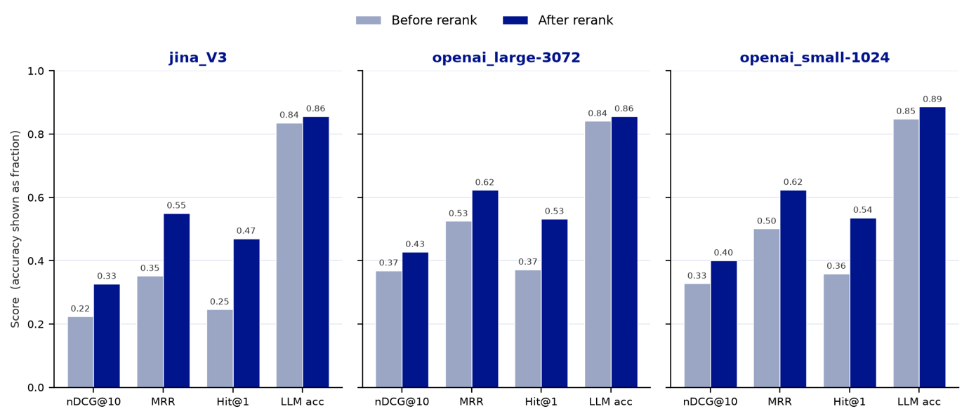
Retrieval
& Reranking
Comparing similarity between the question and block embeddings to find the most likely to have passages.
then re-ordering them more accurately.
  Reranking helps retrieval a lot. Every retrieval metric jumps.
  Hybrid Approach for retrieval was used.
  Measured with MTEB metrics on a graded gold set.
Model: cross-encoder/ms-marco-MiniLM-L-6-v2
PROBLEM SOLUTION DEMO RESULTS ARCHITECTURE PARTS VALUE TIMELINE FUTURE SCOPE
12
Notes:
Retrival is basically finding the chunks which is relevant to the query , we do it by using hybrid search with alpha 0.85 in our method.
hence to find the retrival quality:
we benchmarked our models on various retrival matrices on the graded gold set. and observed that using a reranker is increasing the results quality , hence performed a basic experiment for proving it.

Slide 15
Generator
LLM
LLM | Enriched acc | Cost (run) | Value (acc / $)
gpt-5-mini ★ | 88.6% | $0.36 | 2.45
gpt-5.2 | 88.3% | $1.29 | 0.68
gpt-5.1 | 88.9% | $0.89 | 0.99
gpt-5 | 86.4% | $2.39 | 0.36
gpt-5-nano | 81.1% | $0.13 | 6.18 (cheapest)
gpt-4o-mini | 67.4% | $0.09 | 7.16 (low acc)
gpt-4o | 69.7% | $1.61 | 0.43
Deciding which LLM to send the selected blocks to.
(value study)
Ablations run across different LLM models for the generator LLM
  gpt-5-mini is the sweet spot: comparatively high accuracy AND ~4x cheaper than the flagship.
  gpt-5-nano is a strong budget option when scale matters more than the last few points.
Using: gpt 5-mini llm model
PROBLEM SOLUTION DEMO RESULTS ARCHITECTURE PARTS VALUE TIMELINE FUTURE SCOPE
13

Slide 16
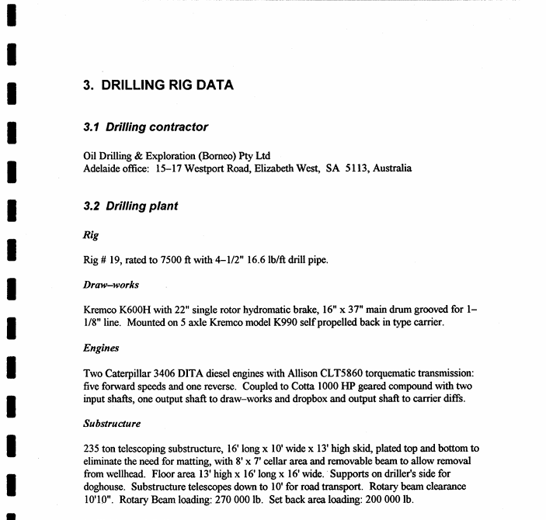
Context Expansion for the LLM
How much neighboring part of the document to send for each selected passage (block) for better results.
Sending just the chunk
Your paragraph text
Sending the full page
Sending parent section of
chunk
PROBLEM SOLUTION DEMO RESULTS ARCHITECTURE PARTS VALUE TIMELINE FUTURE SCOPE
14

Slide 17
Context Expansion for the LLM
Strategy | Enriched acc | Tokens | Time (s)
chunk (just the passages) | 83.3% | 1.48M | 497
full_page (expand to page) | 85.6% | 2.39M | 1098
hierarchical (climb sections) ★ | 88.6% | 1.56M | 526
Ablations run across different methods of context expansion
• Hierarchical wins: start with the matched passage; if the LLM can't answer, add the parent section and retry.
• Best accuracy at nearly the same cost/time as plain chunks.
• Escalation is rare (~1.08 calls/query) — cost stays low because we only climb when needed.
Model: hierarchal context expansion
PROBLEM SOLUTION DEMO RESULTS ARCHITECTURE PARTS VALUE TIMELINE FUTURE SCOPE
15

Slide 18
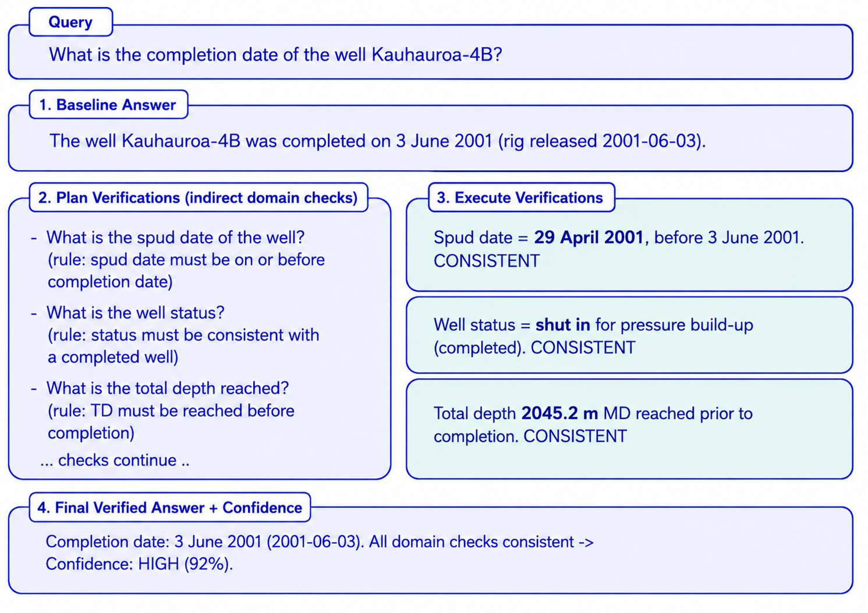
Confidence
(CoVe)
Chain-of-Verification: Trustable Confidence Score
Reference :Dhuliawala, S., et al. (2023)
Chain-of-Verification Reduces Hallucination in Large Language Models
PROBLEM SOLUTION DEMO RESULTS ARCHITECTURE PARTS VALUE TIMELINE FUTURE SCOPE
16

Slide 19
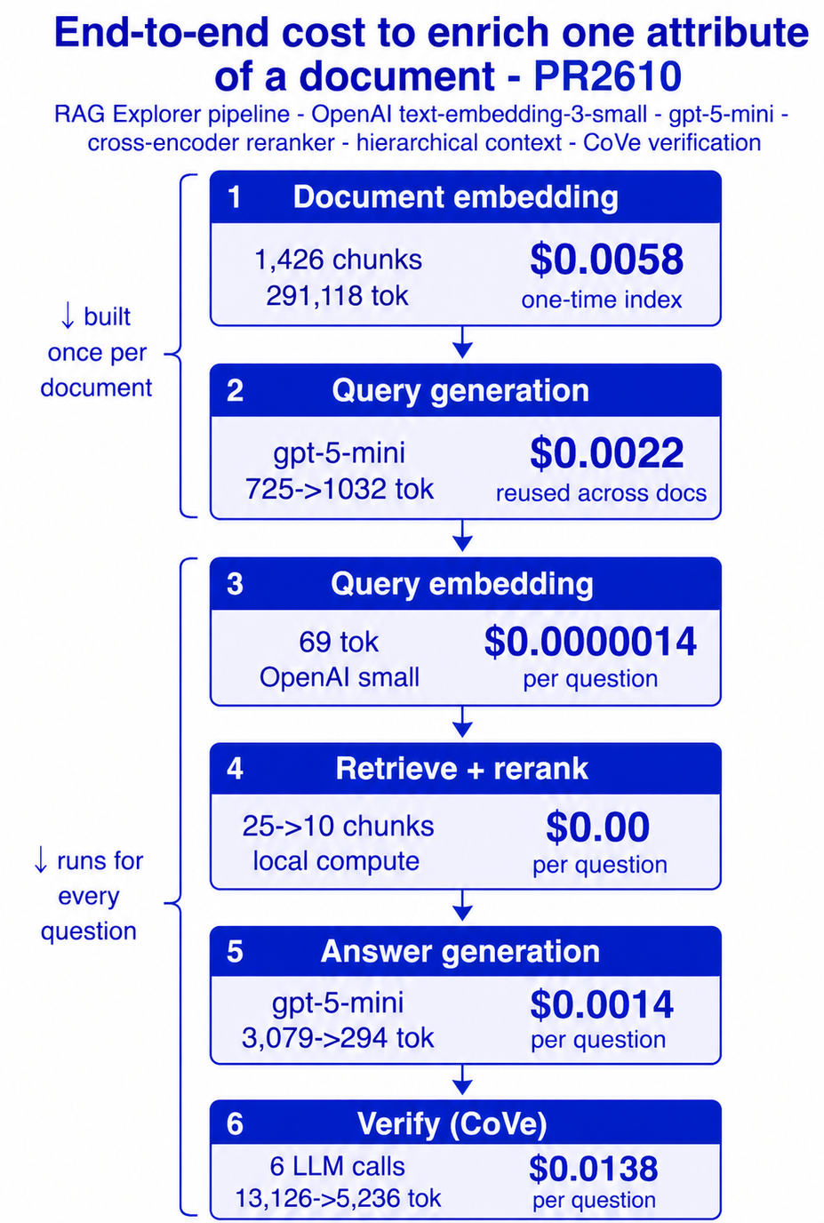
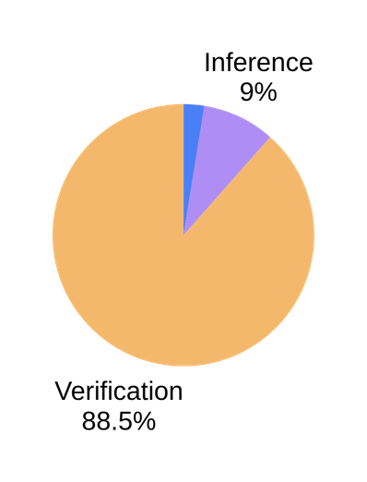
Ingestion (once per doc): 0.80¢
Inference (20 qs per doc): 2.80¢
Pipeline cost (per doc): 3.60¢
Verification (CoVe): 27.60¢
Verification (30% gated): 8.28¢
Cost & Value
Orders of magnitude cheaper, at scale
Note:
Costs are direct API/token costs only. They exclude shared platform costs (FM Hub model serving, vector-DB hosting/storage, and compute infrastructure) which are shared services, not owned by this project.

Slide 20
Timeline
Week 1
Frame & extract
Analyse OSDU data, schema; evaluate Chandra extraction; first queries.
Week 2
Build RAG
Pipeline ; section+hierarchy chunking.
Week 3
Retrieval studies
Embedding ablations; graded gold set; retrieval metrics; first UI.
Week 4
Optimise
Hierarchical context; Query generator; Jina API; benchmarking suite; Matryoshka.
Week 5
Productise
RAG Explorer + enrichment UI; CoVe; human-verified enriched dataset & final ablations.
PROBLEM SOLUTION DEMO RESULTS ARCHITECTURE PARTS VALUE TIMELINE FUTURE SCOPE
18

Slide 21
Future Scope:
What Next?
→ Scale-out: optimized retrieval by grouping chunks for multiple queries to reduce cost.
→ Finding out alternative confidence verification methods which are more cost effective.
→ Conversational assistant over the corpus
→ Tables & figures: deeper extraction of numeric tables and log plots via parallel specialized pipeline.
→Extracting and storing non queried metadata in database for future use.
PROBLEM SOLUTION DEMO RESULTS ARCHITECTURE PARTS VALUE TIMELINE FUTURE SCOPE
19

Slide 22
Learnings:
What we learnt over the internship
  Measure everything: ablations turned opinions into decisions (chunking, embeddings, dims, LLM, context).
  The ground truth itself can be wrong; a good system surfaces that and earns trust with citations.
  Domain knowledge makes the difference → mentors grounded us in subsurface, wells, and OSDU giving us more clear picture of the system we were working .
  During research we came across new models, and also confidence techniques for the model’s answer.
20
Notes:
full end to end pipeline
learnt abt various embedding model
laernt about coVE method
team discussion, ideation with mentoors
time management across the weeks
Team collaboration , dividing the work equally among both of us
Learnt some oil and gas domain knowledge

Slide 23

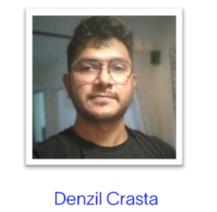

Acknowledgements
Mentor
Mentor
Prashanth Pillai
Manager

Slide 24
Thank you
Questions & discussion
Metadata Enrichment • A RAG product for trusted subsurface metadata

Slide 25
Appendix

Slide 26
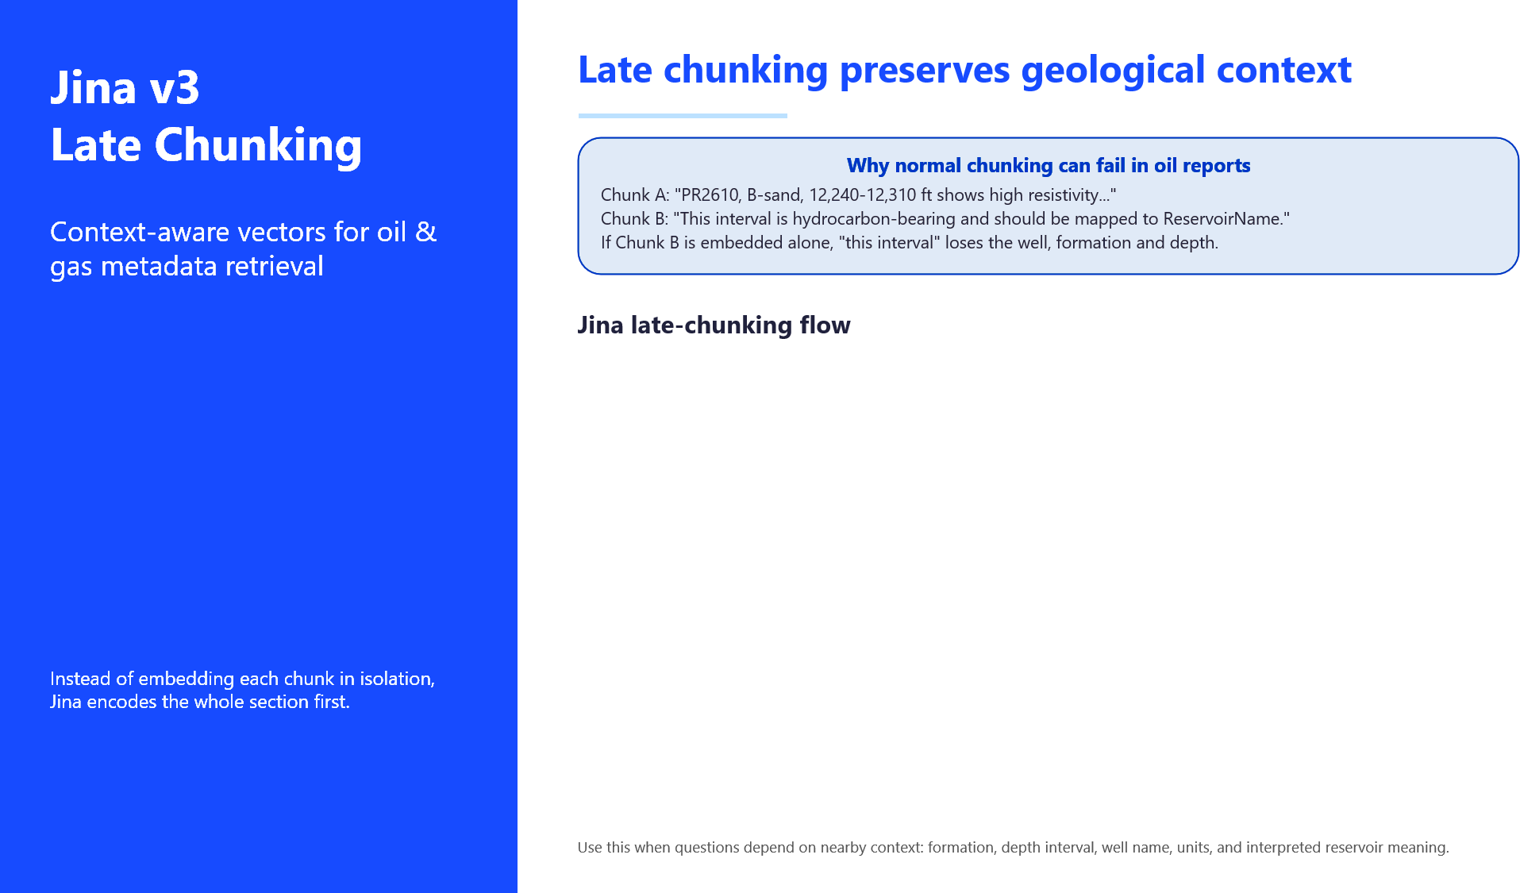
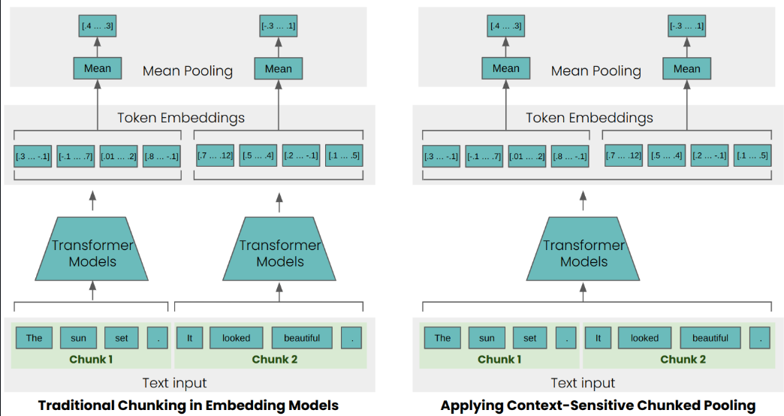
26

Slide 27
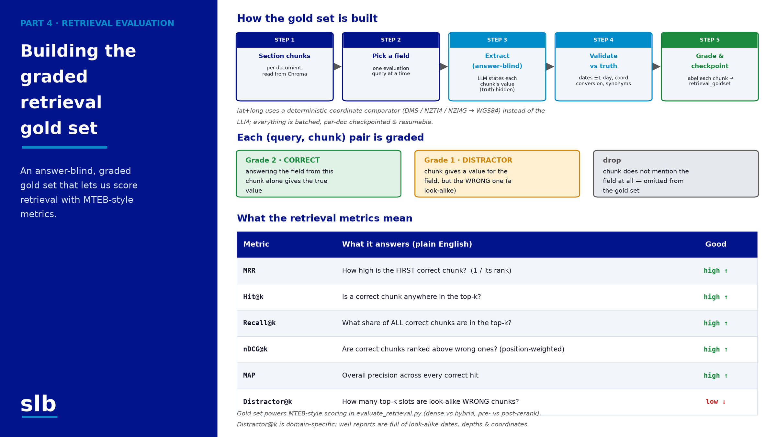

27

Slide 28
RESULTS · DATA QUALITY
WHY
The original OSDU records (matched_json) are ~50% null, and some non-null values are wrong or outdated. Scoring against them is unfair — a 'wrong' answer may actually be the model being right while OSDU is empty or incorrect. We need a trustworthy yardstick to measure TRUE accuracy and the ENRICHMENT VALUE.
Generating enriched Ground Truth
HOW
PDF report + OSDU record
with nulls / errors
Domain reviewer reads the report
manual review
Fills & verifies the attributes
only what's present
Enriched ground truth
7 docs · 132 questions
Re-run ALL benchmarks
embeddings, matryoshka, reranker, LLMs, context
↓ score the SAME answers against BOTH gold standards
WHAT WE FOUND
We rebuilt the gold standard so accuracy reflects reality — and proves the enrichment value.
Same answerable rows
Counting empty fields
Outcome
System ~82-90%
vs OSDU ~77-83%
≈ 6 pp of 'errors' were
OSDU being WRONG
System ~86-89%
vs OSDU ~57-61%
+ ~28 pp of missing
metadata FILLED
Fair accuracy
+ enrichment value
we prove the tool
improves the data
Numbers from output_table/benchmarking_enriched/embeddings/accuracy_on_original.json (enriched vs original OSDU, LLM-judge). Enriched runs use end-to-end accuracy — no MTEB retrieval metrics.

Slide 29
BEFORE (132)
AFTER
RESULTS · DATA QUALITY
96
filled fields
Verified 72
Ground truth: before → after
Updated 16
Mismatched 8
36
empty fields
Newly filled 30
We didn't just match the data — we verified, corrected and filled it. 132 attributes across 7 documents.
Still empty 6
Category | Count | Was | What it means
Verified | 72 | filled | OSDU value confirmed correct — kept as-is
Updated | 16 | filled | value refined / corrected in the enriched set
Mismatched | 8 | filled | OSDU was actually WRONG — the model was right
Newly filled | 30 | empty | enrichment supplied a value OSDU never had
Still empty | 6 | empty | not stated in the report — left null
Why this supports ~88-89% accuracy
• Against raw OSDU the 36 empties can't be graded and the 8 mismatches score the model 'wrong' — so OSDU accuracy looks low (~57-61%).
• The verified set (72 kept + 16 refined + 8 corrected + 30 filled) is a fair, fully-gradable yardstick — best config ≈ 117/132 ≈ 88.6%.
Counts reconciled so both sides total 132 (96 filled = 72+16+8; 36 empty = 30+6). Adjust if your split differs.

Slide 30
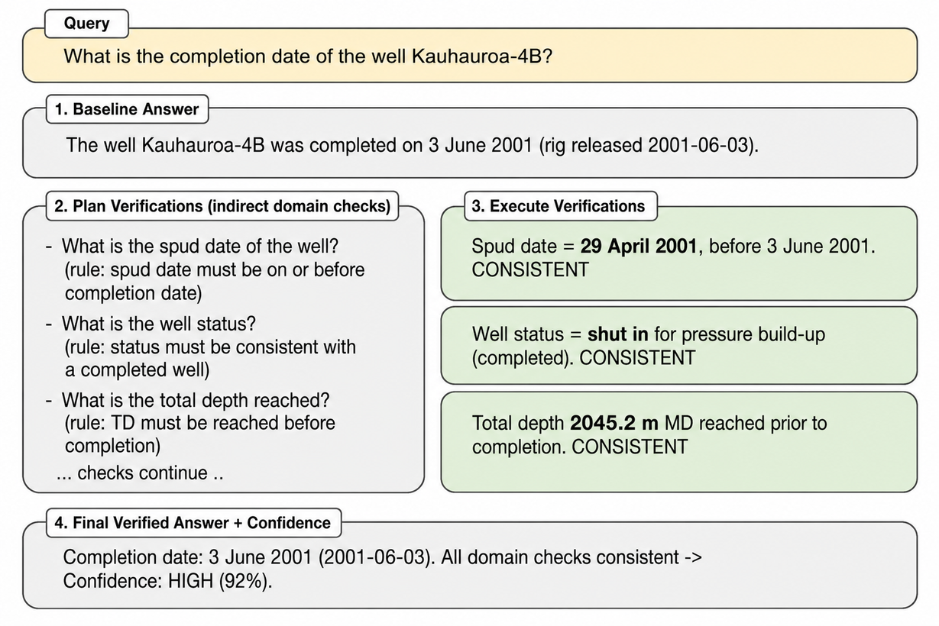
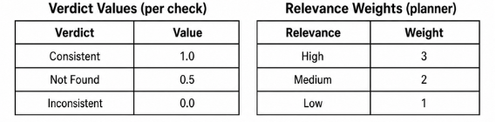

PART 8 · TRUST (COVE)
Chain-of-Verification: Trustable Confidence Score
Reference :Dhuliawala, S., et al. (2023)
Chain-of-Verification Reduces Hallucination in Large Language Models

Slide 31
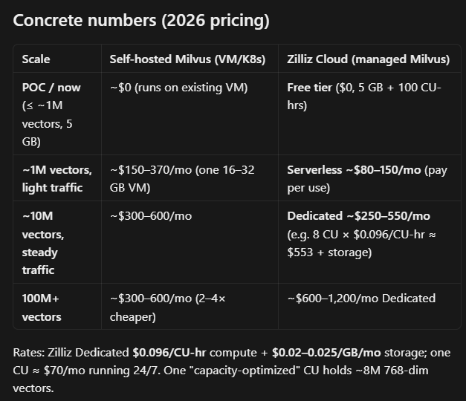
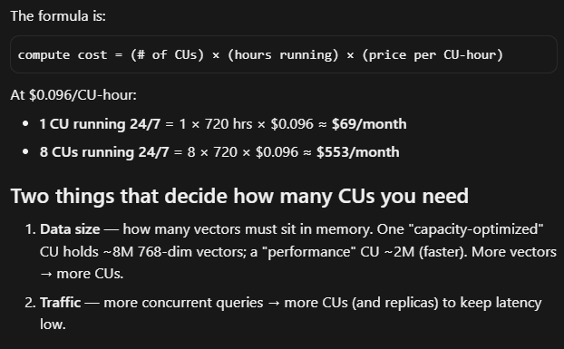
Milvus CU pricing
29

Slide 32
Tela™
Tela: domain expertise + agentic AI
Agentic loop — not just a chatbot:
SLB's agentic-AI assistant
Observe
→
Plan
→
Generate
→
Act
→
Learn
The first oil & gas AI assistant — a conversational teammate that turns complex subsurface and operations data into confident decisions across the energy life cycle.
What powers it
LLMs for language + SLB Domain Foundation Models (e.g. the Tela seismic model), running on the Lumi™ data & AI platform.
What it does
Natural-language querying of structured & unstructured data; assisted import, log prediction, auto-visualization — hours of work in seconds, with governance for accuracy.
Where it lives
Embedded across Petrel™, Techlog™, DrillPlan™, FDPlan™, OptiFlow™ — plus a standalone cross-domain assistant on Lumi.
From governed data to intelligent action:
OSDU
Open, governed energy data
→
Lumi™
Data & AI platform
→
Tela™
Agentic AI assistant
“The convergence of 100 years of domain science with cutting-edge AI.”
How our project connects
Our metadata-enrichment RAG (retrieve → rerank → verify) turns unstructured well documents into verified, structured attributes exactly the trustworthy, governed input an agentic assistant like Tela relies on, and the kind of clean metadata that populates OSDU.
Launched Nov 2025 · Powered by Lumi™
\
15
SLB-Private

Slide 33
OSDU: one open home for energy data
OSDU®
The problem: decades of subsurface, well and production data trapped in incompatible formats, apps and clouds. OSDU makes it discoverable through one standard.
Open Subsurface Data Universe
Core platform services (microservices):
An open-source, cloud-agnostic data platform standard for the energy industry — one common data model and API set that breaks vendor and cloud silos.
Ingestion
Storage
Search / Index
Schema
Legal & Entitlements
File / Dataset
Workflow
Key characteristics
Open-source · cloud-agnostic (Azure, AWS, GCP, IBM/OpenShift) · standardized data model + APIs · certifiable via Standard v1.0. Build once, run on any compliant platform.
Why it matters
No lock-in, faster innovation, and reusable data across exploration, reservoir and production — now extending beyond subsurface to new-energy and emissions data.
Governed by The Open Group. Rivals collaborate on one shared platform — unprecedented in the industry.
How our project connects
OSDU records are only as good as their metadata. Our enrichment pipeline extracts and verifies structured attributes from raw well documents — exactly the clean, governed metadata needed to populate and search an OSDU data platform.
Standard v1.0 · Apr 2026 · Seeded by Shell + SLB DELFI
PROBLEM SOLUTION DEMO RESULTS ARCHITECTURE PARTS VALUE TIMELINE FUTURE SCOPE
16

