Slide 1

CE807 – Assignment 2 - Final Practical Text Analytics and Report
2201110

Slide 2
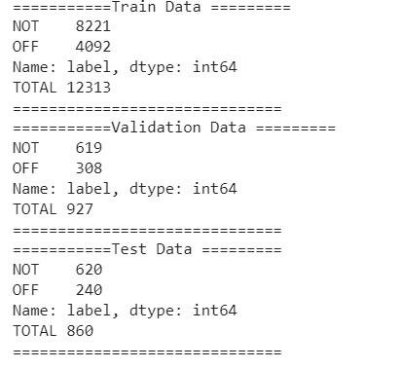
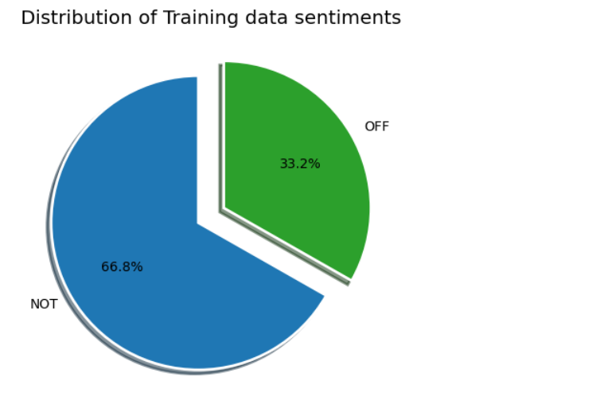
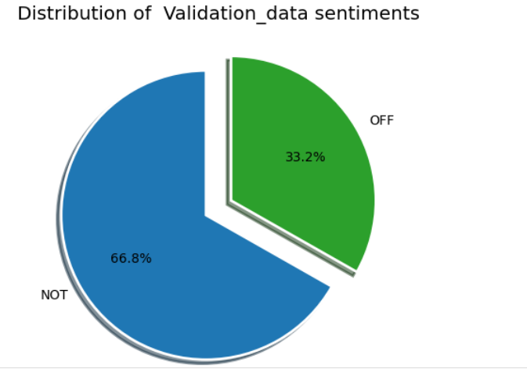
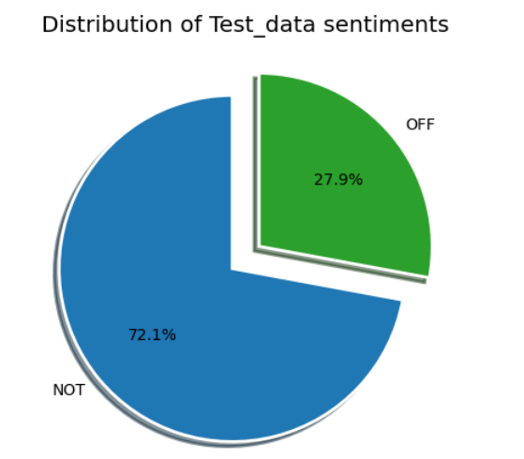
Introduction
Text analytics commonly involves performing text classification, which is a standard task. The specific task at hand is to classify offensive speech using a subset of the OLID dataset
Data Distribution among Training, Validation and Test
Distribution of Label Data – Offensive (OFF) and Not Offensive(NOT) Tweets

Slide 3
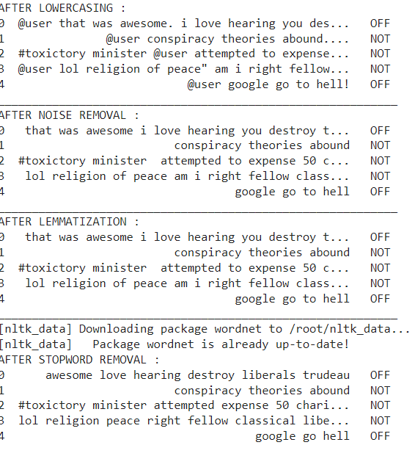
Model 1-LOGISTIC REGRESSION
Logistic regression is particularly well-suited for this task because it is able to model the probability of a binary outcome (e.g., offensive vs. non-offensive) .Logistic regression can be trained on a labeled dataset of offensive and non-offensive texts, and then used to make predictions on new, unseen texts.
Below Preprocessing steps were followed for all the distribution of Data[25,50,75,100]
Hyperparameter tuning was carried out using grid search and these parameters were decided as best. Best parameters: {'C': 1.0, 'solver': 'newton-cg'}

Slide 4
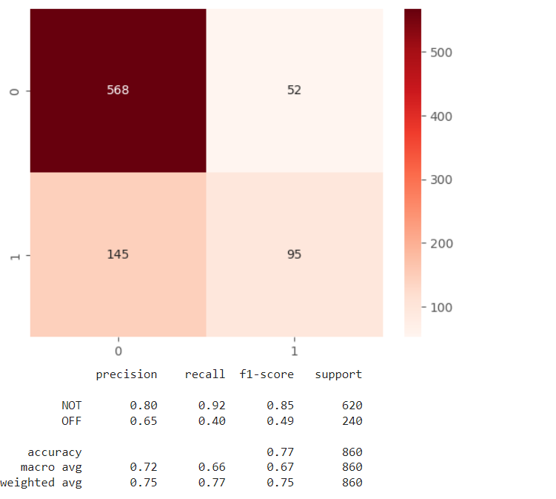
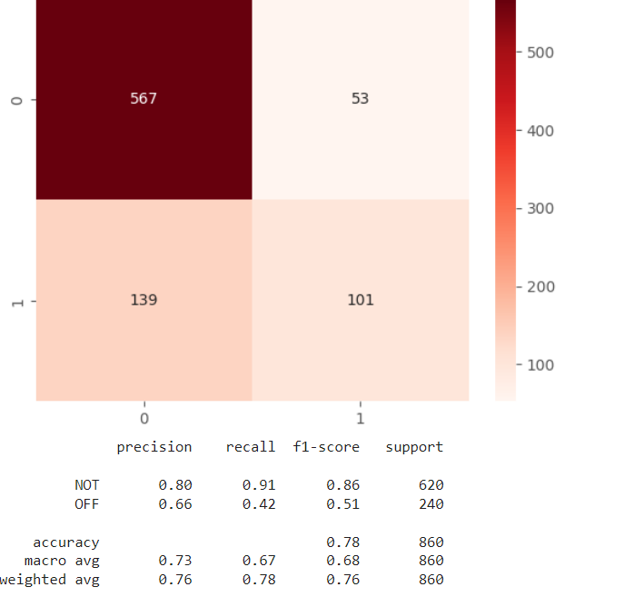
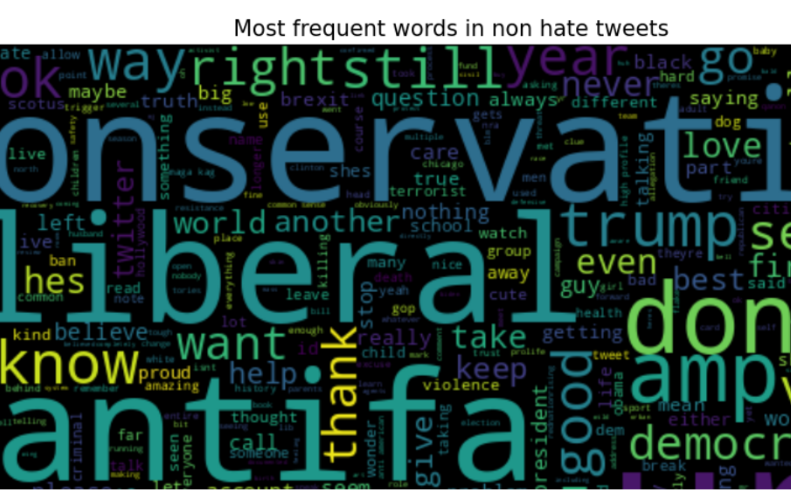
25% Test Data-Performance
50% Test Data-Performance
Most Frequent Words in Not Offensive Words in Tweets

Slide 5
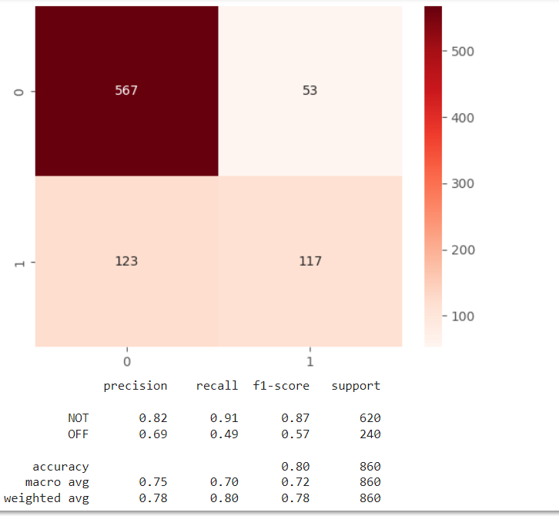
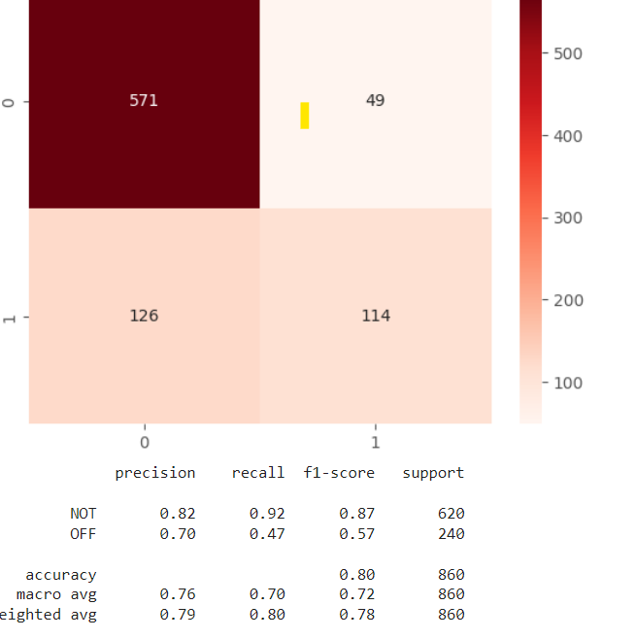
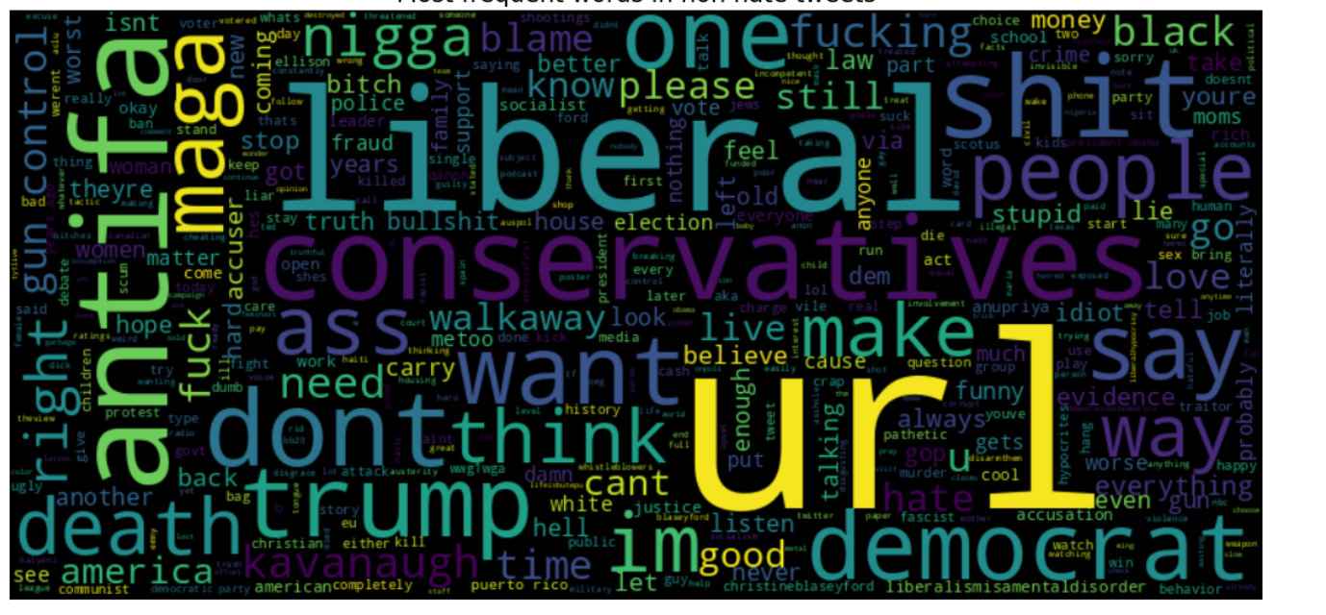
75% Test Data-Performance
100% Test Data-Performance
Most Frequent Words in Offensive Words in Tweets

Slide 6
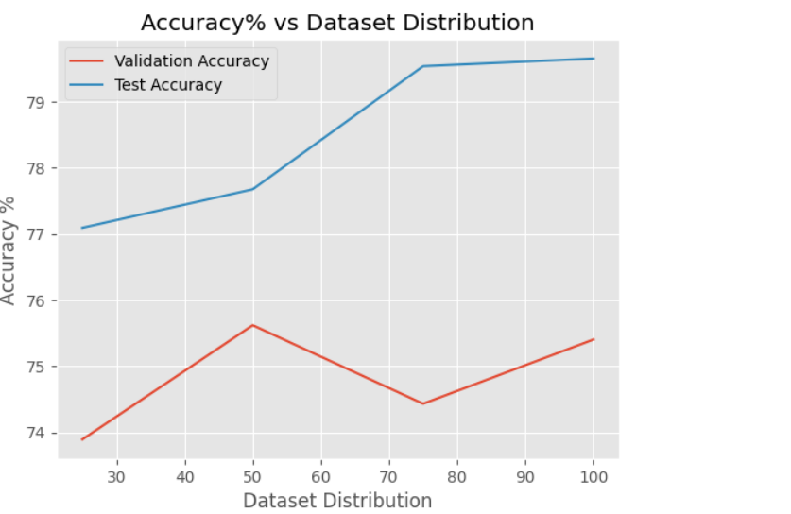
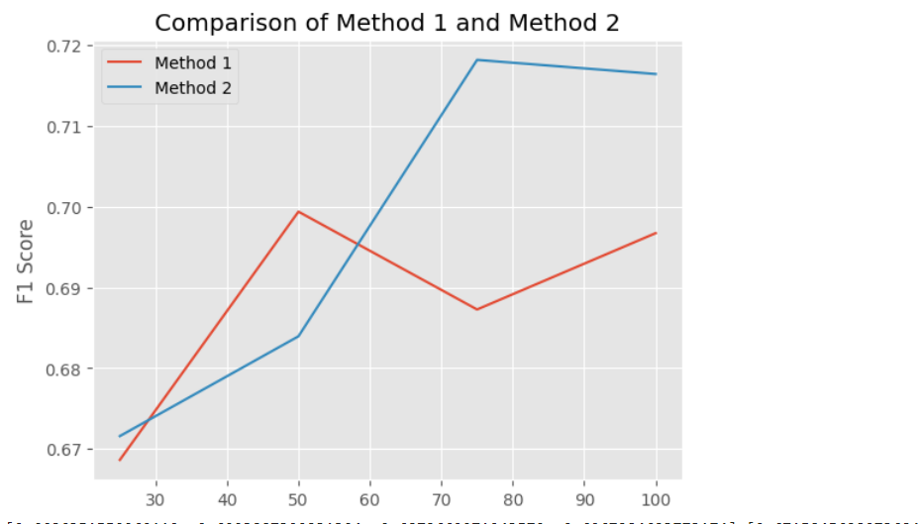
Evaluating Performance

Slide 7
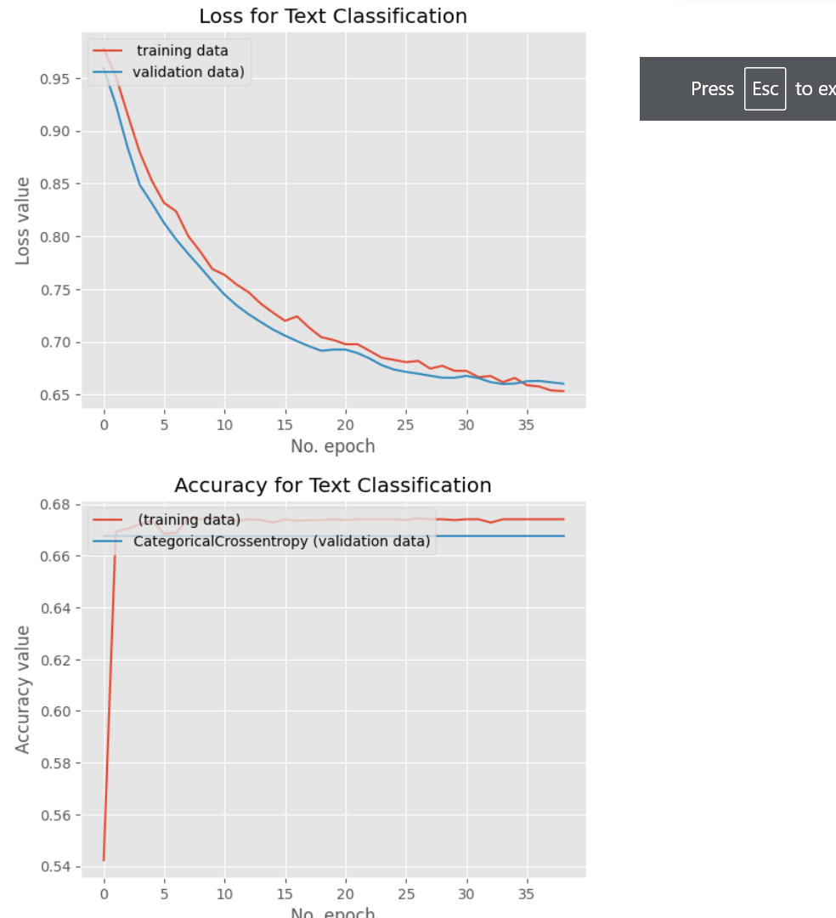
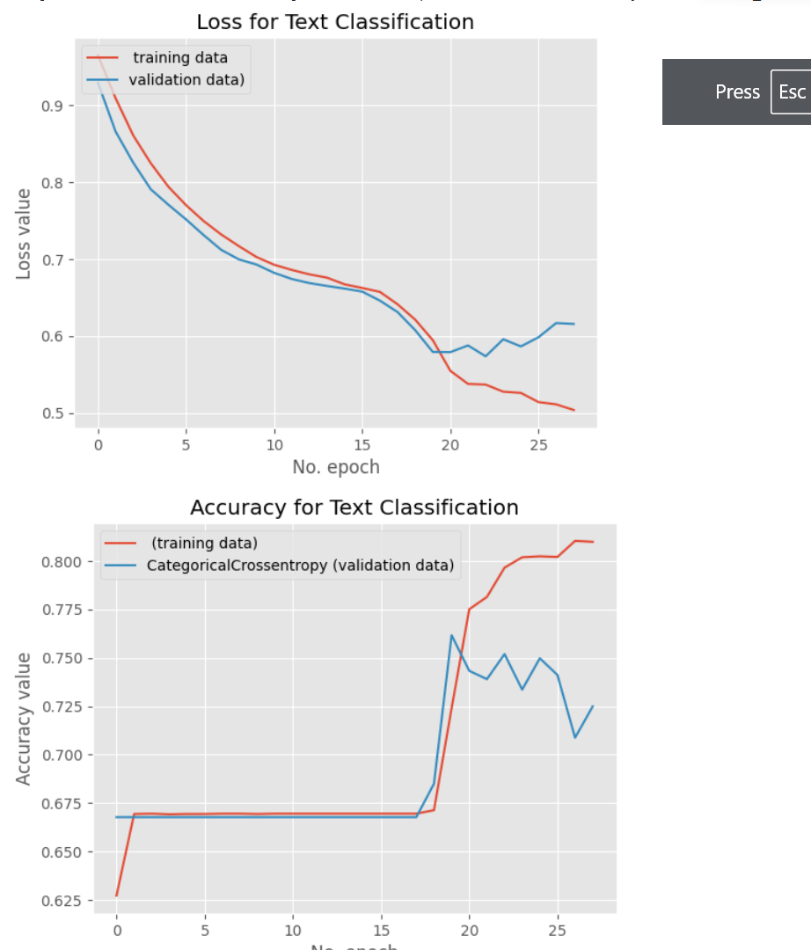
MODEL 2- CNN Loss and Accuracy Metrics for 25% and 50% Dataset

Slide 8
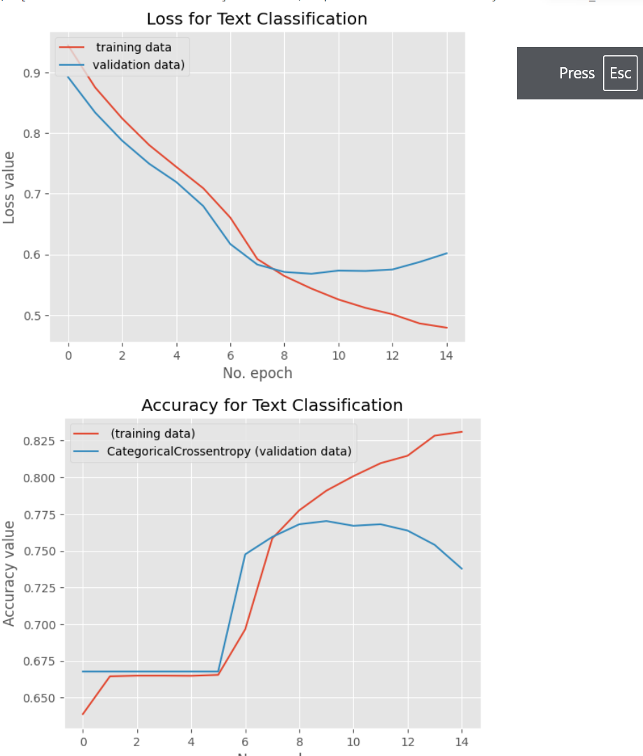
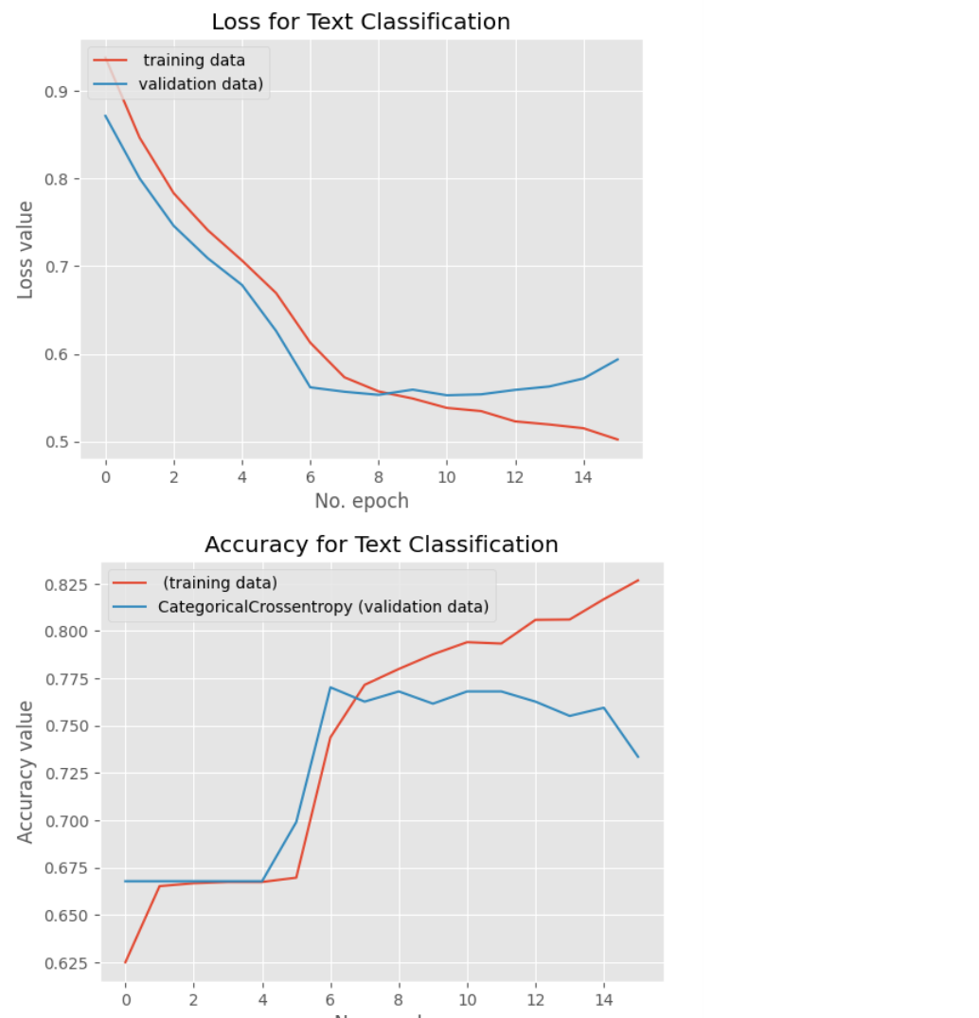
Loss and Accuracy Metrics for 75% and 100% Dataset

Slide 9
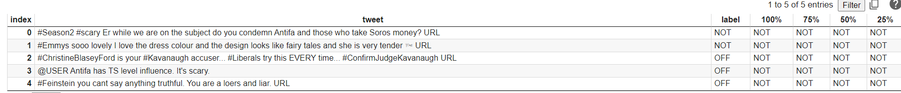
Conclusion
Since we have small dataset Logistic Regression gave better accuracy in comparison to Neural Network Model. Development on more fine grained approached can be focused upon which also use make use of data such as images videos for offensive language detection.

