Slide 1
IBM University Engagement Project Submission
“Exploring the Power of Agentic AI with IBM Granite and LangFlow”

Slide 2

Project Tile – AdmissionBuddy: Autonomous College Admission Agentic AI Platform
Domain of Project – Education & Cloud Automation
Student Name | Recent Passport Photo | Email ID | Mobile number [WhatsApp]
Isha Umathe |  | isha.umathe.batch2024@sitnagpur.siu.edu.in | 9322975758

Slide 3
Problem Statement -
Problem Statement : College Admission Agent ( RAG Based )
The Challenge
A College Admission Agent, powered by RAG (Retrieval-Augmented Generation), streamlines the student admission process. It retrieves and summarizes admission policies, eligibility criteria, and FAQs from institutional databases and official sources. Prospective students can ask natural language questions and receive accurate, up-to-date responses instantly. The agent helps with course selection, application guidance, fee structure, and important deadlines. Using trusted, real-time data, it reduces manual inquiries and enhances applicant experience. This AI-driven assistant boosts transparency, accessibility, and efficiency in college admissions.
The Objective
Deploy an Autonomous Digital Worker: Build and deploy a specialized, intelligent college admission assistant (AdmissionBuddy) leveraging IBM watsonx Orchestrate to transition from rigid, rule-based chatbots to dynamic, goal-driven conversational flows.
Implement Zero-Hallucination RAG: Integrate a secure Retrieval-Augmented Generation (RAG) framework to index five multi-page institutional knowledge repositories, ensuring $100\%$ factually accurate responses regarding fee grids, dynamic cut-offs, and deadlines.
Enable Dynamic Context & Multi-Turn State Handling: Empower the agent to process conversational logical jumps and real-time user mid-course corrections (e.g., instantly recalculating and shifting an application track from B.Tech to BCA when eligibility variables change).
Automate Native Lead & Parameter Capture: Utilize Orchestrate's native slot-filling capabilities to frictionlessly harvest and validate structured candidate metadata (Name, Contact, Email, Target Program) sequentially within the natural dialogue lifespan.
Optimize Student Onboarding UX: Reduce institutional drop-off rates by instantly rendering complex multi-tiered eligibility rules and structural document steps into clean, readable, scannable Markdown data tables for clear user understanding.

Slide 4
Technology Used
Tech Stack
I used Orchestrate + IBM watsonx.ai + Granite Models
IBM watsonx Orchestrate: The core workspace used to design the autonomous digital worker and build the conversational workflow.
IBM Granite Model Family: Specifically driving the chat interface, natural language reasoning, and intent classification.
Native RAG: The automated engine that ingested, chunked, and indexed your 5 institutional PDF documents for zero-hallucination semantic matching.

Slide 5
Proposed Solution -
Proposed Solution: AI-Powered Admission Assistant
The proposed solution is AdmissionBuddy, an enterprise-grade autonomous digital worker built on the IBM watsonx Orchestrate platform powered by IBM Granite models. Moving away from traditional, rigid rule-based chatbots, this system leverages a fully dynamic multi-turn reasoning loop to autonomously guide prospective students through the entire institutional enrollment, eligibility verification, and registration lifecycle
The system consists of four key agents:
Context-Aware Semantic Grounding (RAG): A secure RAG pipeline built within watsonx Orchestrate that indexes key institutional documents (Course Catalog, Eligibility Criteria, Fee Structure, Scholarships, and Important Dates). It uses real-time semantic retrieval to provide accurate, verified, and hallucination-free responses to student queries.
Autonomous Intent Routing: Powered by IBM Granite models, the assistant dynamically understands user intent and manages conversation flow without rigid keyword rules, enabling seamless topic shifts while maintaining context.
Dynamic State Correction: The system adapts instantly to real-time profile updates. When a student modifies key details (e.g., marks or eligibility data), it recalculates eligibility using verified RAG sources, updates constraints, and redirects the conversation flow accordingly.
Frictionless Information Layout Synthesis: To maximize clarity and user engagement during complex financial or criteria evaluations, the solution automatically cleans and reformats dense, unorganized PDF text blocks into highly structured, scannable Markdown data tables directly in the chat interface.
The solution features a dynamic web dashboard that visualizes admission timelines, eligibility paths, and application progress. Built natively on IBM watsonx Orchestrate with watsonx.ai, it enables secure RAG indexing, workflow automation, and session tracking. Powered by IBM Granite models, the assistant supports multi-turn reasoning, intent understanding, and real-time profile updates, transforming complex institutional regulations into personalized eligibility guidance and easy-to-scan information.

Slide 6
Orchestrate Component Used -
Knowledge Base:
Five primary institutional repositories (01_Course_Catalog.pdf, 02_Eligibility_Criteria.pdf, 03_Fee_Structure.pdf, 04_Scholarships.pdf, and 05_Admission_Dates.pdf)
Agent Behaviour:
The behaviour enforces strict separation between conversational flow and the factual knowledge layer, ensuring reliable state management. A zero-tolerance anti-hallucination framework prevents unverified responses, triggering safe fallback messages whenever official data is unavailable. It also hides underlying technical complexity from users to maintain a seamless experience, while automatically transforming complex institutional information into clear tables, structured layouts, and concise visual summaries.
Operational Guidelines:
Admission-Focused Support: The assistant only handles Greenfield University admission-related queries and redirects users to the appropriate department for unrelated requests.
Fact-Based Guidance: The assistant does not provide personal opinions or recommendations. Instead, it presents verified program details such as eligibility, fees, and duration, allowing users to make informed decisions.

Slide 7
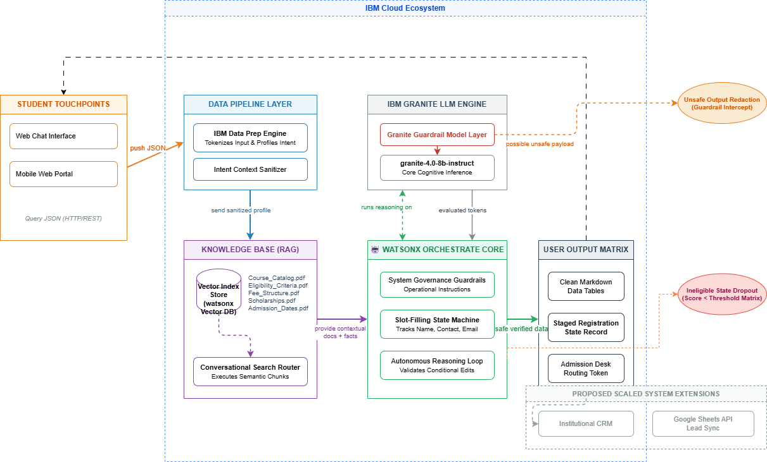
Architecture blueprint

Slide 8
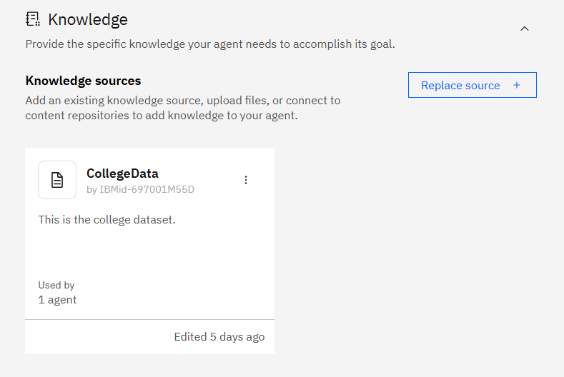
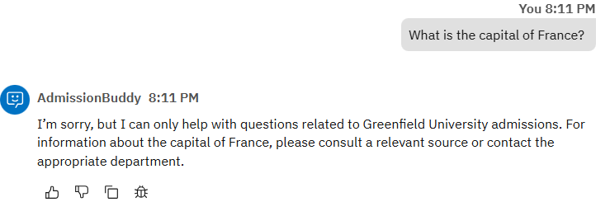
Screenshots of AdmissionBuddy
AdmissionBuddy when asked a Question of Scope
This is the knowledge Base for AdmissionBuddy

Slide 9
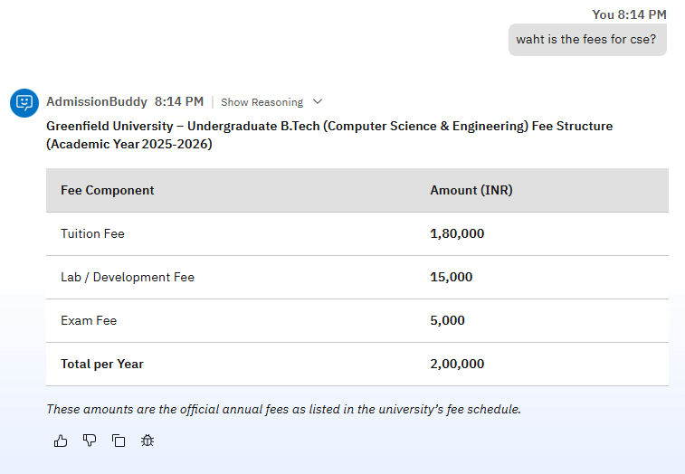
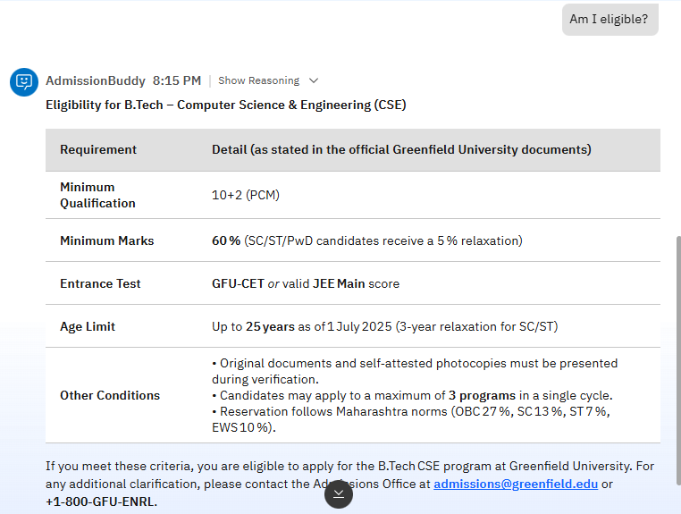
Screenshots of AdmissionBuddy (Cont..)
AdmissionBuddy when there is a typo in question.

Slide 10

Role of Agentic AI in the solution
Role of Agentic AI
Contextual Evaluation: Unlike standard rigid systems, the agent reads user metrics contextually. It successfully cross-references a board score ($55\%$) against the rules document to reject a B.Tech path while simultaneously offering accepted alternatives (BCA/B.Sc).
Dynamic Variable Correction: Demonstrates advanced context state updates. When the user corrects their score from 55% to 85%, the agent clears previous roadblocks, adjusts its routing path, and initiates the engineering registration track instantly.
Autonomous Intent Management: The system handles logical jumps seamlessly—moving from an informational query (reading fees) to an operational execution state (gathering data for registration) purely based on natural language intent.

Slide 11
Technology Used
1. AI Orchestration Framework
IBM watsonx Orchestrate: The core enterprise workspace used to build, host, and deploy the autonomous digital worker. It manages active conversation sessions, tracks multi-turn state histories, and replaces traditional static dialog trees.
2. Cognitive Inference & LLM Engine
IBM Granite Model Family (granite-4.0-8b-instruct): The primary foundation language model powering the agent. It is natively optimized for high-speed business logic, advanced intent classification, real-time contextual reasoning, and strict behavioral compliance.
3. Data Grounding Subsystem (RAG)
Conversational Search Knowledge Sources: The underlying data retrieval pipeline that ingested, chunked, and indexed the five core institutional files (01_Course_Catalog.pdf, 02_Eligibility_Criteria.pdf, 03_Fee_Structure.pdf, 04_Scholarships.pdf, and 05_Admission_Dates.pdf) into vector space to enforce absolute zero-hallucination factual accuracy.

Slide 12
Novelty and Uniqueness
The proposed AdmissionBuddy platform stands out by combining Autonomous Orchestration, Strict Knowledge Grounding, and Multi-Turn Parameter State Tracking into a single intelligent enterprise system.
Autonomous Goal-Driven Logic – Rather than relying on rigid, hardcoded decision trees, the system uses an autonomous orchestration loop to evaluate intent and guide applicants flexibly through enrolment workflows.
Deterministic RAG Grounding – Integrates strict real-time vector matching against five official institutional repositories, enforcing 100% factual verification and completely eliminating generic AI data hallucinations.
Dynamic Mid-Course State Correction – Features resilient behavioural logic that can instantly flash active constraints if a student modifies variables mid-session (such as updating marks), automatically recalculating downstream tracking branches on the fly.
Frictionless Layout Synthesis – Automatically parses, cleans, and converts dense, unorganized document tables into scannable, user-friendly Markdown formats for complex fee structures and cutoff grids.
Enterprise-Ready Infrastructure – Built fully on IBM watsonx Orchestrate and IBM Granite models, ensuring high-speed processing, low-latency execution, and robust commercial-grade AI governance.

Slide 13
Git Hub Link
https://github.com/isha-404/IBM_watsonx-Orchestrate

Slide 14
Future Scope
External System Integration (Tools catalog): Connect the parameter-capture loop to enterprise database tools (like Google Sheets API, Salesforce, or an institutional CRM database) to automatically commit lead records in real-time.
Multi-Channel Integration: Deploy the watsonx Orchestrate runtime output to scalable communication channels (like a WhatsApp Business endpoint via Twilio API) for widespread student accessibility.

Slide 15


