Slide 1

OLA SQL Analysis Project
By Isha Pandey

Slide 2
Some Insights

Slide 3
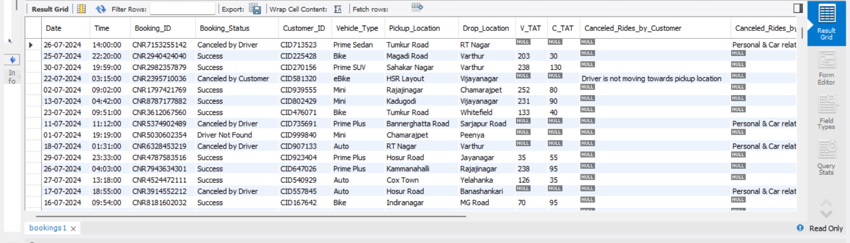
Select * from bookings;

Slide 4
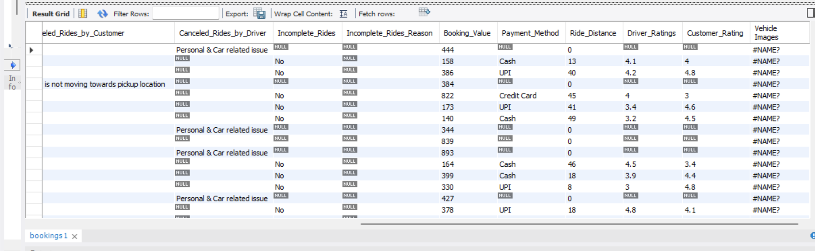

Slide 5
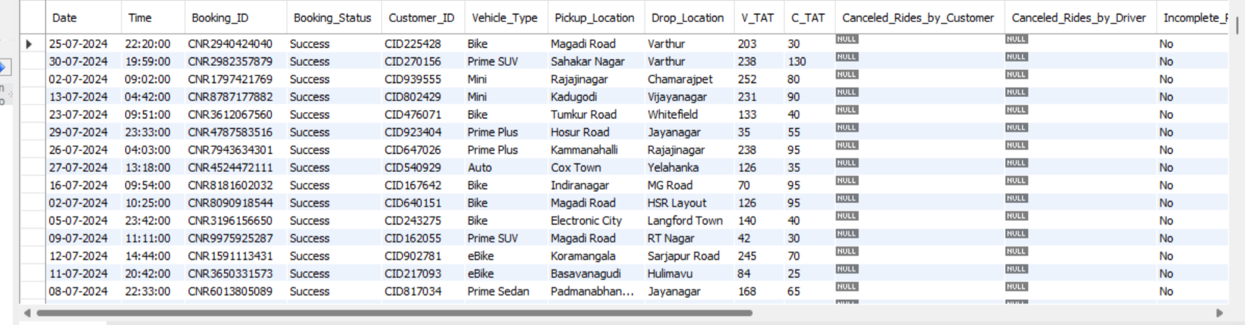
Retrieve all successful bookings:
SELECT * FROM bookings WHERE Booking_Status = 'Success';

Slide 6
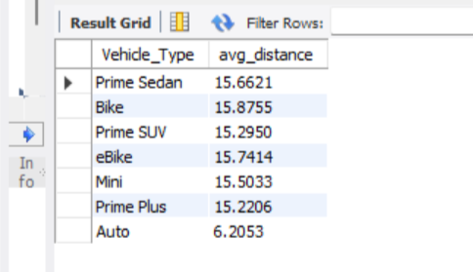
2) Find the average ride distance for each vehicle type:
SELECT Vehicle_Type , AVG(Ride_Distance) as avg_distance FROM bookings GROUP BY Vehicle_Type;

Slide 7
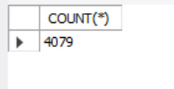
3) Get the total number of cancelled rides by customers:
SELECT COUNT(*) FROM bookings WHERE Booking_Status = 'canceled by Customer';

Slide 8
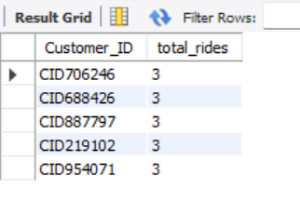
4) List the top 5 customers who booked the highest number of rides:
SELECT Customer_ID, COUNT(Booking_ID) as total_rides FROM bookings GROUP BY Customer_ID ORDER BY total_rides DESC LIMIT 5;

Slide 9
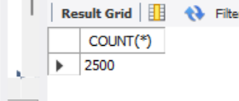
5) Get the number of rides cancelled by drivers due to personal and car-related issues:
SELECT COUNT(*) FROM bookings WHERE cancelled_Rides_by_Driver = 'Personal & Car related issue';

Slide 10
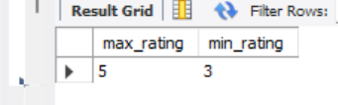
6) Find the maximum and minimum driver ratings for Prime Sedan bookings:
SELECT MAX(Driver_Ratings) as max_rating, MIN(Driver_Ratings) as min_rating FROM bookings WHERE Vehicle_Type = ‘Prime Sedan’.

Slide 11
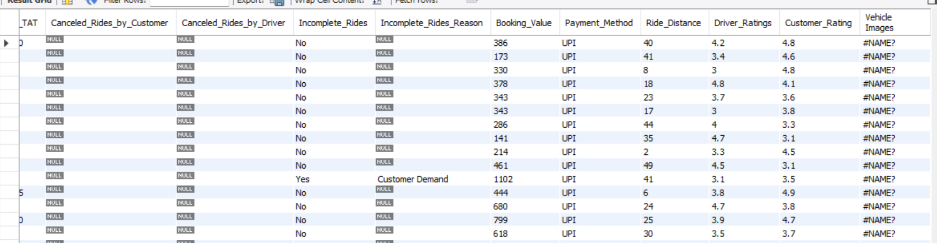
7) Retrieve all rides where payment was made using UPI:
SELECT * FROM bookings WHERE Payment_Method = 'UPI';

Slide 12
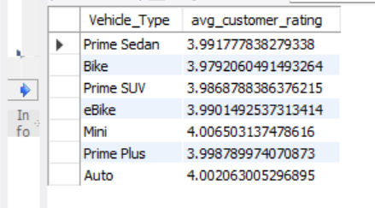
8) Find the average customer rating per vehicle type:
SELECT Vehicle_Type, AVG(Customer_Rating) as avg_customer_rating FROM bookings GROUP BY Vehicle_Type;

Slide 13

9) Calculate the total booking value of rides completed successfully:
SELECT SUM(Booking_Value) as total_successful_value FROM bookings WHERE Booking_Status = 'Success';

Slide 14
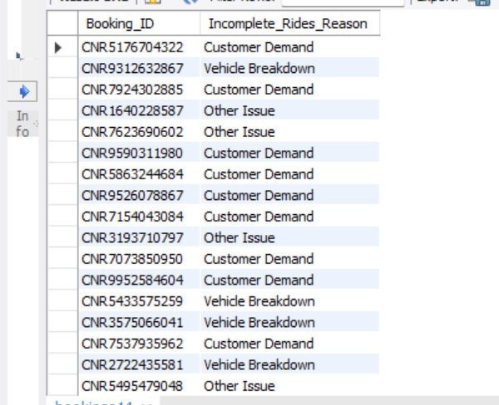
10) List all incomplete rides along with the reason:
SELECT Booking_ID , Incomplete_Rides_Reason FROM bookings WHERE Incomplete_Rides = 'Yes'

