Slide 1
HR
Analytics

Slide 2
Agenda
Executive Summary
Introduction
Methodology
Results
Findings
Strategic Suggestions
Conclusion

Slide 3
EXECUTIVE SUMMARY
In this data analytics project, I conducted a comprehensive analysis of an HR dataset containing 15,416 records across 14 columns. The project involved meticulous data cleaning and preprocessing to ensure high data quality. Using Power BI for visualization, I uncovered key insights into gender diversity, employee performance, motivation, and departmental trends, providing actionable recommendations to support strategic HR decision-making.

Slide 4
introduction
In this presentation, I delved into an HR Data Analytics project for a company. I rigorously analyzed a dataset containing 15,416 records and 14 columns. My focus included data cleaning and transformation using advanced Excel, data analysis through MySQL, and visualization with Power BI. This approach enabled me to uncover hidden insights and trends to inform strategic HR decision-making.

Slide 5


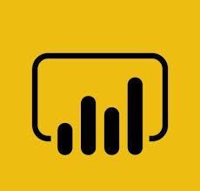


methodology
KAGGLE
EXCEL
MySQL
POWER BI
GITHUB
Data Collection
Kaggle is a vast resource offering a wide variety of datasets, enabling seamless data collection
Data Cleaning
Excel is a powerful tool that provides various functions, streamlining the data cleaning process.
Data
Analysis
MySQL is a robust database that enables efficient data analysis through complex queries, helping extract insights from large datasets.
Data Visualization
Power BI is my preferred tool for visualization, offering interactive dashboards that effectively communicate key insights from marketing data
Project Sharing & Collaboration
GitHub offers a centralized platform for version control and collaboration, also serving as a repository for project sharing

Slide 6

RESULTS

Slide 7
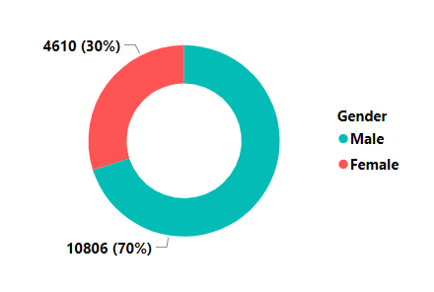
RESULTS
GENDER DIVERSITY
The analysis indicates a significant gender imbalance at the company, with 70% male employees and 30% female employees.

Slide 8
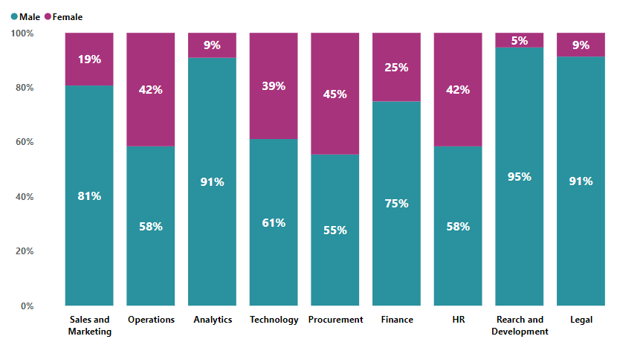
RESULTS
GENDER DIVERSITY BY DEPARTMENT
The result from the analysis indicate a significant imbalance in gender diversity across all departments, with R&D making the largest contribution.

Slide 9
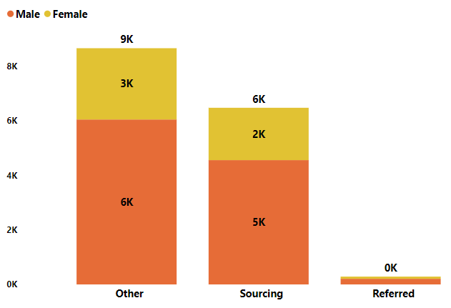
RESULTS
GENDER DIVERSITY BY RECRUITMENT CHANNEL
The results from the analysis indicate that Males are getting preference in hiring across all channels, including sourcing.

Slide 10
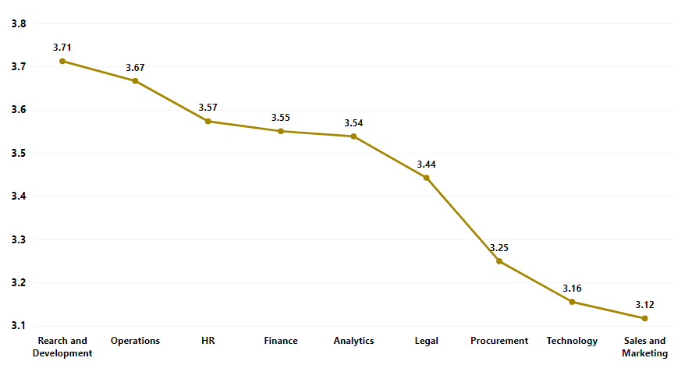
RESULTS
PERFORMANCE RATING BY DEPARTMENT
The results from the analysis indicate that R&D has been the top performer in terms of ratings, whereas the Sales & Marketing department is the lowest performer, with an average rating of 3.1

Slide 11
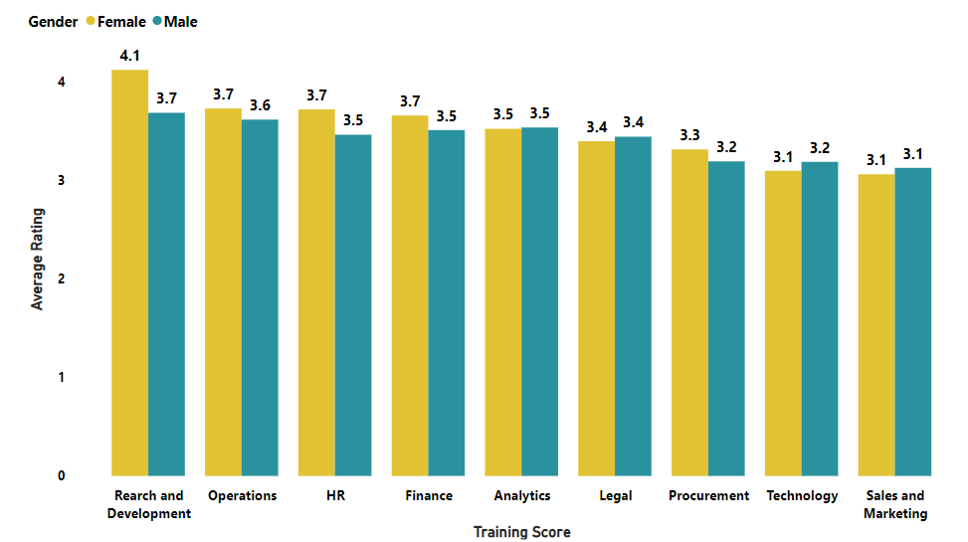
RESULTS
PERFORMANCE RATING BY DEPARTMENT & GENDER
Analysis shows that, across nearly all departments, female receive higher performance ratings than men.
Interestingly, females in R&D outperform males, despite only 5% females exists in R&D.
This highlights the importance of fostering gender diversity throughout the company.

Slide 12
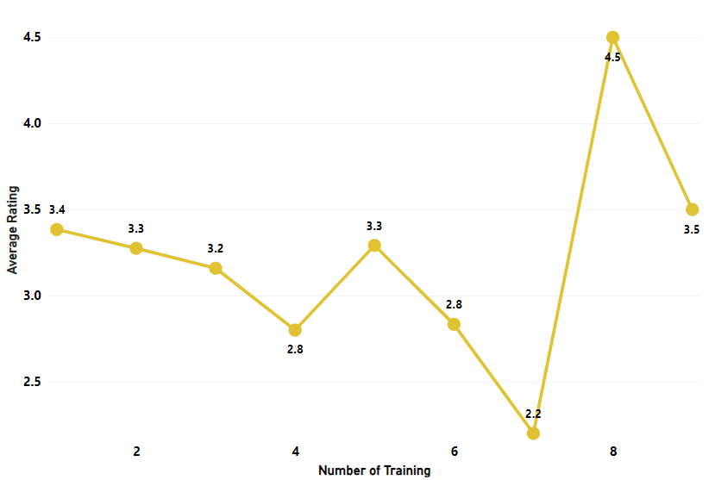
RESULTS
PERFORMANCE RATING BY TRAINING COUNT
The results from the analysis indicate that after three training sessions, performance ratings show significant declines, suggesting that a maximum of three trainings would be the optimal choice.

Slide 13
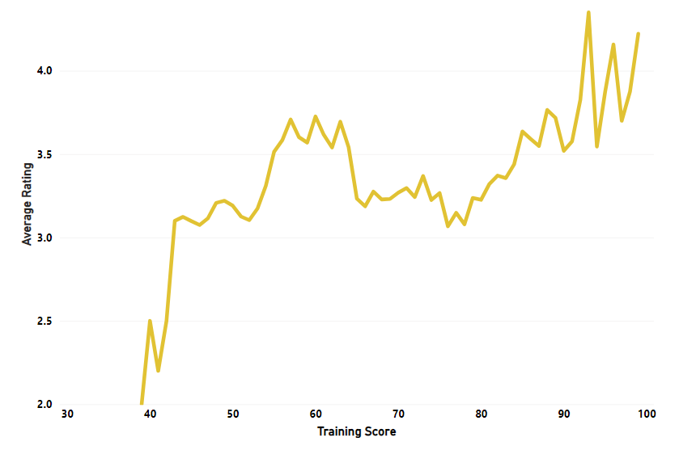
RESULTS
PERFORMANCE RATING BY TRAINING SCORE
Analysis reveals that as training scores increase, average performance ratings rise substantially, reflecting the importance of providing high-quality training to boost employee performance across the company.

Slide 14
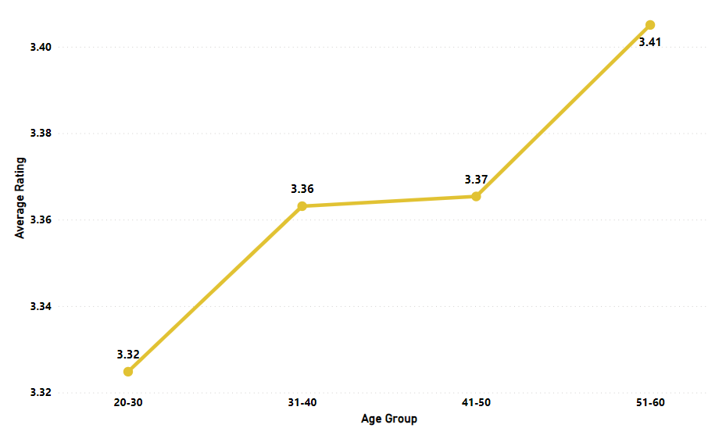
RESULTS
PERFORMANCE RATING BY AGE
The analysis reveals that as age increases, performance ratings also improve. This trend makes sense, as older employees are likely to have more experience, which enhances their career trajectory

Slide 15
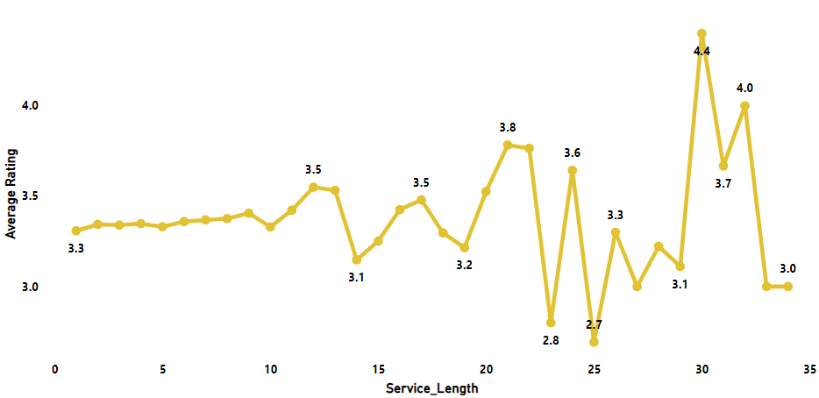
RESULTS
PERFORMANCE RATING BY SERVICE LENGTH
Analysis reveals substantial fluctuations in employee performance ratings beyond the ten-year tenure mark. A notable decline is observed for employees with over two decades of service. This may be influenced by several factors, including job satisfaction, training opportunities, and motivational levels.

Slide 16
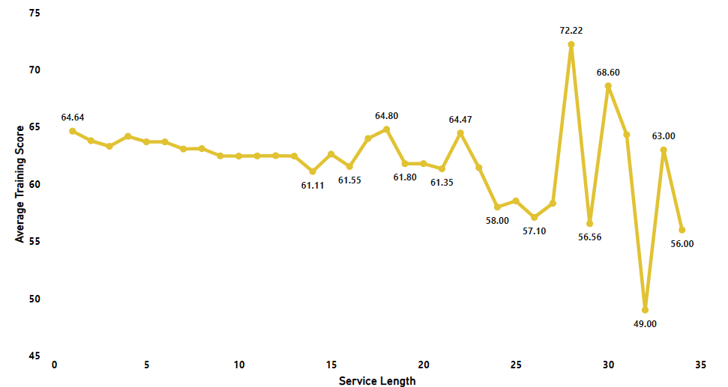
RESULTS
TRAINING SCORE BY SERVICE LENGTH
Analysis reveals that employees with over 10 years at the company show significant declines in training scores. Given the established link between improved training scores and higher performance ratings, this likely explains the performance declines seen in long-tenured employees. These findings highlight the critical need for ongoing, high-quality training for all employees

Slide 17
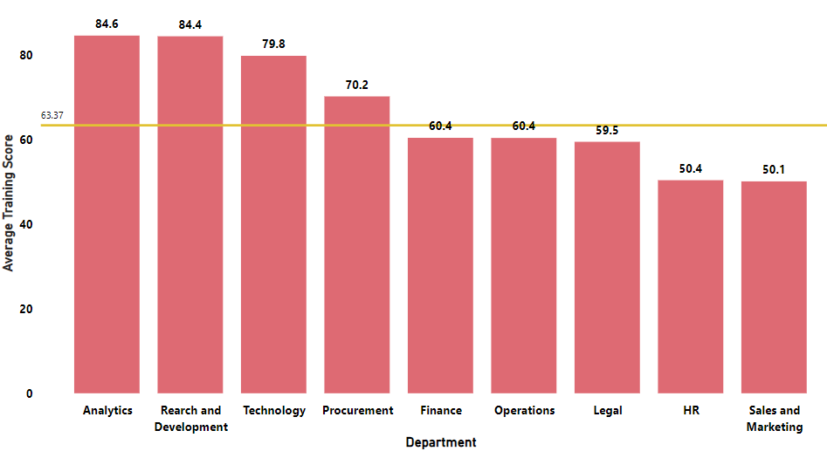
RESULTS
TRAINING SCORE BY DEPARTMENT
The analysis shows that Sales & Marketing and HR departments have below-average training scores, placing them at the bottom. Sales & Marketing's low performance ratings could impact revenue, posing a risk to the company. Likewise, low HR scores indicate a need for quality training to improve performance and ensure effective oversight of training standards.

Slide 18
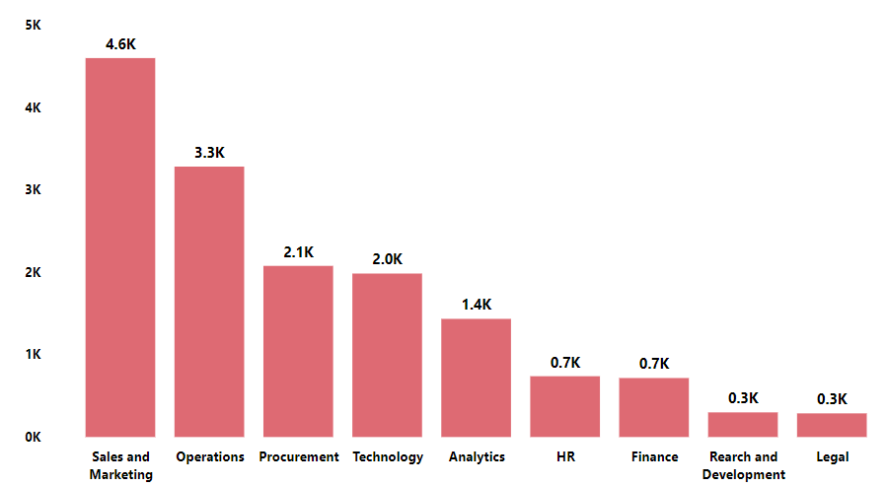
RESULTS
AWARDS WON BY DEPARTMENT
Analysis reveals that despite the lowest performance ratings, Sales & Marketing received the most awards, while high-performing R&D received only few awards.
To maintain motivation, awards should be fairly distributed across all departments

Slide 19
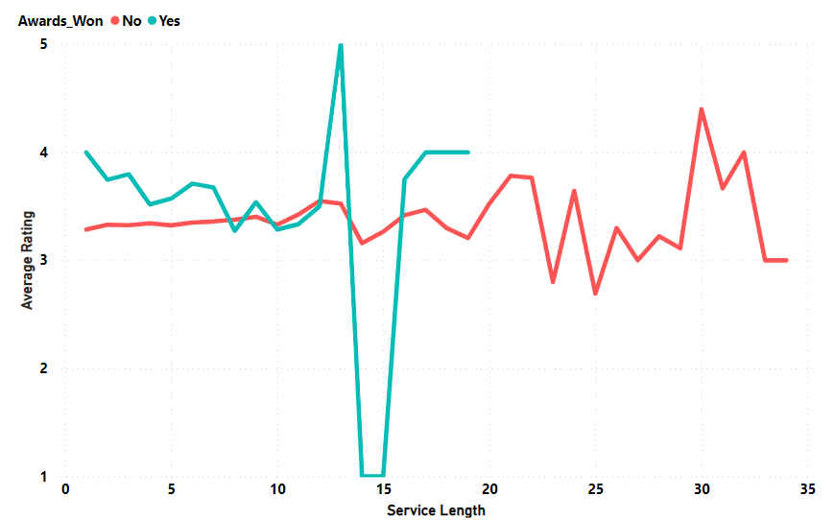
RESULTS
AWARDS WON BY
SERVICE LENGTH & PERFORMANCE RATINGS
The analysis shows that award-winning employees have consistently higher performance ratings than non-winners. There is a significant dip in ratings for employees with 14-15 years of service, suggesting a need for HR intervention to identify the root cause. Additionally, employees with over 20 years of service receive no awards, which correlates with a decline in their performance ratings.

Slide 20
FINDINGS
GENDER BREAKDOWN :
The company has a severe gender imbalance, with 70% male and 30% female employees.
Gender by Department: The R&D department has the most imbalance, with only 5% female and 95% male representation, followed by Legal. Procurement has maintained a more balanced gender diversity.
Male candidates are preferred in hiring across all channels, including sourcing, which should not be the case within the company.

Slide 21
FINDINGS
PERFORMANCE ANALYSIS :
Average Performance rating of the employees is 3.4, which is considered average.
R&D department has been the top performer in terms of ratings, whereas the Sales & Marketing department is the lowest performer, with an average rating of 3.1.
Females receive higher performance ratings than males across most departments, with R&D females outperforming males despite only 5% representation. This highlights the need for greater gender diversity in the company
Performance ratings decline significantly after three training sessions, indicating that three sessions may be optimal.
Higher training scores result in better performance ratings, emphasizing the value of quality training.
As age increases, performance ratings improve, likely due to older employees' greater experience enhancing their careers.
Performance ratings fluctuate significantly after ten years, declining for those with over twenty years, possibly due to job satisfaction, training, and motivation.

Slide 22
FINDINGS
TRAINING SCORE ANALYSIS :
Employees with over 10 years at the company show significant declines in training scores, likely explaining their performance drops. This emphasizes the need for ongoing, high-quality training for all staff.
Additionally, the Sales & Marketing and HR departments have below-average training scores. Poor performance in Sales & Marketing may impact revenue, posing a risk to the company’s financial health. Similarly, low HR scores highlight the urgent need for quality training to improve performance and effectively manage training standards.
EMPLOYEE MOTIVATION ANALYSIS :
Awards Won By Department :
Sales & Marketing received the most awards despite low performance ratings, while high-performing R&D received few. To maintain motivation, awards should be fairly distributed across all departments.
Awards Won By Service Length & Performance Rating : Award-winning employees have higher performance ratings than non-winners. A significant dip occurs for those with 14-15 years of service, signaling a need for HR intervention. Additionally, employees with over 20 years receive no awards, aligning with their declining ratings.

Slide 23
Strategic Suggestions
To enhance gender diversity, the company should maintain a balance across all departments and recruitment channels while strategizing hiring plans. If suitable female candidates are not found, HR could consider talented women with career gaps or those seeking remote roles. Since females are outperforming men, maintaining diversity is essential.
Training sessions should be limited to three to avoid disrupting work-life balance. Prioritizing quality training is essential for improving scores, which correlate with performance. Specialized training should be tailored for all age groups and seniority levels, focusing on employees with longer tenure. Training sessions should cover all relevant aspects, with a major focus on related content. Timely feedback from employees is essential to ensure alignment with training objectives.
The Sales & Marketing department requires more targeted training sessions to boost their performance. Continued low performance in this area could significantly impact revenue, which is not favorable for the company.
Additionally, proper recognition and awards should be implemented periodically across all departments and levels to maintain motivation and enhance performance ratings.

Slide 24
conclusion

Slide 25
conclusion
In conclusion, the HR analytics project revealed a significant imbalance in gender diversity, with 70% male and 30% female representation, as well as inconsistencies in performance, training, and award distribution.
A strong male hiring bias exists, particularly in the R&D (95% male) and Legal (91% male) departments, despite females consistently outperforming males. Increasing gender diversity could improve team performance.
Performance ratings benefit from up to three training sessions, yet drop significantly for employees with over 10 years of service, suggesting a need for sustained training, especially for long-tenured staff. Low training and performance ratings in Sales & Marketing (3.1 rating) department might impact revenue, while similar issues in HR may weaken overall training standards.
Award distribution favors lower-performing departments, such as Sales & Marketing, over high performers like R&D, potentially affecting morale. Additionally, performance drops notably for employees with 14-15 years and over 20 years of service, highlighting a need for HR interventions.
Addressing these issues through diverse hiring, quality training, and balanced recognition will foster a more motivated, inclusive, and high-performing workforce.

Slide 26
thankyou

