Slide 1
Python Dictionary
Dictionaries are ordered collections of unique values stored in (Key-Value) pairs.
Python dictionary represents a mapping between a key and a value.
For example, consider the Phone Book, where it is very easy and fast to find the phone number(value) when we know the name(Key) associated with it.

Slide 2
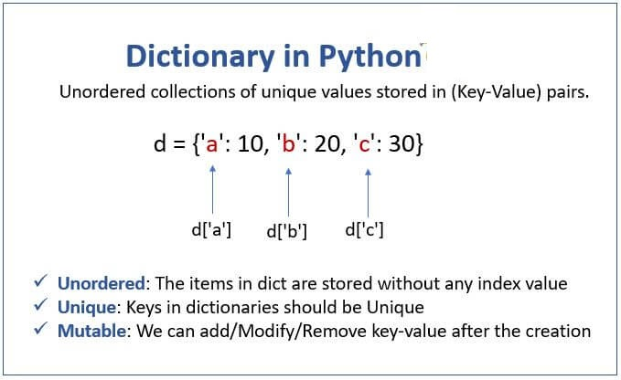

Slide 3
Characteristics of dictionaries
Unordered : The items in dictionaries are stored without any index value. They are stored as Key-Value pairs, and the keys are their index, which will not be in any sequence.
Ordered (In Python 3.7 and higher version): dictionaries are ordered, which means that the items have a defined order, and that order will not change.
Unique: As mentioned above, each value has a Key; the Keys in Dictionaries should be unique. If we store any value with a Key that already exists, then the most recent value will replace the old value.
Mutable: The dictionaries are changeable collections, which implies that we can add or remove items after the creation.

Slide 4
Creating a dictionary
There are following three ways to create a dictionary.
Using curly brackets: The dictionaries are created by enclosing the comma-separated Key: Value pairs inside the {} curly brackets. The colon ‘:‘ is used to separate the key and value in a pair.
Using dict() constructor: Create a dictionary by passing the comma-separated key: value pairs inside the dict().
Using sequence having each item as a pair (key-value)

Slide 5
# create a dictionary using {} person = {"name": "Jessa", "country": "USA", "telephone": 1178} print(person) | # output {'name': 'Jessa', 'country': 'USA', 'telephone': 1178}
# create a dictionary using dict() person = dict({"name": "Jessa", "country": "USA", "telephone": 1178}) print(person) | # output {'name': 'Jessa', 'country': 'USA', 'telephone': 1178}
# create dictionary with mixed keys my_dict = {"name": "Jessa", 10: "Mobile"} print(my_dict) | # output {'name': 'Jessa', 10: 'Mobile'}
# create dictionary with value as a list person = {"name": "Jessa", "telephones": [1178, 2563, 4569]} print(person) | # output {'name': 'Jessa', 'telephones': [1178, 2563, 4569]}

Slide 6
Empty Dictionary
When we create a dictionary without any elements inside the curly brackets then it will be an empty dictionary.
emptydict = {}
print(type(emptydict))
o/p - <class 'dict’>

Slide 7
Accessing elements of a dictionary -There are two different ways to access the elements of a dictionary. -> Retrieve value using the key name inside the [] square brackets -> Retrieve value by passing key name as a parameter to the get() method of a dictionary. # create a dictionary named person person = {"name": "Jessa", "country": "USA", "telephone": 1178}
# access value using key name in []
print(person['name'])
# Output 'Jessa'
# get key value using key name in get()
print(person.get('telephone'))
# Output 1178

Slide 8
Get all keys and values Use the following dictionary methods to retrieve all key and values at once
Method | Description
keys() | Returns the list of all keys present in the dictionary.
values() | Returns the list of all values present in the dictionary
items() | Returns all the items present in the dictionary. Each item will be inside a tuple as a key-value pair.

Slide 9
person = {"name": "Jessa", "country": "USA", "telephone": 1178}
# Get all keys
print(person.keys()) # output dict_keys(['name', 'country', 'telephone'])
print(type(person.keys())) # Output class 'dict_keys'
# Get all values
print(person.values()) # output dict_values(['Jessa', 'USA', 1178])
print(type(person.values())) # Output class 'dict_values'
# Get all key-value pair
print(person.items())
# output dict_items([('name', 'Jessa'), ('country', 'USA'), ('telephone', 1178)])
print(type(person.items())) # Output class 'dict_items'

Slide 10
Iterating a dictionary
person = {"name": "Jessa", "country": "USA", "telephone": 1178}
# Iterating the dictionary using for-loop
print('key', ':', 'value')
for key in person:
print(key, ':', person[key])
o/p-
key : value
name : Jessa
country : USA
telephone : 1178

Slide 11
person = {"name": "Jessa", "country": "USA", "telephone": 1178}
# using items() method
print('key', ':', 'value')
for key_value in person.items():
# first is key, and second is value
print(key_value[0],”:”, key_value[1])
o/p –
key : value
name Jessa
country USA
telephone 1178

Slide 12
Find a length of a dictionary
person = {"name": "Jessa", "country": "USA", "telephone": 1178}
print(len(person))
# output 3

Slide 13
Adding items to the existing dictionary
We can add new items to the dictionary using the following two ways.
Using key-value assignment: Using a simple assignment statement where value can be assigned directly to the new key.
Using update() Method: In this method, the item passed inside the update() method will be inserted into the dictionary. The item can be another dictionary or any iterable like a tuple of key-value pairs.

Slide 14
Now, Let’s see how to add two new keys to the dictionary.
person = {"name": "Jessa", 'country': "USA", "telephone": 1178}
# update dictionary by adding 2 new keys
person["weight"] = 50
person.update({"height": 6})
# print the updated dictionary
print(person)
# output {'name': 'Jessa', 'country': 'USA', 'telephone': 1178, 'weight': 50, 'height': 6}

Slide 15
Aptitude Questions : Directions: The following series are based on a specific pattern. In these series one number is wrong, find that odd one
5, 12, 23, 50, 141, ? A) 415 B) 430 C) 439 D) 488 E) 452 | 7, 13, 25, 45, 75, ? A) 117 B) 153 C) 209 D) 123 E) 141 | 4, 11, 19, 41, ?, 161 A) 62 B) 108 C) 79 D) 90 E) 85 | 4, 8, 21, 59, ?, 314 A) 146 B) 134 C) 125 D) 191 E) 126
11, 6, 5, 9, 16, ? A) 66.5 B) 78.5 C) 89.5 D) 42.5 E) 31.5 | 5, 8, 28, 162, ?, 12870 A) 1738 B) 2318 C) 1288 D) 2224 E) 2950 | 3, 5, 10, 20, 37, ? A) 68 B) 77 C) 78 D) 61 E) 63 | 21, 35, 56, 91, 154, ? A) 273 B) 289 C) 231 D) 240 E) 245
5, 7, 11, 37, 143, ? A) 733 B) 721 C) 764 D) 750 E) 784 | 5, 7, 25, 131, ?, 8335 A) 865 B) 914 C) 1025 D) 802 E) 925 | 960, 839, 758, 709, 684, ? 685 550 485 675 745 | 340, 356, 382, 418, 464, ? 520 480 540 516 496

Slide 16
Pattern: D 5……….12………23………..50……….141…………488 ….+7…….+11……….+27……….+91………+347 ………+4……..+16……….+64………+256 | Option A Pattern: 7 + (2×3) = 13 13 + (3×4) = 25 25 + (4×5) = 45 45 + (5×6) = 75 75 + (6×7) = 117 | Option C Pattern: 4 × 2 + 3 = 11 11 × 2 – 3 = 19 19 × 2 + 3 = 41 41 × 2 – 3 = 79 79 × 2 + 3 = 161 | Option A Pattern: 4……….8………21………..59……….146…………314 ….+4…….+13…….+38………+87………+168 ………+32…….+52……..+72………+92
Option D Pattern: 11 ×0.5 + 0.5 = 6 6 ×1 – 1 = 5 5 ×1.5 + 1.5 = 9 9 ×1 – 1 = 16 16 ×2.5 + 2.5 = 42.5 | Option C Pattern: ×2 – 2, ×4 – 4, ×6 – 6, ×8 – 8, ×10 – 10. | Option E Pattern: + (1²+1), + (2²+1), + (3²+1), + (4²+1), + (5²+1) | Option A Pattern: 21 × 2 – 7 = 35 35 × 2 – 14 = 56 56 × 2 – 21 = 91 91 × 2 – 28 = 154 154 × 2 – 35 = 273
Option B Pattern: 5 × 1 + 2 = 7 7 × 2 – 3 = 11 11 × 3 + 4 = 37 37 × 4 – 5 = 143 143 × 5 + 6 = 721 | Option E Pattern: 5 × 1 + 2 = 7 7 × 3 + 4 = 25 25 × 5 + 6 = 131 131 × 7 + 8 = 925 925 × 9 + 10 = 8335

