Slide 1
Project Presentation of Full Stack Engineering
On
Expense Tracker
Isha Prakash-(2210991679)
Ishika-(2210991687)
Kanika-(2210991735)
Sanskar-(2210992251)
Supervised By
Mr. Rahul Singh
Department of Computer Science and Engineering,
Chitkara University, Punjab

Slide 2
INTRODUCTION
Managing finances effectively is a crucial part of achieving financial stability and growth. An expense tracker is a powerful tool that helps individuals and businesses gain better control over their spending by systematically recording and categorizing expenses.
By tracking every transaction—whether it's daily coffee purchases, utility bills, or major investments—users can analyze their financial habits and identify areas for improvement.
With real-time insights into spending patterns, an expense tracker simplifies budgeting, encourages mindful spending, and helps users stay on top of their financial goals. By fostering financial discipline and transparency, it plays a vital role in avoiding unnecessary debt, optimizing savings, and making well-informed financial decisions.
2

Slide 3
KEY FEATURES OF EXPENSE TRACKER
With detailed financial reports and analytics, users can track their expenses through monthly, yearly, or custom summaries, helping them identify patterns and optimize their budgets. Real-time data updates ensure that transactions are reflected instantly, maintaining accuracy across all devices. The system is designed to handle multiple users efficiently and integrates with third-party services via APIs, making it scalable and adaptable. The platform is built for scalability and cross-platform access, allowing users to manage their finances effortlessly on Web. With AI-driven insights, notifications, and smart alerts, the system offers personalized recommendations to help users make informed financial decisions.

Slide 4
CHALLENGES
.
Additionally, the psychological aspect of spending makes tracking finances an emotional experience for many users. Designing an interface that not only provides data but also motivates users to improve their financial habits is a challenge that goes beyond technical development. Gamification elements,
AI-driven spending recommendations, and behavior-based nudges can enhance user engagement, but they must be carefully implemented to avoid overwhelming users with excessive notifications or suggestions.
Finally, maintaining long-term user engagement is difficult, as many people start using an expense tracker enthusiastically but gradually abandon it. Striking the right balance between automation, reminders, and valuable insights is key to ensuring that users stay committed to managing their finances effectively.

Slide 5
TOOLS & TECHNOLOGIES
JWT (JSON Web Token): A widely used authentication mechanism that securely transmits user authentication data. Usage: Manages secure user sessions, enabling token-based authentication for login and API access.
BCRYPT: A library for hashing passwords to enhance security. Usage: Encrypts user passwords before storing them in the database to prevent unauthorized access.
Redis: An in-memory data store used for caching and session management. Usage: Speeds up authentication processes and stores frequently accessed data to enhance performance.
.React.js or Next.js: Frontend libraries/frameworks for building interactive and dynamic user interfaces. Usage: Creates a seamless, responsive UI for users to manage their expenses efficiently.
Redux or Context API: State management solutions for handling global application data. Usage: Manages user session data, expense categories, and financial reports across the application.
Cloud Storage (AWS S3 or Firebase Storage): Remote storage solutions for managing user data backups and file uploads. Usage: Stores receipts, invoices, or other financial documents uploaded by users.

Slide 6
Continue..
Firebase: A backend-as-a-service that provides authentication, real-time
Database. Usage: Handles user logins, stores expense data, and syncs across devices.
APPWRITE: An open-source alternative to Firebase with PostgreSQL as the
Database. Usage: Manages user authentication, expenses, and financial records.
SQLite: A lightweight, easy-to-use database that runs locally. Usage: Stores expense data directly on the user's device for offline access.

Slide 7
ADVANTAGES
One key benefit is financial accountability, as users become more mindful of their spending habits when every transaction is recorded. This helps reduce impulsive purchases and promotes disciplined money management. Additionally, many expense trackers provide automated insights and analytics, offering spending breakdowns, monthly comparisons, and trend analysis to help users understand where their money is going . Another major advantage is goal-based savings tracking, where users can set financial targets—such as saving for a vacation or paying off debt—and monitor their progress over time. Many expense trackers also support multi-account tracking, allowing users to manage multiple bank accounts, credit cards, and digital wallets in one place for a consolidated financial overview.
For people who share finances, some expense trackers offer collaborative budgeting, enabling couples, families, or roommates to track shared expenses and split bills easily. Additionally, AI-powered recommendations in modern trackers can suggest cost-cutting strategies or alert users when they are close to exceeding their budget.

Slide 8
DISADVANTAGES
While expense trackers offer valuable financial management tools, they also come with certain limitations. One challenge is data accuracy, as users may forget to log transactions, leading to incomplete or misleading financial insights. Even with automation, bank sync issues or incorrect categorization of expenses can cause discrepancies.
Another limitation is privacy concerns, as financial data is stored digitally, making it vulnerable to potential security breaches or unauthorized access. Some free expense trackers may also collect user data for advertising or third-party services, raising concerns about data privacy.
Customization constraints can be another drawback, as not all apps allow users to tailor categories, reporting formats, or budget structures to fit their unique financial needs. Similarly, subscription costs for premium features, such as advanced analytics or multi-account syncing, may not be affordable for all users.

Slide 9
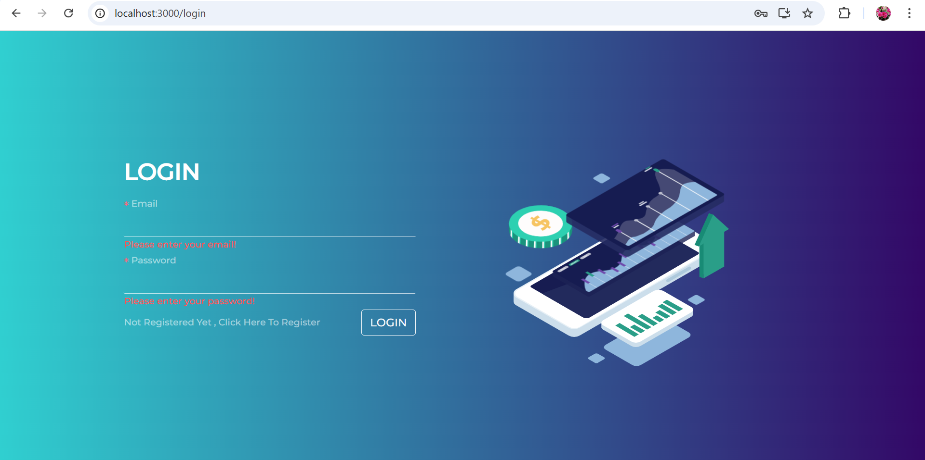
SNAPSHOTS OF THE PROJECT:
LOGIN PAGE:

Slide 10
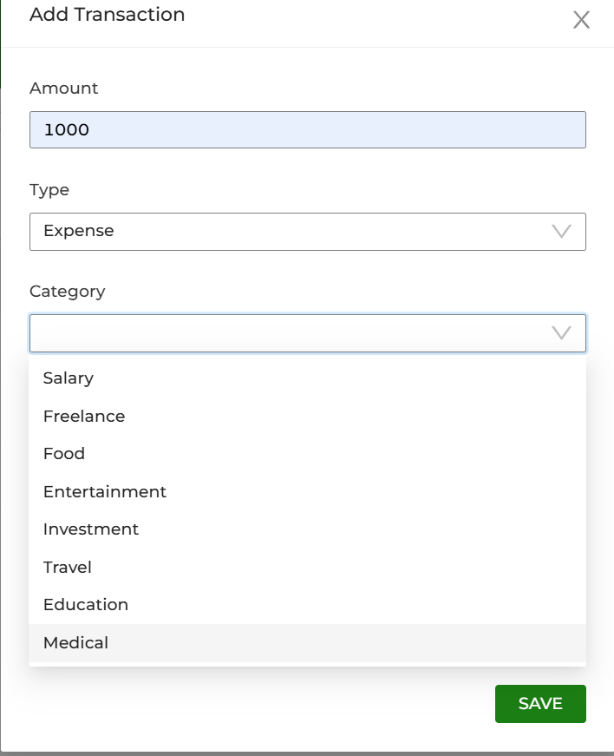
Transaction Page:

Slide 11
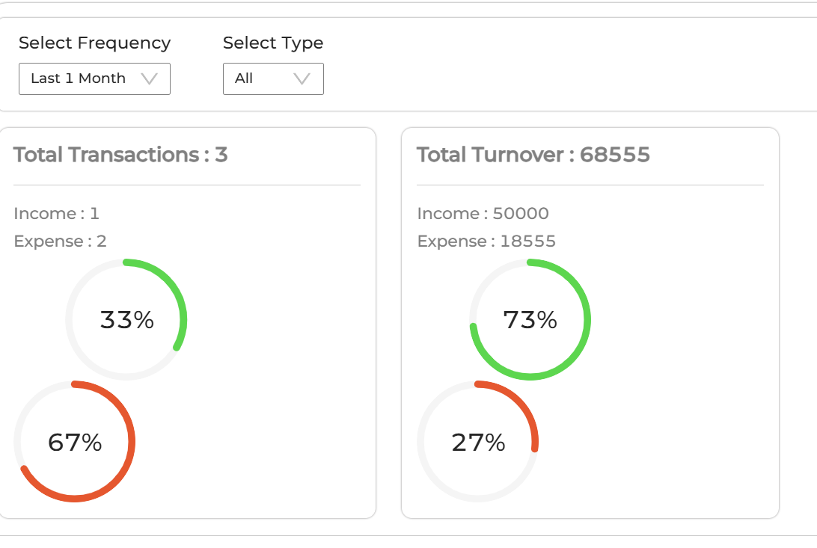
Transaction Graph:

Slide 12
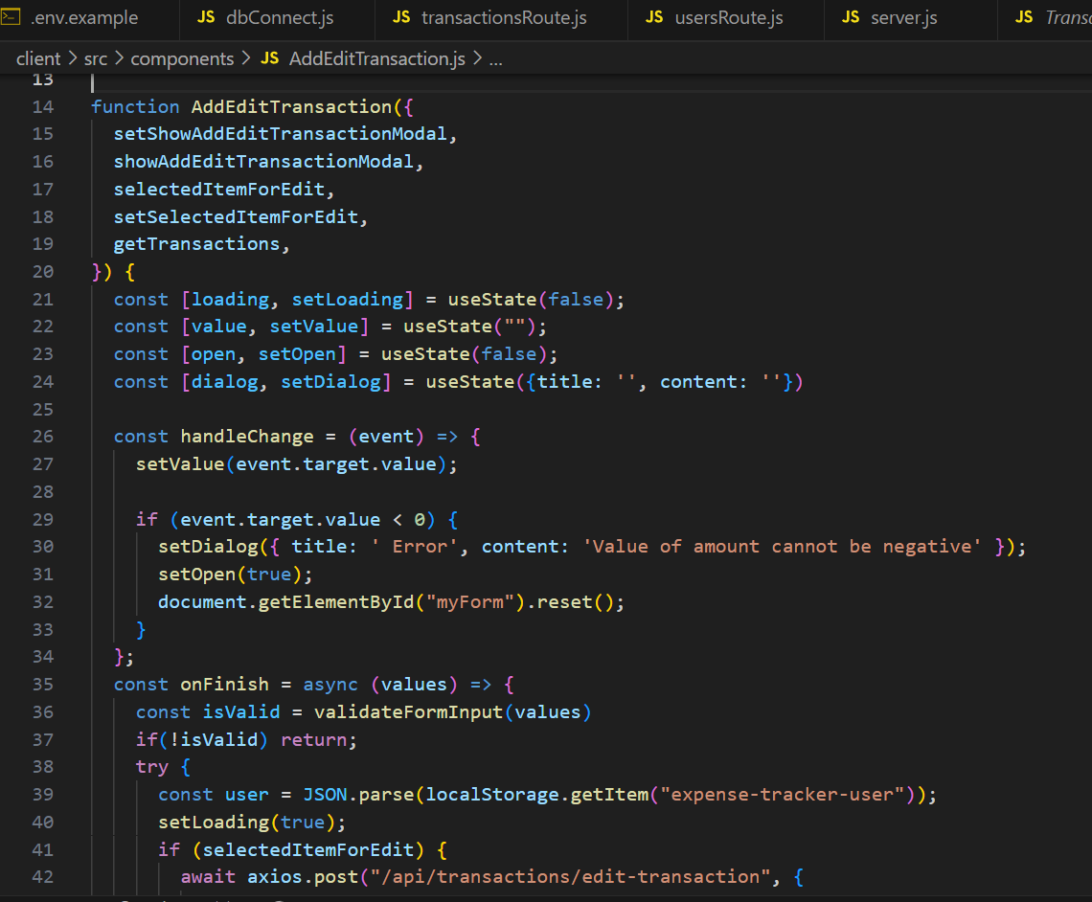
CODE SNIPPET:

Slide 13
FUTURE SCOPE
The future of expense tracking is set to become even more advanced with the integration of emerging technologies and innovative features. Blockchain technology could be used to ensure secure, transparent, and tamper-proof financial records, giving users more confidence in the accuracy of their data. Decentralized finance (DeFi) integration could also allow users to manage cryptocurrency transactions alongside traditional expenses.Voice-enabled assistants and chatbots powered by AI could simplify expense logging by allowing users to add transactions through voice commands or natural conversation. Augmented Reality (AR) interfaces might offer interactive financial dashboards, providing a more engaging way to visualize spending habits and trends.Hyper-personalized financial insights using machine learning could help users identify patterns in their spending, suggest budgeting adjustments, and even warn about potential financial risks based on past behavior. Additionally, automated bill payment systems integrated with smart contracts could ensure that recurring expenses like rent, utilities, and subscriptions are managed seamlessly.

Slide 14
CONCLUSION
Looking ahead, the project has significant potential for expansion, including AI-driven automation, integration with banking APIs for real-time transaction syncing, and enhanced security features like biometric authentication. As financial technology continues to evolve, this tracker can be adapted to offer more personalized and intelligent financial solution . Ultimately, this project serves as a stepping stone toward fostering better financial habits, promoting savings, and helping users work towards long-term financial stability. By continuously refining and expanding its capabilities, the Expense Tracker can become an essential tool for anyone looking to take control of their financial future.

Slide 15
Thank You
15

