Slide 2
LOAD FORECASTING:
Forecasting in the problem of determining the future values of a time series from the current and past values.
Load forecasting is about estimating future consumptions based on various data and information available as per consumer behaviour.
Short-term Load Forecasting can help to estimate the load flows and to make decisions that can prevent overloading. Timely implementations of such decisions lead to improvement of network reliability and to reduced occurrences of equipment failures or blackout.

Slide 3
Role of load forecasting:
For proper planning of Power System.
      To determine the potential need for additional new generating facilities.
      To determine the size of the plants.
      On correct values of demand, load forecasting will prevent over designing of conductor sizes.
For proper planning of Transmission and Distribution facilities.
      Wastage due to unplanning like the purchase of equipment which is not immediately required can be avoided.
For proper Financing.
For proper Grid Formation.

Slide 4
Load Curves:
Variations in load on power station from time to time.
  Daily load curves.
  Monthly load curves.
  Annual load curves.
Load curves give –
  Variation of load during different times.
  Total no. of units generated.
  Maximum demand.
  Average load on a power station.
  Load Factor.

Slide 5
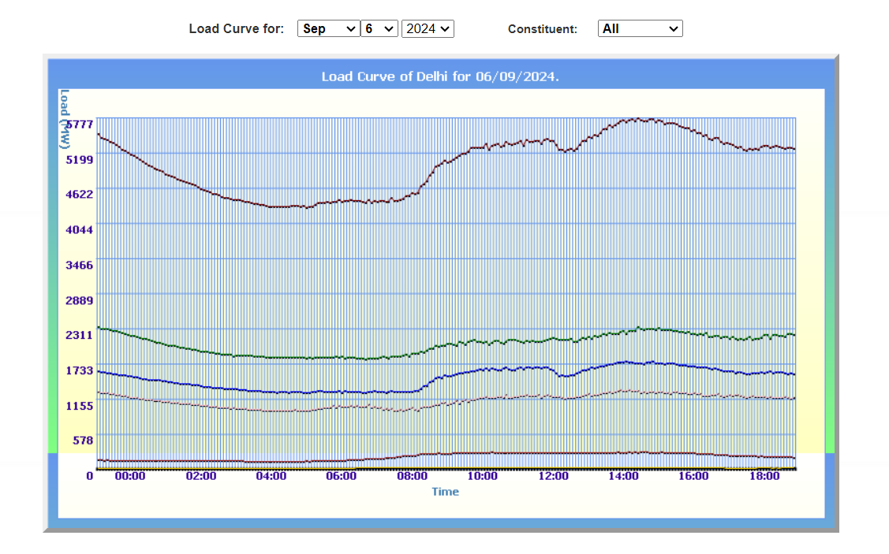
Daily Load Curve sample:

Slide 6
Factors affecting Load Forecasting:
Time factors such as:
  Hours of the day (day/night).
  Days of the week (weekday/ weekend).
  Time of the year (season).
Weather conditions (Temperature and Humidity).
Class of customers (residential, commercial, industrial, agricultural, public, etc).
Special Events (public holidays, etc).
Electricity price.

Slide 7
Data Used:
We have used Delhi Electricity Board’s Data which can be found at https://www.delhisldc.org/Loaddata.aspx?mode=29/04/2018 the above site provides load values (MW) in time step of 5 minutes and we have converted it into 2 hours for our dataset.
We have collected corresponding Humidity and Temperature data from various weather sites.
Features Used
  Time of the day.
  Day of the week.
  Temperature at the corresponding time.
  Humidity at the corresponding time.

Slide 8
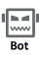
Data scraping:
Hourly Scraping
Hourly Update Request
SLDC
Our Database
Database Updating
Automation

Slide 9
Our Website Model:
Our Database
Our Website
Various AI Algorithms

Slide 10
Website Features:
Daily Load Prediction
Our Website
Different Features
Day wise comparison between Real Load Data
Comparison between Different Algorithms

