Slide 1
Real-time Neural Style Transfer
Name : ISHA Joshi
Roll No : 31338
Guide : Prof. d. d. kadam
Notes:
Good Morning. My name is Isha Joshi. And the topic of my today’s seminar presentation is Real-time Neural Style Transfer. Neural Style Transfer has been one of the most interesting and exciting applications of CNNS.

Slide 2
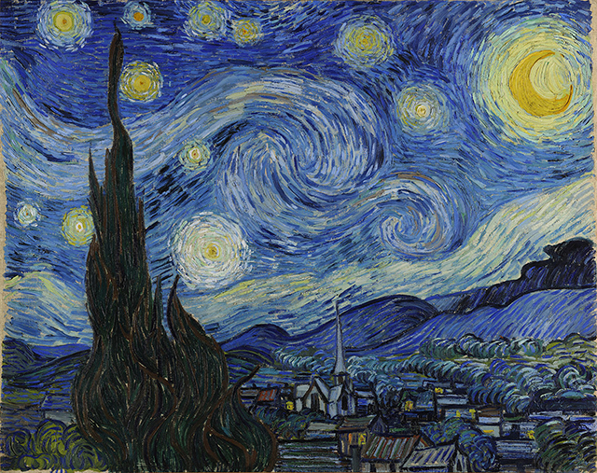
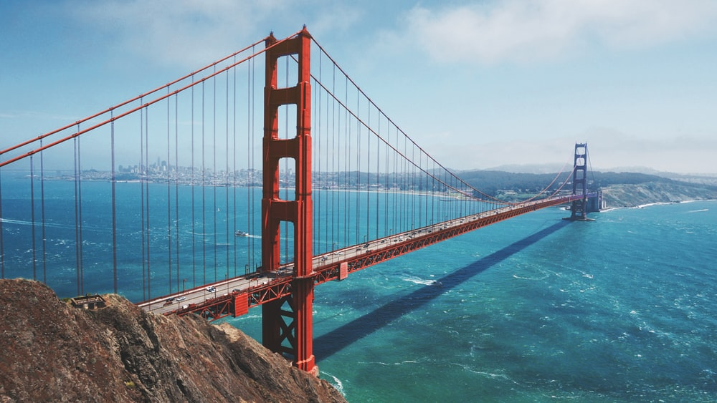
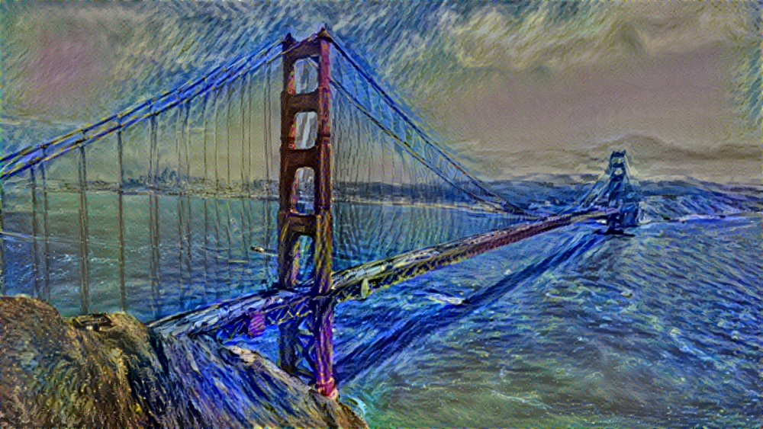
Objective
Content Image
Style Image
Design a real-time neural style transfer system which generates a stylized image from a content image and style image.
Generated Image
Notes:
Let’s discuss what is Neural Style Transfer? Let's say you take this image,
this is actually the picture of Golden Gate Bridge in San Francisco and you want
this picture recreated in the style of this image on the left.
This is actually Van Gogh's, Starry Night painting.
What Neural Style Transfer allows you to do is generate a
new image like the one below which is a picture of
the Golden Gate Bridge that is
painted but drawn in the style of this image. I'm going to use C to denote the content image,
S to denote the style image,
and G to denote the image you will generate.
So the objective of this research is to develop a real-time system that generates the stylized version of any photograph in the style of a famous painting.

Slide 3
Introduction
Style transfer is a computer vision technique that takes two images—a content image and a style reference image.
The two images are blended together so that the output image retains the core elements of the content image, but appears to be “painted” in the style of the style reference image.
Neural style transfer (NST) is a recent technique which employs Deep Neural Networks that extract statistical features of images related to content and style.
Convolutional Neural Networks (CNNs) are a class of Deep Neural Networks that have proven very effective in areas such as image recognition and classification.
Earlier versions of NST treated the task as an optimization problem, requiring hundreds or thousands of iterations to perform style transfer on a single image.
To tackle this inefficiency, fast style transfer also uses deep neural networks but trains a standalone model to transform any image in a single, feed-forward pass.
Notes:
Style transfer takes two images –content image and style image and blends them together so that the resulting image has the structural features of the content image but has textures of the style image. CNNs which are class of Deep Neural networks have proven to be very effective in the fields of object detection, image recognition and classification. CNN have shown to have the ability to separate content and style features of any image.

Slide 4
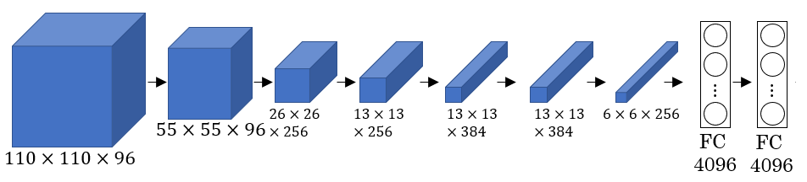
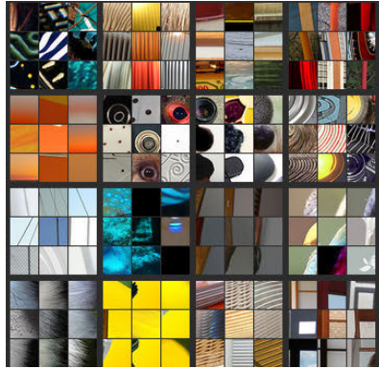
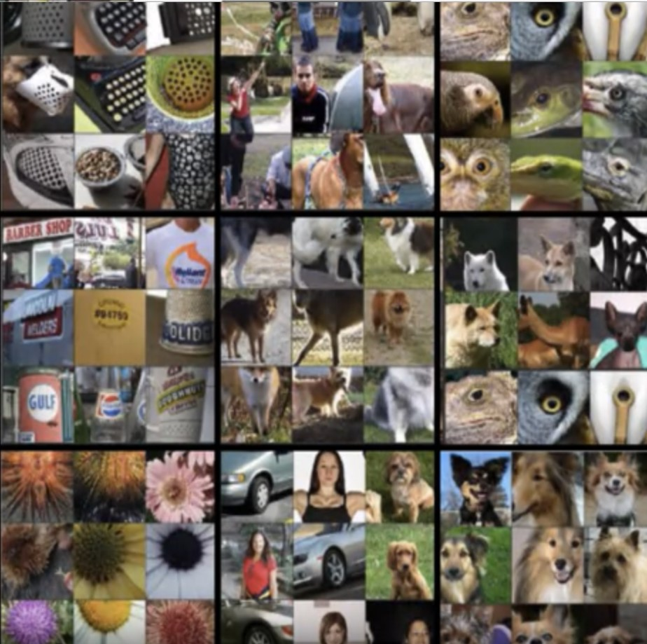
Algorithm
Alex-Net Architecture
Optimization Method
Representations of style and content of an image are separable in CNN.
Visualizing deep layers— Every hidden unit in the deep layers is activated by a certain pattern
These are the nine image patches that cause one hidden unit to be highly activated.
Layer 2
Layer 5
Notes:
In order to implement Neural Style Transfer,
we need to look at the features extracted by ConvNet at various layers,
the shallow and the deeper layers of a ConvNet.
Lets say that we have a pretrained ConvNet, Here we can see the alex-net architecture, It is a leading architecture for tasks like object detection.
Let’s say you want to visualize what the hidden units in different layers are computing.
So if you pick one hidden unit and find the nine input images that maximizes
that unit's activation, you might find nine image patches like this.
So looks like that in the lower region of an image that this particular hidden
unit sees, it's looking for an round shapes that looks like that.
So those are the nine image patches that maximally activate
one hidden unit's activation.
Now, you can then pick a different hidden unit in layer 2 and do the same thing.
So that's a different hidden unit, and looks like this second one,
represented by these 9 image patches here.
Looks like this hidden unit is looking for a line sort of in that portion of its
input region, we'll also call this receptive field.
And if you do this for other hidden units, you'll find other hidden units,
tend to activate in image patches that look like that.
And all of the examples I'm using in
this video come from this paper by Mathew Zeiler and
Rob Fergus, titled visualizing and understanding convolutional networks.
So this is interesting,
layer 2 looks it's detecting complex shapes and patterns.
So for example, this hidden unit looks like it's looking for
a vertical texture with lots of vertical lines.
This hidden unit looks like its highly activated when
there's a rounder shape to the left part of the image.
Here's one that is looking for very thin vertical lines and so on.
In layer 5 it is detecting even more sophisticated things.
So you'll notice there's also a neuron that seems to be a dog detector,
but set of dogs detecting here seems to be more varied.
And then this seems to be detecting keyboards and things with a keyboard
like texture, although maybe lots of dots against background.
I think this neuron here may be detecting text, it's always hard to be sure.
And then this one here is detecting flowers.
So we've gone a long way from detecting relatively simple things
such as edges in layer 2,
up to detecting very complex objects in the deeper layers.

Slide 5
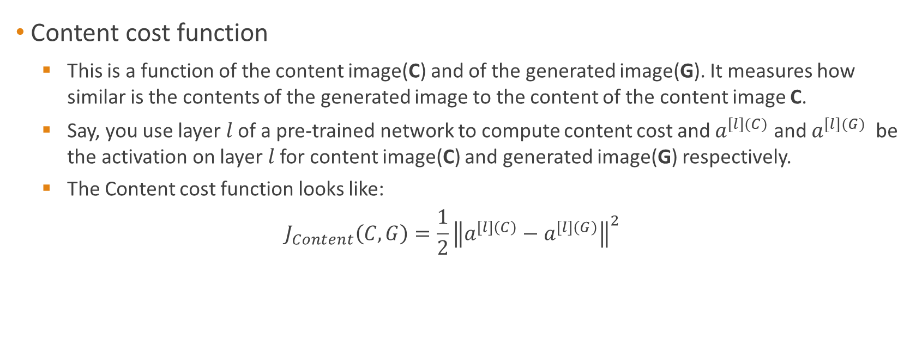
Optimization Method
Content cost function
This is a function of the content image(C) and of the generated image(G). It measures how similar is the contents of the generated image to the content of the content image C.
Say, you use layer $l$ of a pre-trained network to compute content cost and $a^{[l](C)}$ and $a^{[l](G)}$ be the activation on layer $l$ for content image(C) and generated image(G) respectively.
The Content cost function looks like:
$$J_{Content}\left(C,G\right)=\frac{1}{2}{\left\|a^{[l](C)}−a^{[l](G)}\right\|}^{2}$$
Notes:
To build a Neural Style Transfer system,
let's define a cost function for the generated image.
What you see later is that by minimizing this cost function,
you can generate the image that you want.
Remember what the problem formulation is.
You're given a content image C,
given a style image S and you goal is to generate a new image
G. In order to implement neural style transfer,
what you're going to do is define a cost function J of G that measures how good is
a particular generated image and we'll use gradient to
descent to minimize J of G in order to generate this image.
How good is a particular image?
Well, we're going to define two parts to this cost function.
The first part is called the content cost.
This is a function of the content image and of the generated image and
what it does is it measures how similar is the contents of the generated image
to the content of the content image C. And then going to
add that to a style cost function which is now a function of
S,G and what this does is it measures how similar is
the style of the image G to the style of the image S.
Let's say that you use hidden layer l to compute the content cost.
If l is a very small number, if you use hidden layer one,
then it will really force your generated image
to pixel values very similar to your content image.
Whereas, if you use a very deep layer,
then it's just asking, "Well,
if there is a dog in your content image,
then make sure there is a dog somewhere in your generated image. "
So in practice, layer l chosen somewhere in between.
It's neither too shallow nor too deep in the neural network.
And because you plan this yourself,
in the problem exercise that you did at the end of this week,
I'll leave you to gain some intuitions with
the concrete examples in the problem exercise as well.
But usually, I was chosen to be somewhere
in the middle of the layers of the neural network,
neither too shallow nor too deep.
What you can do is then use a pre-trained ConvNet,
maybe a VGG network,
or could be some other neural network as well.
And now, you want to measure,
given a content image and given a generated image,
how similar are they in content.
So let's let this
a_superscript_[l](c) and this be the activations of layer l on these two images,
on the images C and G. So,
if these two activations are similar,
then that would seem to imply that both images have similar content.
So, what we'll do is define
J_content(C,G) as just how
soon or how different are these two activations.
So, we'll take the element-wise difference between
these hidden unit activations in layer l,
between when you pass in the content image compared
to when you pass in the generated image,
and take that squared.
And you could have a normalization constant in front or not,
so it's just one of the two or something else.
It doesn't really matter since this can be adjusted as well by this hyperparameter alpha.
So, just be clear
on using this notation as if both of these have been unrolled into vectors,
so then, this becomes the square root of the l_2 norm between this and this,
after you've unrolled them both into vectors.
There's really just the element-wise sum of
squared differences between these two activation.
But it's really just the element-wise sum of
squares of differences between the activations in layer l,
between the images in C and G. And so,
when later you perform gradient descent on J_of_G to try to find a value of G,
so that the overall cost is low,
this will incentivize the algorithm to find an image G,
so that these hidden layer activations are similar to what you got for the content image.
So, that's how you define the content cost function for the neural style transfer.
Next, let's move on to the style cost function.

Slide 6
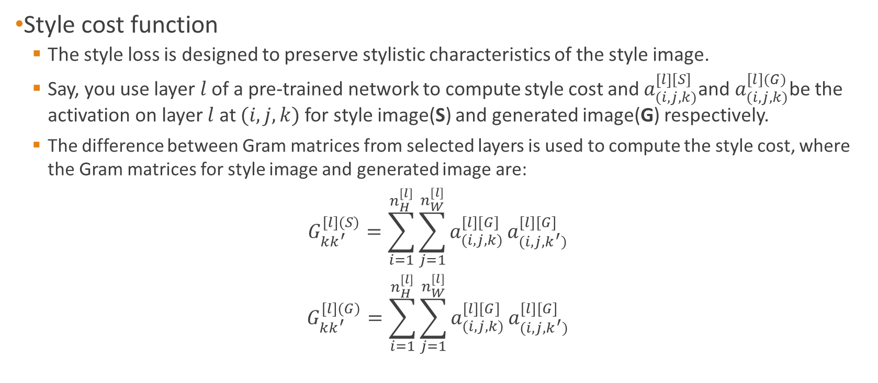
Optimization Method
Style cost function
The style loss is designed to preserve stylistic characteristics of the style image.
Say, you use layer $l$ of a pre-trained network to compute style cost and $a_{(i,j,k)}^{\left[l\right][S]}$and $a_{(i,j,k)}^{[l](G)}$be the activation on layer $l$ at $(i,j,k)$ for style image(S) and generated image(G) respectively.
The difference between Gram matrices from selected layers is used to compute the style cost, where the Gram matrices for style image and generated image are:
$$G_{kk^{′}}^{\left[l\right](S)}=\sum_{i=1}^{n_{H}^{[l]}}{\sum_{j=1}^{n_{W}^{[l]}}{a_{(i,j,k)}^{\left[l\right][G]}}}a_{(i,j,k^{′})}^{\left[l\right][G]}$$
$$G_{kk^{′}}^{\left[l\right](G)}=\sum_{i=1}^{n_{H}^{[l]}}{\sum_{j=1}^{n_{W}^{[l]}}{a_{(i,j,k)}^{\left[l\right][G]}}}a_{(i,j,k^{′})}^{\left[l\right][G]}$$
Notes:
And let's say you've chosen some layer L,
maybe that layer to define the measure of the style of an image.
What we need to do is define the style as the correlation between
activations across different channels in this layer L activation.
So what you can to do is given an image computes something called a style matrix,
which will measure all those correlations we talks about on the last slide.
So, more formally, let's let a superscript l, subscript i,
j,k denote the activation at position i,j,k in
hidden layer l. So i indexes into the height,
j indexes into the width,
and k indexes across the different channels.
So, in the previous slide,
we had five channels that k will index across those five channels.
So what the style matrix will do is you're going to compute a matrix clauses
G superscript square bracketed l. This is going to be an nc by nc dimensional matrix,
so it'd be a square matrix.
Remember you have nc channels and so you have an
nc by nc dimensional matrix in order to measure how correlated each pair of them is.
So particular G, l, k,
k prime will measure how correlated are the activations in
channel k compared to the activations in channel k prime.
Well here, k and k prime will range from 1 through nc,
the number of channels they're all up in that layer.
So more formally, the way you compute G,
l and I'm just going to write down the formula for computing one elements.
So the k, k prime elements of this.
This is going to be sum of a i,
sum of a j,
of deactivation and that layer i, j,
k times the activation at i, j, k prime.
So, here, remember i and j index across to a different positions in the block,
indexes over the height and width.
So i is the sum from one to nh and j is a sum from one to nw
and k here and k prime index over the channel so
k and k prime range from one to
the total number of channels in that layer of the neural network.
So all this is doing
is summing over the different positions that the image over the height and width and just
multiplying the activations together of
the channels k and k prime and that's the definition of G,k,k prime.
And you do this for every value of k and k prime to compute this matrix G,
also called the style matrix.
And so notice that if both of these activations tend to be lashed together,
then G, k, k prime will be large,
whereas if they are uncorrelated then g,k,
k prime might be small.
And technically, I've been using
the term correlation to convey intuition but this is actually
the unnormalized cross of the areas because we're not
subtracting out the mean and this is just multiplied by these elements directly.
So this is how you compute the style of an image.
And you'd actually do this for both the style image s,n for
the generated image G. So just to distinguish that this is the style image,
maybe let me add a round bracket S there,
just to denote that this is the style image for the image
S and those are the activations on the image
S. And what you do is then compute the same thing for the generated image.
So it's really the same thing summarized sum of a j, a, i,
j, k, l, a,
i, j,k,l and the summation indices are the same.
Let's follow this and you want to just denote this is for the generated image,
I'll just put the round brackets G there.
So, now, you have two matrices they capture what is the style with
the image s and what is the style of the image G. And,
by the way, we've been using the alphabet capital G to denote these matrices.
In linear algebra, these are also called the
grand matrix of these in called grand matrices but in this video,
I'm just going to use the term style matrix because this term grand
matrix that most of these using capital G to denote these matrices.
Finally, the cost function,
the style cost function.
If you're doing this on layer l between s and G,
you can now define that to be
just the difference
between these two matrices,
G l, G square and these are matrices.
So just take it from the previous one.
This is just the sum of squares of the element wise differences between
these two matrices and just divides this out this is going to be sum over k,
sum over k prime of these differences of s, k,
k prime minus G l,
G, k, k prime and then the sum of square of the elements.
The authors actually used this for the normalization constants two times of nh,
nw, in that layer,
nc in that layer and I'll square this and you can put this up here as well.
But a normalization constant doesn't matter that much because this
causes multiplied by some hyperparameter b anyway.
So just to finish up,
this is the style cost function defined
using layer l and as you saw on the previous slide,
this is basically the Frobenius norm between the two star matrices computed on
the image s and on the image G
Frobenius on squared and never by the just low normalization constants,
which isn't that important.
And, finally, it turns out that you get more visually pleasing results if you
use the style cost function from multiple different layers.
So, the overall style cost function,
you can define as sum over
all the different layers of the style cost function for that layer.
We should define the book weighted by some set of parameters,
by some set of additional hyperparameters,
which we'll denote as lambda l here.
So what it does is allows you to use different layers in a neural network.
Well of the early ones,
which measure relatively simpler low level features
like edges as well as some later layers,
which measure high level features and cause a neural network to take
both low level and high level correlations into account when computing style.
And, in the following exercise,
you gain more intuition about what might be
reasonable choices for this type of parameter lambda as well.
And so just to wrap this up,
you can now define the overall cost function
as alpha times the content cost between c and G plus
beta times the style cost between s and G and then just create in the sense
or a more sophisticated optimization algorithm if you want
in order to try to find an image G that normalize,
that tries to minimize this cost function j of G.

Slide 7
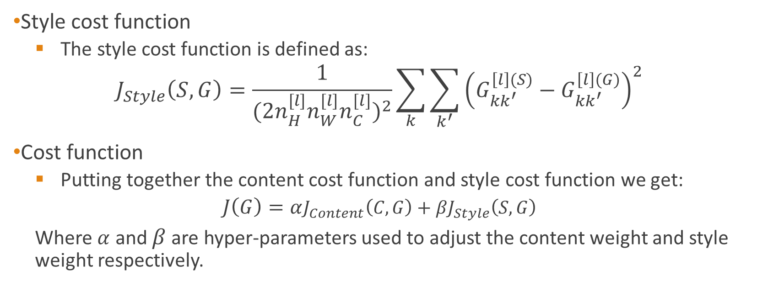
Optimization Method
Style cost function
The style cost function is defined as:
$$J_{Style}\left(S,G\right)=\frac{1}{{(2n_{H}^{[l]}n_{W}^{[l]}n_{C}^{[l]})}^{2}}\sum_{k}{\sum_{k^{′}}{{\left(G_{kk^{′}}^{\left[l\right](S)}−G_{kk^{′}}^{\left[l\right](G)}\right)}^{2}}}$$
Cost function
Putting together the content cost function and style cost function we get:
$$J\left(G\right)=αJ_{Content}\left(C,G\right)+βJ_{Style}\left(S,G\right)$$
Where $α$ and $β$ are hyper-parameters used to adjust the content weight and style weight respectively.
Notes:
The way the algorithm would run is as follows,
having to find the cost function J of G in
order to actually generate a new image what you do is the following.
You would initialize the generated image
G randomly so it might be 100 by 100 by 3 or 500 by 500 by
3 or whatever dimension you want it to be.
Then we'll define the cost function J of G on the previous slide.
What you can do is use gradient descent to minimize this so you can update G as
G minus the derivative respect to the cost function of J of G. In this process,
you're actually updating the pixel values of this image G which is
a 100 by 100 by 3 maybe rgb channel image.
Here's an example, let's say you start with this content image and this style image.
This is a another probably Picasso image.
Then when you initialize G randomly,
you're initial randomly generated image is
just this white noise image with each pixel value chosen at random.
As you run gradient descent,
you minimize the cost function J of G slowly through the pixel value so then you get
slowly an image that looks more and more like
your content image rendered in the style of your style image.
In this video, you saw the overall outline of
the Neural Style Transfer Algorithm where you define
a cost function for the generated image G and minimize it.

Slide 8
Feed-forward Method
The optimization method proves to be inefficient as it takes thousands of iterations to generate the output image.
The idea of this method is that we train the network to learn a style reference image so well that it can generate the stylized version of any content image instantly.
Feedforward transformation networks are trained for converting any given image to the stylized version of the reference image.
Feedforward transformation networks are trained for style transfer, but rather than using per-pixel loss functions depending only on low-level pixel information, the networks are trained using perceptual loss functions that depend on high-level features from a pretrained loss network.
Notes:
The optimization method which is the original algorithm takes hundreds and thousands of iterations and proves to be inefficient. The feedforward method improves the testing time drastically as it generates the output image in a single pass. In this method image transformation networks are trained to convert any given image into the stylized image within seconds.

Slide 9
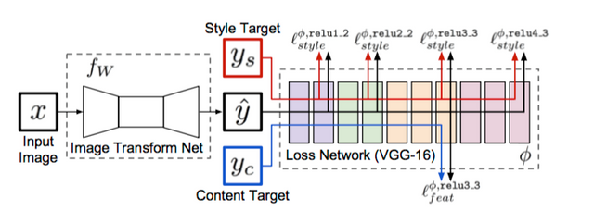
Feedforward method
Image Transformation Network converts input image x into a possible stylized image $\hat{y}$
Image Transformation Network converts input image x into a possible stylized image 𝑦 ̂
Stylized image $\hat{y}$, Style image $y_{S}$, Content image $y_{C}$ are passed through the loss network
Stylized image 𝑦 ̂, Style image 𝑦_𝑆, Content image 𝑦_𝐶 are passed through the loss network
Content cost and Style cost is calculated using $y_{S}$,$y_{C }$and $y$
Content cost and Style cost is calculated using 𝑦_𝑆,𝑦_(𝐶 )and 𝑦
To reduce the cost, the parameters are backpropagated to the transformation network

Slide 10
Feed-forward Method
An untrained Image Transformation Network transforms the content image into its best guess at an appealing stylized version.
We then use this as the stylized image which, along with the content and style images, is passed through the pretrained image classification network (now called the Loss Network) to compute our content and style losses.
Finally, to minimize the loss, we backpropagate into the parameters of the Image Transformation Network, not directly into the pastiche image.
We do this with a ton of random content image examples, thereby training the Image Transformation Network to transform any given picture into the style of some predefined artwork.

Slide 11
Applications
Photo and Video Editors: Style transfer models can easily be embedded on mobile phones—allowing for applications that can process and transform images and video in real-time.
Commercial Art: Style transfer can be used to create reproducible, high-quality prints for oﬃce buildings, or for large-scale advertising campaigns.
Gaming: Stadia by Google is video game streaming service and one of the primary features included in that demo was an in-game style transfer feature that automatically recomposes the virtual world with textures and color palettes from a potentially limitless range of art styles.
Virtual Reality: Style transfer has the potential to radically alter the ways VR developers tell visual stories through their applications, games, ﬁlms, and more

Slide 12
Advantages/Disadvantages
Optimization Method
Feedforward method
Output is generated after forward propagation and backpropagation through a CNN.
A single pretrained network can be used for various style reference images.
The time taken to train the network is less.
It takes more time in the testing stage when the image is passed though the network.
Finer details of the stylized image are not maintained.
Output is generated through a feedforward network in a single pass.
There is a different model for every style reference image
It takes more time to train the network for a single style image.
The time taken in the testing stage is reduced drastically because image is generated in a single pass.
Finer details and edges are maintained in the stylized image

Slide 13
Future Enhancements
One clear area of improvement is making the algorithm robust to a greater range of style and content images.
This can be done by deﬁning regions of the style image with a richer selection of style and also having a better segmentation process or removing the need for a mask in the algorithm.
Another area of improvement is combining multiple styles from diﬀerent images to stylize an image.
Conclusion
In this project we have seen the beneﬁts of feed-forward image transformation tasks and optimization-based methods for image generation by training feed-forward transformation networks with perceptual loss functions.
We have applied this method to style transfer where we achieve comparable performance and drastically improved speed compared to existing methods and training with a perceptual loss allows the model to better reconstruct ﬁne details and edges.
Also it can be concluded that, what constitutes a successful style transfer is not deﬁnitive
Notes:
There is a lot of scope to the field of style transfer and one clear area of improvement is making the system more robust to a greater range of style and content images. The system usually tends to distort human faces in content images. Also styles from multiple images can be used to render a content image. These are some of the improvements possible in the future. To conclude, through this project we were able to implement fats style transfer and compare the original optimization algorithm with the feed-forward algorithm. The feed-forward algorithm gave comparable results to the original algorithm and reduced the testing time drastically. However since art is subjective, we cannot constitute which one of the two algorithms gives more appealing results.

Slide 14
References
Gatys, Leon A., Ecker, Alexander S., and Bethge, Matthias. A neural algorithm of artistic style. CoRR, abs/1508.06576, 2015b.
I. J. Goodfellow, J. Pouget-Abadie, M. Mirza, B. Xu, D. Warde-Farley, S. Ozair, A. C. Courville, and Y. Bengio. Generative adversarial nets. In Advances in Neural Information Processing Systems (NIPS), pages 2672–2680, 2014.
J. Johnson, A. Alahi, and L. Fei-Fei. Perceptual losses for real-time style transfer and super-resolution. In Computer Vision - ECCV 2016 - 14th European Conference, Amsterdam, The Netherlands, October 11-14, 2016, Proceedings, Part II, pages 694–711, 2016.
A. Radford, L. Metz, and S. Chintala. Unsupervised representation learning with deep convolutional generative adversarial networks. CoRR, abs/1511.06434, 2015.
D. Ulyanov, V. Lebedev, A. Vedaldi, and V. S. Lempitsky. Texture networks: Feed-forward synthesis of textures and stylized images. In Proceedings of the 33nd International Conference on Machine Learning, ICML 2016, New York City, NY, USA, June 19-24, 2016, pages 1349–1357, 2016.

Slide 15
Thank You.
-ISHA JOSHI
ROLl no:31338

