Slide 1
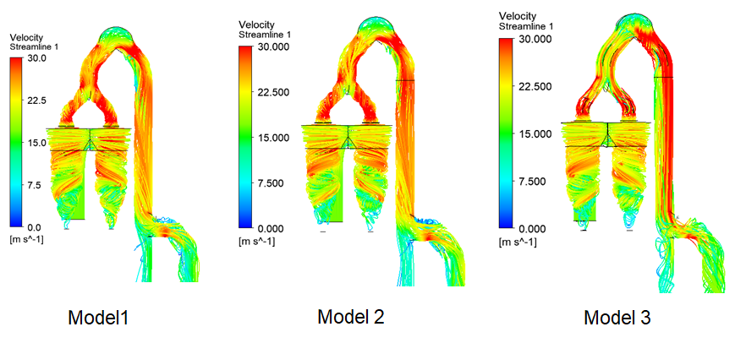
Cyclone
location | Pressure (Pa) |  |  | Pressure Drop across | Pressure drop (Pa)
 | Model 1 | Model 2 | Model 3 |  | Model 1 | Model 2 | Model 3
Point 1 | -8832 | -8876 | -8772 | Point 1 to Outlet | 1033 | 989 | 1093
Outlet | -9865 | -9865 | -9865
A CFD study was carried out to find out the cause of blockage and suggest preventive measures

Slide 2
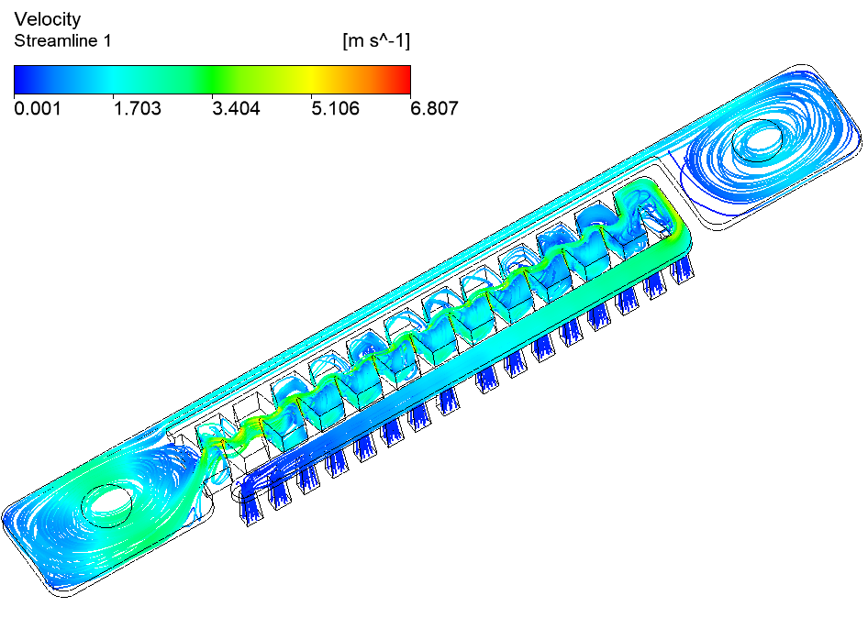
Water Dripper
 | Pressure (kg/cm²) | Pressure Drop (Kg/cm²)
Inlet | 1 | 1.145
Outlet | -0.145
A CFD simulation was carried out to study the flow pattern and find out the flow rate distribution at two outlets for various deigns
Flowrate=1.712Lph
Flowrate=2.287 Lph
 | Mass flow rate (Lph) | % Mass flow rate
Outlet 1 | 2.287 | 57%
Outlet 2 | 1.712 | 43%
Outlet at Top
Outlet at Top

Slide 3
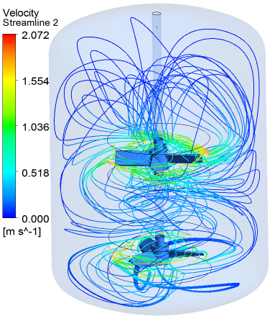
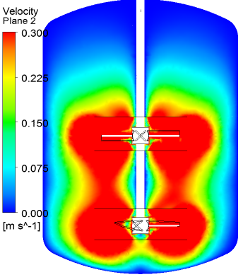
Mixer
A CFD simulation was carried out to study the flow pattern in a mixer and study the effect of the design of agitator blades

Slide 4
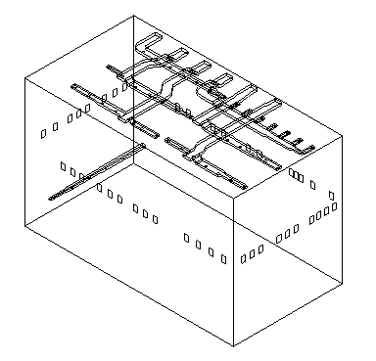
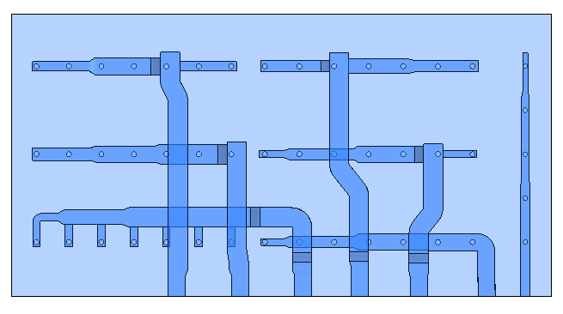
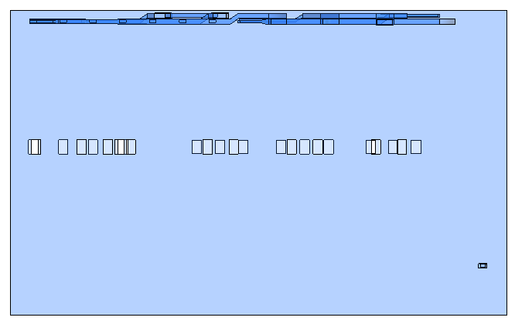
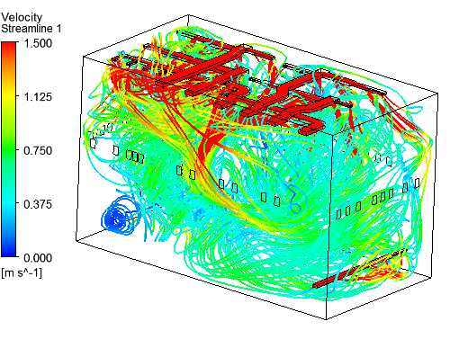
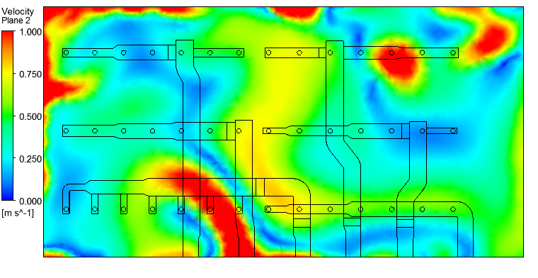
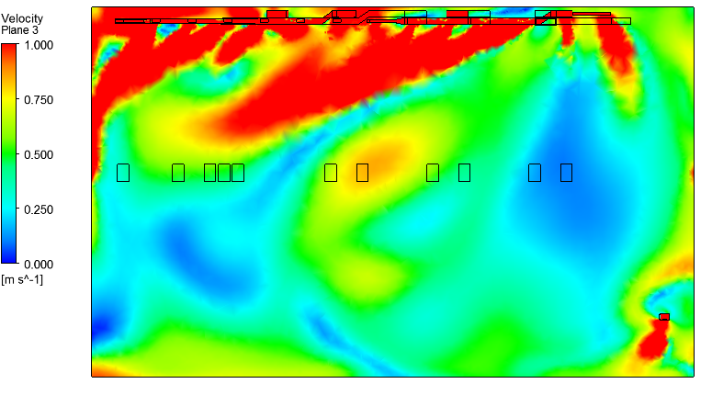
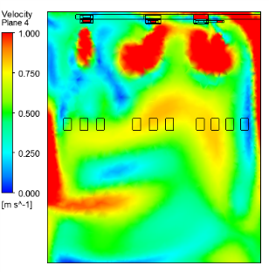
Warehouse
A CFD simulation was carried out to study the flow pattern in a warehouse and suggest design modifications for uniform flow distribution

Slide 5
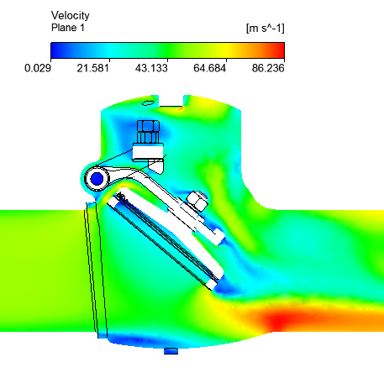
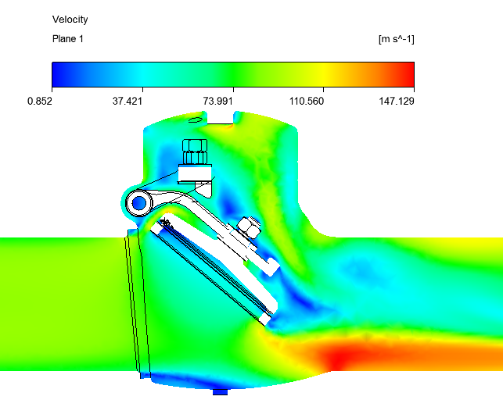
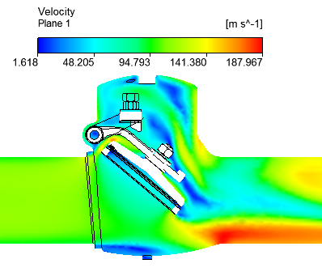
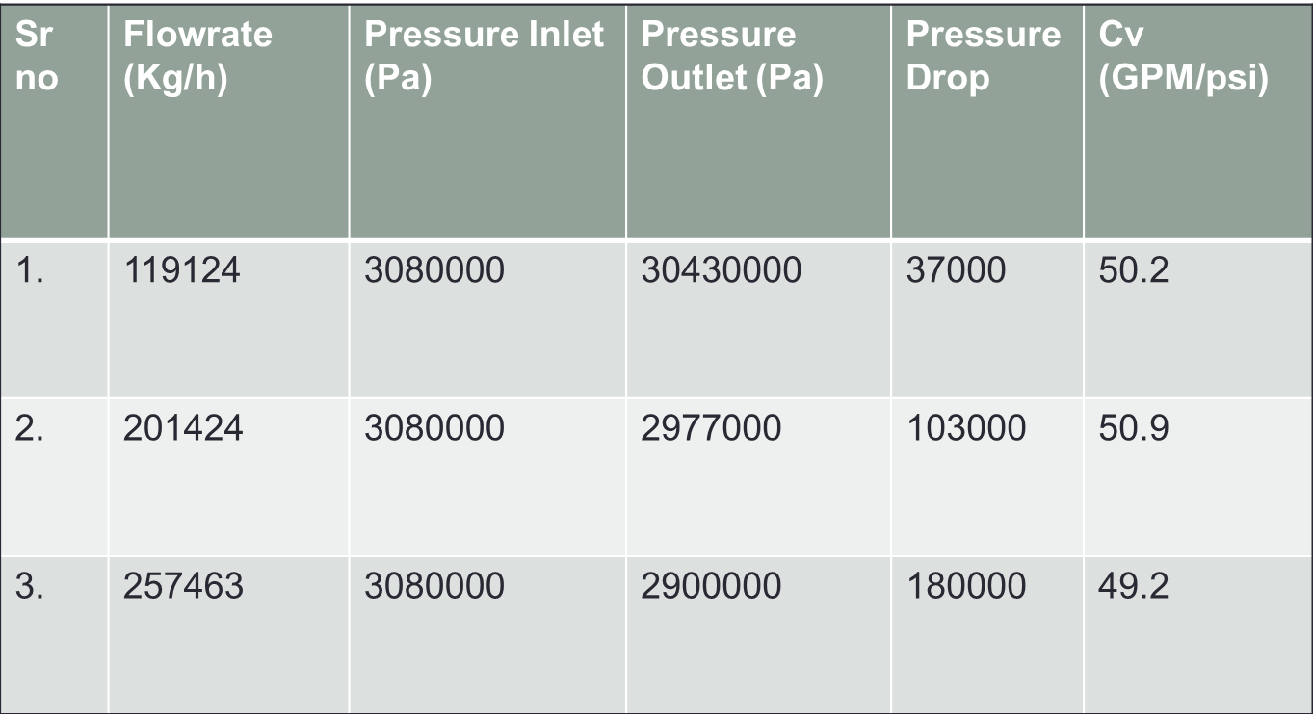
Swing Check valve
A CFD simulation was carried out to study the flow pattern in a swing check valve and find out the Cv for three different valves.

