Slide 1


Slide 2
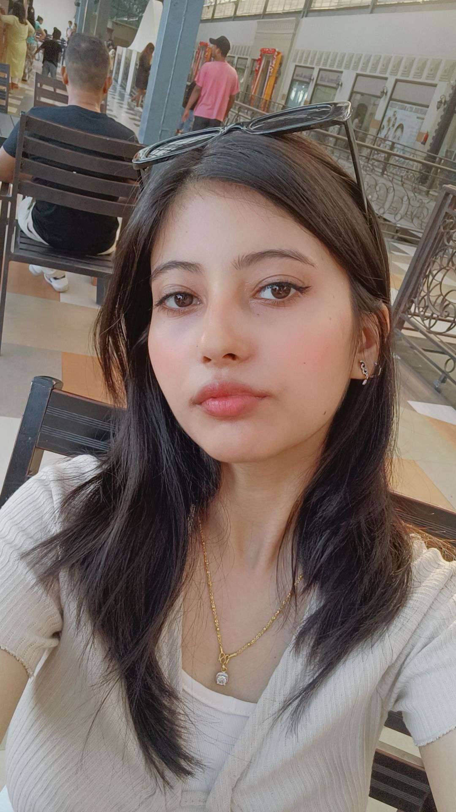
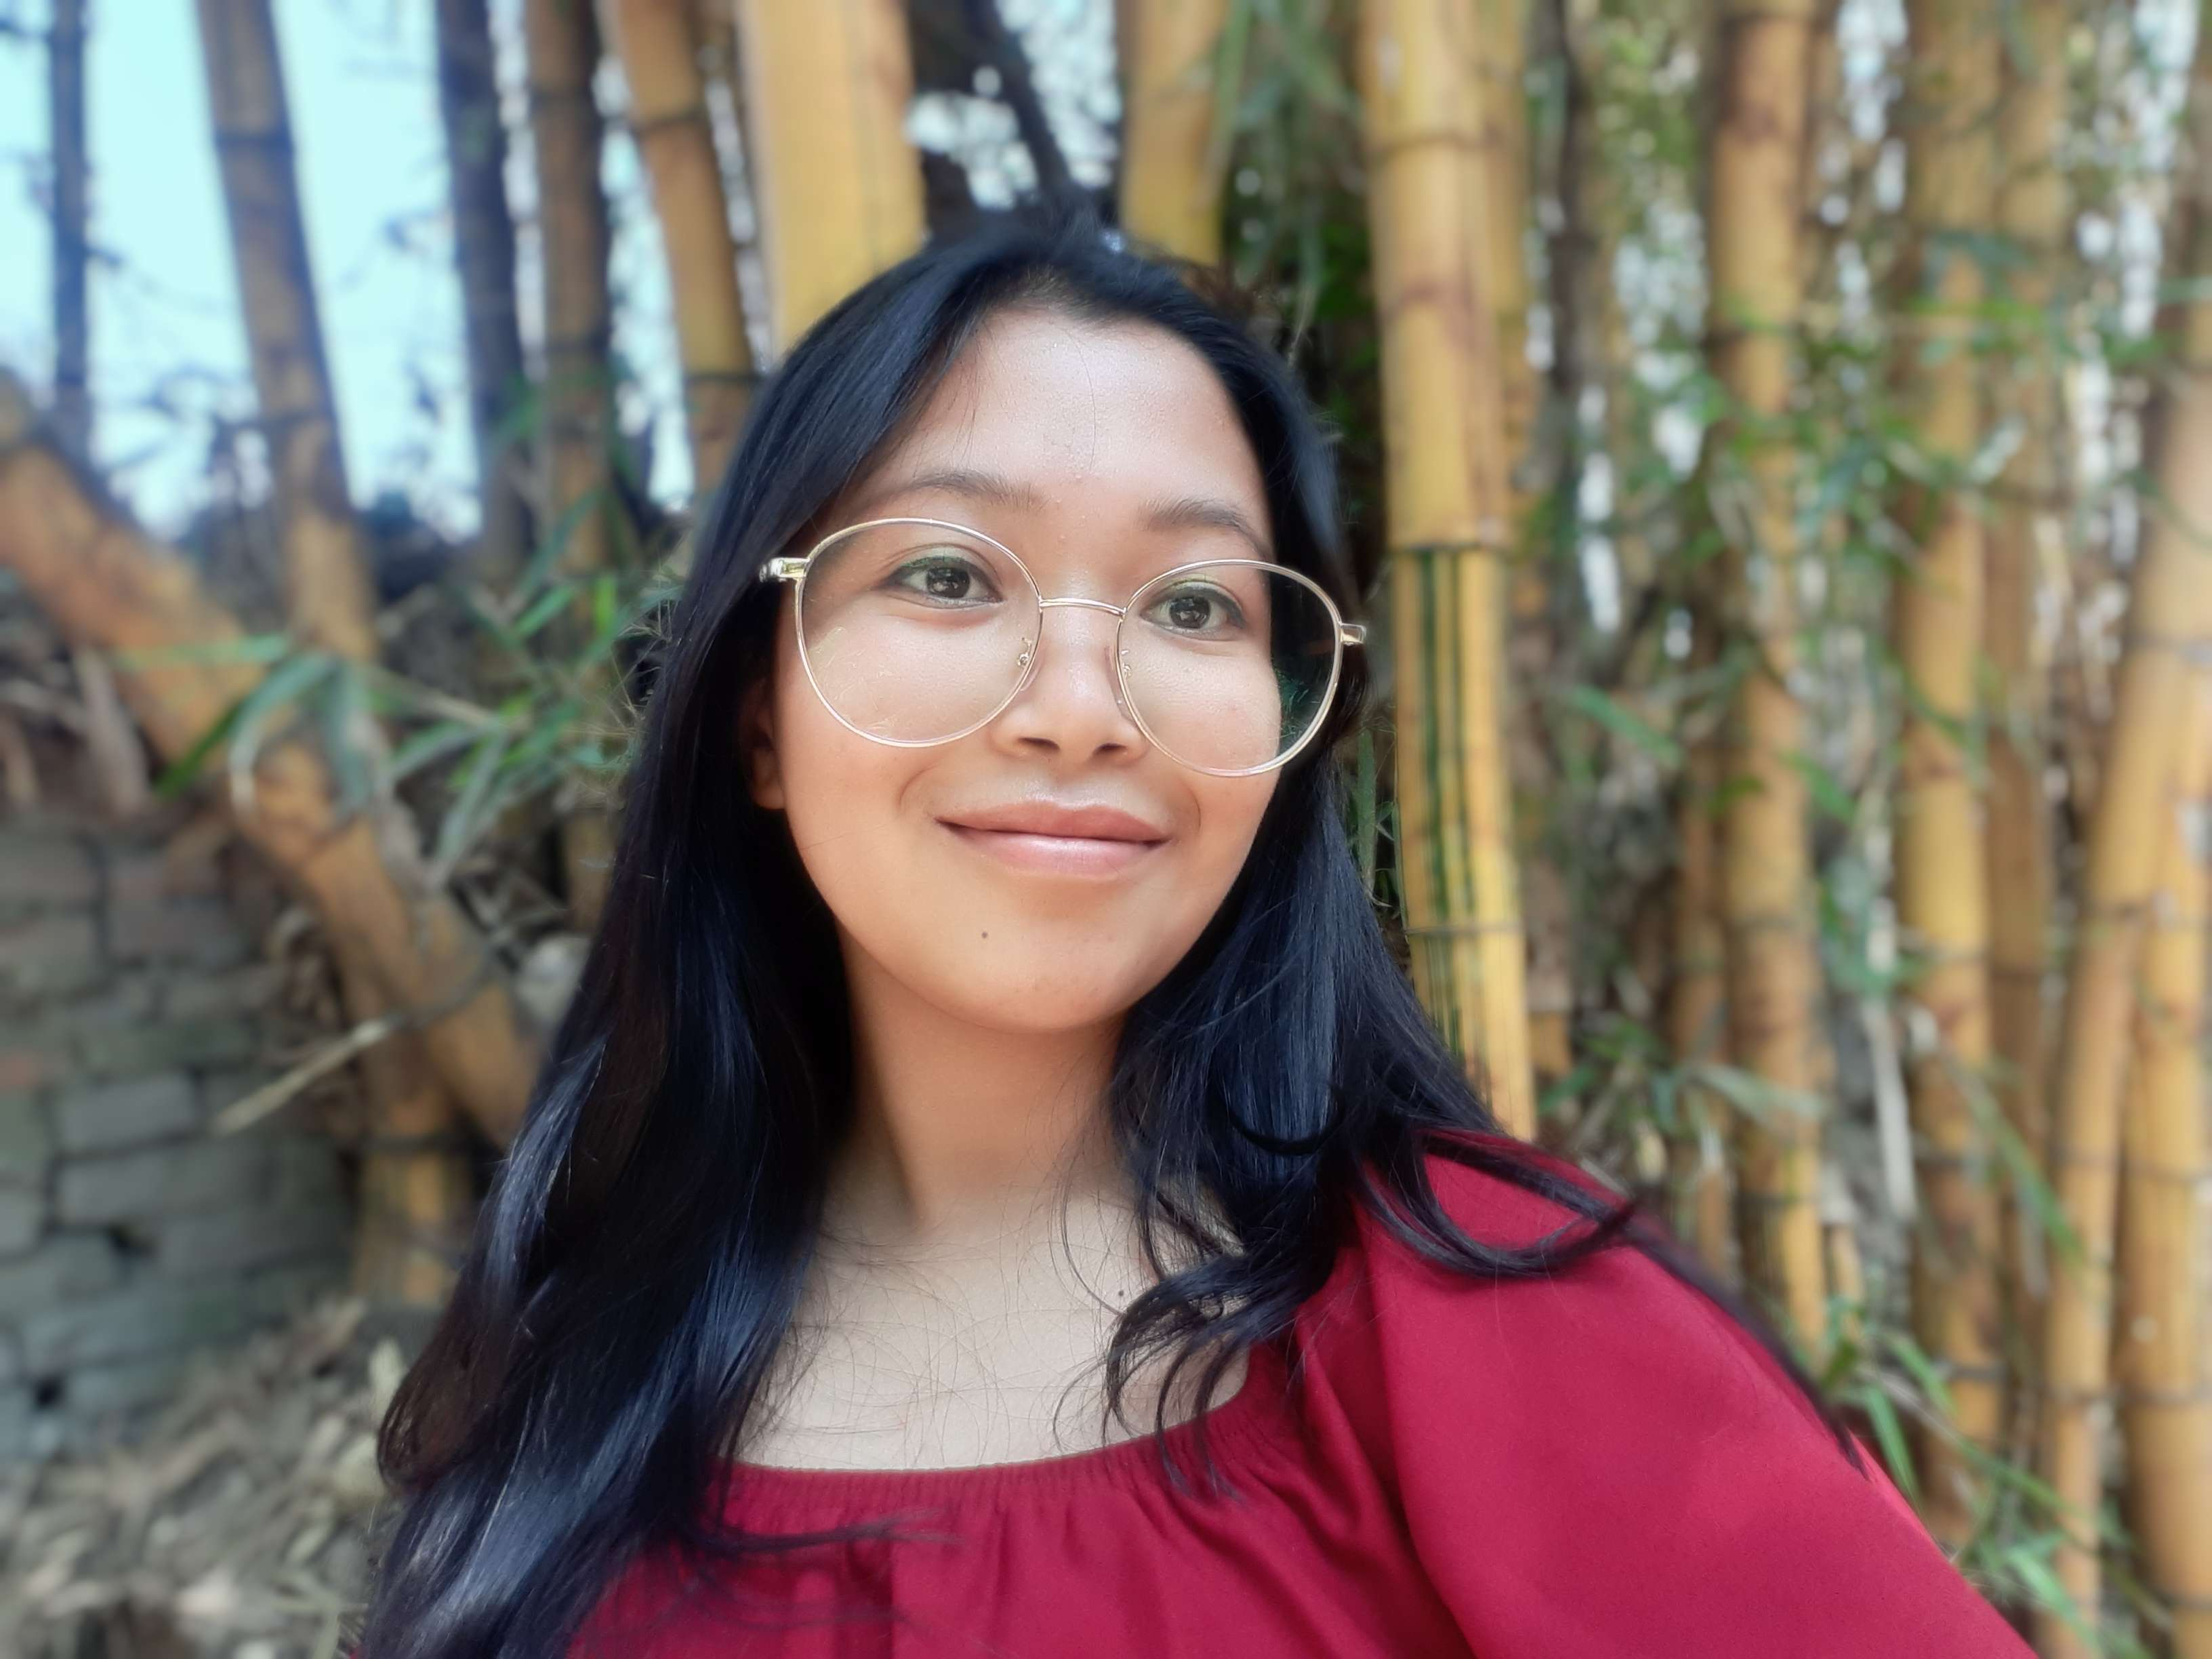
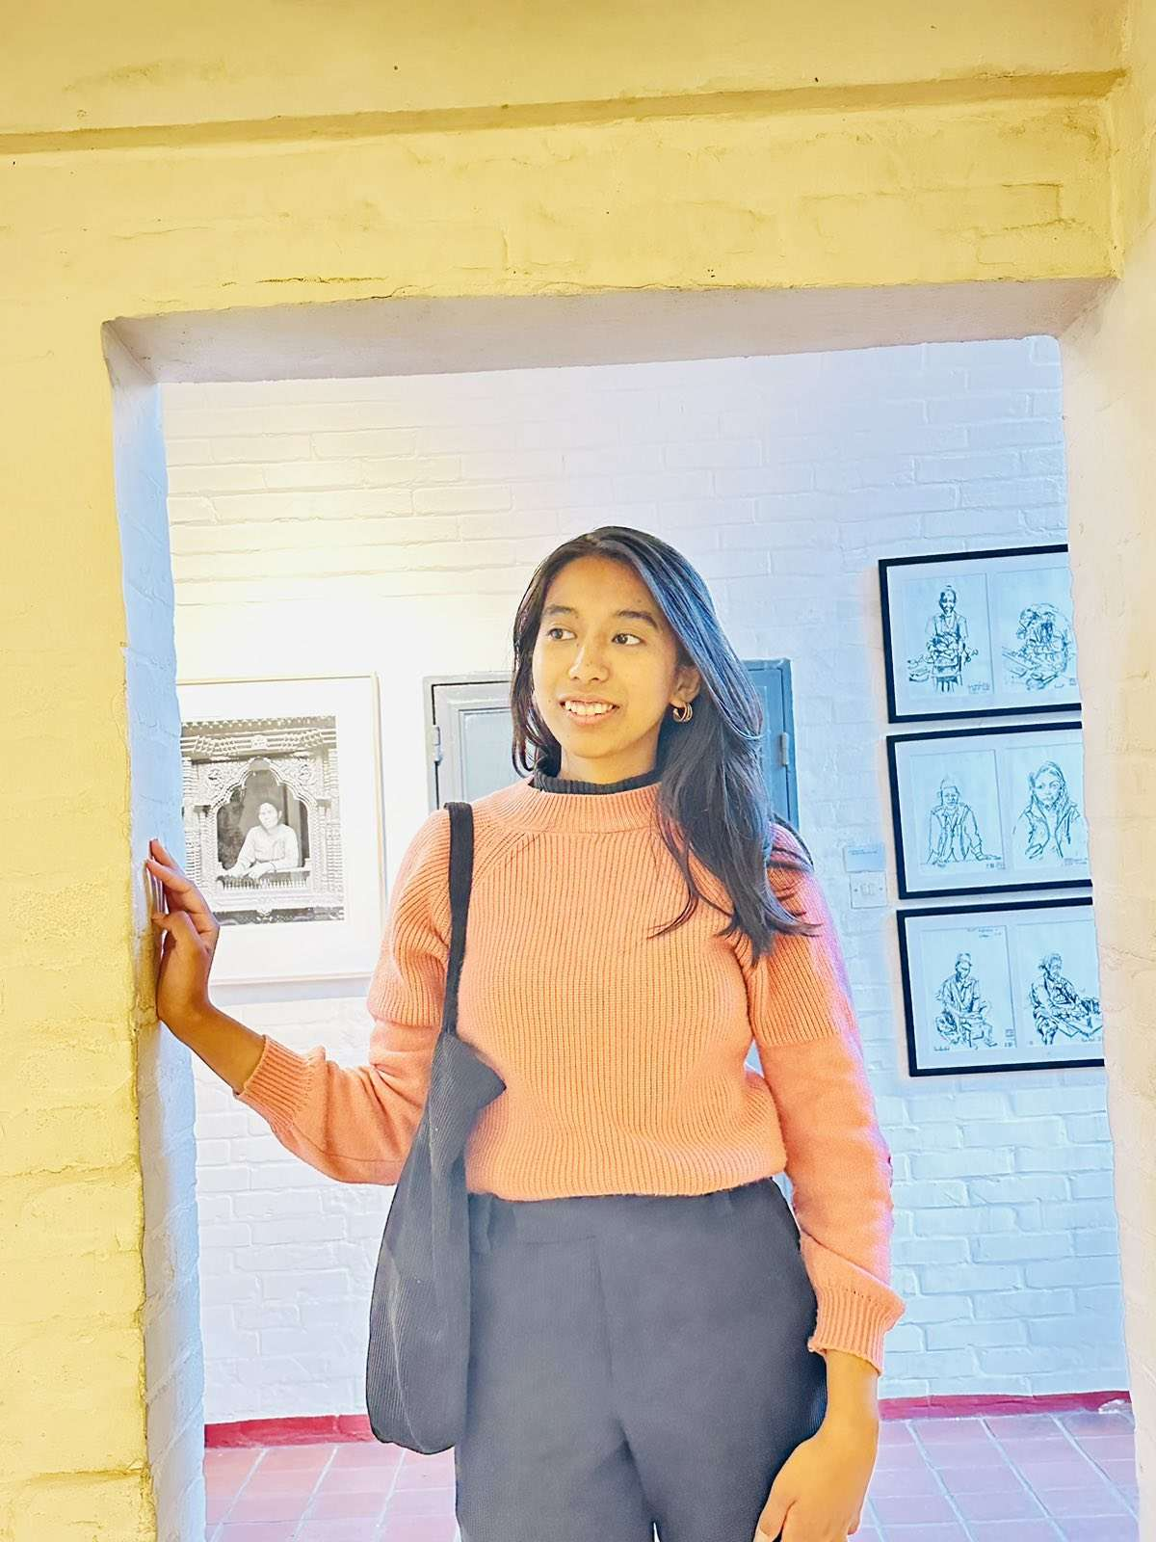
Who are we?
We are The Visions, a team with a commitment to empower women and foster connections.
Our mission: Bridging the gap between women and impactful employment.
Isha BhattaraiI
Jenisha Shrestha
Jeeni Shrestha

Slide 3
The Problem
Despite possessing unique ideas and entrepreneurial ambitions, women are still confined to traditional roles and bound by so called ‘societal norms ’. Because there are many limitations imposed on them, the skills they have remain unutilized or the skills they want to have remain unreachable. Though some may go against these societal norms, they face unconscious bias and unequal pay.

Slide 4
Nepalese women population who are not working for pay

Slide 5
Plans to implement the solution
USER PROFILE
GEOLOGICAL MAPPING
Allows the user to choose their desired work location
COMPANY PROFILE
Company can create their profile to provide info about the workplace
Users can create their profile showcasing their skills

Slide 6
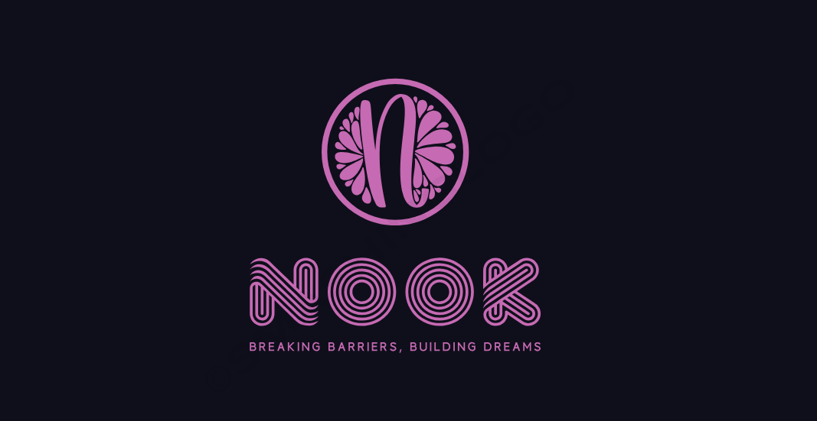

Slide 7

About our app
A digital platform which focuses on empowering women by providing them with opportunities to showcase their skills and connecting them to those that are seeking those skills. Our mission is to bridge the gap between women and impactful employment.
NOOK
“Breaking Barriers , Building Dreams”

Slide 8
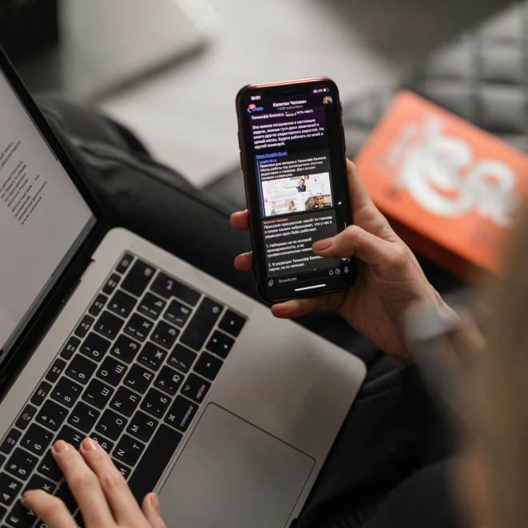

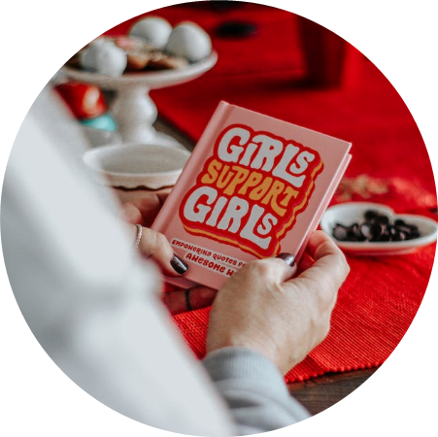
Features of Nook
User and Company profiles
Geolocation Matching
Networking
Provides tools that allows to create detailed profiles showcasing their skills, education and work experiences
The platform utilizes advanced geolocation technology to match these preferences with potential employers in the specified areas
Facilitates connections between women to build a supportive community and exchange knowledge.

Slide 9

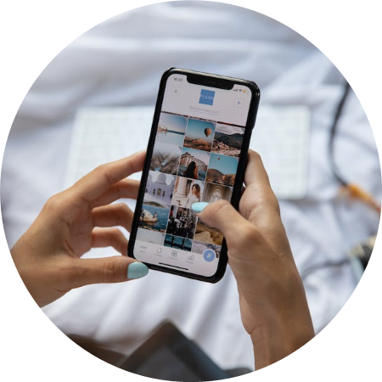

Features of Nook
Skill Development
Empowerment Resources
Chatbot
Provides tools and courses to help women enhance their skills and pursue their ambitions.
Access to educational, financial, and health resources tailored to the needs of women.
Helps the women connect in the app in their native language

Slide 10
Marketing Strategy:
Partnerships with women focused NGOs
Conducting orientation programs
Social Media
Low subscription price
Partnerships with other companies
Target Audience
Women seeking career opportunities
Entrepreneurs
Organizations promoting women empowerment

Slide 11
Monetary value :
Subscription fees and paid features
Corporate partnerships and sponsorships
Advertisement revenue

Slide 12


Sustainable Development Goals
~Bridging gap between women and impactful employment

Slide 13
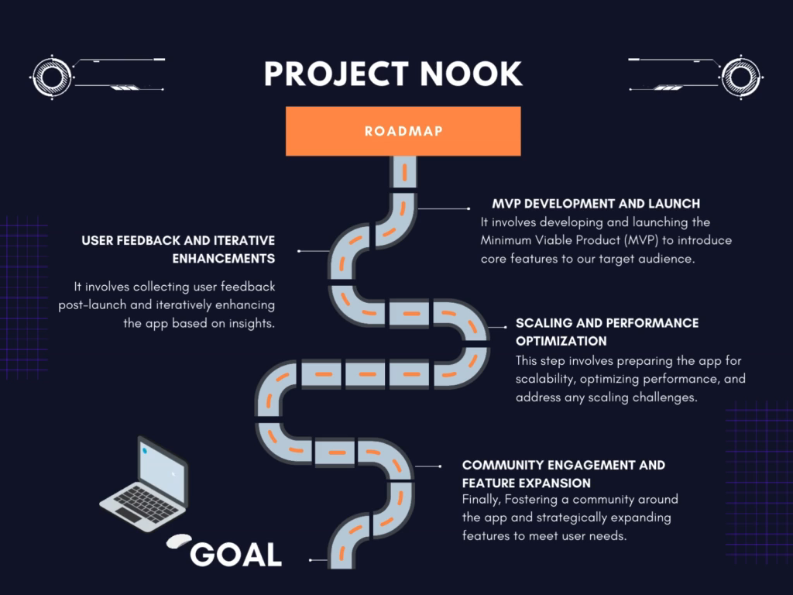
Notes:
To implement this project, firstly an MVP shall be developed and launched. User feedback will be taken into account and further scaling and performance optimizations will be done.

Slide 14
Notes:
Furthermore, the one million dollar shall be utitlized as per the stats represented by the chart shown.

Slide 15

~Bridging gap between women and impactful employment
Notes:
Nook shall act as a source of resilience and empowerment. Lets break the barriers and build dreams.

