Slide 1


NEXT HIKES IT SOLUTIONS_ Python - Powered GUI Calculator
The visually polished and functionally robust calculator application was developed that can perform arithmetic operations like addition, subtraction, multiplication, and division using Python’s Tkinter library for creating a graphical user interface (GUI).
Mr. Ishaan Sharma

Slide 2
Project Goals & Objectives
The goal of this project is to create a functional and user-friendly calculator using Python’s Tkinter library for the graphical user interface (GUI), and Handle mathematical expressions and operation efficiently.
A simple Python calculator using Tkinter.
This is a simple calculator built using python’s Tkinter library.
It can perform basic mathematical operations like addition, subtraction, multiplication, division .
Seamless execution of mathematical calculations ,yielding results(=), coupled with the ability to clear the equation display.
The user interface (GUI) is designed with button for each operation.
GUI CALCULATOR: IS A CALCULATOR THAT CAN BE USED BY CLICKING BUTTONS. IN THIS CALCULATOR, ALL ITS NUMBERS AND OPERATORS ARE REPRESENTED GRAPHICALLY AND CAN BE USED WITH ONE CLICK.
GUI : IS A VISUAL AND MORE EASY WAY TO INTERACT WITH THE COMPUTER.IT INCLUDES GRAPHICAL REPRESENTATION LIKEBUTTONS AND ICONS AND WE CAN INTERACT WITH THESE ICONS RATHER THAN TEXT BASED INTERACTION.
TKINTER : IS A LIBRARY WHICH PROVIDES GUI API TO WORK WITH AND MANAGE ALL ERRORS IN THE BACKGROUND.

Slide 3




_tools & Software Used in calculator_
Visual Studio Code: commonly referred to as VS Code is an integrated development environment developed by Microsoft for Windows, Linux, macOS and web browsers. Features include support for debugging,
syntax highlighting, intelligent code completion, snippets, code refactoring, and embedded
version control with Git. Users can change the theme, keyboard shortcuts, preferences,
and install extensions that add functionality.
Python: Python is a high-level, general-purpose programming language. Its design philosophy emphasizes code readability with the use of significant indentation. I gained experience with core Python programming constructs like functions, variables, control structures, and error handling.
Tkinter Library: Learned how to build a GUI using Tkinter, adding interactive buttons, entry fields, and event handling.
GitHub : Version-controlled the project and learned to manage code on GitHub.

Slide 4
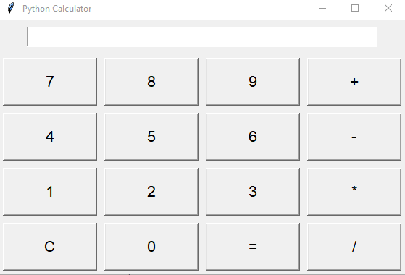
Design & Components of the calculator
Design
Equation Display Area (Screen): To show mathematical expressions and results.
Clickable Buttons: Representing numbers (0-9) and operators (+, -, *, ÷, etc.).
Result Calculation & Clear Functionality: Displaying results after calculations and providing a "Clear" button for resetting the screen.
Core Mathematical Operations: Addition, subtraction, multiplication, and division.
components
Display (Screen): An entry widget to show inputs and results.
Buttons: Created using Tkinter Button widget, each representing a number or operator.
Backspace and Clear Function: The calculator can remove the last character or reset the screen.
Output Field: Displays the result of the calculation.

Slide 5
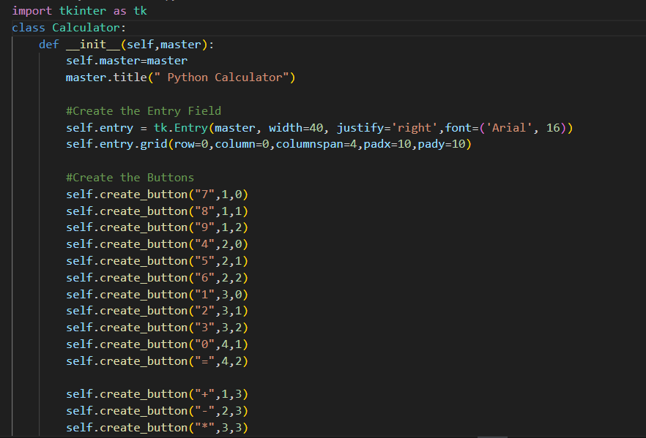
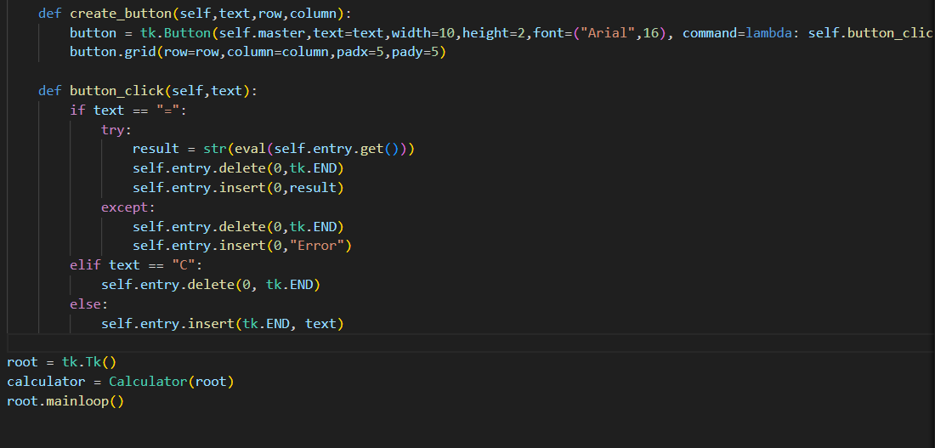
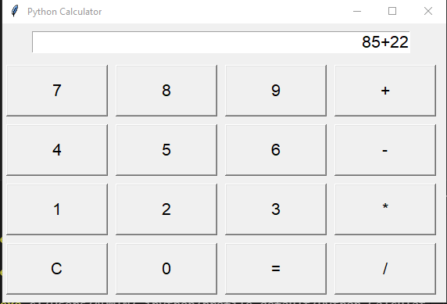
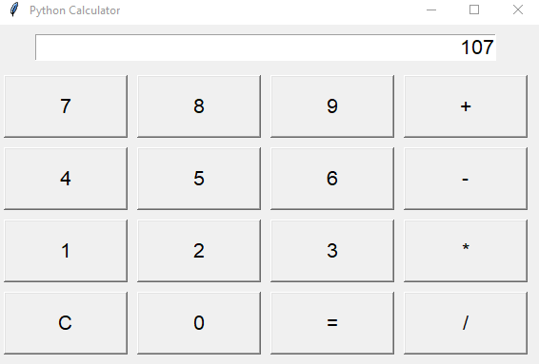
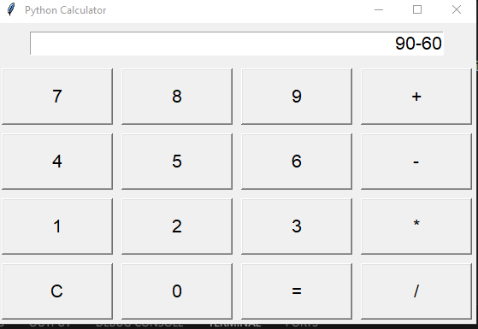
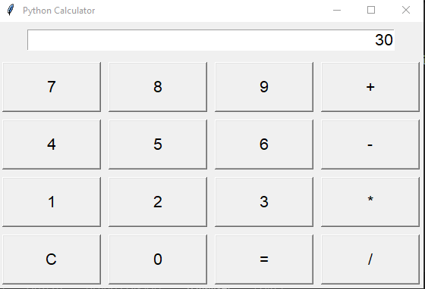
Code - buttons and GUI operation visual demo
Addition is done using GUI calci i.e 85+22=107
Subtraction is done using GUI calci i.e 90-60=30

Slide 6
Conclusion & Enhancements
CONCLUSION
The Simple Calculator built using Tkinter successfully meets its goal of providing a basic, interactive calculator for arithmetic operations. Key features include:
Arithmetic operations (addition, subtraction, multiplication, and division).
Error handling for invalid expressions (e.g., division by zero).
A simple, user-friendly graphical interface.
The project provided valuable experience in event-driven programming, GUI design with Tkinter, and basic Python error handling.
ENHANCEMENTS
Scientific Functions: Add support for advanced operations like square roots, trigonometry, and logarithms.
History Feature: Implement a history log to track past calculations.
Memory Functions: Introduce memory operations (e.g., store, recall, clear).
Improved Error Handling: Provide more specific error messages and input validation.
User Interface Improvements: Enhance the design with color schemes, responsive layout, and a more modern look.
Multi-Line Input: Support multi-line expressions and scrolling text areas.
Keyboard Shortcuts: Enable keyboard input for more efficient usage.
Mode Toggle: Add a switch between basic and scientific modes.
Cross-Platform Compatibility: Package the app for Windows, mac OS, and mobile devices.
These enhancements will improve the calculator’s functionality, usability, and overall user experience.

Slide 7
THANK YOU
I appreciate you talking the time to view this presentation and hope you enjoyed it.

