Slide 1
Customer Analysis
Data Insights Credit Card Program

Slide 2
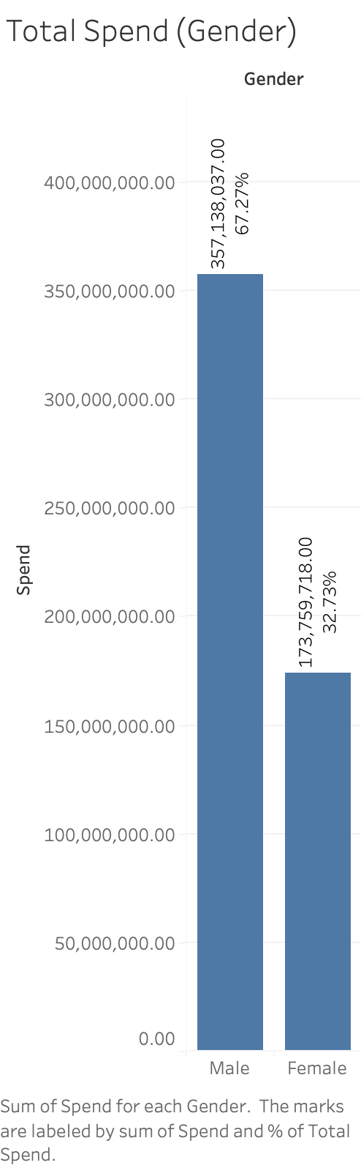
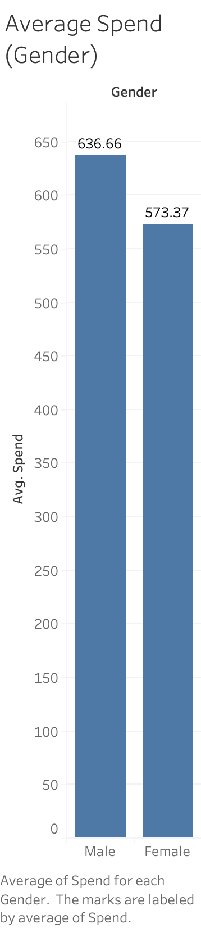
Male customers dominate spending, accounting for 67%, while female customers represent 33% of the expenditure.
In terms of customer demographics, 65% identify as male, and 35% as female.
Overall spending aligns with the gender distribution within the customer base.
On average, spending by men surpasses that of women by 11%.

Slide 3
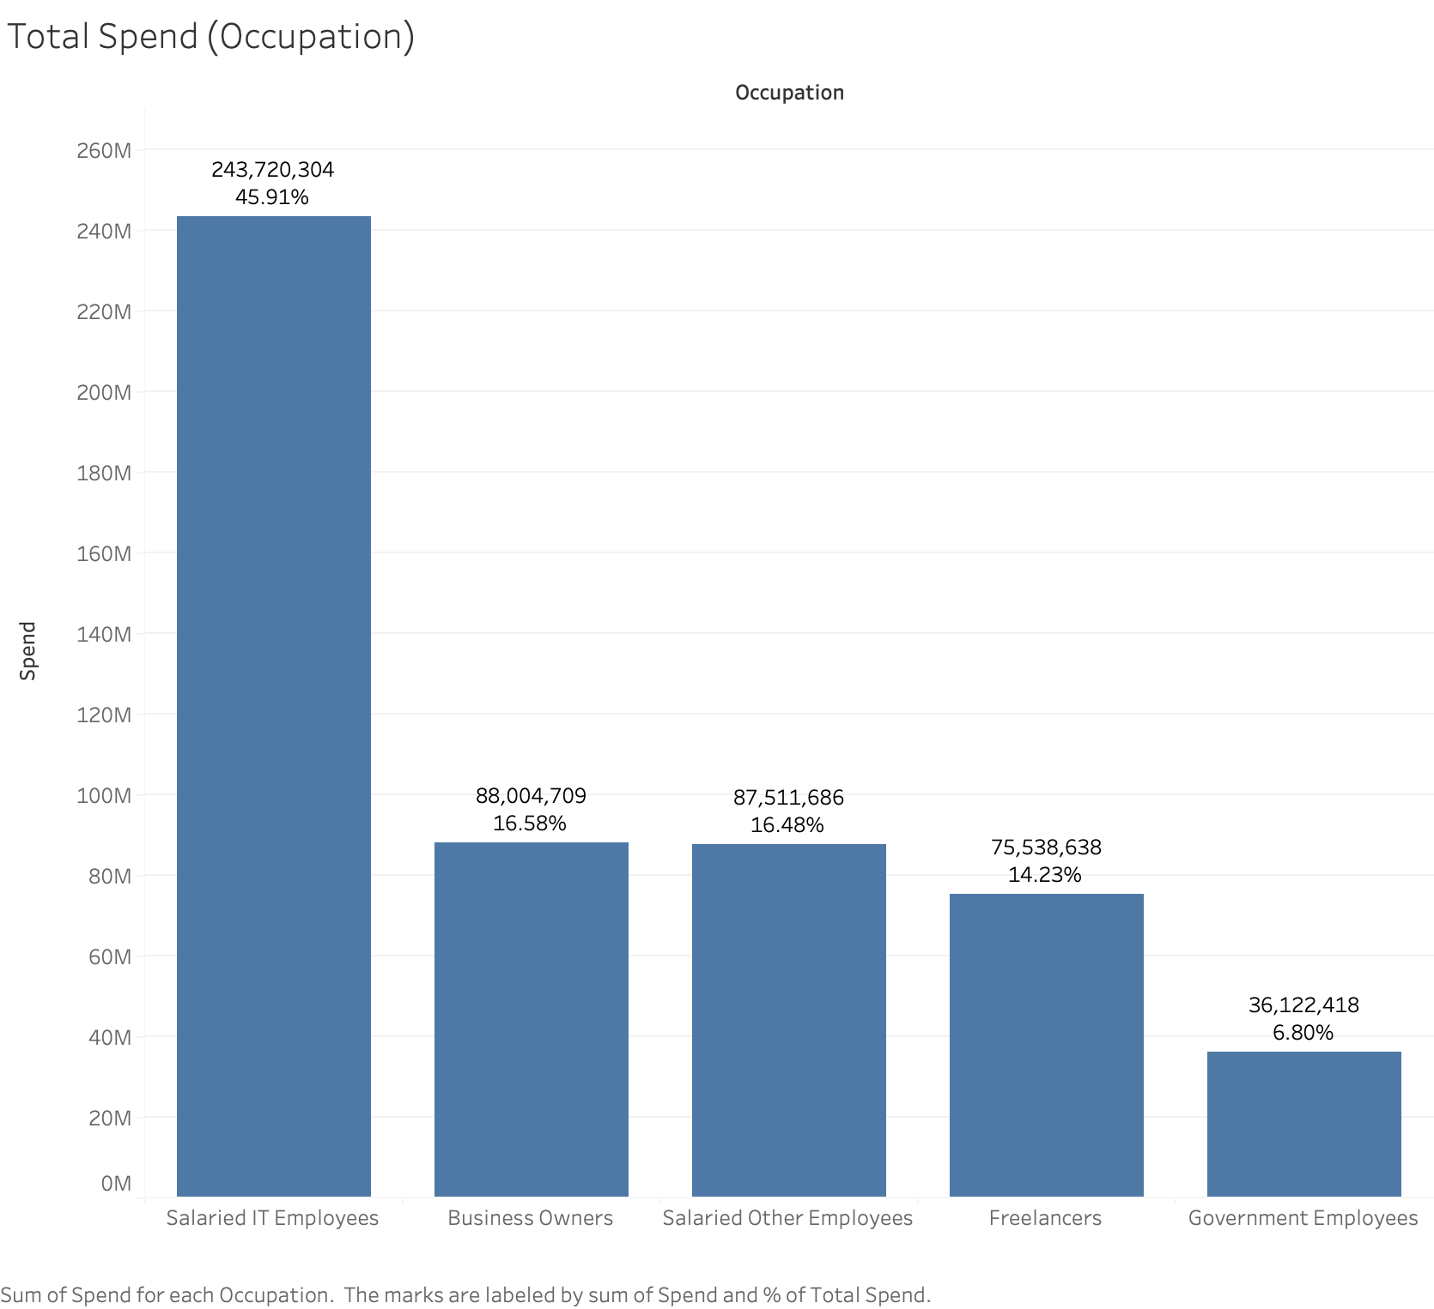
Salaried IT employees, constituting 32% of the customer base, contribute significantly to spending, representing 45%.
The business owners group, comprising 16% of customers, is the next major spender, contributing 17% to total spending.
Other salaried employees, forming 22% of the customer base, contribute 16% to the transaction value.
Freelancers, representing 20% of customers, account for 14% of transaction amounts.
Government employees, comprising 10% of the customer base, contribute 7% to overall spending.

Slide 4
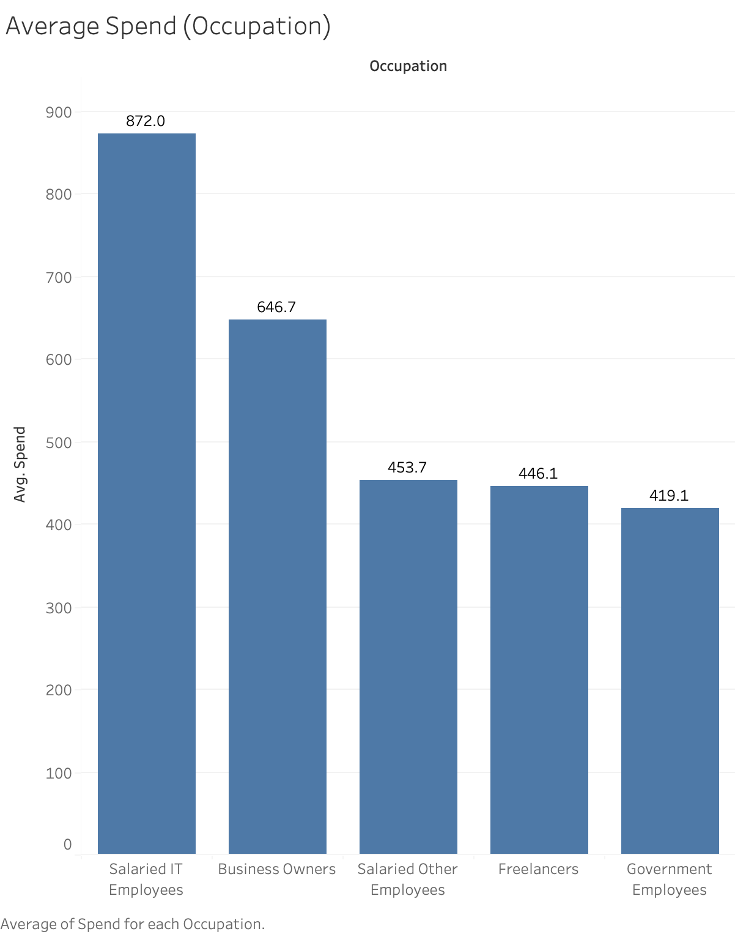
On average, Salaried IT employees lead in spending with 872 rupees, followed by business owners at 647 rupees.
Other salaried employees, freelancers, and government employees demonstrate comparable spending levels, with amounts of 454, 446, and 419 rupees, respectively.
The data suggests that Salaried IT employees and business owners exhibit higher average spending compared to other occupational groups.

Slide 5
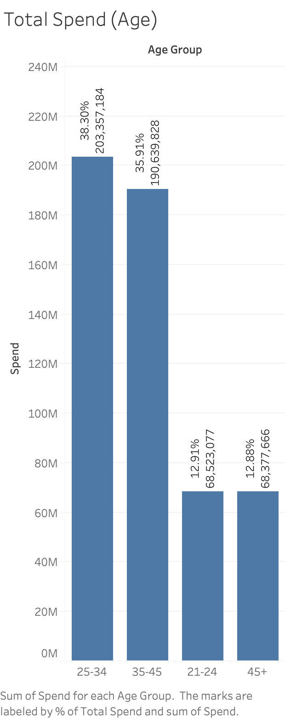
The 25-34 age group is the primary contributor to spending, representing 37% of our customer base and 38% to overall spending.
The 35-45 age group closely follows, with 32% of customers and a corresponding 36% share in spending.
While the 21-24 and 45+ age groups make up 17% and 13% of the customer base respectively, their spending aligns proportionally at 13%.
Tailoring our credit card program to the preferences and financial behaviours of the 25-34 and 35-45 age groups will be vital for maximizing engagement and program success.

Slide 6
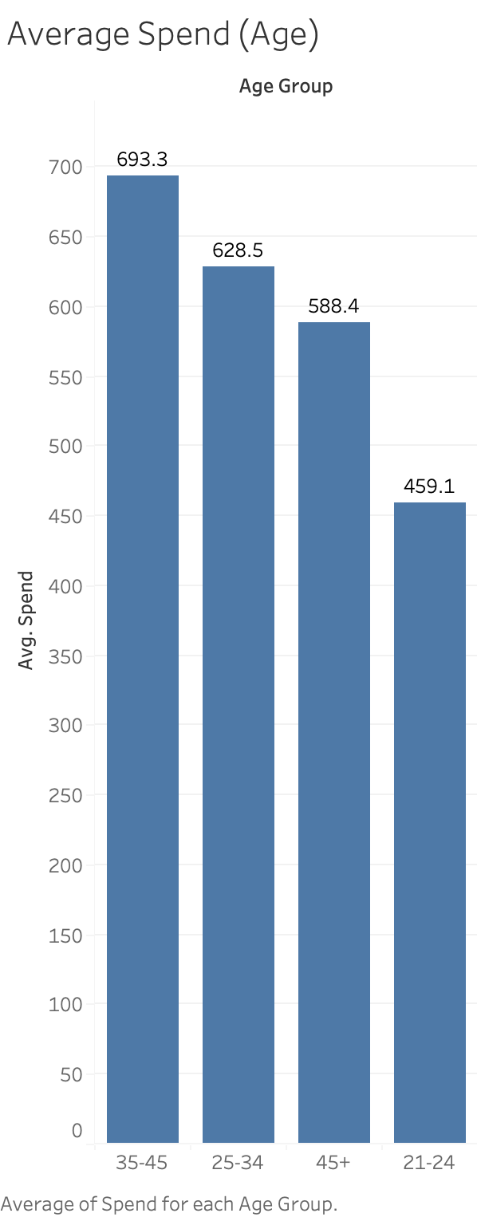
35-45 Age Group Leads:
Avg. Transaction: 694 Rupees
25-34 Age Group:
Avg. Transaction: 629 Rupees (91% of 35-45)
45+ Age Group:
Avg. Transaction: 588 Rupees (85% of 35-45)
21-24 Age Group:
Avg. Transaction: 459 Rupees (66% of 35-45)
Strategy:
Tailor credit card benefits for optimal engagement in 35-45 and 25-34 age groups.

Slide 7
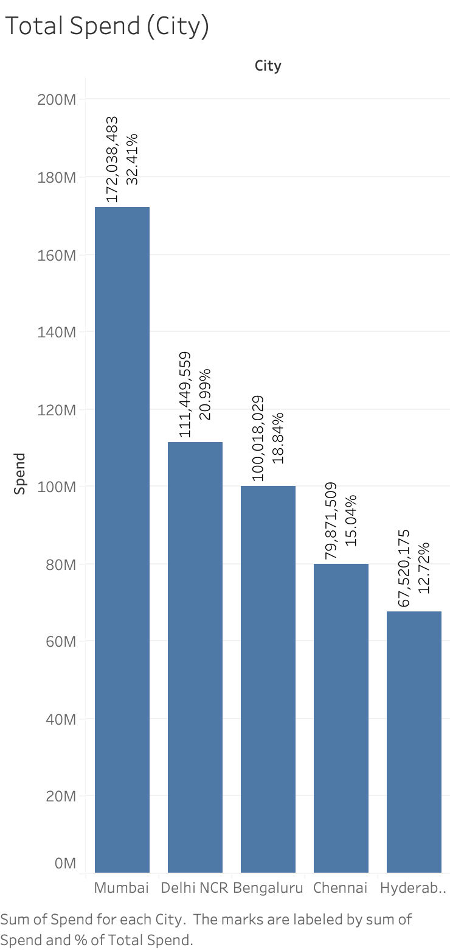
Mumbai leads in spending, contributing 32%, followed by Delhi NCR at 21%, Bengaluru at 19%, Chennai at 15%, and Hyderabad at 12%.
Bengaluru, Chennai, and Delhi NCR each comprise roughly 20% of the customer base, while Hyderabad constitutes 15%, and Mumbai has the highest customer share at 27%.
Targeted initiatives may optimize engagement in high-potential regions like Mumbai while maintaining proportionality in other regions.

Slide 8
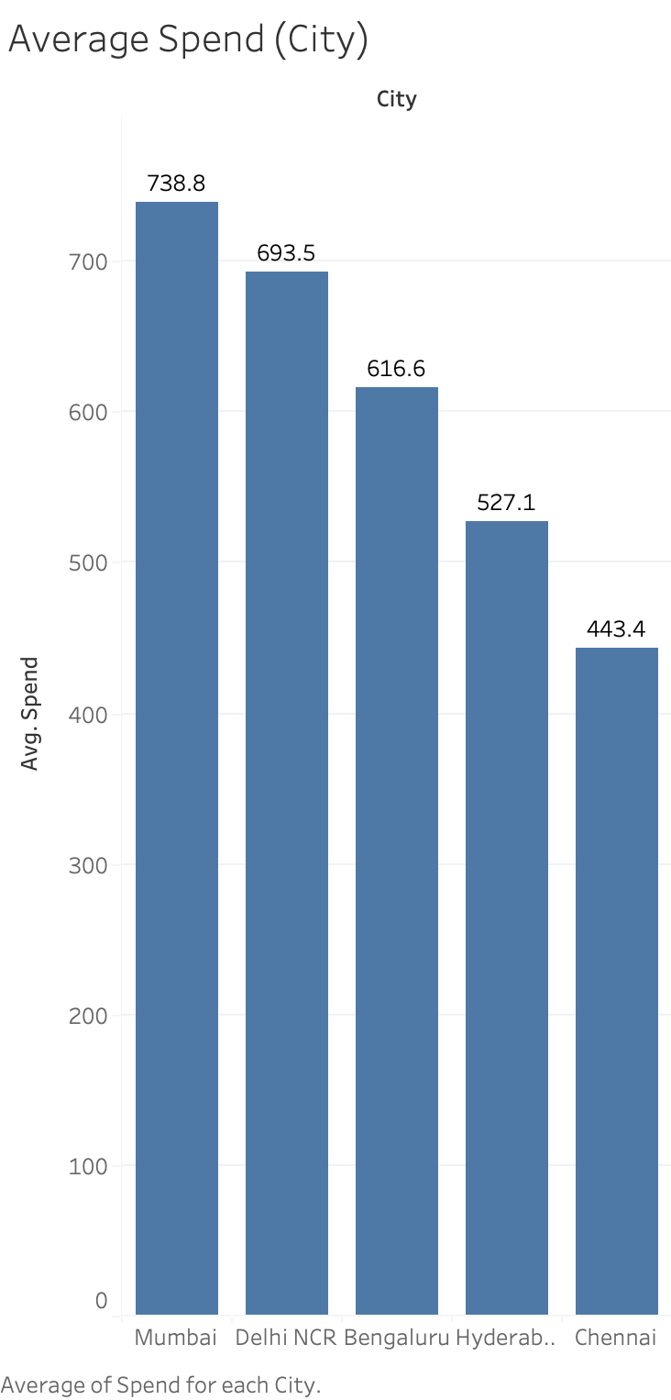
Mumbai:
Avg. Spend: 739 Rupees
Delhi NCR:
Avg. Spend: 694 Rupees (94% of Mumbai)
Bengaluru:
Avg. Spend: 617 Rupees (83% of Mumbai)
Hyderabad:
Avg. Spend: 527 Rupees (71% of Mumbai)
Chennai:
Avg. Spend: 443 Rupees (60% of Mumbai)

Slide 9
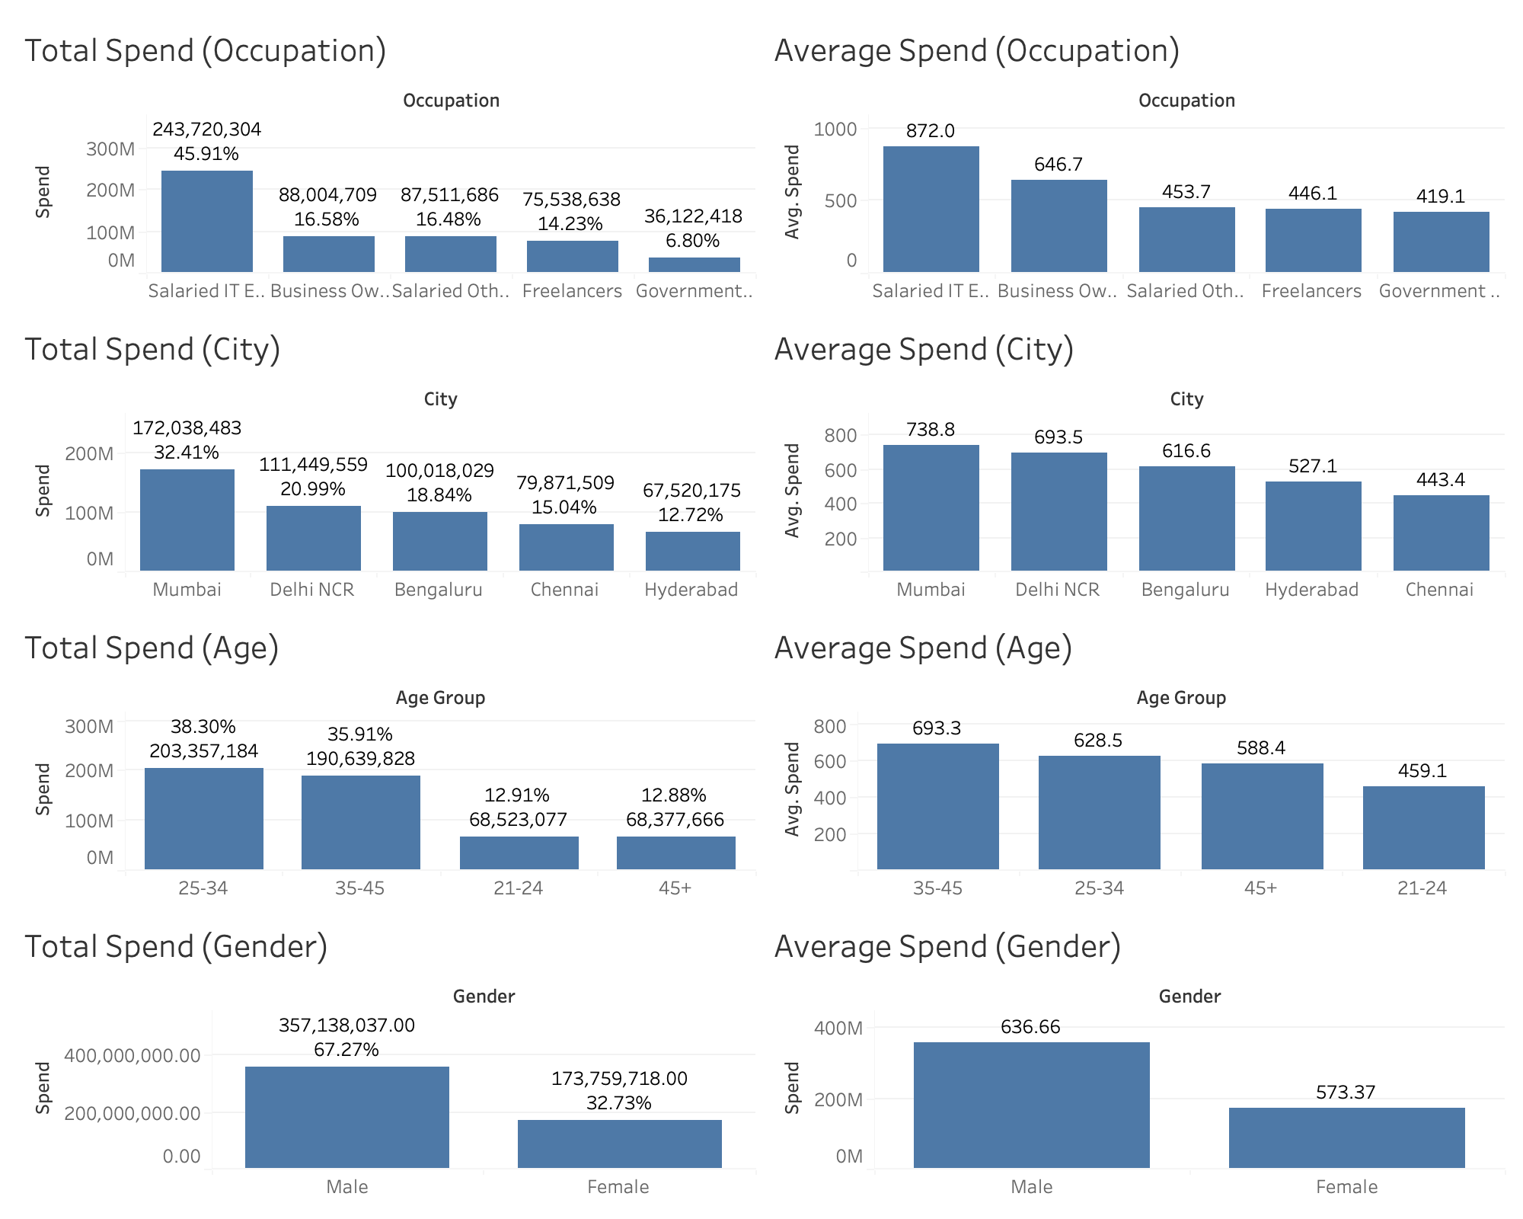

Slide 10
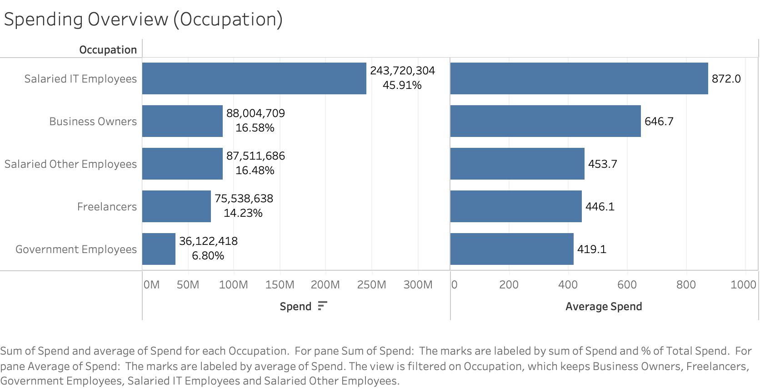

Slide 11
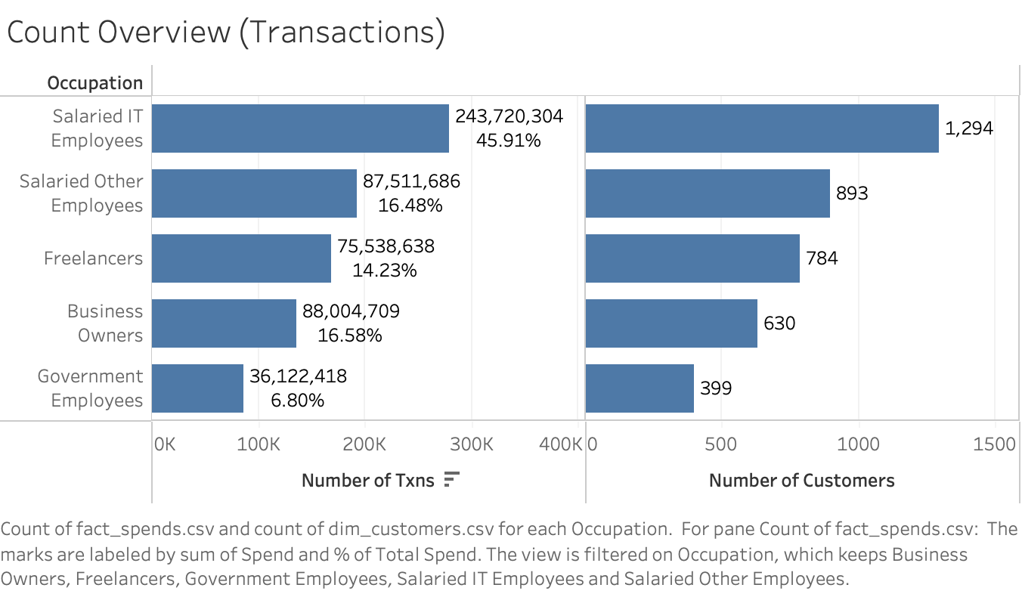

Slide 12
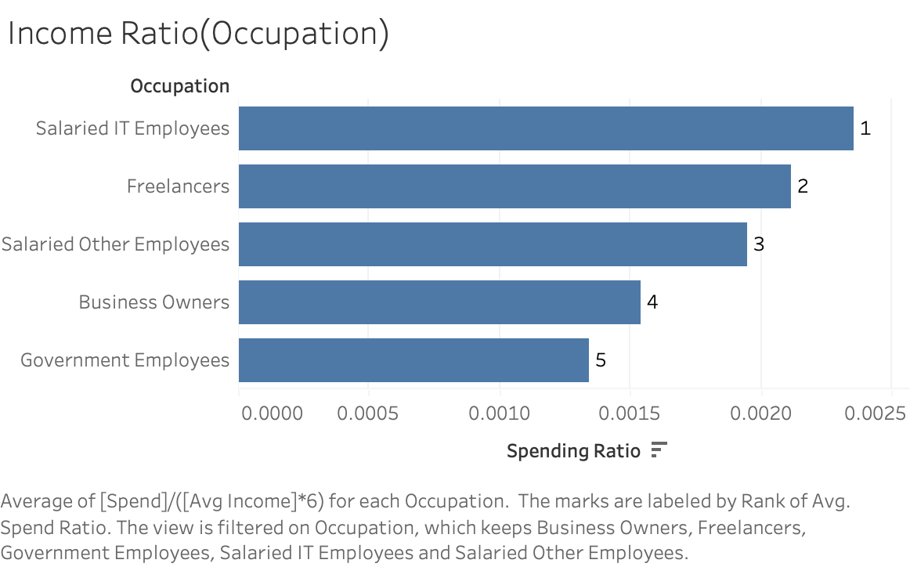
Customers (grouped by occupation) ranked by spending relative to 6 month income.

Slide 13
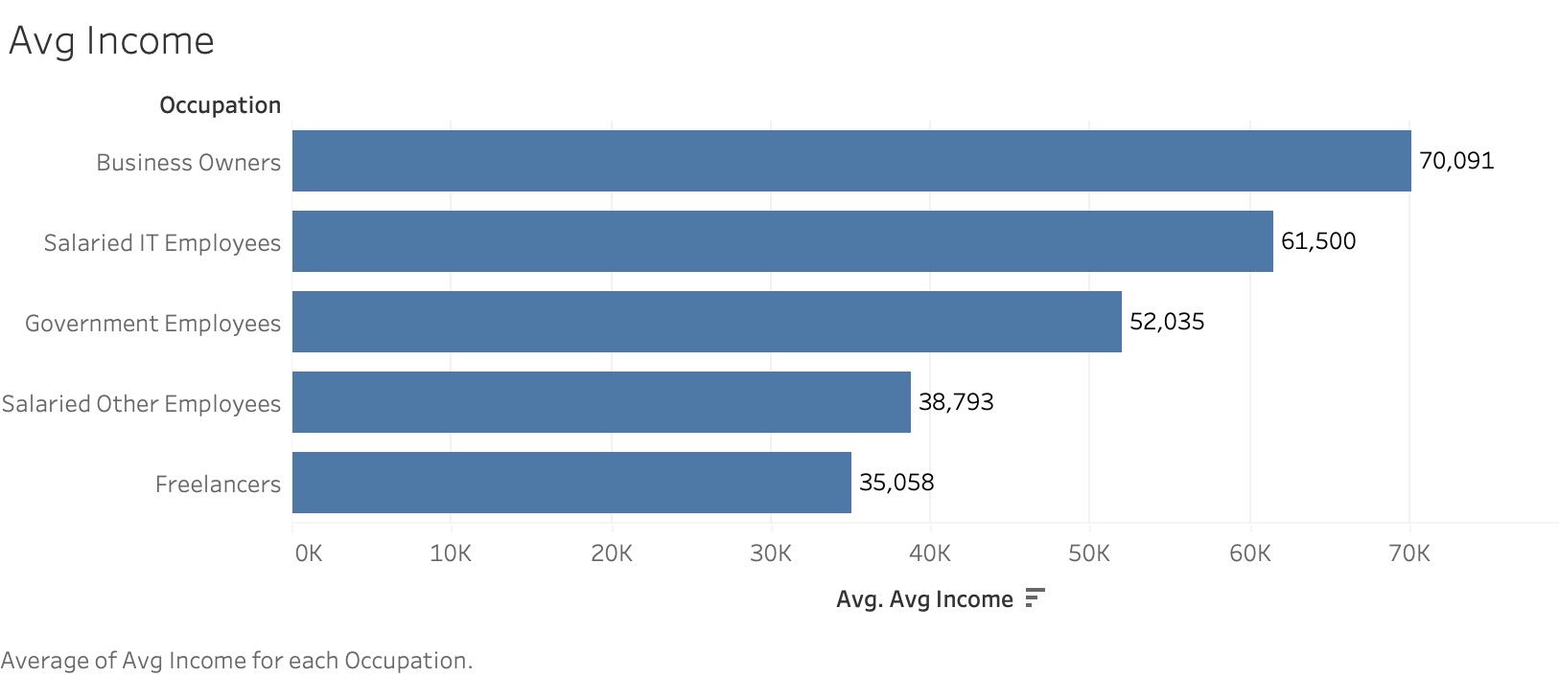

Slide 14
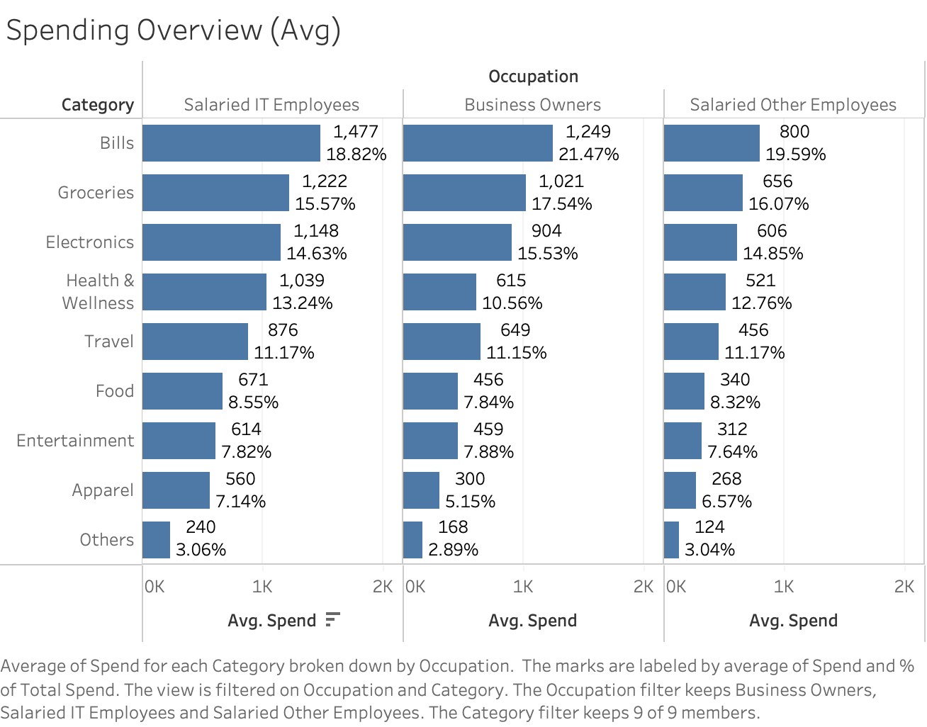

Slide 15
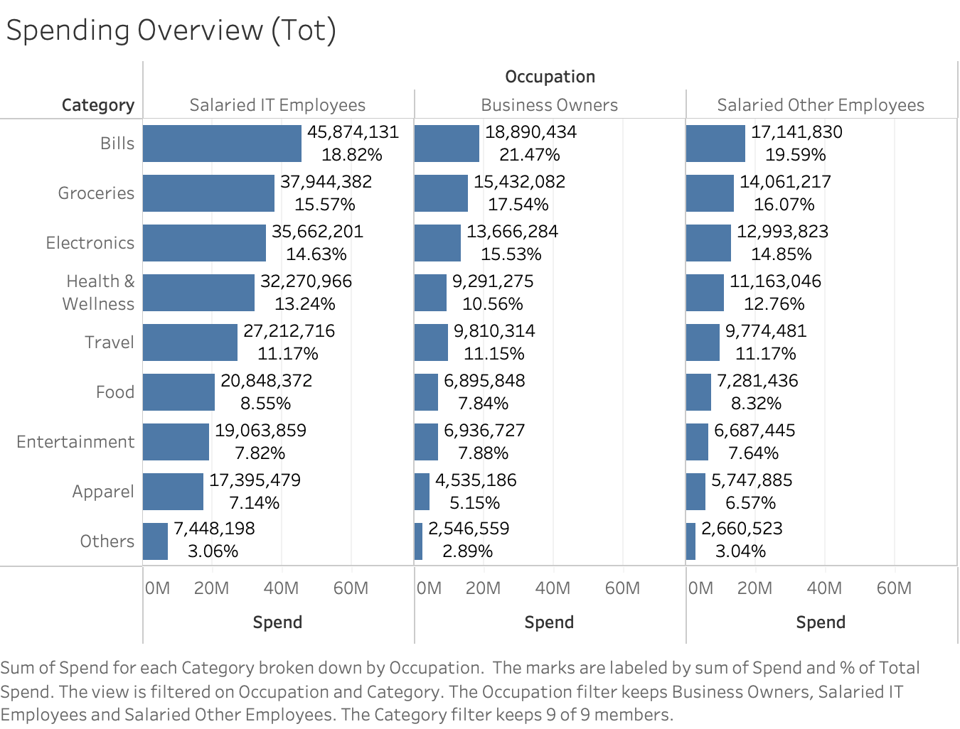

Slide 16
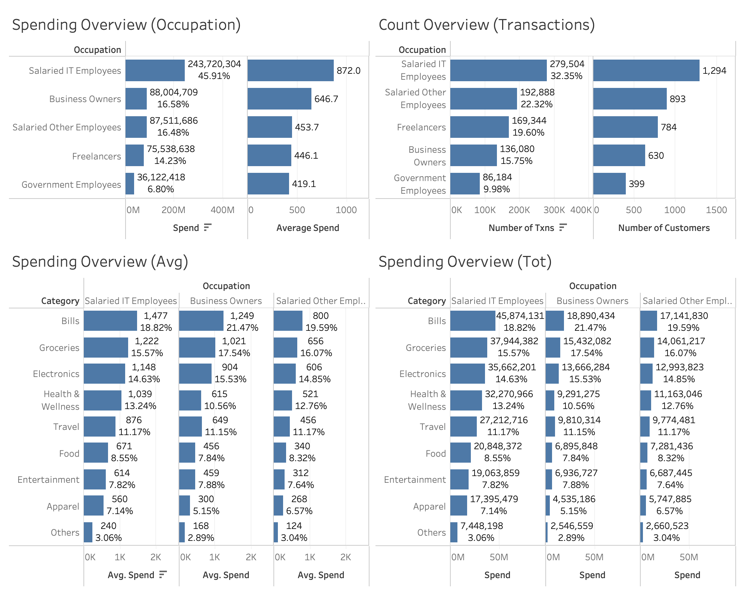

Slide 17
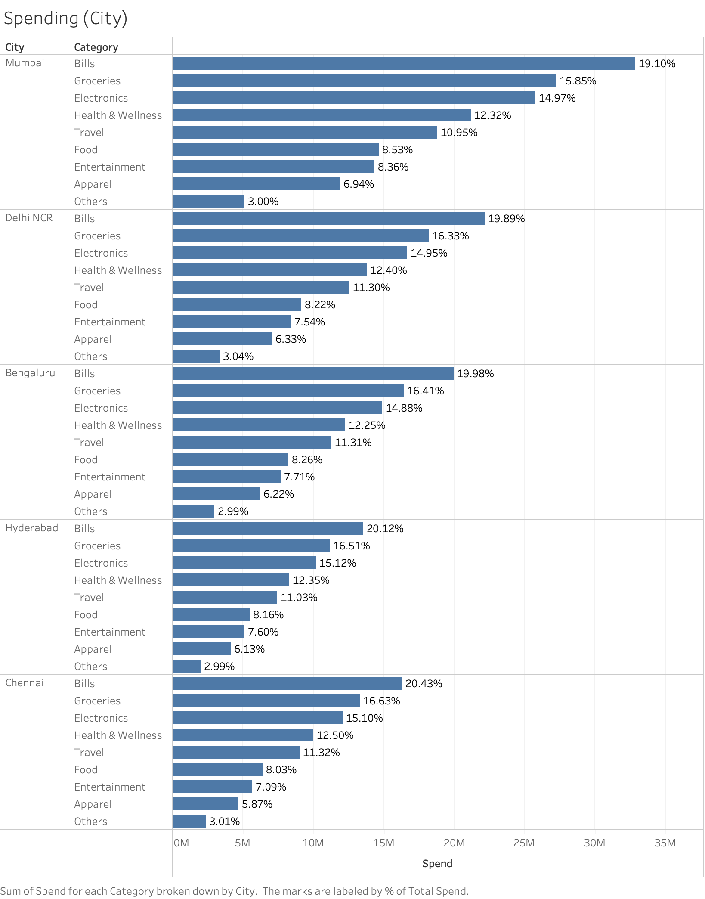

Slide 18
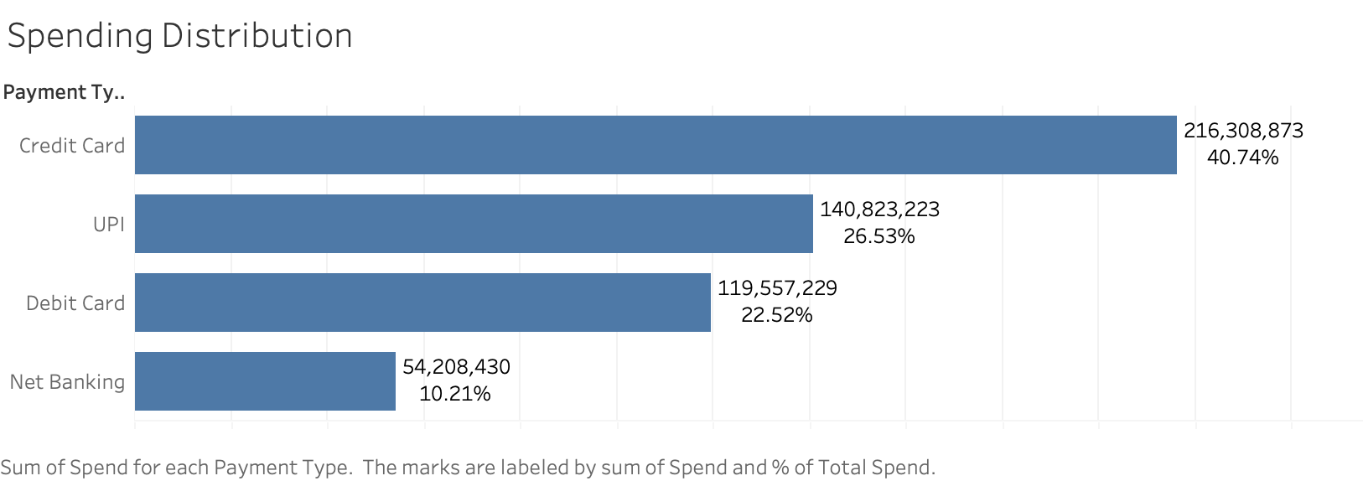

Slide 19
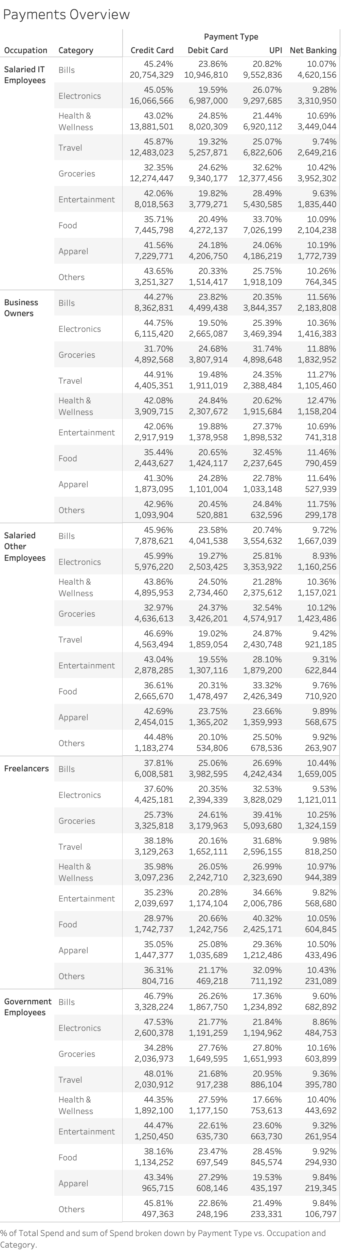

Slide 20
Insights
Salaried IT Employees and Business Owners are top spenders.
The top 5 categories of Spending are bills, Groceries, electronics, health and wellness, and travel.
Rewards can be designed to boost spending in these categories.
Credit card spending can be increased by capturing transactions made by UPI and debit cards.
Targeted pre-approvals to identified top spenders can prove to be efficient in capturing more expenditure.
The program should focus on customers aged 25-45.
Mumbai, Delhi NCR and Bengaluru should be the focus regions.

