Slide 1
“Socialize” = Social + Optimize
Using Data Science to optimize social media engagement
Jessica Chau
Ishaan Jaffer

Slide 2
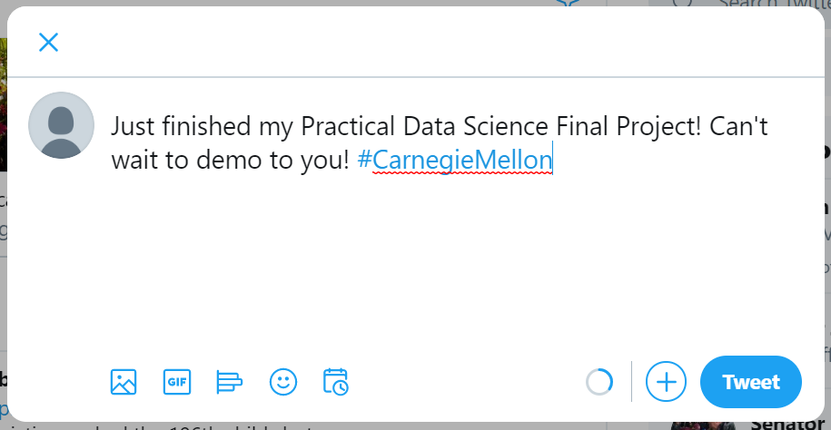
Optimizations for a tweet
Best time to post
What hashtags to use
Popular keywords
Sentiment Analysis

Slide 3
Data Science Pipeline
User enters tweet
content they intend on
Using, and Category of
their tweet
c
Gather data on the activity of the user’s followers from the Twitter API
c
Identify keywords and rank importance of each word based on category

