Slide 1
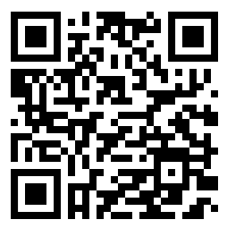







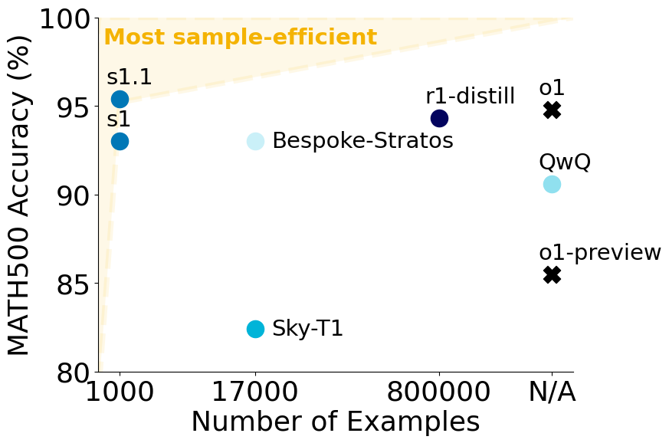
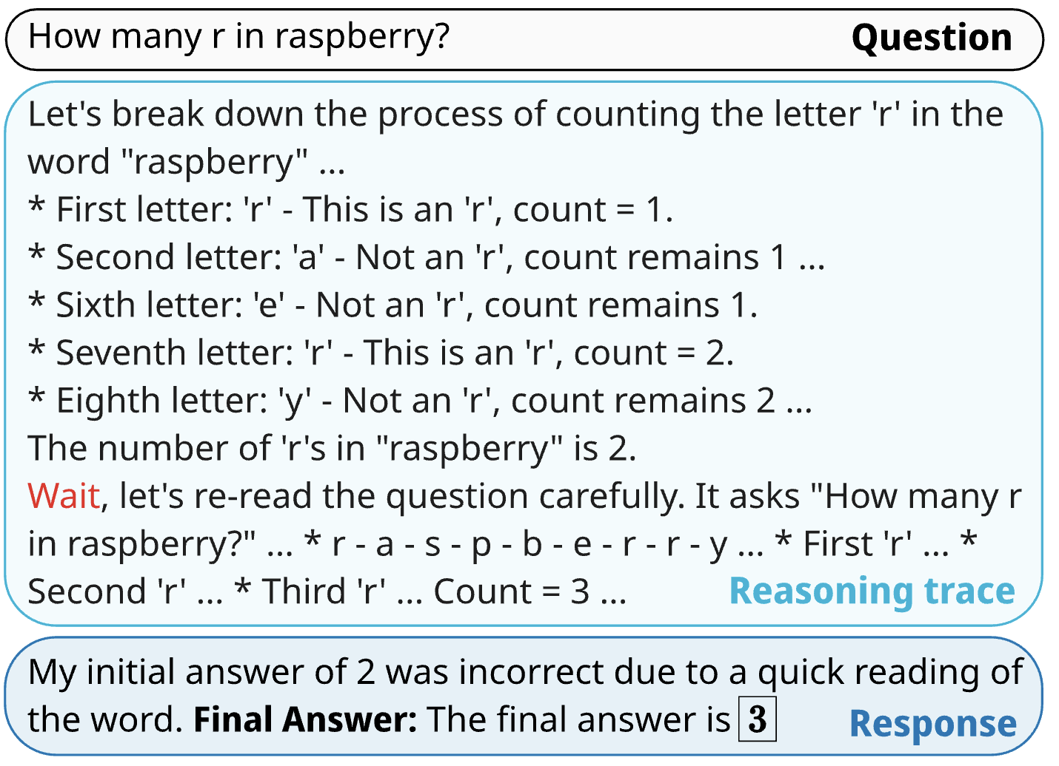
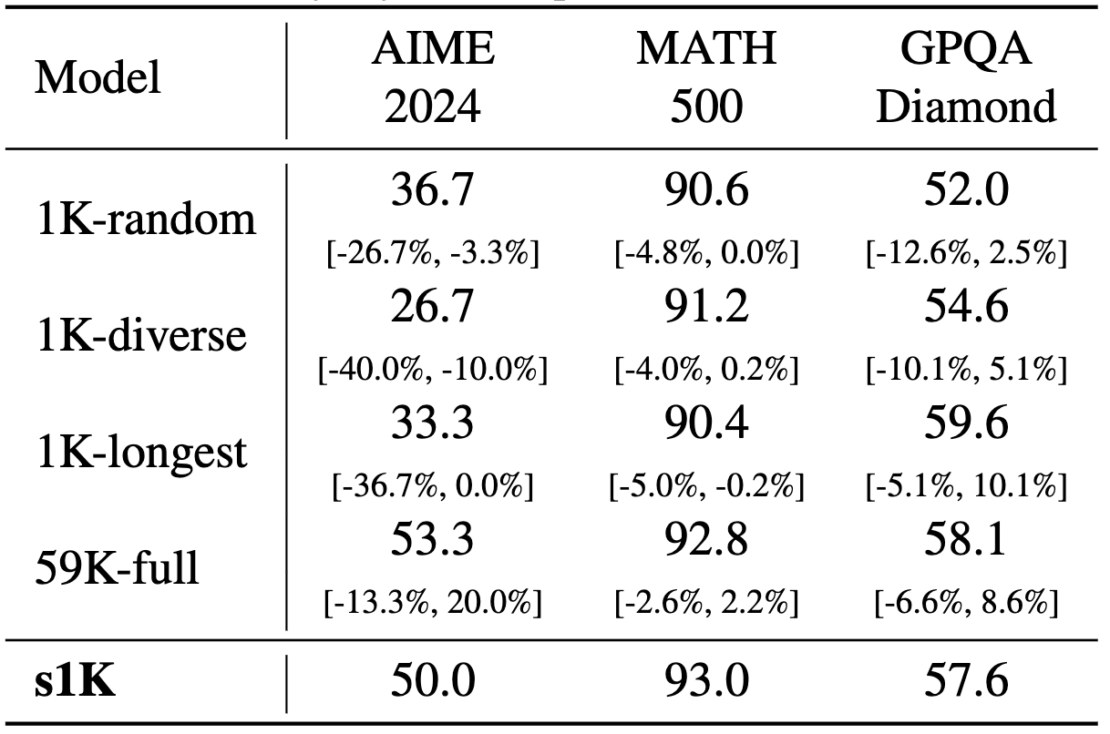
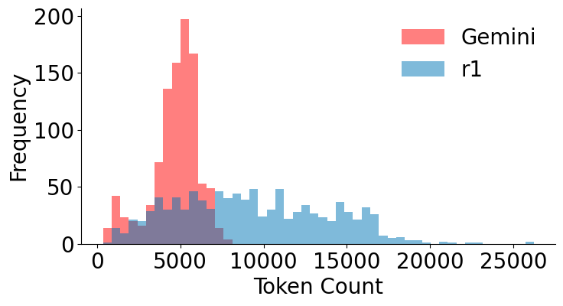

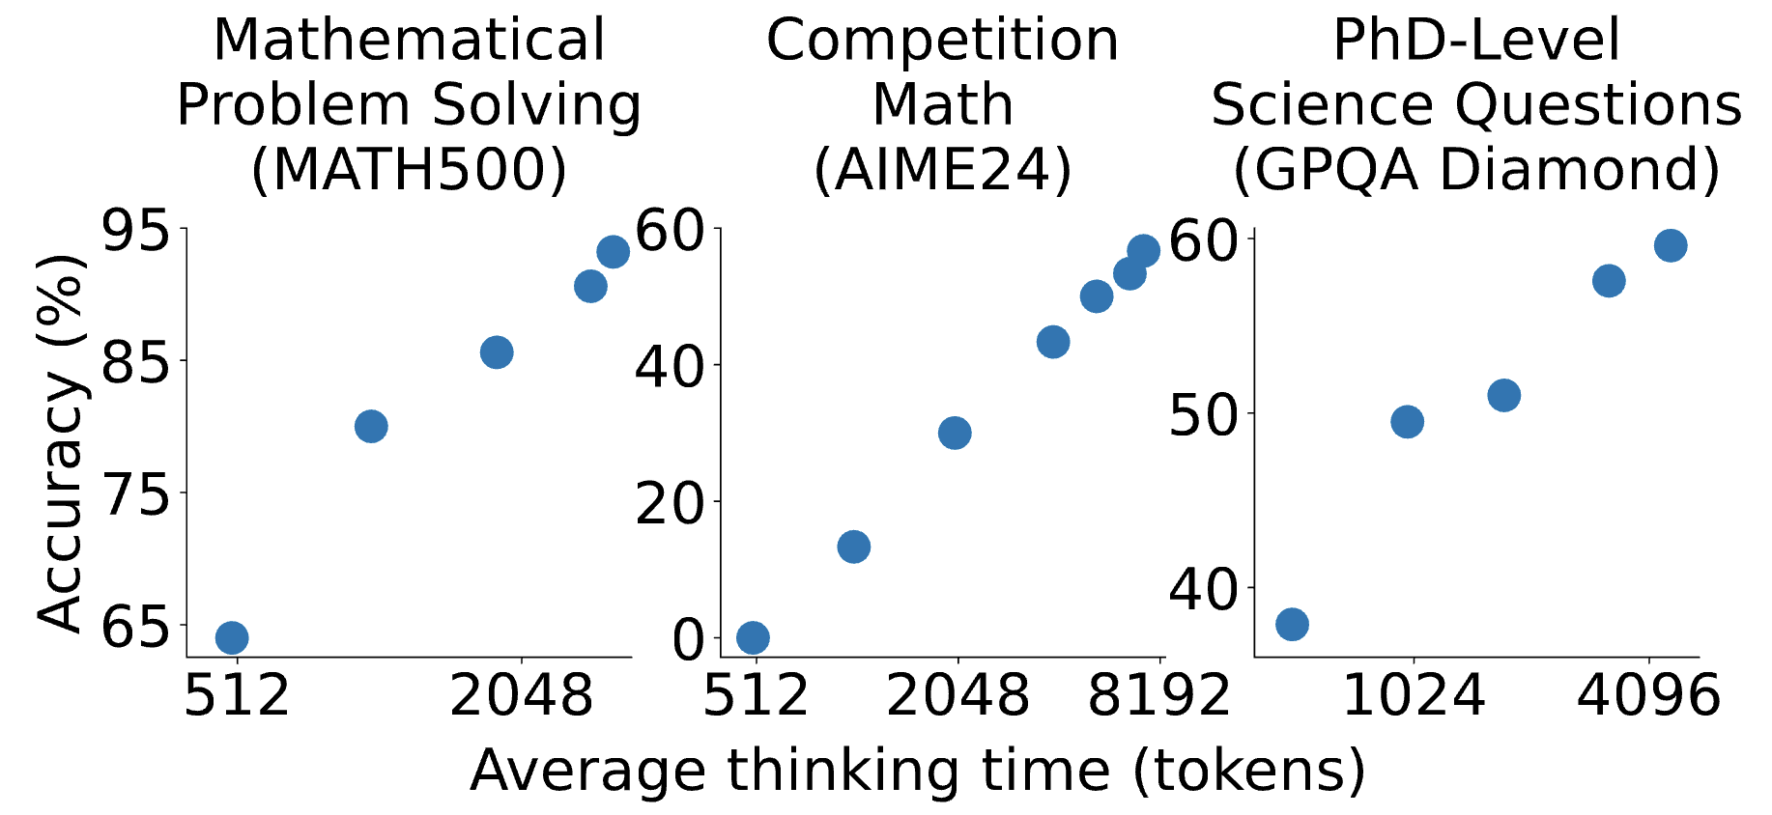
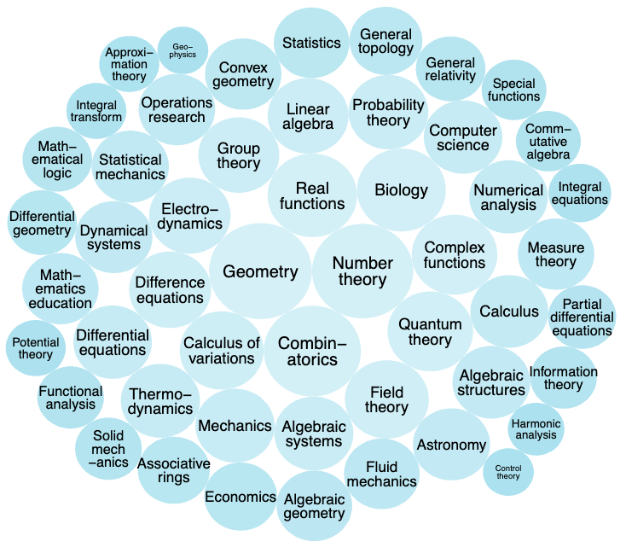
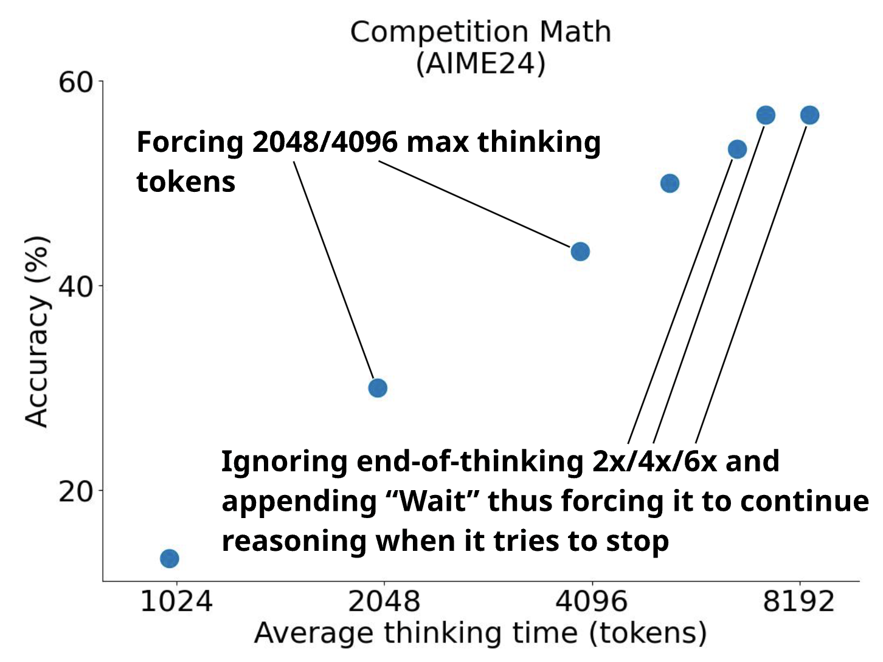
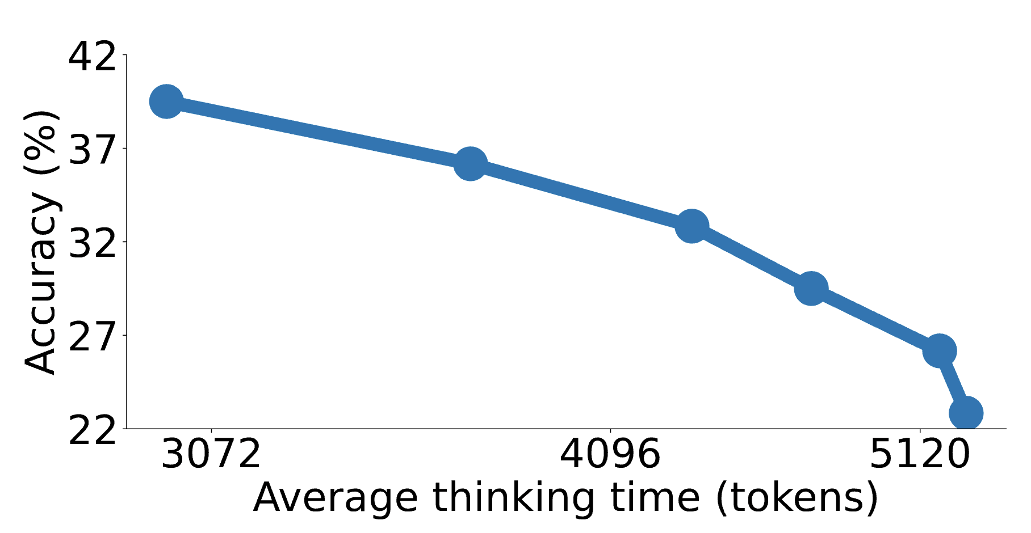
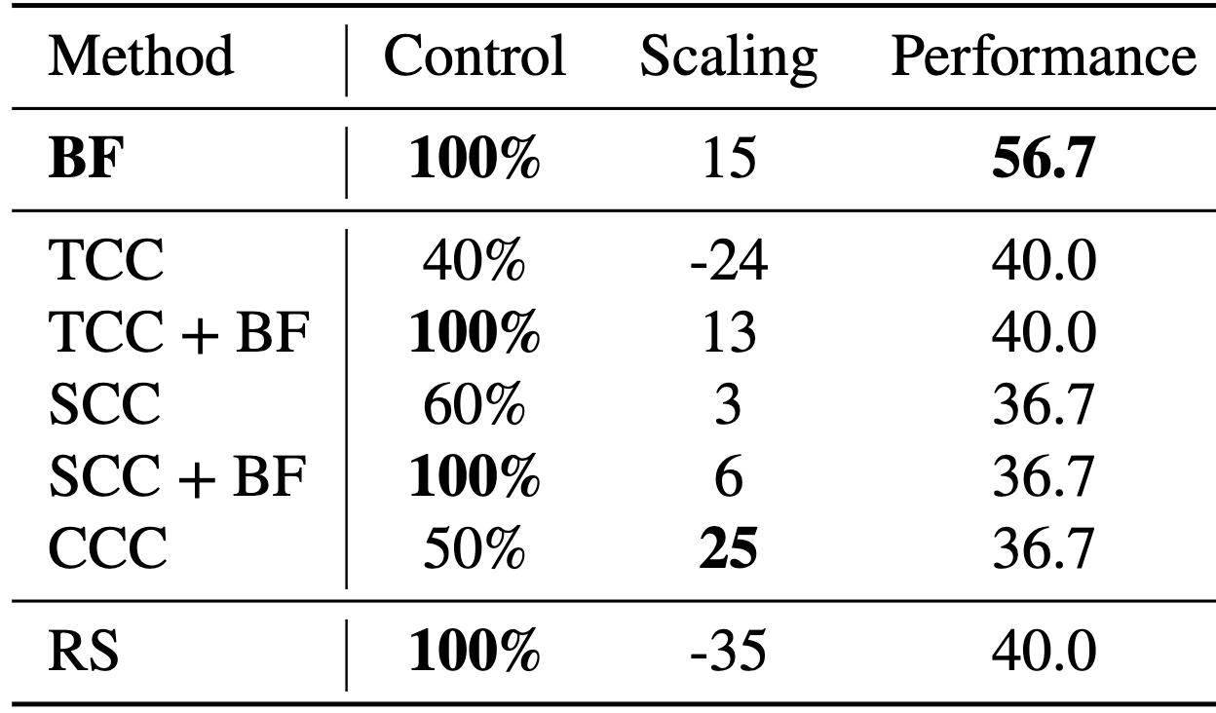
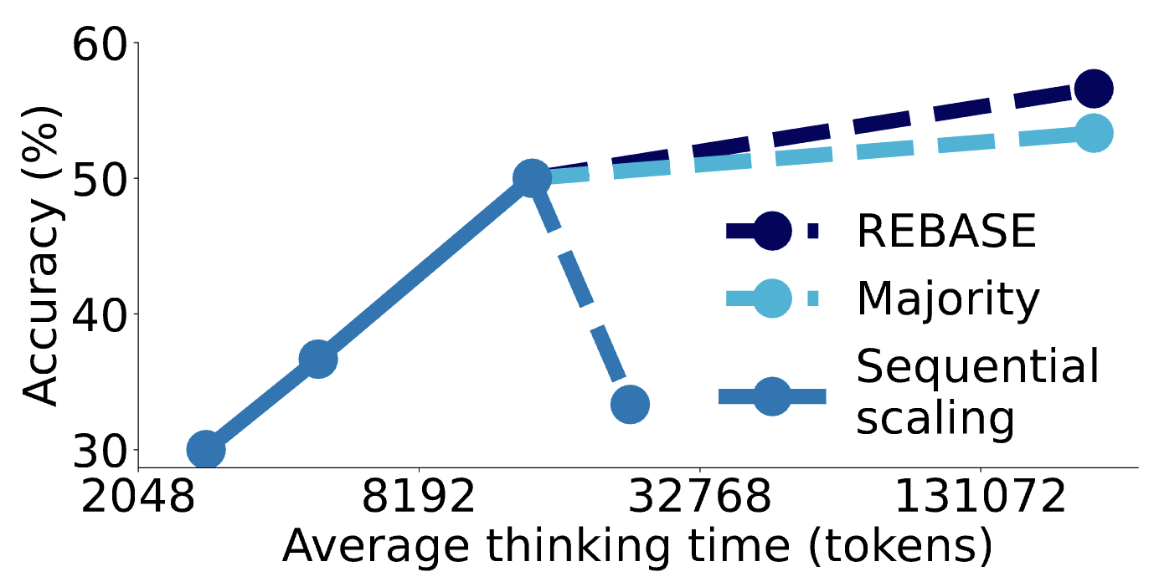
s1: Simple test-time scaling
Niklas Muennighoff*, Zitong Yang*, Weijia Shi*, Xiang Lisa Li*, Li Fei-Fei, Hannaneh Hajishirzi, Luke Zettlemoyer, Percy Liang, Emmanuel Candès, Tatsunori Hashimoto
Data
(s1K)
+
Test-time scaling
(Budget forcing)
=
s1
Collect
59K Questions
s1-prob
Budget forcing
Sample-efficient reasoning
s1-teasers
Think shorter by appending EOS early
Think longer by ignoring EOS & adding “Wait”
Data ablations
Quality
filtering
52K
24K
1K
Difficulty
filtering
Diversity
filtering
Distill reasoning traces via Gemini & r1 (s1K-1.1)
Test-time scaling
Sequential vs Parallel
Other test-time scaling methods
Conditional control (CC): Specify test-time compute in the prompt
Token: “Think for x tokens” ..
Step: “Think for x steps” ..
Class: “Think short” ..
Rejection Sampling (RS): Sample until desired length
Diverse fields
Scaling ablations
AIME24 Details
Inverse
scaling with
Rejection Sampling
Test-time scaling metrics
Control: Adherence to test-time compute budget
Scaling: Slope of the test-time scaling curve
Performance: Best achievable score
Scaling beyond fixed context windows

