Slide 1

Guidelines
Kindly use the given template for submitting your prototype(Make a copy of the template)
One team is only required to submit one project.
Follow this template while preparing your presentation.
You are welcome to add as many POCs and design concepts to support your project.
The project should be feasible and the team members should be capable enough, to come up with the fully functioning prototype of the same idea, if required.

Slide 2

Team Details
  Team name:
  Team leader name:

Slide 3
Brief about your solution
Six columns in. 252 columns out.
A distributor's catalogue arrives as a part number, a 35-character line of trade shorthand and three brand columns that are mostly placeholder markers. The Unilog delivery template asks for a full taxonomy path, six description variants, twenty feature bullets and sixty attribute triplets. Everything in between has to be recovered — and every recovered value has to be defensible.
The Product Intelligence Engine reads that shorthand the way a product manager does. It decodes what is deterministic, infers what the catalogue itself can support, asks a language model only for what is genuinely left, then judges its own output and routes anything it cannot defend to a human — with the evidence, source and confidence attached to every single value.
1,000
rows processed in 7.2s
7,330
fields recovered
96%
identity coverage
100%
taxonomy coverage
83%
auto-approved

Slide 4
1. How does your solution enrich minimal product information?
Briefly explain how your solution transforms limited inputs (e.g., Part Number, Brand, Short Description) into rich product intelligence.
2. How does your solution ensure accuracy and trust in the generated product data?
Describe your validation strategy. This may include:
(Confidence scoring, Multi-source verification, Human review, Rule-based validation, AI validation, Other approaches)
3. What makes your solution scalable for enterprise product catalogs?
Describe how your solution would handle: Large product catalogs, New manufacturers, Different document formats, Continuous product updates
Worked example — one real row from the supplied file
IN: 3MABR-7100075678 | "3M 775L Stikit Film P150 - Cubitron II 50 Disc/Box" | brand: -- Unbranded -- | Part_Manuf: Jam Industrial Supply LLC
Decode
Trade shorthand is parsed, not guessed: form, grit P150, attachment system, pack quantity, selling unit — no model call.
Identify
Part_Manuf is the account bought from, not the maker. It is published as supplier; 3M is recovered as brand and manufacturer from the description.
Classify
Keyword classifier settles 71% of the file; the model escalates the rest into the 26-class taxonomy.
Infer
Catalogue peers fill gaps — but brand-scoped attributes are refused outside a brand-scoped peer group, so 3M's series never lands on a Diablo belt.
Write
Six commerce descriptions and the feature bullets are generated to the template's own length targets.
Judge
A model reviews the finished record; anything unsupported is flagged, de-confidenced and queued for a human.

Slide 5
Opportunities
  How different is it from any of the other existing ideas?
  How will it be able to solve the problem statement given?
  USP of the proposed solution
Different from an "AI enrichment" wrapper
• Deterministic first. The decoders cover all 1,000 rows in 7.2 seconds with no API key at all. The model is the last resort, not the pipeline.
• Every value carries method, source, evidence and confidence — a buyer can ask "why does this say P150?" and get an answer, not a vibe.
• It scores itself. Quality is decomposed into completeness, accuracy, consistency and richness, measured before and after, so uplift is a number and not a claim.
How it solves the problem statement
• 252-column delivery template filled directly — column order is read from the template file at runtime, so a revised template needs no code change.
• Blank beats wrong: anything below the publish floor is held back and queued, because a blank cell is recoverable and a confident wrong value is not.
USP
An enrichment engine that argues with itself. Switching the model on initially made the quality score fall — because the judge had started catching two real defects nobody had checked for. Both were fixed at the source. That is the difference between filling cells and shipping a catalogue.

Slide 6
List of features offered by the solution
Trade-shorthand decoder
Identity resolution
Form, grit, dimensions, colour, base type, pack quantity and selling unit parsed from a 35-character line.
Supplier account vs brand vs manufacturer, separated and published on the right lines — 552 brands recovered.
26-class taxonomy + escalation
Catalogue knowledge graph
Keyword classifier, then LLM escalation for what it cannot settle. Dept / Class / Fine path filled 100%.
Peer consensus fills gaps and exposes outliers — scoped so inference never crosses a brand boundary.
Commerce content generation
LLM judge + rule engine
Six description variants and twenty feature bullets, written to the template's own length targets.
Unit sanity, magnitude plausibility, internal contradiction and evidence-support checks.
Human review queue
Evidence-first export
Approve / correct / reject with notes; every decision is stored and turned into reviewer calibration.
252-column delivery CSV, flat catalogue CSV, full audit JSON, open-queue CSV.

Slide 7
Process flow diagram or Use-case diagram
Ingest
Classify
Decode
Resolve
Validate
6 columns
header mapping
keyword →
LLM escalation
shorthand,
units, enums
golden record
source precedence
rules, ranges,
contradictions
Enrich
Generate
Judge
Route
Export
peers → graph
→ LLM
6 descriptions
20 features
LLM review
de-confidence
auto-approve
or human queue
252-column
delivery CSV
↺ reviewer corrections re-enter the record and re-score it
No model call happens until the deterministic stages have taken everything they can.

Slide 8
Wireframes/Mock diagrams of the proposed solution (optional)

Slide 9
Architecture diagram of the proposed solution
Interface
Streamlit app — 6 pages
Headless CLI runner
252-column exporter
Intelligence
Trade-shorthand decoders
Identity resolver
Knowledge graph + RAG
LLM extract / generate / judge
Contract
attributes.json — 26 classes
Delivery template header
Quality scorer
Foundation
Provider-agnostic LLM client
SQLite store + prompt cache
Rate limiter + retry
Anthropic · Gemini · OpenAI · Groq — first provider with a key wins, and a failure falls through to the next, so one vendor's rate limit cannot stop a run.

Slide 10
Technologies used in the solution
Core
Python 3.13 · pydantic · pandas · numpy
Intelligence
Gemini 3.5 Flash-Lite (bulk) · Gemini 3.6 Flash (vision) · provider-agnostic client with Anthropic / OpenAI / Groq fallback
Retrieval & graph
networkx knowledge graph · TF-IDF peer retrieval (scikit-learn) · rapidfuzz alias matching
Documents
PyMuPDF for datasheet tables · Pillow for image evidence · openpyxl
Interface
Streamlit · Plotly
Storage
SQLite — catalogue, runs, review decisions and the prompt cache
Quality
pytest — 35 tests over decoding, identity and request pacing

Slide 11
Estimated implementation cost (optional)
The deterministic pass is the product. The model is an optional accelerant.
₹0
full 1,000-row deterministic pass
7.2s
end to end, no network
~4,000
model calls for a full LLM pass
15 RPM
free-tier ceiling per model
• Running the whole file through the model on a free tier takes about five hours — so the engine is built so that it never has to. Deterministic decoding covers all 1,000 rows; the model is pointed at what is left.
• Every completion is cached by (provider, model, prompt) hash, so a re-run during a demo or a review cycle costs nothing at all.
• A paid key changes only the throughput, not the architecture: at Gemini Flash-Lite list pricing a full 1,000-row enrichment is a low single-digit dollar job.
• Self-hosting cost is a Streamlit process and a SQLite file — no vector database, no queue, no GPU.

Slide 12
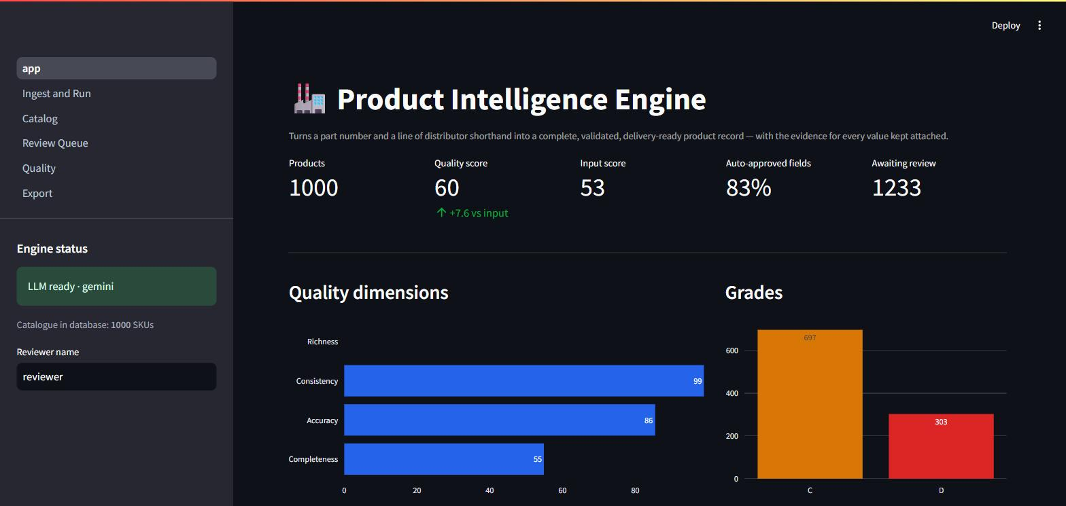
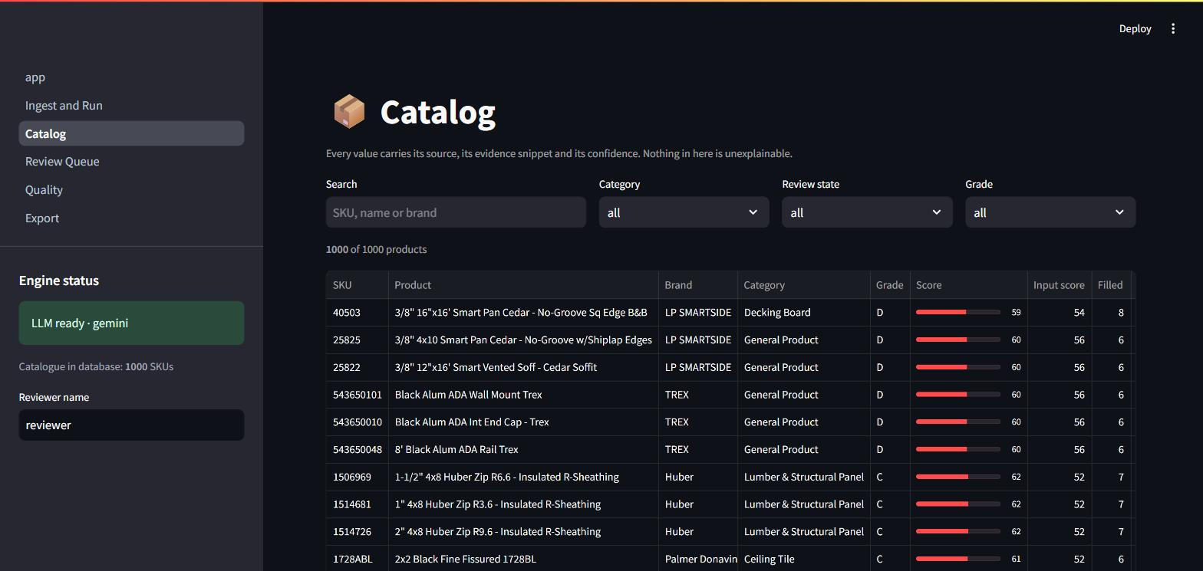
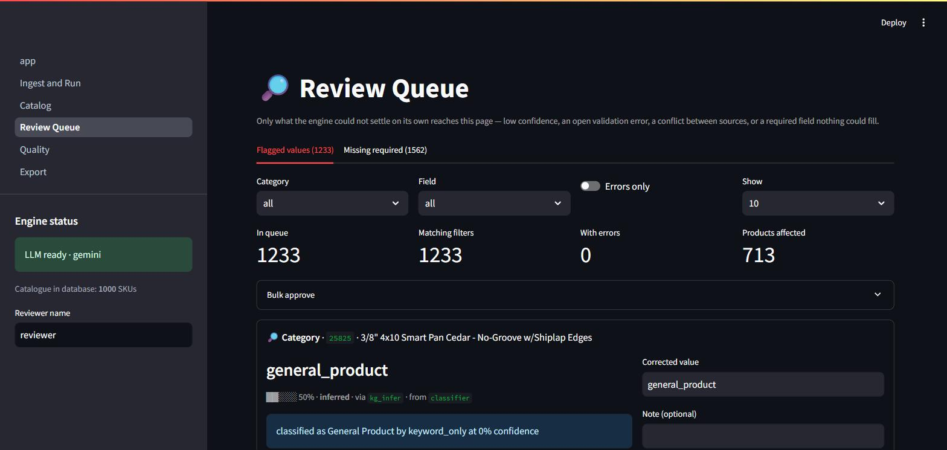
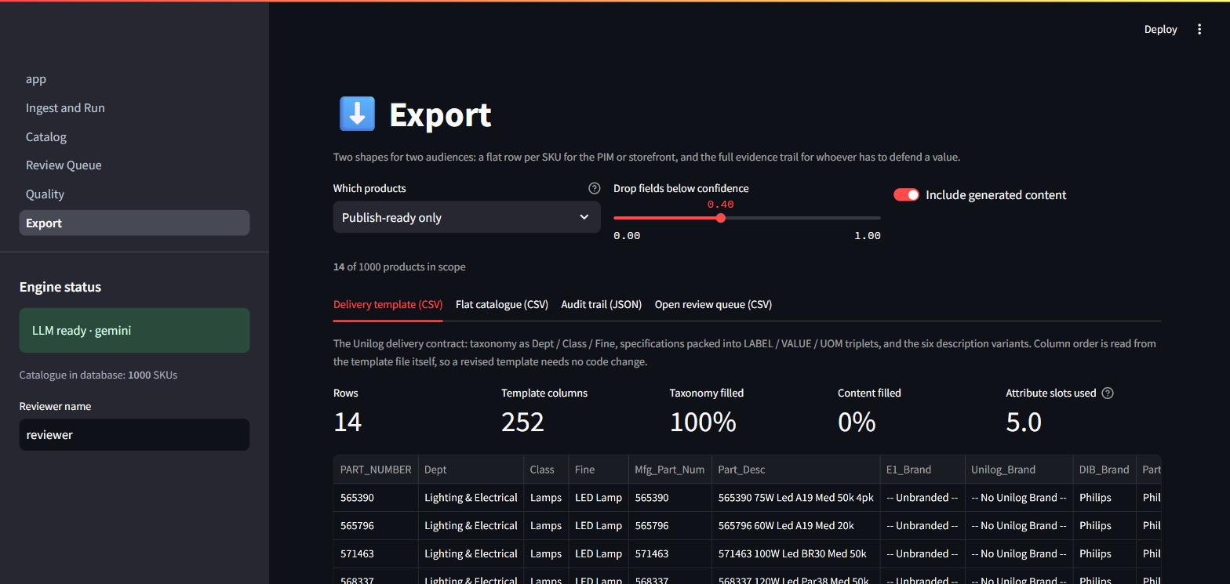
Snapshots of the MVP
Overview — measured uplift, not a claim
Catalog — every value, its evidence and its confidence
Review Queue — only what the engine could not settle
Export — the 252-column delivery contract

Slide 13
Additional Details/Future Development (if any)
What is deliberately not done yet
• Distributor-side columns — SKU - MY_PART_NUMBER, List Price, Prop 65 — export blank. They are commercial data no enrichment can honestly invent.
• 290 rows classify as General Product deterministically; LLM escalation resolves about three quarters, and the rest are genuinely outside the 26-class taxonomy.
Next
• Manufacturer datasheet ingestion at scale — the PDF table extractor and the vision path are built and wired; they need a document source per SKU.
• Learned confidence calibration: the review decisions already stored are the training signal for replacing the hand-set confidence constants.
• Taxonomy expansion driven by what lands in General Product, so the schema grows from evidence rather than guesswork.
• Persisted knowledge graph across runs, so peer consensus improves as the catalogue grows instead of being rebuilt per run.

Slide 14
Provide links to your:
GitHub Public Repository
Demo Video Link (3 Minutes)
Working Prototype Link
GitHub public repository
<paste repository URL>
Demo video (3 minutes)
<paste video URL>
Working prototype
<paste Streamlit Cloud URL>

Slide 15


