Slide 1
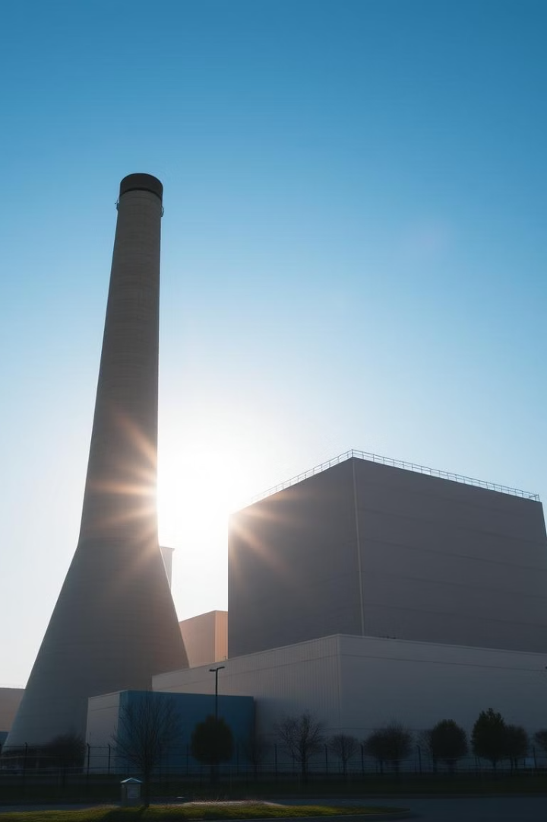
Predicting Energy Demand: A Data-Driven Approach
This presentation explores how data science can be used to predict and manage energy demand, ultimately helping eSC meet customer needs while minimizing environmental impact.
by Marko Masnikosa, Luis Riviere, Ishaan Lodhi

Slide 2
Understanding the Problem
Growing Demand
Potential Blackouts
eSC is concerned about increasing energy demand, especially during hot summer months.
A surge in demand could lead to blackouts, disrupting customer service and impacting reliability.

Slide 3

The Solution: Data-Driven Insights
Identify Key Drivers
Predictive Model
Reduce Usage
Uncover the main factors driving energy consumption in South Carolina.
Develop a model to anticipate future energy demand based on key drivers.
Suggest strategies to encourage customers to conserve energy, mitigating peak demand.

Slide 4
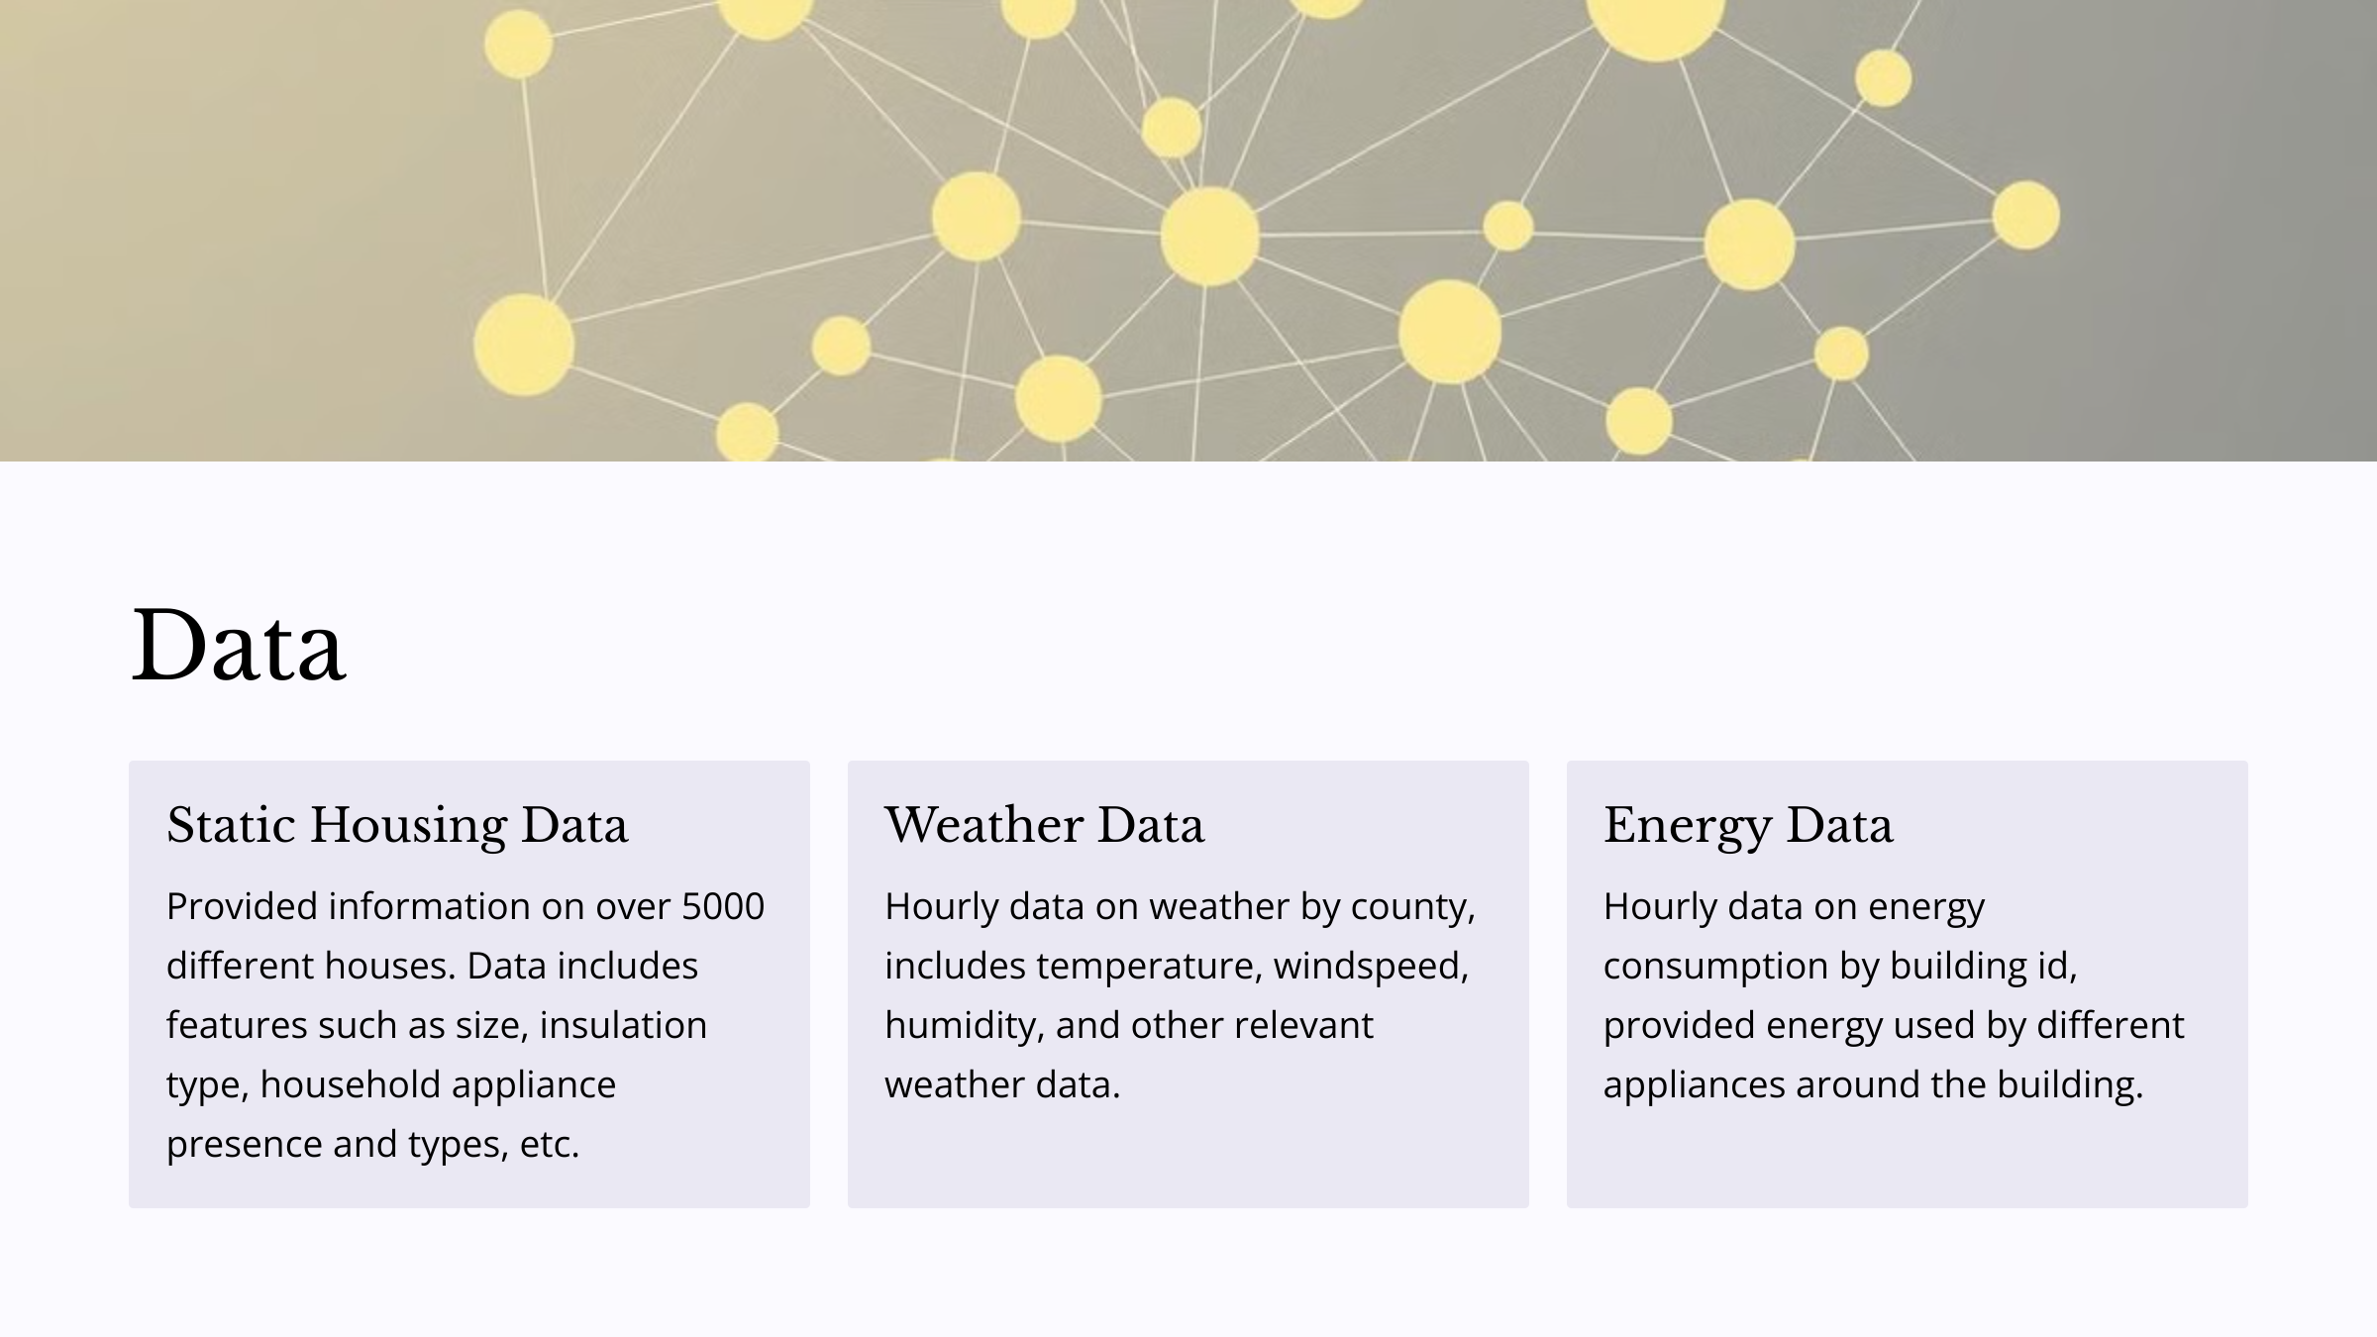
Notes:
Marko: After gathering all of the data, I ran a low variance filter to eliminate some of the less helpful datapoints. One datapoint to consider including in future analysis is the PV electricity generation at an hourly rate, the current values are static and can’t be relied on to predict the offset of energy generation demands.

Slide 5
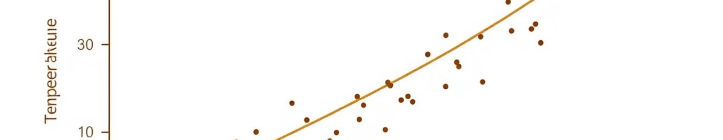
Data Insights: Our Findings
1
Key Driver: Temperature
2
Dataset Size
3
High Accuracy
We found a correlation between temperature and energy usage.
The analysis encompassed a large dataset of energy usage records.
The models achieved a high level of accuracy in predicting energy demand.
Notes:
A weak correlation exists between the temperature and the total energy usage. Energy usage seems to peak just after the temperature peaks for that day and has a longer rampdown period.

Slide 6
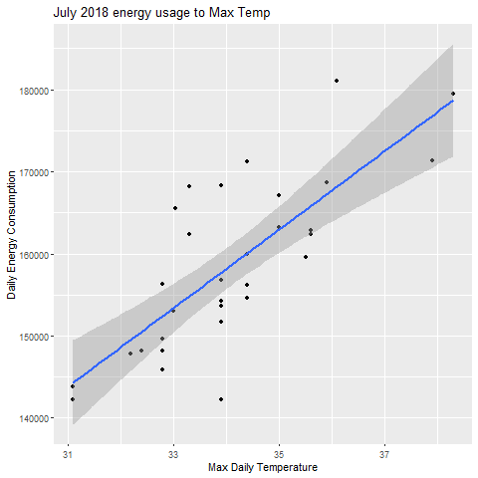
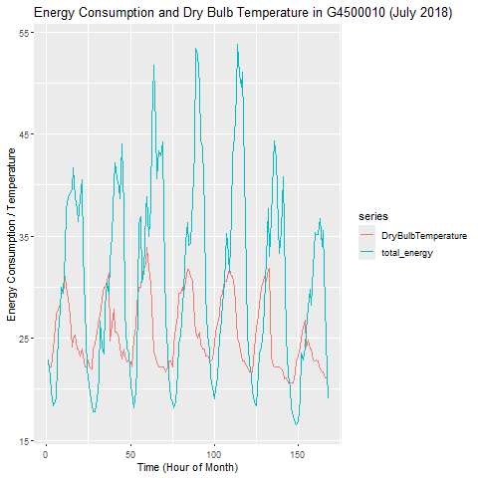
Visualizations
Notes:
The graph on the left demonstrates the lag between the peak temperature and the hottest point in a day, as well as the slow decay of energy usage as the day cools. On average, the peak temperature is 2-3 hours before the peak energy consumption.

Slide 7

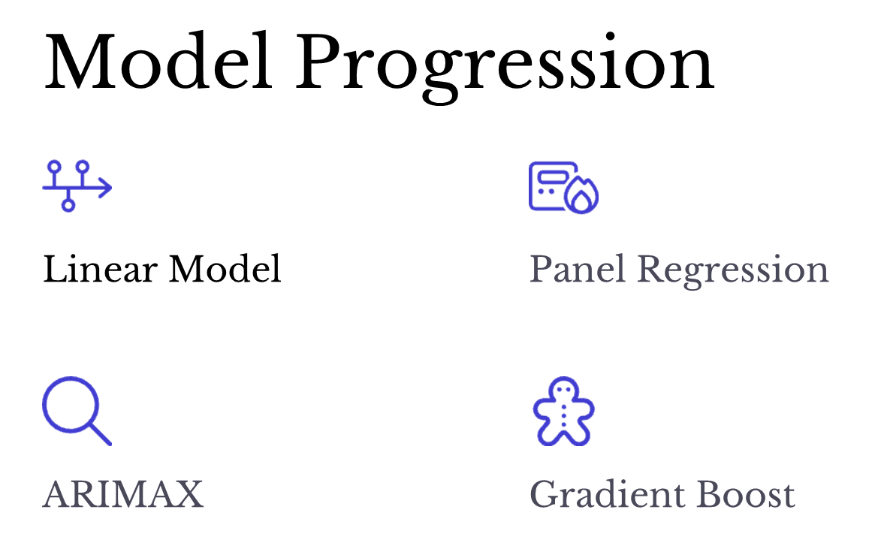

Slide 8
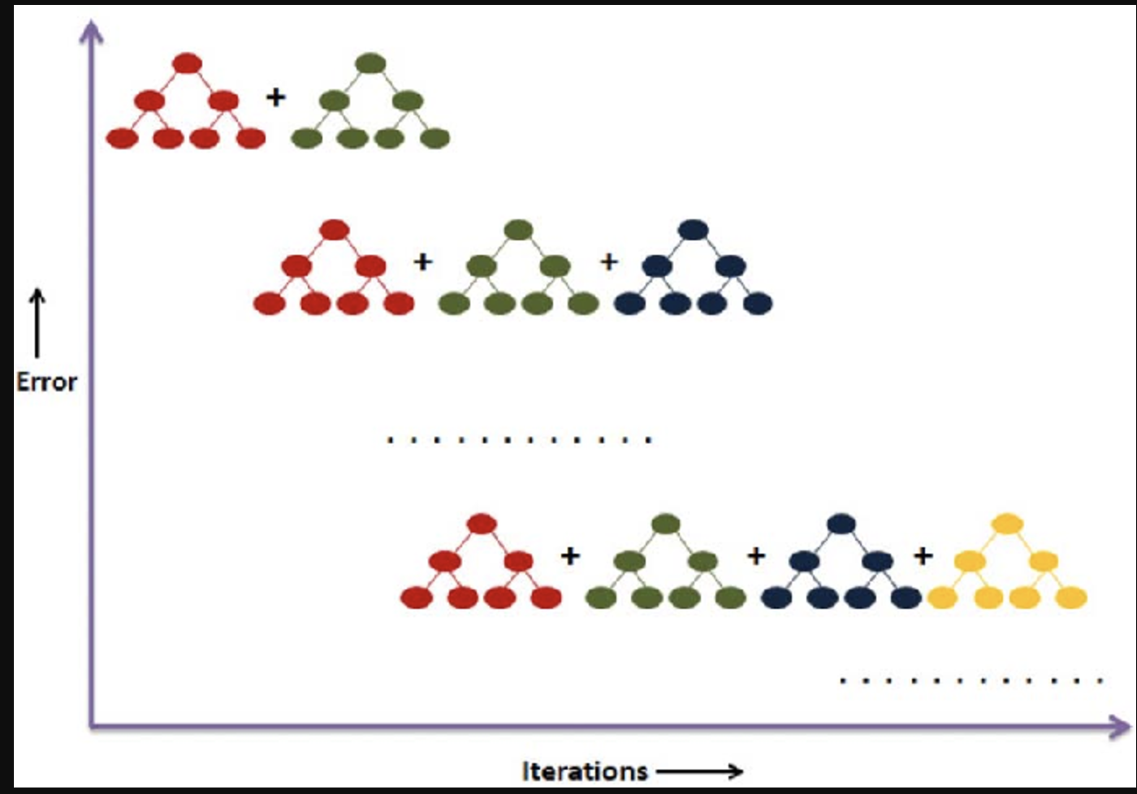
Model: Gradient Boosting
1
Wide range of predictors
Use of static data in addition to weather data
2
Forecasting
The model accurately forecasts energy consumption for higher temperatures
3
Metrics
The model explained almost 75% of the variance in energy consumption
Notes:
A weak correlation exists between the temperature and the total energy usage. Energy usage seems to peak just after the temperature peaks for that day and has a longer rampdown period.

Slide 9
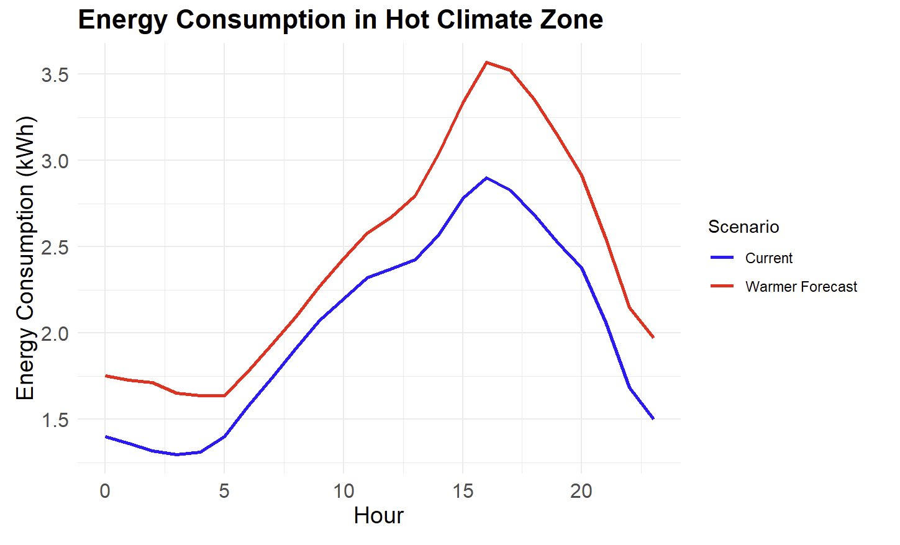

Slide 10
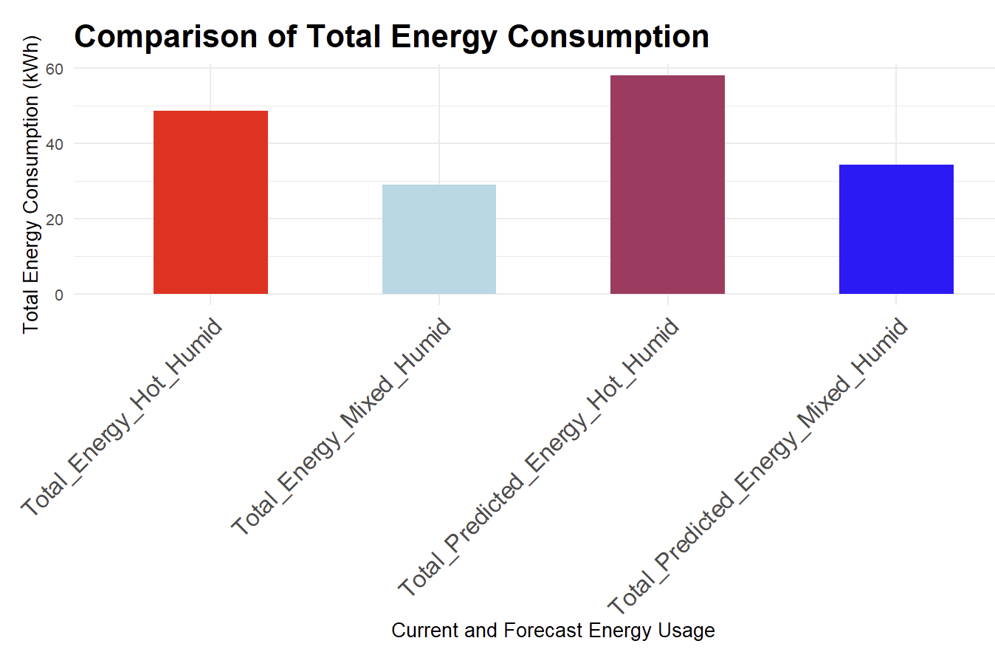

Slide 11
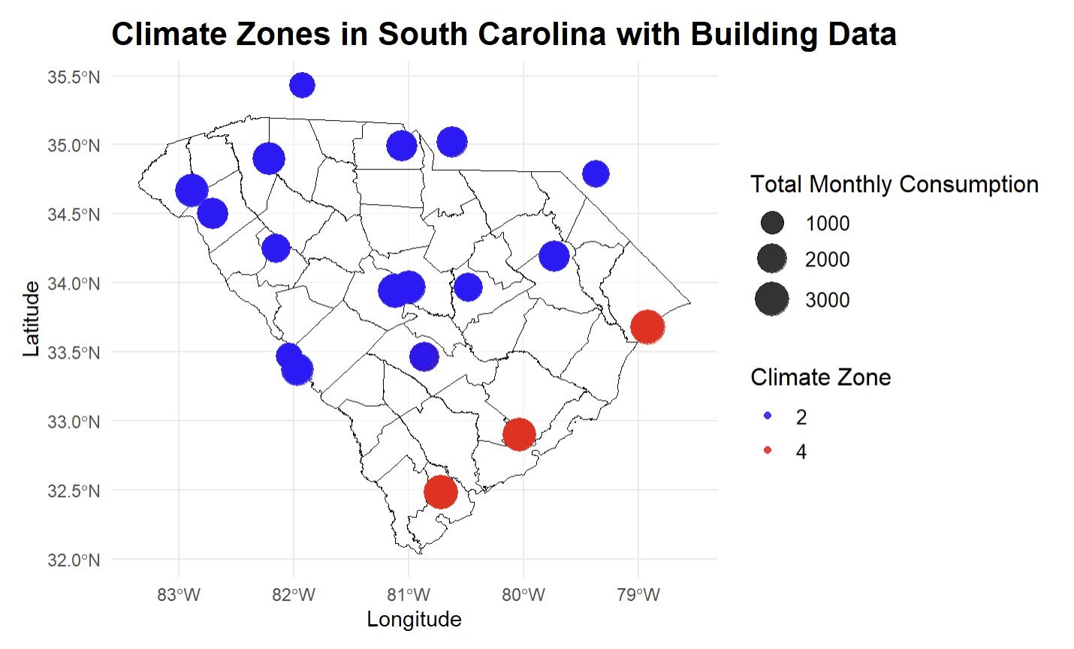

Slide 12
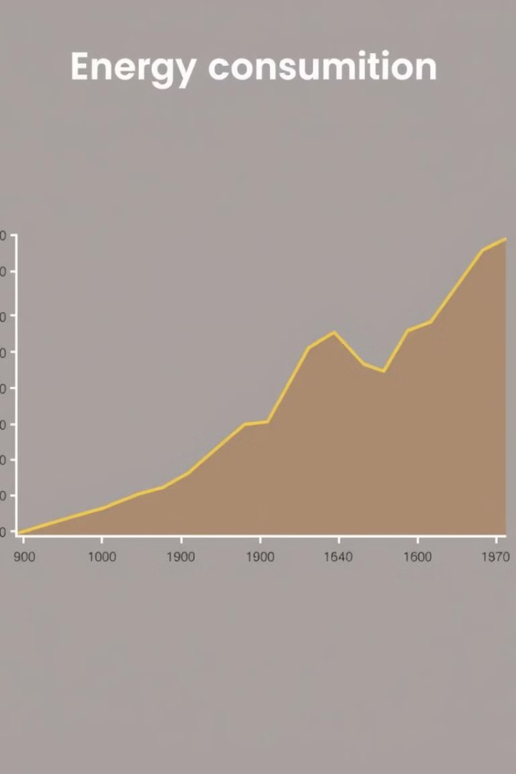
Impact of Temperature on Energy Demand
1
Mild Temperatures
Energy consumption remains moderate in cooler temperatures.
2
Rising Temperatures
As temperatures rise, energy demand increases.
3
Extreme Heat
Energy consumption peaks during periods of extreme heat.

Slide 13



Strategies for Reducing Energy Consumption
Installing a Heat Pump
1
Increases HVAC cooling efficiency, thereby reducing costs
Phasing out inefficient refrigerators
2
Replace EF 6.7 rated refrigerators with newer models
Optimal Solar Size
3
Install solar panels with capacity of 7 Kilo Watts
Notes:
Currently, PV usage only accounts for up to 1.5% in some counties. Warmer forecasts can help drive adoption for solar panels and thus drive down demand from the grid.

Slide 14
Next Steps: Moving Forward
Model Deployment
Customer Outreach
Continuous Improvement
Deploy the predictive model to provide real-time energy demand forecasts.
Implement the strategies for reducing energy consumption.
Continuously monitor and refine the model for greater accuracy and effectiveness.

