Slide 1
Introduction
The ACM Computing Curricula 2005 defined "computing" as
"In a general way, we can define computing to mean any goal-oriented activity requiring, benefiting from, or creating computers. Thus, computing includes designing and building hardware and software systems for a wide range of purposes; processing, structuring, and managing various kinds of information; doing scientific studies using computers; making computer systems behave intelligently; creating and using communications and entertainment media; finding and gathering information relevant to any particular purpose, and so on. The list is virtually endless, and the possibilities are vast."
2

Slide 2
Cloud Computing Course - Overview
I.
Introduction to Cloud Computing
Overview of Computing
Cloud Computing (NIST Model)
Properties, Characteristics & Disadvantages
Role of Open Standards
Cloud Computing Architecture
Cloud computing stack
Service Models (XaaS)
Infrastructure as a Service(IaaS)
Platform as a Service(PaaS)
Software as a Service(SaaS)
iii.
Deployment Models
III.
Service Management in Cloud Computing
Service Level Agreements(SLAs)
Cloud Economics
IV. Resource Management in Cloud Computing

Slide 3
Cloud Computing Course (contd.)
Data Management in Cloud Computing
Looking at Data, Scalability & Cloud Services
Database & Data Stores in Cloud
Large Scale Data Processing
Cloud Security
Infrastructure Security
Data security and Storage
Identity and Access Management
Access Control, Trust, Reputation, Risk
Case Study on Open Source and Commercial Clouds, Cloud Simulator
Research trend in Cloud Computing, Fog Computing

Slide 4
Trends in Computing
Distributed Computing
Grid Computing
Cluster Computing
Utility Computing
Cloud Computing

Slide 5
Distributed Computing

Slide 6
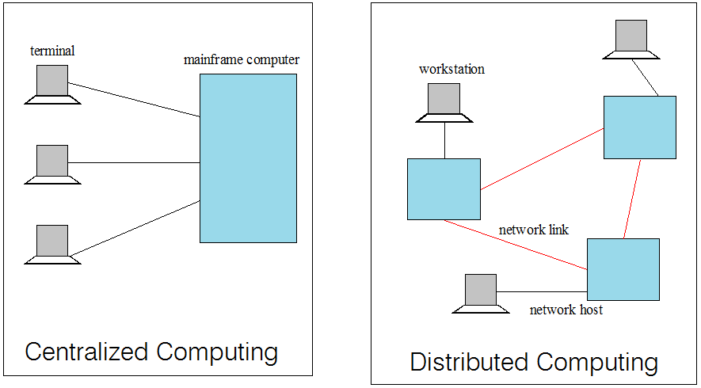
Centralized vs. Distributed Computing
Early computing was performed on a single processor. Uni-processor computing can be called centralized computing.

Slide 7
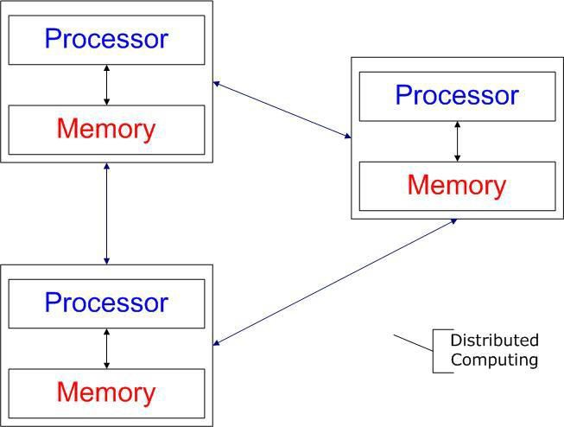
Distributed Computing/System?
Distributed computing
Field of computing science that studies distributed system.
Use of distributed systems to solve computational problems.
Distributed system
Wikipedia
There are several autonomous computational entities, each of which has its own local memory.
The entities communicate with each other by message passing.
Operating System Concept
The processors communicate with one another through various communication lines, such as high-speed buses or telephone lines.
Each processor has its own local memory.

Slide 8
Example Distributed Systems
•
•
•
•
Internet
ATM (bank) machines Intranets/Workgroups
Computing landscape will soon consist of ubiquitous
network-connected devices

Slide 9
Computers in a Distributed System
Workstations: Computers used by end-users to perform computing
Server Systems: Computers which provide resources and
services
Personal Assistance Devices: Handheld computers connected to the system via a wireless communication link.
10

Slide 10
Common properties of Distributed Computing
Fault tolerance
When one or some nodes fails, the whole system can still work fine except performance.
Need to check the status of each node
Each node play partial role
Each computer has only a limited, incomplete view of the system.
Each computer may know only one part of the input.
Resource sharing
Each user can share the computing power and storage resource in the system with other
users
Load Sharing
Dispatching several tasks to each nodes can help share loading to the whole system.
Easy to expand
We expect to use few time when adding nodes. Hope to spend no time if possible.
Performance
Parallel computing can be considered a subset of distributed computing

Slide 11
Why Distributed Computing?
Nature of application
Performance
Computing intensive
The task could consume a lot of time on computing. For example, Computation of Pi value using Monte Carlo simulation
Data intensive
The task that deals with a large amount or large size of files. For example, Facebook, LHC(Large Hadron Collider) experimental data processing.
Robustness
No SPOF (Single Point Of Failure)
Other nodes can execute the same task executed on failed node.

Slide 12
Why Distributed Computing?
Nature of application
Performance
Computing intensive
The task could consume a lot of time on computing. For example, Computation of Pi value using Monte Carlo simulation
Data intensive
The task that deals with a large amount or large size of files. For example, Facebook, LHC(Large Hadron Collider) experimental data processing.
Robustness
No SPOF (Single Point Of Failure)
Other nodes can execute the same task executed on failed node.

Slide 13
Distributed applications
Applications that consist of a set of processes that are distributed across a network of machines and work together as an ensemble to solve a common problem
In the past, mostly “client-server”
Resource management centralized at the server
“Peer to Peer” computing represents a movement towards more “truly”
distributed applications

Slide 14
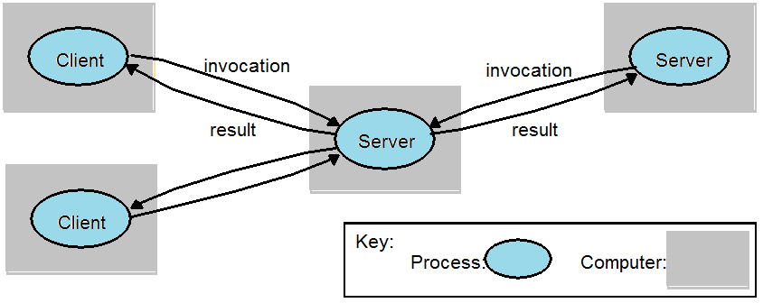
Clients invoke individual servers

Slide 15
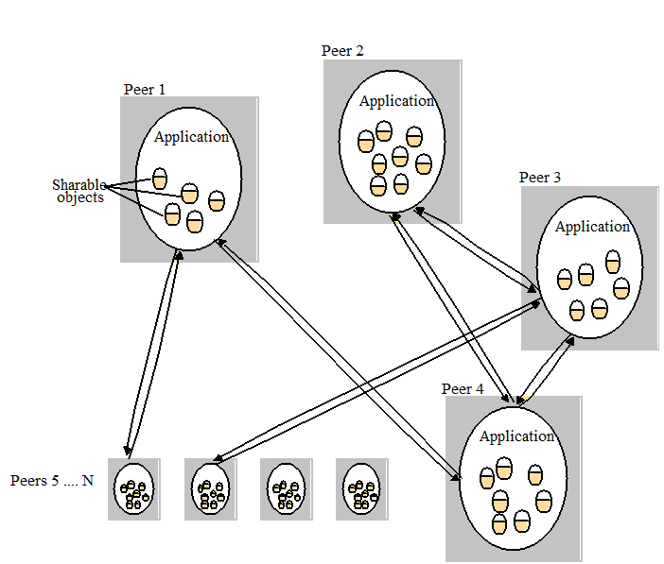
A typical distributed application based on peer processes

Slide 16
Grid Computing

Slide 17
Grid Computing?
Pcwebopedia.com
A form of networking. unlike conventional networks that focus on communication among devices, grid computing harnesses unused processing cycles of all computers in a network for solving problems too intensive for any stand-alone machine.
IBM
Grid computing enables the virtualization of distributed computing and data resources such as processing, network bandwidth and storage capacity to create a single system image, granting users and applications seamless access to vast IT capabilities. Just as an Internet user views a unified instance of content via the Web, a grid user essentially sees a single, large virtual computer.
Sun Microsystems
– Grid Computing is a computing infrastructure that provides dependable, consistent, pervasive and inexpensive access to computational capabilities

Slide 18
Electrical Power Grid Analogy
Electrical Power Grid
Users (or electrical appliances) get access to electricity through wall sockets with no care or consideration for where or how the electricity is actually generated.
“The power grid” links together power plants of many different kinds
Grid
Users (or client applications) gain access to computing resources (processors, storage, data, applications, and so on) as needed with little or no knowledge of where those resources are located or what the underlying technologies, hardware, operating system, and so on are
“The Grid" links together computing resources (PCs, workstations, servers, storage elements) and provides the mechanism needed to access them.

Slide 19
Grid Computing
When v use
Share more than information: Data, computing power, applications in dynamic environment, multi-institutional, virtual organizations
Efficient use of resources at many institutes. People from many institutions
working to solve a common problem (virtual organisation).
Join local communities.
Interactions with the underneath layers must be transparent and seamless to the user.

Slide 20
Need of Grid Computing?
Today’s Science/Research is based on computations, data analysis, data visualization & collaborations
Computer Simulations & Modelling are more cost effective than
^{experimental methods} Mathematical modeling of systems
Scientific and Engineering problems are becoming more complex & users need more accurate, precise solutions to their problems in shortest possible time
Data Visualization is becoming very important
Exploiting under utilized resources
10

Slide 21
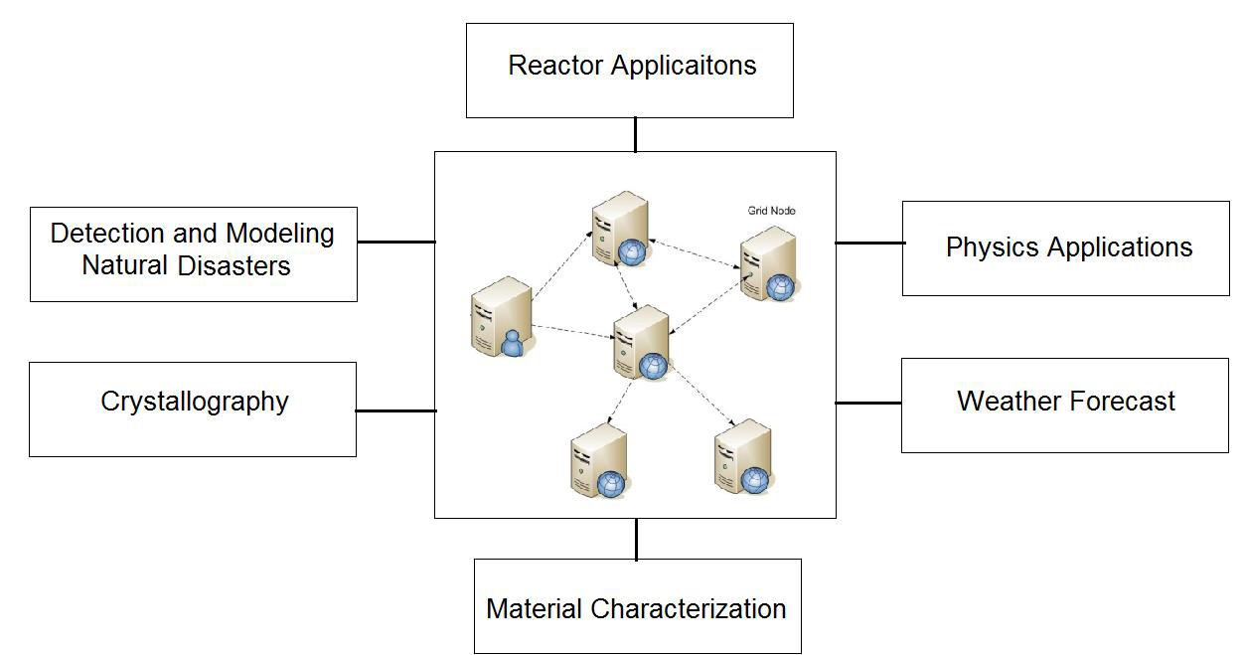
Who uses Grid Computing ?

Slide 22
Type of Grids
Computational Grid: These grids provide secure access to huge pool of shared processing power suitable for high throughput applications and computation intensive computing.
Data Grid: Data grids provide an infrastructure to support data storage, data discovery, data handling, data publication, and data manipulation of large volumes of data actually stored in various heterogeneous databases and file systems.
Collaboration Grid: With the advent of Internet, there has been an increased demand for better collaboration. Such advanced collaboration is possible using the grid. For instance, persons from different companies in a virtual enterprise can work on different components of a CAD project without even disclosing their proprietary technologies.

Slide 23
Type of Grids
Network Grid: A Network Grid provides fault-tolerant and high-performance communication services. Each grid node works as a data router between two communication points, providing data-caching and other facilities to speed up the communications between such points.
Utility Grid: This is the ultimate form of the Grid, in which not only data and computation cycles are shared but software or just about any resource is shared. The main services provided through utility grids are software and special equipment. For instance, the applications can be run on one machine and all the users can send their data to be processed to that machine and receive the result back.

Slide 24
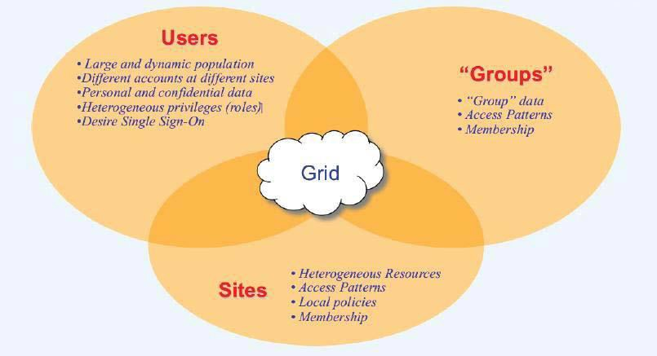
Grid Components
Source:KajariMazumdar “GRID:ComputingWithoutBorders” DepartmentofHighEnergyPhysicsTIFR,Mumbai.

Slide 25
Cluster Computing

Slide 26
What is Cluster Computing?
A cluster is a type of parallel or distributed computer system, which consists of a collection of inter-connected stand-alone computers working together as a single integrated computing resource .
Key components of a cluster include multiple standalone computers (PCs, Workstations, or SMPs), operating systems, high-performance interconnects, middleware, parallel programming environments, and applications.

Slide 27
Cluster Computing?
Clusters are usually deployed to improve speed and/or reliability over that provided by a single computer, while typically being much more cost effective than single computer the of comparable speed or reliability
In a typical cluster:
Network: Faster, closer connection than a typical network (LAN)
Low latency communication protocols
Loosely coupled than SMP

Slide 28
Types of Cluster
High Availability or Failover Clusters
Load Balancing Cluster
Parallel/Distributed Processing Clusters

Slide 29
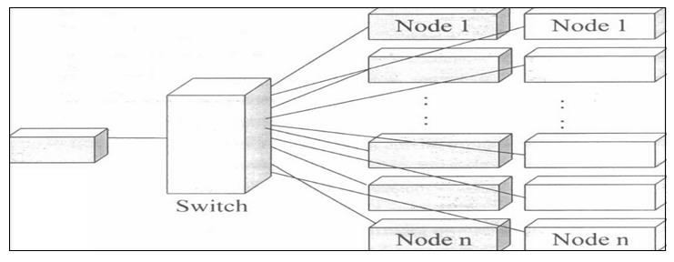
Cluster Components
Basic building blocks of clusters are broken down into multiple categories:
Cluster Nodes
Cluster Network
Network Characterization

Slide 30
Key Operational Benefits of Clustering
System availability: offer inherent high system availability due to the redundancy of hardware, operating systems, and applications.
Hardware fault tolerance: redundancy for most system components (eg. disk-RAID), including both hardware and software.
OS and application reliability: run multiple copies of the OS and applications, and through this redundancy
Scalability. adding servers to the cluster or by adding more clusters
to the network as the need arises or CPU to SMP.
High performance: (running cluster enabled programs)
20

Slide 31
Utility Computing

Slide 32
“Utility” Computing ?
Utility Computing is purely a concept which cloud computing practically implements.
Utility computing is a service provisioning model in which a service provider makes computing resources and infrastructure management available to the customer as needed, and charges them for specific usage rather than a flat rate.
This model has the advantage of a low or no initial cost to acquire computer resources; instead, computational resources are essentially rented.
The word utility is used to make an analogy to other services, such as electrical power, that seek to meet fluctuating customer needs, and charge for the resources based on usage rather than on a flat-rate basis. This approach, sometimes known as pay-per-use

Slide 33
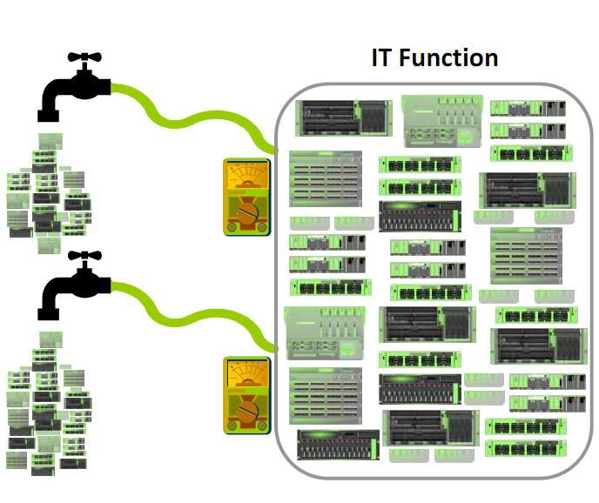
“Utility” Computing ?
"Utility computing" has usually envisioned some form of virtualization so that the amount of storage or computing power available is considerably larger than that of a single time- sharing computer.
Source:AlanMcSweeney, “The Economicsof Utility Computing”

Slide 34
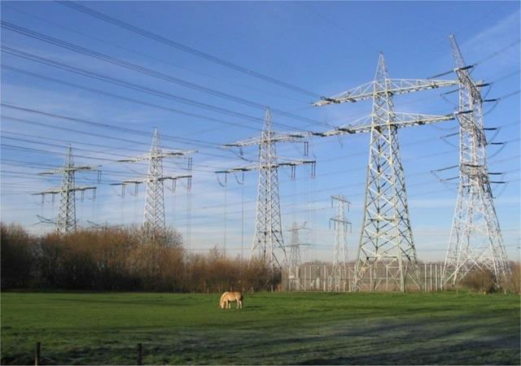
“Utility” Computing ?
Pay-for-use Pricing Business Model
Data Center Virtualization and Provisioning
Solves Resource Utilization Problem
Outsourcing
Web Services Delivery
Automation

Slide 35
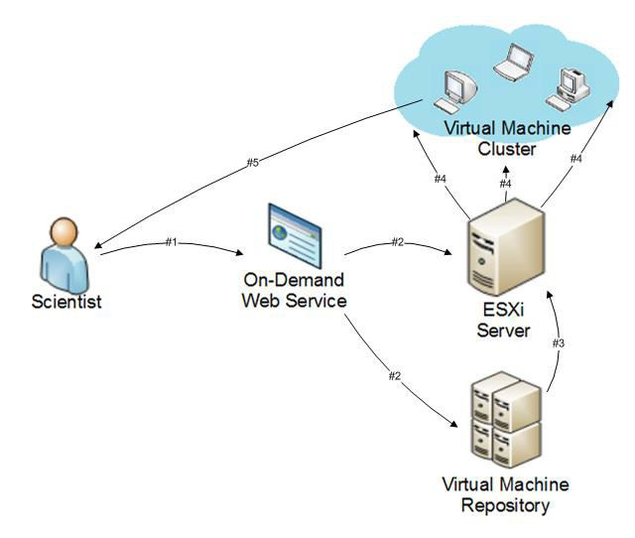
Utility Computing Example
On-Demand Cyber Infrastructure

Slide 36
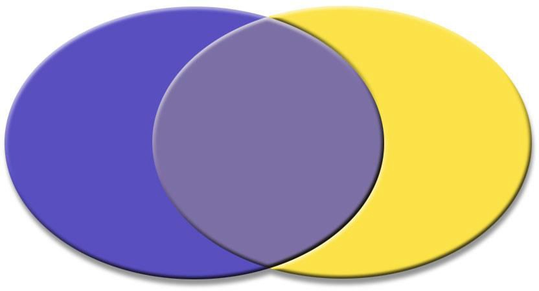
Utility Solution – Your Perspective
Consumer
vs
Provider
Service
Procurement
Infrastructure
Procurement
Service
Equipment
Ma
Resource
Assurance
Pricing
intenance
Availability
Contractor Management
Consultants
Utilization Technology Refresh System
Security
SLA
Application Sizing
Admins Capacity
Planning
Source: Perry Boster, “Utility Computing for Shared Services”, Massachusetts Digital Government Summit, September 23rd, 2004 –
Boston, MA

Slide 37
Utility Computing Payment Models
Same range of charging models as other utility providers: gas, electricity, telecommunications, water, television broadcasting
− Flat rate
− Tiered
− Subscription
− Metered
− Pay as you go
− Standing charges
Different pricing models for different customers based on factors such as scale, commitment and payment frequency
But the principle of utility computing remains
The pricing model is simply an expression by the provider of the costs of provision of the resources and a profit margin

Slide 38
Cloud Computing

Slide 39
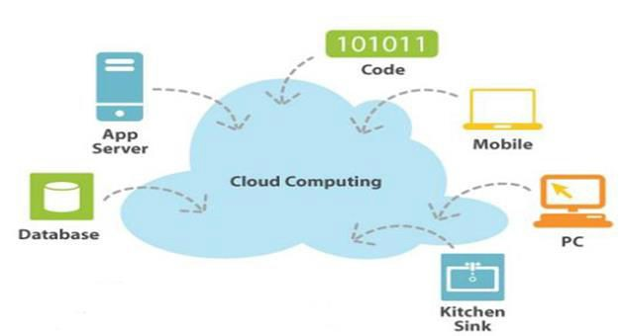
Cloud Computing
US National Institute of Standards and Technology defines Computing as
“ Cloud computing is a model for enabling ubiquitous, convenient, on-demand network access to a shared pool of configurable computing resources (e.g networks, servers, storage, applications, and services) that can be rapidly provisioned and released with minimal management effort or service provider interaction. ”
Source: http://www.smallbiztechnology.com/archive/2011/09/wait-what-is-cloud-computing.htm³⁰l/

Slide 40
Cloud Computing

Slide 41
Cloud Computing
US National Institute of Standards and Technology (NIST) defines Computing as:
“ Cloud computing is a model for enabling ubiquitous(omnipresent), convenient, on-demand network access to a shared pool of configurable computing resources (e.g. networks, servers, storage, applications, and services) that can be rapidly provisioned and released with minimal management effort or service provider interaction. ”
http://www.smallbiztechnology.com/archive/2011/09/wait-what-is-cloud-computing.html

Slide 42
Essential Characteristics
On-demand self-service
A consumer can unilaterally provision computing capabilities, such as server time and network storage, as needed automatically without requiring human interaction with each service provider.
Broad network access
Capabilities are available over the network and accessed through standard mechanisms that promote use by heterogeneous thin or thick client platforms (e.g., mobile phones, tablets, laptops, and workstations).
Resource pooling
The provider’s computing resources are pooled to serve multiple consumers using a multi-tenant model, with different physical and virtual resources dynamically assigned and reassigned according to consumer demand.

Slide 43
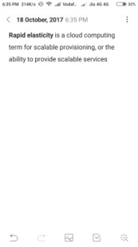
Cloud Characteristics
•
Measured Service
Cloud systems automatically control and optimize resource use by leveraging a metering capability at some level of abstraction appropriate to the type of service (e.g., storage, processing, bandwidth, and active user accounts). Resource usage can be
monitored, controlled, and reported, providing transparency for both the provider and consumer of the utilized service.
Rapid elasticity
– Capabilities can be elastically provisioned and released, in some cases automatically, to scale rapidly outward and inward commensurate with demand. To the consumer, the capabilities available for provisioning often appear to be unlimited and can be appropriated in any quantity at any time.

Slide 44
Common Characteristics
Massive Scale
Resilient Computing
Homogeneity
Geographic Distribution
Virtualization
Service Orientation
Low Cost Software
Advanced Security

Slide 45
Characteristics of Cloud Computing
There are basically 5 essential characteristics of Cloud Computing.
On-demand self-services: The Cloud computing services does not require any human administrators, user themselves are able to provision, monitor and manage computing resources as needed.
Broad network access: The Computing services are generally provided over standard networks and heterogeneous devices.
Rapid elasticity: The Computing services should have IT resources that are able to scale out and in quickly and on as needed basis. Whenever the user require services it is provided to him and it is scale out as soon as its requirement gets over.
Resource pooling: The IT resource (e.g., networks, servers, storage, applications, and services) present are shared across multiple applications and occupant in an uncommitted manner. Multiple clients are provided service from a same physical resource.
Measured service: The resource utilization is tracked for each application and occupant, it will provide both the user and the resource provider with an account of what has been used. This is done for various reasons like monitoring billing and effective use of resource.

