Slide 1
CRE Paper Presentation
Team: Ishaan Pathak, Jaswanth Krishna Kondisetty, Rahul Potharaju.
Title: Learning to Summarize from Human Feedback.
Authors: Nisan Stiennon, Long Ouyang, Jeff Wu, Daniel Ziegler, Ryan Lowe Chelsea Voss, Alec Radford, Dario Amodei, Paul Christiano.
Published in NeurIPS 2020 proceedings.
Citations: 34.

Slide 2
Key Objectives
What’s the main goal?
Traditional summarization models rely on automatic metrics like ROUGE, which don’t always reflect what humans find useful.
This research uses human feedback to improve AI-generated summaries.
How do they achieve this?
They train a reward model that learns what summaries humans prefer.
Instead of supervised learning, they use reinforcement learning (PPO) to fine-tune the AI.
The model is tested to see if it generalizes well (performs well on new data).
The final step is comparing human feedback with traditional evaluation metrics like ROUGE to show why human preferences are better.

Slide 3
Methodology-AI Training Process
How was the AI trained?
A baseline AI summarization model was trained using the Reddit TL;DR dataset to generate concise summaries from long text inputs.
Human annotators compared AI-generated summaries and provided preference-based rankings, helping to identify which summaries better aligned with human expectations.
A reward model was trained to predict human preferences, learning what makes a summary high-quality according to humans.
The summarization model was fine-tuned using Proximal Policy Optimization (PPO), ensuring that the AI optimized summaries based on human preferences rather than traditional evaluation metrics like ROUGE.

Slide 4
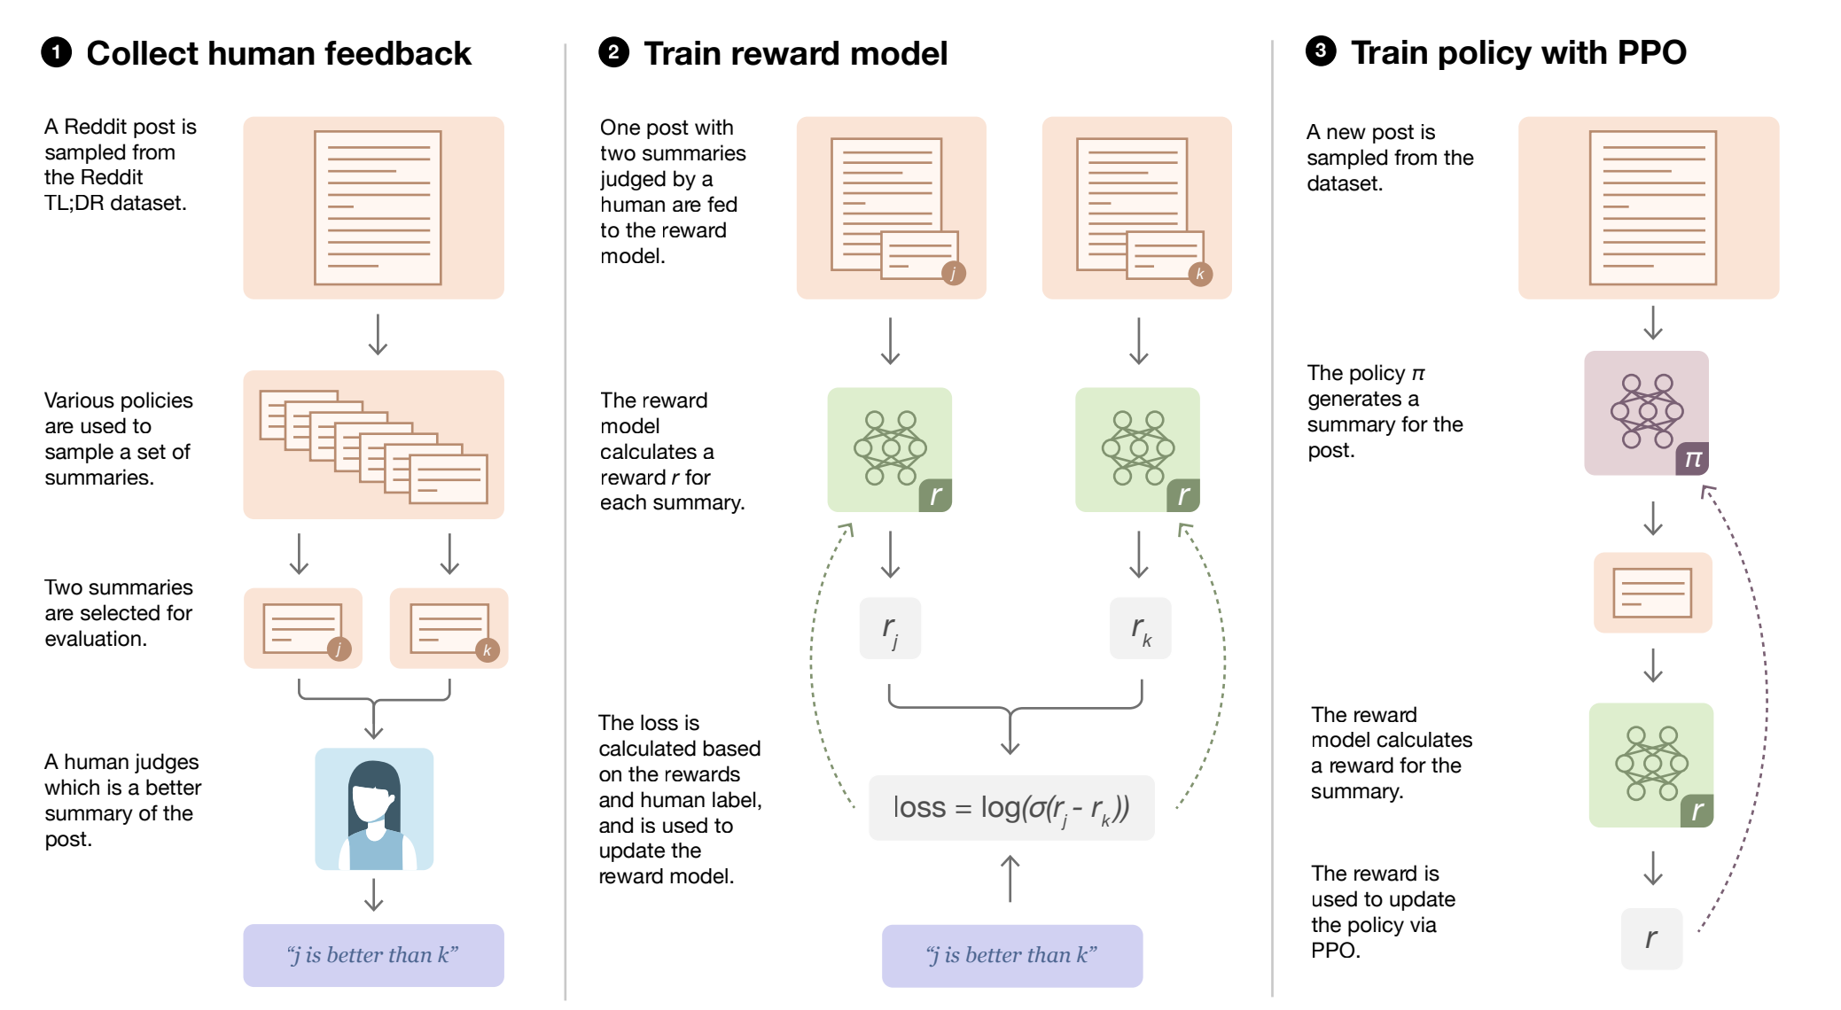
How AI Learns to Summarize: Human Feedback Approach

Slide 5
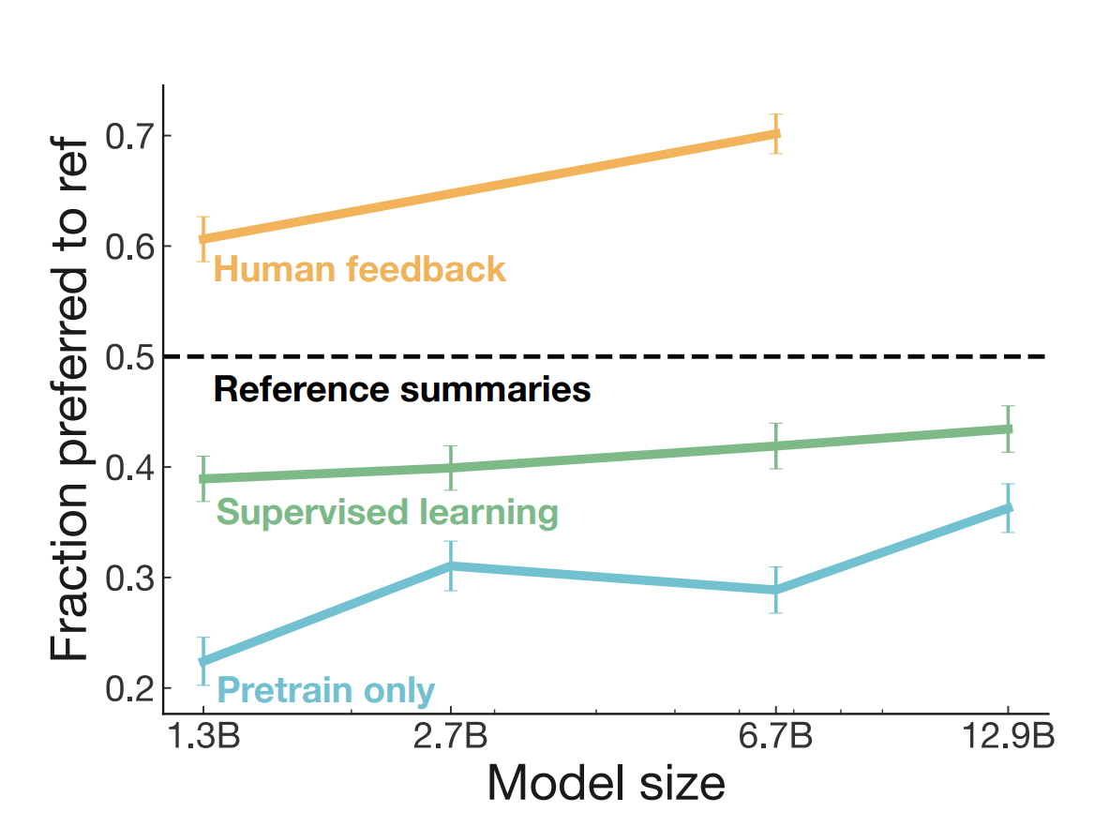
Key Findings – Performance Comparison
AI models trained with human feedback outperform traditional supervised models.
Even smaller models trained with human feedback achieve better results than larger supervised models.
Summaries generated by human feedback-trained models are often preferred over human-written ones.

Slide 6
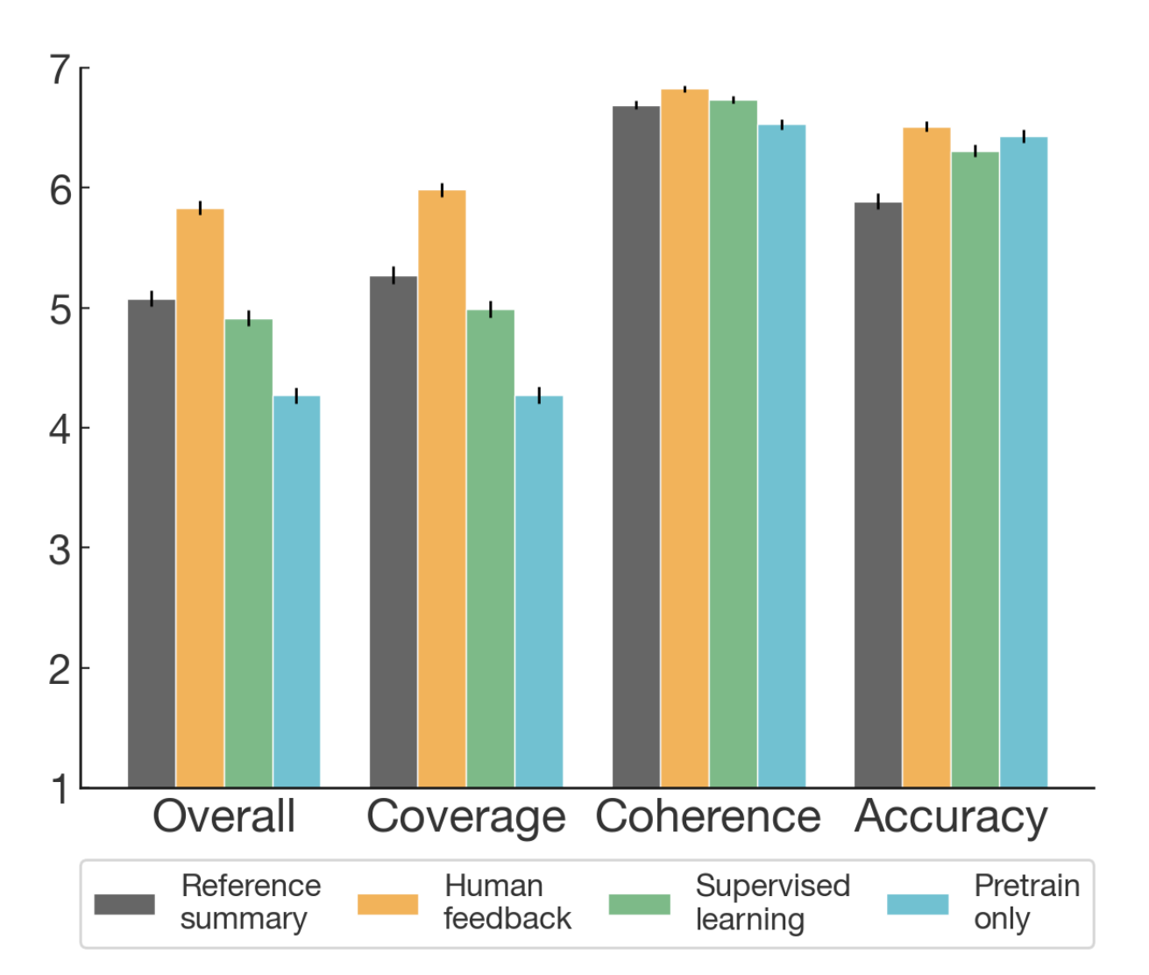
Key Findings - Summary Quality Metrics
AI trained with human feedback improves across multiple factors:
Coverage – Captures important information.
Coherence – Produces clear, structured summaries.
Accuracy – Avoids incorrect or misleading information.
Overall Quality – Summaries align better with human preferences.
Why does this matter?
Traditional AI evaluation metrics (ROUGE) do not measure
readability or human preference.
Human feedback leads to better, more human-like summaries.

Slide 7
Why Traditional AI Models Fail?
Traditional AI summarization models struggle because:
They rely too heavily on ROUGE, which does not reflect human preferences.
They often miss key details, leading to incomplete or misleading summaries.
They fail to generalize across different domains.
How does human feedback solve this?
It teaches AI what humans prefer, leading to more meaningful summaries.

Slide 8
Real-World Applications
How this research improves AI summarization in real-world applications:
News Summarization – it can generate more readable news summaries.
Customer Support Bots - AI chatbots summarize user queries better.
Educational - AI simplifies complex topics for better understanding.
Other NLP Applications - Search Engine Summarization
Dialogue Systems – these chatbots give more relevant responses.
Machine Translation – it can produce more natural translations.

Slide 9
Ideas for Future Research
Potential improvements for AI summarization:
Expanding human feedback learning to other NLP tasks, chatbots and search engines.
Improving human feedback collection to reduce annotation costs and labeling bias.
Preventing over-optimization – ensuring models do not learn shortcuts that reduce summary quality.
Scaling up AI reward models to handle more complex language processing tasks.

Slide 10
Our Implementation
Phase 1: Supervised Summarization with Preference Labeling
Phase 2: Reward Model Training based on Preference
Data Objective: Align summarization with human-like
Preferences
Tools Used: BART, BERT, Hugging Face Transformers, CNN/DailyMail Dataset

Slide 11
Phase 1 – Supervised Summarization
Summarizer Used: Facebook/Bart-large-cnn
Summary Generation Techniques:
Greedy Decoding
Beam Search Decoding
Preference Selection:
Used ROUGE-L score to pick the preferred summary. Built labeled dataset: (Article, Greedy Summary, Beam Summary, Preferred Label).

Slide 12
Phase 2 – Reward Model Training
Model: Bert-base-uncased fine-tuned for binary classification
Inputs:(Article + Summary) pairs
Labels:1 → Preferred0 → Not Preferred
Objective: Predict which summary a human would prefer automatically

Slide 13
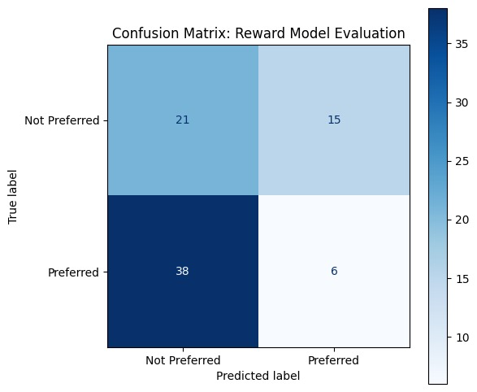
Reward Model Evaluation
Metrics Achieved: Accuracy, Precision, Recall, F1-score
Visualization: Confusion Matrix showing model performance
Outcome:
Model successfully learned to predict preferences
Demonstrated the feasibility of automating feedback without human annotation.

Slide 14
Alignment with Future Scope
Successfully built:
Summarization preference dataset
Automated reward model
Directly enables the next step: Reinforcement Learning (PPO)
Ready to extend:
Multi-domain preference modeling,
Real-time human-in-the-loop feedback systems
Fully aligned with future work proposed by Stiennon et al., 2020

Slide 15
Conclusions
Human feedback significantly improves AI summarization quality.
Models trained with human feedback generalize better than supervised models.
ROUGE and other automated metrics are unreliable.
Future research should focus on scaling human feedback-driven AI training methods.
Final Thought:
"This research is a glimpse into the future of AI training— were
instead of optimizing for arbitrary metrics, AI learns directly from
humans. The implications go far beyond summarization, shaping
how AI aligns with human needs in the years to come."

Slide 16
“Thank you for your time!”
“Any questions?”

