Slide 1
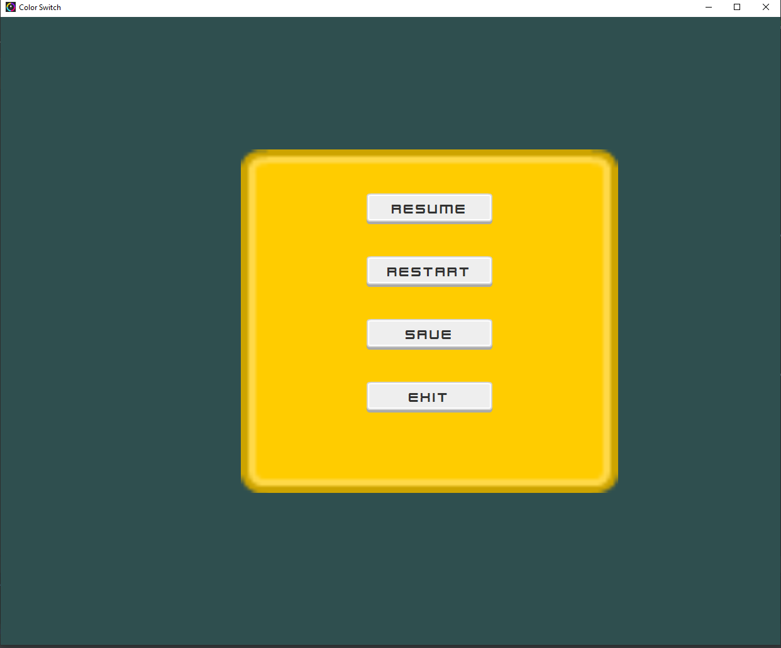
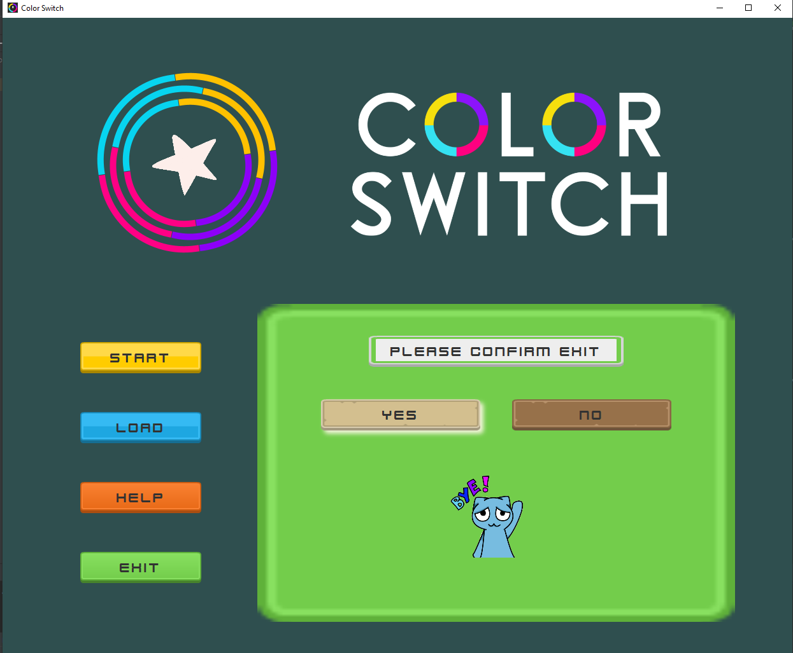
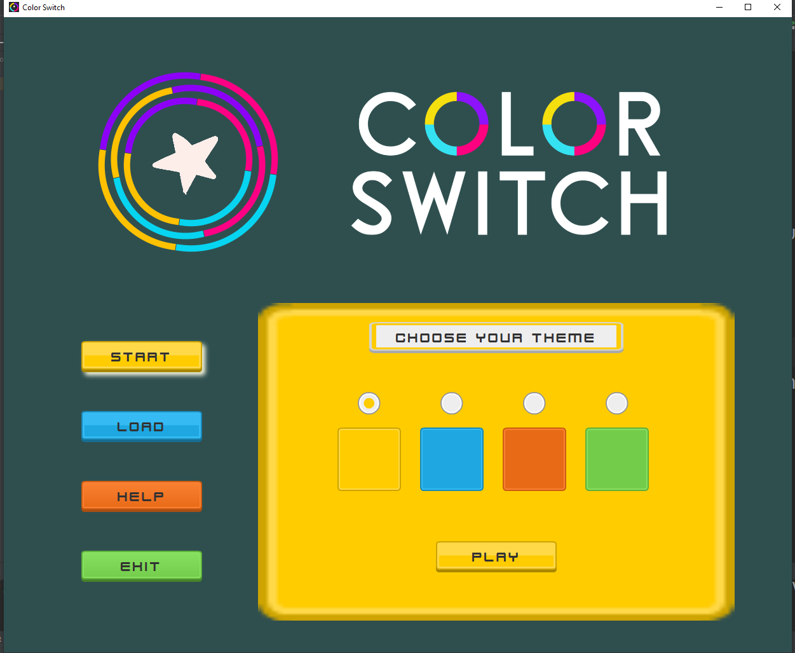
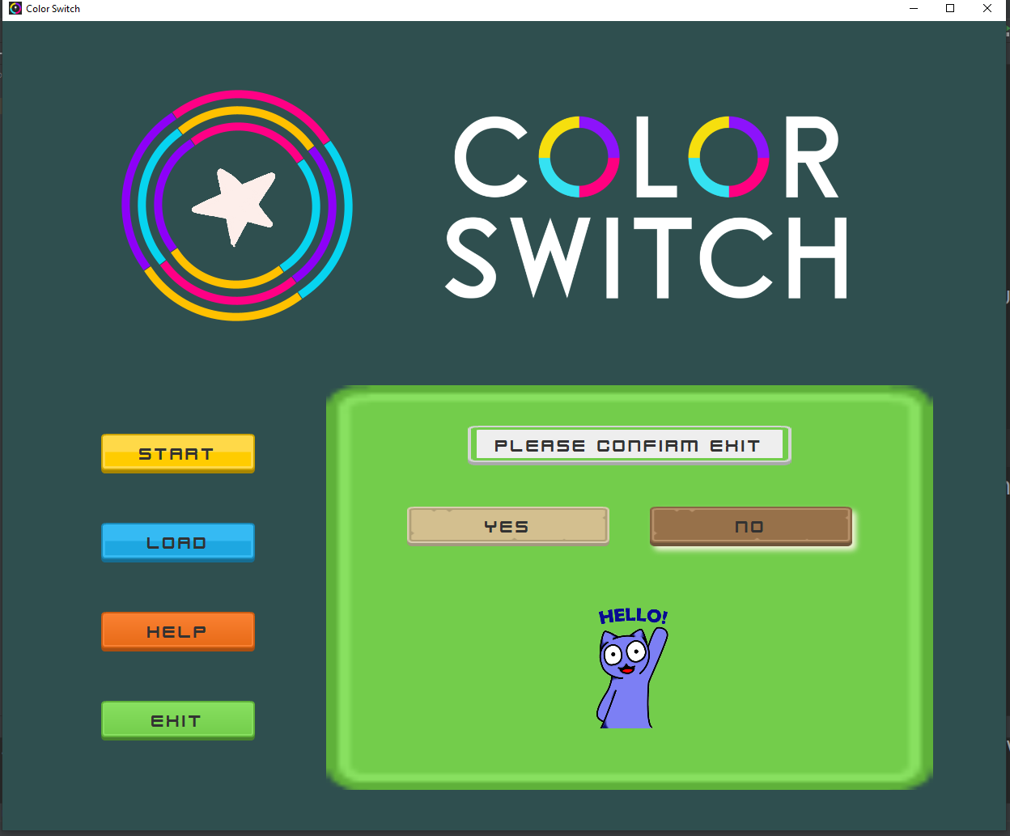
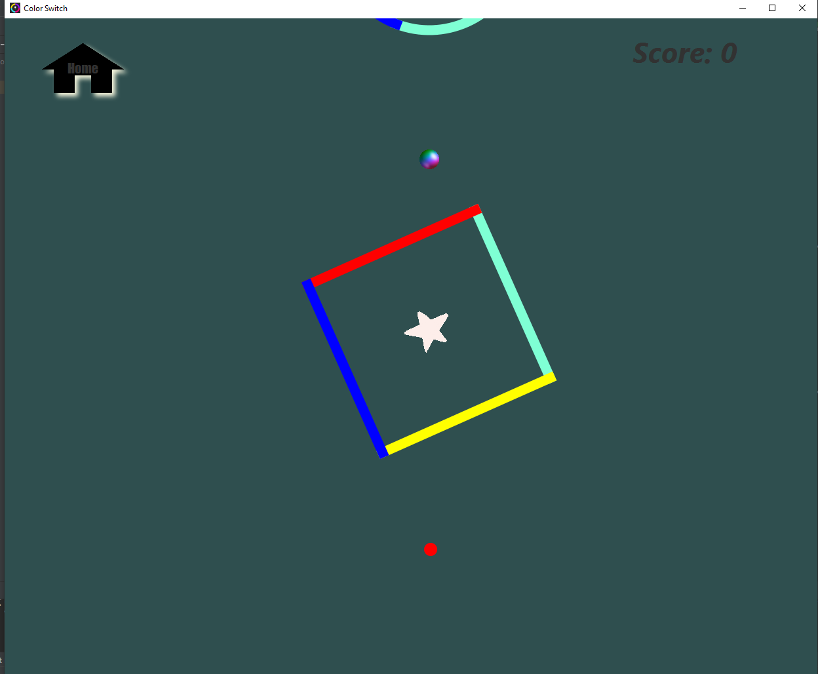
Color Switcher JAVAFX

Slide 2
Game Details
Navigation is happening using FXML files.
All the static components of game screens are made using fxml.
Custom reusable components which represents UI have been made by extending corresponding component classes from javafx. These are present inside model package.
Controllers contains the game logic and event handling part. These are present inside the application package along with the sprites based classes.
View package consists of class ViewManager and fxml files. It provides facility for switching between various game screens.
Various animation timers are used to create the game loop. Each of these represent a different thread implicitly made by JVM.
Features include everything that is present in the standard Color Switch game with an additional load/save functionality.
Design Patterns Used: Iterator, Flyweight, Facade.
Link to GitHub repository(Will be made public during demo): https://github.com/ishaan19246/Color_Switch

Slide 3
Individual Contribution
Naman Gupta
Implemented the game screen and the game logic. This includes collision logic, ball-jump logic and move-screen logic . Static components include obstacles.
Added the game save logic(Serialization and Deserialization).
Animations: Game logo and Obstacle motion.
GUI: Backgrounds.
Roll No. - 2019436
Ishaan Jindal
Implemented the home screen and other static components of the game screen including the pause screen menu, color switcher, stars and score.
Added the bonus component(Next Slide).
Animations: Exit animations and Subscenes.
GUI: Custom buttons , Theme picker. Roll No. - 2019246

Slide 4
Bonus Components
Sounds
Animations : Collision animations and star collect animations.
Welcome screen using wait/notify or threading mechanism(Subject to time availability) .

