Slide 1

A PROJECT REVIEW MEETING ON PRODUCT SEARCH AND RECCOMENDATION SYSTEM
By
Name Ishaan Kulkarni Roll 2520030267
Name Mohammad Faizaan Roll 2520030359````````````````````````````````
TEAM NUMBER:
Under the guidance of
Pavithra. D
Assistant Professor
Department of Computer Science and Engineering
Koneru Lakshmaiah Education Foundation (Deemed to be University estd. u/s. 3 of the UGC Act, 1956)
Off-Campus: Bachupally-Gandimaisamma Road, Bowrampet, Hyderabad, Telangana - 500 043.
Phone No: 7815926816, www.klh.edu.in

Slide 2
Outline of the Presentation
01
02
03
Abstract
Introduction
Problem Statement
04
05
06
Project Flow Diagram
Objectives with Justification
Modules [Frontend web pages]
07
08
09
Expected Outcomes of the Proposed Work
Conclusion
References

Slide 3
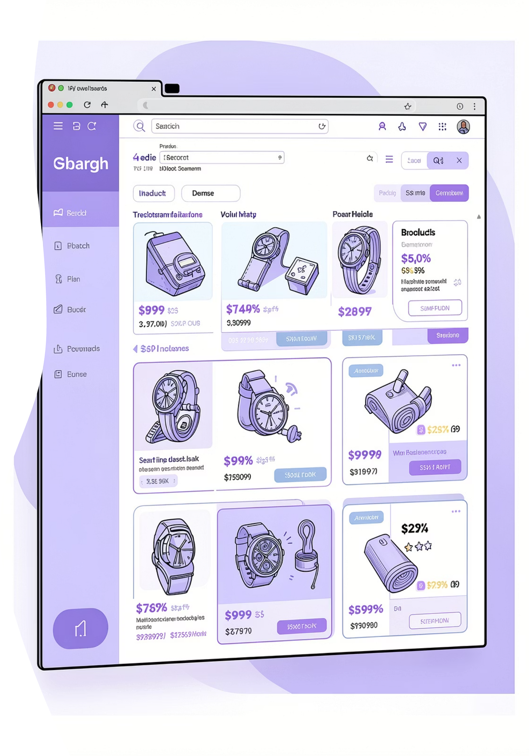
Abstract
The Smart Product Search and Recommendation Engine is a web-based platform designed to simplify online product discovery. Instead of searching across multiple e-commerce websites individually, users can search for a product once and receive consolidated results from various trusted platforms. The system identifies available products, compares prices, and presents the best purchasing options to users.
Additionally, the platform maintains user search history and utilizes recommendation techniques to display personalized product suggestions on the home page. The project aims to improve convenience, reduce search effort, and enhance the online shopping experience through a centralized product discovery interface.

Slide 4
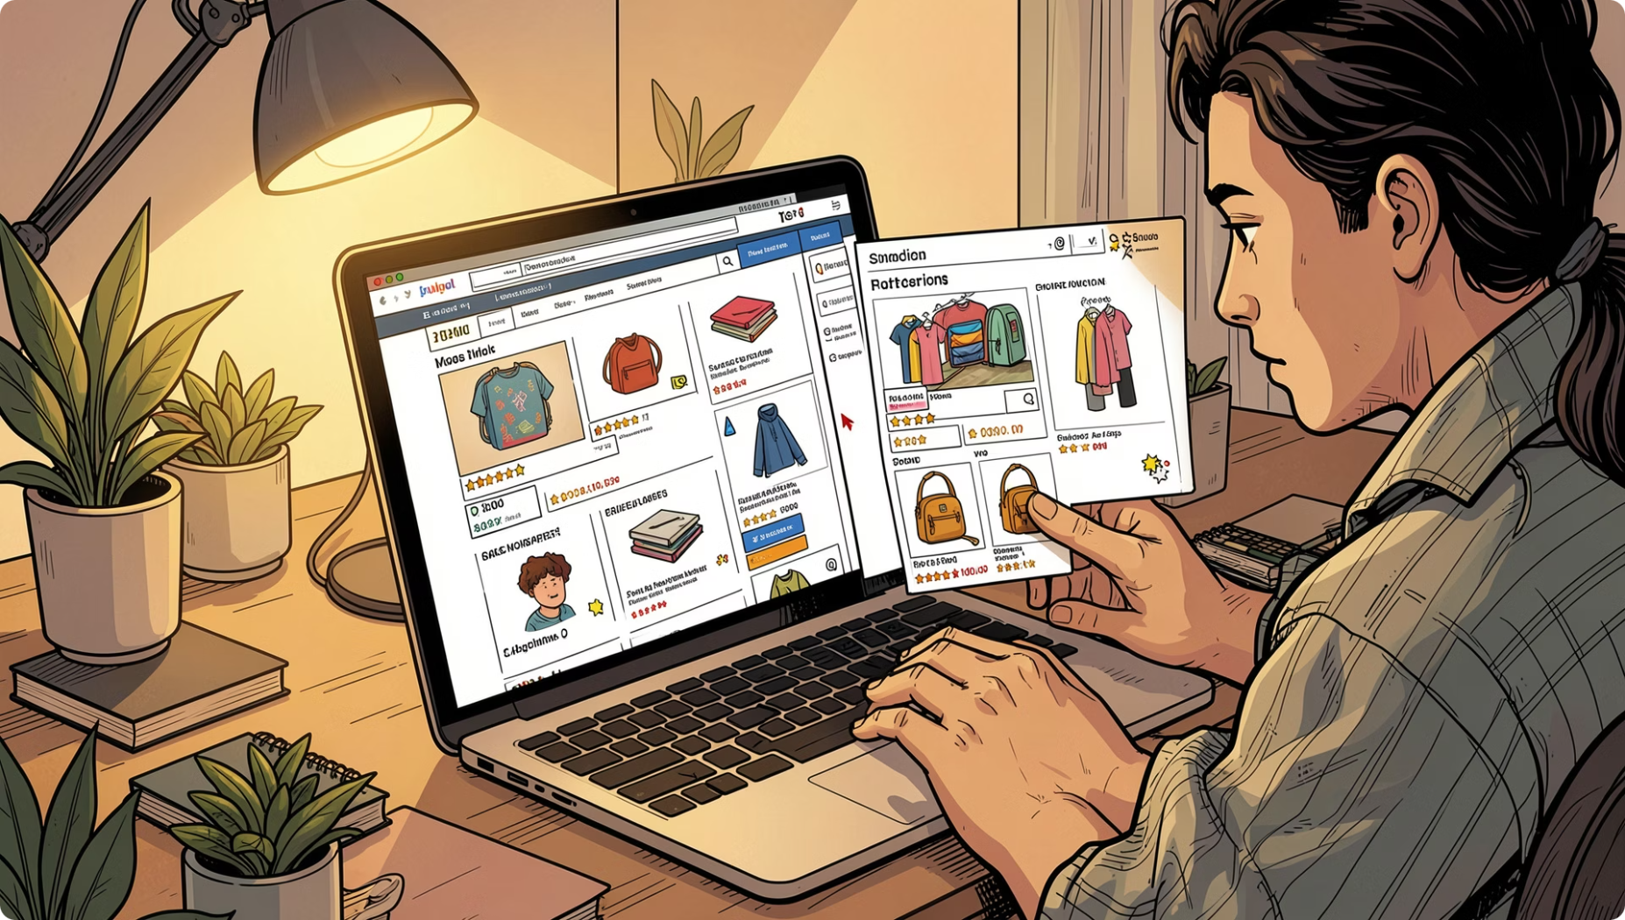
Introduction
Online shoppers often visit multiple websites such as Amazon, Flipkart, Myntra, and other marketplaces to compare prices and availability. This process is time-consuming and inefficient, especially for niche or less common products.
The proposed system provides a unified platform where users can search once and obtain product information from multiple trusted sources. The platform also generates personalized recommendations based on previous searches and browsing behavior.

Slide 5

Problem Statement
The Challenge
Consumers spend significant time comparing products across different e-commerce platforms. There is currently no simple centralized interface that allows users to discover products, compare prices, and receive personalized recommendations from multiple trusted sources.
The Objective
The objective is to develop a platform that aggregates product information and simplifies product discovery through a single search interface.

Slide 6
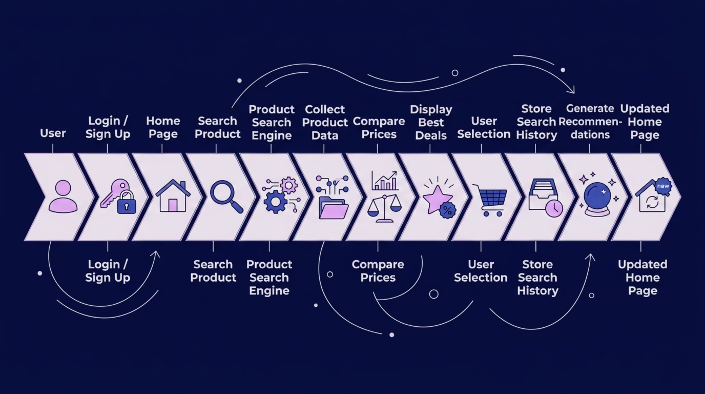
Project Flow Diagram

Slide 7
Objectives with Justification
Objective 1
1
Develop a centralized product search interface.
Justification: Reduces the need to visit multiple websites.
Objective 2
2
Implement multi-platform product comparison.
Justification: Helps users identify the best available deals.
Objective 3
3
Provide personalized recommendations.
Justification: Improves user engagement and relevance.
Objective 4
4
Create secure user authentication.
Justification: Allows storage of preferences and search history.
Objective 5
5
Build a scalable frontend architecture.
Justification: Supports future integration with APIs and AI models.

Slide 8
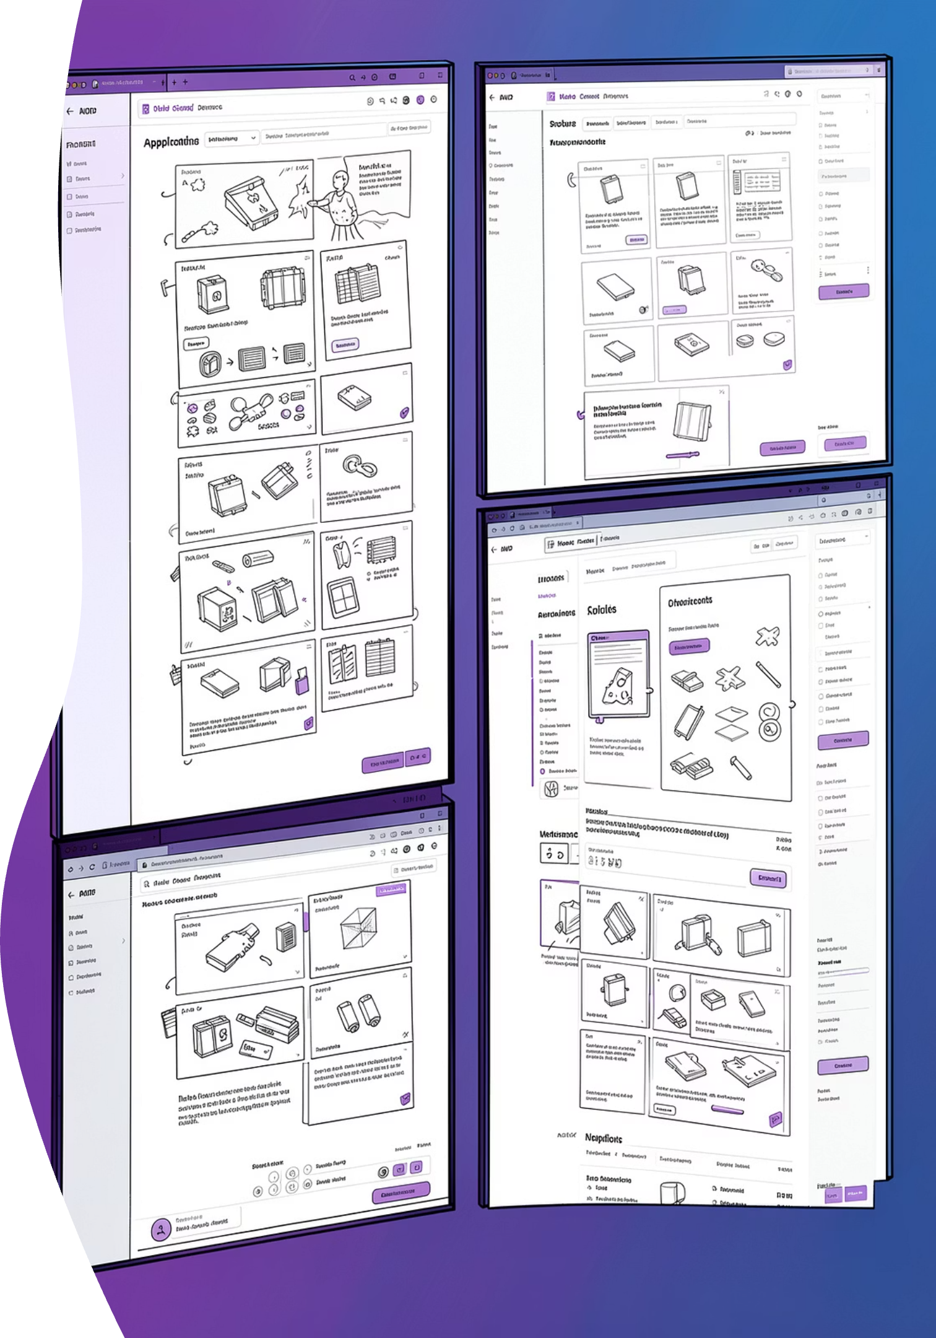
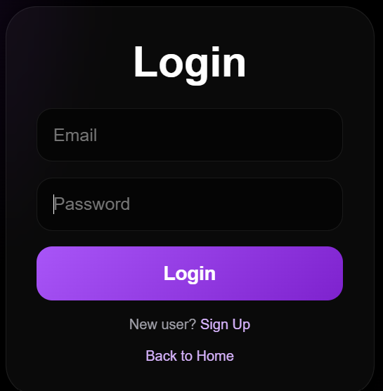
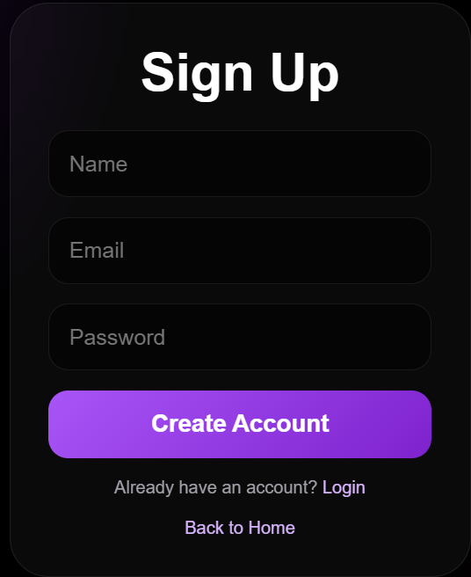
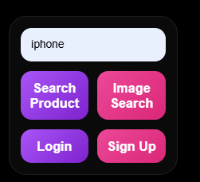
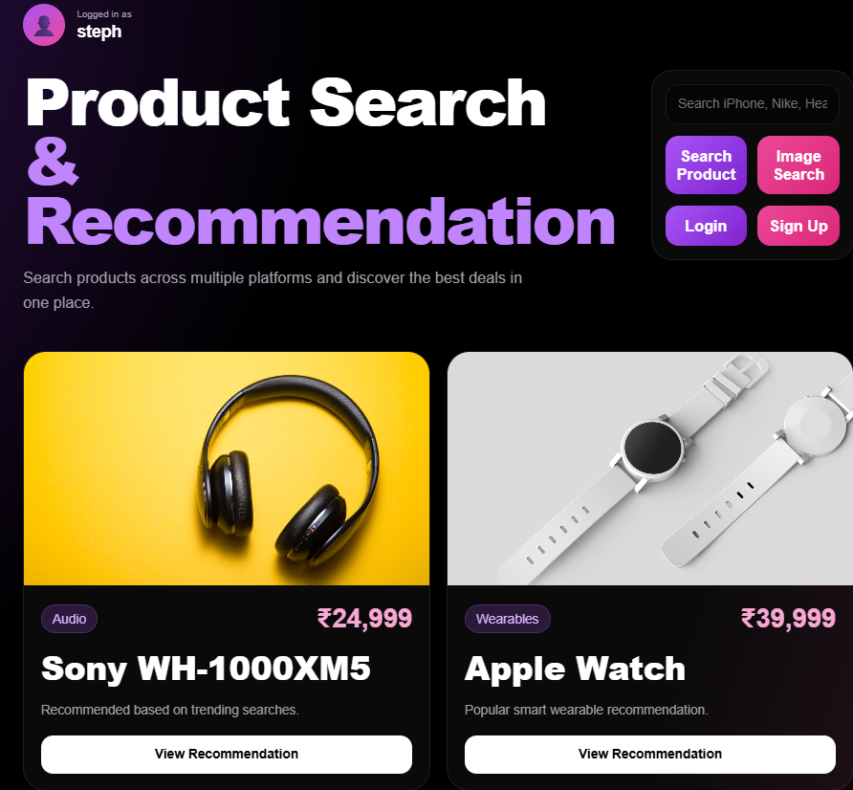
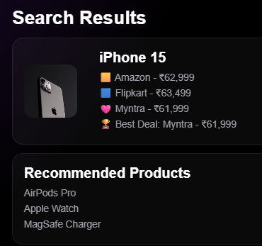
Modules [Frontend Web Pages]

Slide 9
Expected Outcomes of the Proposed Work
Single-search product discovery
Faster comparison of products
Better shopping decisions
Personalized recommendations
Reduced user effort
Improved shopping experience

Slide 10
Conclusion and Future Scope
Conclusion
Future Scope
The proposed Smart Product Search and Recommendation Engine provides a centralized solution for product discovery and price comparison. By combining search functionality, recommendation techniques, and price comparison features, the system reduces the effort required to find products across multiple platforms while improving user experience.
AI Recommendation Models
Real-Time API Integration
Voice Search
Image-Based Product Search
Browser Extension
Mobile Application
Price Drop Notifications
Wishlist Tracking

