Slide 1
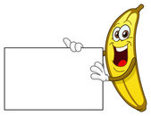
Canteen Management System
-: Project By :-
Hrishikesh Balaji B010
Ishaan Almeida B007

Slide 2
-: Introduction :-
“The Canteen Management System” is a simulation of a real management system which numerous workspaces use in order to cater to the need of people who wish to avail the food/beverages that is provided by said Canteen.

Slide 3
-: Aim :-
Our goal is to be able to implement our project in real time with some or no needed modifications that might help our program to function smoothly at said implementation.

Slide 4
-: Functions Used :-
Enables the User to create his own order record.
Enables the User to place an order.
Allows the User to choose a food item or a beverage from a variety of choices specified in the menu.
Permits the User to check his history of orders.
It provides the User with an option of deleting his records if need be.
The System recommends the most ordered food item to someone who might be placing an order then.

Slide 5
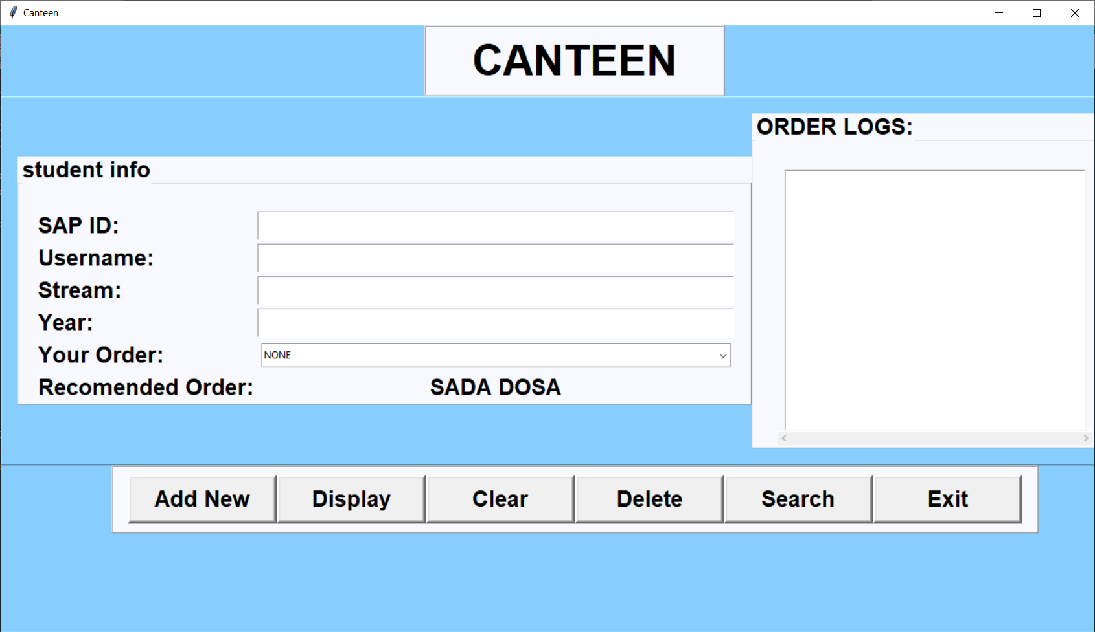

Slide 6
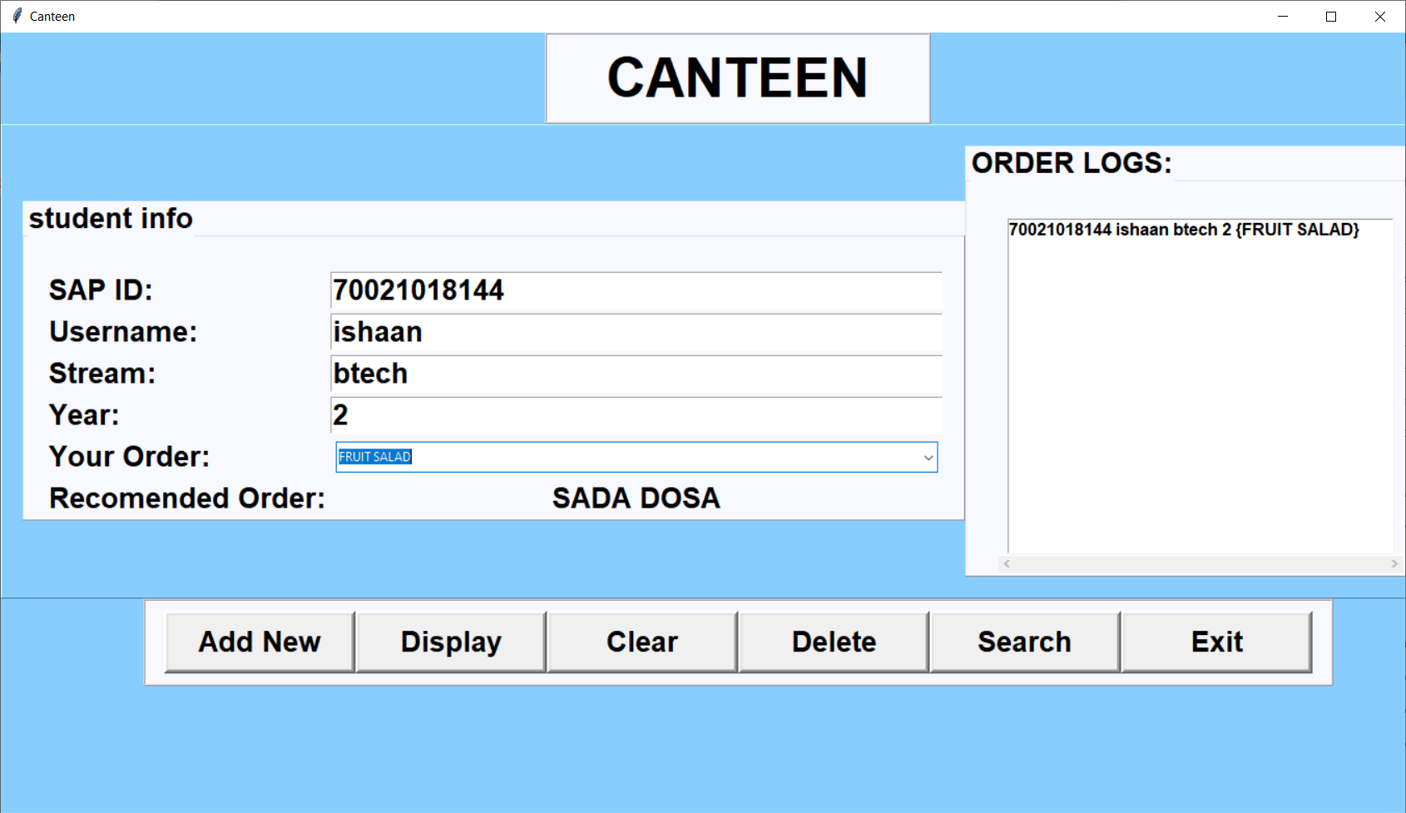

Slide 7
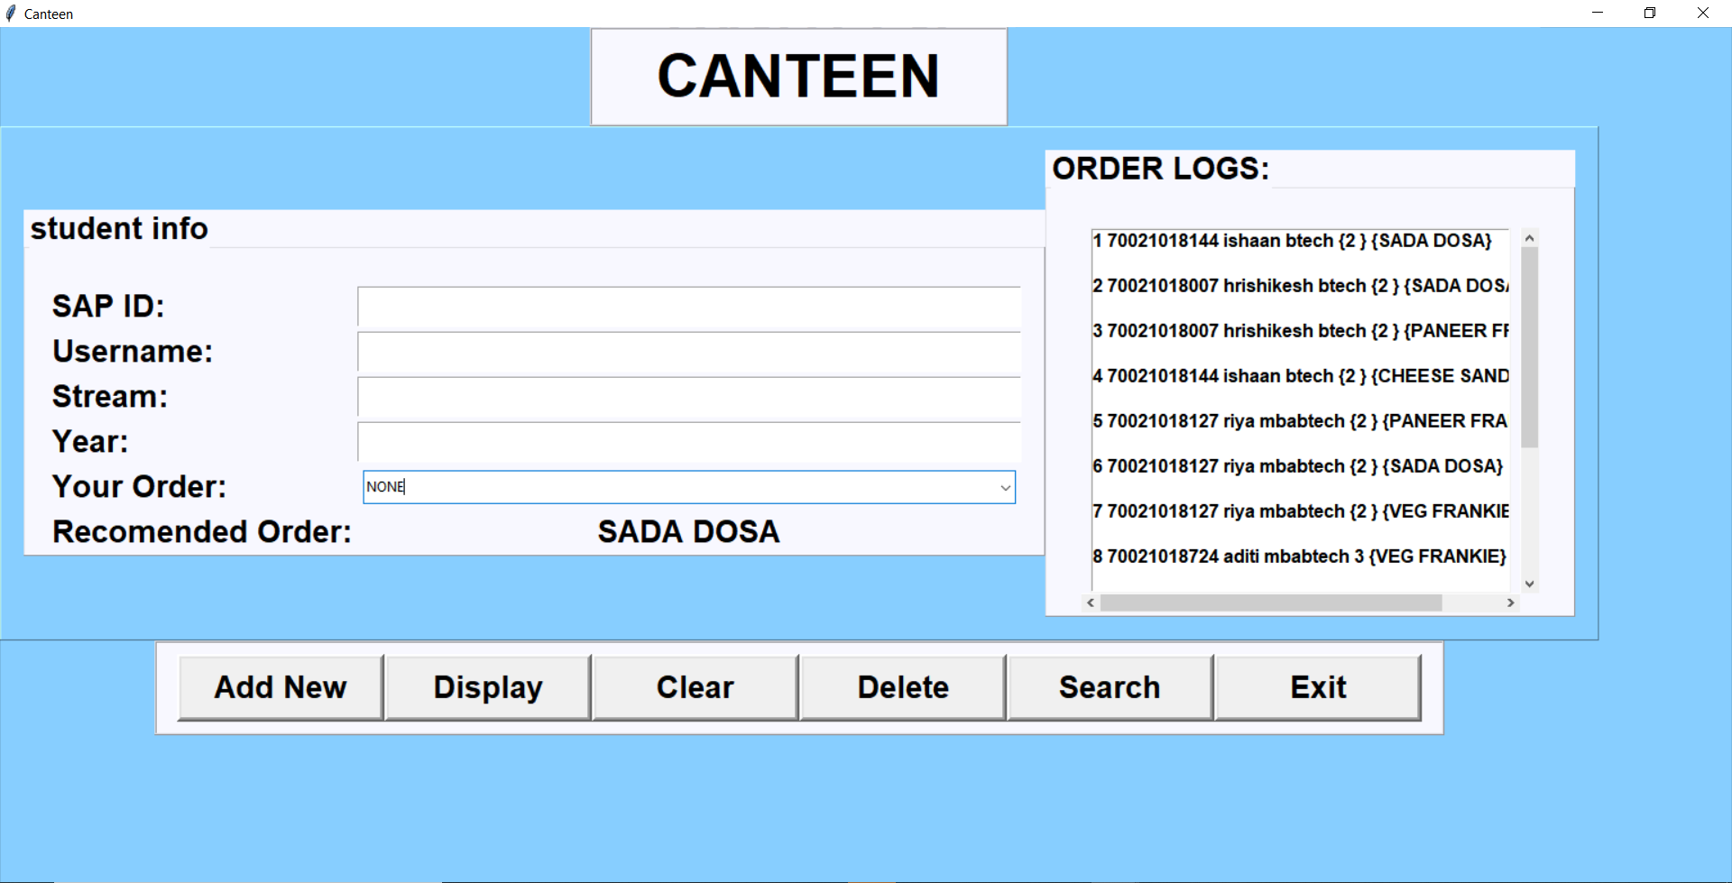

Slide 8
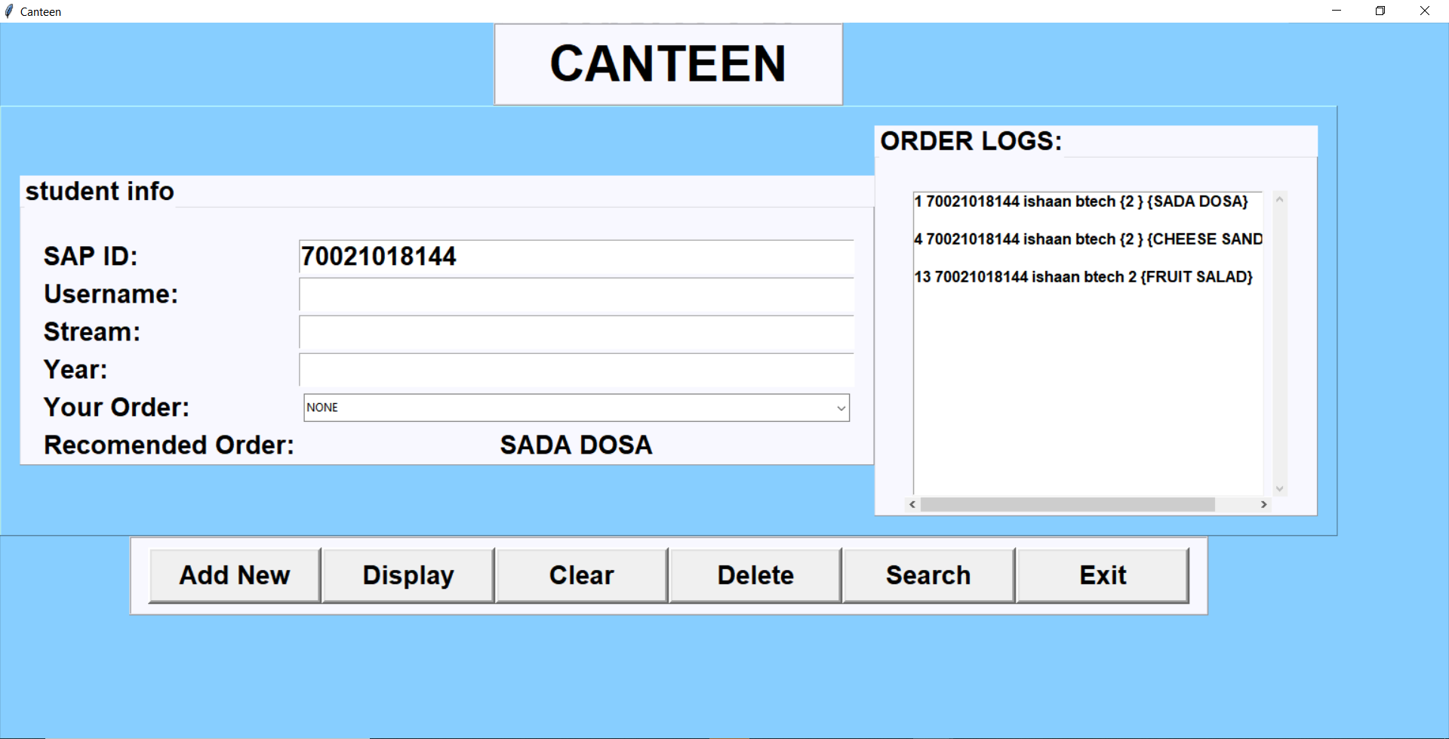

Slide 9
-: Software Used :-
Python IDLE 3.8
DB Browser
-: API Used :-
Sqlite3
Tkinter

Slide 10
-: Conclusion :-
This project was assigned to us by Prof. Kamal Mistry as a part of our curriculum. This in turn paved way for us to develop a keen interest in developing and working with user interfaces, databases, database management and so on. During the course of the making of our managerial system, the two of us learnt how various concepts of Python (Programming Language) and SQLite could be used to combine stand alone programs and databases to create a combined large application.

