Slide 1
CS 6365 ENTERPRISE COMPUTING · SUMMER 2026 · GROUP 4
NORP Food Assistance
Need-Capacity Gap Explorer
Where does food-related community need outpace the nonprofit capacity to address it?
Ishaan Bhardwaj · Gowtam Kommi
3.42M
3,066
17 / 17
nonprofits analyzed (full table)
US counties in the scored panel
committed verification checks pass
Final Presentation
01 / 14

Slide 2
THE PROBLEM
speaker Ishaan
An exploration layer, not another query bot
— Past NORP semesters built NL2SQL chatbots and drifted into SQL-generation benchmarking rather than surfacing insight.
— This project is an agentic layer that cleans real data, gates its own quality, and computes correlations it can defend.
— One concrete question, answered across 3,066 counties on 5-digit FIPS.
Python computes every statistic. The language model only proposes hypotheses and writes framing, so no reported number depends on a model being right.
NORP Need-Capacity Gap Explorer
02 / 14

Slide 3
THE DATA
speaker Gowtam
Six raw tables joined at the county level
3.42M
131,587
72,742
nonprofits (EIN, county, category), full source table
IRS 990/990EZ/990PF filings (revenue, net assets)
disadvantaged-community census tracts of need
Three hazards shaped the whole design:
— Capacity names counties in text while need uses FIPS codes, and text names are an unreliable key: spellings and suffixes vary and names repeat across states.
— Only about four percent of nonprofits have a matched filing, so financials are treated as missing, never as zero.
— Until this checkpoint we held only a truncated extract of the nonprofit table (that becomes the story of the final run).
NORP Need-Capacity Gap Explorer
03 / 14

Slide 4
ARCHITECTURE
speaker Ishaan
The pipeline decides for itself at three points
1
2
3
Profiler & gate
LLM candidate agent
Statistical critic
Classifies every table and join, then issues proceed / warning / stop on its own, no manual intervention.
Reads only the schema and proposes pairs; Python computes the exhaustive 28-pair grid regardless.
Re-tests every proposal with FDR control and permutation nulls; a matching sign is not support.
Flow: load → profile → gate → capacity + need tables → scored panel → correlation agent → critic → fixed effects → maps → findings, with a committed verifier re-deriving every number (17 checks, all pass).
NORP Need-Capacity Gap Explorer
04 / 14

Slide 5
AUTONOMY IN ACTION
speaker Gowtam
The gate acts on its own verdict
proceed
93.2%
231,927
the gate's own verdict (with warning) on the full run
county-name match rate on 3.42M rows
rows auto-dropped, 99.3% Florida + Connecticut
— Florida and Connecticut cannot be mapped in the committed FIPS lookup, so they auto-drop, logged with per-state counts, never hand-patched.
— Checkpoint 1 feedback told us to let the profiler do its job; the manual FL/CT patch we had planned was deleted in response.
— That rule held all the way to the final run: everything dropped is logged with a reason, everything kept arrived through a general rule.
NORP Need-Capacity Gap Explorer
05 / 14

Slide 6
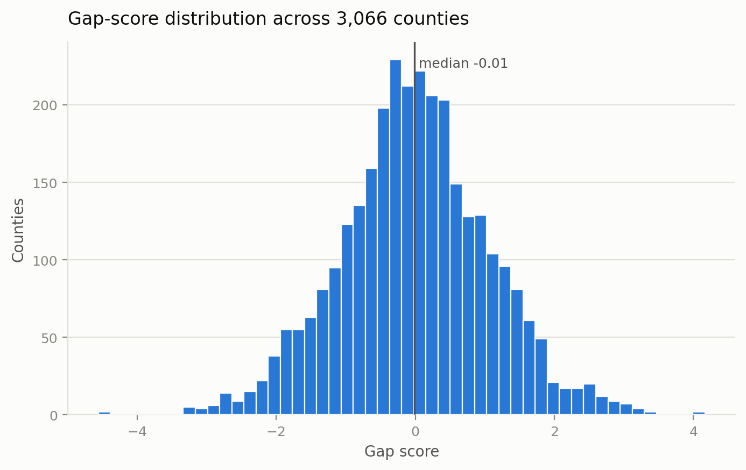
METHOD
speaker Gowtam
An explainable gap score, hardened against outliers
— Gap = mean z-score of need indicators minus mean z-score of capacity; positive means need outpaces capacity.
— Capacity metrics pass through a signed-log transform so one large nonprofit cannot dominate a county; missing filings stay missing.
Nearly symmetric distribution, so the tail counties are genuine outliers, not artifacts of skew.
NORP Need-Capacity Gap Explorer
06 / 14

Slide 7
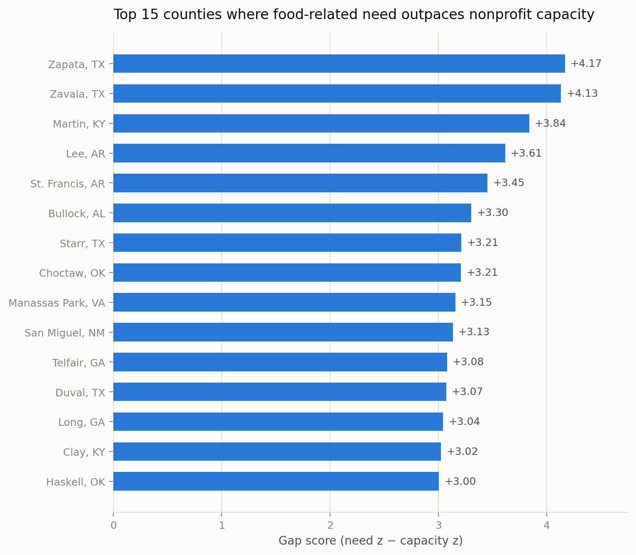
THE ANSWER
speaker Ishaan
A triage list of counties, and it is face-valid
Texas border, Arkansas/Mississippi Delta, Appalachian Kentucky, the Black Belt: exactly where a domain expert would expect the need-capacity gap to be widest.
NORP Need-Capacity Gap Explorer
07 / 14

Slide 8
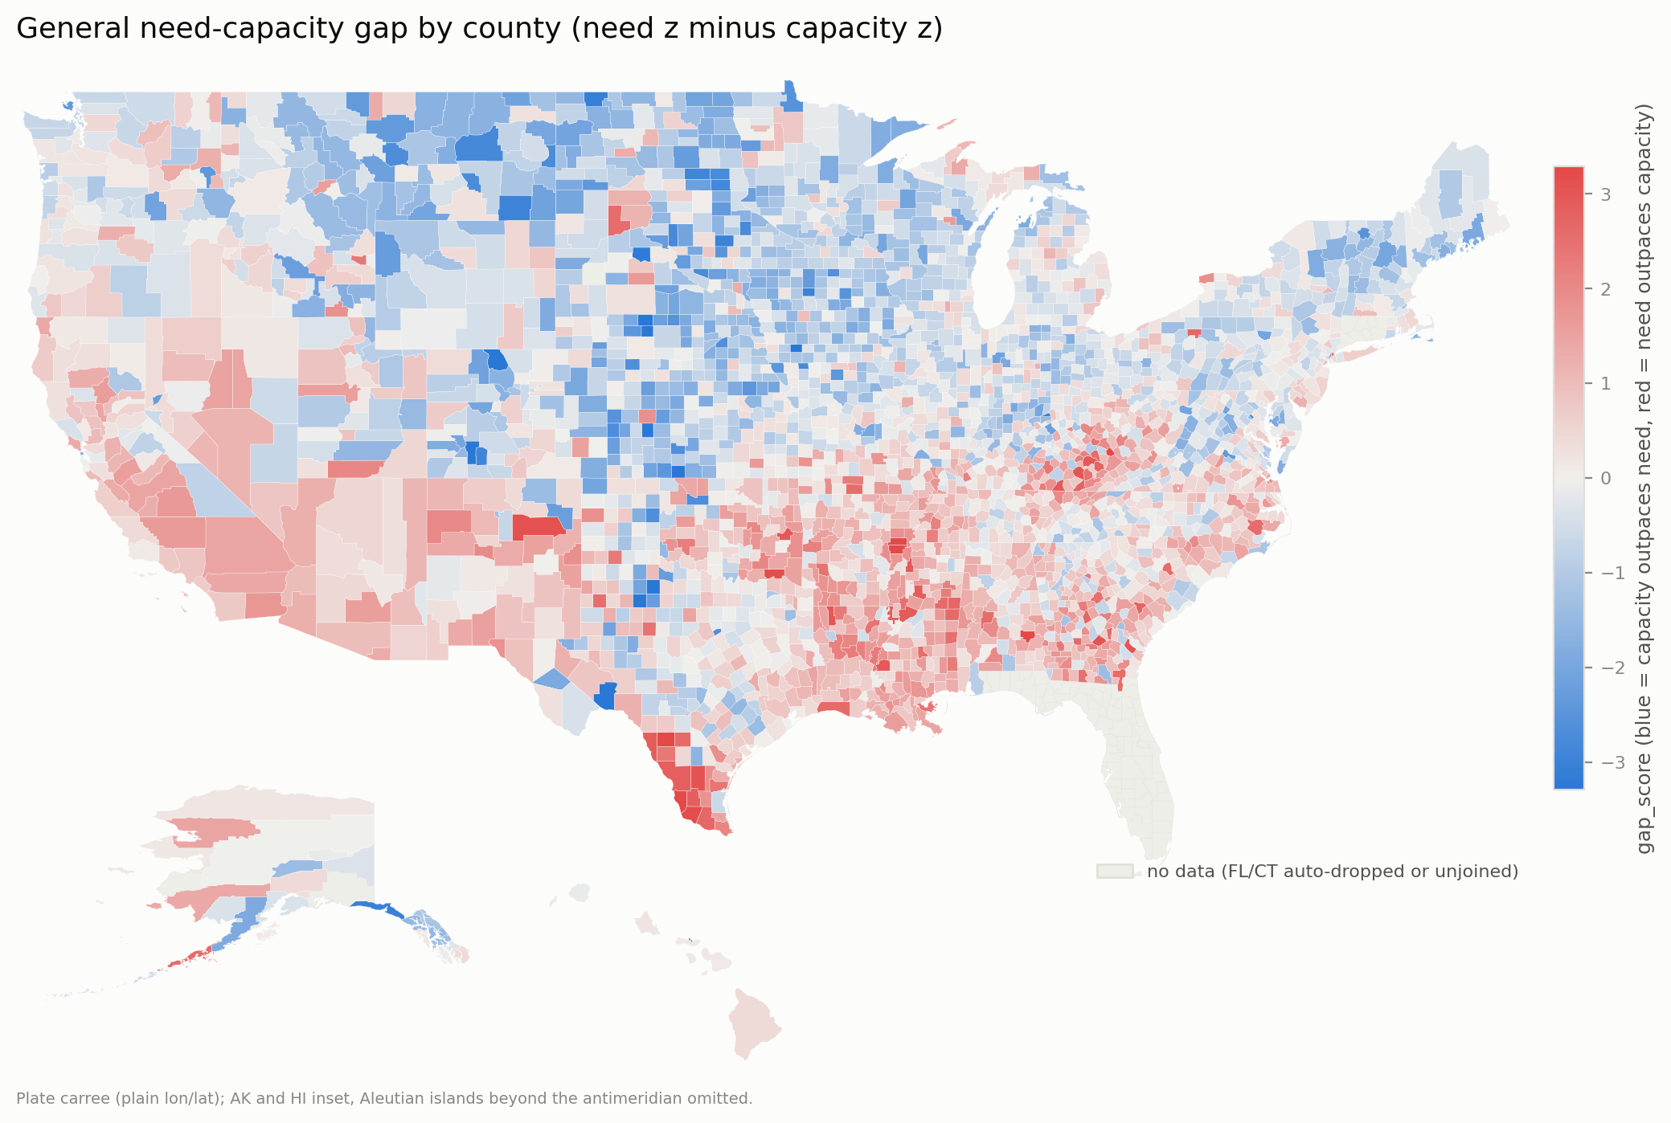
GEOGRAPHY
speaker Ishaan
The same result on the map
Red = need outpaces capacity; blue = the reverse; grey = Florida and Connecticut, absent by an honest rule. A true county-polygon map in matplotlib, no GIS dependencies.
NORP Need-Capacity Gap Explorer
08 / 14

Slide 9
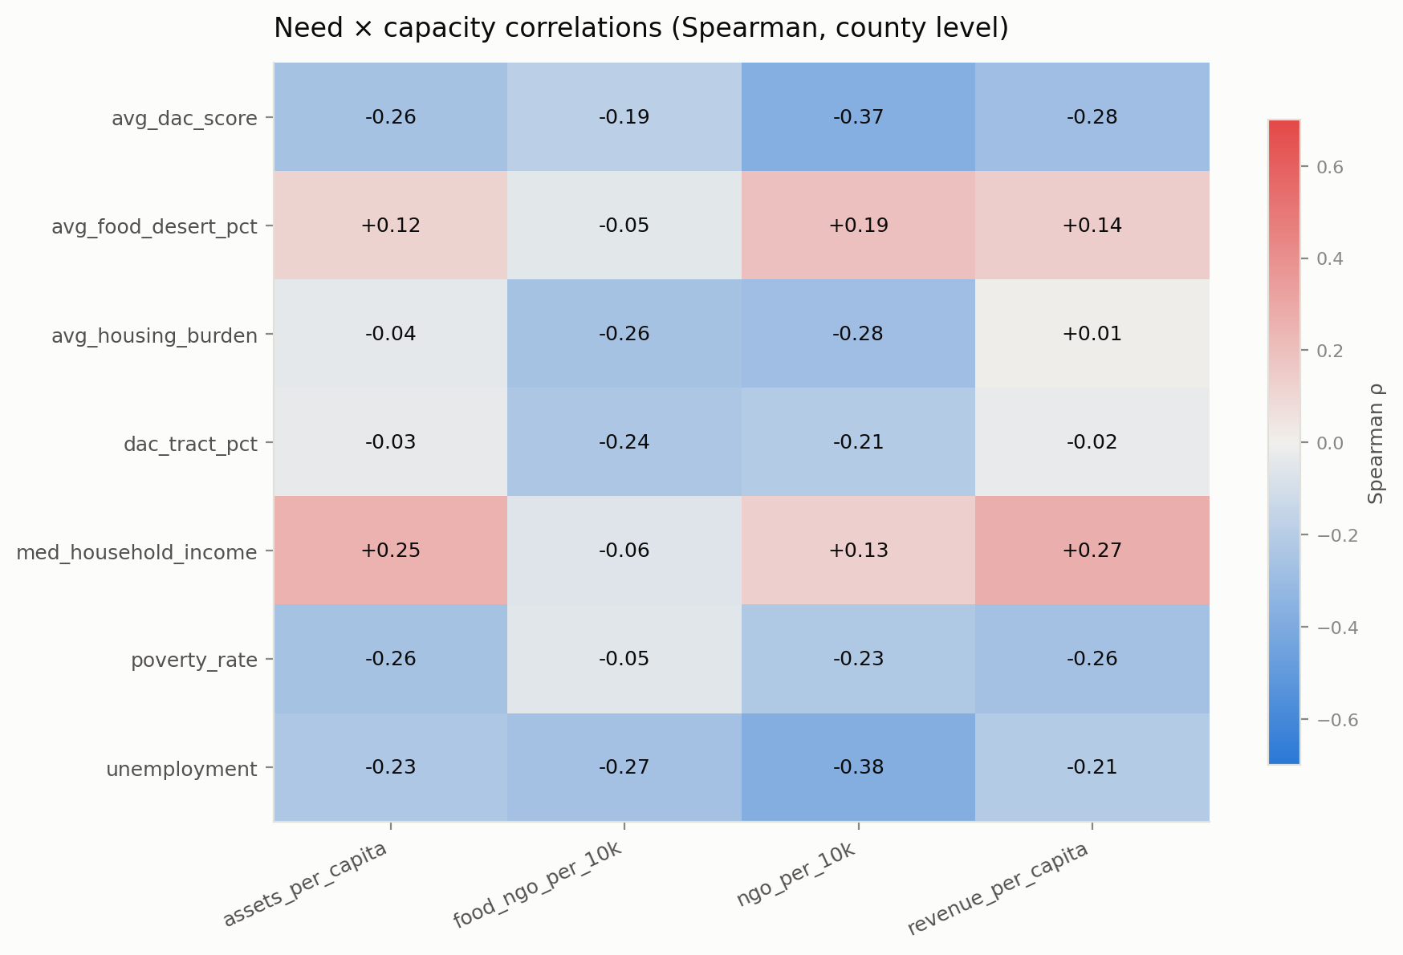
SEPARATION OF CONCERNS
speaker Gowtam
The model proposes; Python computes everything
— Seven hypotheses proposed from the schema alone; no raw rows leave the machine.
— Python tests all 28 need-by-capacity pairs, so the proposals sit inside a complete grid and nothing is cherry-picked.
The full 7x4 Spearman grid the critic operates on.
NORP Need-Capacity Gap Explorer
09 / 14

Slide 10
VERIFICATION
speaker Gowtam
A deterministic critic grades every hypothesis
4
2
1
supported: FDR, permutation, and effect floor all cleared
weak: right sign, but fails a layer
unsupported: sign wrong or not significant
— Three layers: false-discovery control across all 28 tests, a state-stratified permutation null (2,000 within-state shuffles), and a pre-committed effect-size floor.
— Poverty versus nonprofit density has q = 7.7e-36 yet permutation p = 1.0: statistically significant and still a pure between-state artifact.
— Treating that null as a finding, not a failure, is the most defensible thing the pipeline does.
NORP Need-Capacity Gap Explorer
10 / 14

Slide 11
NEW ANALYSIS
speaker Ishaan
The wealth-capacity link survives state fixed effects
+0.132
4.2e-09
2,939
within-state slope per $10k of median income
cluster-robust p-value at the state level
counties across 49 states
— State fixed effects absorb every additive state-level shift (cost of living, filing coverage, tax geography); the slope is estimated from within-state variation only.
— The pooled slope (+0.194) barely attenuates under absorption, so the relationship is within states, not composition.
— On the raw dollar scale the same regression finds nothing (p = 0.61), which is exactly why the signed-log transform exists.
NORP Need-Capacity Gap Explorer
11 / 14

Slide 12
ABOVE AND BEYOND
speaker Ishaan
We audited the AI benchmark like we audit ourselves
0 rows
34 + 1
recovered by the benchmark's Virginia fix on the real data
VA independent cities plus Dona Ana NM recovered by our resolver
— Its exact-first pass only helps names that exist verbatim in the lookup, and its tests only use those names, so the tests pass while the fix recovers nothing.
— We keep its good ideas with credit (exact-first matching so Fairfax City never folds into Fairfax County) and add the missing general rules: a city-suffix fallback plus an encoding repair for the lookup's own corrupted bytes.
— Panel: 3,027 to 3,066 counties, every recovery machine-verified.
NORP Need-Capacity Gap Explorer
12 / 14

Slide 13
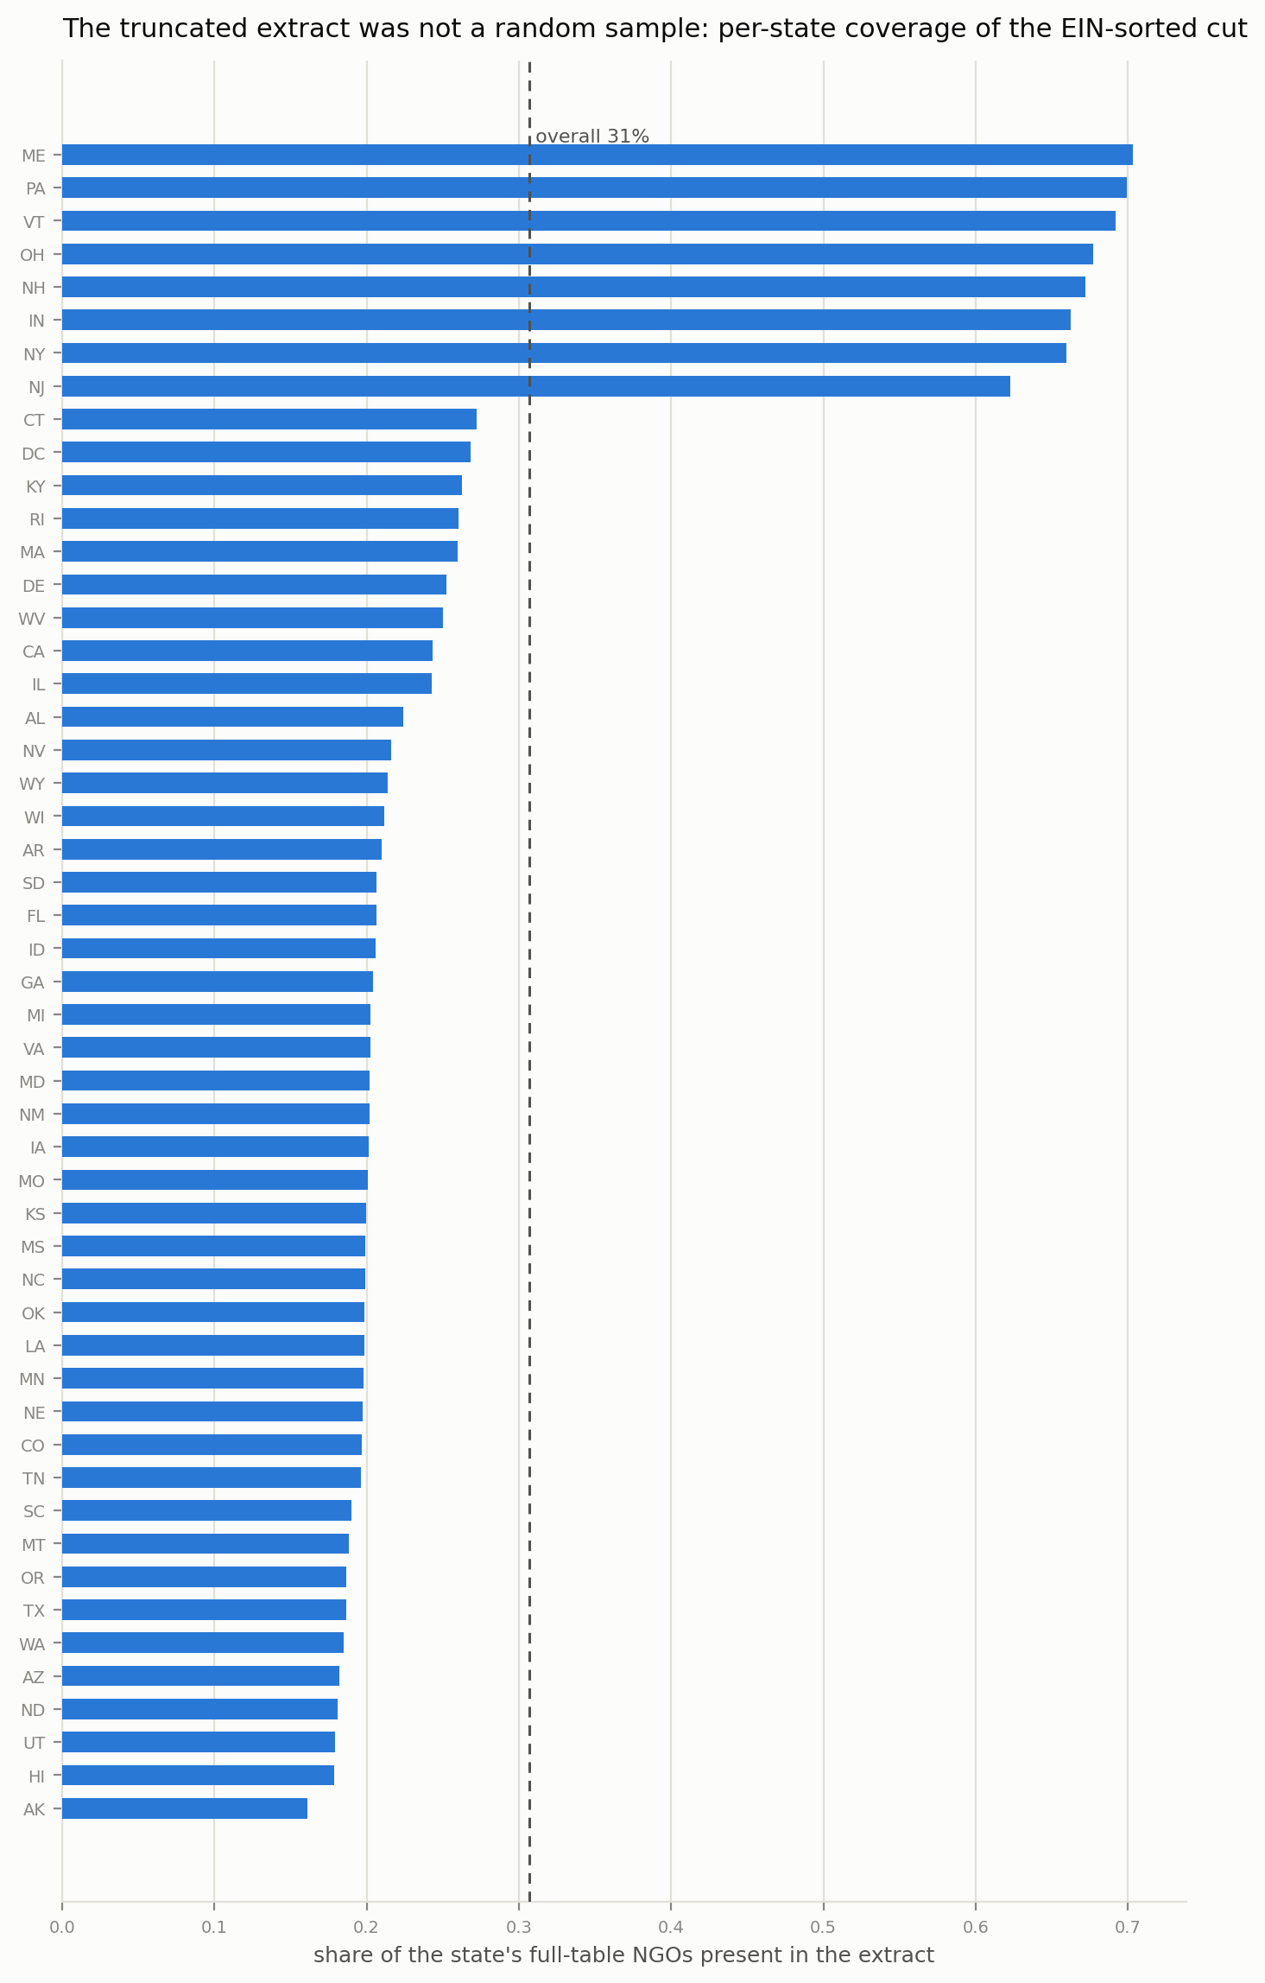
CLOSING THE GAP
speaker Gowtam
The data gap is closed, and the bias is measured
30.7%
of nonprofit rows were in the old extract
26.2%
of food nonprofits: the sector was under-sampled
0.73
gap rank correlation vs CP3: geography held, sectors shifted
NORP Need-Capacity Gap Explorer
13 / 14

Slide 14
IN CLOSING
speaker Both
A pipeline that shows its work
17
66
100%
committed verification checks, all passing
offline tests, no API key to reproduce anything
of headline numbers re-derivable from the repo
— Honest accounting is the product: FL/CT absence, sparse filings, unverifiable upstream labels, all enumerated, never hidden.
— Next: an authoritative FL/CT county mapping, a second filing year for a temporal panel, and publishing the triage list with its caveats.
github.com/ishaanbhardwaj2003/NORP-Food-Assistance-Need-Capacity-Gap-Explorer
NORP Need-Capacity Gap Explorer
14 / 14

