Slide 1
NLP PROJECT · REVIEW
VoiceRiders
Context-Aware, Noise-Adaptive Voice Controller for Spotify
Team NeuroVoices · 4-minute review
Ishaan Balakrishna Duddi
BL.SC.U4CSE24015
Architecture & Tech Stack
One line
MD Thejas
BL.SC.U4CSE24028
Literature Survey
A rider picks a playlist, starts Ride Mode, and controls Spotify entirely by voice — offline speech recognition on the phone, with context and confidence deciding whether a noisy command is really a command.
Jai Abhinav
BL.SC.U4CSE24033
Competing Market
Praveen Raj
BL.SC.U4CSE24040
Current Status

Slide 2
ARCHITECTURE & TECH STACK
Speaker 1 — how a spoken word becomes playback
Pipeline
Tech Stack
• Microphone + VAD → only real speech is captured
• Whisper ASR on-device → text, no network
• Normalise → number words become digits ("seven" → 7)
• Intent classification → ML (TF-IDF + Logistic Regression) fused with a rule baseline
• Entity extraction → song number
• Fuzzy match (edit distance + phonetics) → survives ASR errors
• Context → resolves "play" to RESUME while paused
• Confidence gate → 45 % intent + 25 % fuzzy + 20 % ASR + 10 % context
• Dispatcher → Spotify Web API
• Mobile: React Native + Expo (TypeScript)
• Speech: whisper.cpp on-device + energy VAD — offline, no API key
• ML: scikit-learn (TF-IDF + Logistic Regression) trained in Python; weights exported to JSON and run on-device
• Spotify: Web API + OAuth 2.0 PKCE — no client secret stored
• Infra: one serverless HTTPS relay (Spotify rejects custom-scheme redirects)
• Storage: OS Keychain / Android Keystore
• Build: EAS → installable Android APK
Second branch: Adaptive Audio — ambient noise → smoothing → noise zone → hysteresis → small volume steps above the rider's baseline.
VoiceRiders
2

Slide 3
LITERATURE SURVEY
Speaker 2 — what we build on, and what is missing
SPEECH RECOGNITION
VOICE ACTIVITY
NOISE HANDLING
Whisper — Radford et al., 2022
WebRTC VAD (Google) · Silero VAD
Spectral subtraction — Boll, 1979
Robust large-scale ASR; whisper.cpp runs it on-device. No notion of music commands.
Detect speech cheaply so silence never reaches ASR. We use an energy VAD — far cheaper per frame.
Denoises before recognition, but needs a reliable noise estimate — which a moving bike does not give.
TEXT CLASSIFICATION
FUZZY MATCHING
AUTHORIZATION
TF-IDF — Salton & Buckley, 1988
Levenshtein 1966 · Jaro-Winkler 1990
RFC 7636 — PKCE, 2015
Proven and lightweight; small enough to run on a phone without a transformer.
Similarity that survives speech-to-text damage ("increse volum").
Lets a public mobile client authenticate with no client secret.
Gap: none of this work targets the rider case — no wake word, wind and engine noise, hands free. VoiceRiders joins these pieces and adds a confidence gate that refuses to guess.
VoiceRiders
3

Slide 4
COMPETING MARKET
Speaker 3 — mainstream assistants, motorbike OEM systems, and where the gap is
Option | Hardware needed | Wake word | Noise-aware | Song by number | Recognition in app
Siri / Google Assistant | Any phone | Required | No | No | No (OS)
Spotify in-app voice | Any phone | Required | No | No | No (OS)
Android Auto / car head unit | Head unit + screen | Required | No | No | No (OS)
Honda Smartphone Voice Control | Selected Honda + headset | Required | No | No | No (OS)
Harley-Davidson Boom! Box | Touring models only | Required | No | No | No (OS)
Cardo / Sena helmet intercoms | Helmet intercom | Required | No | No | No (OS)
Bluetooth media buttons | Any BT headset | n/a | No | No | n/a
VoiceRiders | Any phone + any headset | None | Yes | Yes | Yes (on-device)
The motorbike manufacturers do have voice systems — Honda's Smartphone Voice Control, Harley's Boom! Box — but they need a specific motorcycle, and they hand the actual recognition to your phone's assistant.
The gap: no wake word + noise-aware + song-number navigation + recognition that runs inside the app, on any phone and any bike, with no extra hardware.
VoiceRiders
4

Slide 5
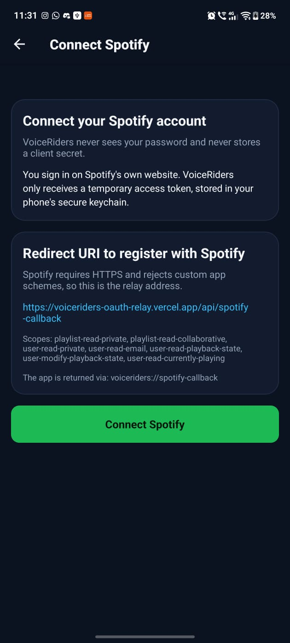
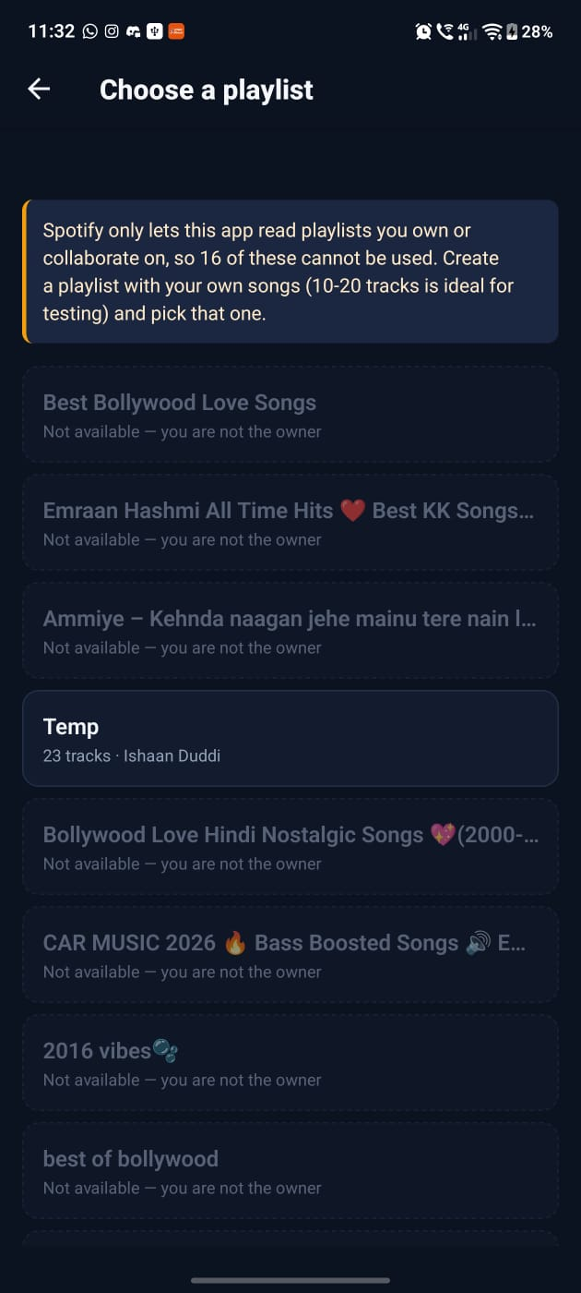
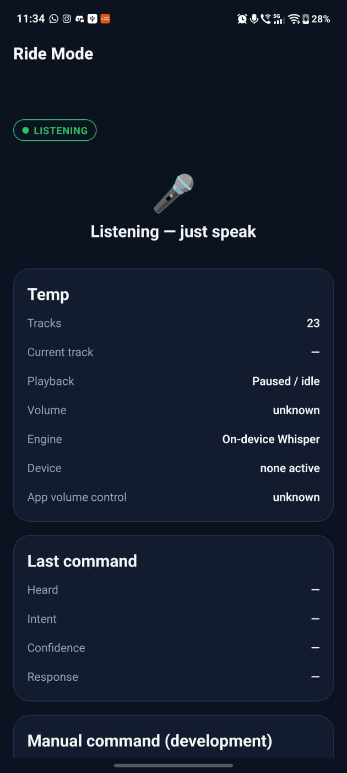
CURRENT STATUS
Speaker 4 — what runs today, on a real phone
Working now
• Spotify login with OAuth 2.0 + PKCE through the relay
• Playlists load with real track counts
• Numbered playlist map — "play song number 7" resolves to a track
• Playback control: play, pause, resume, next, previous, volume
• Ride Mode: VAD → on-device Whisper → NLP → confidence gate → Spotify
• Adaptive Audio: ambient noise raises the volume in small steps
• Installable Android APK built with EAS
• On-device diagnostics (microphone, device, engine) in Ride Mode
Known limits: Development Mode can only read playlists you own; speaker playback needs headphones (no echo cancellation); app volume depends on the active Spotify device.
Connect Spotify
Choose a playlist
Ride Mode
VoiceRiders
5

Slide 6
Thank you
Questions?
Code, evaluation scripts and the architecture notes are in the repository: github.com/ishaanduddi/VoiceRide
Not affiliated with Spotify AB. Built with the Spotify Web API under the Spotify Developer Terms.

