Slide 1
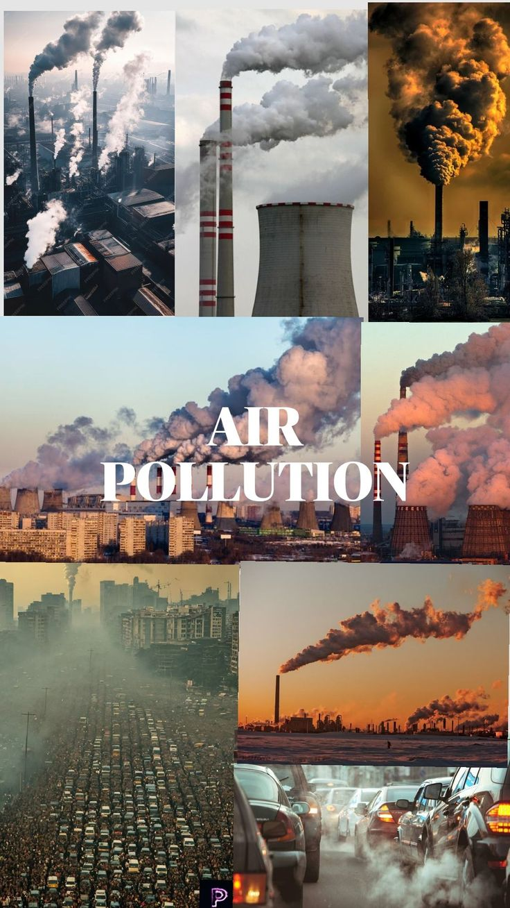
Air Quality Index Prediction and Smart Monitoring System Using Machine Learning
An approach to understanding how air quality affects health risks in urban environments.
Team Members
Mayank Garg Saksham Kansal Sanshi Ishaan Gupta Vineet Kailay
1024170442 1024031135 1024031137 1024031118 1024031147

Slide 2

BACKGROUND
The Growing Challenge of Urban Air Pollution
Fast urban growth and expanding industries have turned air pollution into a serious public health concern in many Indian cities. Increasing vehicle exhaust, factory emissions, and large-scale construction activities have significantly contributed to worsening air quality levels.
Breathing polluted air for long periods can seriously harm our health, leading to breathing problems, heart diseases, and even a shorter lifespan. Even with these dangers, many people still do not have easy access to simple tools that help them understand daily air quality levels and what they mean for their health.

Slide 3
PROJECT GOALS
Research Objectives and Expected Outcomes
AQI Prediction
Early Warning System
Interactive Platform
Create reliable prediction models using pollution data to estimate upcoming Air Quality Index levels.
Send early health warnings to at-risk people before air pollution rises to dangerous levels.
Design an monitoring system that allows people to check air quality based on different pollution levels.

Slide 4
DATA OVERVIEW
Dataset Characteristics and Sources
Data Collection
Key Features
Air quality data for Indian cities (city-day level) from Kaggle: Air Quality Data in India (daily pollution measurements across multiple locations).
Particulate Matter: PM2.5 concentrations (fine particles)
Nitrogen Compounds: NO, NO₂, NOₓ levels
Carbon Monoxide: CO measurements
Sulphur Dioxide: SO₂ concentrations
Ground-level Ozone: O₃ readings
Target Variable: Air Quality Index (AQI)
Time Period:
Multi-year historical records from year 2015 to 2020

Slide 5

Handling Missing Values and Data Quality
Remove Missing AQI
Median Impute Pollutants
Outlier Removal Using IQR
Date Feature Engineering
AQI Records Removal
Median Imputation Strategy
Removed rows where Air Quality Index (AQI) was missing, since supervised learning models need correct output labels to learn properly.
Used Median values to fill missing pollution data instead of mean as environmental data is often uneven affected by extreme values
Outlier Removal Using IQR
Date Feature Creation
Applied the Interquartile Range(IQR) method to detect and remove extreme pollution values that could negatively impact model performance.
Transformed date data into useful features like month and season to better capture repeating pollution pattern influenced by weather changes and human activities

Slide 6
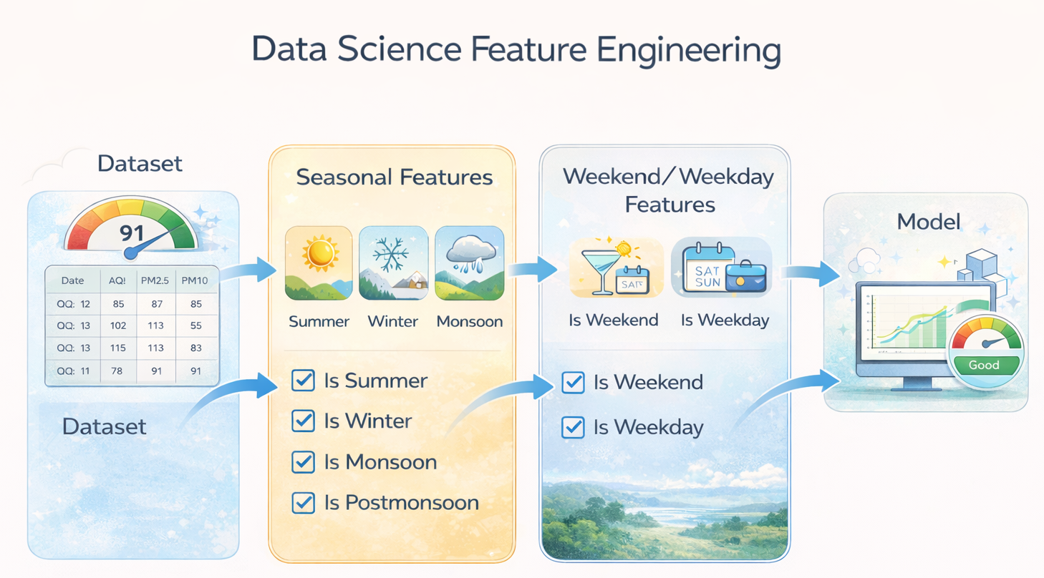
FEATURES ADDED
Feature Engineering Approach
Strategic Variable Selection
Feature Engineering was aimed at finding the pollutants that have the strongest statistical relationship with changes in AQI. Through data analysis PM2.5,NO₂ and O₃ were identified as the main factors influencing AQI levels.
Seasonal Pattern Integration
Added time-based features to reflect seasonal changes in pollution levels. Pollution usually rises during winter because temperature inversions trap pollutants near the ground, while the monsoon season often helps reduce pollution naturally through rainfall.

Slide 7
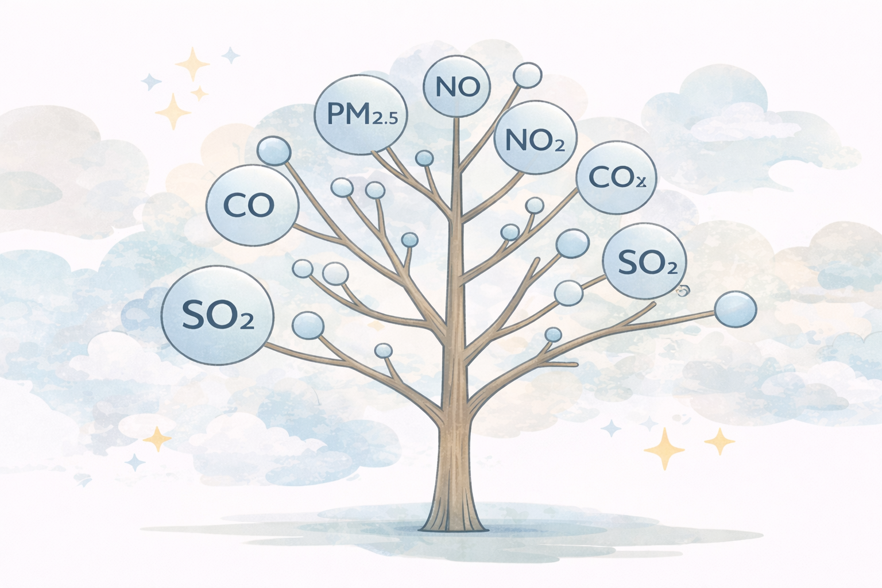
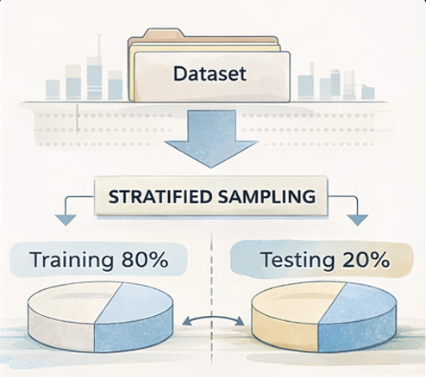
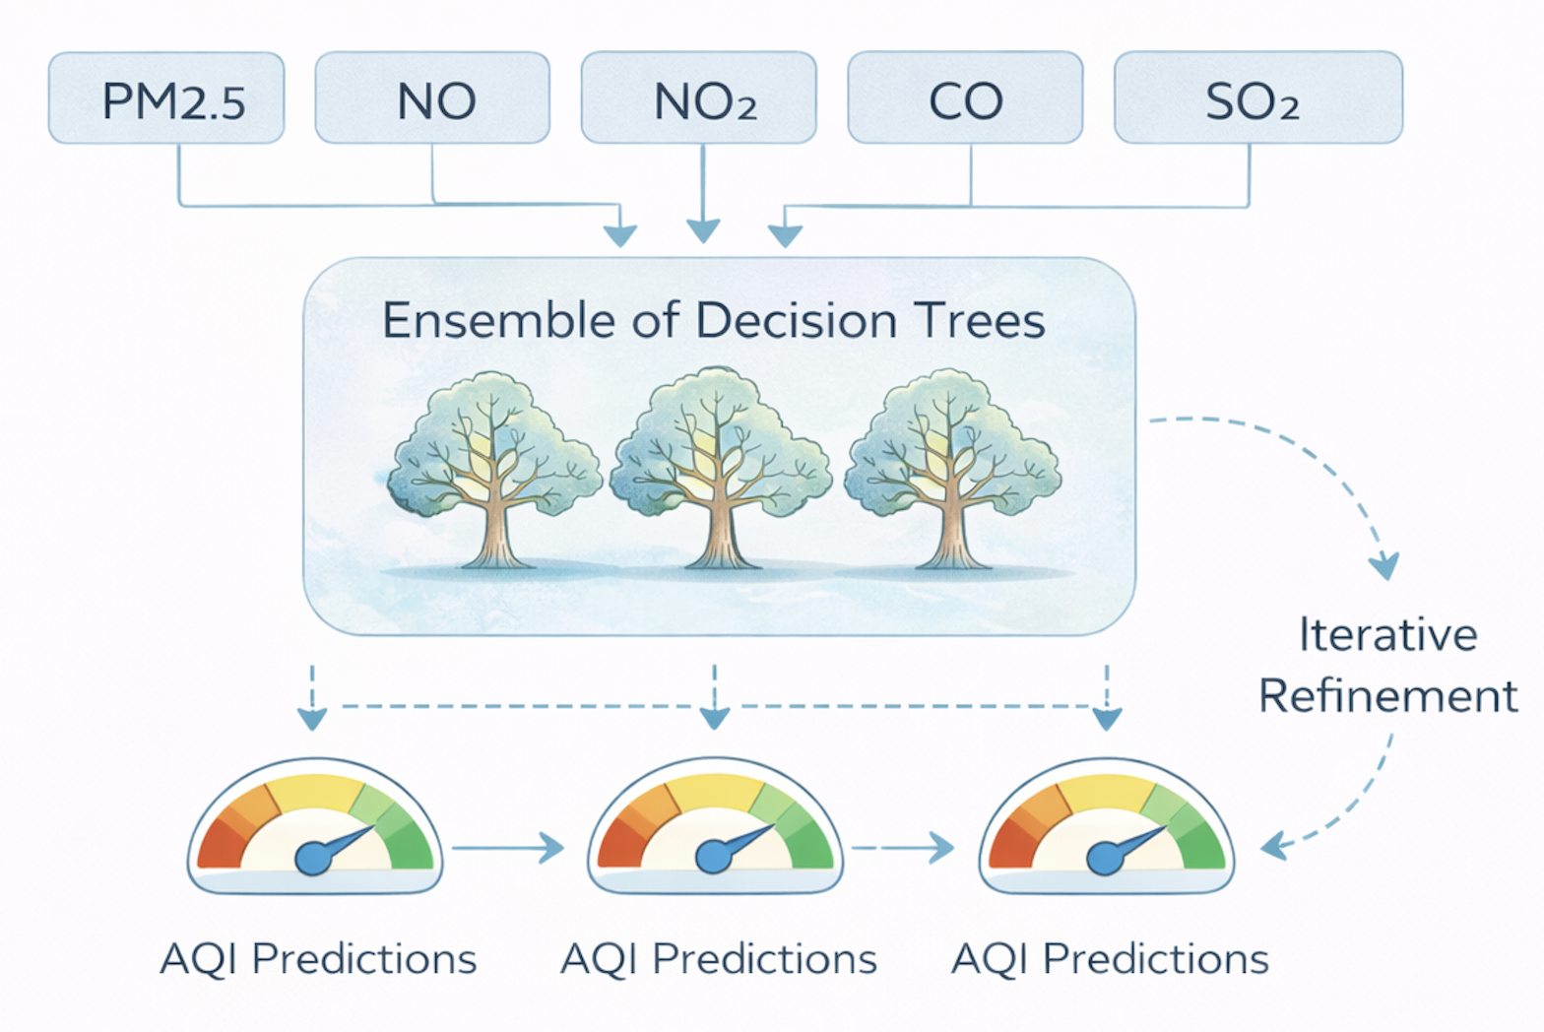
MODEL DEVELOPMENT
Random Forest Regression Architecture
Algorithm Selection
Data Partitioning
Model Training
Random Forest was selected because it can understand complex, non-linear relationships between pollutants while reducing the risk of overfitting.
We split the data into two parts 80% to train the model and 20% to test how well it learned making sure both parts had a similar mix of data so the results would be reliable.
The model gradually learns detailed patterns between pollution levels and the resulting AQI by continuously improving itself with each step.

Slide 8
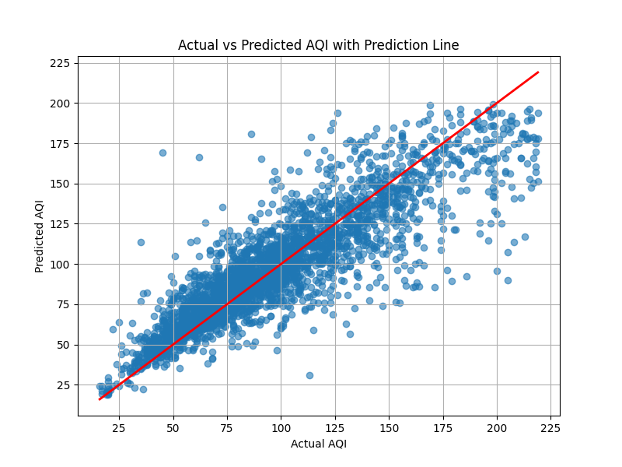
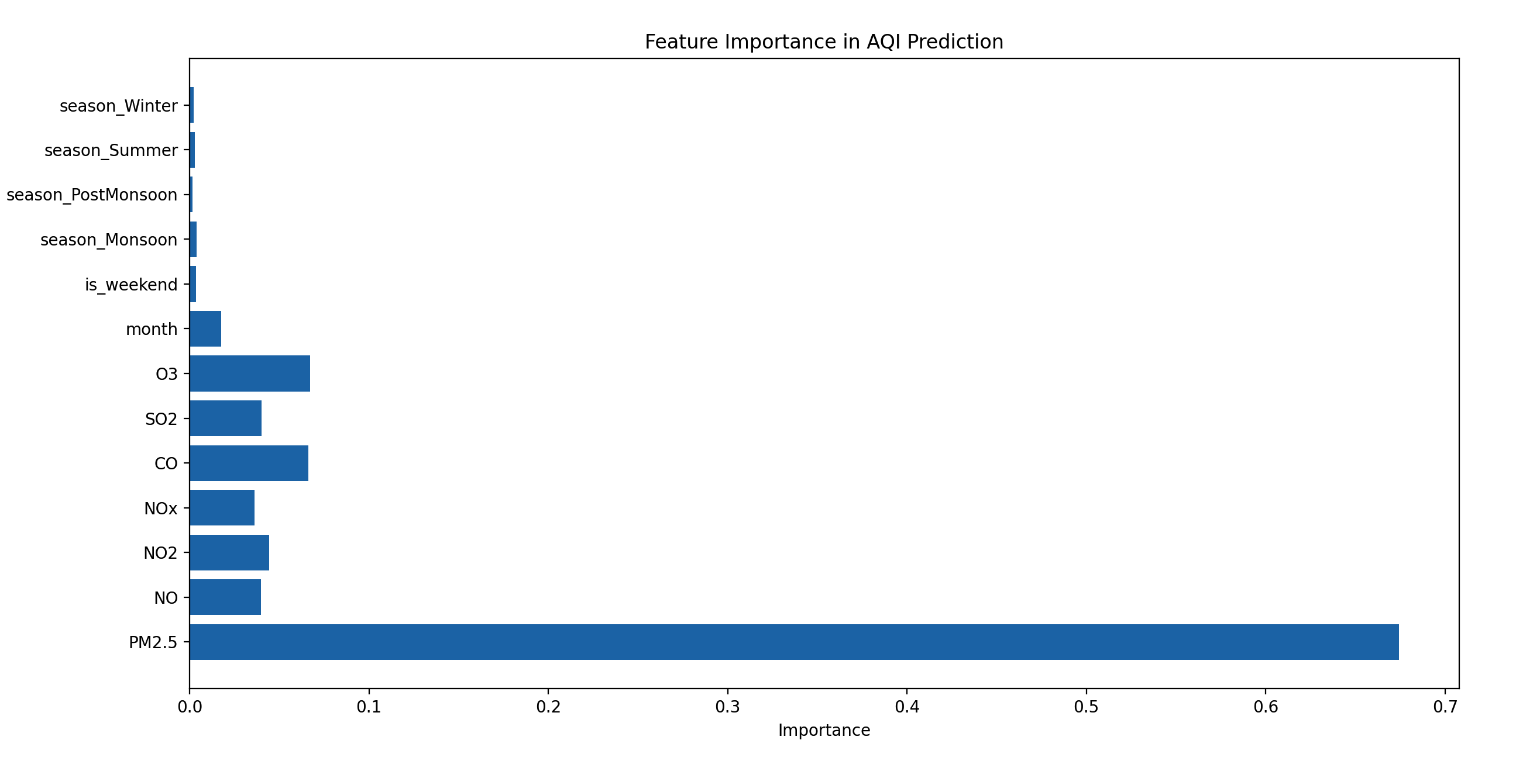
VISUALIZATION
Model Visualization
Actual vs Predicted AQI
Feature Importance

Slide 9
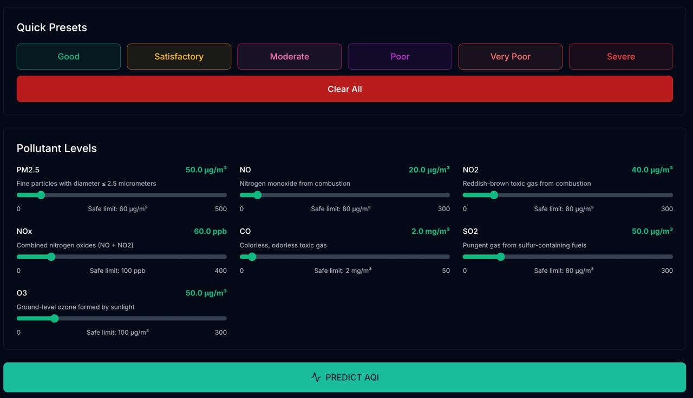
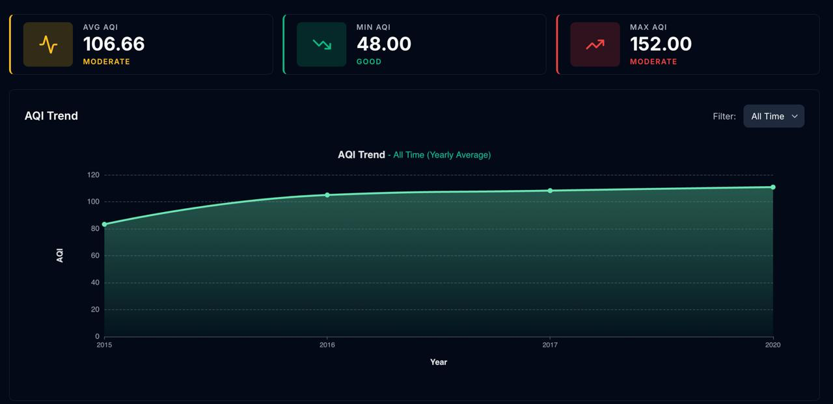
SYSTEM UI
Building Interactive User Interface
Quick Presets and Pollutants Range Selector for Predicting AQI
Analyzing Dashboard for Monitoring Cities With Time Filter

Slide 10

MODEL PERFORMANCE
Evaluating Model Performance
~ 0.76
~ 13.85
~ 397.5
~ 19.94
R² Score
MAE
MSE
RMSE
Our model shows decent performance, with an R² score of about 0.76. This means it can explain around 76% of the changes in AQI levels, so it captures most of the important patterns in air quality data.
The MAE value of 13.85 AQI units indicates that, on average, the model’s predictions are fairly close to the actual values. The RMSE is around 19.94 AQI units, which suggests that while there are some larger errors, they are not too extreme.
Overall, the results show that the model performs reasonably well and can be useful for analyzing and predicting air quality in real-world situations.

Slide 11
Thanks

