Slide 1
THERAPIQUE “Healing Minds, One Converstaion at a Time”
PRESENTED BY:-
Ishaan Jain CSE-B/61
Rishab Negi CSE-B/78
Tarun CSE-B/70

Slide 2
Table of contents
01
02
Introduction
Business Idea
03
04
UI/UX DESIGNS
Business Model Canvas & Customer Profiling

Slide 3
01
Introduction

Slide 4
Revolutionizing Mental Healthcare
THERAPIQUE bridges the gap between traditional therapy and modern accessibility, creating India's first truly anonymous, AI-powered mental health ecosystem

Slide 5
Overview
The Mental Health Crisis
86% treatment gap in mental healthcare
₹1.03 trillion economic impact annually
Severe stigma prevents help-seeking
Our Solution Impact
Complete anonymity removes stigma
24/7 accessibility breaks barriers
AI-powered personalization
197 M
Indians with mental disorders
0.75
Psychiatrists per 100,000 people
₹840 Cr
Market opportunity by 2025
40%
Cost reduction vs traditional therapy
100% Anonymous
No personal details required. Complete privacy guaranteed with end-to-end encryption.
Instant Access
Connect with therapists in under 2 minutes. No appointments, no waiting lists.
AI-Enhanced
Smart mood tracking, personalized insights, and predictive mental health analytics.
Affordable Care
Starting at ₹499/session - 60% cheaper than traditional therapy options.

Slide 6
Comprehensive Mental Health Ecosystem
Therapy Modes
AI Features
Wellness Tools
Anonymous text chat
Voice-only sessions
Video consultations
Group therapy rooms
Mood pattern analysis
Crisis detection alerts
Therapist matching algorithm
Progress tracking insights
Guided meditation library
CBT exercise modules
Peer support communities
Emergency helpline
integration
Why THERAPIQUE Will Succeed ?
First-Mover-Anonymous therapy advantage
Proven Model- AstroTalk-inspired success
Tech-Forward- AI-powered personalization
Scalable- Cloud-native architecture

Slide 7

02
Business Idea

Slide 8
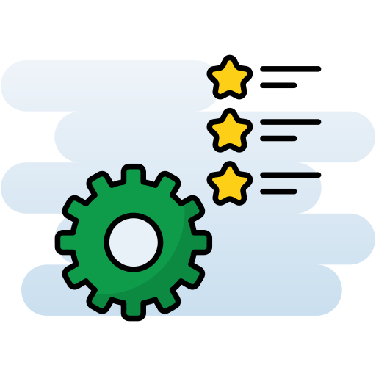




Planned Features:
🎥 Video/audio therapy sessions:
What it is: Live, scheduled sessions with licensed therapists over secure video or audio.
Why it matters: Replicates in-person therapy without travel, saving time and cost.
How it helps: Flexible format—video for richer connection, audio for privacy or low bandwidth; ideal for users with limited time or mobility.
💬 Instant chat with therapists:
What it is: Real-time text-based conversations with a therapist inside the app.
Why it matters: Reduces long wait times; users can get support when stress peaks.
How it helps: Lower barrier to start (typing feels safer for many), discreet in shared homes, and works well on slower networks.

Slide 9


🤖 AI-based daily mood tracker:
What it is: Simple daily check-ins (emojis, sliders, short prompts) that log mood and surface personalized tips.
Why it matters: Builds self-awareness and habit formation; small, consistent steps improve outcomes over time.
How it helps: Sends gentle nudges, identifies patterns (e.g., weekday anxiety), and offers micro-interventions like breathing exercises or journaling prompts.
🕶️ Anonymous therapy option:
Allows users to attend sessions without revealing their identity, helping break the stigma around mental health in India.
How it helps: Encourages first-time help-seeking, especially for students and rural users; preserves dignity and safety with pseudonyms and privacy controls.
📚 Resource library (articles, videos, exercises):
A self-help section with curated mental health articles, short videos, and exercises to support users between sessions.

Slide 10



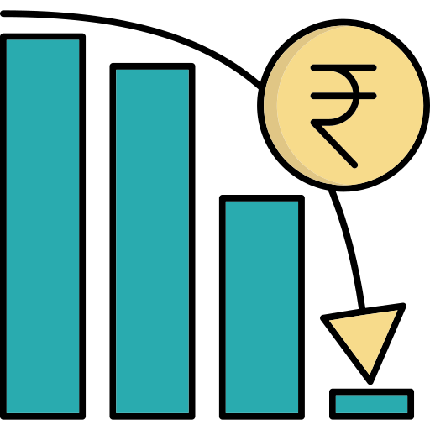


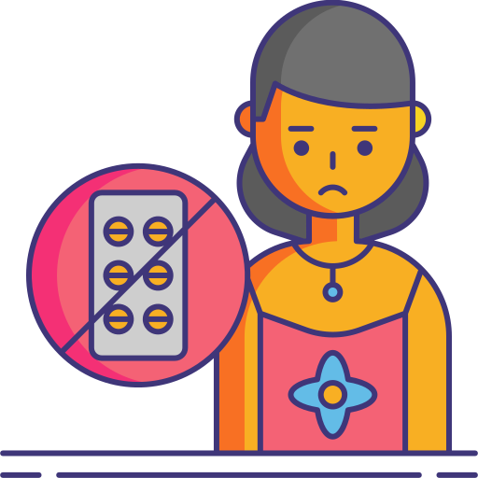


Planned Problems & Solutions
Table format:
Current Problem | Our Planned Solution
Mental health stigma | Anonymous sessions — pseudonyms and private chat/video reduce fear of judgment and encourage first contact.
High therapy costs | Affordable pricing — tiered monthly plans and bundles lower entry cost and support consistent, ongoing care.
Lack of rural therapists | Fully online platform — video/audio/chat remove geography barriers and work on low bandwidth for wider reach.
Long waiting periods | Instant therapist matching — smart routing to next-available qualified therapists enables same-day chat and quicker starts.

Slide 11
03
Business Model Canvas
.

Slide 12
Target Market
.
Students(16-25)
Academic stress, career anxiety, personal stress
Urban Stressed Population
City life pressures
.
PRIMARY
SEGMENT
Working Professional (25-40)
Work-life balance, burnout and anxiety
Rural with Online Access
Limited local resources

Slide 13
Target Market
.
Corporates
Corporates offering wellness benefits
.
SECONDARY
SEGMENT
NGO’S
NGOs focusing upon mental health

Slide 14
Value Proposition & Channels
Value Proposition
.
.
Channels
• Privacy: Anonymous sessions for
stigma-free help
• Accessibility: Available anywhere via
app/website
• Affordability: Lower cost than traditional
therapy
• Certified Therapists: Verified
professionals with relevant expertise
• AI Mood Tracking: Continuous mental
health monitoring
• Digital Platforms: Mobile app,
website
• Social Media: Awareness
campaigns & content marketing
• Partnerships: Corporates,
NGOs, therapist associations

Slide 15
Customer Relationships, Revenue Streams, Key Activities
Customer Relationships
Revenue Streams
.
.
Key Activities
• Personalized Support: Matching with
suitable therapists
• Anonymous Option: Comfort for
hesitant users
• 24/7 Availability: On-demand sessions
& AI chat
• Monthly/Annual subscription plans
• Pay-per-session option
• Corporate wellness packages
• Platform development &
maintenance
• Onboarding & verifying therapists
• Marketing & awareness
campaigns
• AI mood tracking model
improvement

Slide 16
Key Resources, Key Partners, Cost Structure
Key Resources
Key Partners
.
.
Cost Structure
• Certified therapists & counselors
• Tech development team
• AI-based mood tracking tools
• Marketing & community outreach
team
• NGOs working on mental health
awareness
• Therapist associations & universities
• Corporates for employee wellness
tie-ups
• Salaries (therapists, tech,
marketing)
• Technology maintenance &
hosting
• Marketing & partnerships
• Licensing & compliance

Slide 17
Competitive Analysis
Table format:
Platform | Anonymous Sessions | AI Mood Tracker | Pricing (₹) | Localized (India) | Corporate Wellness
YourDost | ❌ | ❌ | ~₹800 –₹2,070/session | ✅ | ✅Limited (Institution MoUs)
BetterHelp | ❌ | ❌ | ~₹21,660 –₹29,729/month | ❌ Global-only | ❌
Talkspace | ❌ | ❌ | ~₹5,400 –₹9,545/week | ❌ Global-only | ❌
THERAPIQUE | ✅ | ✅ | ₹499 – ₹999/session | ✅ | ✅Corporate plan

Slide 18
Operational Plan
👩‍⚕️ Key Resources
📍 Location
• 20 Certified Therapists
• Tech Dev Team (3–5)
• AI Chatbot
• Cloud Servers
• Fully online HQ
• Cloud-based hosting
• Nationwide clients
🤝 Strategic Partners
• NGOs – awareness
• Mental Health Assoc.
• Corporate HR tie-ups

Slide 19
04
UI/UX DESIGNS
.

Slide 20
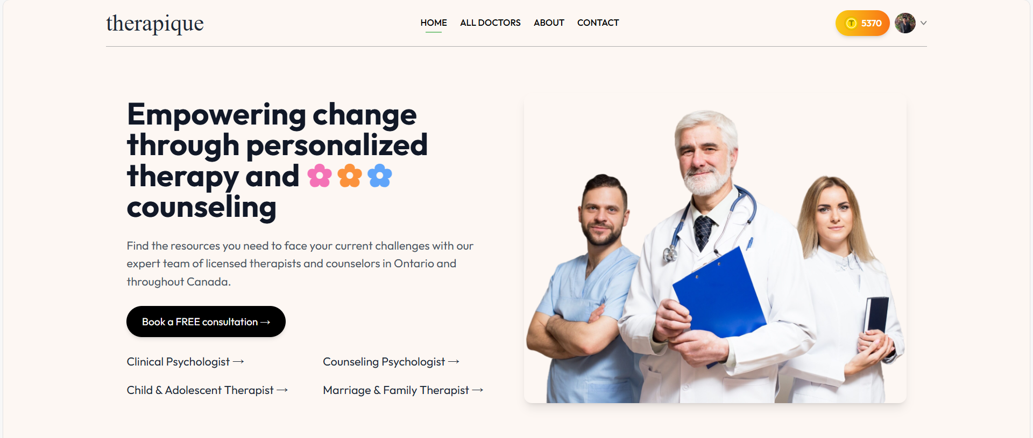
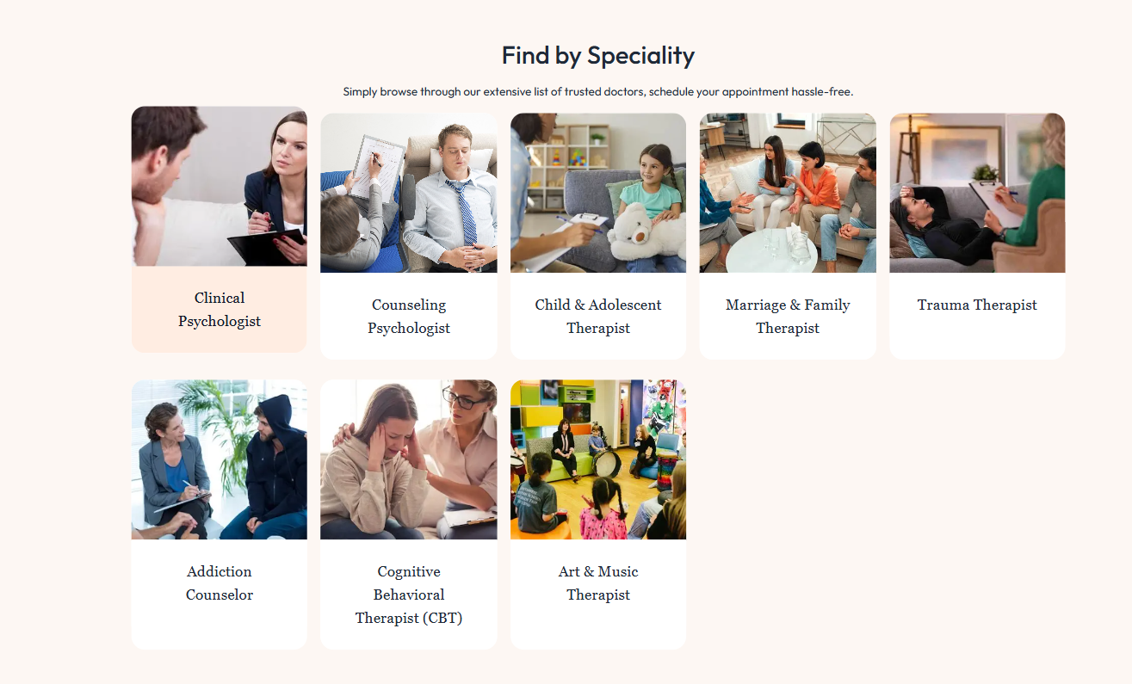
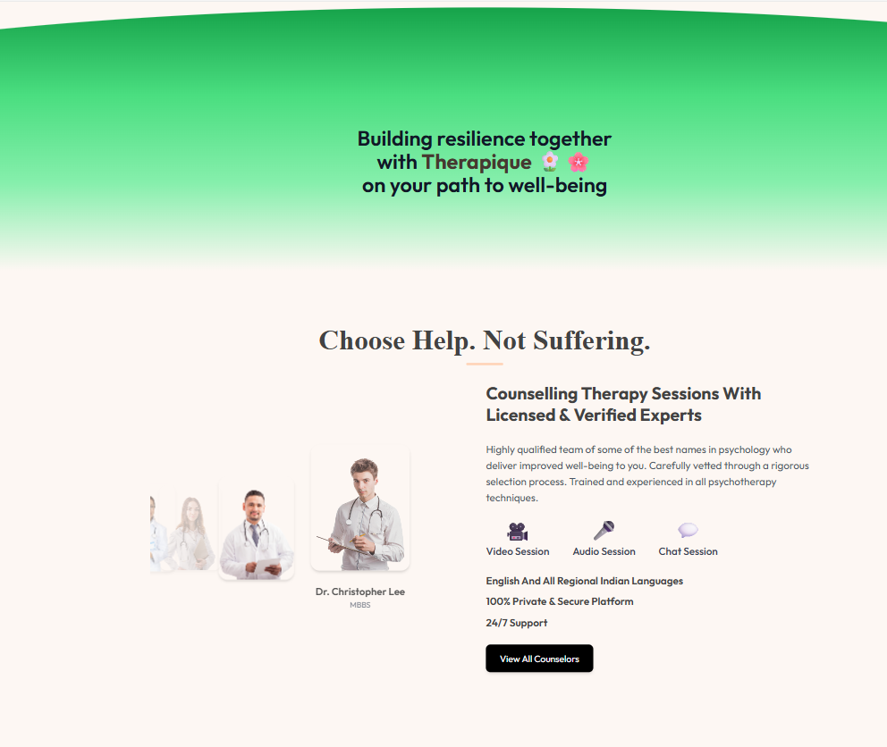
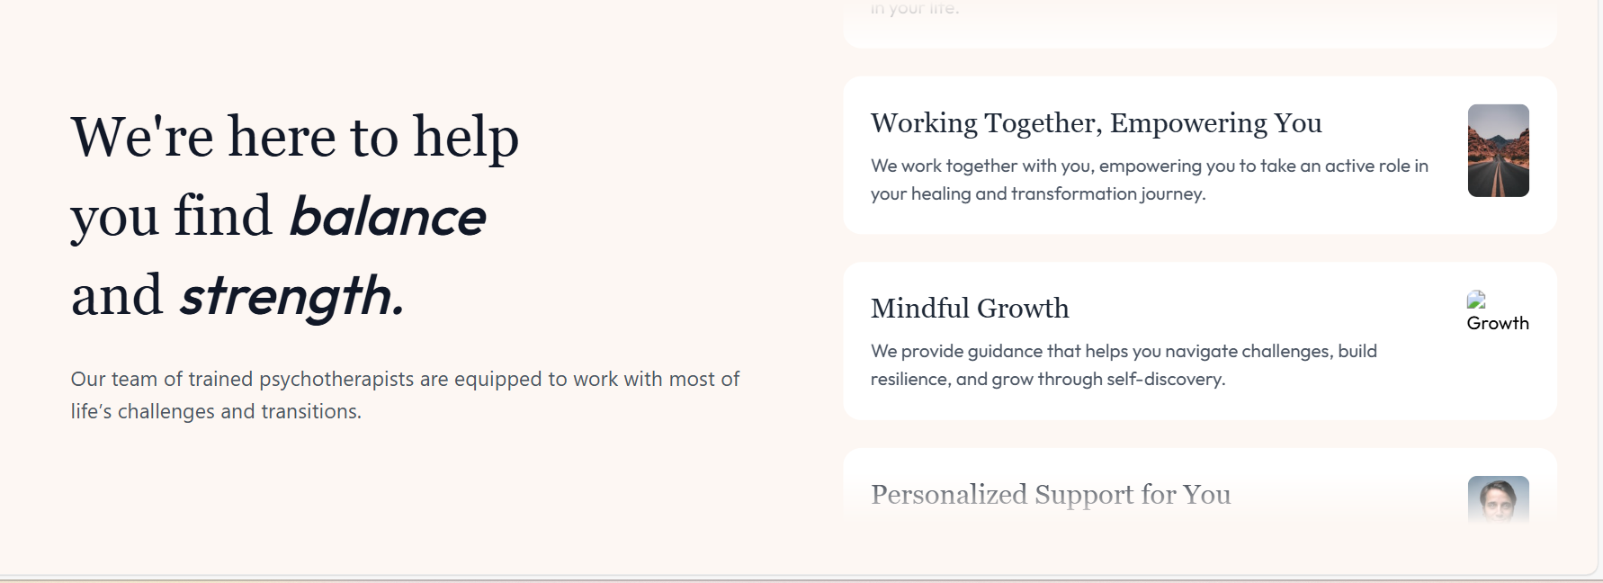
Home Page

Slide 21
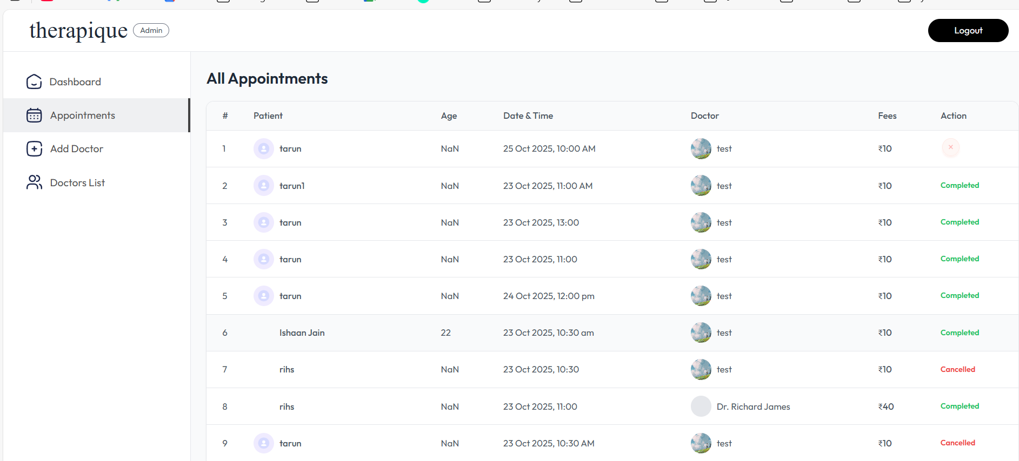
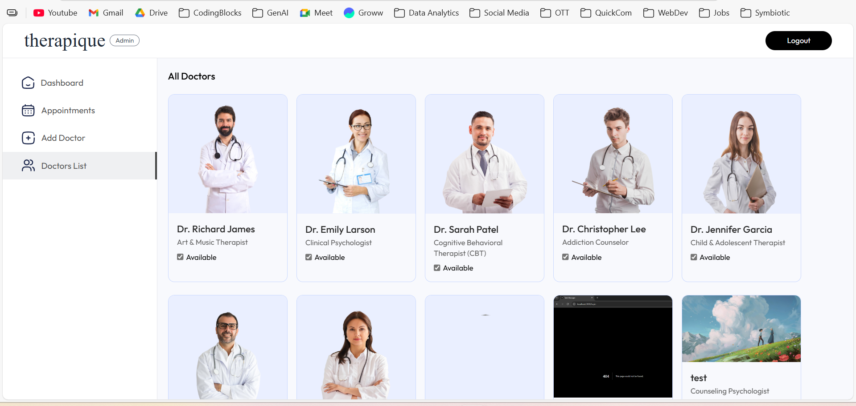
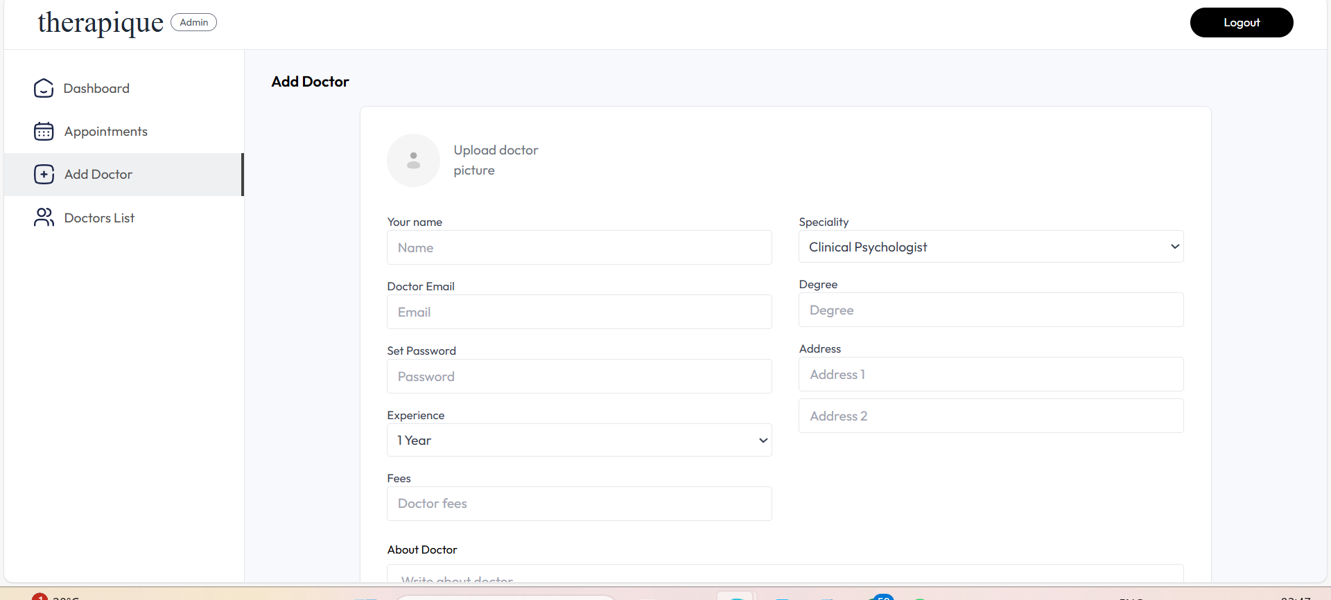
Admin Dashboard having appointments add Docator and View the available doctors

Slide 22
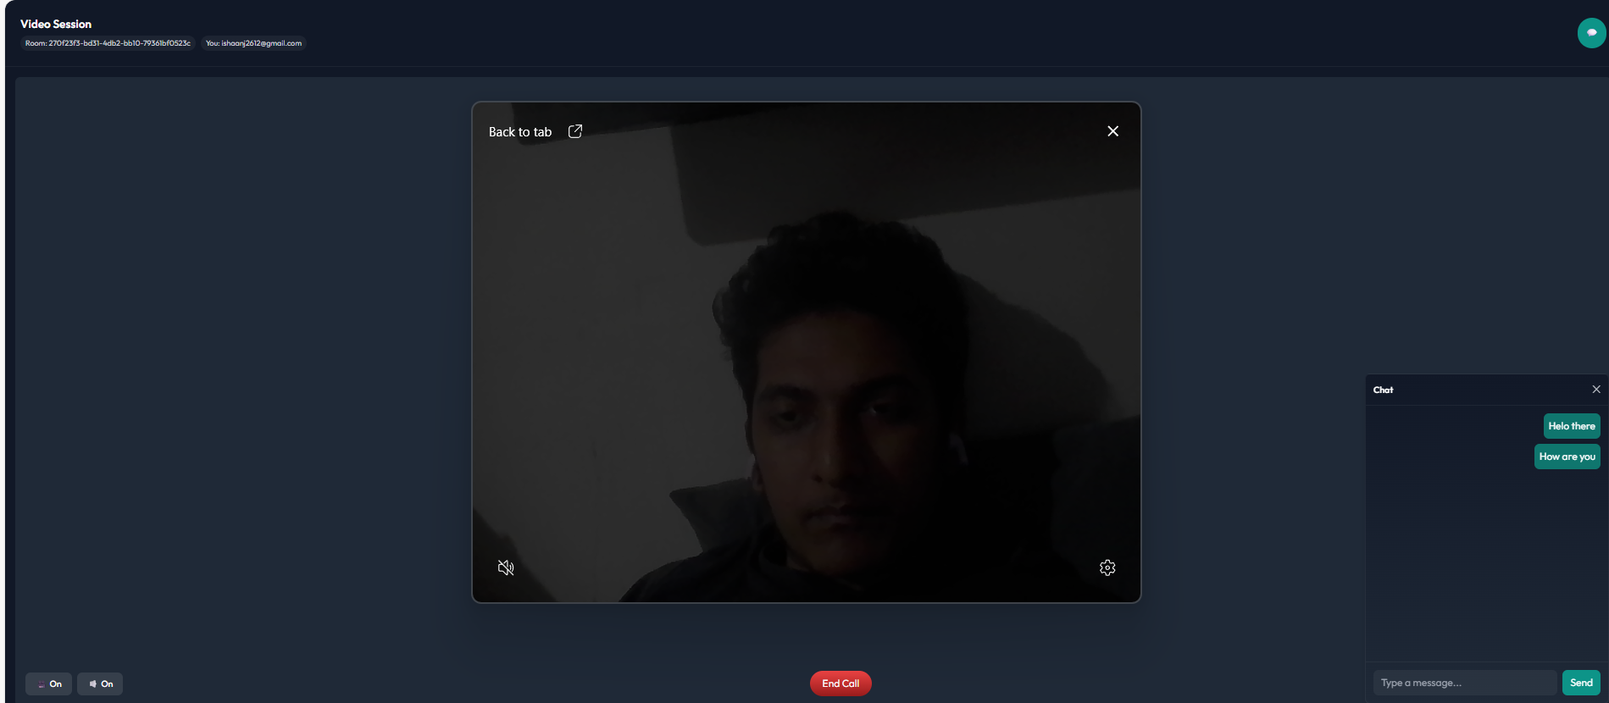
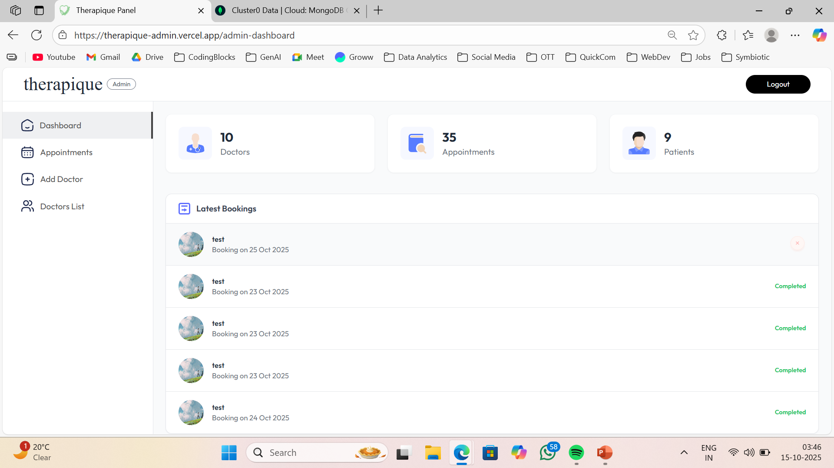
Video Session Along With VideoChat
Admin Dashbaord

Slide 23
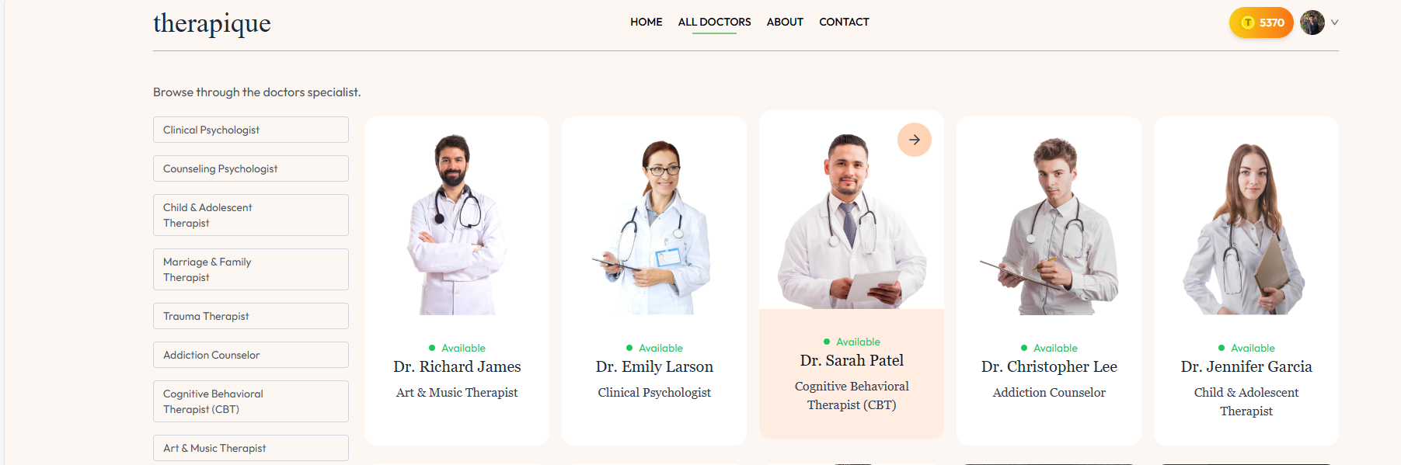
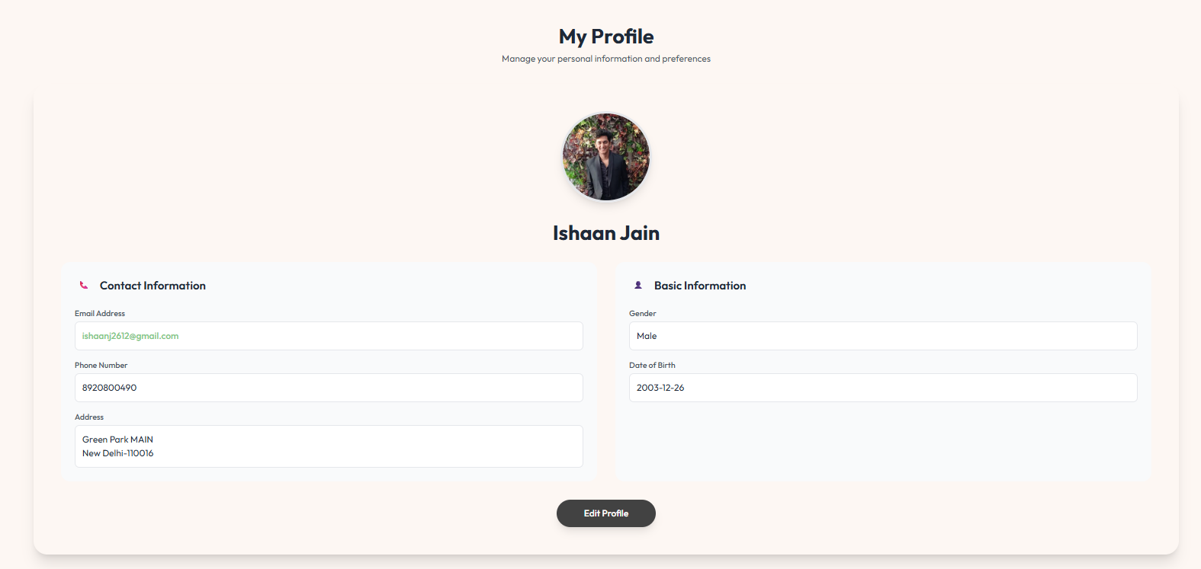
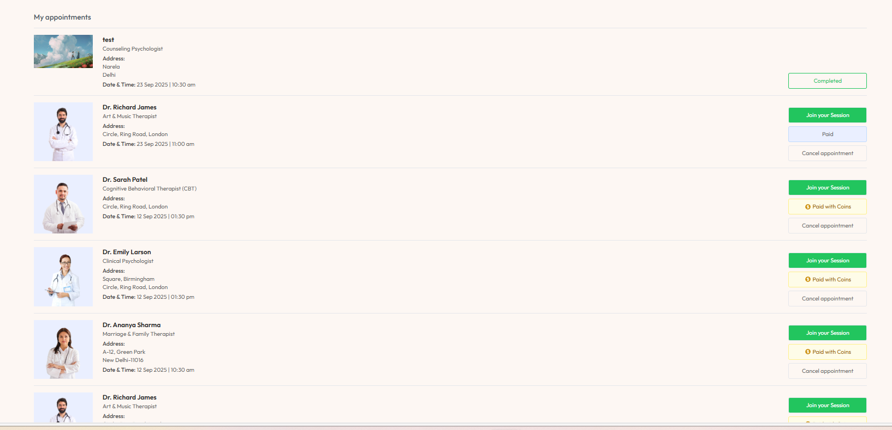
All Doctors Filter By Type Of Therapist
My Profile Page
My Appointments Page

Slide 24
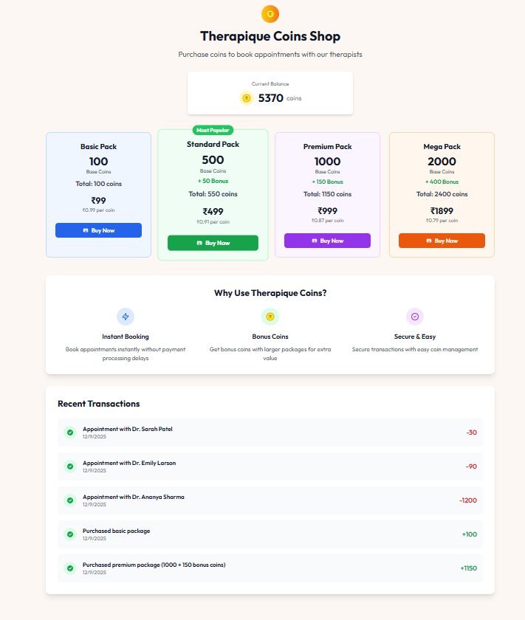
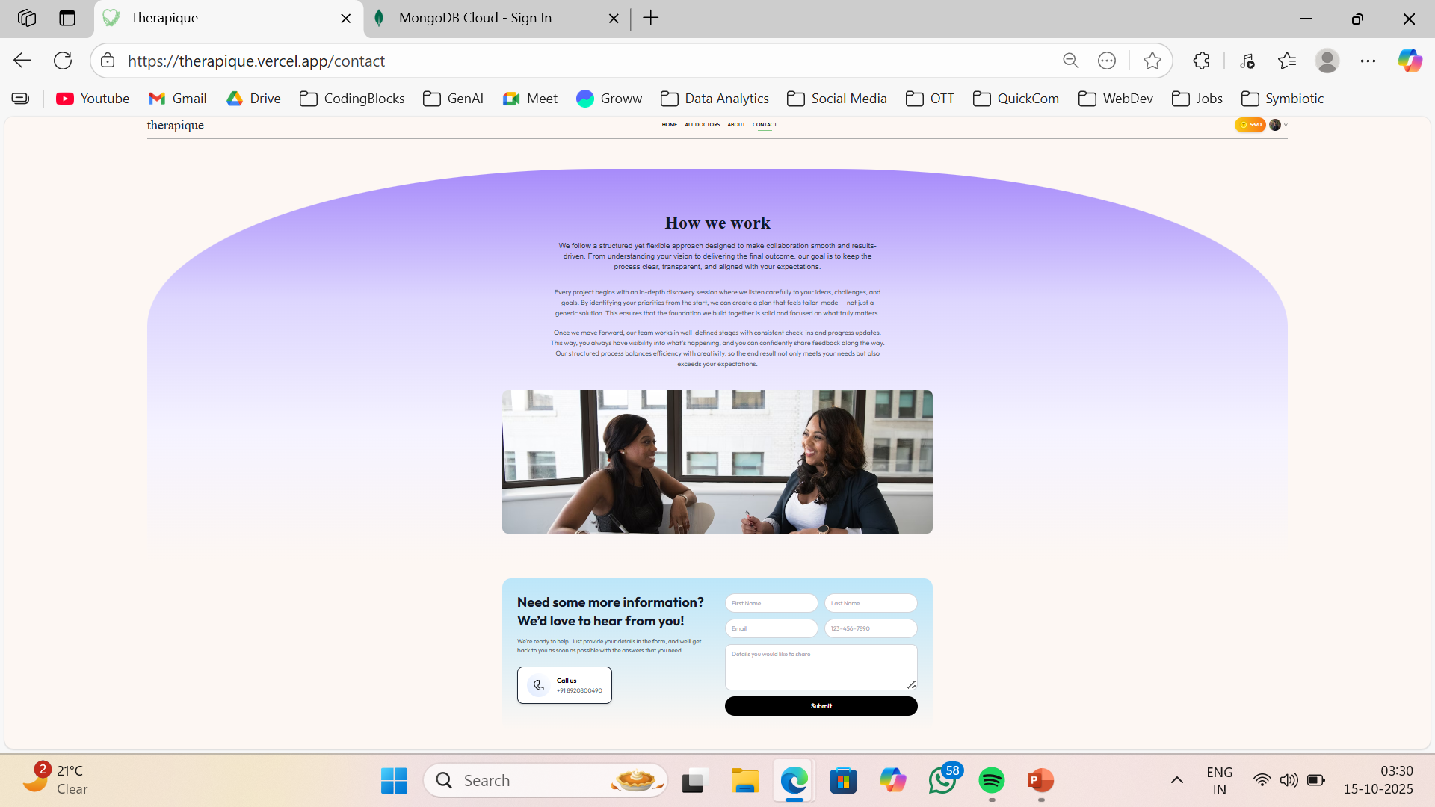
Buy Coins
Contact Us

Slide 25
Thanks!

