Slide 1

Fraud Detection for Mobile and Card Payment Transactions
A Machine Learning Case Study
By:
Ishaan Jain – 06117702722 (CSE B)
Archita Sinha – 09117702722 (CSE B)
Subject: Machine Learning and Data Analytics

Slide 2




The Growing Need for Advanced Fraud Detection
The rapid expansion of online and mobile payments has unfortunately fueled a surge in sophisticated fraudulent activities. Financial institutions face an immense challenge in combating these evolving threats.
Escalating Digital Fraud
Digital transactions create countless opportunities for fraudsters, with global losses projected to exceed $400 billion by 2030.
Limitations of Traditional Systems
Static, rule-based systems struggle to adapt to new schemes, leading to high false positives and missed complex fraud patterns.
Machine Learning: The Adaptive Solution
ML offers a powerful way to automatically identify subtle, unusual patterns and complex, hidden relationships within vast transaction data.

Slide 3

Section 1: Defining the Challenge
Problem Statement: Moving Beyond Static Rules
Traditional fraud detection systems depend on fixed, rule-based logic (e.g., blocking transactions above a certain limit or from specific locations). But fraudsters constantly change their strategies and adapt their techniques, making static rules increasingly ineffective and prone to being bypassed.
The Key Challenge
Identify fraudulent transactions hidden among millions of legitimate ones, in real-time, with minimal false alarms (false positives).
ML Solution Goal
Develop a predictive model that can analyze complex transaction data, learn patterns of normal and abnormal behavior, and predict whether a transaction is fraudulent before it completes.

Slide 4





Section 2: Data Exploration
Dataset and Feature Engineering
This case study utilized a public Credit Card Fraud Detection dataset (e.g., Kaggle European Card Transaction data), which contained over 280,000 transactions.
Dataset Link:- https://www.kaggle.com/datasets/mlg-ulb/creditcardfraud
Severe Class Imbalance
PCA-Transformed Features
Time and Amount
Only 492 transactions (0.17%) were fraudulent. This high imbalance is the primary challenge in modeling.
Time (seconds elapsed since the first transaction) and Amount (transaction value) are the only raw, non-PCA features.
Features V1 through V28 are anonymized using Principal Component Analysis (PCA) to protect privacy, representing hidden patterns in user behavior.
The extreme class imbalance dictates that standard accuracy metrics are unreliable; the model must be evaluated on its ability to detect the minority class.

Slide 5

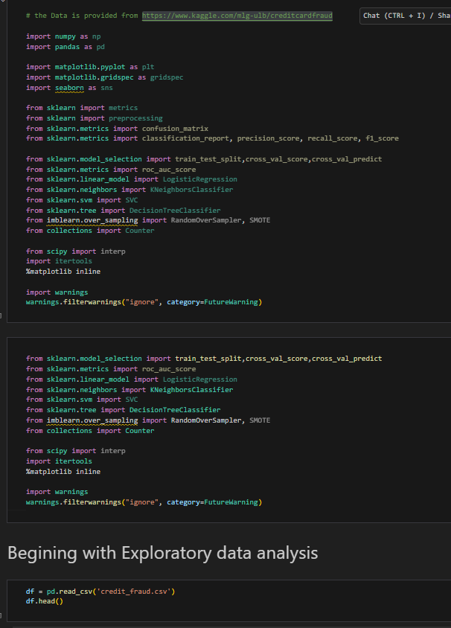
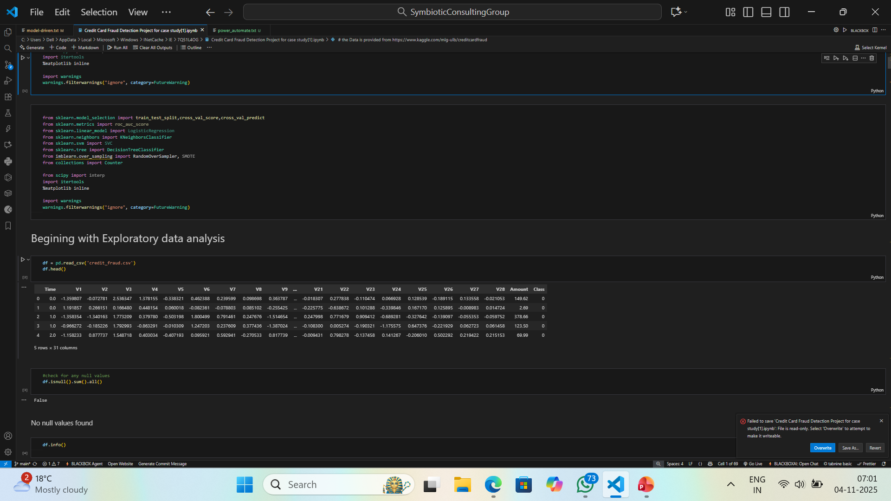
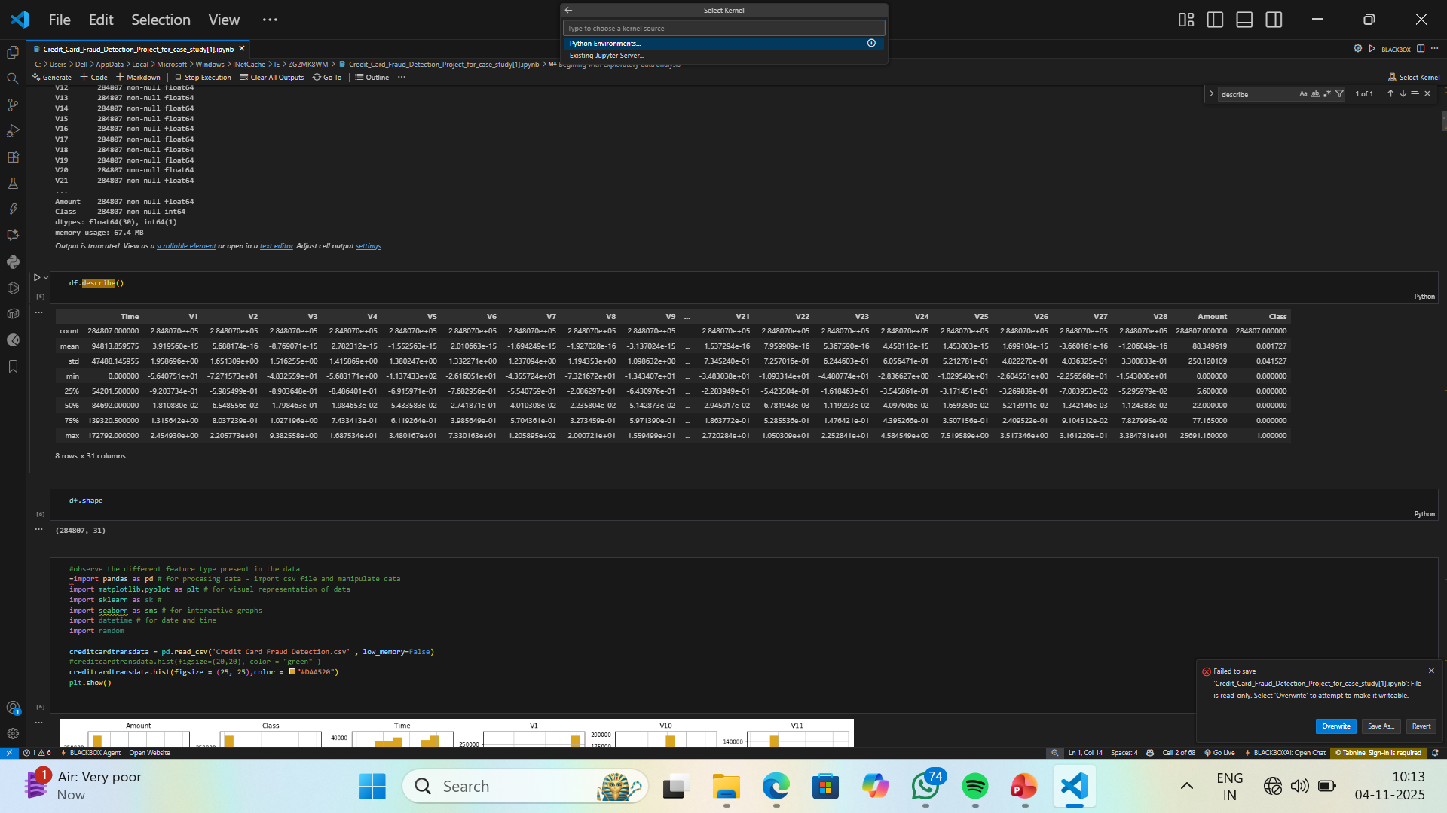
Exploratory Data Analysis
Reading the Data
S
Data Description

Slide 6
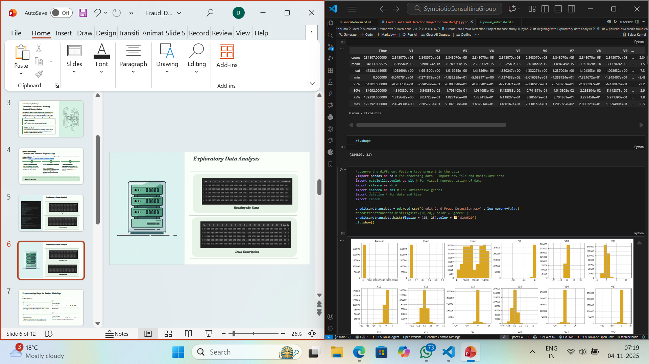
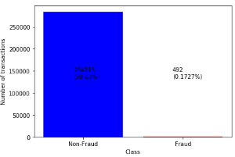
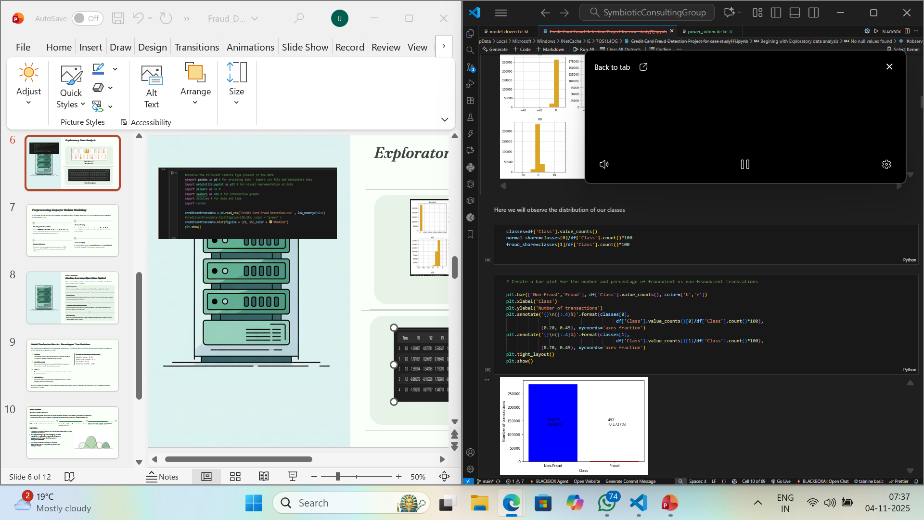
Exploratory Data Analysis
Fraudulent Vs Non- Fraudulent

Slide 7
Exploratory Data Analysis
Data Features Visualization

Slide 8



Preprocessing Steps for Robust Modeling
Before training, the raw data must be cleaned and transformed to ensure the model can generalize effectively and not be biased toward the legitimate majority class.
Feature Scaling
Normalized the transaction amounts using a StandardScaler to ensure all features contribute equally to the distance calculation during training.
Train-Test Split
Feature Selection
Divided the dataset into an 80% training set and a 20% testing set to validate the model's performance on unseen data.
Removed irrelevant columns and used techniques like PCA (already applied to V-features) to manage dimensionality effectively.

Slide 9
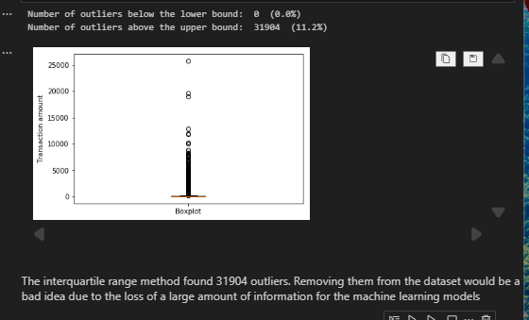
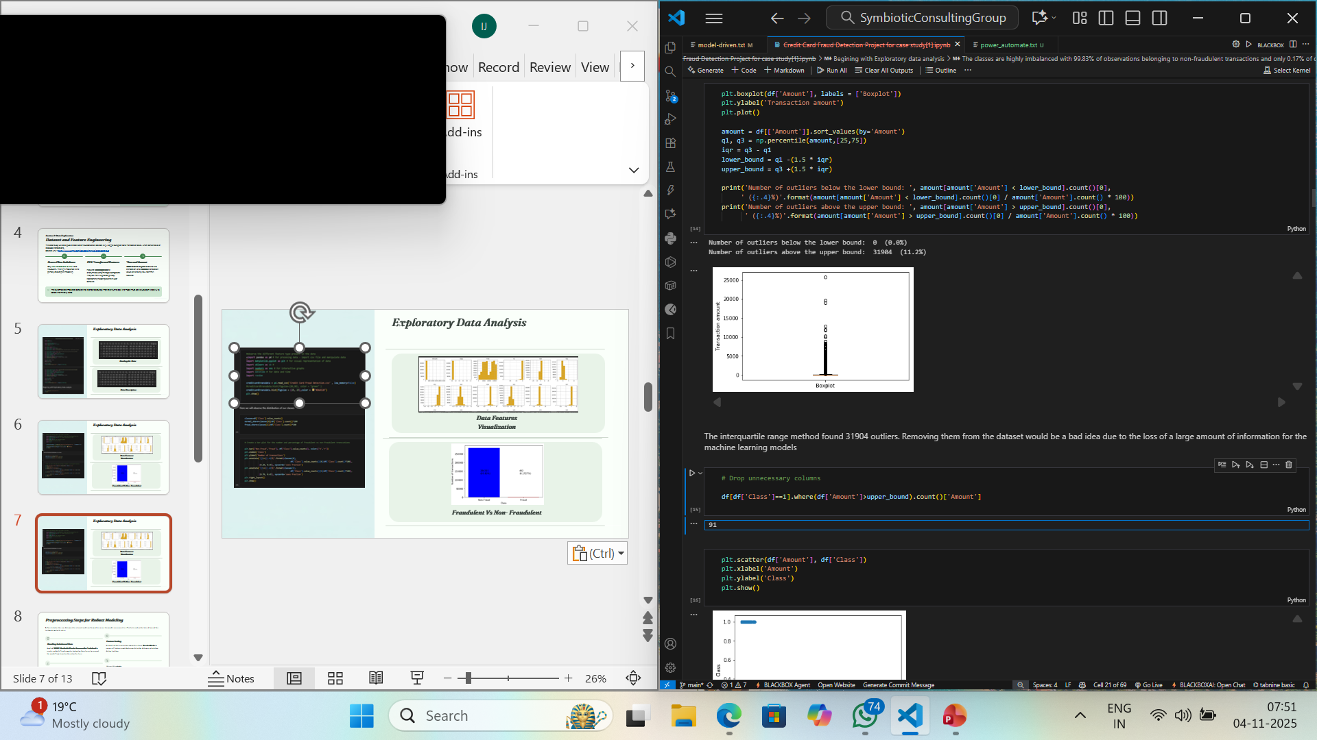
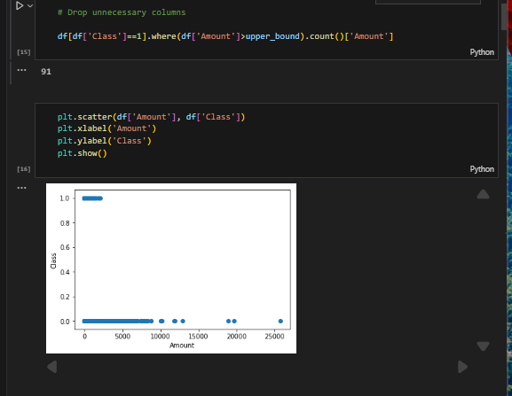
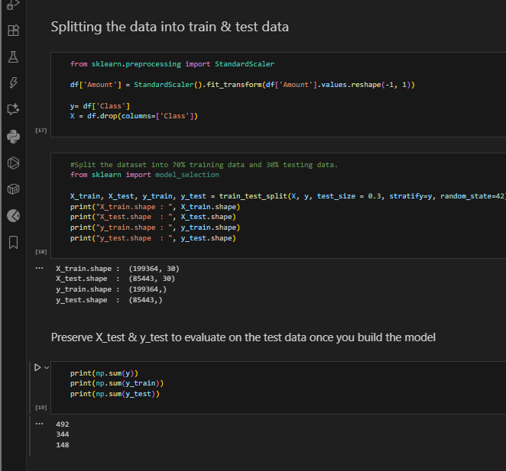
Exploratory Data Analysis
Box Plot Visualization
Dropping Transaction where Fraudulent Amount is an Outlier
Testing-Training data split

Slide 10



Section 3: Methodology
Machine Learning Algorithms Applied
A diverse set of classification algorithms were implemented to compare their efficacy in handling highly complex and imbalanced transaction data.
Logistic Regression
Used as a baseline model for probabilistic binary classification. Simple and highly interpretable.
Random Forest
An ensemble method that builds multiple decision trees. Highly effective at handling complex, nonlinear relations and managing data imbalance.
XGBoost (Extreme Gradient Boosting)
A high-performance gradient boosting framework. Known for its speed and exceptional predictive accuracy in complex classification tasks.
Neural Network
A Deep Learning approach applied for recognizing complex, non-linear patterns from the large set of PCA-transformed features (V1-V28).

Slide 11

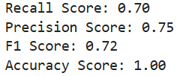
Model Evaluation Metrics: Focusing on True Positives
Since fraud detection is an imbalanced classification problem, standard accuracy is misleading. We must use metrics that specifically evaluate the model's performance on correctly identifying the rare, minority class (fraud).
Precision
Example Result (Logistic Regression)
The percentage of predicted frauds that are actually fraudulent. Minimizing false positives (legitimate transactions flagged as fraud).
Recall (Sensitivity)
The percentage of actual frauds correctly detected. Crucial for minimizing false negatives (actual frauds missed by the system).
F1-Score
The harmonic mean of precision and recall, providing a balanced measure of the model’s performance.
ROC-AUC Score
Measures the model’s ability to distinguish between the two classes (fraud vs. legitimate) across all threshold settings.
Observation: XGBoost and Random Forest consistently outperformed the other models, successfully balancing high fraud detection (Recall) with minimal disruption to legitimate users (Precision).

Slide 12
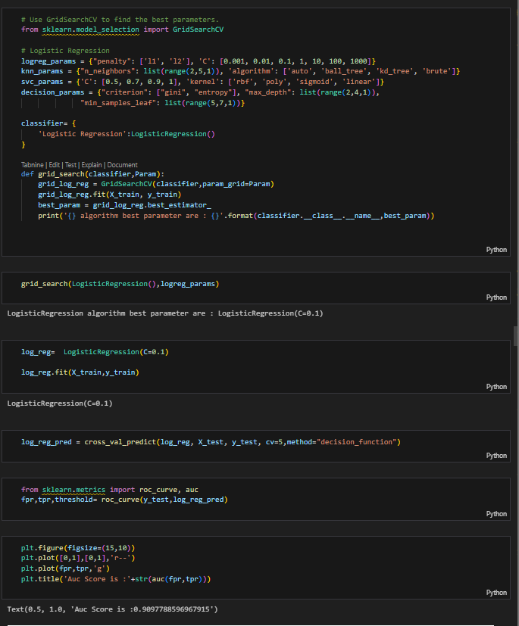
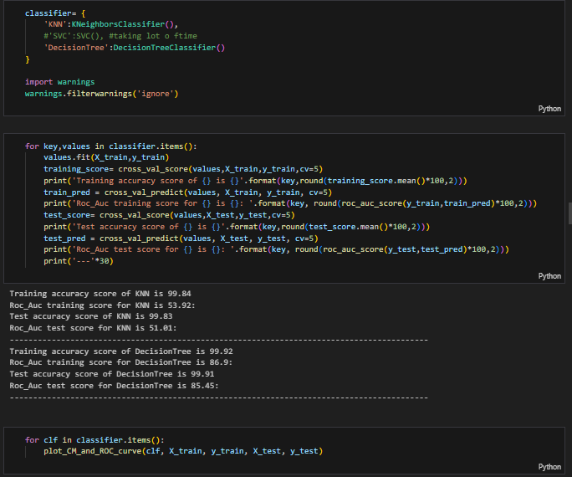
Logistic Regression Modelling
KNN Modelling

Slide 13
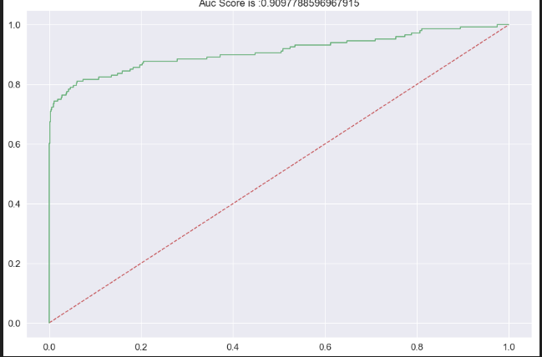
Model Evaluation Metrics
(Logistic Regression)

Slide 14
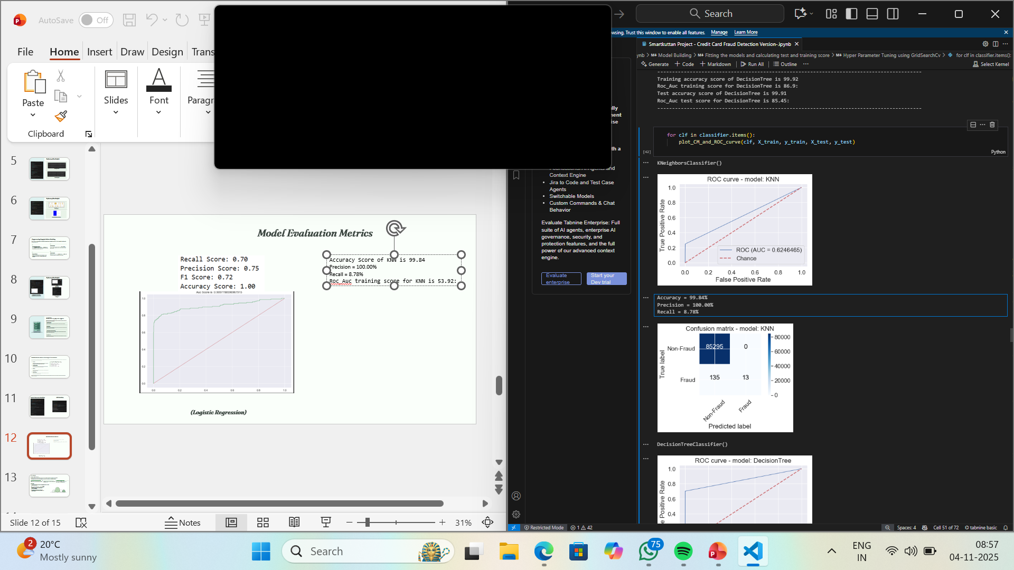
Model Evaluation Metrics
Accuracy Score of KNN is 99.84
Precision = 100.00%
Recall = 8.78%
Roc_Auc training score for KNN is 53.92:
(KNN Modelling)

Slide 15
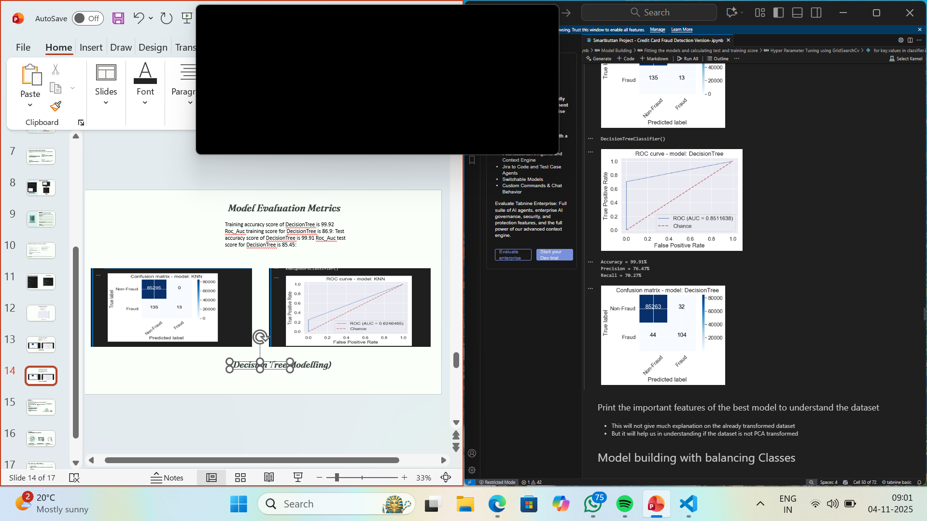
Model Evaluation Metrics
Training accuracy score of DecisionTree is 99.92 Roc_Auc training score for DecisionTree is 86.9: Test accuracy score of DecisionTree is 99.91
Roc_Auc test score for DecisionTree is 85.45:
(Decision Tree Modelling)

Slide 16
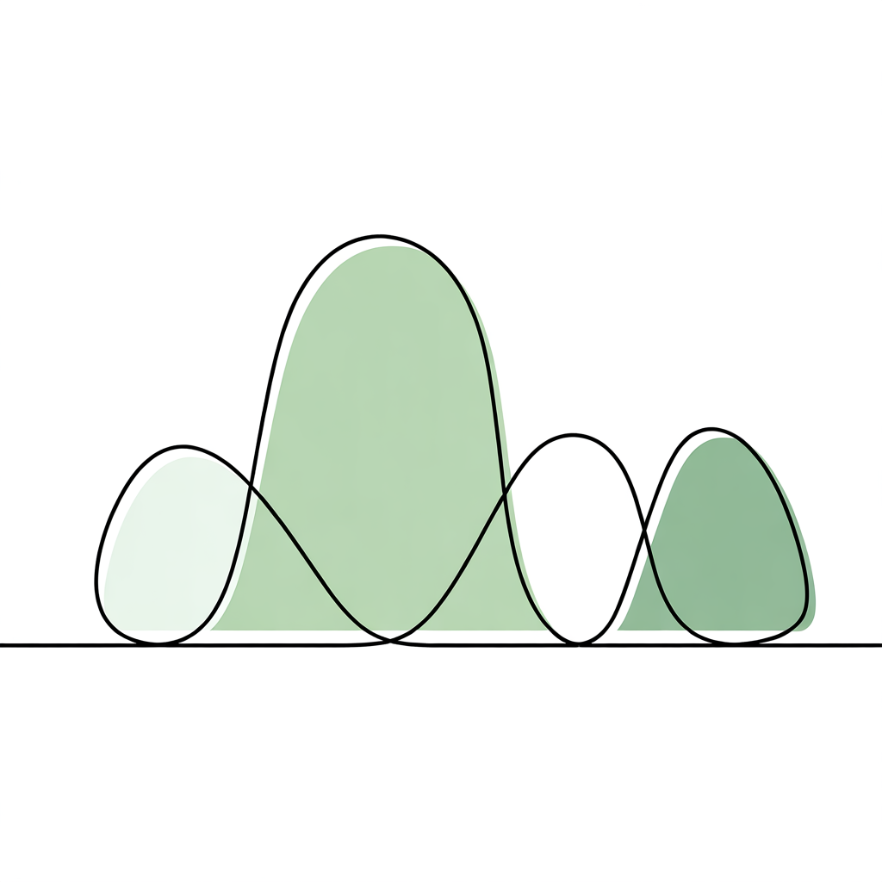
Section 4: Key Insights
Results and Visualization
The model comparison confirmed the effectiveness of ensemble and boosting methods in this domain.
Furthermore, analyzing the feature importance revealed critical patterns in fraudulent behavior.
89%
75%
Random Forest F1-Score: Strong performance due to
ensemble diversity.
Logistic Regression F1-Score: Useful baseline,
but less powerful for hidden patterns.
Key Insights:
Fraudulent transactions often have low amounts but occur in short,
intense time intervals.
The anonymized PCA features (V-features) contributed most to the predictive power of the complex models.

Slide 17



Section 5: Deployment
Real-World Applications in FinTech
The principles demonstrated in this case study are already standard practice in the financial industry, where real-time analysis is non-negotiable for securing vast daily transaction volumes.
E-Wallets (PayPal, Google Pay)
Card Networks (Visa & Mastercard)
Financial Institutions
Use deep neural networks and behavioral analysis to detect anomalies, such as changes in device, location, or unusually high transaction frequency.
Employ advanced AI models to evaluate transaction risk scores instantly (in milliseconds) before authorization is granted.
Banks use real-time streaming data analytics combined with ML models to score every transaction for risk, continuously learning and adapting to new fraud schemes.

Slide 18




Future Directions and Open Challenges
While ML has significantly advanced fraud detection, several challenges remain and drive the next wave of research and development in this field.
Graph Neural Networks (GNNs)
Moving beyond single transactions to detect sophisticated fraud rings and networks by analyzing relationships between users, accounts, and merchants.
Federated Learning
Allows multiple financial institutions to collaboratively train robust fraud detection models without sharing sensitive proprietary customer data.
Explainable AI (XAI)
Improving model transparency to provide justifications for why a specific transaction was flagged, which is critical for regulatory compliance and customer trust.
Real-Time Scalability
Addressing the engineering challenge of deploying complex models that can process millions of transactions per second with low latency across global networks.

