Slide 1

Assignment 1
Course : Principles of Management for Engineers
Subject Code : (MS-302)
Presented by:
ISHAAN JAIN (06117702722)
TARUN PANDORE (07017702722)
CSE B RISHAB NEGI (07817702722)
AYUSH RAWAT (07617702722)
SAIJAL (09017702722)

Slide 2

Altor: smart mobility
"A revolutionary smart helmet designed for enhanced rider safety through AI-powered features.”

Slide 3
CONTENTS
Introduction to Altor Smart Helmet
Key Features and Technology
1
2
Benefits and Applications
Shark Tank Pitch
3
4
Market Challenges and Opportunities
6
Future Prospects and Innovations
5

Slide 4

01
Introduction

Slide 5
OVERVIEW
HISTORY AND DEVELOPMENT
PURPOSE AND MISSION
ABOUT ALTOR
NEED FOR ALTOR
Altor Smart Helmet was conceived by a team of experts dedicated to enhancing cyclist safety, with development beginning in early 2015
The primary mission of the Altor Smart Helmet is to reduce cycling- related injuries through smart technology integration for improved safety and awareness.
Founded by Shamik Guha, Sayan Tapadar, Muhammad Bilal Shakil, and Anirban Gupta, offers innovative helmets for two-wheelers with advanced features like connectivity and accident detection.
With the increasing number of accidents involving two-wheelers, they saw an urgent need for a solution that could enhance rider safety through technology.

Slide 6
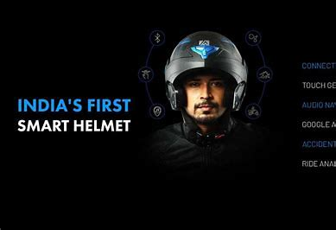
SIGNIFICANCE
SAFETY INNOVATION
1
The helmet includes innovations such as impact detection, emergency alerts, and built- in lighting, GPS tracking, Bluetooth connectivity and voice commands to increase rider visibility and safety.
MARKET IMPACT
2
Since its launch, the Smart Helmet has disrupted the market, setting new standards in safety features and gaining recognition from industry leaders.
USER ADOPTION
3
Users have widely adopted the Altor Smart Helmet, with many praising its advanced features and the additional layer of safety it provides.

Slide 7
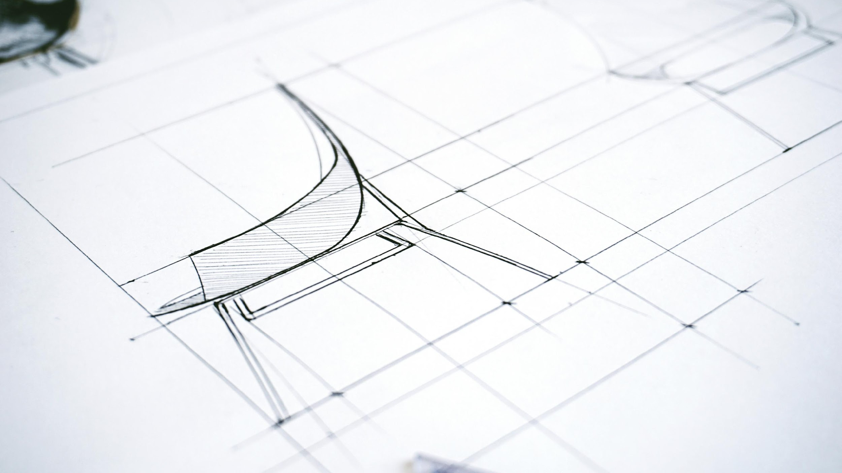
02
KEY FEATURES
&
TECHNOLOGY

Slide 8
SAFETY MECHANISM
IMPACT SENSORS
Impact sensors detect collisions and ensure timely deployment of safety features, minimizing injury risks in adverse events.
EMERGENCY RESPONSE INTEGRATION
This integration connects with emergency services, providing immediate assistance and crucial data during accidents for improved response times.

Slide 9

CONNECTIVITY
APP SYNCHRONIATION
The app synchronization feature links the device to your smartphone, facilitating access to features and information on- the- go.
Bluetooth and Wi-Fi
REAL-TIME ALERTS
Bluetooth and Wi- Fi enable seamless connections to other devices, allowing for easy information exchange and enhanced user experience.
Real- time alerts keep the user instantly informed about important updates, ensuring prompt action and increased safety.

Slide 10
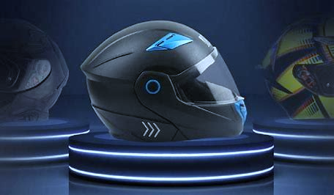


COMFORT AND DESIGN
Ergonomic Design
Customizability
Ergonomic design prioritizes user comfort, reducing strain and enhancing the overall experience during prolonged usage.
Customizability allows users to modify settings and adapt the device to their individual preferences, ensuring a tailored and comfortable fit

Slide 11
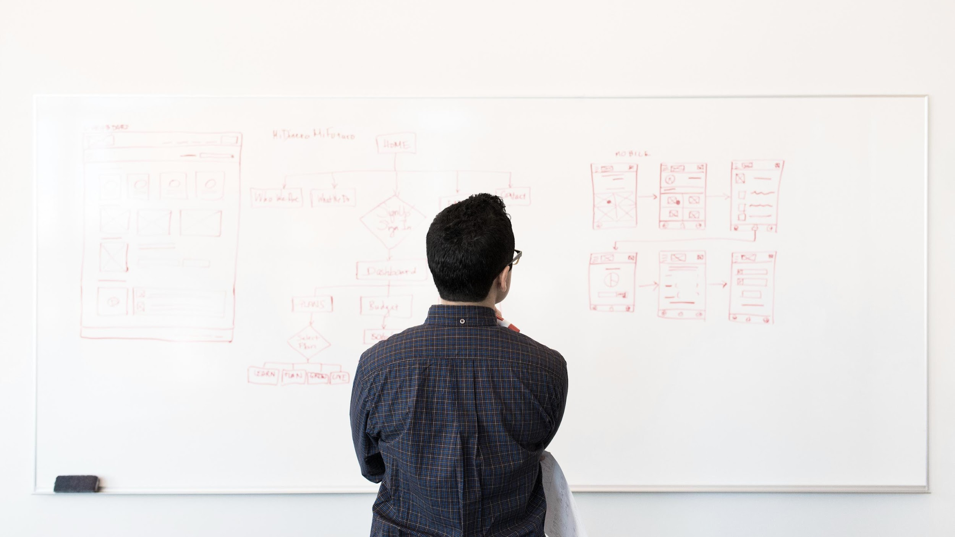
03
BENEFITS & APPLICATIONS

Slide 12
INDIVISUAL USERS
Motorcyclists
Motorcyclists benefit from enhanced safety features and navigation systems that offer real- time updates, helping them to avoid traffic and find the best routes.
CYCLISTS
Cyclists can use these applications for route optimization, fitness tracking, and ensuring better safety through alert systems that notify them about potential hazards.
Delivery Riders
Delivery Riders can use these applications for route optimization and ensuring better safety through alert systems that notify them about potential hazards. They can know about traffic and be alerted with smart technology and need now check the phone continuously

Slide 13



PROFFESIONAL USE
DELIVERY SERVICES
Delivery services leverage these applications for efficient route planning, tracking deliveries in real- time, and improving customer satisfaction through accurate ETA notifications.
LAW ENFORCEMENT
SPORTS PROFESSIOANLS
Law enforcement agencies utilize these technologies for effective patrol coordination, real- time communication, and rapid response to incidents, enhancing overall public safety.
Sports professionals use these tools for performance tracking, monitoring physical metrics, and designing training programs tailored to improve their sporting achievements.

Slide 14
04
Shark Tank Pitch

Slide 15
Pitching Offer
Aspect | Details | Original Ask | Final Deal | Investor Feedback
Ask
Valuation | ₹10 crore valuation | ₹10 crore | ₹7.14 crore (due to 7% equity) | Questions on scalability and product adoption
Technology Demo | Smart helmet with accident detection and voice assist | Demo of smart helmet features | Demo of accident detection and communication features | Impressed with innovation but cautious on pricing
Investor Interest | Namita Thapar and Aman Gupta | 2 investors showed interest | Namita Thapar and Aman Gupta final offer | Focus on road safety and scalability concerns
Visibility Post-Show | Gained significant brand recognition | Low brand awareness before pitch. | Increased visibility and consumer interest | Greater media exposure, leading to growth.
Expansion Plans | Expand market reach and enhance technology. | Market expansion | Expand to more cities and improve product features | Need for more market penetration and customer education
₹50 lakhs for 5% equity
₹50 lakhs for 5% equity
₹50 lakhs for 7% equity
Strong interest in road safety innovation

Slide 16
05
MARKET CHALLENGES &
OPPORTUNITIES

Slide 17


CHALLENGES
COMPETITION
COST AND AFFORDABILITY
Intense competition from established players and new entrants increases pressure on market share, pricing strategies, and innovation.
High production costs and low affordability hinder market entry and expansion, especially in price- sensitive markets and among cost- conscious consumers.
01
02
MARKET CHALLENGES
Scalability Concerns
Facing competition from traditional helmets and the need to educate consumers about the benefits of smart helmet.
Struggled with expanding their product to a larger audience due to pricing and awareness barriers.
03
04

Slide 18

OPPORTUNITIES
Partnerships and Collaborations
Growing demand in emerging markets offers significant growth opportunities, enabling companies to tap into new customer bases and revenue streams.
Expansion to New Markets
Technological Advancements
Growing demand in emerging markets offers significant growth opportunities, enabling companies to tap into new customer bases and revenue streams.
Advances in technology create opportunities for improved products, increased efficiency, and the potential to disrupt existing market norms.

Slide 19
06
FUTURE PROSPECTS AND INNOVATIONS

Slide 20
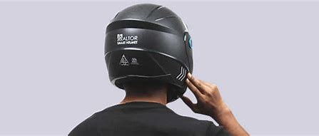


UPCOMING FEATURES
ADVANCED AI INTEGRATION
ENHANCED BATTERY LIFE
Detailed description about this title about 20- 30 words. The integration of more sophisticated AI will allow for smarter, more intuitive user interactions and a higher level of automated functionalities.
Detailed description about this title about 20- 30 words. Innovations in battery technology aim to deliver longer usage times, quicker charging, and improved energy efficiency for a seamless user experience.

Slide 21
VISION FOR THE FUTURE
Global Accessibility
Our goal is to make the technology accessible to users worldwide, regardless of geographical or economic barriers, ensuring inclusivity and equity.
Broader Applications
Improved User Experience
We foresee expanding the use of our technology into diverse fields such as healthcare, education, and finance, addressing a wider range of user needs.
Focused on user- centric design, we aim to enhance interface intuitiveness, simplify navigation, and deliver a more engaging and satisfying user experience.

Slide 22
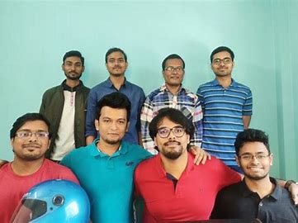
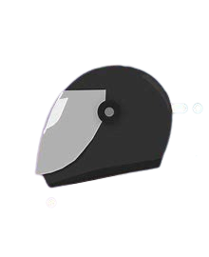
THANKYOU
DRIVE SAFE AND SMART

