Slide 1
Unit III – Distributed File Systems & Resource Management

Slide 2
Overview of Unit III
• Distributed File Systems (DFS)
• File Models & Accessing Mechanisms
• File Replication & Atomic Transactions
• Case Study: Hadoop HDFS
• Resource and Process Management
• Task Assignment, Load Balancing, Load Sharing

Slide 3
Distributed File Systems
A Distributed File System (DFS) is a file system that enables users to store, access, and manage files across multiple machines in a distributed network as if they were stored on a single local computer. In simple terms, DFS allows files to be shared and accessed from different computers over a network while maintaining consistency, security, and reliability.

Slide 4
Objectives of DFS
Provide transparent access to remote files
Ensure data sharing among multiple users
Maintain reliability and fault tolerance
Support scalability (easy expansion of storage)
Offer high performance

Slide 5
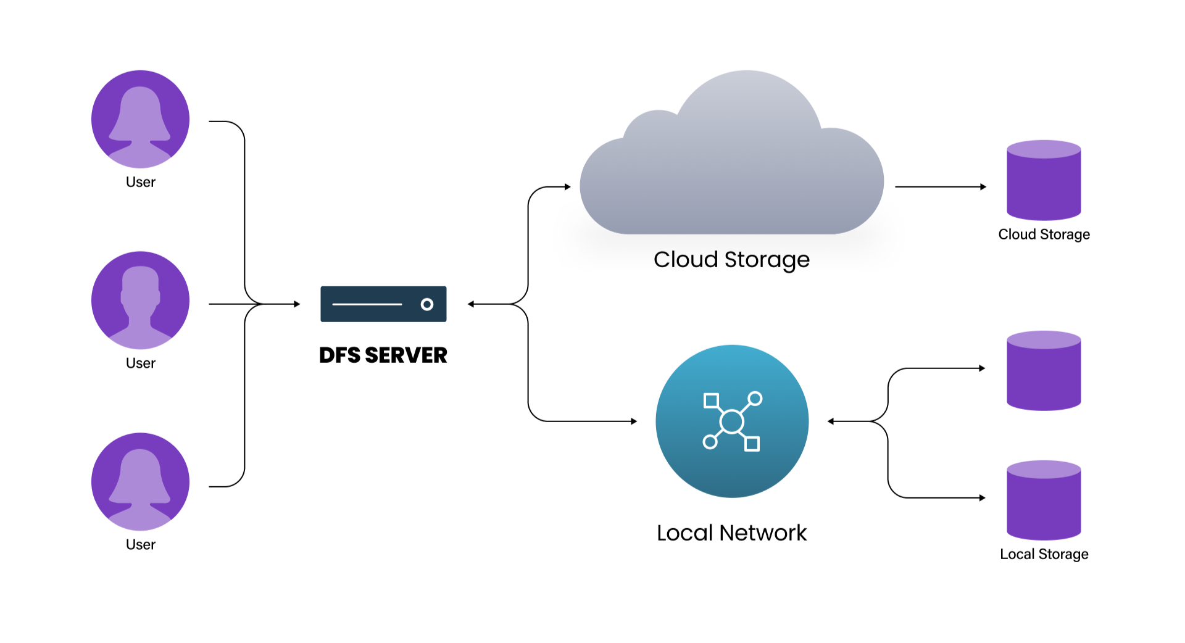
Distributed File System

Slide 6
Components of DFS
Servers – Store the actual files
Clients – Access files from servers
Naming System – Maps file names to their actual location
Communication Protocols – Ensure secure transfer of data

Slide 7
File Models
A file model defines how a file is accessed and updated in a distributed environment. It represents the rules and structure to manage file operations across multiple machines.
Common file models in DFS
Ordinary File Model: Treats a file as a sequence of bytes. Any type of data (text, image, audio) is supported and the system does not interpret its contents.
Structured File Model: Represents a file as a collection of records (for example, each record in a database). Supports direct access to records instead of reading the whole file.
Shared File Model: Allows files to be accessed and shared by multiple users or processes simultaneously.
Transaction File Model: Uses ACID (Atomicity, Consistency, Isolation, Durability) properties and supports rollback and commit. Useful for banking and database-like systems.

Slide 8
Accessing Mechanisms
Accessing mechanisms define how clients interact with servers to access or modify files stored remotely in a DFS.
4-Types
Remote Access Technique
Upload/Download Technique
Caching Technique
Block Access (Low-level access)

Slide 9
Accessing Mechanisms
Remote Access Technique • All operations (open, read, write, close) are performed directly on the remote server. • The client sends requests over the network. • Suitable when files are large or rarely used. • Disadvantage: high network traffic.
Upload/Download Technique • Also called the remote file copy model. • The file is first copied from the server to the client. • Client edits the file locally and uploads it back after modifications. • Advantage: low network usage during editing. • Disadvantage: conflict may occur if multiple clients edit the same file.
Caching Technique • A copy of the file (or part of it) is stored temporarily on the client side. • Access becomes faster because repeated requests do not always go to the server. • Needs cache consistency protocols to ensure the latest version of the file.
Block Access (Low-level access) • Instead of reading the whole file, small chunks or blocks are accessed directly. • Useful for distributed databases and cloud storage systems.

Slide 10
File Replication
File replication means keeping multiple copies of the same file on different servers or nodes in a distributed system. The goal is to improve reliability, availability, and performance.
Reasons for file replication: • To ensure that data is still accessible even if one server fails • To reduce access time by placing copies closer to users • To balance the load when many clients try to access the same file

Slide 11
Benefits of file replication • High availability: users can access the file even if one replica is unavailable • Fault tolerance: system continues working during server or network failures • Improved read performance: multiple servers can serve requests simultaneously
Challenges of file replication • Keeping all replicas consistent when updates occur • Managing synchronization when many users edit files • Extra storage space required for maintaining multiple copies

Slide 12
Atomic Transactions in DFS
An atomic transaction refers to a set of file operations that are treated as a single unit: either all operations are completed successfully or none of them are applied. This ensures that the file system never remains in an inconsistent state.
Atomic transactions are based on ACID properties: • Atomicity – the transaction is indivisible; it fully completes or fully aborts • Consistency – the file system remains in a correct state after the transaction • Isolation – multiple transactions do not interfere with each other • Durability – once committed, results are permanent even after failures

Slide 13
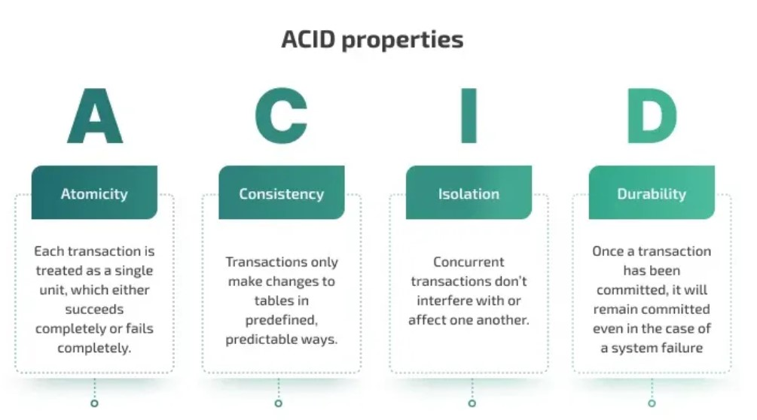

Slide 14
Two-Phase Commit Protocol (2PC) for atomic transactions
Voting phase – the coordinator asks all servers whether they are ready to commit
Commit phase – if all servers agree, the coordinator commits the transaction; otherwise, it aborts
Advantages of atomic transactions • Guarantees safe file updates in distributed environments • Prevents partial updates or corrupted data • Ensures reliability even during system crashes
Use cases • Banking and financial applications • Reservation systems • E-commerce transactions • Distributed databases and cloud systems

Slide 15
Case Study – Hadoop HDFS
HDFS (Hadoop Distributed File System) is a distributed file system designed to store and process very large datasets across clusters of commodity hardware. It is one of the core components of the Apache Hadoop framework.
HDFS follows a write-once and read-many access model, making it suitable for big data analytics rather than frequent file updates.

Slide 16
Architecture of HDFS
HDFS uses a master–slave architecture with two main components:
NameNode • Acts as the master server • Manages metadata such as filenames, permissions, and block locations • Does not store actual data
DataNode • Store the actual file data in the form of blocks • Respond to read/write requests from clients • Periodically send heartbeats and block reports to the NameNode

Slide 17
Architecture of HDFS
Block Concept in HDFS • Files are split into large blocks (default size 128 MB) before storing • Each block is stored on multiple DataNodes • This helps achieve parallel processing and fault tolerance
Replication in HDFS • HDFS stores copies of each block across different DataNodes • Default replication factor is 3 • If one DataNode fails, the data is still available from another replica

Slide 18
Case Study – Hadoop HDFS
HDFS (Hadoop Distributed File System) is the primary storage system used by Apache Hadoop. It is designed to store and manage large volumes of data across multiple machines in a distributed and fault-tolerant manner. HDFS allows applications to work with very large datasets by breaking files into blocks and distributing them across a cluster of commodity hardware.

Slide 19
Hadoop HDFS
Fault Tolerance: Data is replicated across multiple nodes. If one node fails, the system automatically retrieves the data from another copy.
High Throughput: Optimized for high data access throughput rather than low latency. Ideal for batch processing tasks.
Scalability: Easily scales horizontally by adding more nodes to the cluster without major configuration changes.
Data Locality: Moves computation (MapReduce tasks) closer to where data resides, reducing network congestion and improving performance.
Streaming Data Access: Designed for large, sequential read/write operations instead of random access.

Slide 20
Hadoop HDFS
HDFS Architecture Components
NameNode (Master Node):
Manages the file system namespace and metadata (information about files, directories, and blocks).
Does not store actual data, only metadata (like block locations).
Is critical — if it fails, the cluster can become inoperable (though Secondary NameNode or standby NameNode provides backup).
DataNode (Worker Node):
Stores actual data blocks on the local disks.
Periodically sends heartbeats and block reports to the NameNode.
Executes read/write requests from clients as instructed by the NameNode.
Secondary NameNode:
Not a backup NameNode.
Periodically merges the edit logs with the file system image (FsImage) to prevent the NameNode from overloading.
Client:
Interacts with the NameNode for metadata and with DataNodes for data operations.
Splits large files into blocks and requests block placement from the NameNode.

Slide 21
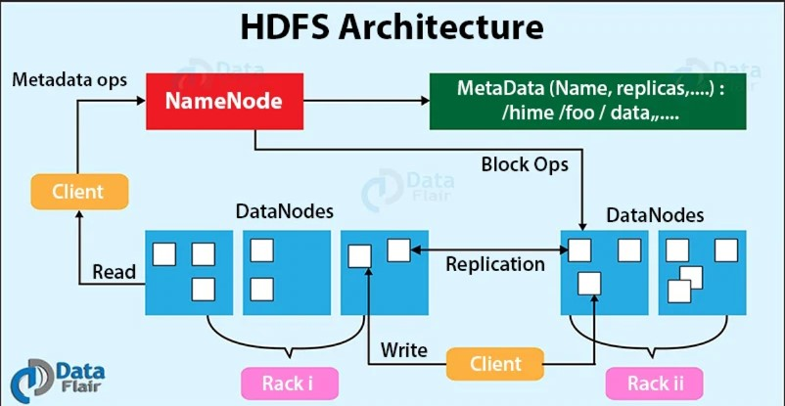

Slide 22
Hadoop MapReduce
MapReduce is a programming and processing framework in Hadoop used for large-scale data processing. It allows parallel processing of massive datasets across distributed clusters in a reliable and fault-tolerant way.
MapReduce works on the principle of divide and conquer. A large dataset is divided into smaller chunks and processed simultaneously across multiple nodes to speed up computation.

Slide 23
Two main phases of MapReduce
Mapper • Input data is divided into key–value pairs • The map function processes each pair and produces a set of intermediate key–value pairs • Multiple mappers run in parallel on different chunks of data
Reducer • Collects intermediate key–value pairs generated by the Map phase • Groups values having the same key • Performs aggregation operations such as sum, count, average, sorting, etc. • Produces the final output

Slide 24
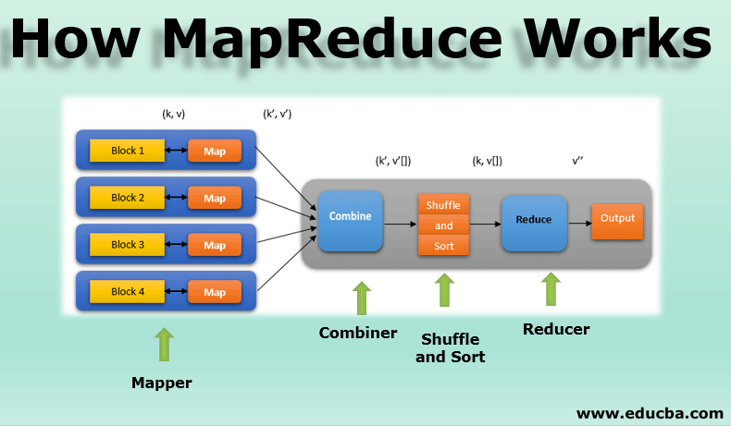
Map Reduce Architecture

Slide 25
Hadoop Resource and Process Management
In Hadoop, resource and process management refers to how computing resources such as CPU, memory, and processing tasks are allocated and controlled across nodes in a cluster. Efficient resource management is necessary to ensure high performance, fairness, scalability, and fault tolerance in big data processing.
Hadoop originally used the MapReduce framework for process execution and JobTracker/TaskTracker for resource management, but this had limitations. Therefore, Hadoop introduced YARN (Yet Another Resource Negotiator) to manage cluster resources more efficiently.

Slide 26
YARN Architecture (Core Component)
Resource Manager (RM) • Central authority that manages and allocates cluster resources • Decides which application gets how much resource • Maintains information about all available nodes and resources
Node Manager (NM) • Runs on every worker node • Reports the node's resources and health to the Resource Manager • Starts and monitors application containers
Application Master (AM) • Responsible for the execution of a single application or job • Requests resources from the Resource Manager • Monitors and controls tasks running in containers
Containers • Units of resource allocation (CPU, memory) assigned to tasks • Launched by Node Managers as requested by the Application Master

Slide 27
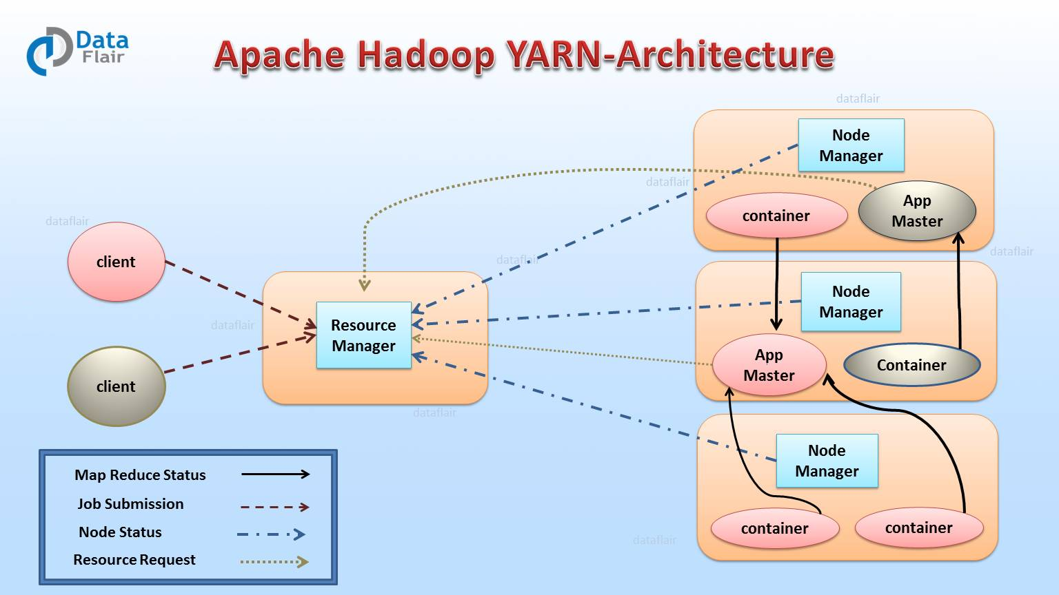

Slide 28
Benefits of YARN
• Supports multiple types of processing engines (MapReduce, Spark, Hive, Flink) • Better scalability than traditional JobTracker system • Improves cluster utilization and overall performance • Efficient failure handling and resource sharing • Supports multi-user and multi-application environments

Slide 29
Load Balancing Approach
Load balancing is a more advanced technique in which the objective is to evenly distribute workload across all nodes in the system so that all nodes operate at similar levels of utilization.
Characteristics • Tasks are continuously distributed across nodes • Attempts to achieve fairness and maximize performance • Load on all nodes is monitored and adjusted dynamically

Slide 30
Load Sharing Approach
Load sharing is a technique used in distributed systems to improve performance by distributing processes among available nodes so that no node becomes heavily overloaded while others remain idle. The main aim is to avoid overload but not necessarily to achieve perfect balance.
Characteristics • Tasks are transferred only when a node is overloaded • Does not try to equalize load among all nodes • Helps reduce bottlenecks and improve response time

Slide 31
Comparison
Parameter | Load Sharing | Load Balancing
Goal | Prevent overload | Equalize load across nodes
Load monitoring | Only when overloaded | Continuous monitoring
Complexity | Low | High
Performance | Moderate | High
Resource utilization | Partial | Maximum

Slide 32
Books To Refere
Tom White et al., Hadoop The Definitive Guide
Tanenbaum & Van Steen, Distributed Systems: Principles and Paradigms
HDFS documentation (Apache Hadoop)

