Slide 1
Unit IV – Cloud Computing

Slide 2
Overview of Unit IV
Introduction to Cloud Computing
Layers and Types of Clouds
Features and Infrastructure Management
Service Models (IaaS, PaaS, SaaS, HaaS)
Challenges & Risks
Cloud Migration Approaches

Slide 3
Cloud Computing
Cloud computing is the delivery of computing services such as servers, storage, databases, networking, software, analytics and more over the Internet (“the cloud”).
With cloud computing user can access database resources via the internet from anywhere anytime without worrying about maintenance and management
Term cloud refers to a network or internet. Cloud is something which is present at remote location

Slide 4
Deployment models of cloud computing
Deployment model defines the type of access to the cloud
The cloud deployment model identifies the specific type of cloud environment based on ownership, scale, and access, as well as the cloud’s nature and purpose.
Relationships between the infrastructure and users defined by cloud deployment models

Slide 5
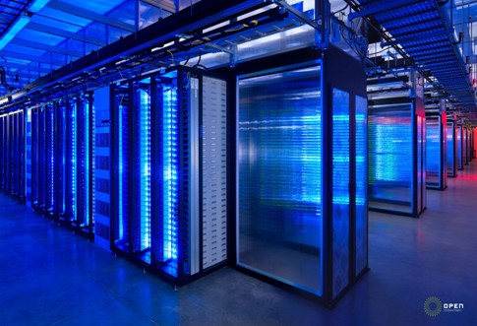

Slide 6
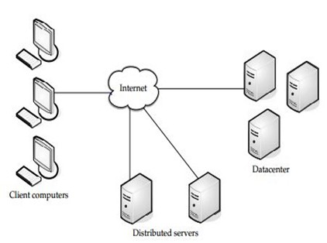

Slide 7
Characteristics of cloud computing
There are basically five essential characteristics of cloud computing :
1. On demand self service
2. Broad network access
3. Rapid elasticity
4. Resource pooling
5. Measured services

Slide 8
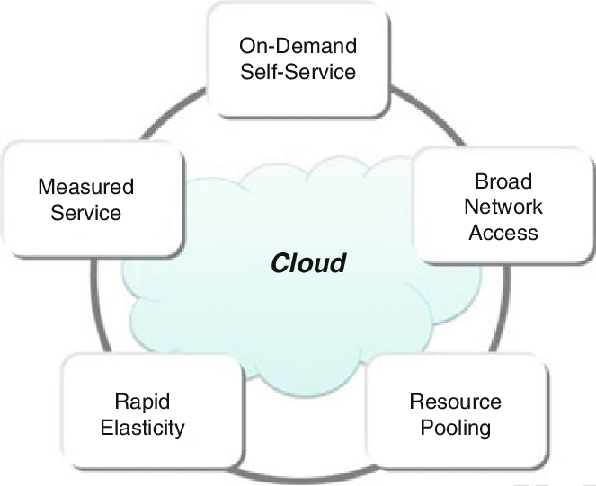

Slide 9
Service models of cloud computing
Service models are the reference models on which the cloud computing is based.
There are three main types of service models in cloud computing.
Each service model provide different levels of control, flexibility, and management.

Slide 10
The three cloud service models are as follows: 1. Infrastructure as a Service (IaaS) 2. Platform as a Service (PaaS) 3. Software as a Service (SaaS)

Slide 11
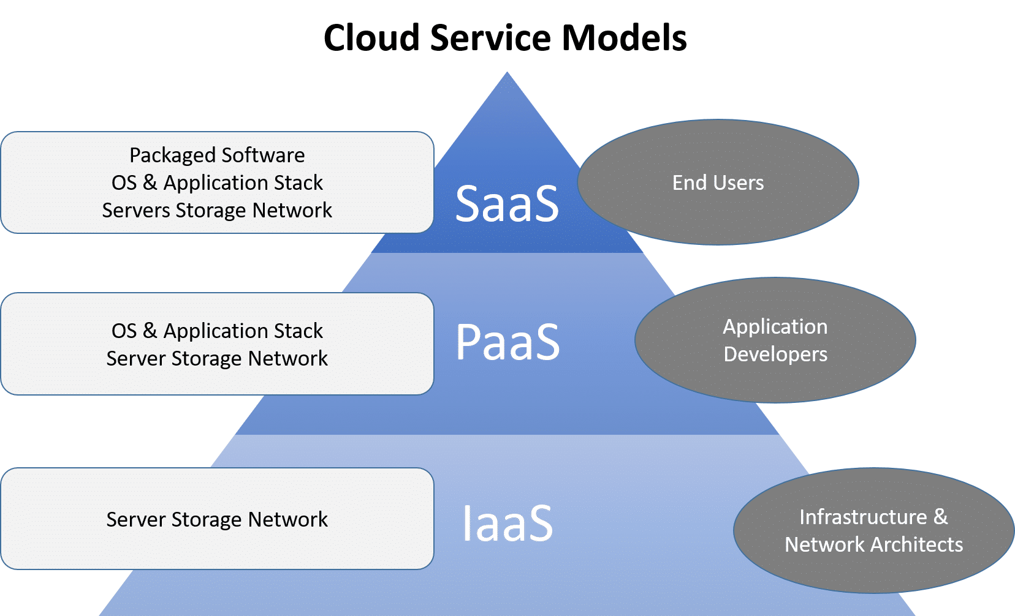

Slide 12
Infrastructure As A Service (IaaS)
It is the most flexible type of cloud service which lets you rent the hardware and contains the basic building blocks for cloud
It gives complete control over the hardware that runs your application (servers, VMs, storage, networks & operating systems)
IaaS gives you the very best level of flexibility and management control over your IT resources.
Examples: Amazon Web Services (AWS), Microsoft Azure, IBM Cloud, Rackspace, Digital Ocean, Oracle Cloud.

Slide 13
Platform As A Service (PaaS)
PaaS is a cloud service model that gives a ready-to-use development environment where developers can specialize in writing and executing high-quality code to make customized applications.
It offers a scalable, secure, and on-demand platform to create, administer, and maintain databases.
IT department won’t need to spend time on manual deployments or server management.
Examples: Windows Azure, SalesForce.com, Google App Engine, OpenShift, SAP Cloud, AWS Lambda, Azure Functions.

Slide 14
Software As A Service (SaaS)
SaaS provides you with a complete product that is run and managed by the service provider.
The software is hosted online and made available to customers on a subscription basis or for purchase in this cloud service model.
One of the biggest benefits of SaaS is that it lowers your total cost of ownership (TCO) by eliminating hardware expenses and maintenance costs.
Examples: Microsoft Office 365, YouTube, Gmail, Dropbox

Slide 15
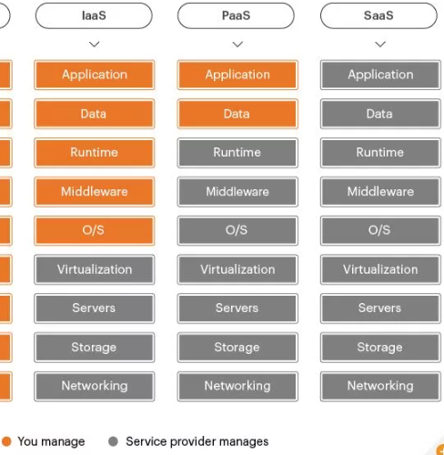

Slide 16
Applications of cloud computing
Online Data Storage
Backup and Recovery
Big Data Analysis
Testing and Development
Antivirus Applications
E-commerce Application
Cloud Computing in Education

Slide 17
Challenges in cloud computing
Data Security and Privacy
Efficient load balancing
Under optimization of the resources
Interoperability and flexibility
Lack of knowledge and expertise
Requires a fast speed internet connection.
High energy requirement

Slide 18
Cloud computing architecture
Cloud computing technology is used by both small and large organizations to store the information in cloud and access it from anywhere at anytime using the internet connection
Cloud computing architecture is divided into the following two parts
Front End
Back End

Slide 19
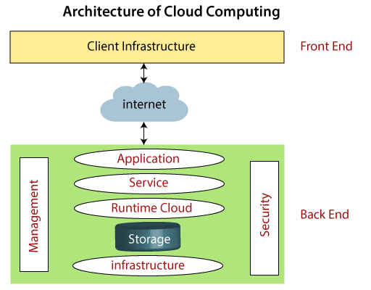

Slide 20
Front End
The front end is used by the client. It contains client-side interfaces and applications that are required to access the cloud computing platforms
The front end includes web servers (including Chrome, Firefox, internet explorer, etc.), tablets, and mobile devices.

Slide 21
Back End
The back end is used by the service provider. It manages all the resources that are required to provide cloud computing services.
It includes a huge amount of data storage, security mechanism, virtual machines, deploying models, servers, traffic control mechanisms, etc.

Slide 22
Different types of cloud computing deployment models: 1. Public 2. Private 3. Community 4. Hybrid

Slide 23
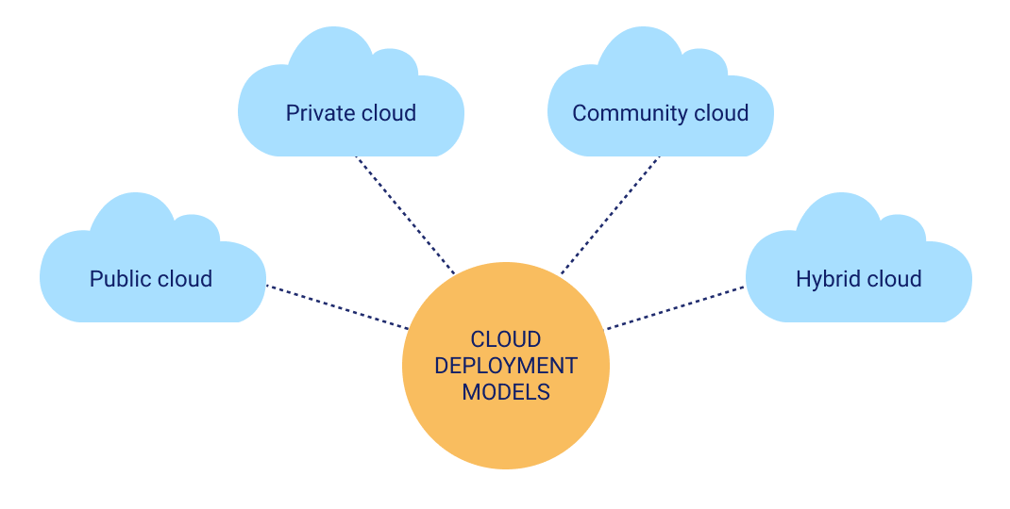

Slide 24
Public cloud
The public cloud makes it possible for anybody to access systems and services.
The public cloud may be less secure as it is open for everyone.
In this arrangement, storage backup and retrieval services are given for free, as a subscription, or on a per-use basis.
Examples: Google drive, Google App Engine, Blue Cloud by IBM and Azure services Platform by Windows.

Slide 25
Private cloud
It’s a one-on-one environment for a single user (customer)
There is no need to share hardware with anyone else
The cloud platform is implemented in a cloud-based secure environment that is protected by powerful firewalls and under the supervision of an organization’s IT department.
Examples: Amazon Web Services, Microsoft Azure, IBM Cloud, Google Cloud Platform, Oracle Cloud.

Slide 26
Hybrid cloud
Hybrid cloud is a mixture of both public and private cloud
Critical activities are performed using private cloud while the non critical activities performed by public cloud
Businesses with more flexibility can design personalized solutions that meet their particular needs

Slide 27
Community cloud
It allows systems and services to be accessible by a specific group of organizations
It allows to share resources, infrastructure, etc. with multiple organizations
It is suitable for both collaboration and data sharing
It is generally managed by a third party or by the combination of one or more organizations in the community
Examples: community cloud used by different govt. departments.

Slide 28
The Seven-Step Model of Migration into a Cloud
The Seven-Step Model of Migration into a Cloud is a structured approach that organizations follow to move their IT applications, data, and services from traditional on-premises systems to cloud platforms. It ensures that cloud migration is planned, secure, and cost-effective.
1. Identify system candidates for migration (Assessment step) In this step, the organization evaluates which applications or workloads are suitable for cloud migration based on factors like performance needs, security, data sensitivity, and cost.
2. Map application components to cloud services (Isolation step) The internal components of the application (database, storage, compute, network, middleware, etc.) are analyzed and matched with equivalent cloud services (such as VMs, containers, managed databases, and storage services).

Slide 29
The Seven-Step Model of Migration into a Cloud
Create a migration strategy The organization decides the best method for migration. Common strategies include re-hosting (lift-and-shift), re-platforming, re-architecting, or replacing the application with a SaaS solution.
Perform risk analysis Security threats, downtime issues, compliance policies, vendor lock-in, and costs are evaluated to understand the possible risks involved in cloud migration.
Build and test migration plan A complete migration plan is prepared including backup, disaster recovery, resource allocation, cut-over strategy, and timelines. A test migration or pilot migration is performed in a controlled environment.

Slide 30
The Seven-Step Model of Migration into a Cloud
6 Execute migration
In this phase the actual migration happens. Resources and data are transferred to the cloud, applications are deployed on cloud infrastructure, and performance monitoring begins.
7 Final testing and optimization Once migration is complete, all features of the system are tested for performance, security, and scalability. Optimization steps may be taken to reduce cost, improve speed, automate scaling, and configure monitoring tools.

