Slide 1
Need of Synchronization in DS
It is important that multiple processes do not simultaneously access a shared resource, such as printer, but instead cooperate in granting each other temporary exclusive access.
Multiple processes may sometimes need to agree on the ordering of events, such as whether message ml from process P was sent before or after message m2 from process Q.

Slide 2
In distributed systems, there is no single global clock.
A distributed system consists of multiple independent computers (nodes) connected by a network.
Each machine has its own local clock, but due to hardware differences and network delays, these clocks drift (move at slightly different speeds).
Unlike in a single system, there is no shared physical clock to keep all nodes in perfect sync.

Slide 3
Problem with Physical Clocks
Multiple physical clocks are generally considered desirable, which yields two problems:
(1) How do we synchronize them with real world clocks.
(2) How do we synchronize the clocks with each other?

Slide 4
Lamport's Logical Clock was created by Leslie Lamport. It is a procedure to determine the order of events occurring. It provides a basis for the more advanced vector clock algorithm Due to the absence of a Global Clock in a Distributed Operating System Lamport Logical Clock is needed.
Lamport's Logical Clock

Slide 5
Lamport’s Algorithm
Happened before relation(->): a ~ b, means 'a' happened before 'b'.
Logical Clock: The criteria for the logical clocks are:
[C1]: C_{i} (a) < C_{i}(b), [ C_{i} -> Logical Clock, If 'a' happened before 'b', then time of 'a' will be less than 'b' in a particular process. ]
[C2]: C_{i}(a) < C_{j}(b), [ Clock value of C_{i}(a) is less than C_{j}(b) ]
Reference
Process: P_{i}
Event: E_{ij}, where i is the process in number and j: j_{th} event in the i^{th} process.
t_{m}: vector time span for message m.
C_{i} vector clock associated with process P_{i}, the j^{th} element is Ci[j] and contains P_{i}'s latest value for the current time in process P_{j}.
d: drift time, generally d is 1.

Slide 6
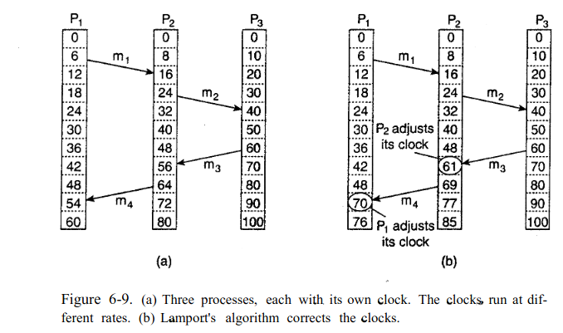
Lamport’s Algorithm

Slide 7
Vector Clock
Definition: An improved logical clock mechanism using a vector of counters.
Working
Each process maintains a vector [P1, P2, …, Pn] of size = number of processes.
On a local event : increment own entry.
On sending message : send the vector.
On receiving message : take element-wise maximum of local vector and received vector.

Slide 8
Vector Clock
Properties
If VC(a) < VC(b) (element-wise), then a → b.
If neither VC(a) ≤ VC(b) nor VC(b) ≤ VC(a), then a || b (concurrent).
Advantage: Can detect concurrent events.
Limitation: Higher overhead (vector size grows with number of processes).

Slide 9
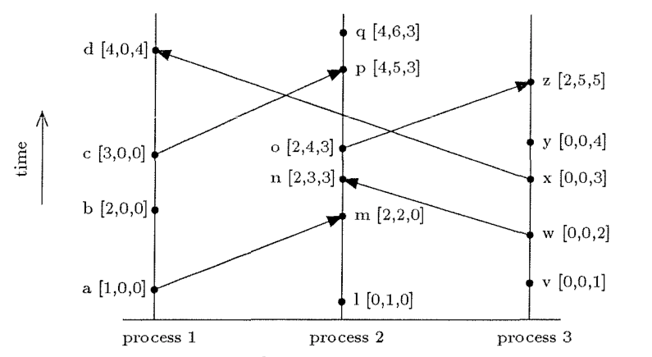
Vector Clock

Slide 10
Vector Clock
Aspect | Lamport Clock | Vector Clock
Structure | Single integer counter per process | Vector of integers (size = no. of processes)
Ordering | Provides partial ordering | Provides causal ordering
Concurrency | Cannot detect concurrency | Can detect anomalies in concurrency
Overhead | Very low (just one counter) | High (vector maintained & exchanged)
Use cases | Simple event ordering | Precise causal dependency tracking

