Slide 1


Computational Music Analysis: Audio
A.K.A. “Audio Content Analysis”
Linear Algebra Primer
Claire Arthur
Noël Alben

Slide 2
Agenda
Vectors
Vector Operations
Basis vectors, Linear Independence
Matrices
Matrix Operations
Matrix Factorization
Eigen Values

Slide 3
Agenda
Vectors
Vector Operations
Basis vectors, Linear Independence
Matrices
Matrix Operations
Matrix Factorization
Eigen Values
This lecture is derived from multiple sources and meant to give a quick & terse overview of some fundamental mathematical concepts that will be helpful moving forward.
1. https://sites.gatech.edu/mfml-fall-2023/
2.https://www.youtube.com/playlist?list=PLZHQObOWTQDPD3MizzM2xVFitgF8hE_ab
3. https://www.audiolabs-erlangen.de/media/pages/fau/professor/mueller/publications/3e4cd56cfb-1560756948/2019_LopezSerranoDOM_NMF_DAFx.pdf
4. https://bvanderlei.github.io/jupyter-guide-to-linear-algebra/Planar_Transformations.html
Topic: Linear Algebra Primer

Slide 4
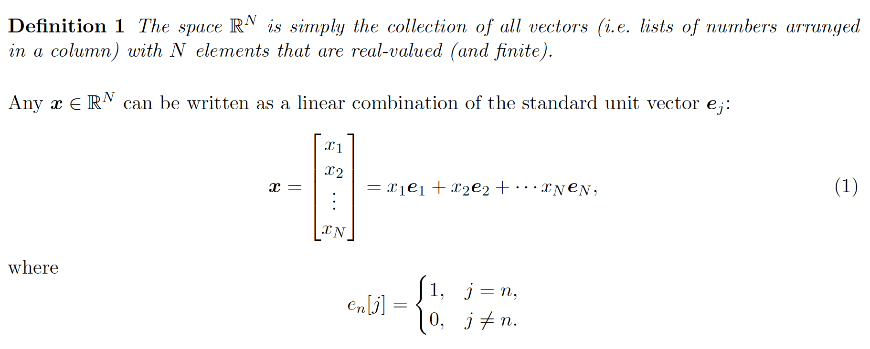
Vectors
Topic: Linear Algebra Primer

Slide 5
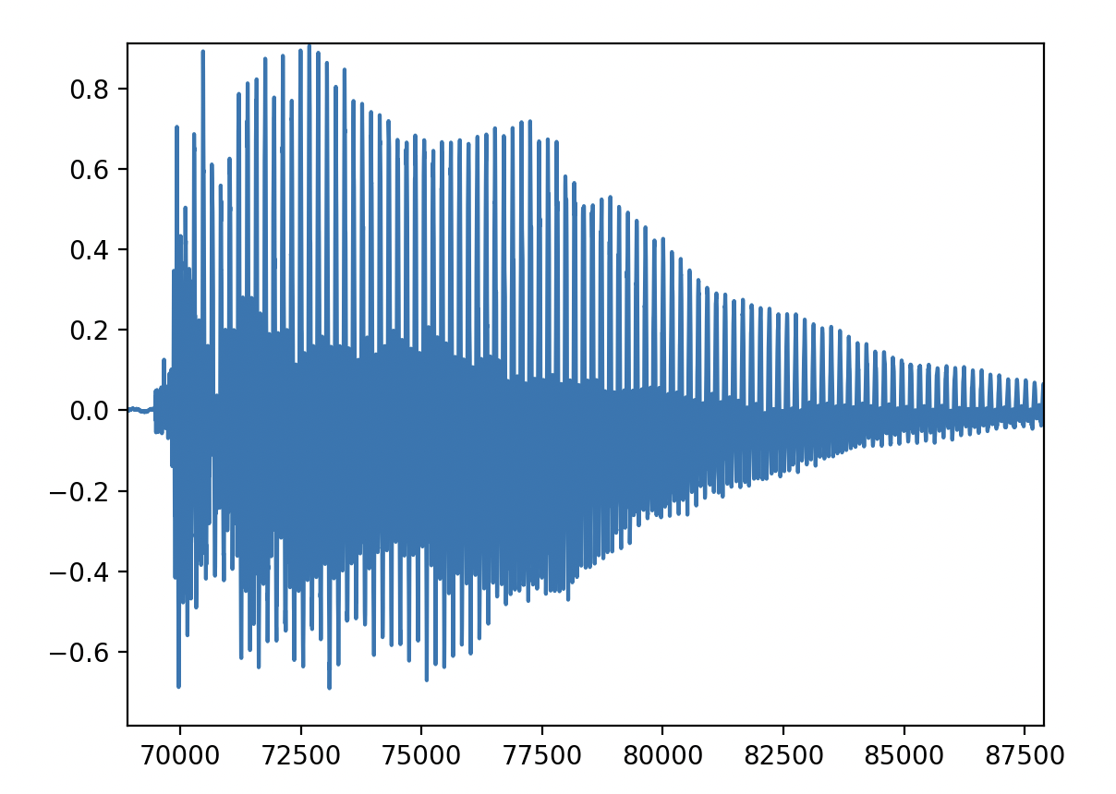
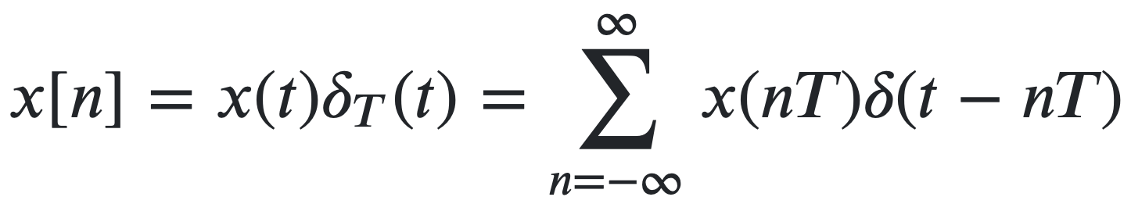
Vectors
Audio Analogy
Each sample is a scaled value of a discrete point on the time axis

Slide 6
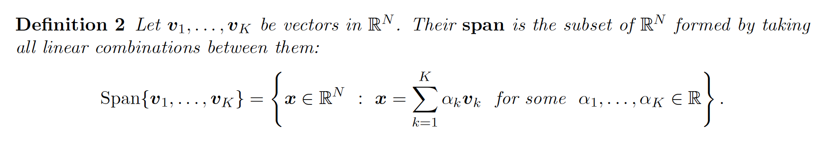
Vectors

Slide 7
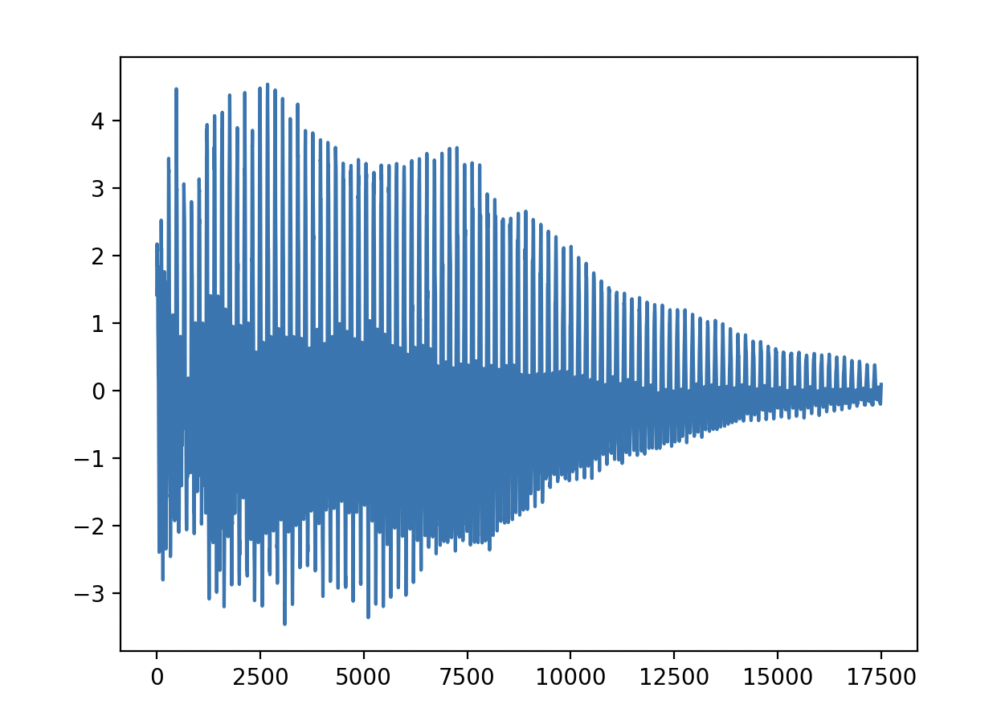
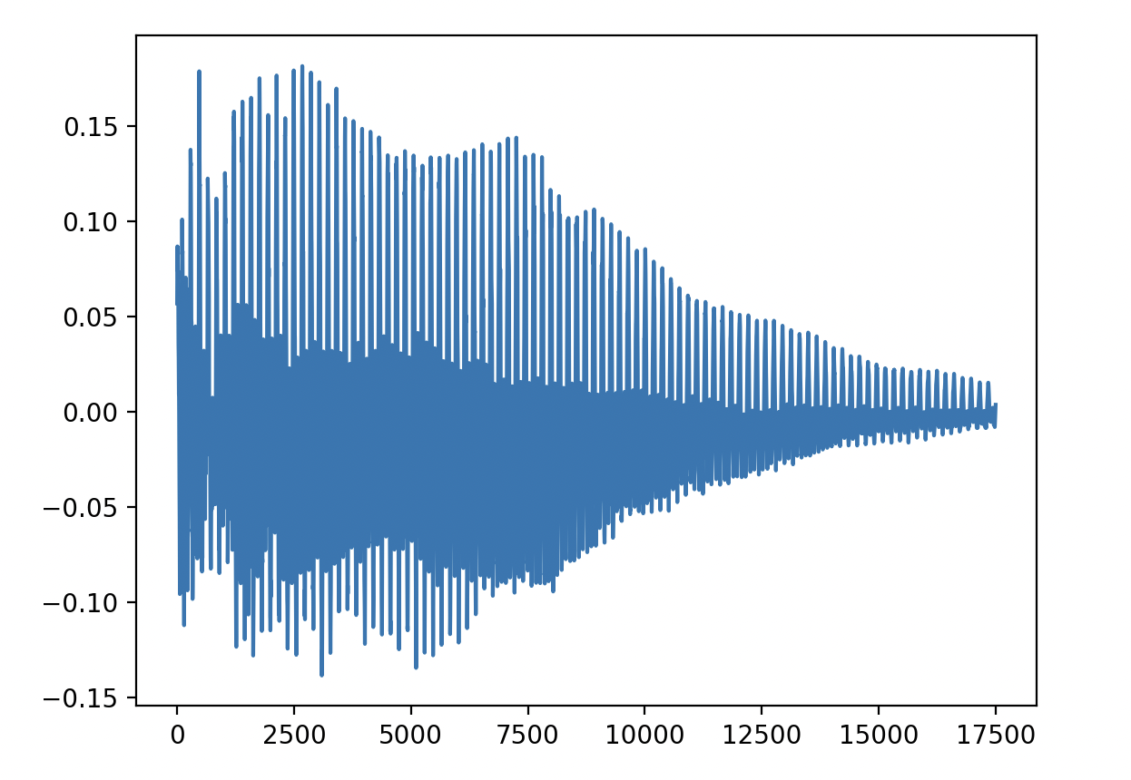



Vectors
Audio Analogy
$$α = 1$$
$$α = 5$$
$$α = 0.2$$
Performing linear operations on audio vectors
Scaling the values of the audio signals
Adding the audio signals linearly

Slide 8
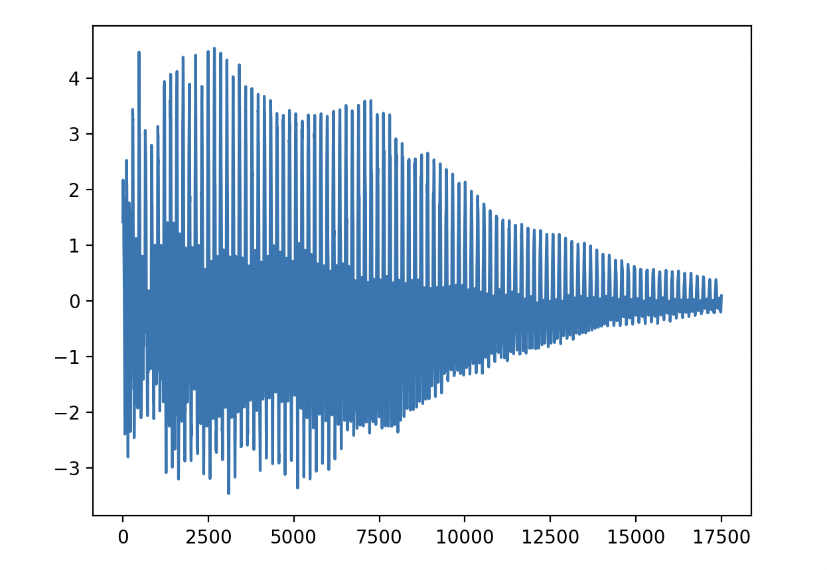

Vectors
Audio Analogy
$$α1*data +α2*data +α3*data$$
Performing linear operations on audio vectors
Scaling the values of the audio signals
Adding the audio signals linearly

Slide 9
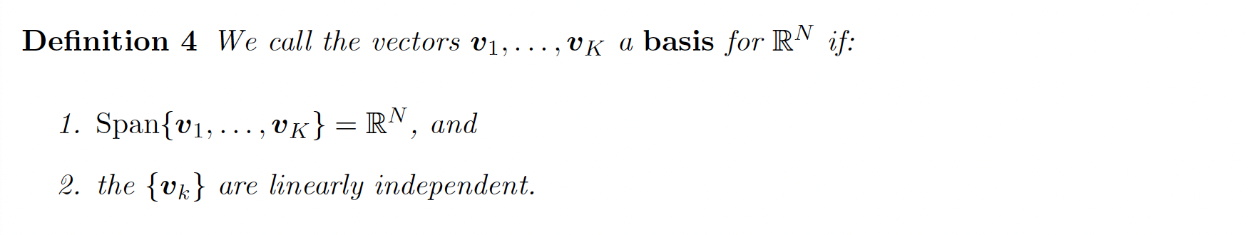
Vectors

Slide 10
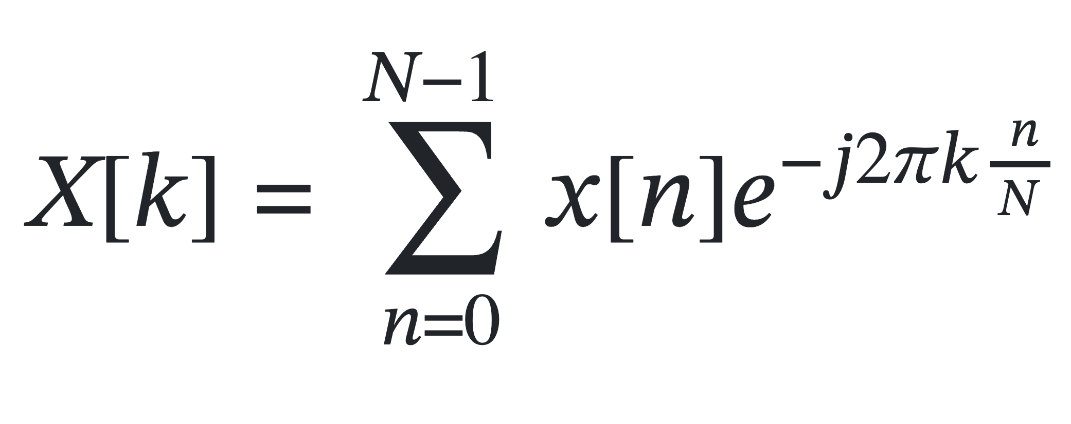
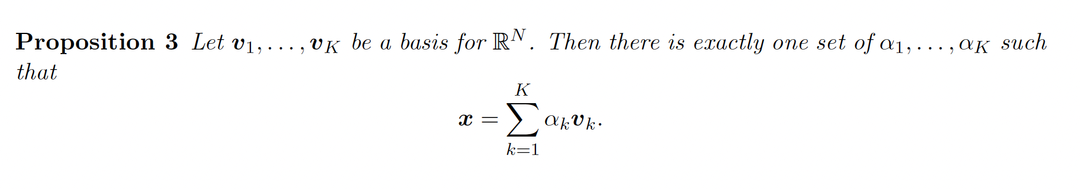
Vectors
Discrete Fourier Transform

Slide 11
Shifting Basis
https://www.myfourierepicycles.com
https://bilimneguzellan.net/en/purrier-series-meow-and-making-images-speak/

Slide 12
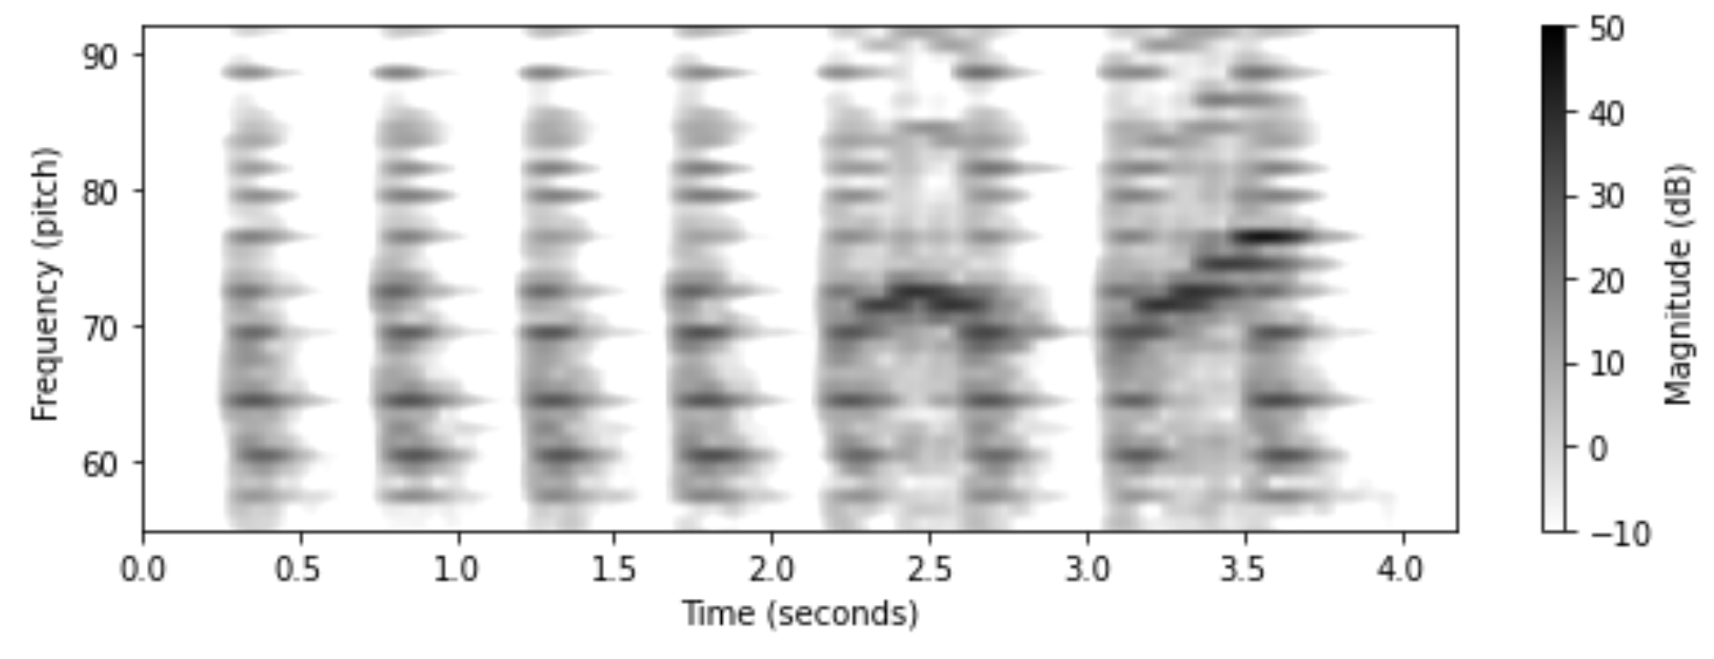
Matrix
A Matrix is a rectangular array of discrete entries (numbers) with entries arranged in rows or columns

Slide 13
Matrix Operations
Scalar Multiplication
Scaling operations
Linear Combinations
Adding and Subtracting
Element Wise Multiplication
Frequency Masking of Real Valued Magnitude Spectrogram
Special Matrices
Identity Matrix
Self-Similarity Matrix
Transformations
Rotation
Reflection
Inverting
Matrix Multiplications
Mel-Spectrogram Filter Banks

Slide 14
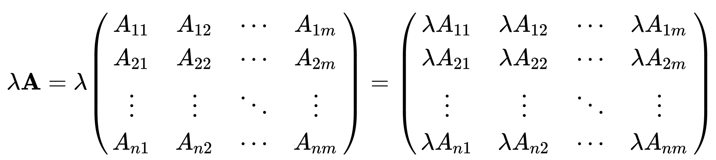
Matrix Operations
Scalar Multiplication
Scaling operations

Slide 15
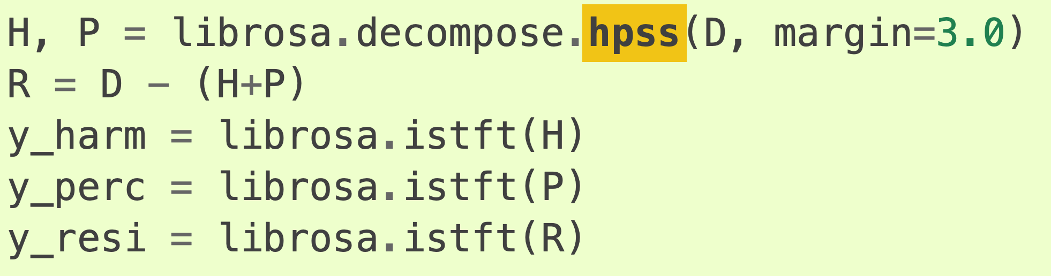
Matrix Operations
Linear Combinations
Adding and Subtracting
Element Wise Multiplication
Frequency Masking of Real Valued Magnitude Spectrogram
https://www.audiolabs-erlangen.de/media/pages/resources/aps-w23/papers/7ef50065d9-1663763115/2010_FitzGerald_HarmonicPercussiveSep_DAFx.pdf
D is your spectrogram matrix
https://librosa.org/doc/0.11.0/generated/librosa.decompose.hpss.html#librosa.decompose.hpss

Slide 16
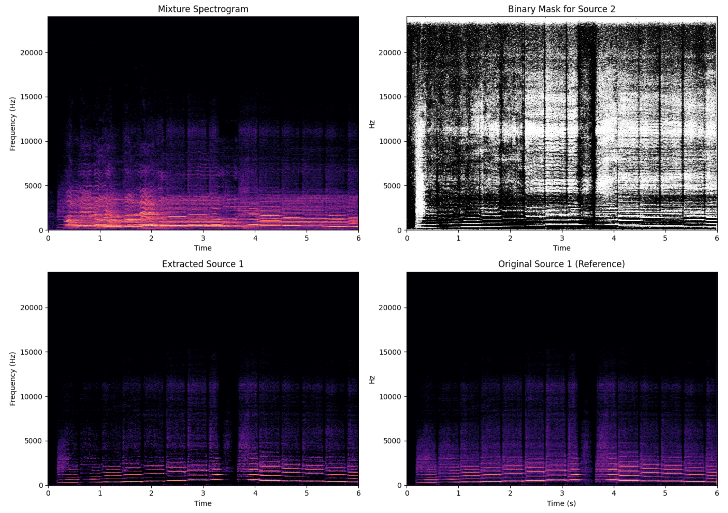
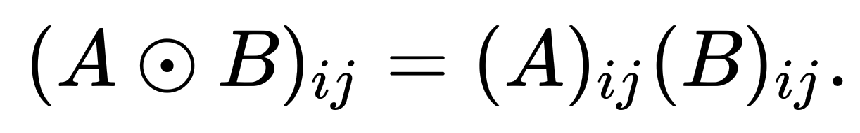
Matrix Operations
Linear Combinations
Adding and Subtracting
Element Wise Multiplication
Frequency Masking of Real Valued Magnitude Spectrogram
Simple Source Separation Using Binary Soft Masks

Slide 17
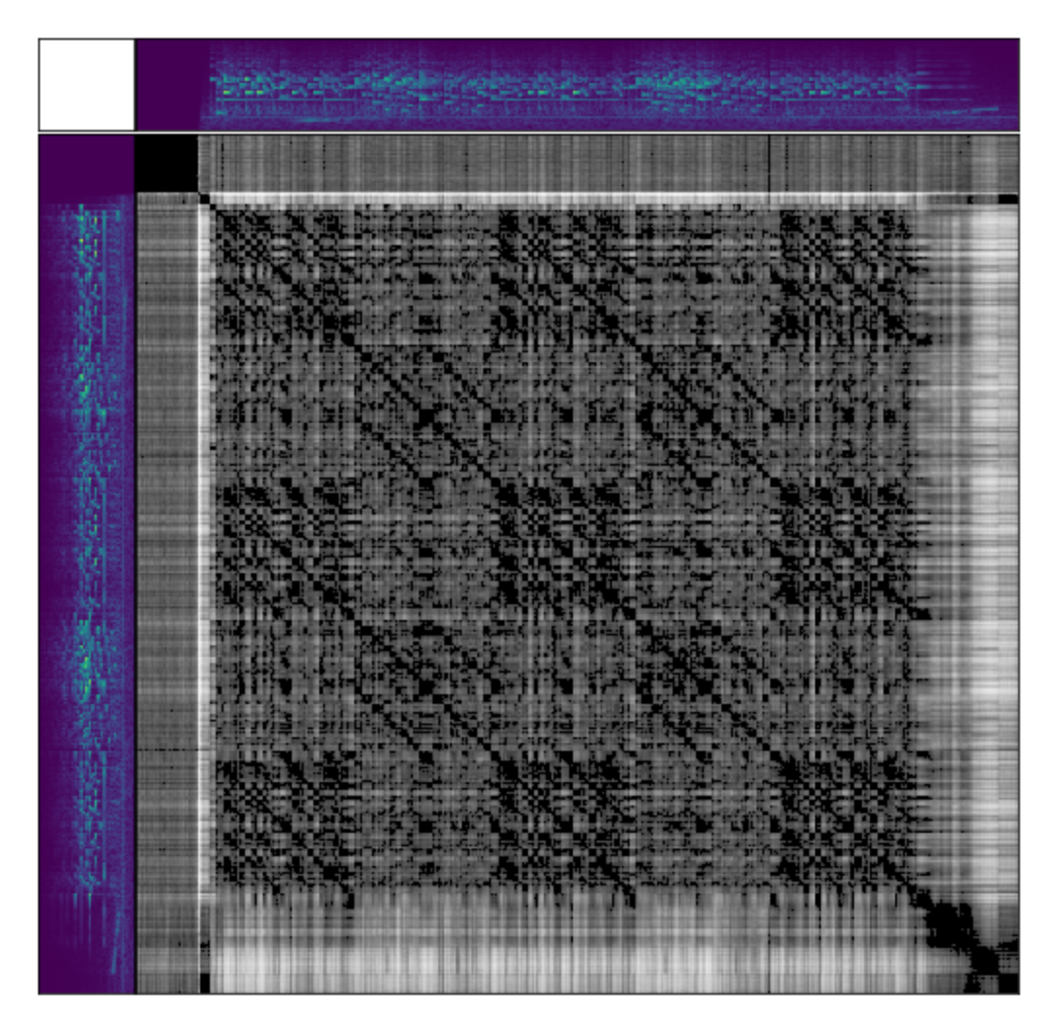
Matrix Operations
Special Matrices
Identity Matrix
Self-Similarity Matrix
Using distance metrics

Slide 18
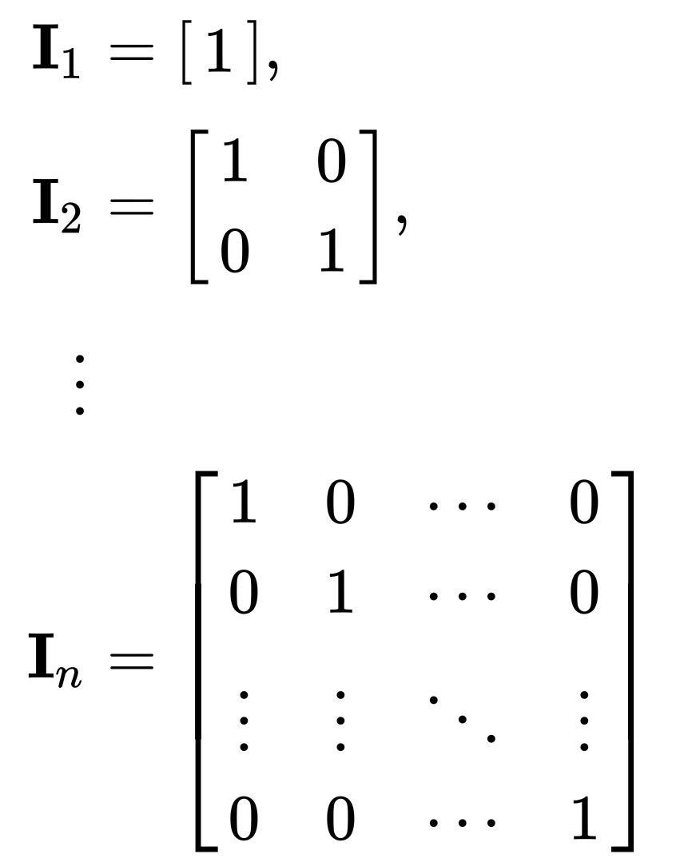

Matrix Operations
Identity Matrix
Matrix Multiplication with identity matrix, leaves matrix unchanged

Slide 19
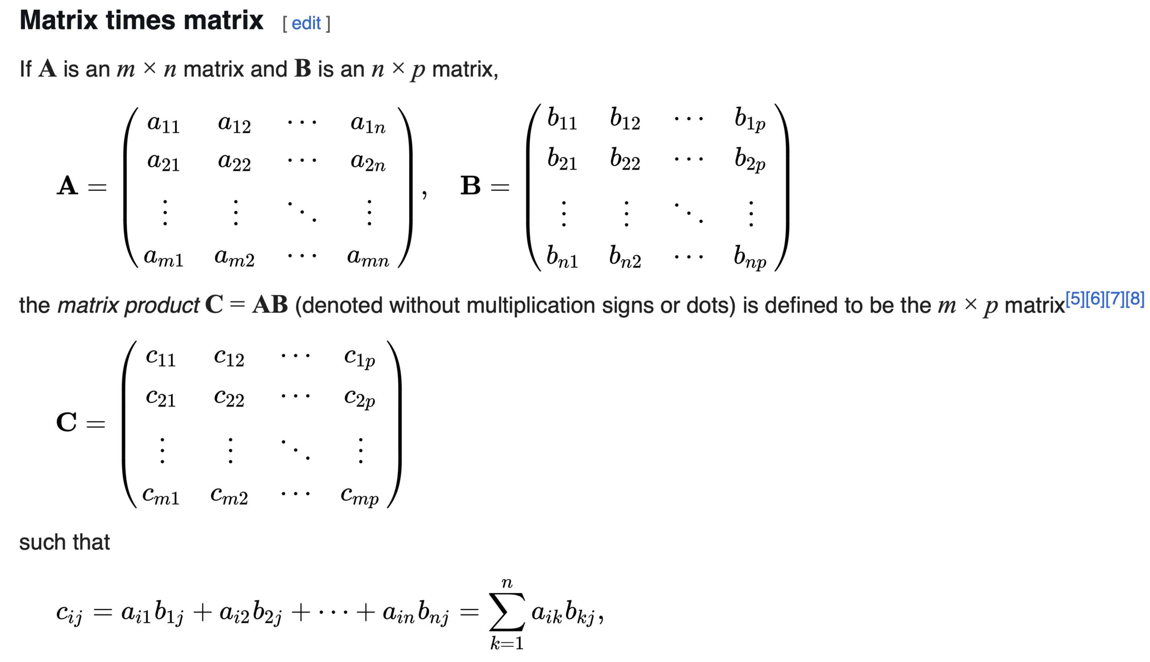
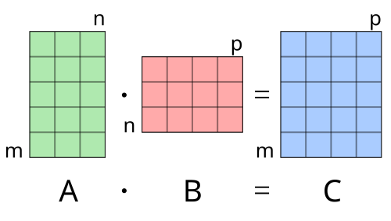
Matrix Operations
Matrix Multiplication
https://www.dsprelated.com/freebooks/filters/Matrix_Filter_Representations.html
A @ B in NUMPY

Slide 20
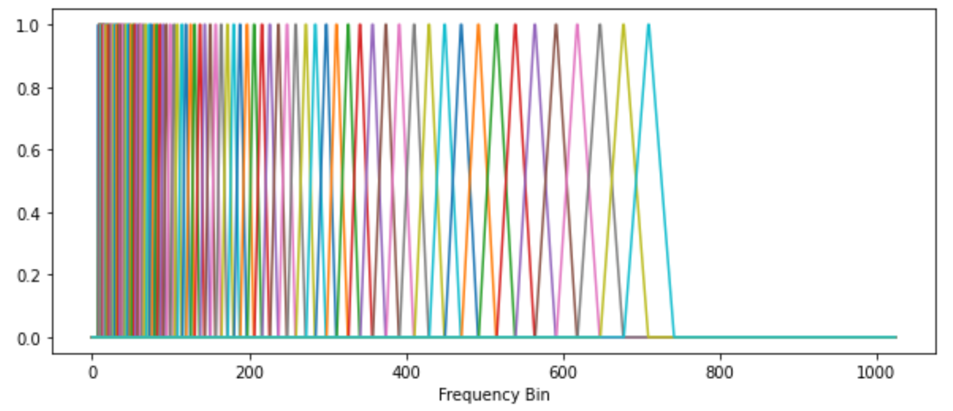
Matrix Operations
Matrix Multiplication
Activity, think of Mel Filter banks
as a matrix multiplication

Slide 21
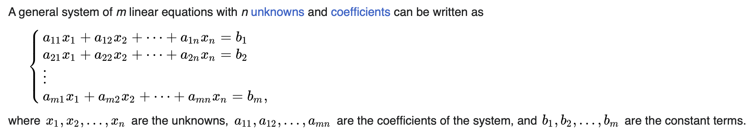
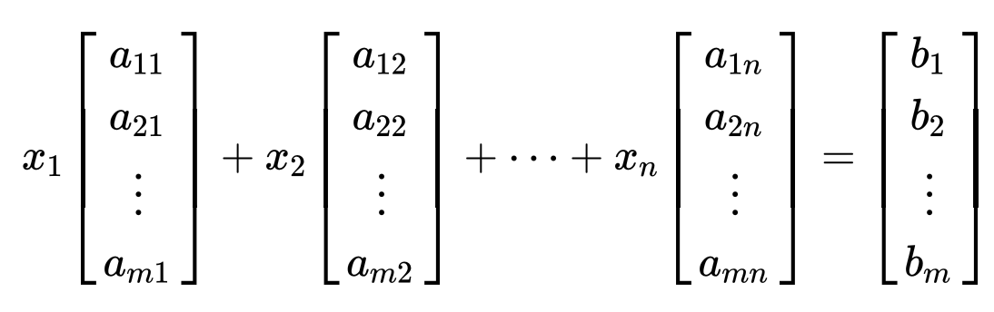
Matrices
Can be represented as

Slide 22
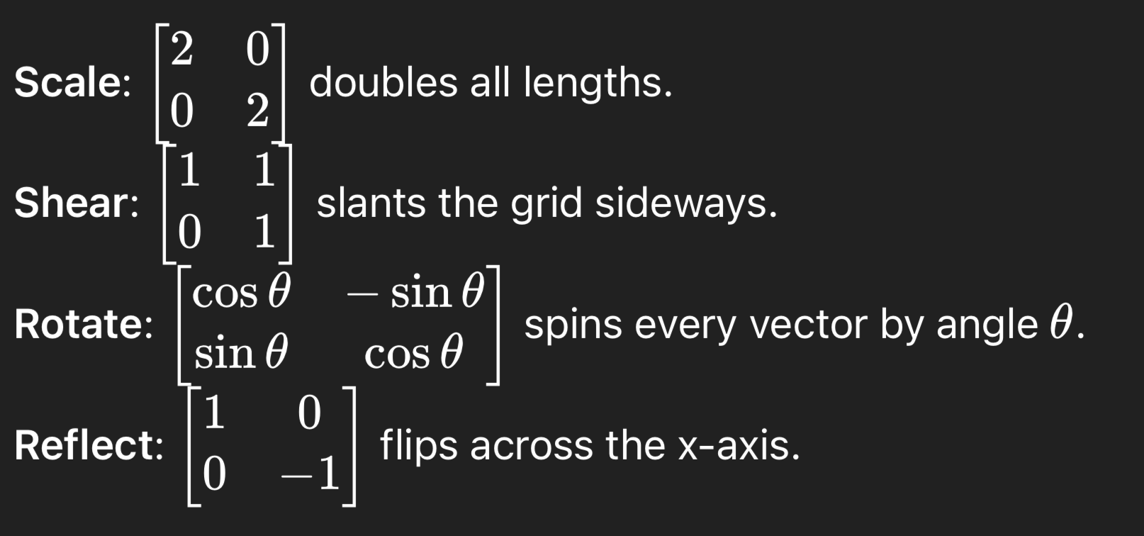
Matrices
Matrix Transformations

Slide 23
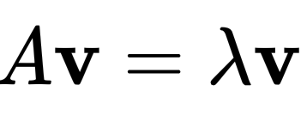
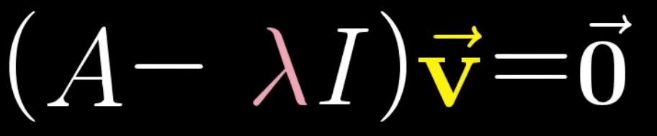
Matrices
Eigen Vectors
https://www.youtube.com/watch?v=fAxHlLK3Oyk&list=RDfAxHlLK3Oyk&start_radio=1
Useful for
Dimensionality Reduction
Embeddings
Modes of vibration
https://numpy.org/doc/2.3/reference/generated/numpy.linalg.eig.html

Slide 24
Recap
Vectors
Vector Operations
Basis vectors, Linear Independence
Matrices
Matrix Operations
Matrix Factorization
Eigen Values

