Slide 1


Computational Music Analysis: Audio
A.K.A. “Audio Content Analysis”
4. Feature Aggregation, Clustering, and Classification
Claire Arthur
Noel Albën

Slide 2
Feature Extraction for Multiple Features
We use feature extraction to assist with some task or process (e.g., classification, segregation, etc.)
This requires the establishment of “data pipelines” for processing audio, computing features, and storing the feature values to pass for further processing

Slide 3
Pipeline
Audio input & Preprocessing
Feature Calculation & Aggregation
Visualization / Analysis
Audio File
Stereo to Mono
Normalize amplitude
Resample to consistent SR
[ Silence / Noise trimming ]
Audio array
Audio blocking / STFT [windowing / FFT size]
Features: 1 2 3 …
Per-feature normalization
Aggregate (over time)
Normalize each feature dimension
Relation/
independence between features
[ Clustering/ dimensionality reduction ]
Classification

Slide 4
Feature Aggregation
Why we need feature aggregation:
MIR features are often frame-based (hundreds/thousands per track).
Models can’t handle raw frame-level features for whole tracks across an entire dataset: too many (and too noisy).
Solution: Aggregate into track-level descriptors.
Example: mean, variance, skewness, percentiles, histograms.

Slide 5
Feature Normalization
Why (and when) do we need to normalize?

Slide 6
Feature Normalization
Fair comparison across features: Different units/scales distort. Without normalization, large-magnitude features dominate.
Distance-based methods: kNN, k-means, PCA, MDS all rely on distances/variance (also biased by units and scale distortion)
Interpretability: After normalization, feature weights (coefficients) are comparable in magnitude: we can see which features matter more (comparing apples & apples).

Slide 7
Feature Normalization
Edit: So how do we normalize, anyway?
A few features have their own normalization schemes prior to aggregating. These include:
Spectral flux
“L2”/”Euclidean” normalization per frame. Goal: reflect only relative shape changes frame to frame (not overall loudness swings)
MFCCs
Cepstral Mean and Variance Normalization, aka CMVN: For each MFCC coefficient within a single file, subtract the mean and divide by the standard deviation. Goal: reflect only relative loudness in spectral shape (not overall)
Chromagrams
L2 (or L1) normalization. Dynamic range, background noise, and balance between instruments can skew chroma magnitudes.Goal: capture the relative distribution of energy across pitch classes.

Slide 8
Feature Correlation
Why might features be correlated?
Why is it a problem?

Slide 9
Feature Correlation
Why might features be correlated?
Redundancy in measurement. Different features capture similar or overlapping information, e.g., ZCR & spectral centroid.
Common signal sources, constraints, or conditions. Underlying acoustics—pitch, instrument, timbre influence many features at once.
Derived relationships. As we saw, most features are statistical ‘summaries’ (i.e., spectral shape) which means they tend to relate.

Slide 10
Feature Correlation
Why is correlation a problem?
Correlation = redundancy in features. Doesn’t add new information, just clutter.
Distance distortion. Many classifiers are distance based and overrepresented features (from redundancy) can “over weight” feature importance
Model fit/convergence. High correlations (“multicollinearity”) make it hard to estimate unique effects of each feature & coefficients become unstable (models get confused).

Slide 11
Clustering
Several problems in MIR are classification based (i.e., a sorting or threshold problem), e.g.
Genre
Instrument
Voiced/unvoiced
Spoken/sung
Emotion/mood
General idea is that objects in the same category will have similar features/characteristics

Slide 12
Feature Visualization
Visualizing feature values is an important step in understanding your data.
Identify feature spreads and relations (i.e., highly correlated, tightly clustered or sparse, etc.)
Identify “outliers” or potential mistakes/errors in feature calculations (or “problem files”).

Slide 13
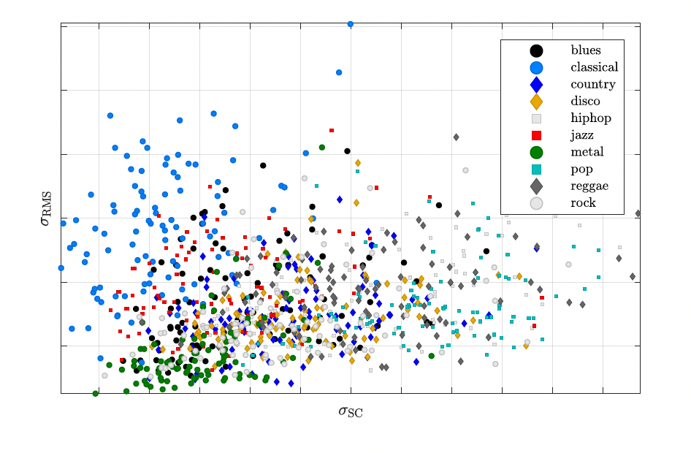
Feature Visualization

Slide 14
Pause for Activity ☺
Set up a “pipeline” to calculate spectral features for the four files shared in Files > Audio > Activities > FourInstrumentFiles
Calculate:
Spectral centroid
Spectral spread*
Spectral flux**
MFCCs***
For all four files, make at least 4 plots visualizing 2D feature space – pair up and plot opposite things!
Notes:
* Spectral spread can be taken with librosa’s “bandwidth” function with parameter p =2 (equivalent)
**Need to write our own spectral flux function
*** MFCCs: consider number of filters and number to keep.

Slide 15
Clustering
Several problems in MIR are classification based (i.e., a sorting or threshold problem), e.g.
Genre
Instrument
Voiced/unvoiced
Spoken/sung
Emotion/mood
General idea is that objects in the same category will have similar features/characteristics

Slide 16
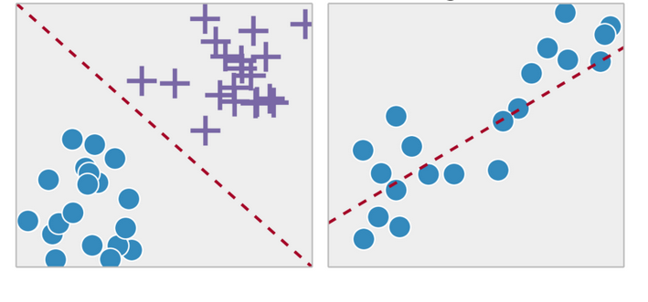

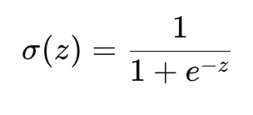
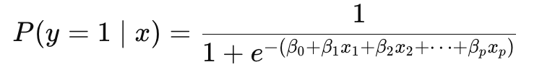
Basic Machine Learning: Overview
Linear vs logistic regression:
Linear regression: predicts a continuous variable as a weighted sum of features
Logistic regression: predicts a probability of belonging to a class (uses sigmoid)
Notes:
In statistics, we usually keep the whole formula expanded: log-odds = intercept + slopes × predictors. In CS, it’s common to bundle that sum into a single symbol: “z” Then they write \hat{y} = \sigmoid(z)\hat{y}
It’s the same thing, just shorthand. This takes a linear sum and “squashes” to the range of 0-1.

Slide 17
Basic Machine Learning: Overview
Linear vs logistic regression:
Both methods use a linear predictor (i.e., always weighted combo of inputs)
Both estimate coefficients by optimizing a loss (minimize squared error or maximize likelihood).
Important difference is the target & the likelihood: estimate y directly vs probability; loss/estimation methods differ

Slide 18
Supervised vs Unsupervised “Learning”
Classification (like logistic regression) is a very common procedure/task in MIR
Lots of “flavors” of classification (i.e., many different methods, logistic regression is only one)
Different methods for two different situations:
You have “ground truth” labels (i.e., known correct class)
You do not have “ground truth” (no known class info)
Supervised
Unsupervised

Slide 19
Supervised vs Unsupervised “Learning”
Commonly used supervised classification methods:
Logistic Regression
kNN (k-nearest neighbors)
SVM (support vector machine)
Decision trees / random forest
Commonly used unsupervised classification methods:
K-means clustering
Hierarchical clustering
GMMs (gaussian mixture models)

Slide 20
Supervised Learning
Overall Approach:
Dataset with ground truth labels
Idea: learn from labeled examples to make predictions on new, unseen data.
Set gets randomly (or systematically) divided into:
Portion for training - fit the model (estimate the weights/parameters).
Portion for validation – “tune” (tweak) model parameters for performance
Portion for testing – test the model on unseen data to evaluate overall success on new (unseen) data (i.e., generalizability)

Slide 21
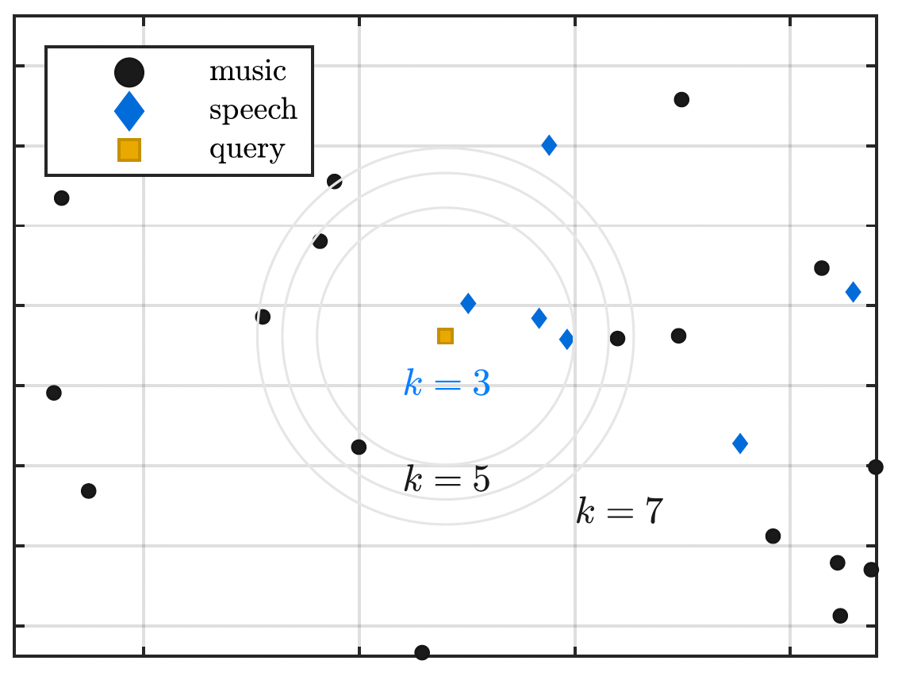
Supervised Learning: kNN
Edit: How does it work?
Vote-based system:
Take unseen file (query) & assign it the category of the majority k closest (neighboring) files. Value of k is a “hyperparameter”
2D plots (right) often shown for illustration, but computation compares entire feature vector (not one at a time) against each feature vector in training set.
Distance (literally closer/ farther in feature space) measure is a “hyperparameter”

Slide 22
Basic Instrument Classifier
Goal: train a baseline classifier for instrument identification
Data: micro medleydb ☺
Edit:
use scikit learn package
Optional: train_test_split()
Returns 4 values:
features for training.
features for validation/testing
labels for training
labels for validation/testing
from sklearn.neighbors import KNeighborsClassifier
# Initialize a classifier model
knn = KNeighborsClassifier(n_neighbors=3)
# split testing data for validation/optimization
# i.e., first test on non-test data!
# "Training" step (stores training data internally)
knn.fit(train_features, train_labels)
# Predict on test data
y_pred = knn.predict(test_features)

Slide 23
Terminology across fields
Concept | Inference Fields (Stats/Psych/Econ) | CS fields (i.e. ML)
Predictor variables | Independent variables (IVs) | Features
Outcome variable | Dependent variable, response variable | Target, label, ground truth
Model coefficients | Coefficients, slopes, betas (β) | Weights, parameters
Intercept | Constant, β₀ | Bias term
Error term | Residuals, noise, ε | Loss, cost, objective
Model fit | R², adjusted R², significance tests | Accuracy, F1 score, AUC, cross-validation performance
Estimation method | Ordinary Least Squares (OLS), Maximum Likelihood | Optimization, gradient descent, training
Generalization | External validity | Test set performance, overfitting/underfitting
Inference | Hypothesis testing, p-values, confidence intervals | Feature importance, weights, learned parameters
Model | Statistical model | Algorithm, architecture
Model choices | Model selection, tuning parameter(s) | hyperparameters
Notes:
Notes 1. In ML, “feature engineering” = selecting/transforming predictors.
2. “Label” is standard in supervised ML.
3. Both describe how features contribute to the prediction.
4. Both shift the prediction baseline.
5. Stats emphasizes explanation of residuals; ML emphasizes minimizing loss.
6. Different emphasis: inference vs predictive power.
7. ML borrows the same math, but emphasizes algorithms and scalability.
8. Same concern: how well the model works on new data.
9. ML less about “significance,” more about predictive utility.
10. Language difference: same core idea.

