Slide 1


Computational Music Analysis: Audio
A.K.A. “Audio Content Analysis”
4.2 Principal Components Analysis
Claire Arthur
Noel Albën

Slide 2
What is PCA?
Principal Components Analysis (PCA) is a “dimensionality reduction” tool (i.e. collapses features)
It finds patterns/relationships in your data by identifying which ‘directions’ (combinations of features) produce the greatest variation.
PCA can “de noise” and simplify your data, especially if original features were somewhat redundant.

Slide 3
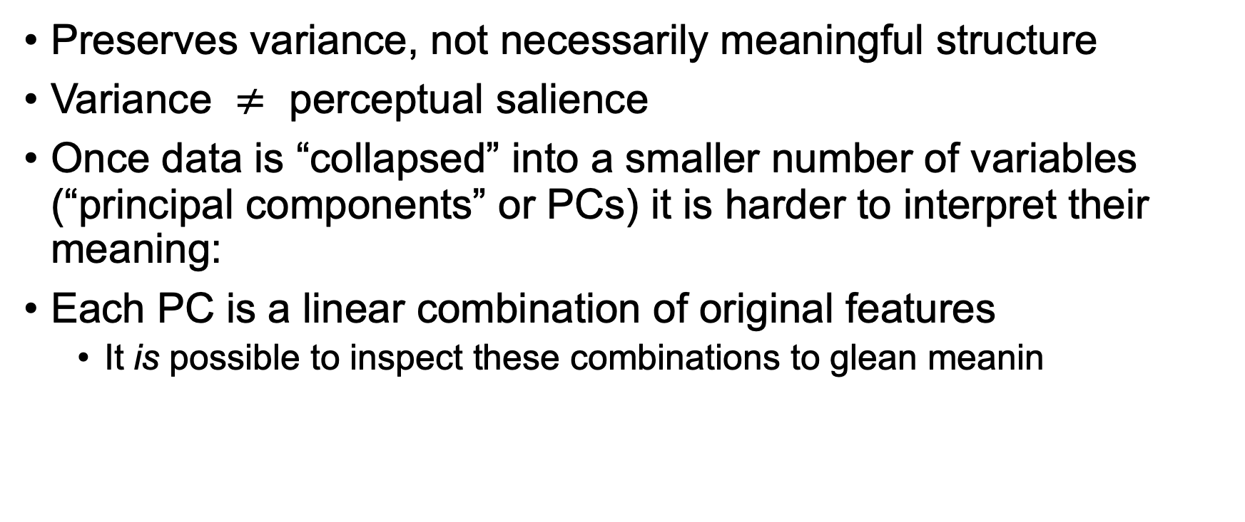
Conceptual Loss
Preserves variance, not necessarily meaningful structure
Variance $≠$ perceptual salience
Once data is “collapsed” into a smaller number of variables (“principal components” or PCs) it is harder to interpret their meaning:
Each PC is a linear combination of original features
It is possible to inspect these combinations to glean meanin

Slide 4
When to do PCA?
Back to pipeline…

Slide 5
Pipeline
Audio input & Preprocessing
Feature Calculation & Aggregation
Visualization / Analysis
Audio File
Stereo to Mono
Normalize amplitude
Resample to consistent SR
[ Silence / Noise trimming ]
Audio array
Audio blocking / STFT [windowing / FFT size]
Features: 1 2 3 …
Per-feature normalization
Aggregate (over time)
Normalize each feature dimension
Relation/
independence between features
[ Clustering/ dimensionality reduction ]
Classification
?
?

Slide 6
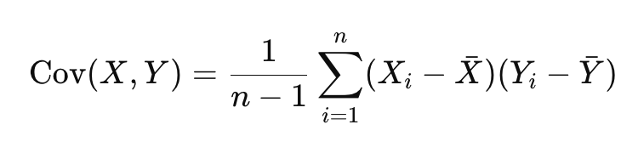
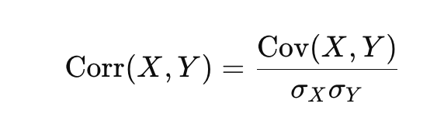

Covariance
Related to correlation but not the same thing
Correlation is a normalized version of covariance:
(Dividing by product of standard deviations scales from -1 to 1)

Slide 7
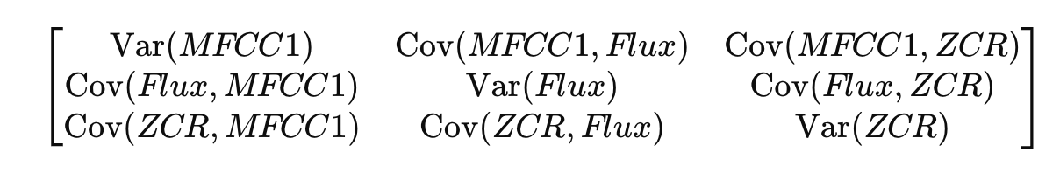
Covariance Matrix
A covariance matrix tells us about the relation between our variables
For three aggregated features (e.g., MFCC1, Flux, ZCR) over N files, our covariance matrix outputs a table showing:
Diagonal entries = variance within feature
Off-diagonal = covariance between feature pairs

Slide 8
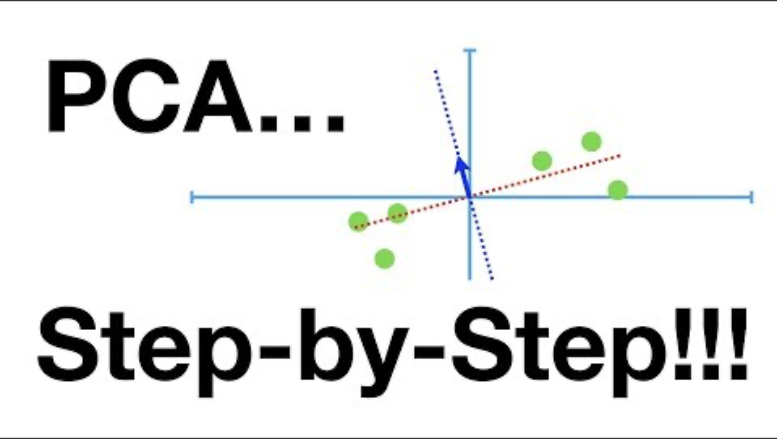
PCA video explanation

Slide 9
PCA Summary
Given full vector of normalized features, find axis that maximizes variance between data points (line that allows data points to be the most “spread out”).
Averaged sum of squared distances from data points to mean = eigenvalue for that PC.
Slope (direction) of vector can be converted to a coordinate (e.g., 2x, 1y) and “amounts” of each variable are scaled such that the eigenvector has unit length = 1. (These “amounts” are the coefficients/weights/factor loadings and make up the eigenvector.)
Continue process for additional PCs such that:
The next PC is chosen to maximize remaining variance (with constraint that must be orthogonal to the previous PCs and pass through origin)

Slide 10
PCA steps
Input: All normalized (z-scored) features you want to reduce to N dimensions (rows = files, columns = features).
[Optional sanity check: compute covariance matrix. (Reveals how features co-vary)]
Find eigenvectors & eigenvalues:
Eigenvectors: directions of maximum variance
Eigenvalues: amount of variance explained
Rank eigenvectors by descending eigenvalues
Select top k eigenvectors: defines the reduced feature space (with usually some loss of overall variance explained).

Slide 11
Terminology
Eigenvector – a direction (vector of unit length) in feature space (defines a PC axis)
Eigenvalues – a measure of avg data spread along its eigenvectors (s.s. distances: larger = more variance explained.)
[Singular values – sq.root of eigenvalues (representation of eigenvalue / variance explained)]
[Singular value decomposition (SVD) – method for computing the PCA basis (components)]
Principal Component – axis formed as linear combination of the original features, ordered by variance explained (PC1 = most variance)
Loadings – the amount of each variable that is weighting a given component (i.e., coefficients/weights in your linear combination of features that define each principal component)
Scores – the coordinates of each observation (file) when projected into the final PC space

Slide 12
Playalong activity
Copy and paste the code snippet from Canvas representing aggregated & normalized features for 6 songs into your IDE
Plot the raw features in 3 dimensions using seaborn’s scatterplot() function:
First arg is the data (full pd.DataFrame)
Pass one feature (column) as ‘x’, one as ‘y’, and one to the ‘size’ or ‘hue’ variable
Normalize (Z-score) & re-plot features (z-score the matrix; convert to DataFrame again).
Compute (and save) covariance matrix using np.cov(data)
Include arg ‘rowvar=False’ (rows are observations, columns are variables)
Pass covariance matrix to np.linalg.eig() & sort
Returns tuple: eigenvalues, eigenvectors
Compute ‘explained variance ratio’ by dividing each eigenvalue by total sum
Project data to PC space (i.e., get scores) by computing the dot product of the matrix of z-scored data with the eigenvectors
Plot PC1 vs PC2

