Slide 1
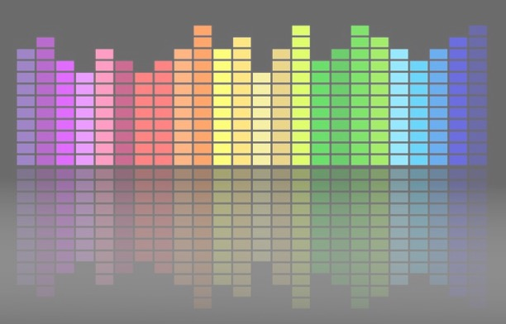

Computational Music Analysis: Audio
A.K.A. “Audio Content Analysis”
Evaluation
Claire Arthur
Noël Alben

Slide 2
Agenda
In Class Activity MFCC
Review Of Assignment F0 Detection
Evaluation Of Pitch Detection Algorithm
Evaluation strategies and the world of MIREX
Fall 2025 Project Expectations

Slide 3
Review Of Assignment F0 Detection
Some Key Observations
Not checking for edge cases in user input parameters
Window size too large
Lack of normalization using acf[0]
Varied implementations without the use of np.correlate
Peak Detection and Thresholding

Slide 4
Review Of Assignment F0 Detection
Some Key Observations
Not checking for edge cases in user input parameters
Window size too large
Lack of normalization using acf[0]
Varied implementations without the use of np.correlate
Peak Detection and Thresholding

Slide 5
Review Of Assignment F0 Detection
Some Key Observations
Not checking for edge cases in user input parameters
Window size too large
Lack of normalization using acf[0]
Varied implementations without the use of np.correlate
Peak Detection and Thresholding

Slide 6
Review Of Assignment F0 Detection
Some Key Observations
Not checking for edge cases in user input parameters
Window size too large
Lack of normalization using acf[0]
Varied implementations without the use of np.correlate
Peak Detection and Thresholding

Slide 7
Review Of Assignment F0 Detection
Some Key Observations
Not checking for edge cases in user input parameters
Window size too large
Lack of normalization using acf[0]
Varied implementations without the use of np.correlate
Peak Detection and Thresholding

Slide 8
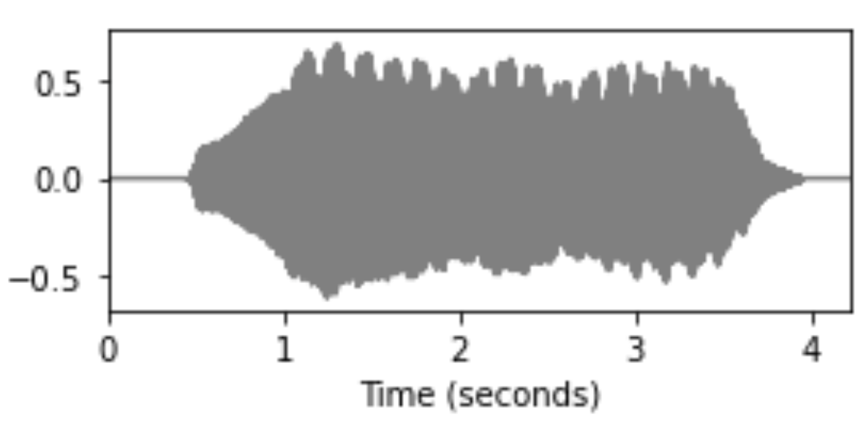
Review Of Assignment F0 Detection
End to End System Design
For every block
f0[0]
f0[1]
block_audio
autocorrelation
f0[2]
peak_picking
f0[n]

Slide 9
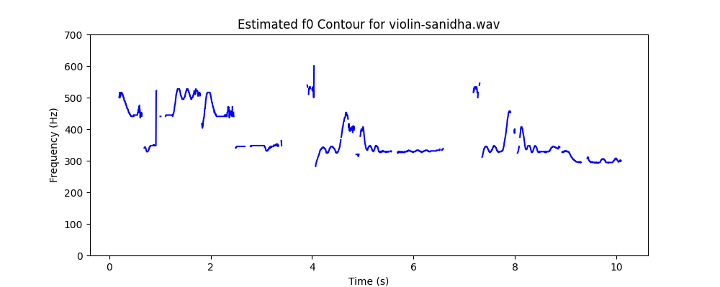
Review Of Assignment F0 Detection
End to End System Design
For every block
f0[0]
f0[1]
block_audio
autocorrelation
f0[2]
peak_picking
f0[n]

Slide 10
Review Of Assignment F0 Detection
System Design Requirements
Needs to be robust to various input signals
Able to pick up wide range of frequencies
Low sensitivity to noise and spurious amplitude changes
Real time system ?

Slide 11
Review Of Assignment F0 Detection
End to End System Design
Points of error
For every block
f0[0]
f0[1]
block_audio
autocorrelation
f0[2]
peak_picking
f0[n]

Slide 12
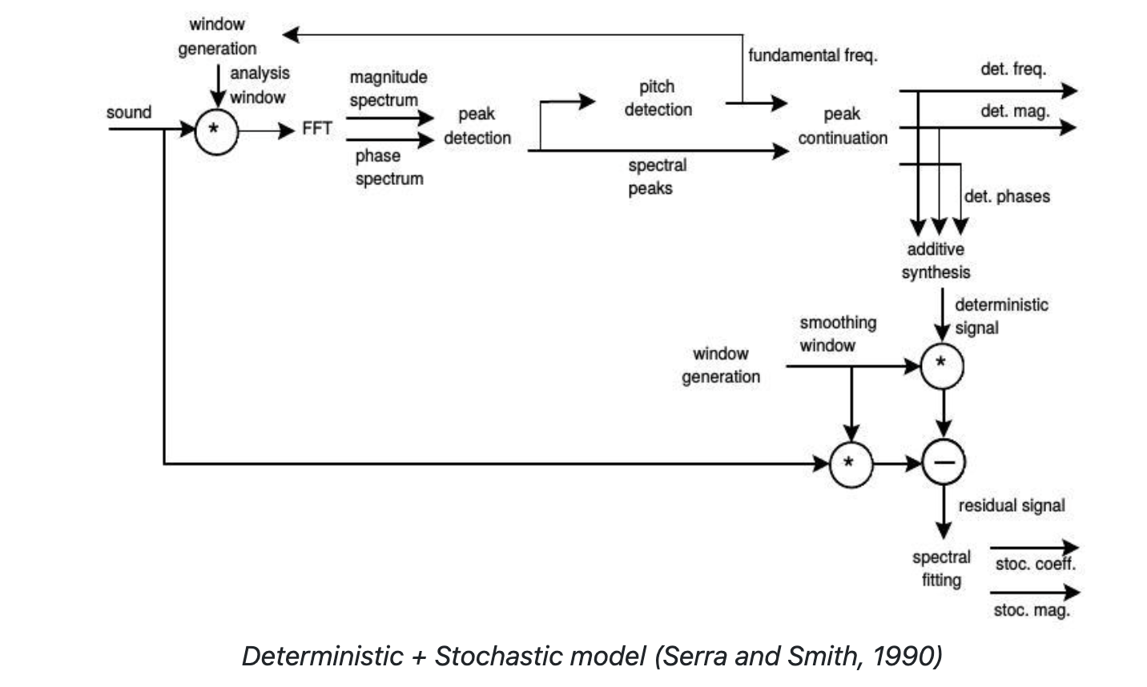
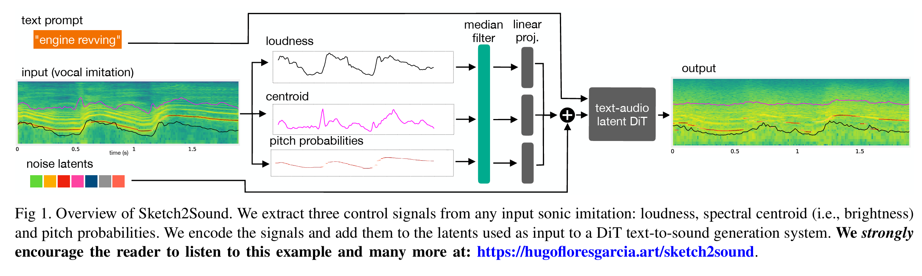
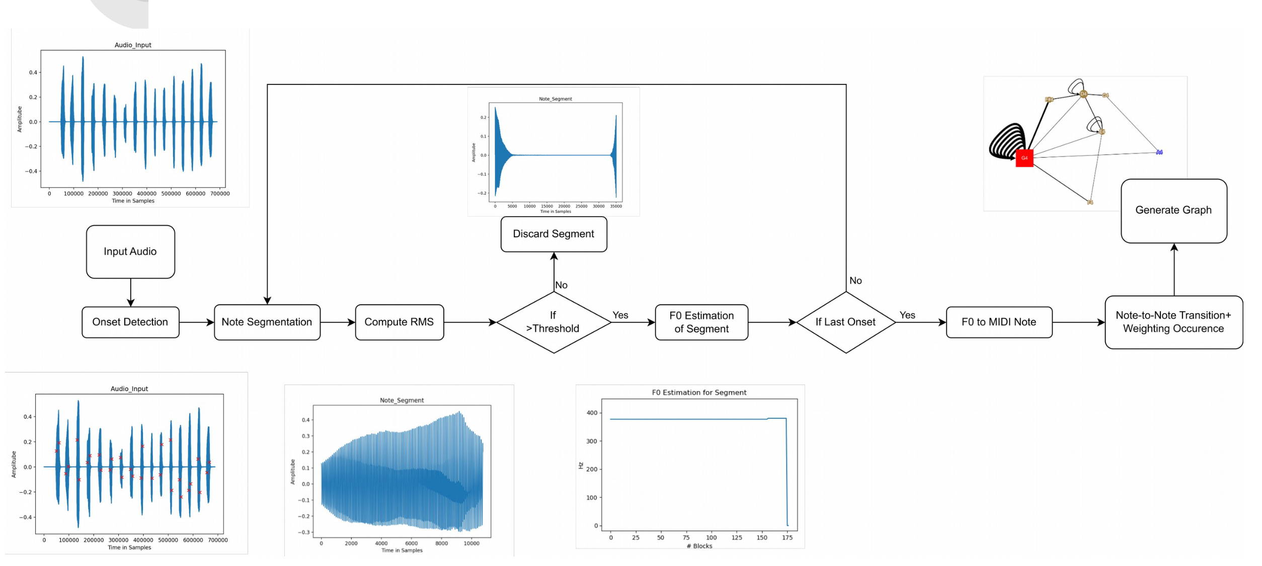
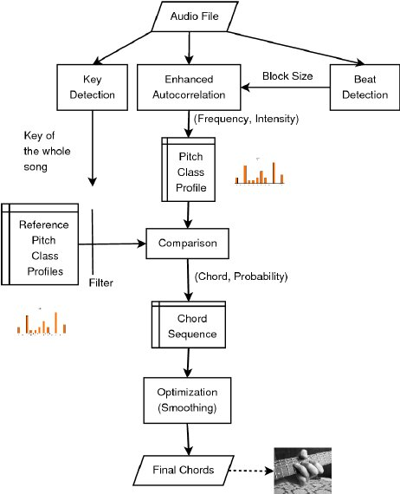
Review Of Assignment F0 Detection
Automatic Chord Detection Incorporating Beat and Key Detection
Thiago, Noel, Rhythm Fall 21 ACA Project

Slide 13
Review Of Assignment F0 Detection
Automatic Chord Detection Incorporating Beat and Key Detection
Thiago, Noel, Rhythm Fall 21 ACA Project

Slide 14
Evaluation Of Pitch Tracking Systems
Planning a systematic evaluation of pitch detection systems
Goal of evaluation: Compare system predicted pitch with ground truth pitch

Slide 15
Evaluation Of Pitch Tracking Systems
Planning a systematic evaluation of pitch detection systems
Goal of evaluation: Compare system predicted pitch with ground truth pitch
First Determine the Pitch Detection Task
• pitch of individual notes in a monophonic melody

Slide 16
Evaluation Of Pitch Tracking Systems
Planning a systematic evaluation of pitch detection systems
Goal of evaluation: Compare system predicted pitch with ground truth pitch
How do you annotate the F0 data for the ground truth?

Slide 17
Evaluation Of Pitch Tracking Systems
Planning a systematic evaluation of pitch detection systems
Goal of evaluation: Compare system predicted pitch with ground truth pitch
How do you annotate the F0 data for the ground truth?
Pitch Discretization
• (MIDI/score) pitch of individual notes
• F0
Time Discretization
• start and stop time of note
• equidistant time stamps

Slide 18
Evaluation Of Pitch Tracking Systems
Planning a systematic evaluation of pitch detection systems
Goal of evaluation: Compare system predicted pitch with ground truth pitch
What metrics will you calculate in this scenario?

Slide 19
Evaluation Of Pitch Tracking Systems
Planning a systematic evaluation of pitch detection systems
Goal of evaluation: Compare system predicted pitch with ground truth pitch
What metrics will you calculate in this scenario?
Raw Pitch Accuracy (RPA)
What it measures: how often your system’s estimated F0 exactly matches the reference F0 (within a tolerance).
Raw Chroma Accuracy (RCA)
What it measures: how often your system’s estimated F0 is correct up to octave equivalence. If system detects A3 but the ground truth is A4. (within a tolerance)

Slide 20
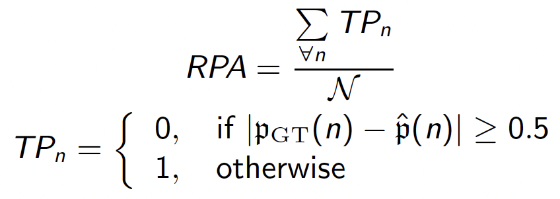
Evaluation Of Pitch Tracking Systems
Planning a systematic evaluation of pitch detection systems
Goal of evaluation: Compare system predicted pitch with ground truth pitch
What metrics will you calculate in this scenario?
Raw Pitch Accuracy (RPA)

Slide 21
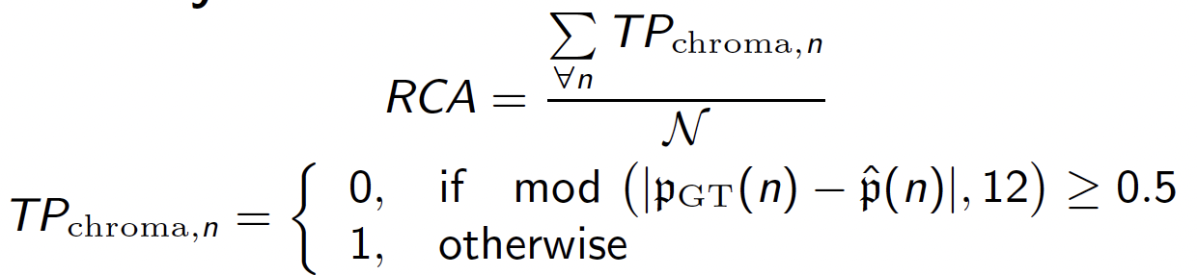
Evaluation Of Pitch Tracking Systems
Planning a systematic evaluation of pitch detection systems
Goal of evaluation: Compare system predicted pitch with ground truth pitch
What metrics will you calculate in this scenario?
Raw Chroma Accuracy (RCA)

Slide 22
Evaluation Of Pitch Tracking Systems
Practical Workflow for a rule-based system
Find an annotated dataset
Divide the dataset
a. Development Set (pick files that will help you tweak parameters, test and debug)
b. Test Set (unseen data to report metrics)
Understand the conventions and data structure of your dataset
Ensure your system output data structure is in line with the data structure of the dataset

Slide 23
Activity
Pair up with your assignment partner, move and sit next to them
Download the files from Files/Activities/Evalutaion_Annotation
Create your own Annotated F0 dataset
Come up with your own annotation format;
for eg: [onset time, duration, f0]
Write pseudocode for how you would generate metrics with your autocorrelation assignment
What changes will you bring to your system/ output of your current code?

Slide 24
Evaluation Of Pitch Tracking Systems
System Design
“ Several musical applications need F0 estimation, such as automatic score transcription or real-time interactive systems, but here again the imperfect reliability of available methods is an obstacle.” [YIN, a fundamental frequency estimator for speech and music]

Slide 25
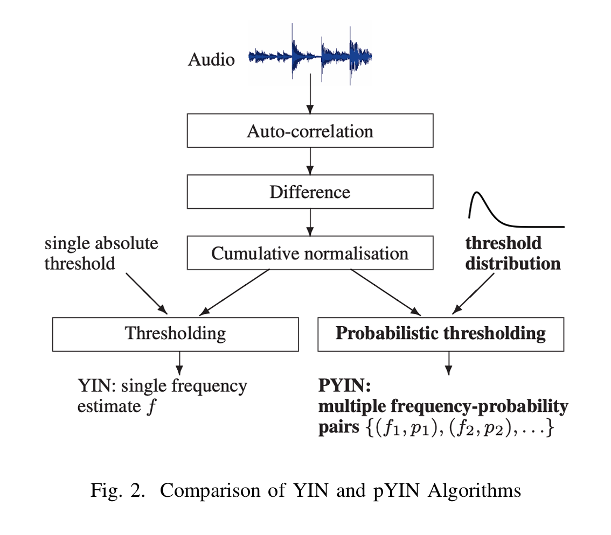
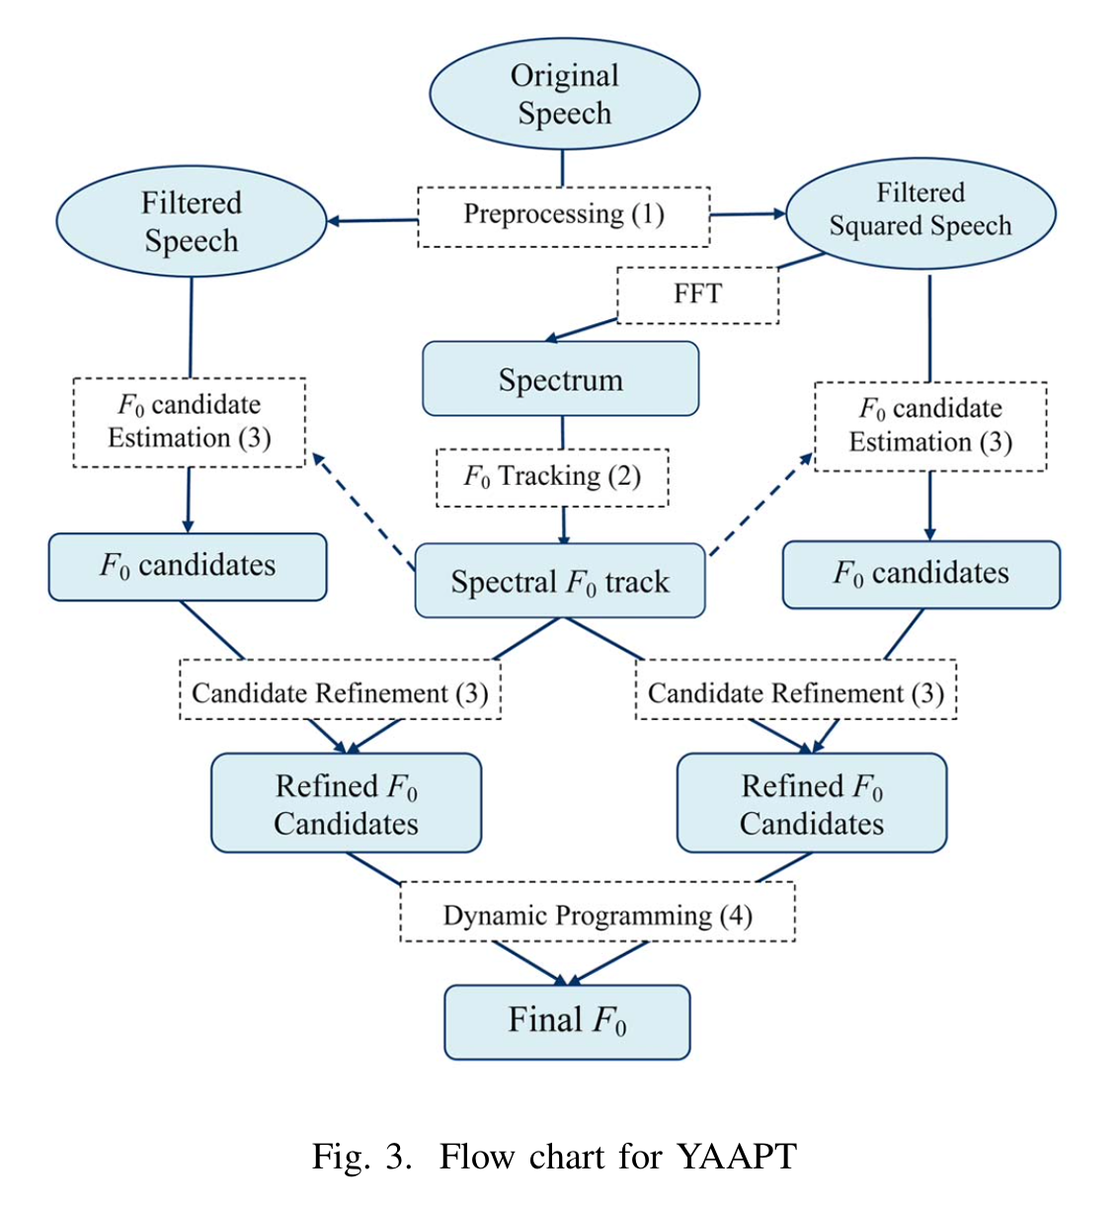
Evaluation Of Pitch Tracking Systems

Slide 26
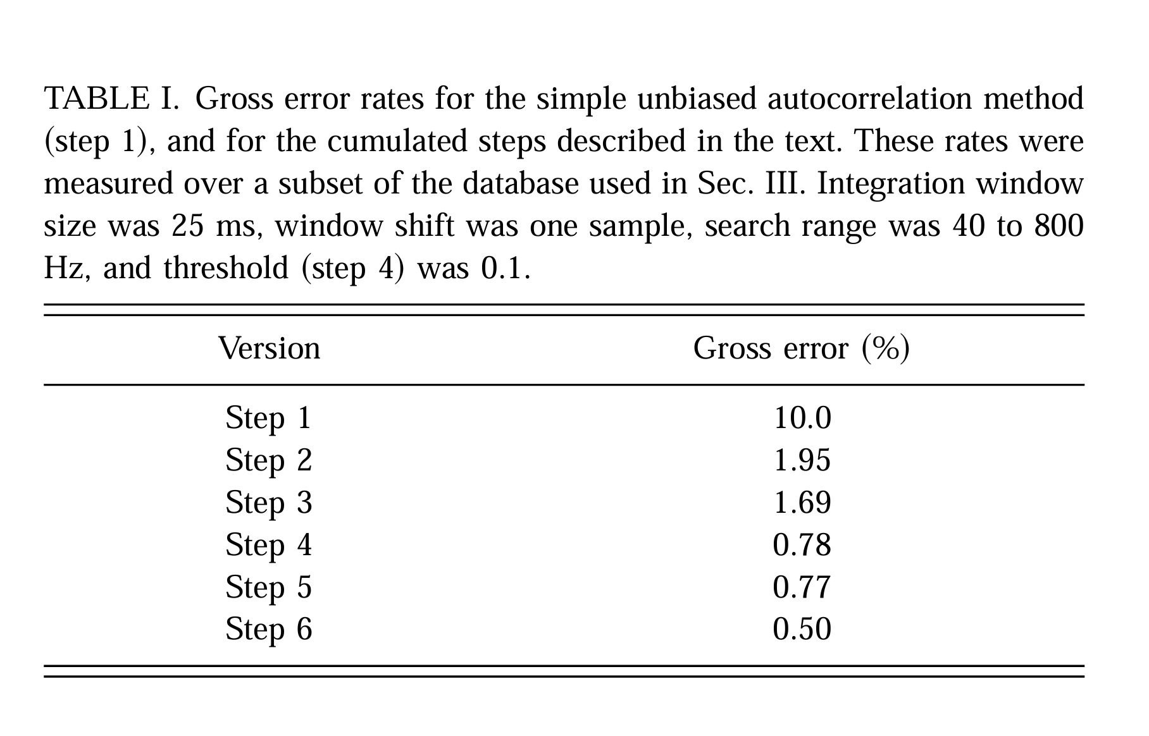
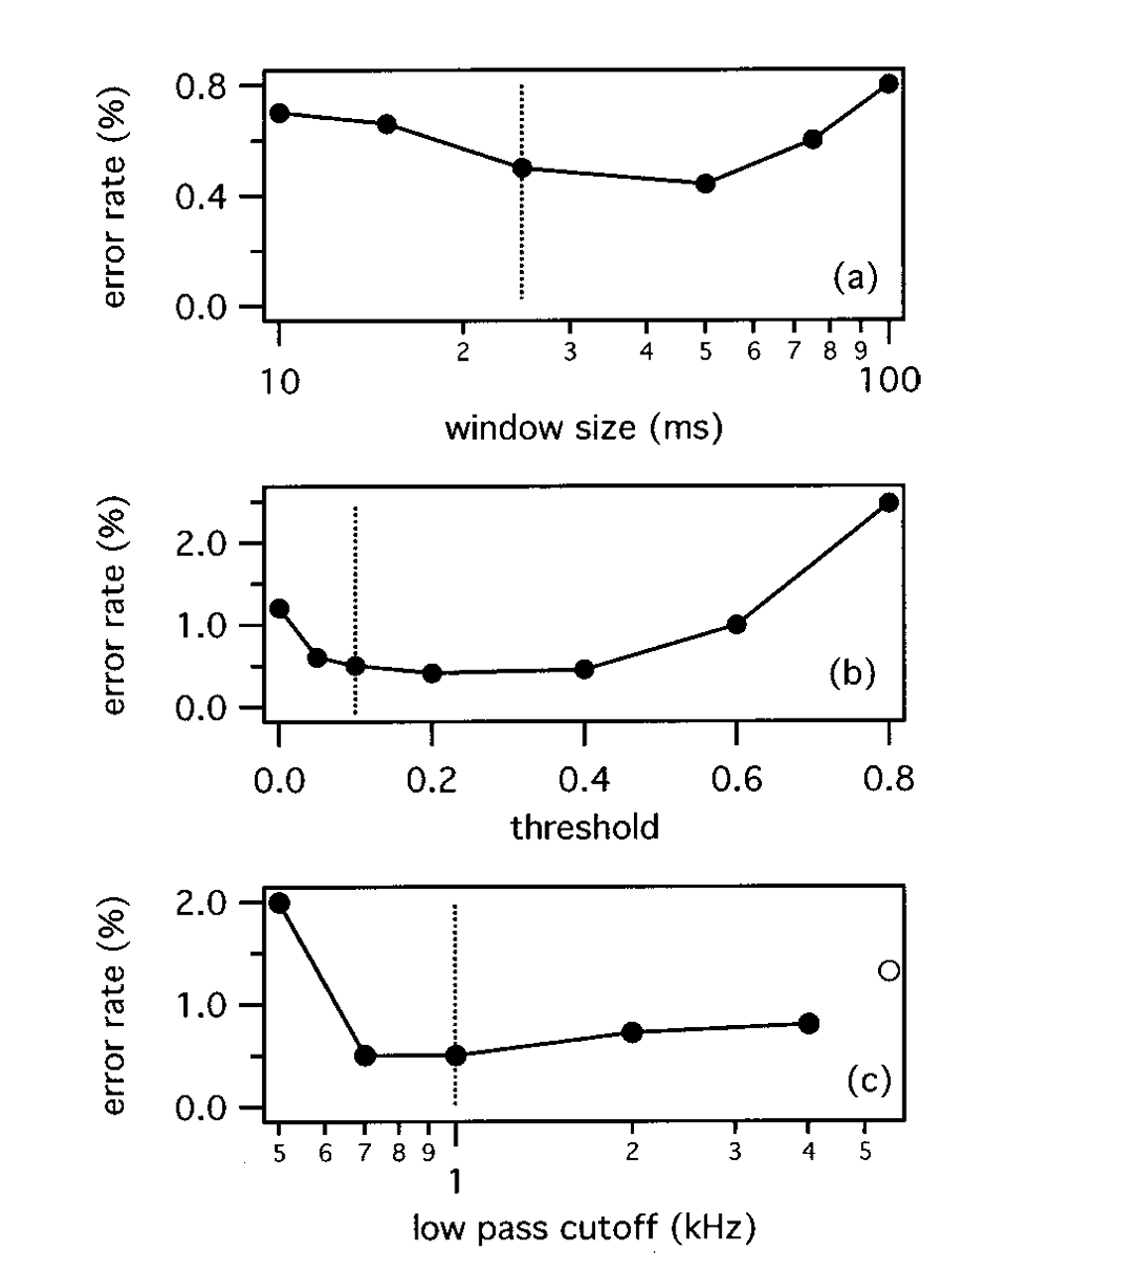
Evaluation Of Pitch Tracking Systems
Tracking performance improvements: Ablation Study

Slide 27
Fall 2025 Project Expectations & Outcomes
Pick a relevant MIREX task from: https://www.musicir.org/mirex/wiki/2025:Previous_Tasks
Need to design and submit a packaged system that automatically accepts (audio input) and extracts/ performs the chosen task
Design and develop evaluation methodologies to score the performance of their system
using the annotated ground truth data provided in the MIREX task description.
Write a submit a paper describing the task
Paper contains relevant literature survey in support of the current state of the art for the task
describe your methodology and system
evaluation designed
the particular metrics derived from the task.

Slide 28
Fall 2025 Project Expectations & Outcomes
Requirements
The task needs to be an Audio Based Task, we have the power to veto any project idea
There are limited slots at a first come first serve basis for each task, so the earlier you form groups and decide on a task you get your pick
Students are allowed to use any library, code resources found online even AI, we expect thoroughness in understanding of the task at hand and attention to detail to the evaluation

