Slide 1
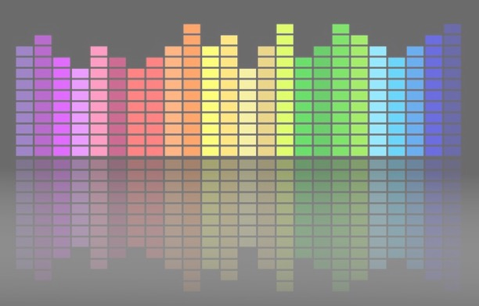

Computational Music Analysis: Audio
A.K.A. “Audio Content Analysis”
3.3. MFCCs
Claire Arthur
Noel Albën

Slide 2



Mel Frequency Cepstrum Coefficients
Who is Mel?
What the heck is a Cepstrum?

Slide 3
Mel Frequency Cepstrum Coefficients
A statistical representation of a bunch of transformations on the spectrum (i.e. VERY ABSTRACT, but very useful!)
Helps to understand:
What is a Cepstrum
What is a “Mel” (or Mel Frequency)
Knowing how this complex feature is constructed “keeps us honest”
Feature heavily “engineered”/modified by use case (knowledge required)

Slide 4

What is a Cepstrum?
The cepstrum exposes periodicity (patterns) in the spectral domain.
Process:
Waveform log(magnitude spectrum) iFFT
(effectively a fourier transform of a fourier transform!)
Normally:
Waveform -> DFT -> iFFT gets us back to a time representation (i.e. waveform)
Here:
Keep only magnitude info (no phase);
Log transformation of magnitude spectrum
iFFT: What we get back is NOT time domain but:
Wait for it….
quefrency domain
Notes:
“…where sections with singing voice alternate with purely instrumental or percussive sections, MFCC-based feature representations are well suited for novelty-based and homogeneity-based segmentation.” – Muller p. 181

Slide 5
What is a Cepstrum?
In 1963, Bogert, Healy, and Tukey introduced the cepstrum. (And everyone has been confused ever since).
They deliberately made it tongue-in-cheek:
spectrum → cepstrum
frequency → quefrency
harmonic → rahmonic
filter → lifter
Notes:
“…where sections with singing voice alternate with purely instrumental or percussive sections, MFCC-based feature representations are well suited for novelty-based and homogeneity-based segmentation.” – Muller p. 181

Slide 6

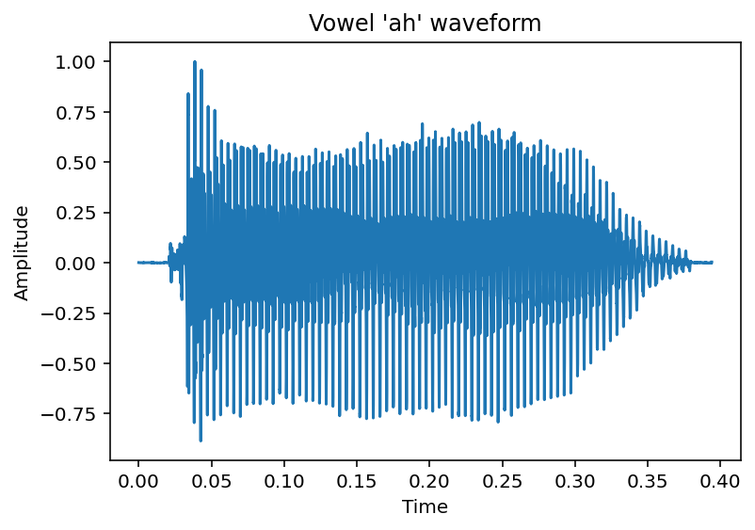
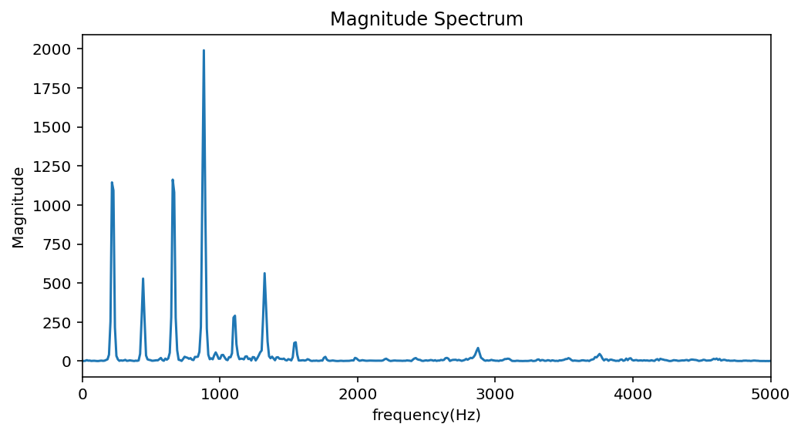
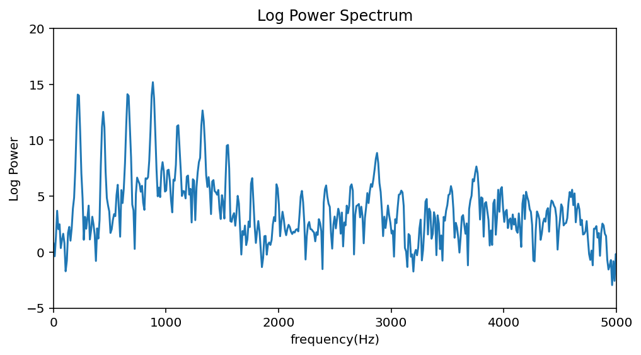
What is a Cepstrum?
Example:
log
DFT
Notes:
Singer “ah” on A3

Slide 7
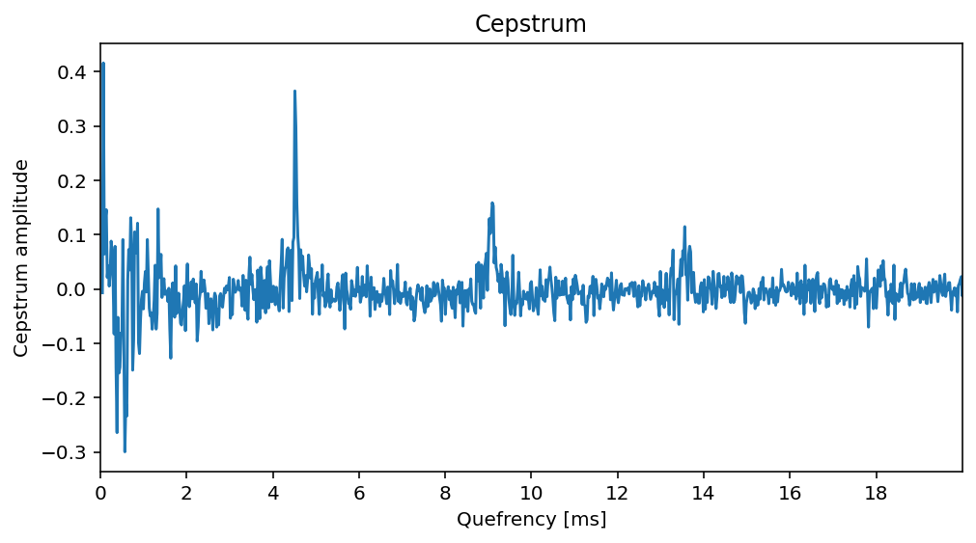
What is a Cepstrum?
Example:
log
iFFT
DFT
Notes:
Singer “ah” on A4

Slide 8
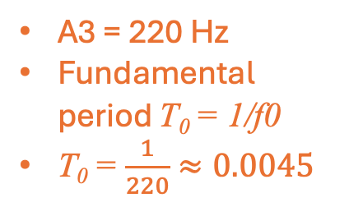
What is a Cepstrum?
Example:
log
iFFT
DFT
A3 = 220 Hz
Fundamental period T₀ = 1/f0
T₀ = $\frac{1}{220}$ $≈0.0045$
T₀
1st rahmonic
…
Notes:
Singer “ah” on A4
If the log amplitude spectrum contains many regularly spaced harmonics, then the Fourier analysis of the spectrum will give a peak corresponding to the spacing between the harmonics--that is equivalent to fundamental frequency. (The cepstrum’s spike at T0T_0T0​ (≈ 4.5 ms here) is the periodicity in the frequency domain caused by harmonic spacing.) Effectively we are using the spectrum of sound signal as another signal, and trying to calculate periodicity in the spectrum itself. The unit of x-axis of the cepstrum is quefrency, and peaks in the cepstrum (relating to periodicities in the spectrum) are called rahmonics.

Slide 9
What is a Cepstrum
In sum:
A cepstrum is a spectrum of a spectrum
It is effectively treating the log spectrum as a signal and looking for periodicities in it
This results in peaks in the cepstrum that relate to periodicity in the frequency domain representation caused by harmonic spacing.
The primary or main “peak” is the first “rahmonic” and its value in ms (or seconds) relates to the fundamental frequency.

Slide 10
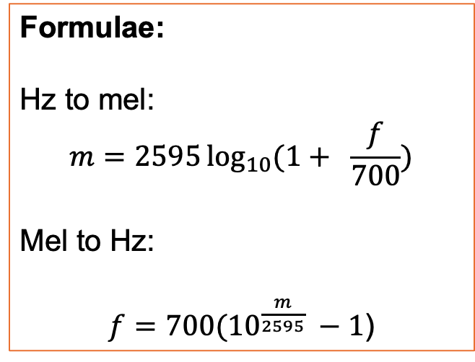
What is a Mel Scale?
Origin: Introduced by Stevens, Volkmann & Newman (1937!)
refined in later psychophysical studies
Method: Listeners asked to judge when two pure tones were equally spaced in perceived pitch.
Formulae:
Hz to mel:
$$m=2595\log_{10}{(1+ \frac{f}{700})}$$
Mel to Hz:
$f=700({10}^{\frac{m}{2595}} −1$)

Slide 11
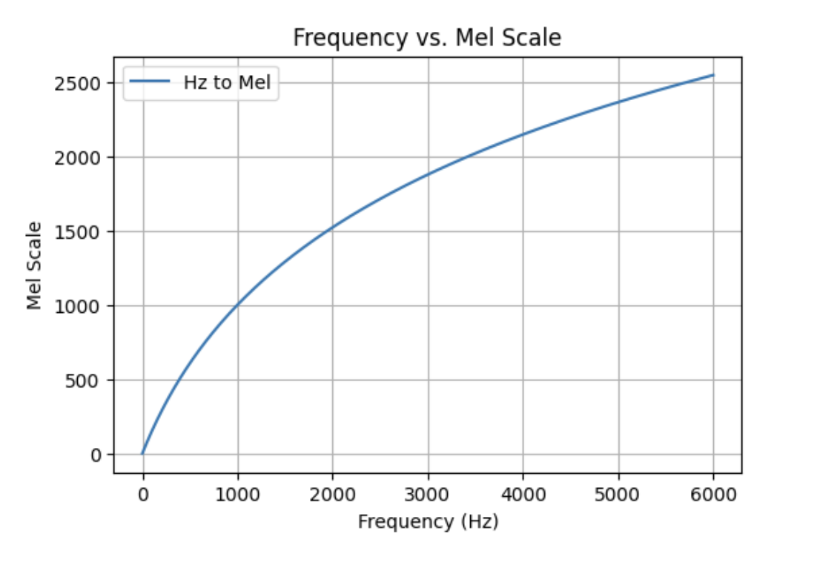
What is a Mel Scale?
“Perceptually-derived” scale
Units in mels are equidistant perceptually

Slide 12
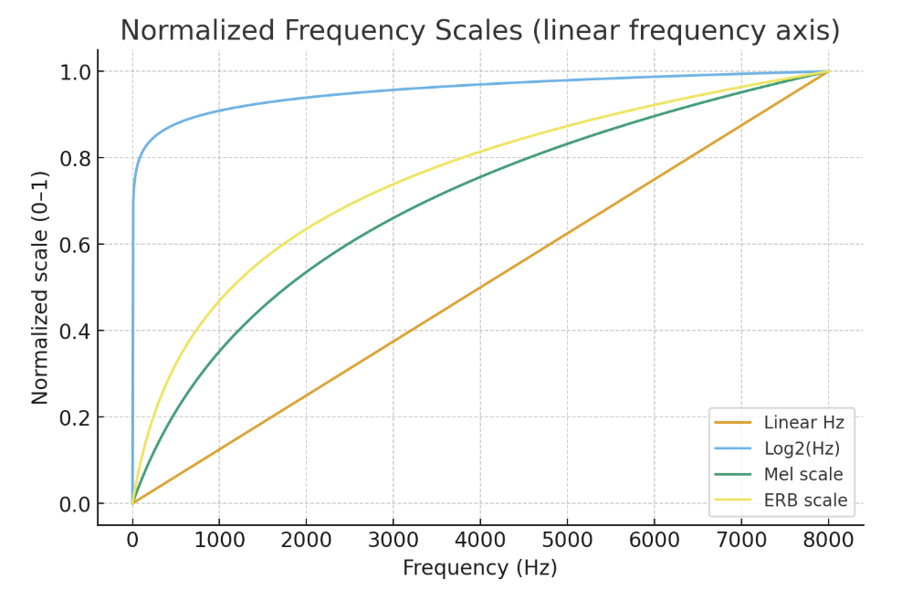
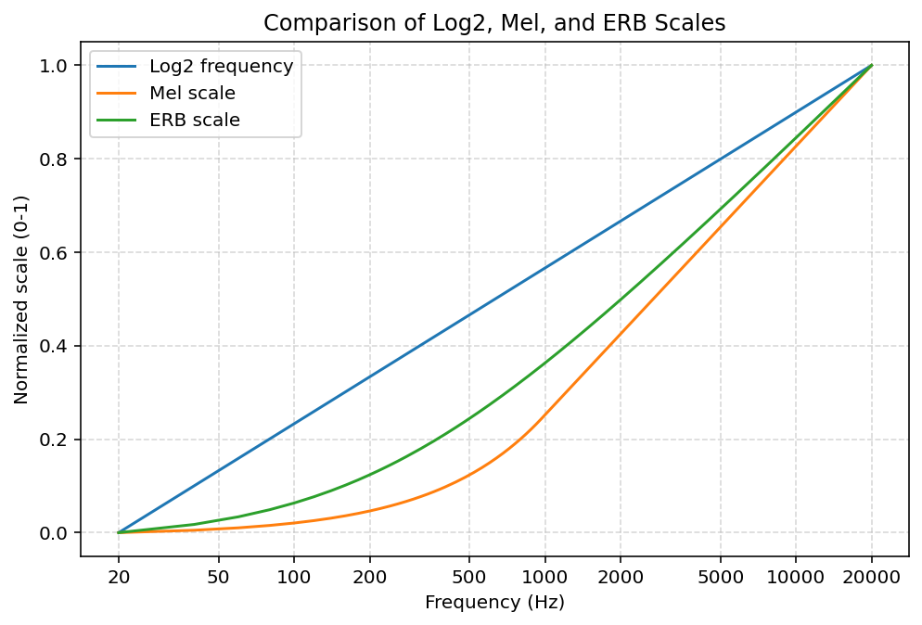
What is a Mel Scale?

Slide 13
Back to MFCC
So …
To get to Mel Frequency cepstrum coefficients…
We have to map from linear Hz to Mels
> This step involves a kind of quantization

Slide 14
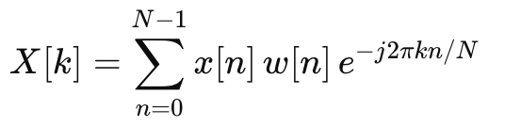

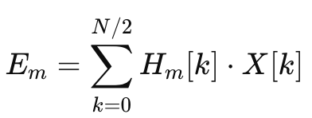

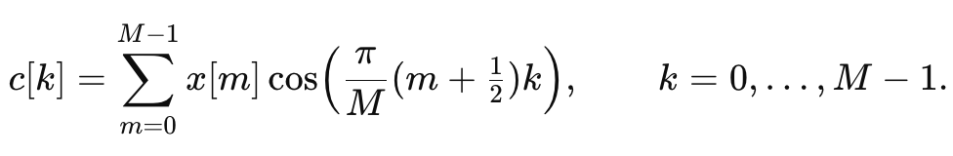
Calculating MFCCs
waveform
spectrum
power spectrum
Map spectrum into mel-spaced bands
Sum log energies inside each filter
DCT (akin to iFFT)
Notes:
where H_m[k] is the m-th triangular mel filter.
This gives us end output that is “cepstrum-like” but not actually on a quefrency domain (because of use of DCT and not iFFT; and because of the transformations that occur before that step.)
Output are simply the dot product of the summed log energies at each M and a cosine basis function!

Slide 15
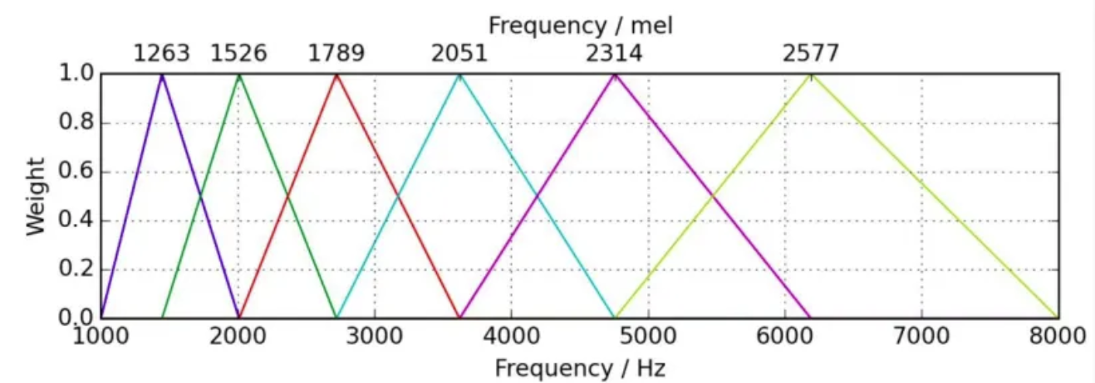
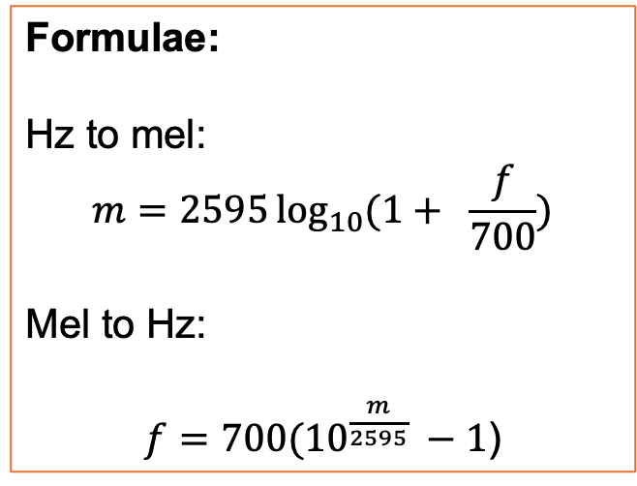
Mel Filterbanks
Formulae:
Hz to mel:
$$m=2595\log_{10}{(1+ \frac{f}{700})}$$
Mel to Hz:
$f=700({10}^{\frac{m}{2595}} −1$)

Slide 16
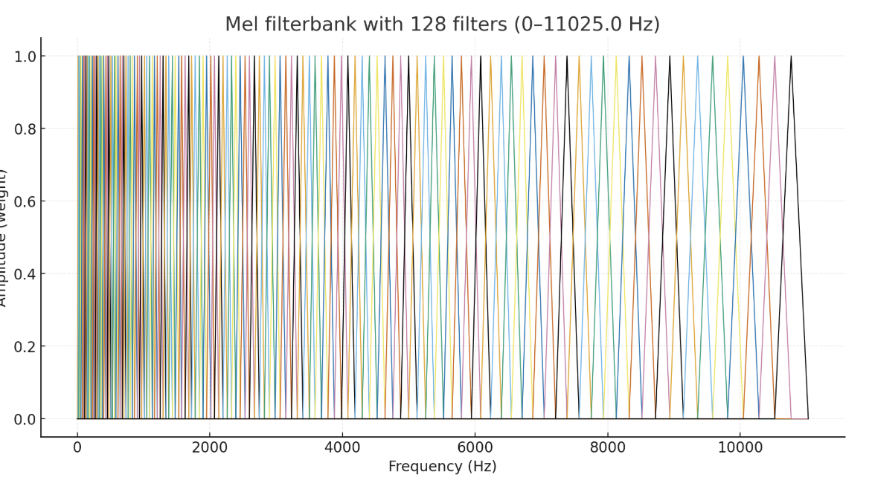
Mel Filterbanks
How many should we use??

Slide 17
Calculating MFCCs
waveform
spectrum
power spectrum
Map spectrum into mel-spaced bands
Sum log energies inside each filter
DCT (akin to iFFT)
Notes:
where H_m[k] is the m-th triangular mel filter.
This gives us end output that is “cepstrum-like” but not actually on a quefrency domain (because of use of DCT and not iFFT; and because of the transformations that occur before that step.)
Output are simply the dot product of the summed log energies at each M and a cosine basis function!

Slide 18
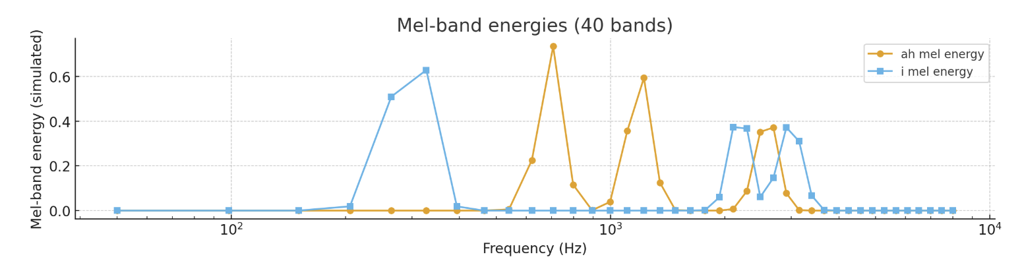
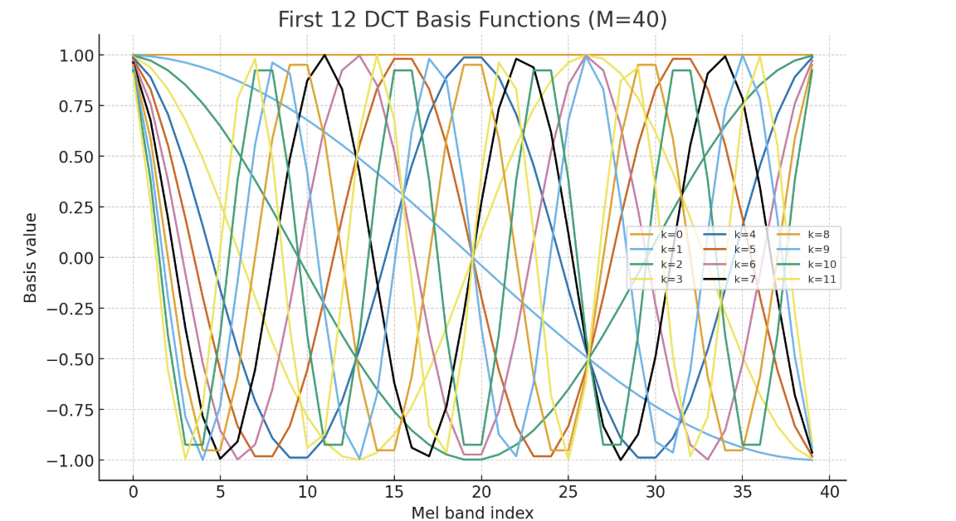
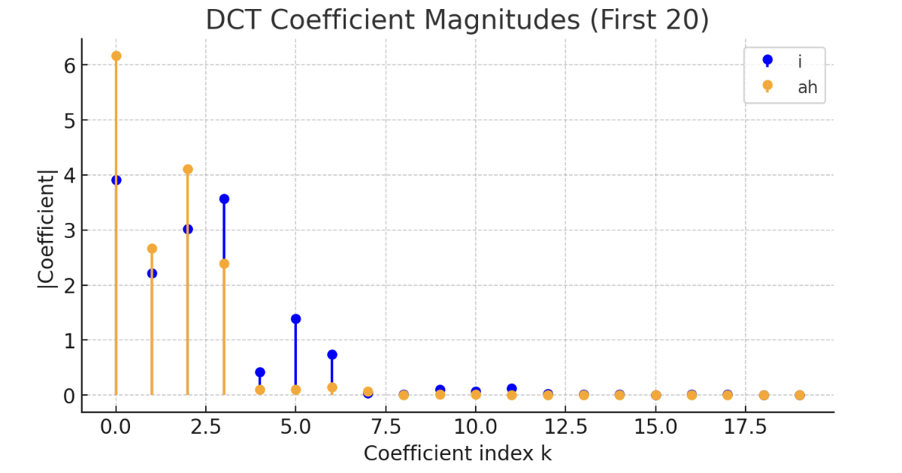
Mel Filterbanks

Slide 19
What do the coefficients represent?
Low-order coefficients (0-4) represent:
Overall energy (0th bin only, sometimes useful others ignored)
Spectral slope & some formants (~C1-4 e.g., brightness)
Finer variations in timbre (~C5-15 e.g., instrument body, vowels)
Very high spectral information (~C15+ , e.g.,

Slide 20
Conventions
There are certain conventions or tendencies in computing MFCCs
These conventions relate to their primary use/design (i.e., speech vs music processing)
Number of mel filterbanks (commonly 40…or 128!)
Speech: 40 mel bands
Music: 64–128 mel bands
Number of k coefficients to “keep” from the MFCC output
Speech: 12–13 MFCCs
Music: 20–30 MFCCs

Slide 21
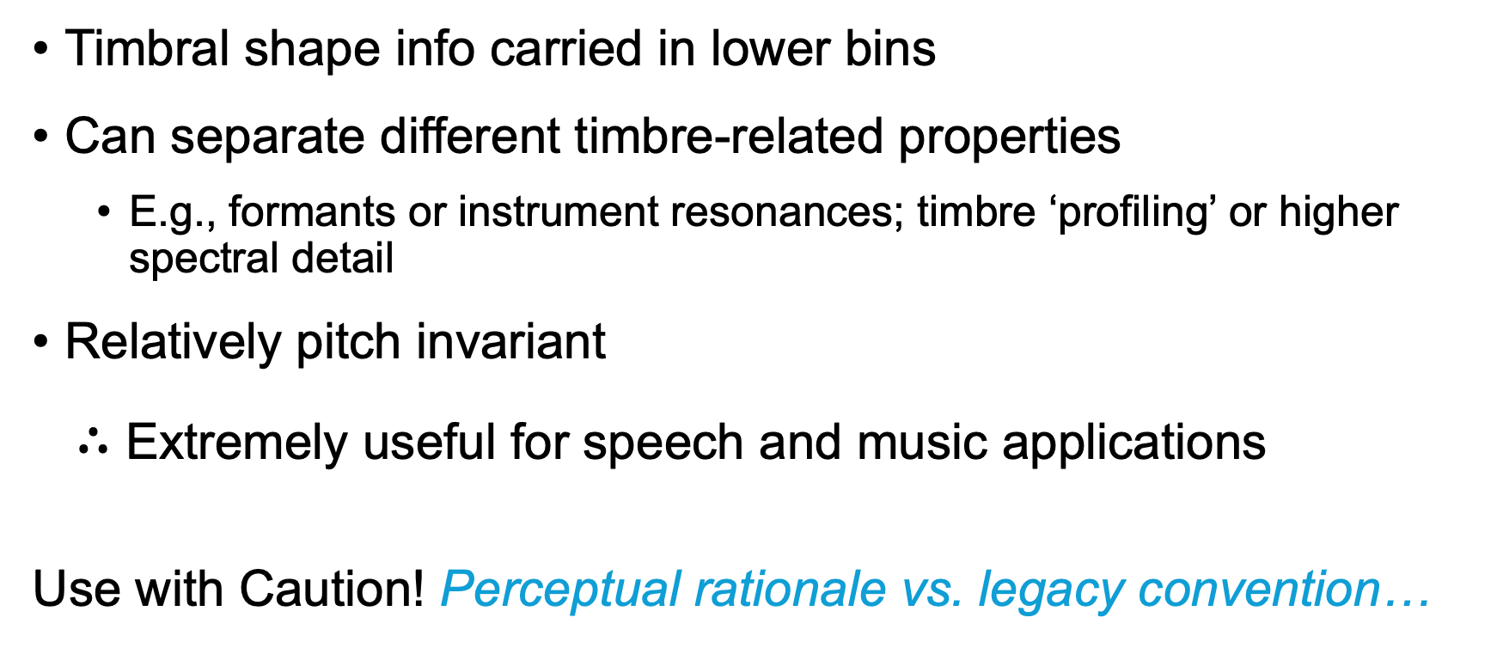
Why MFCCs are so useful
Timbral shape info carried in lower bins
Can separate different timbre-related properties
E.g., formants or instrument resonances; timbre ‘profiling’ or higher spectral detail
Relatively pitch invariant
$∴$Extremely useful for speech and music applications
Use with Caution! Perceptual rationale vs. legacy convention…

Slide 22
Activity
Listen to the file “vowels_sung.wav”
Using librosa, calculate:
Mel spectrogram
Try: changing the “n_mels” parameter from 128 to 40 & examine difference
Hint: look at docs for how to plot & convert to db first!
MFCC
Try: change MFCC parameters:
n_mels (hidden!) = 40 vs 128
n_mfcc = 13 vs 40
Try to plot differences ⚠️
Axes don’t have intuitive interpretation (x-axis = frames, y=axis equals coeffs)
Higher on y-axis is not higher in frequency!

